Slide 1
Exploration of the universe with gravitational waves
R. Weiss, MIT on behalf of the LIGO Scientific Collaboration
THE TRANSIENT UNIVERSE
NTU, Singapore
February 26, 2018

Slide 2
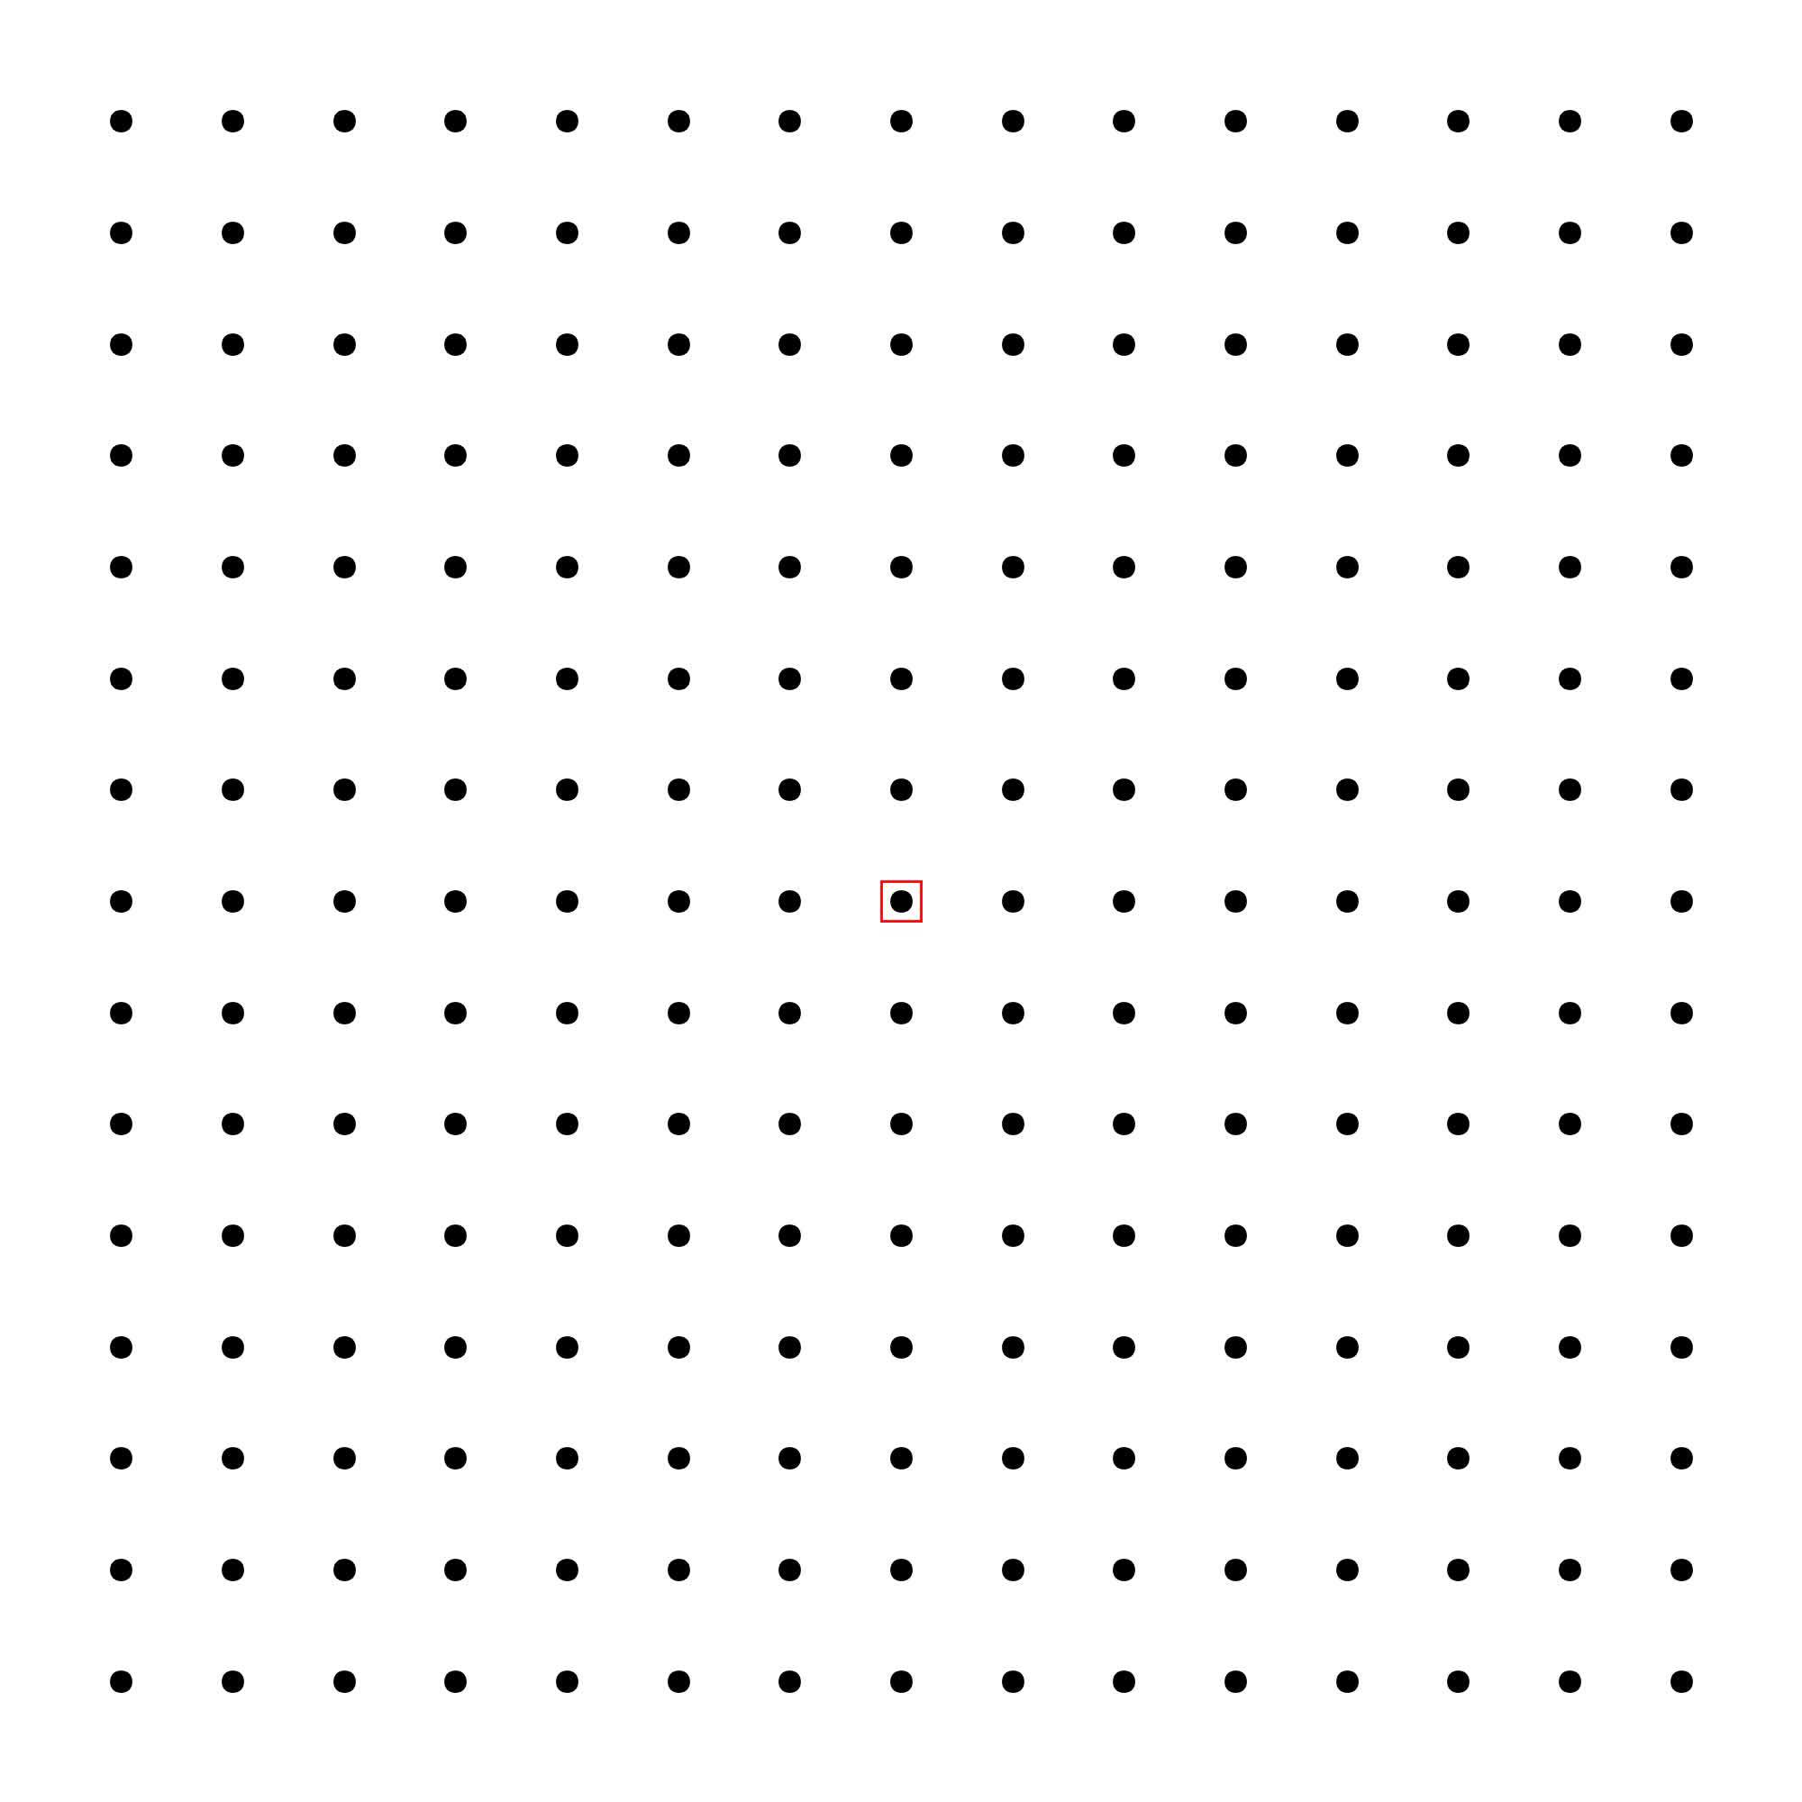
Gravitational waves
Einstein 1916 and 1918
  Sources: non-spherically symmetric accelerated masses
  Kinematics:
    propagate at speed of light
    transverse waves, strains in space (tension and compression)

Slide 3
Gravitational waves
Einstein 1916 and 1918
  Sources: non-spherically symmetric accelerated masses
  Kinematics:
    propagate at speed of light
    transverse waves, strains in space (tension and compression)

Slide 4
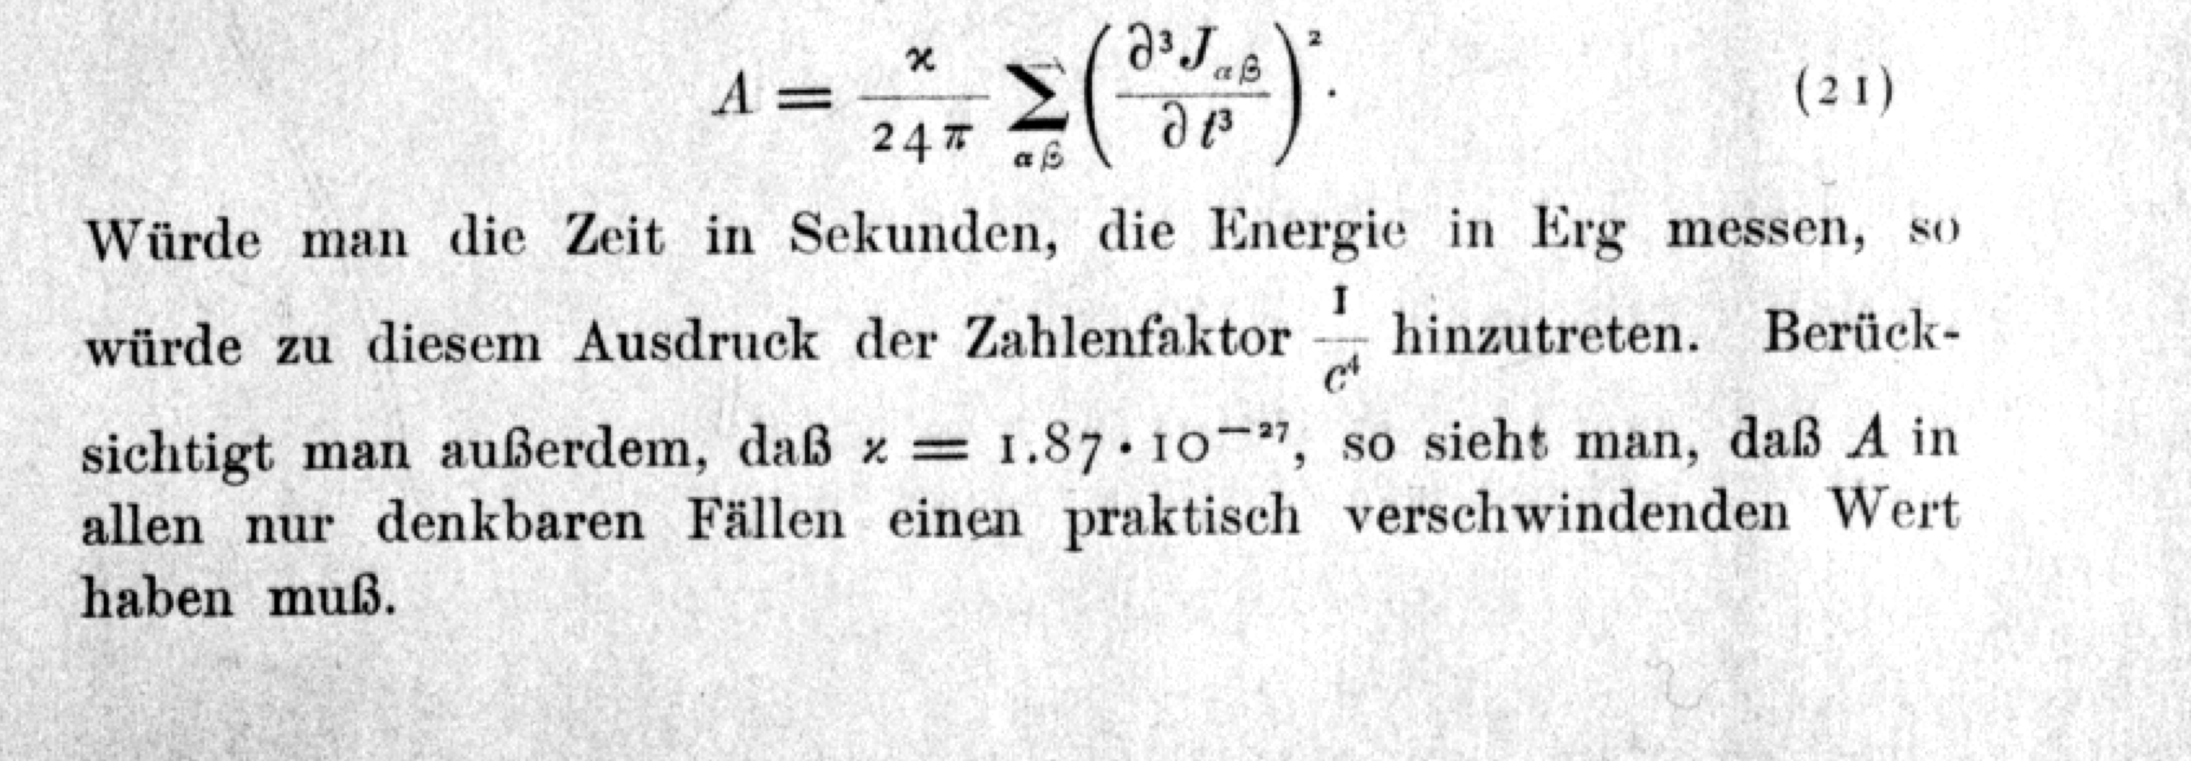
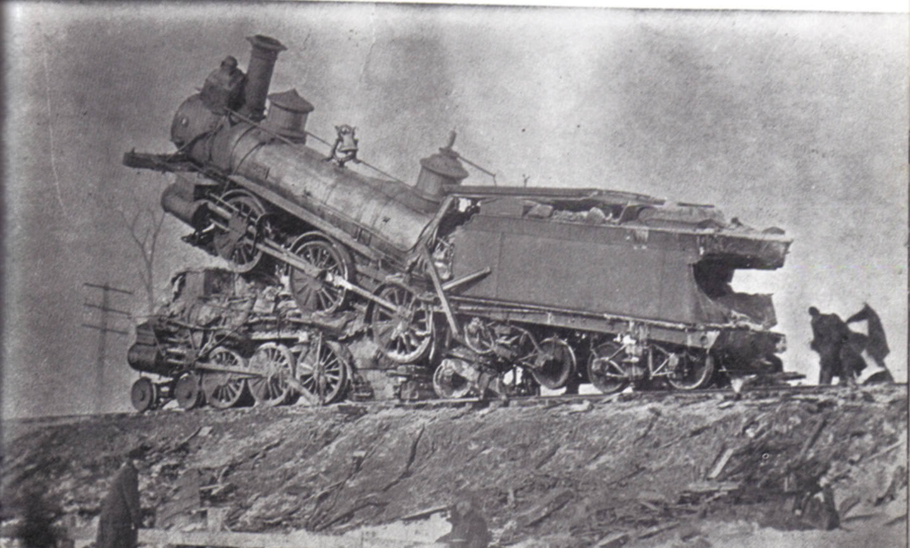
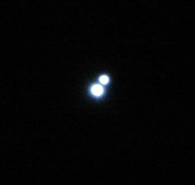
Einstein 1916
“…..in any case one can think of A will have a practically
vanishing value.”
1916 examples: train colllision binary star decay
m = 10⁵ kg
v = 100km/hr
T_{collision} = 1/3 sec
R_{radiation}= 300km
h ~ 10⁻⁴²
m₁=m₂= 1 solar mass
T_{orbit}= 1 day
R = 10 Kly
h ~ 10⁻²³ @ ½ day period

Slide 5
Michelson Interferometer Schematic and GW sidebands

Slide 6
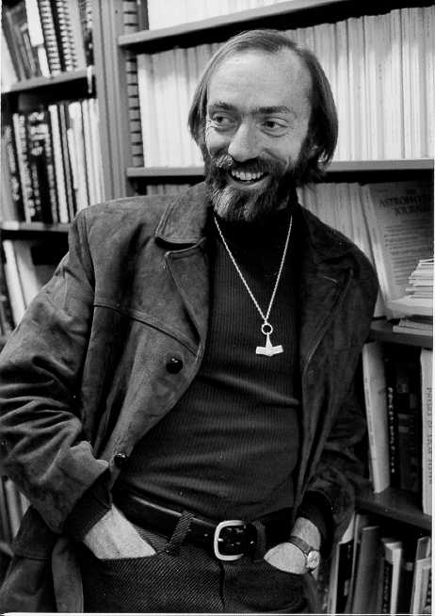
The measurement challenge
Kip Thorne

Slide 7
Advanced LIGO Fabry-Perot Michelson Interferometer Schematic

Slide 8
Initial LIGO Interferometer Noise Budget

Slide 9
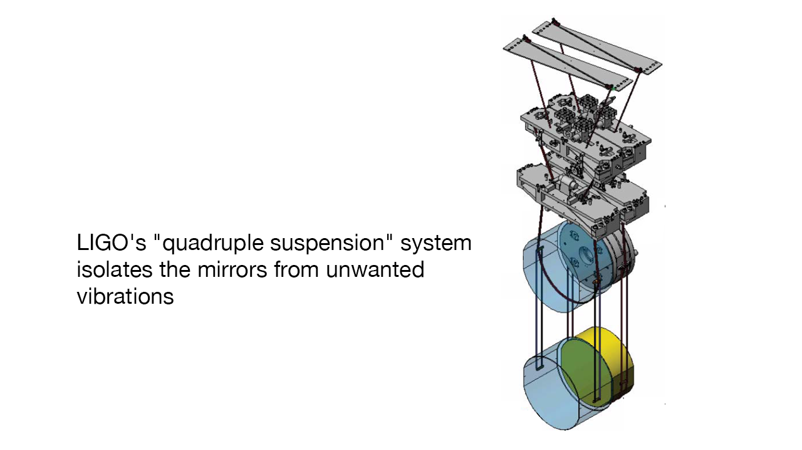
Advanced LIGO design noise budget

Slide 11
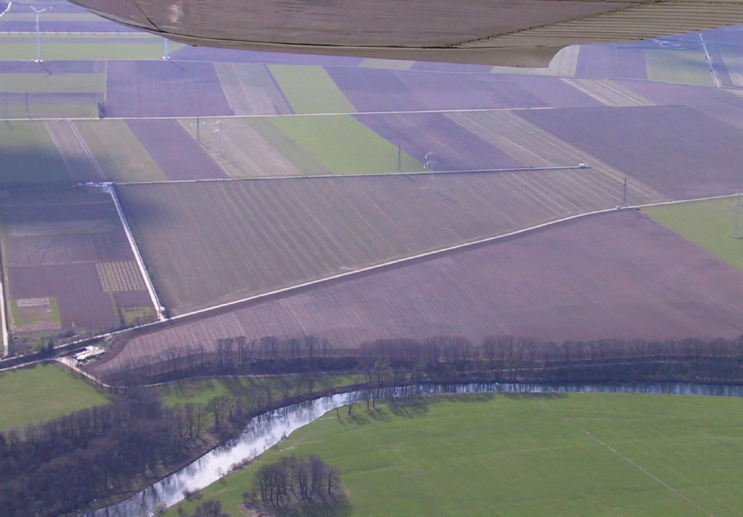
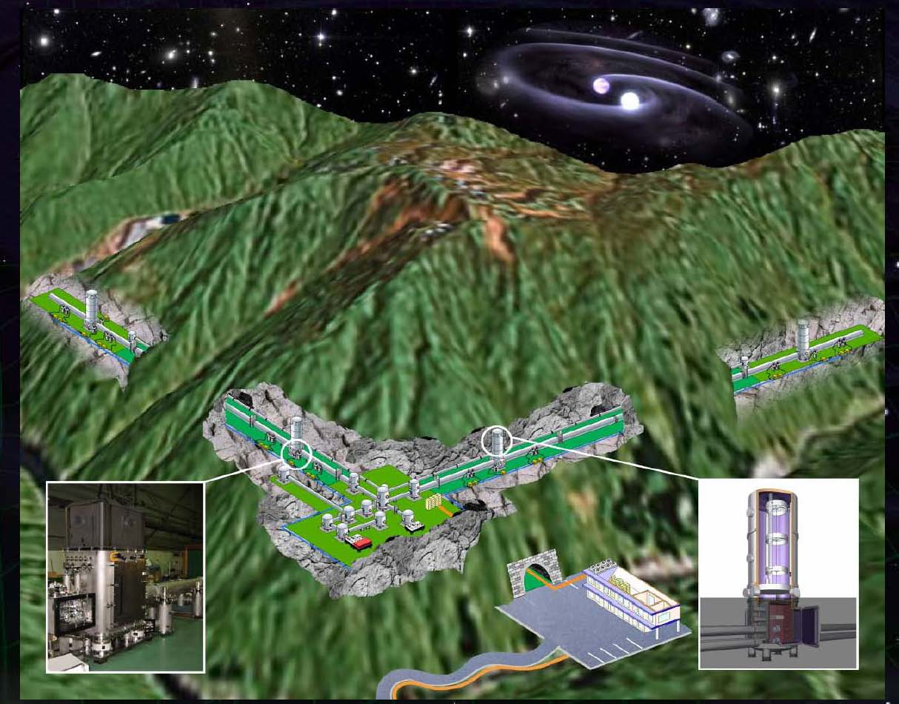
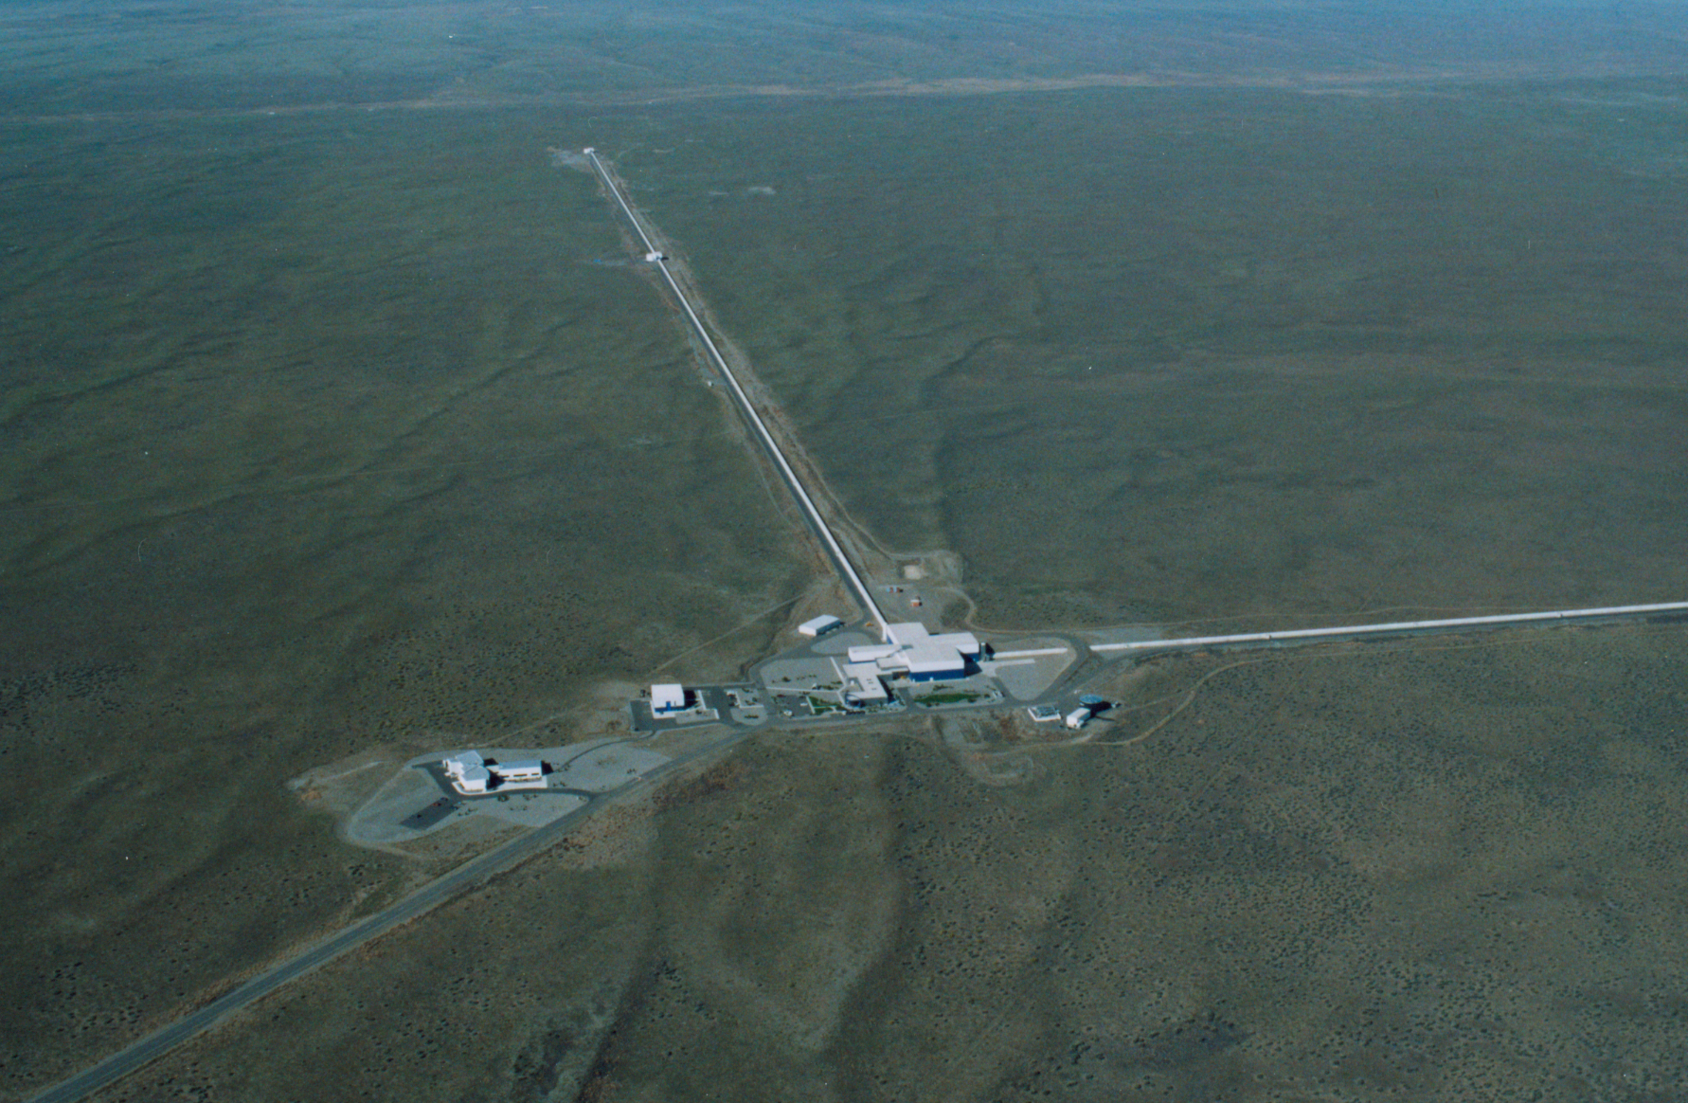
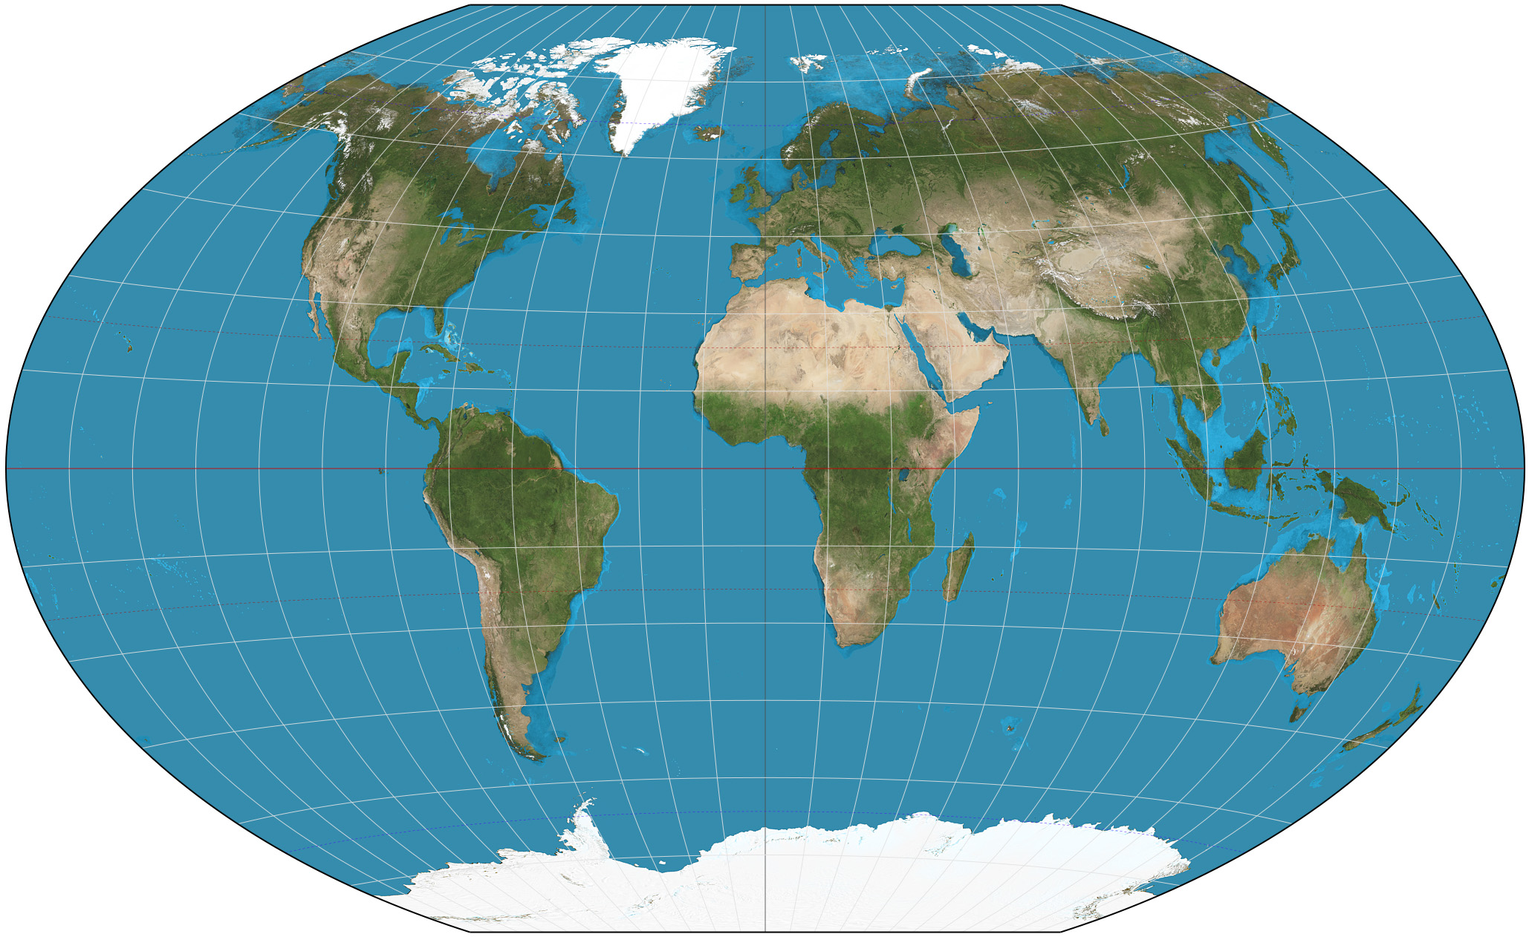
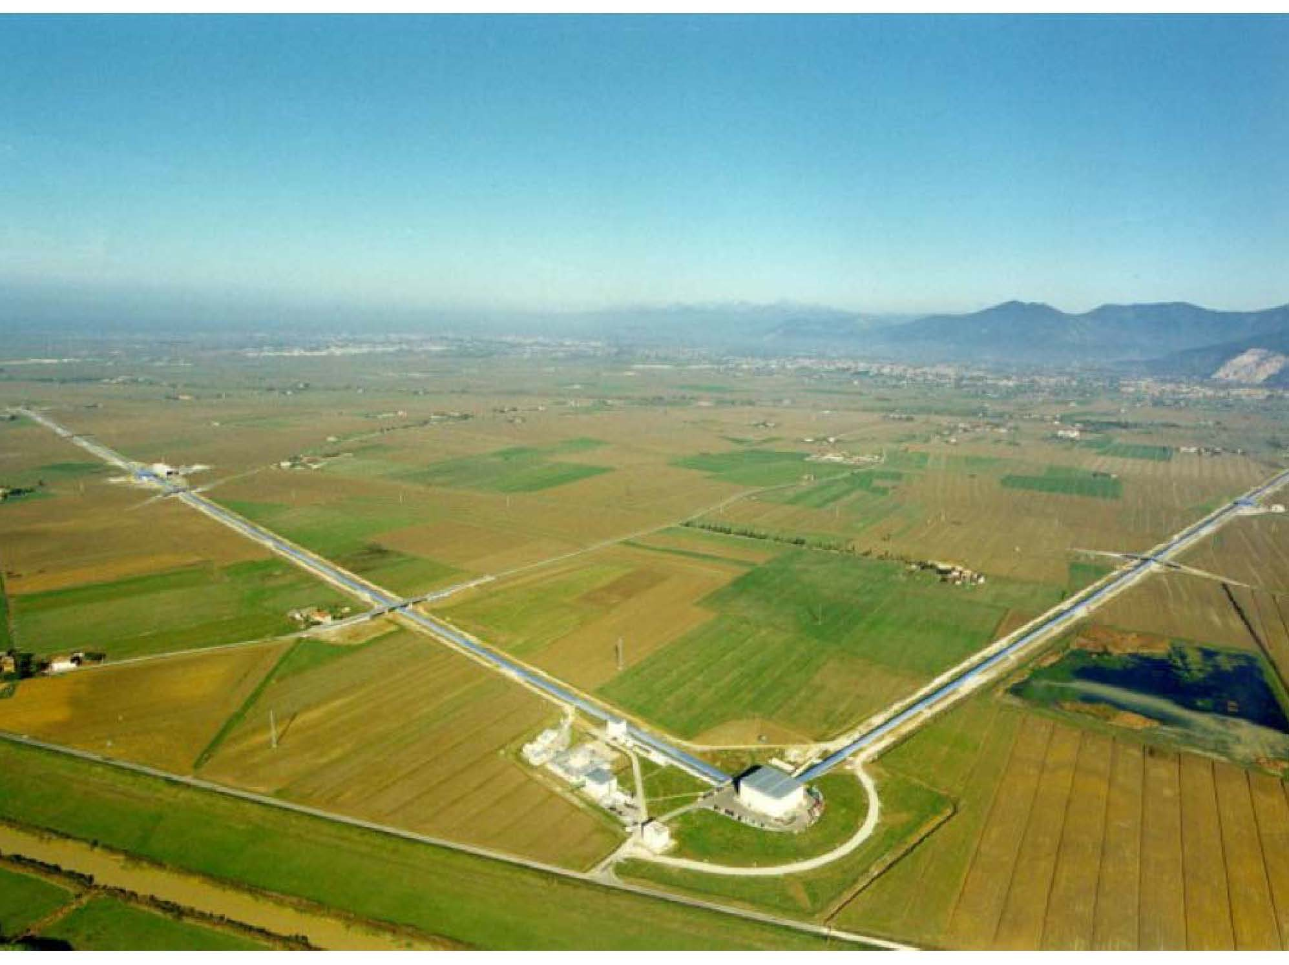
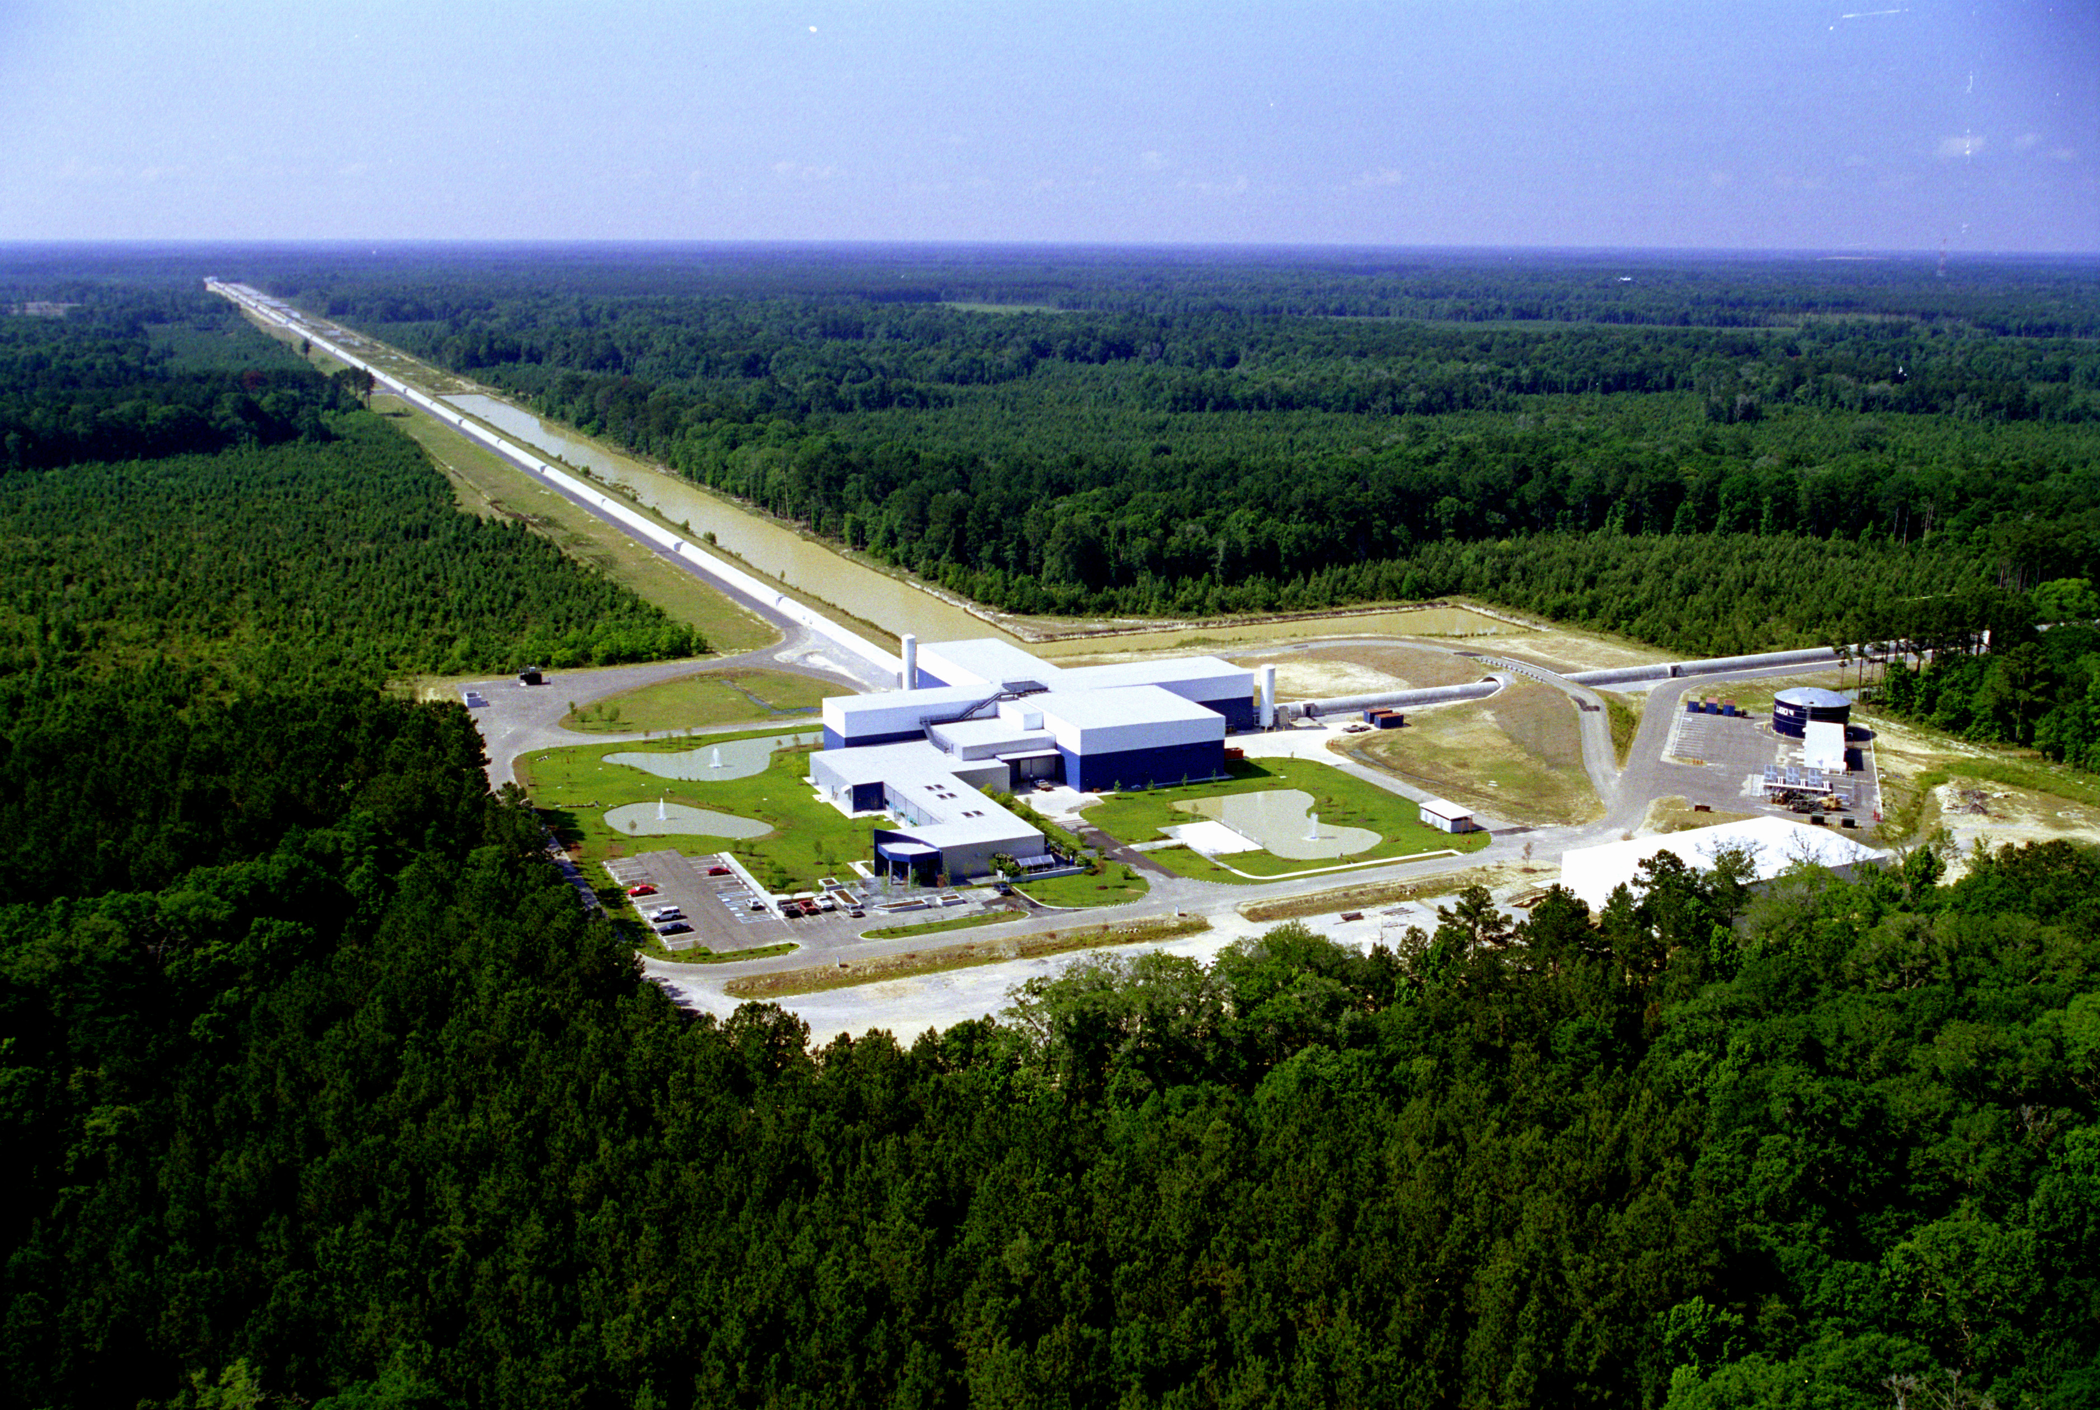
GEO
KAGRA
LHO
VIRGO
LIGO INDIA
LLO

Slide 12
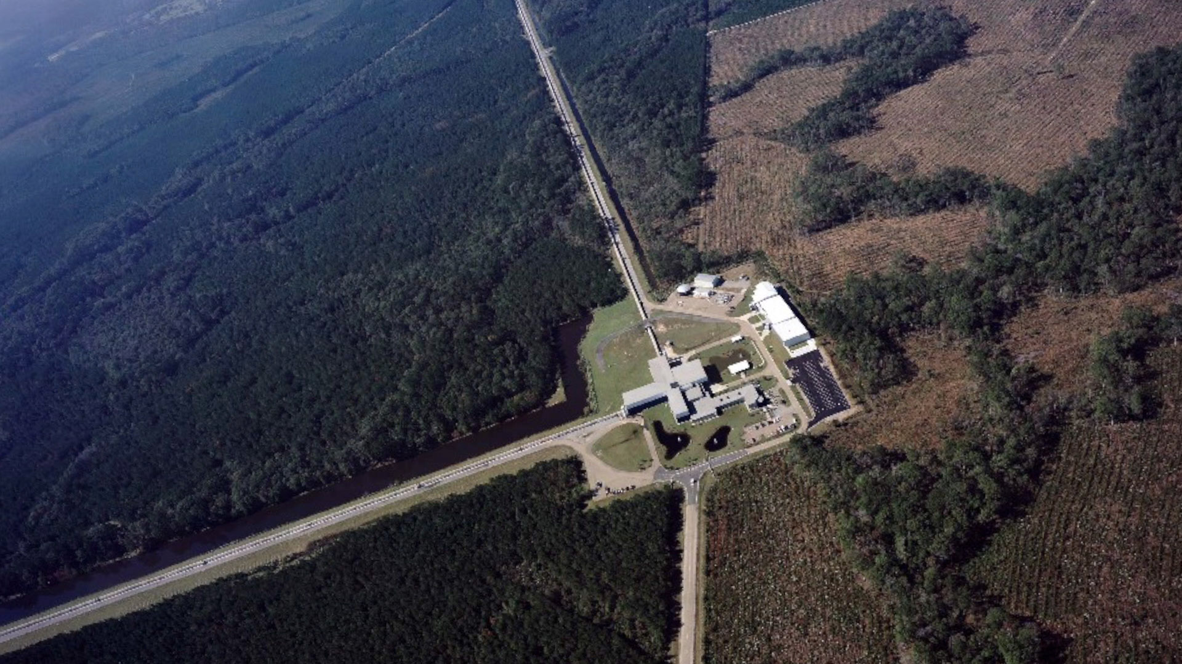

Slide 13
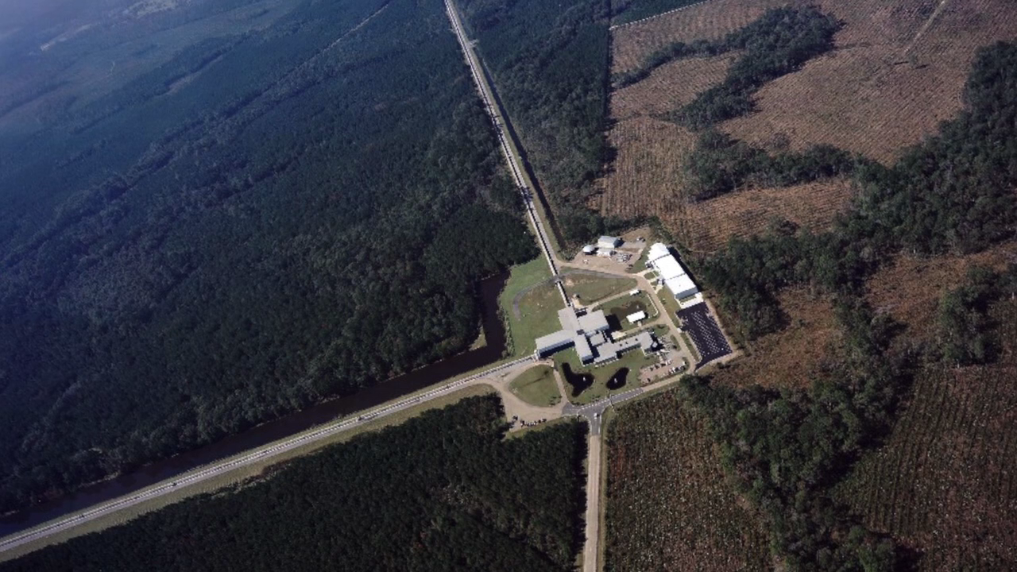

Slide 14
Criteria for transient detection
The same waveform must be seen at the Louisiana and Washington sites within ± 10 msec
The waveform at a site cannot be coincident with signals from the environmental monitors at the site
    3 axis seismometers
    3 axis accelerometers on the chambers
    Tilt meters
    Microphones
    Magnetometers
    RF monitors
    Line voltage monitors
    Wind speed monitors
The waveform at a site cannot be coincident with auxiliary signals in the interferometer not directly associated with the gravitational wave output
    Alignment control signals
    Laser frequency and amplitude control signals
    Approximately 10⁵ sensing signals within the instrument

Slide 15
Simple high-low pass
filter with notches

Slide 17
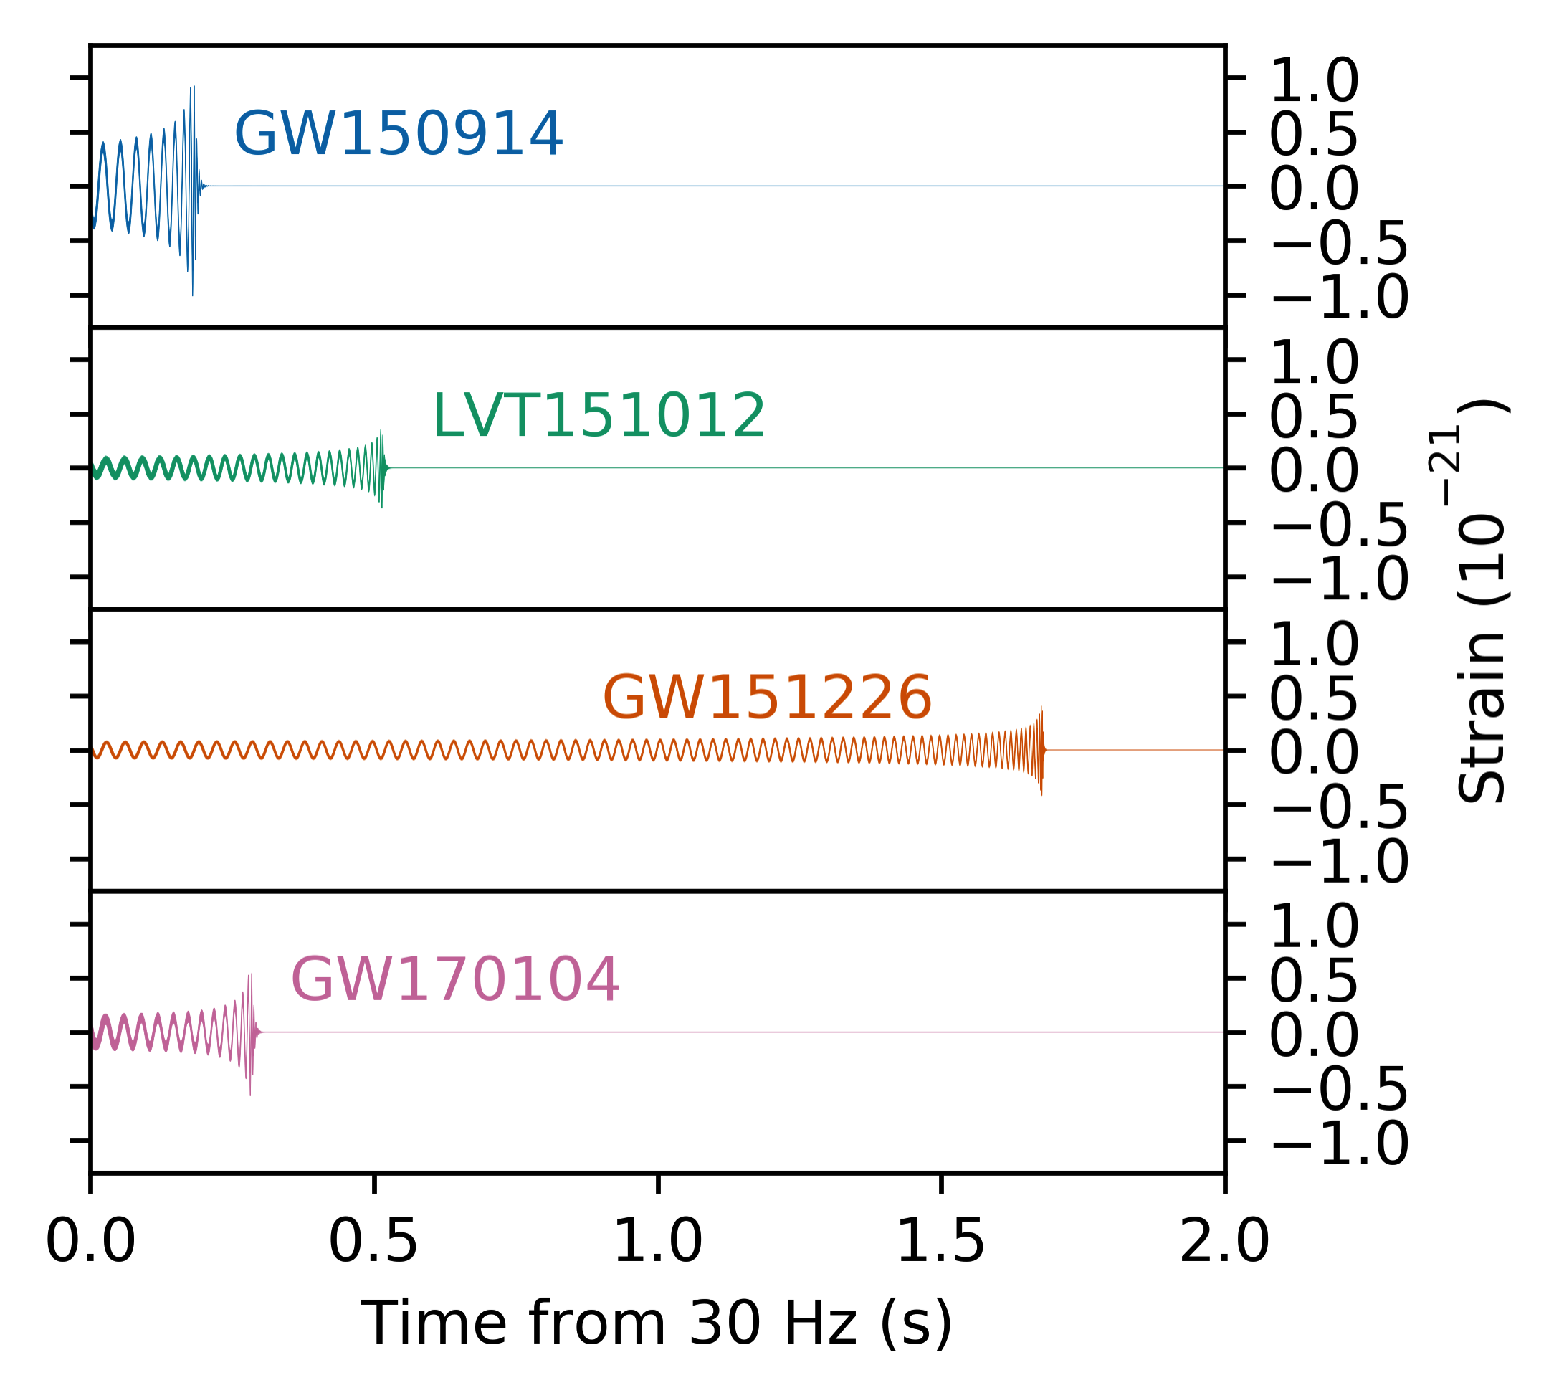
Results of O1 and O2 run announced June 1, 2017
m1=36, m2= 29, Δm=3
if at 1 au
h ~10⁻⁶
I_{g}~ 10²⁵ w/m²
m1=23, m2= 13, Δm=1.5
m1=14.2, m2= 7.5, Δm=1
m1=31, m2= 19, Δm=2
masses in source frame

Slide 19
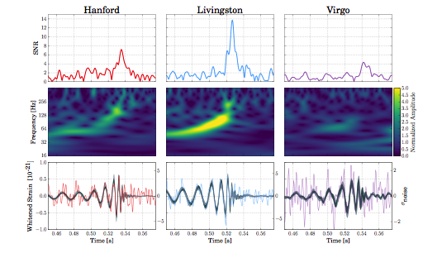
Triple coincidence
GW 170814
M₁ = 30
M₂ = 25
ΔM = 2.7
Localization on sky and distance

Slide 20
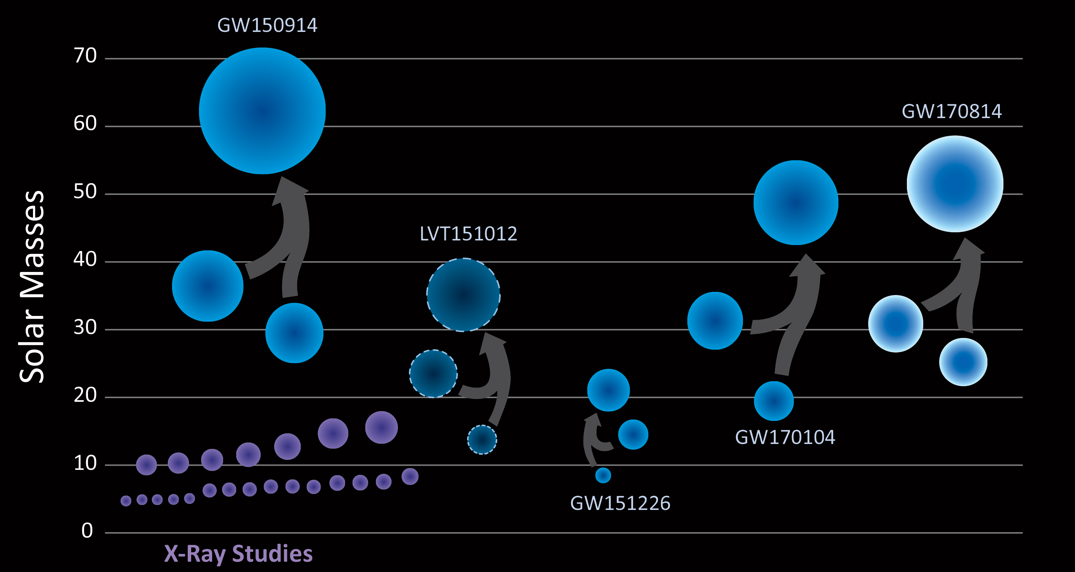
“Solar Mass” Black Holes
Credit: LIGO/Caltech/Sonoma State (Simonnet)

Slide 21
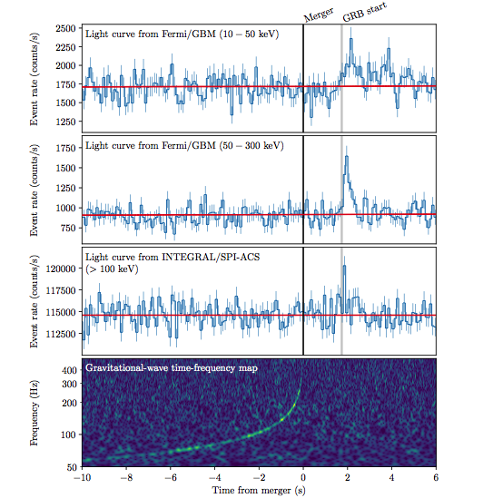

Slide 22
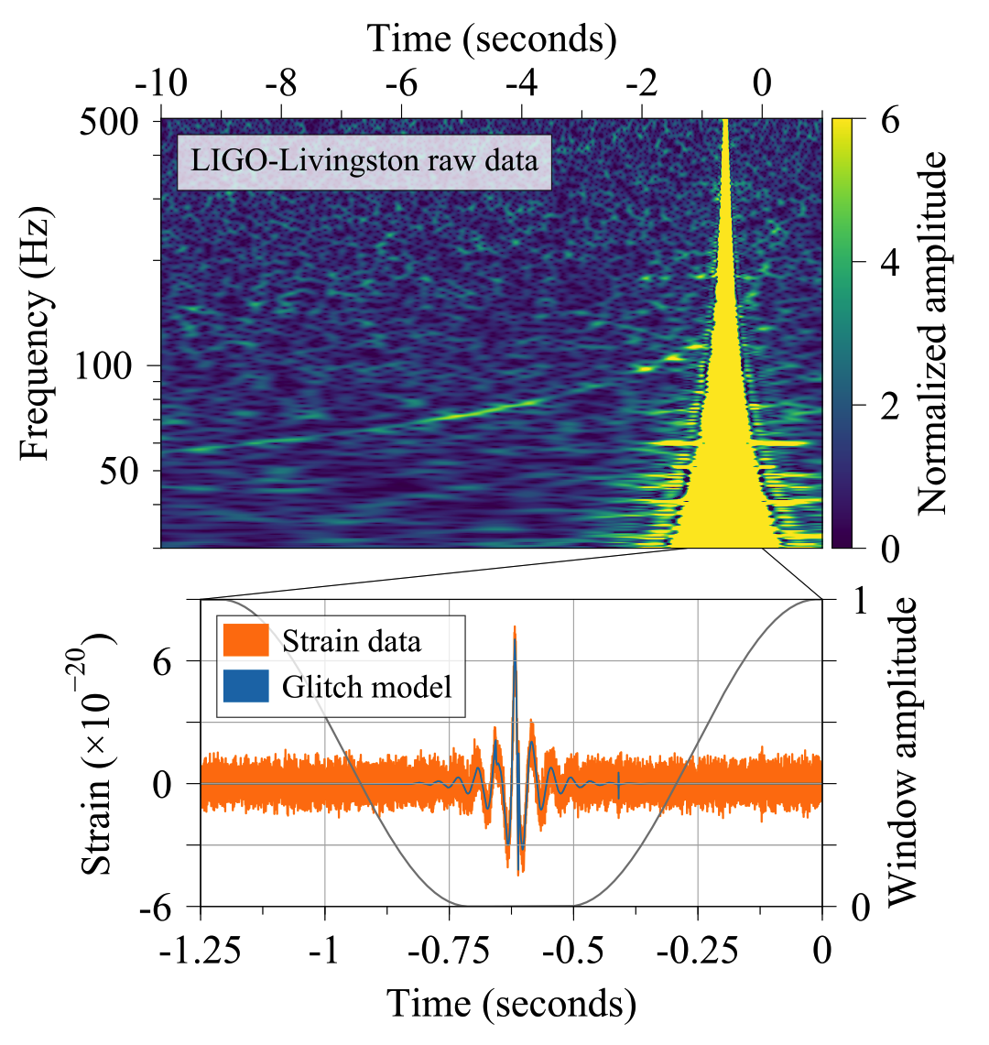
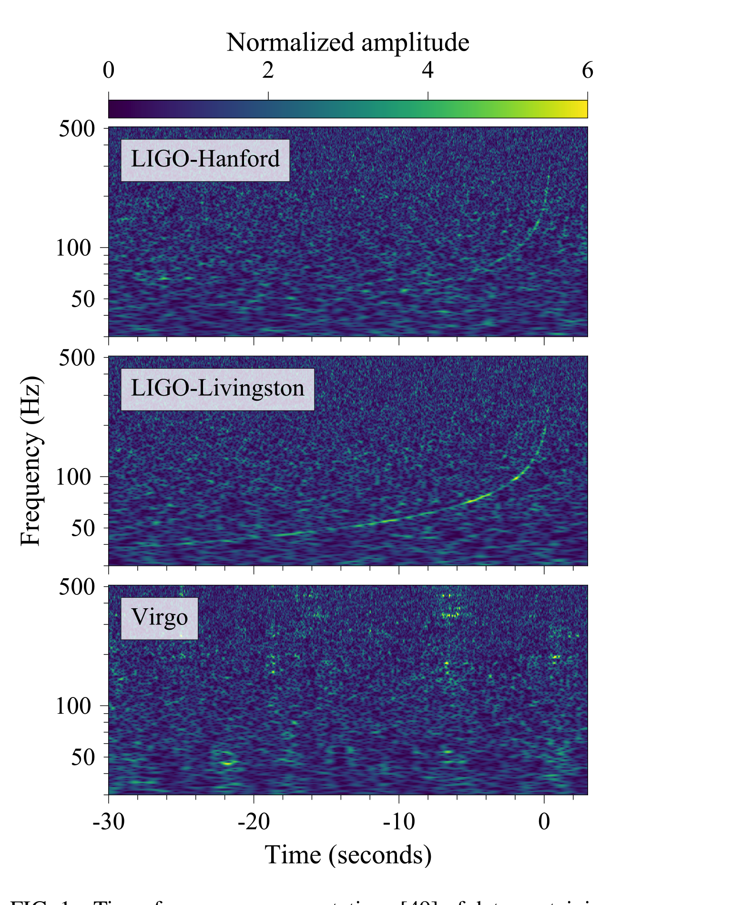

Slide 23
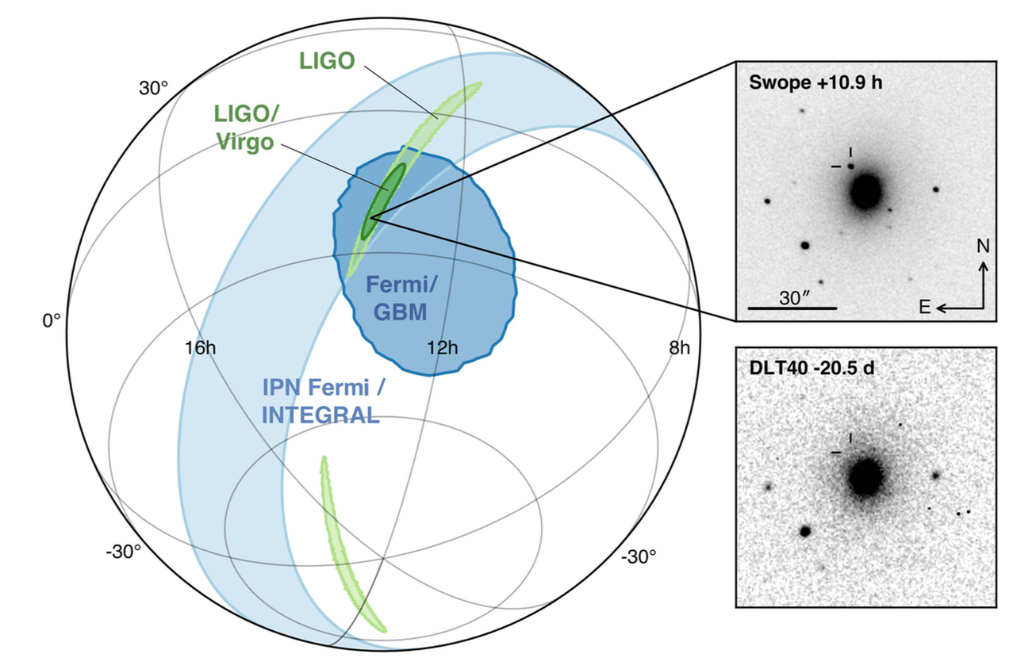
NGC4493

Slide 24
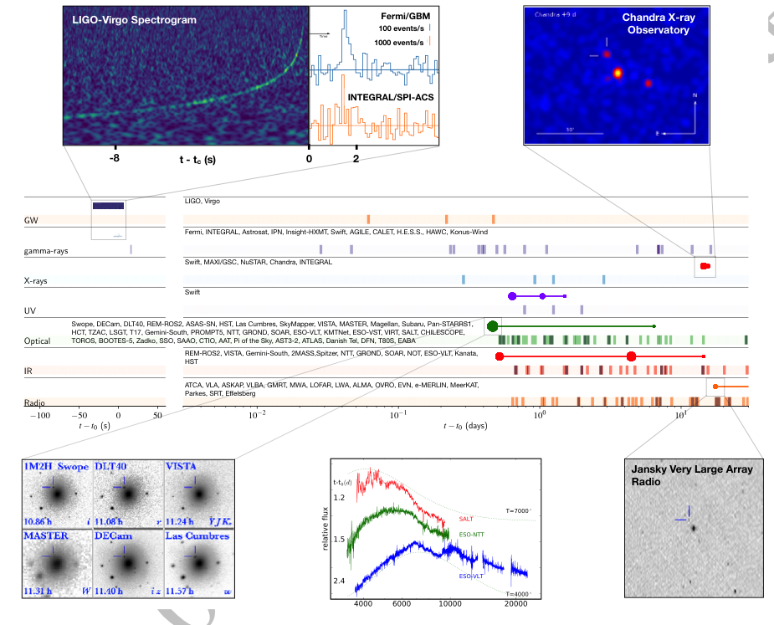

Slide 26
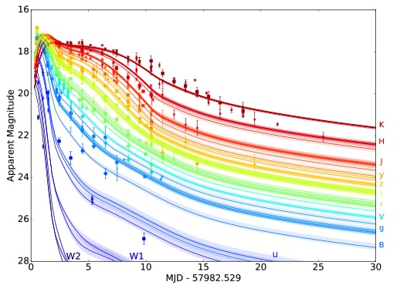
Broad band kilonova spectra vs time
Villar et al arXiv astroph 1710.11576

Slide 27
Hubble constant measurement: Galaxy z and distance from GW amplitude

Slide 28
Classes of sources and searches
Compact binary inspiral: template search
  BH/BH
  NS/NS and BH/NS
Low duty cycle transients: wavelets,T/f clusters
  Supernova
  BH normal modes
  Unknown types of sources
Triggered searches
  Gamma ray bursts
  EM transients
Periodic CW sources
  Pulsars
  Low mass x-ray binaries (quasi periodic)
Stochastic background
  Cosmological isotropic background
  Foreground sources : gravitational wave radiometry

Slide 29
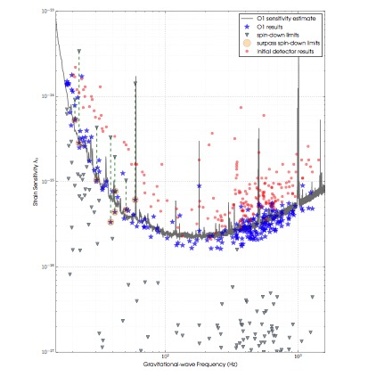
CW radiometer search Scorpius X1
CW search periodic sources
K. Riles preprint

Slide 31
GEO
KAGRA
LHO
VIRGO
LIGO INDIA
LLO

Slide 32
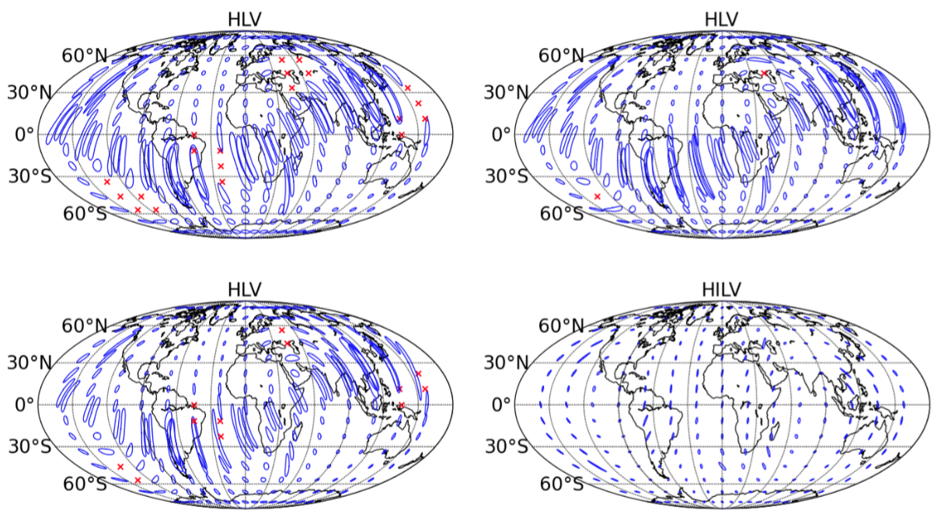

Slide 35
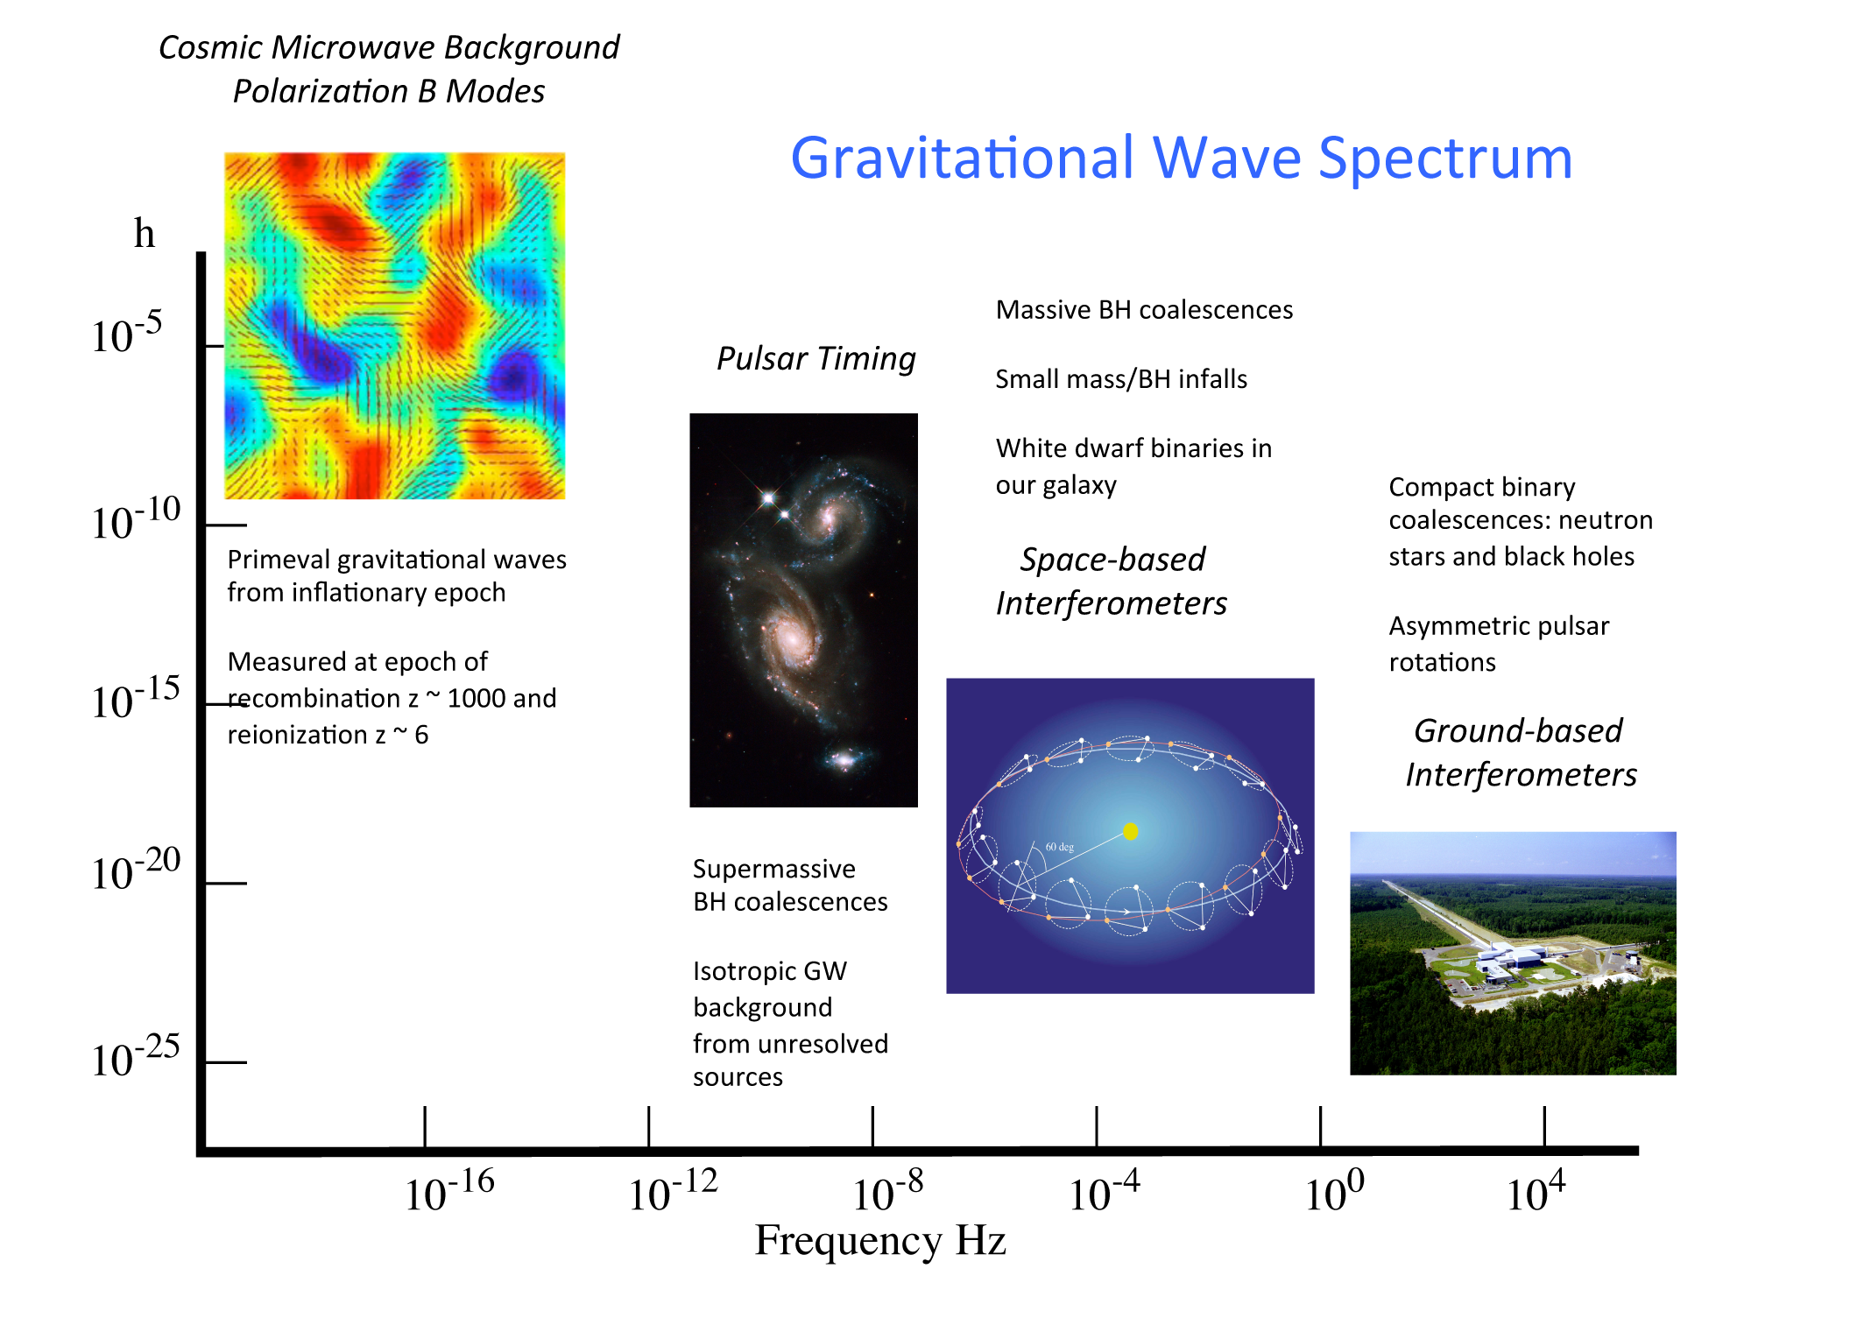
age of universe years hours minutes 1/10 to 1/1000 sec

Slide 38
age of universe years hours minutes 1/10 to 1/1000 sec

Slide 39














































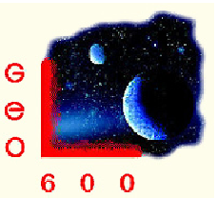




















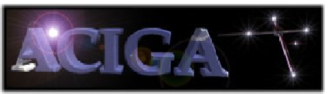








LIGO Scientific Collaboration

Slide 40
SPARE SLIDES

