Slide 1
A trio of unintended null experiments
An autobiographical indulgence
+
Why graduate students should not give up
Rainer Weiss, MIT
Louisiana State University
April 25, 2013

Slide 2
The experiments
The fountain atomic clock
  Paucity of slow atoms in a beam
  A really precise clock with laser cooling
The cosmic background as a velocity reference
  The galactic interstellar dust got in the way
  The right choices for COBE
Tired light: cause for the Hubble expansion
  QED works, photon/photon collisions do not
  Experimental evidence for LIGO

Slide 3
Relevant properties of atomic clocks
Single isolated quantum systems
  Well defined states and energy levels
  Each Cs atom the same as the next
  Independent of epoch (maybe not?)
Accuracy: anyone can set it up and get the same answer – control of systematics
Precision:
n atoms (no systematics)
single atom

Slide 4
Breit – Rabi plot Cs hfs energy vs B field

Slide 5
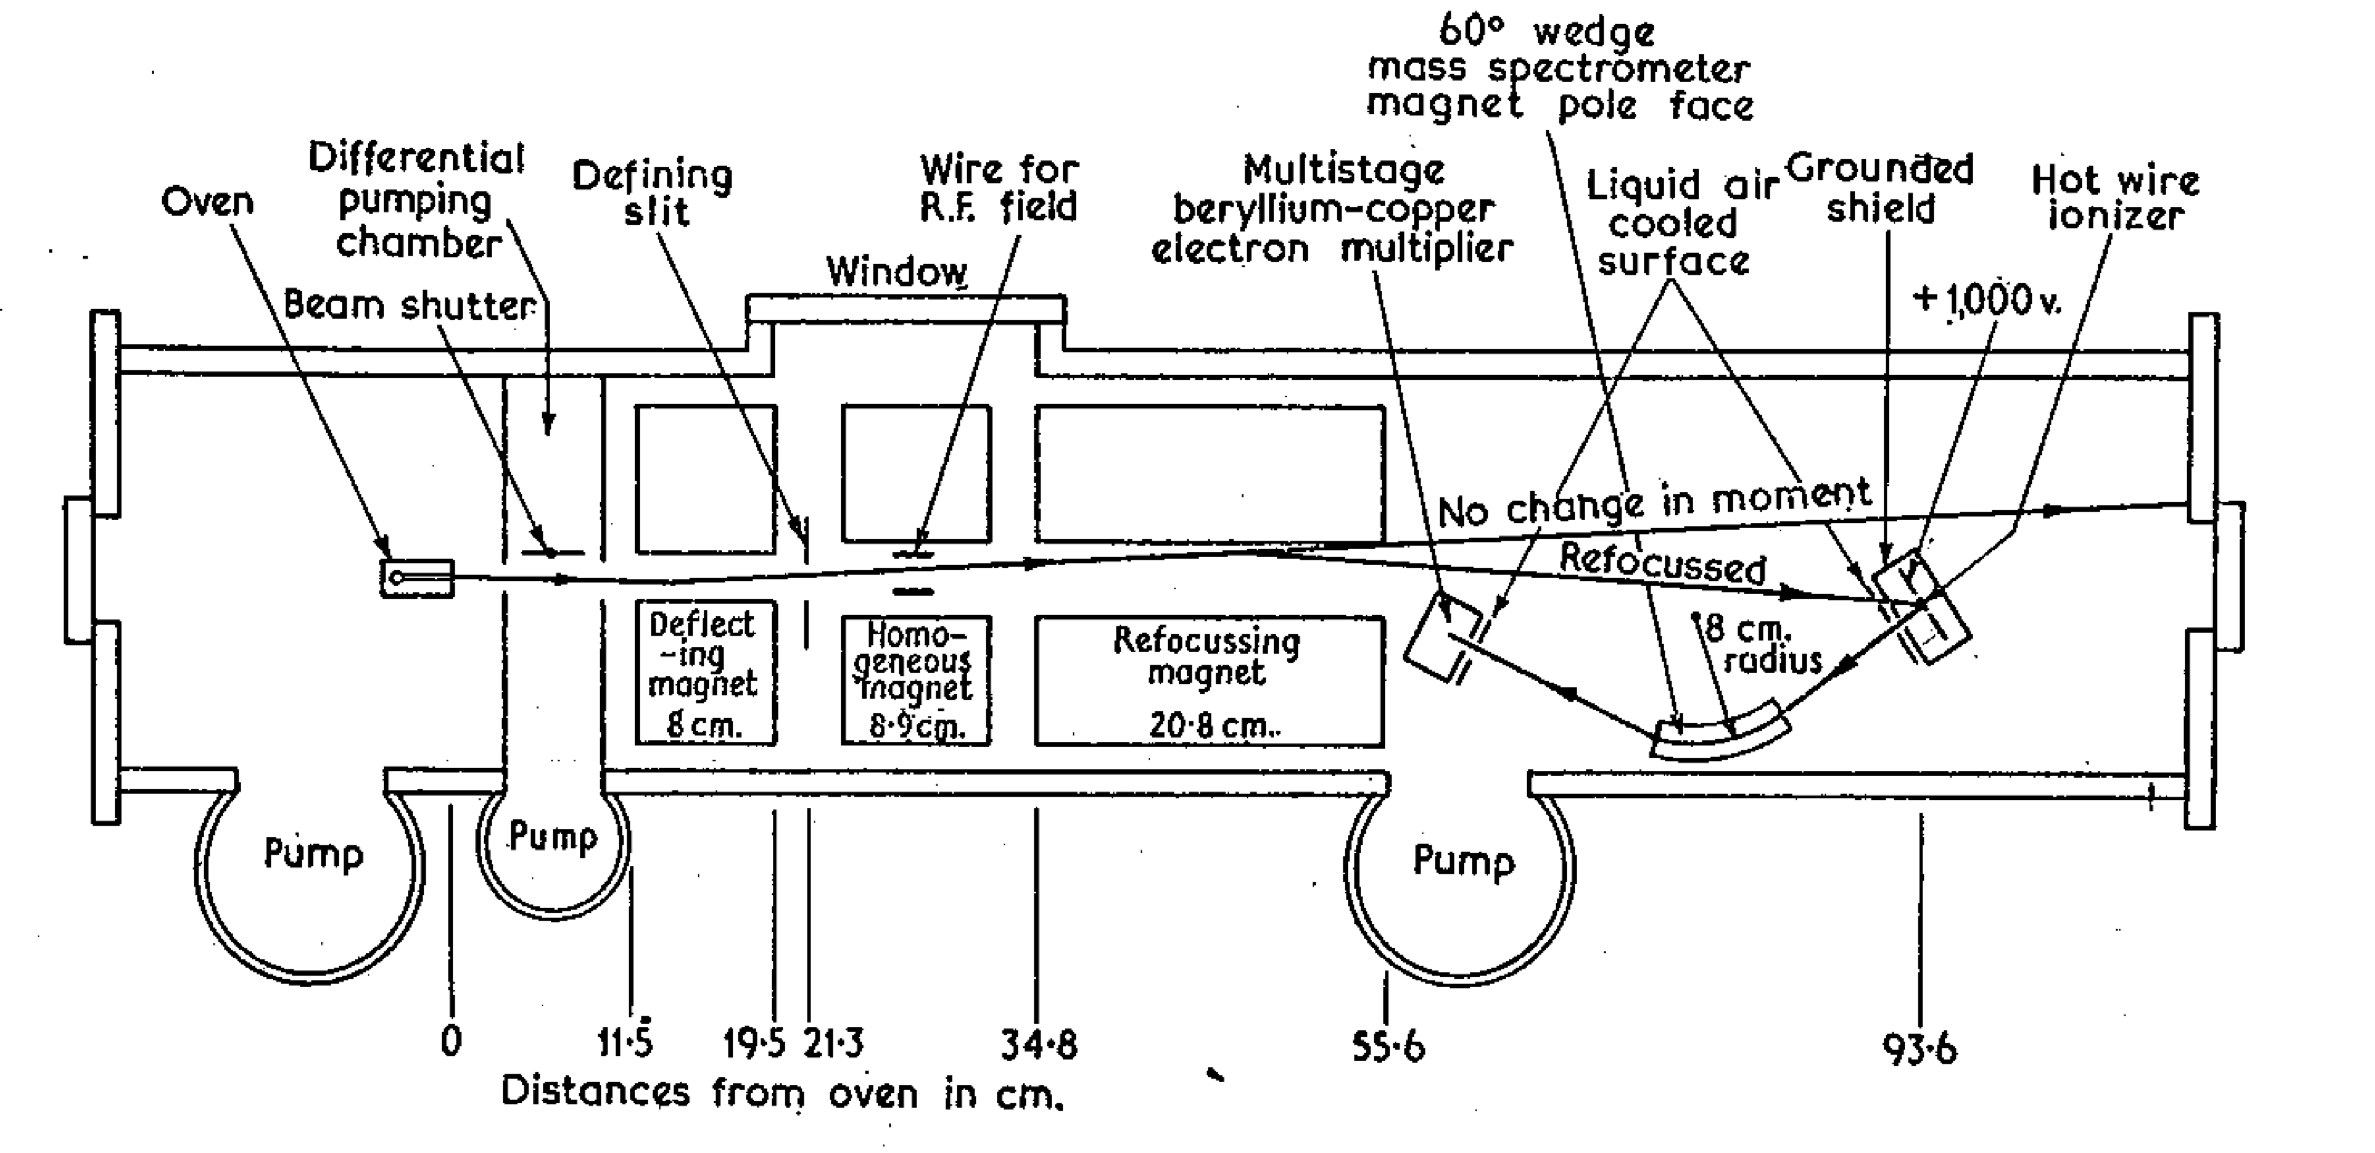
Rabi magnetic resonance apparatus

Slide 6
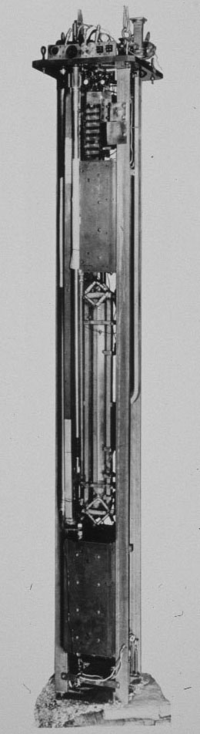
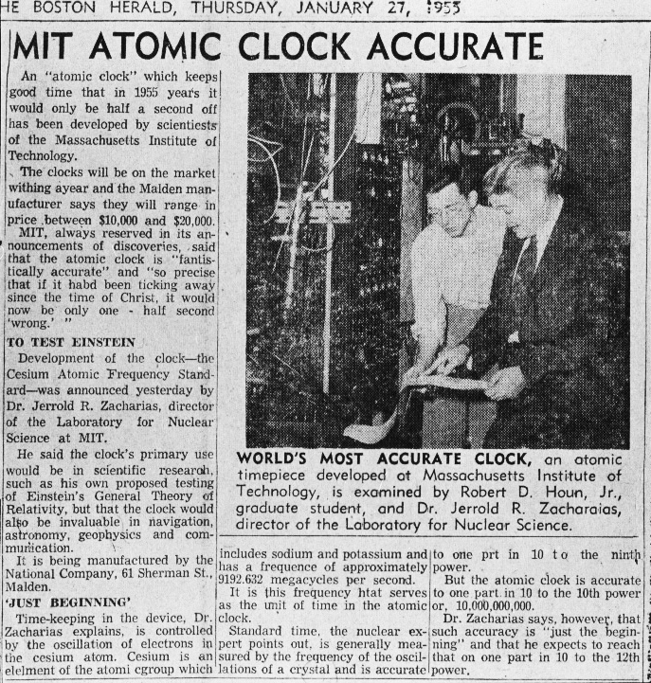
Small Cs clock

Slide 7
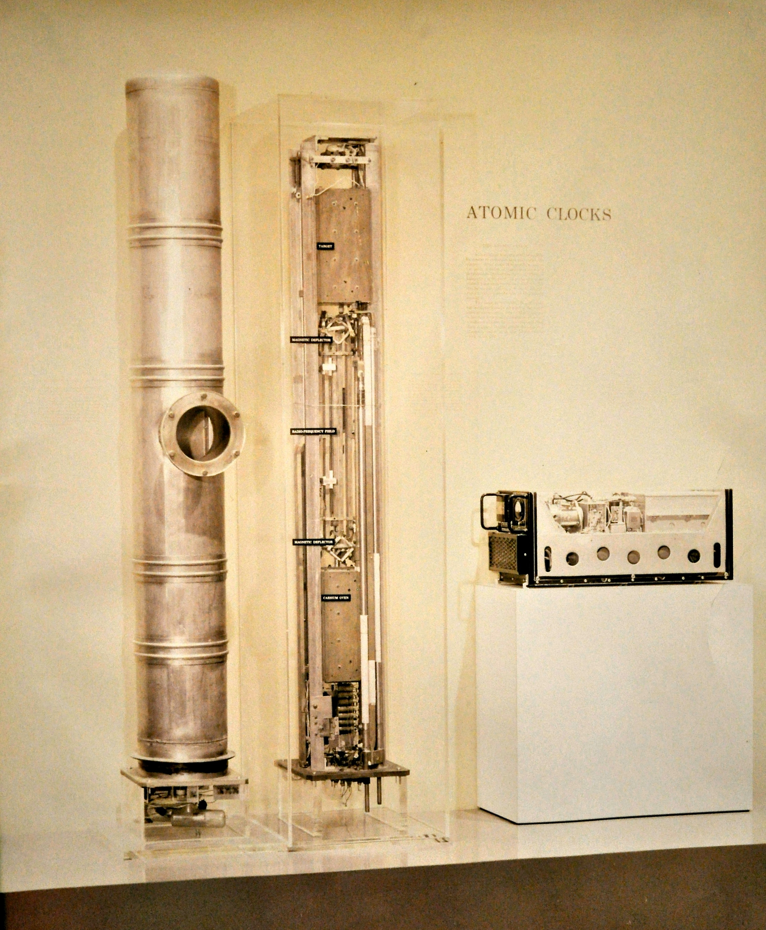
Smithsonian exhibit

Slide 8
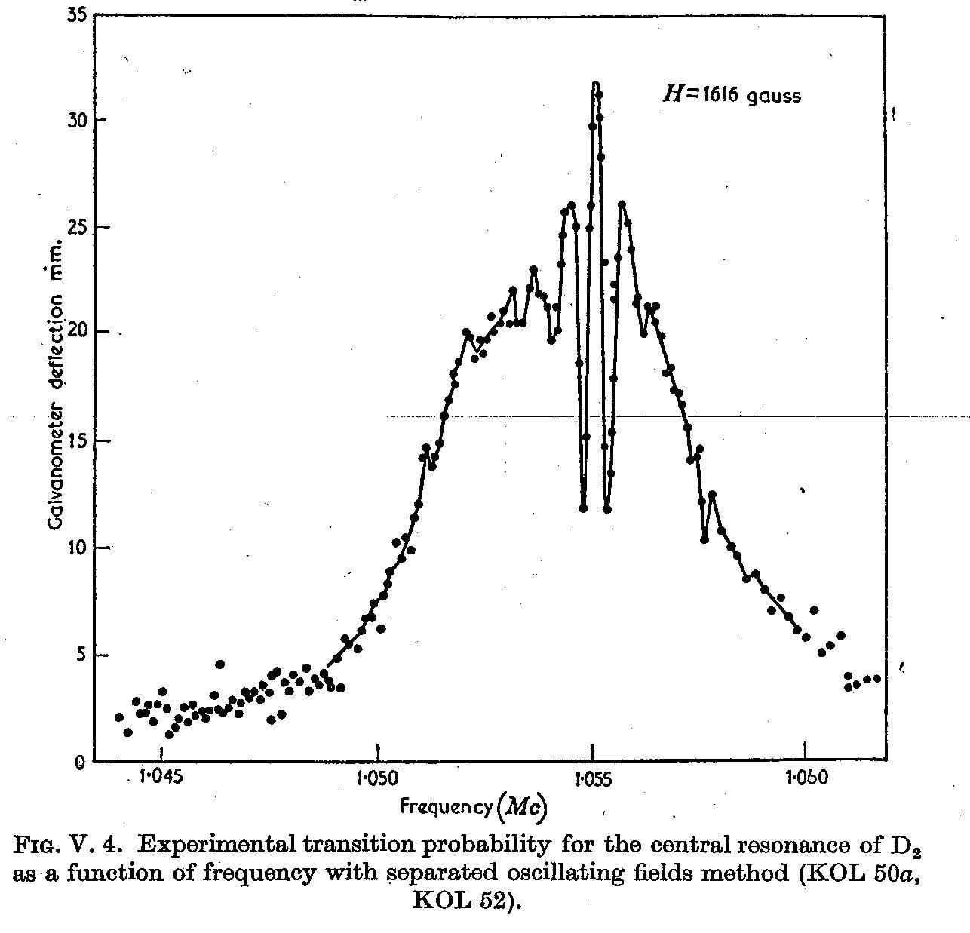
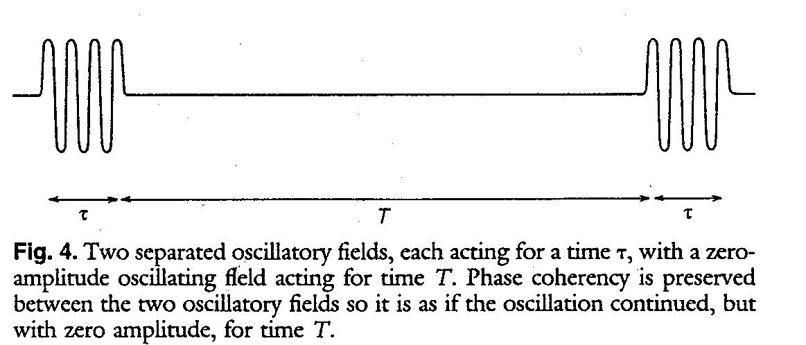
Ramsey separated oscillatory field excitation

Slide 9
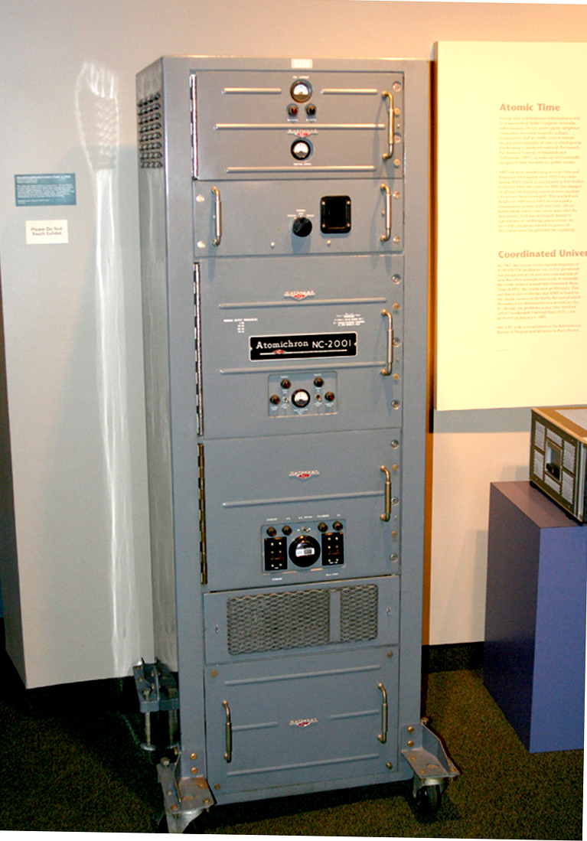
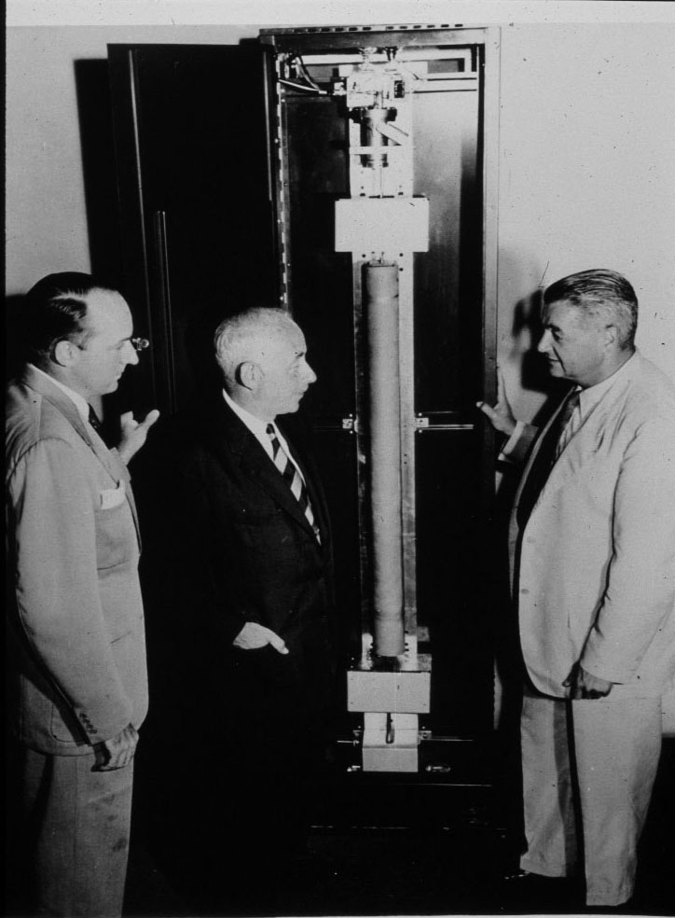
The Atomichron: National company

Slide 10
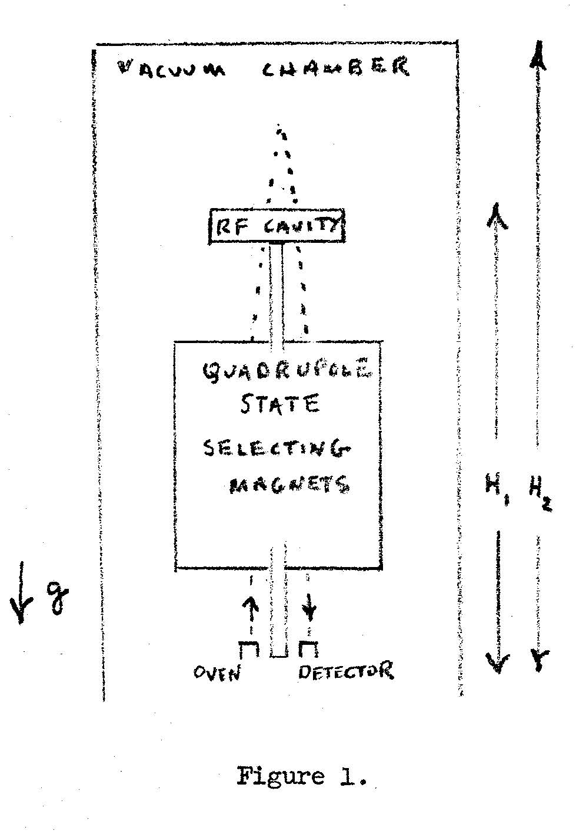
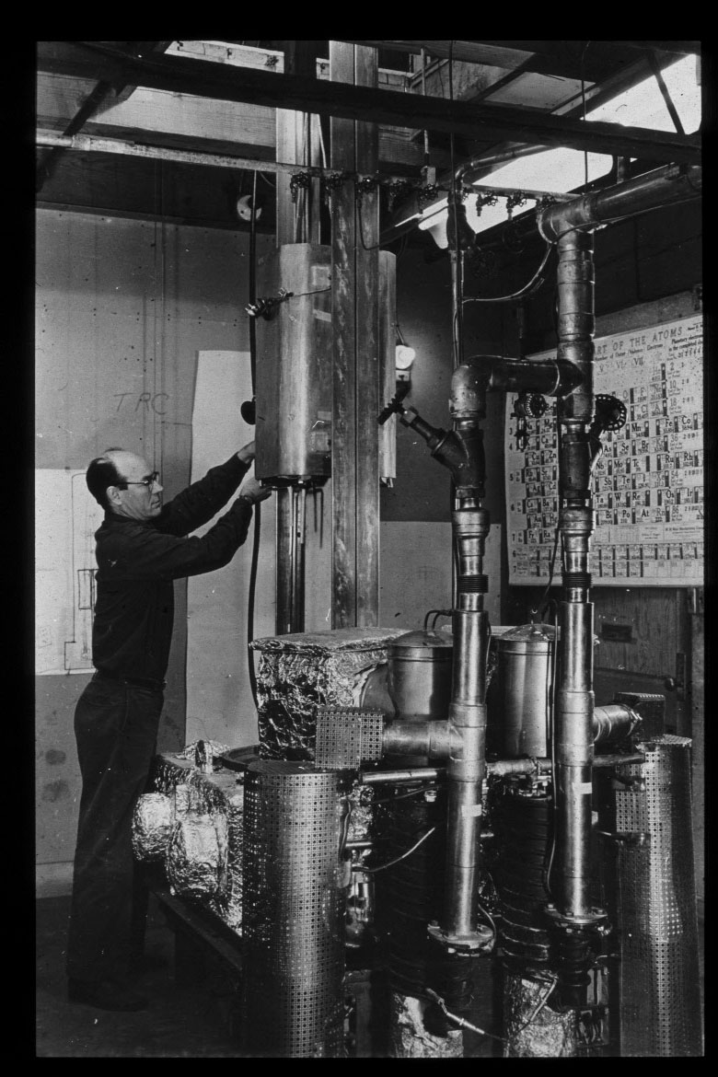
The big clock: Zacharias fountain
per atom
Einstein red shift

Slide 11
Velocity of atoms in a beam
Cs @ 373K
Beam intensity between two heights, h/h₀<<1
h₂=5m h₁=3m

Slide 12
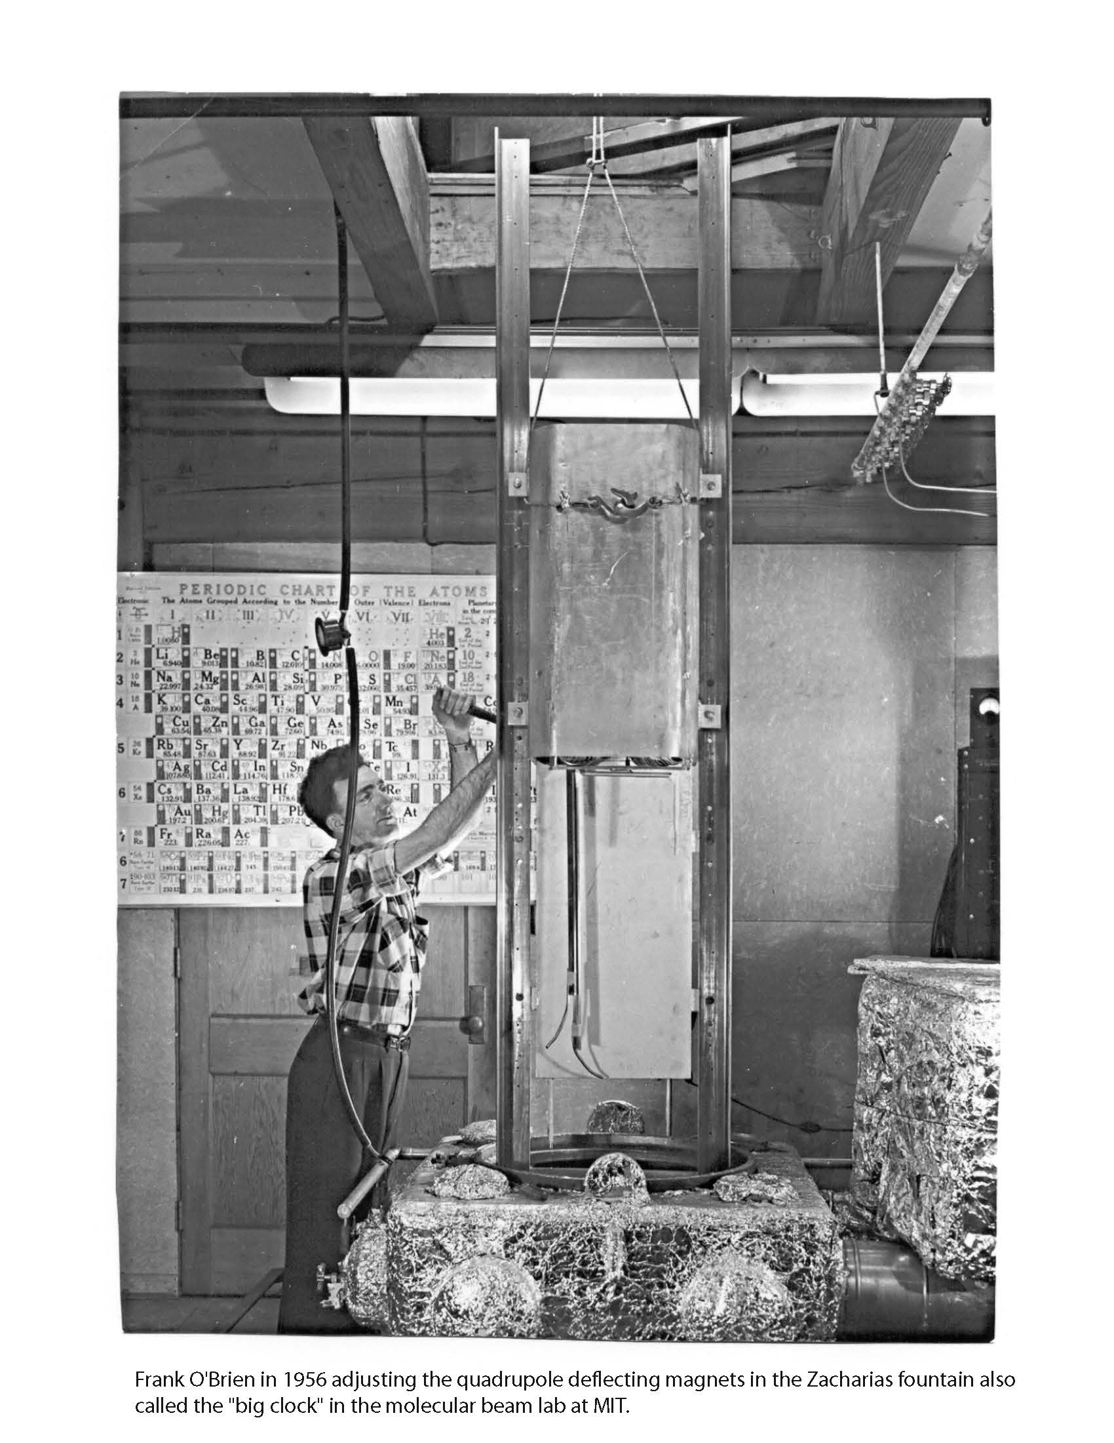

Slide 13
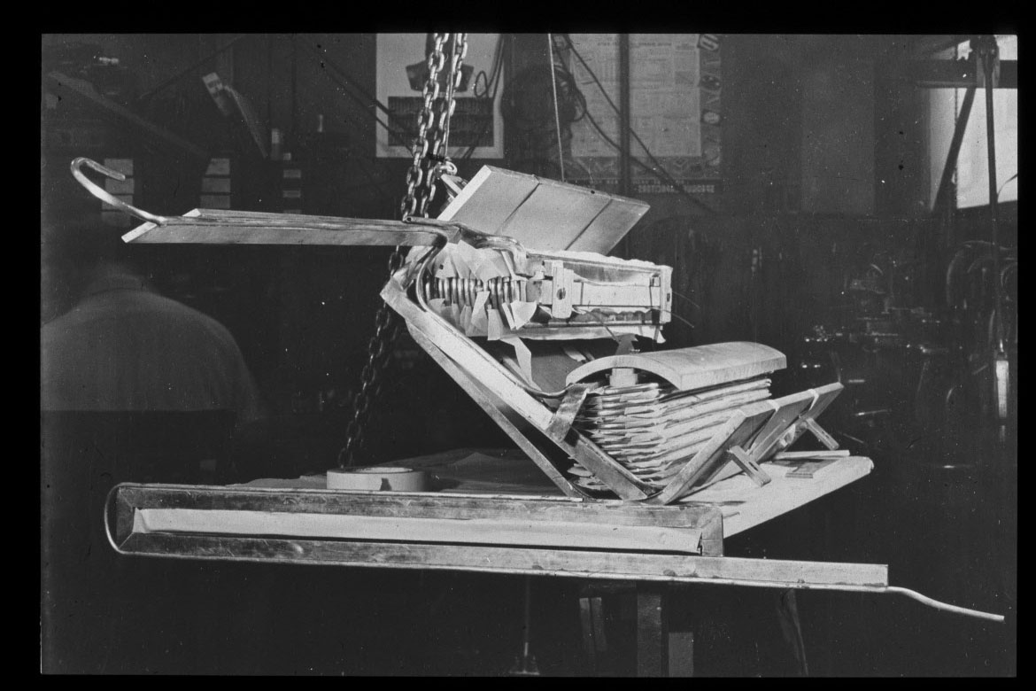
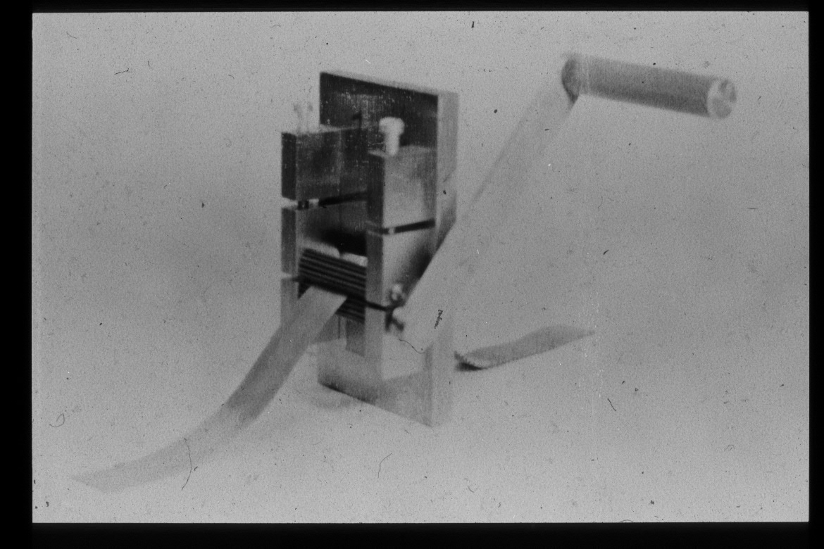
Scaling for the fountain
Gears to make corrugated sheet alternating with flat sheets for a multitube Cs oven
Quadrupole focusing magnet uses steel magnet image surface of structure for other poles

Slide 14
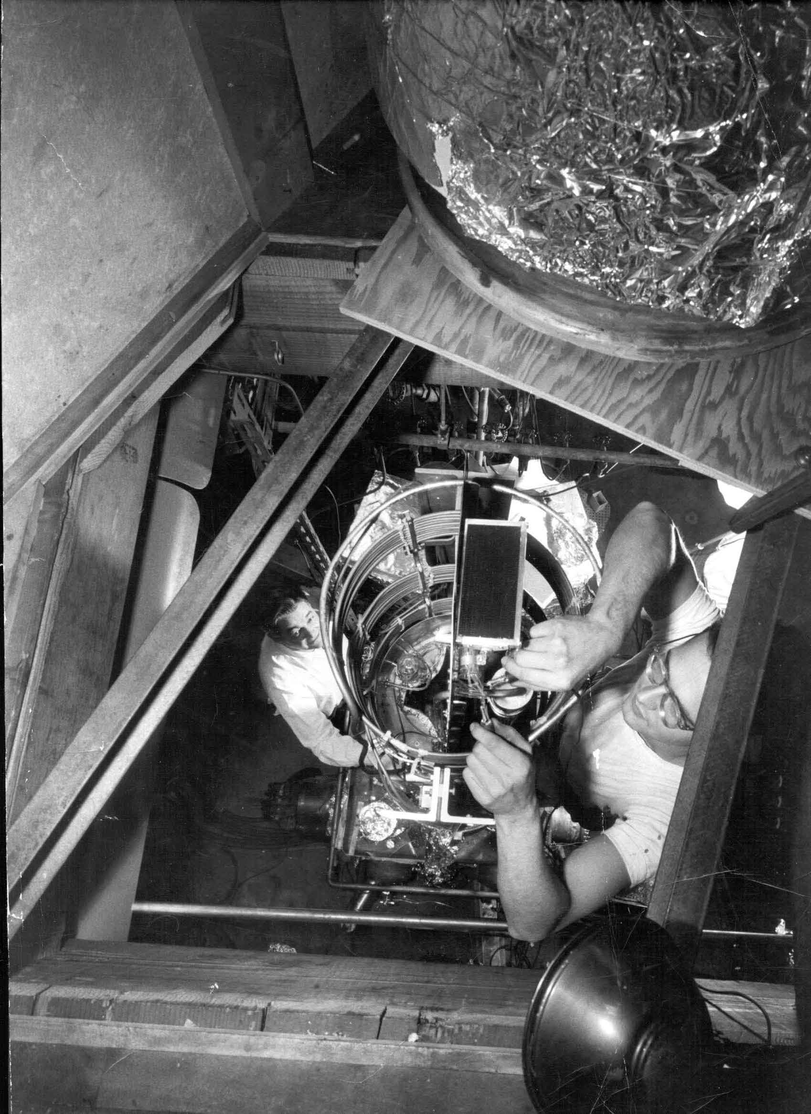

Slide 15
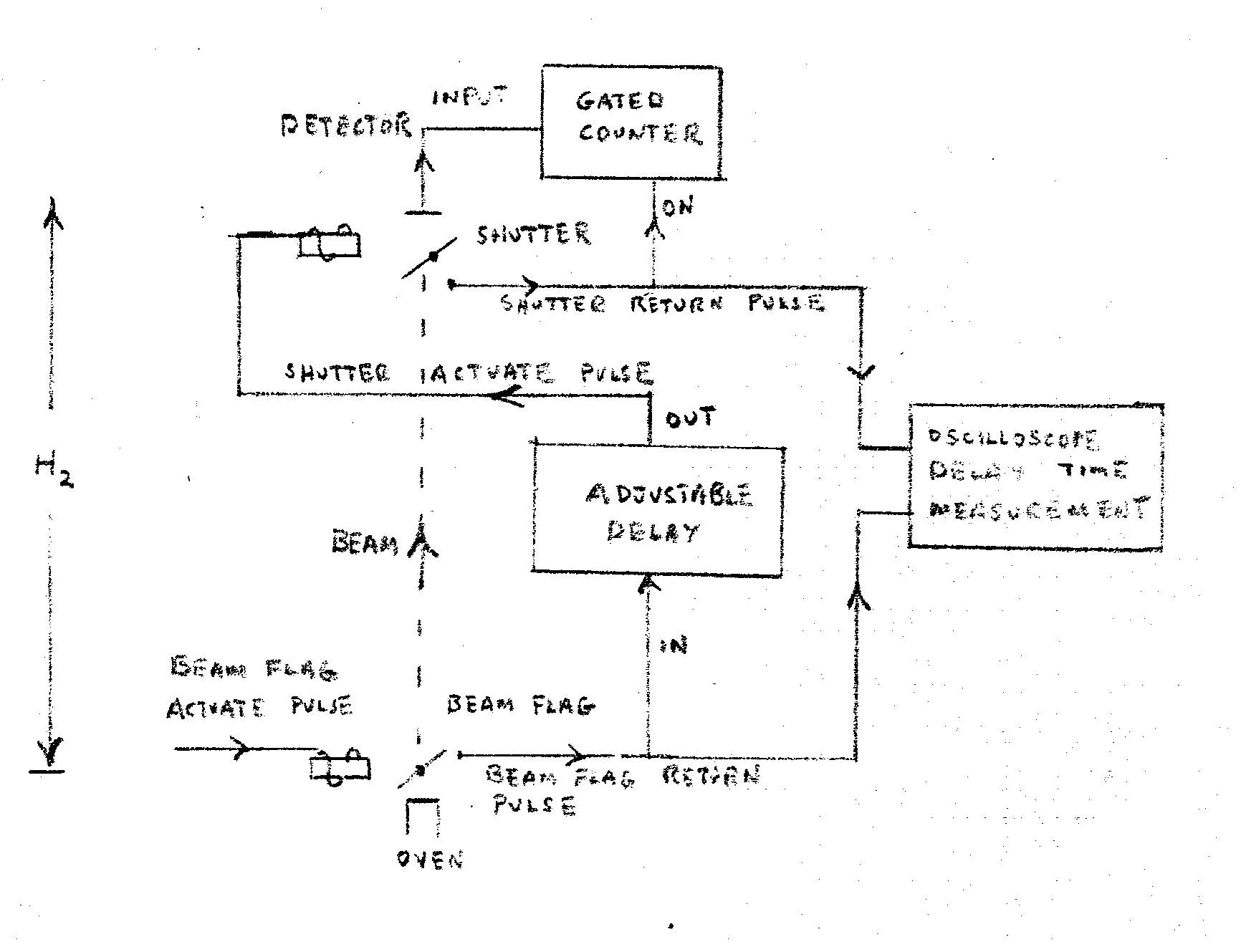
Pulse measurement of velocities
Apparatus had been extended through the next floor: h₂ = 6m, t₀=27 millisec

Slide 16
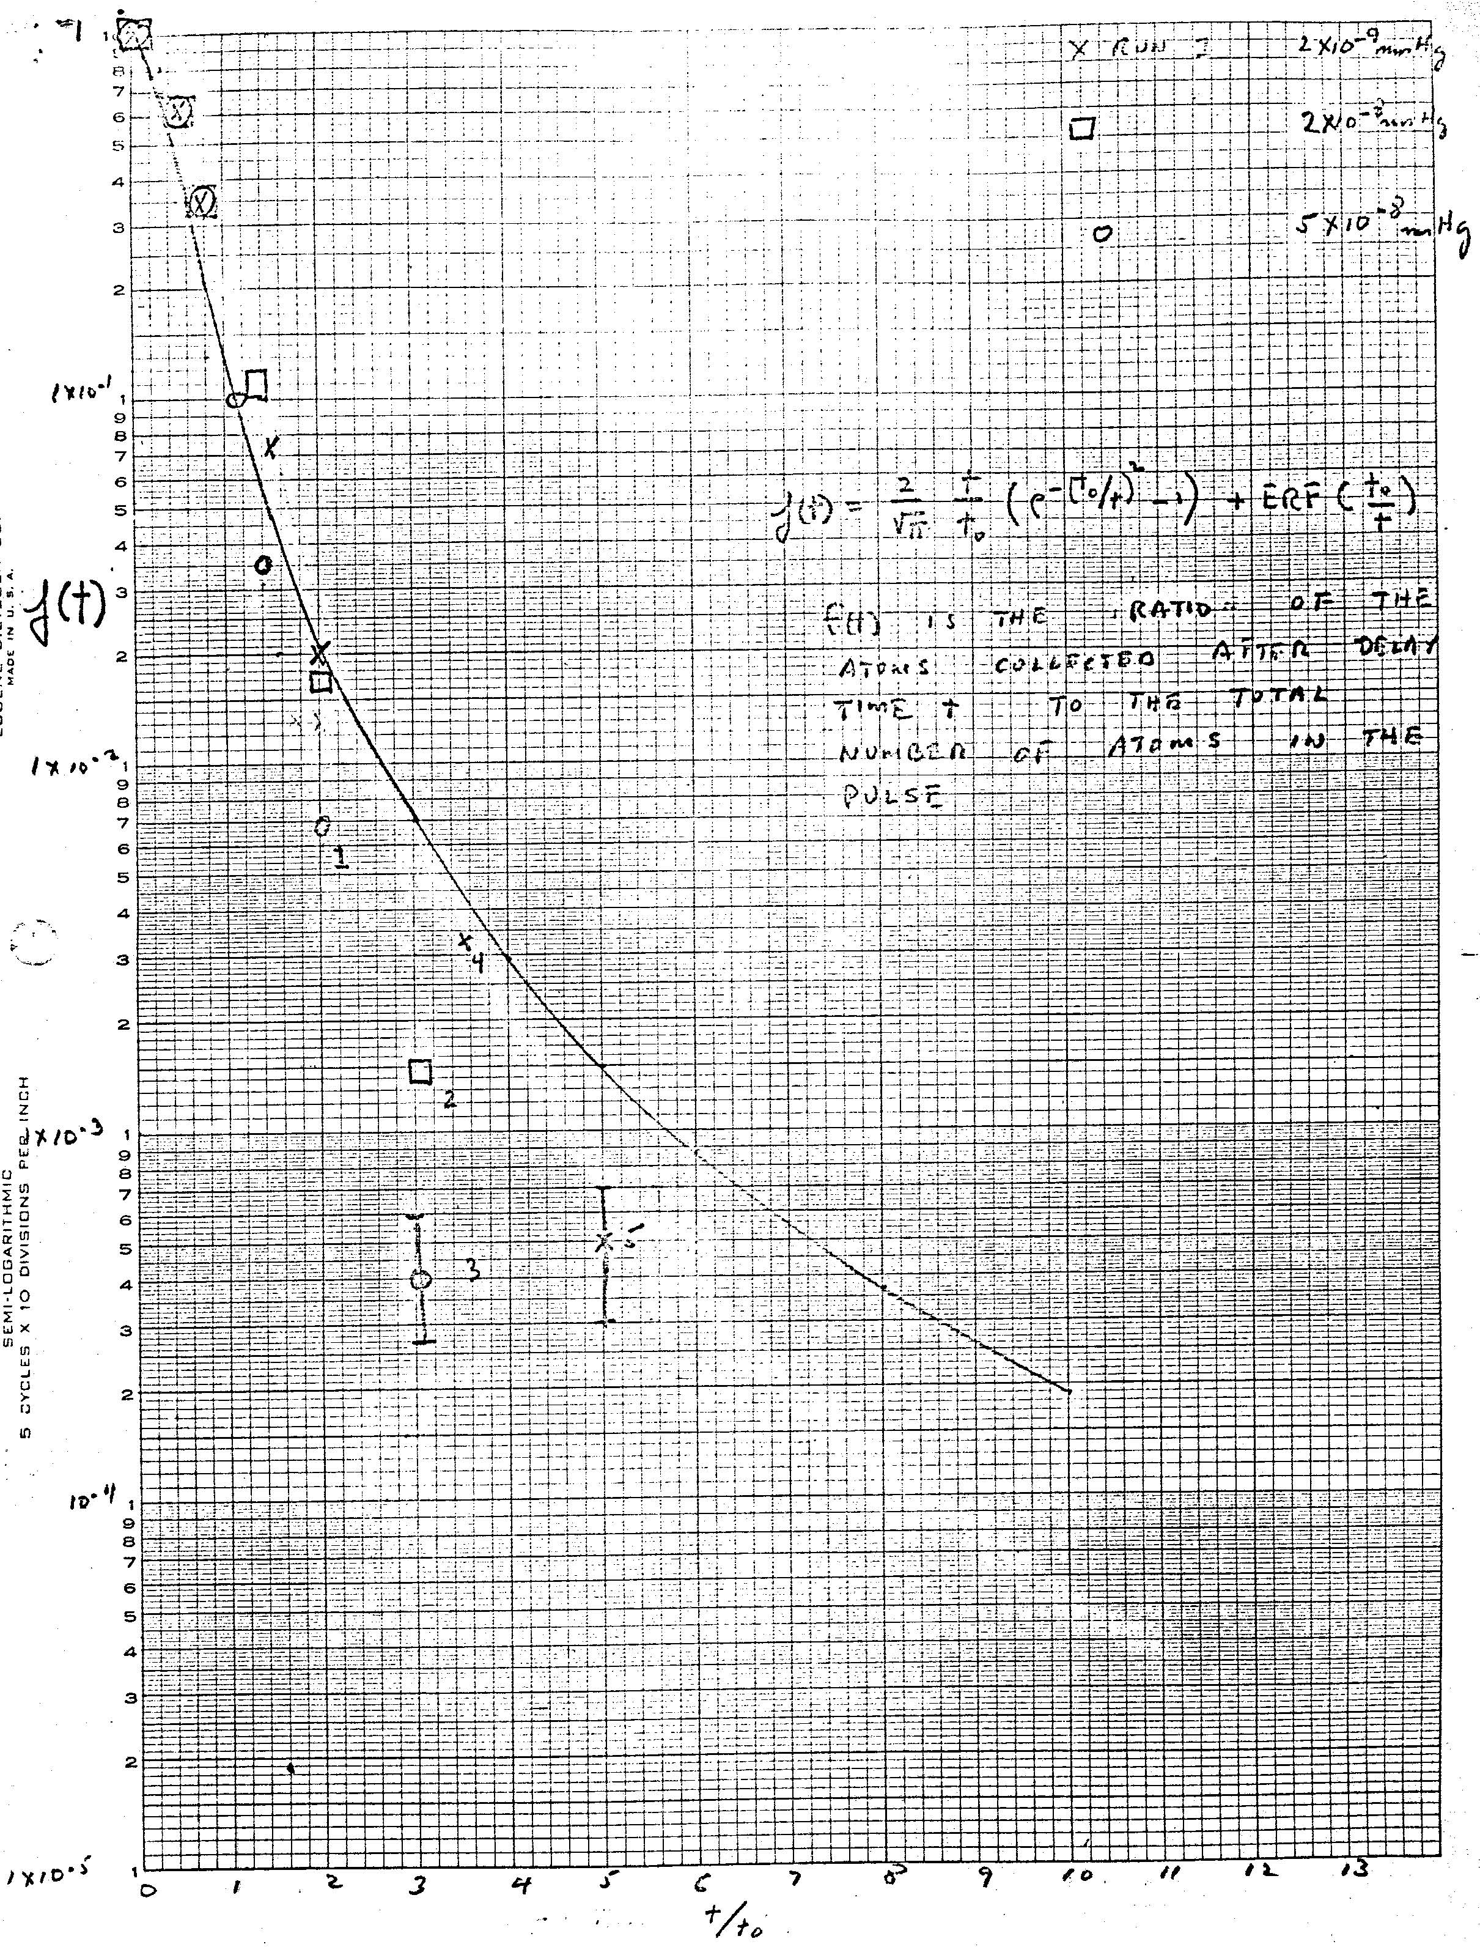
Big clock velocity data: what went wrong
Fast atoms scatter slow atoms in the beam
60 hits/slow atom
for t/t₀=22

Slide 17
Zacharias Fountain 1991

Slide 18
Cosmic Background as velocity reference
Critical issues after discovery of the Cosmic Background
  Is the spectrum thermal – a Planck distribution in frequency
  Is the angular distribution isotropic
Spectrum
w/cm²/sr
Peak in wavenumbers at 2T
Anisotropy due to motion of detector relative to last scatterers
Best estimate in 1970’s : v/c = 1 x 10⁻³
due to rotation of our galaxy

Slide 19
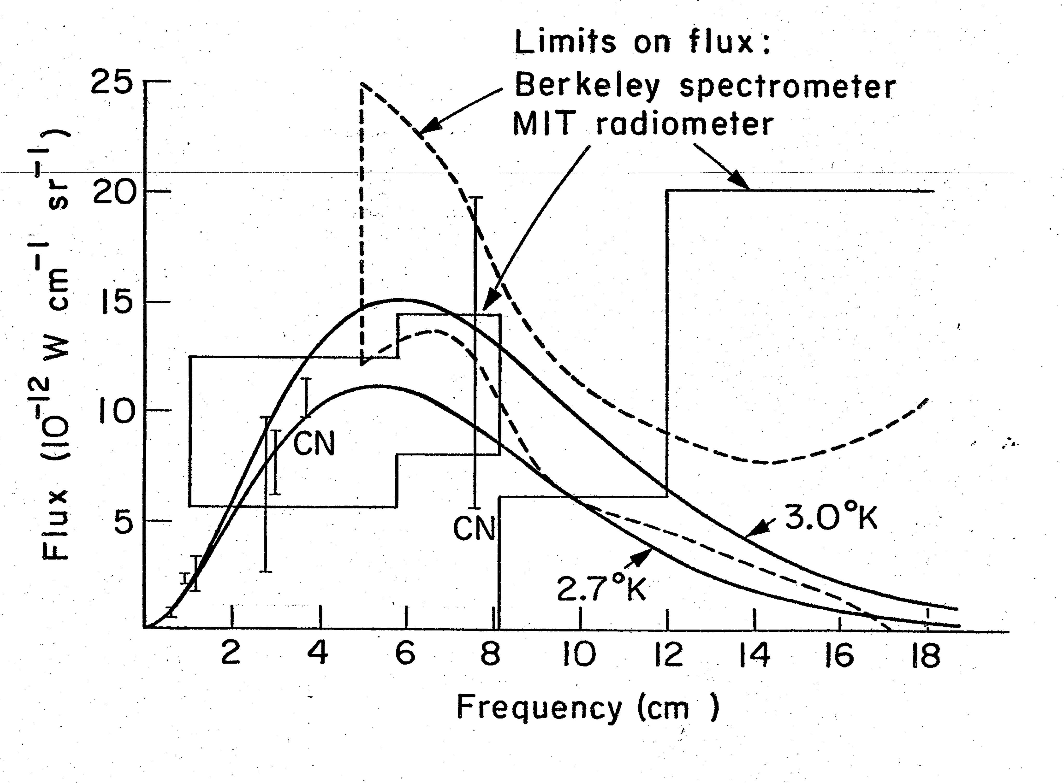
Spectrum 1972 - 1978
1978
1972
D.Muehlner

Slide 20
MIT anisotropy instrument

Slide 21
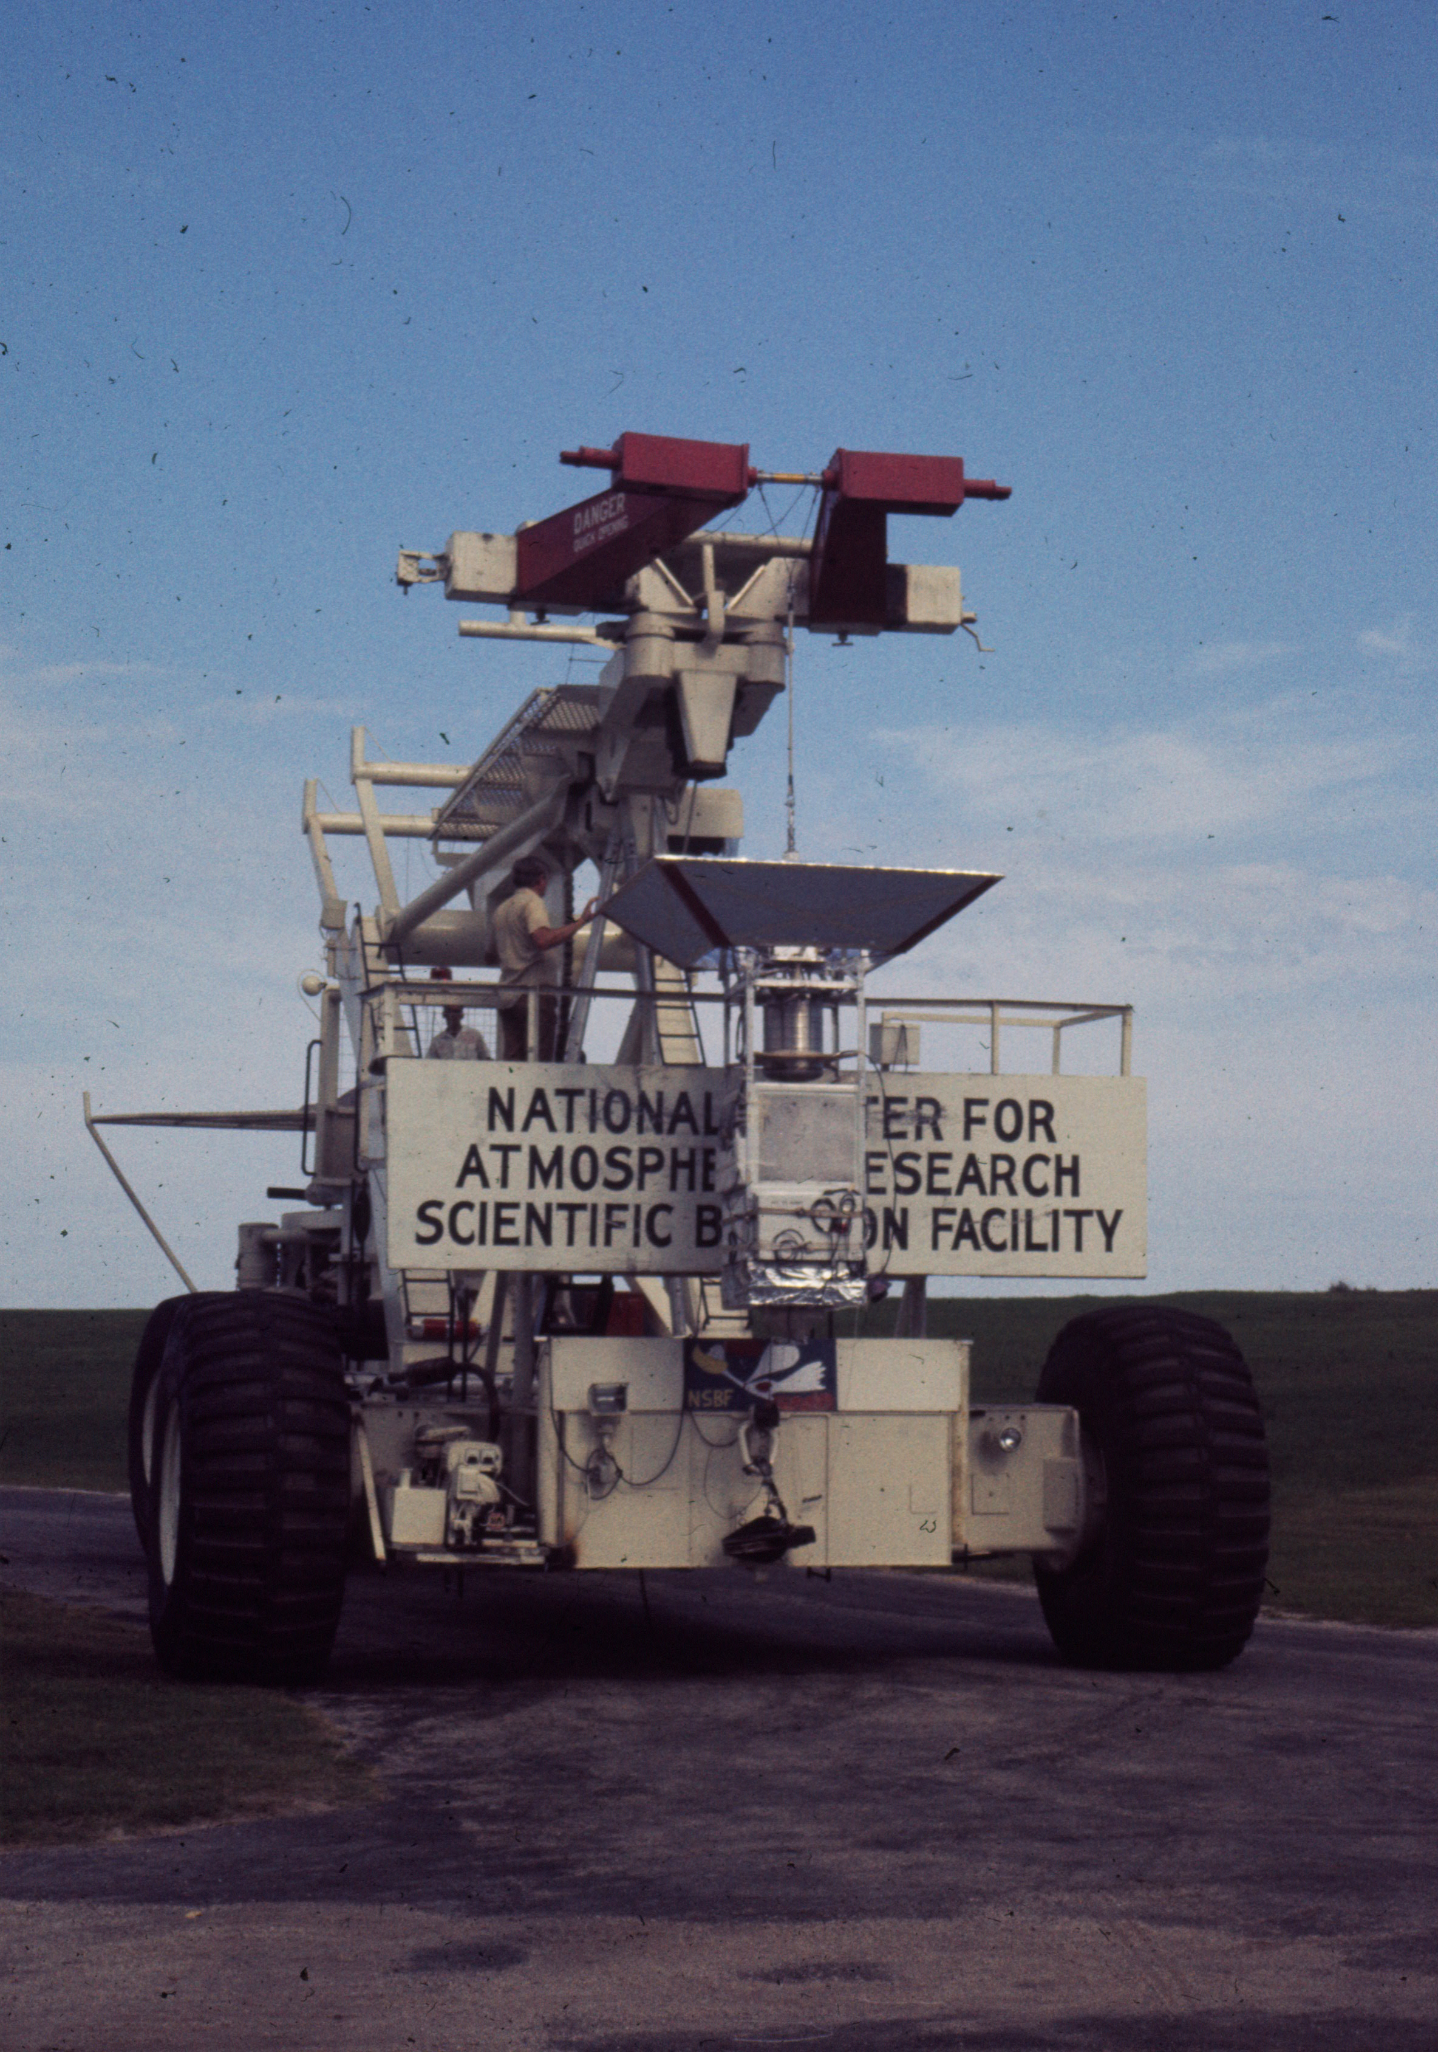

Slide 22
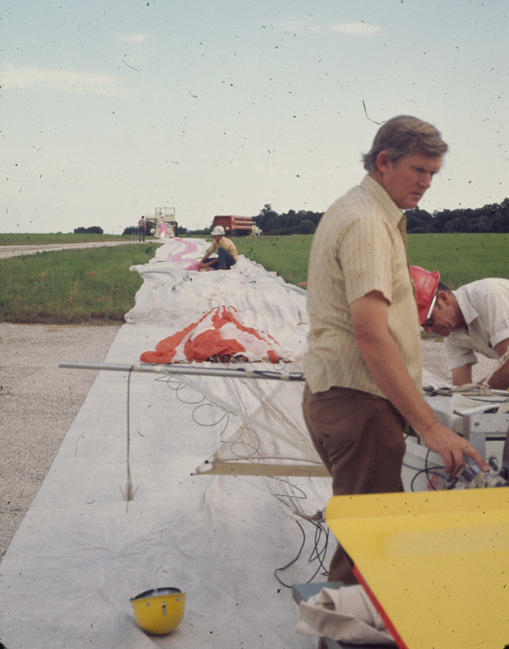

Slide 23
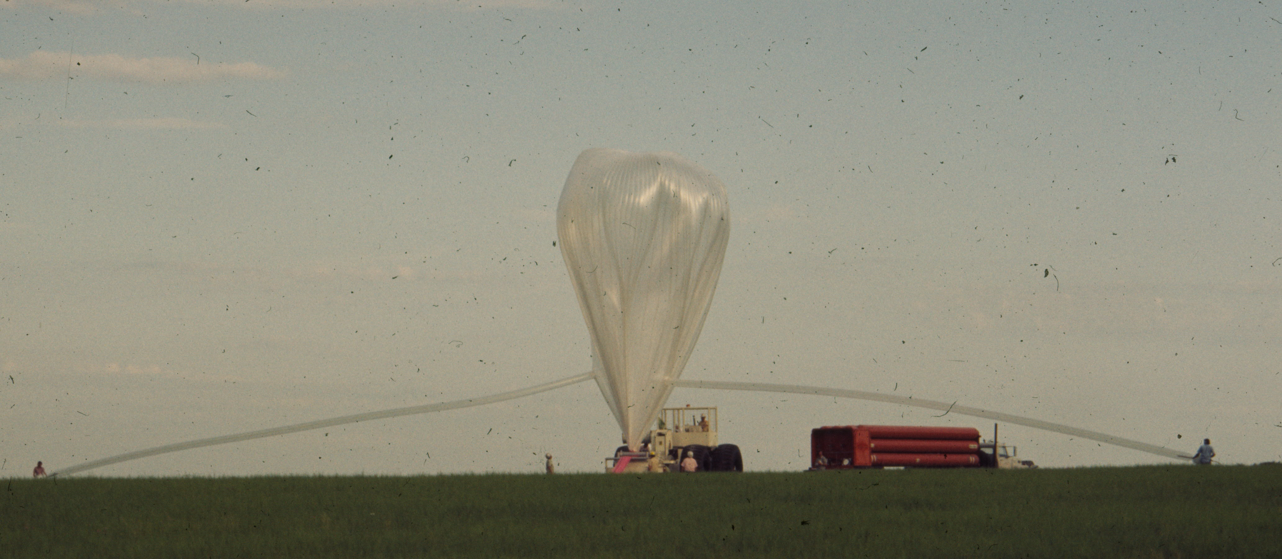

Slide 24
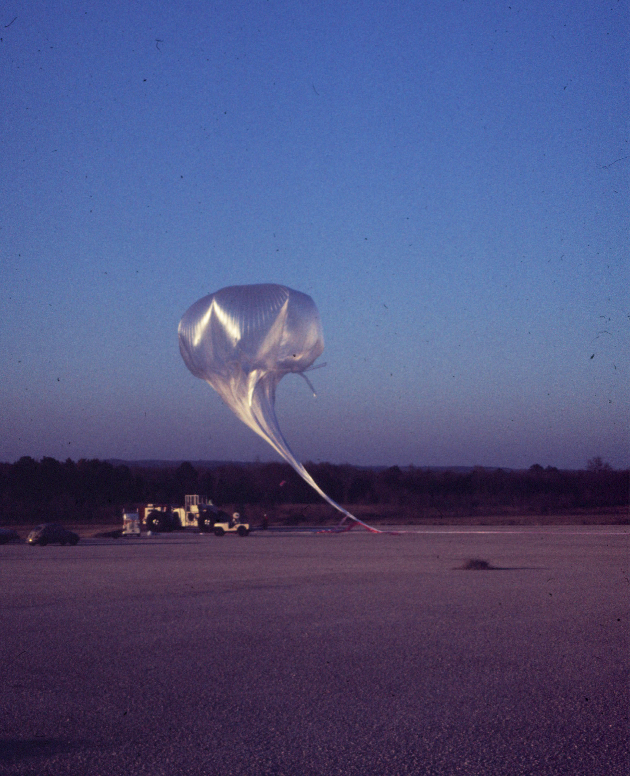
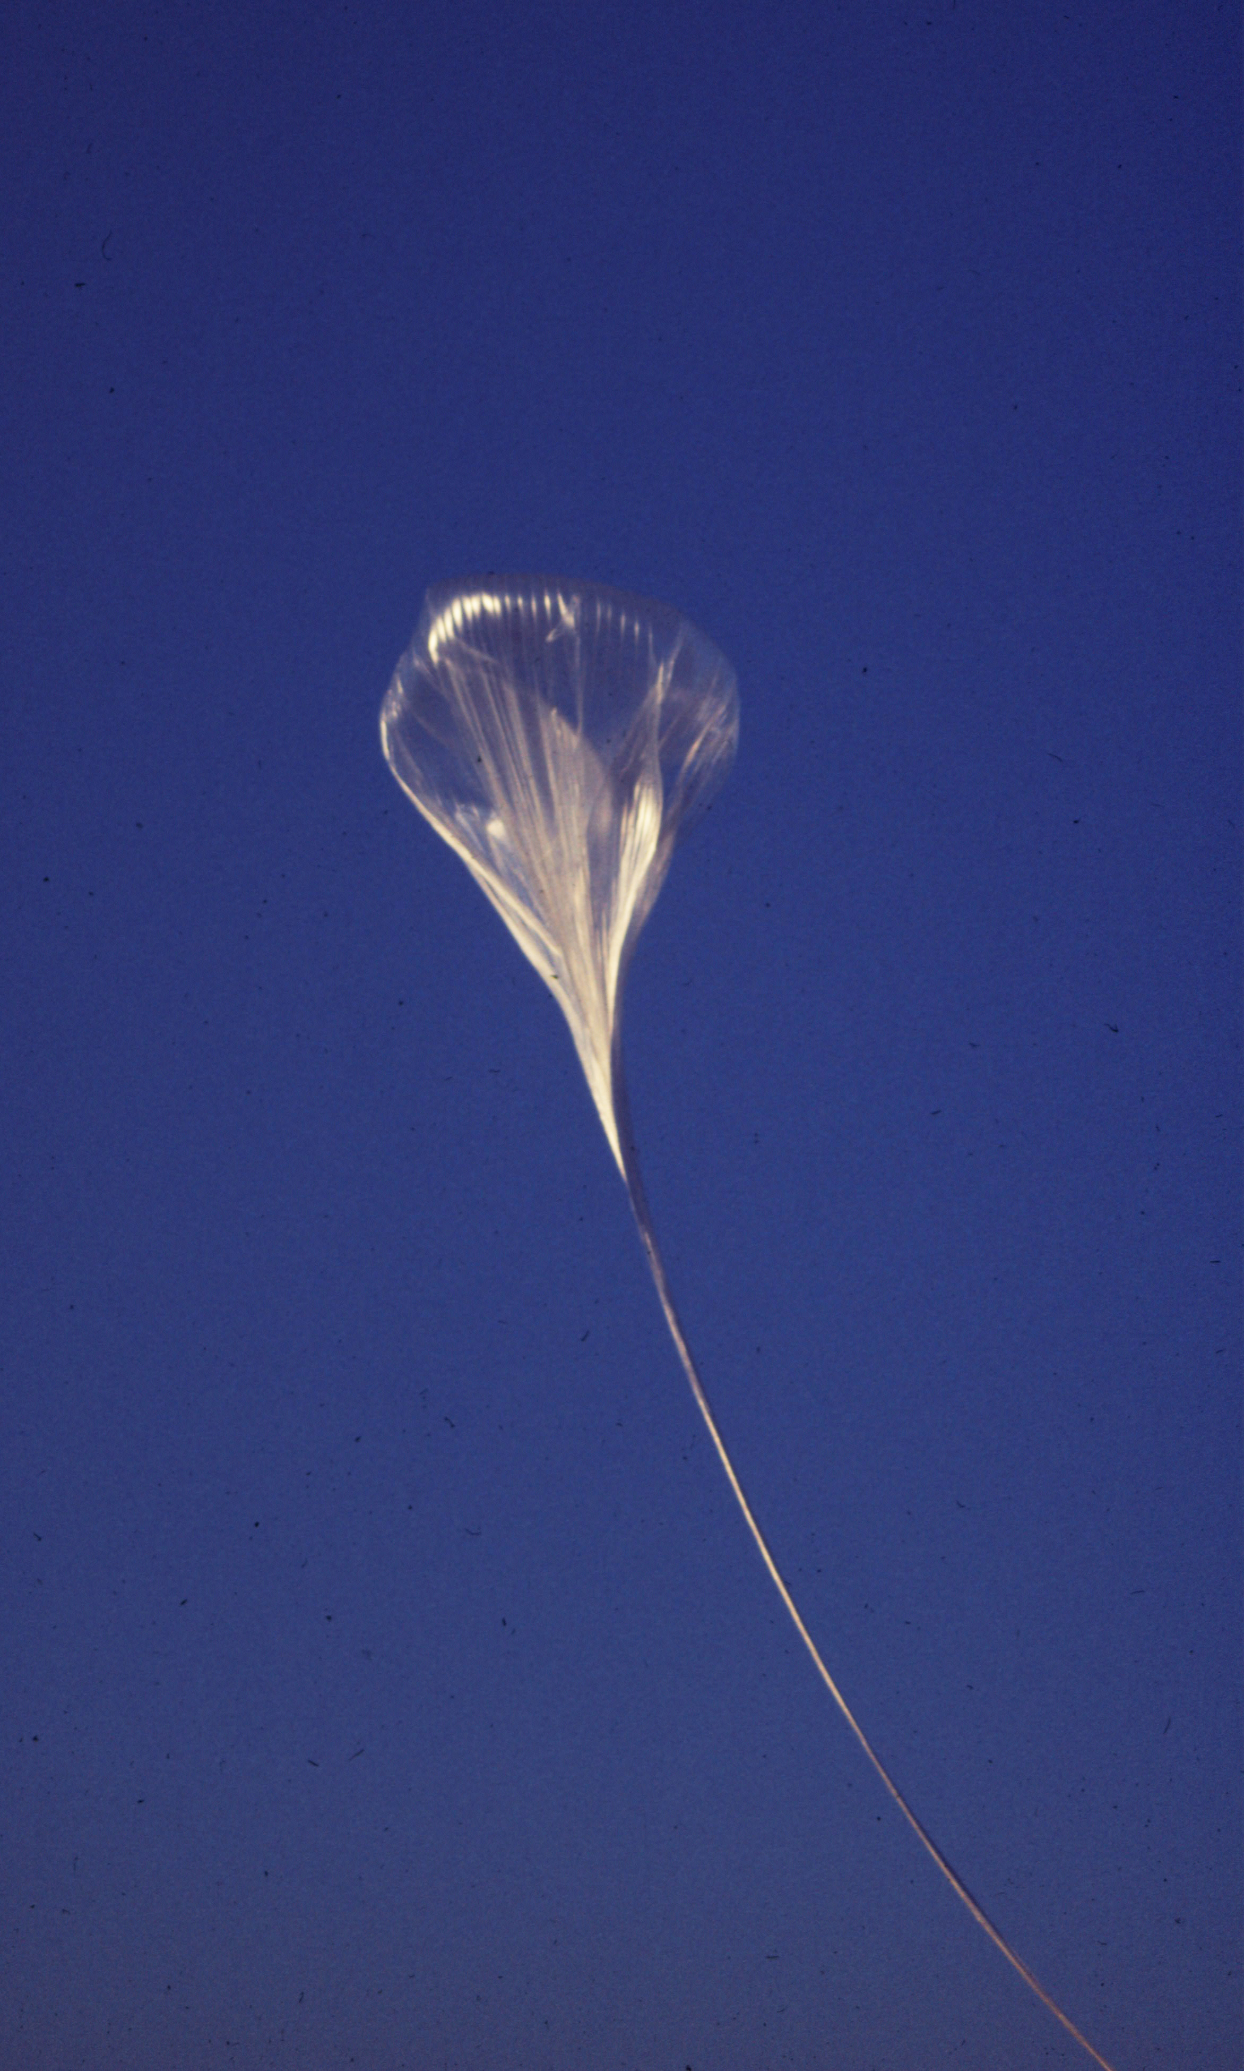

Slide 25
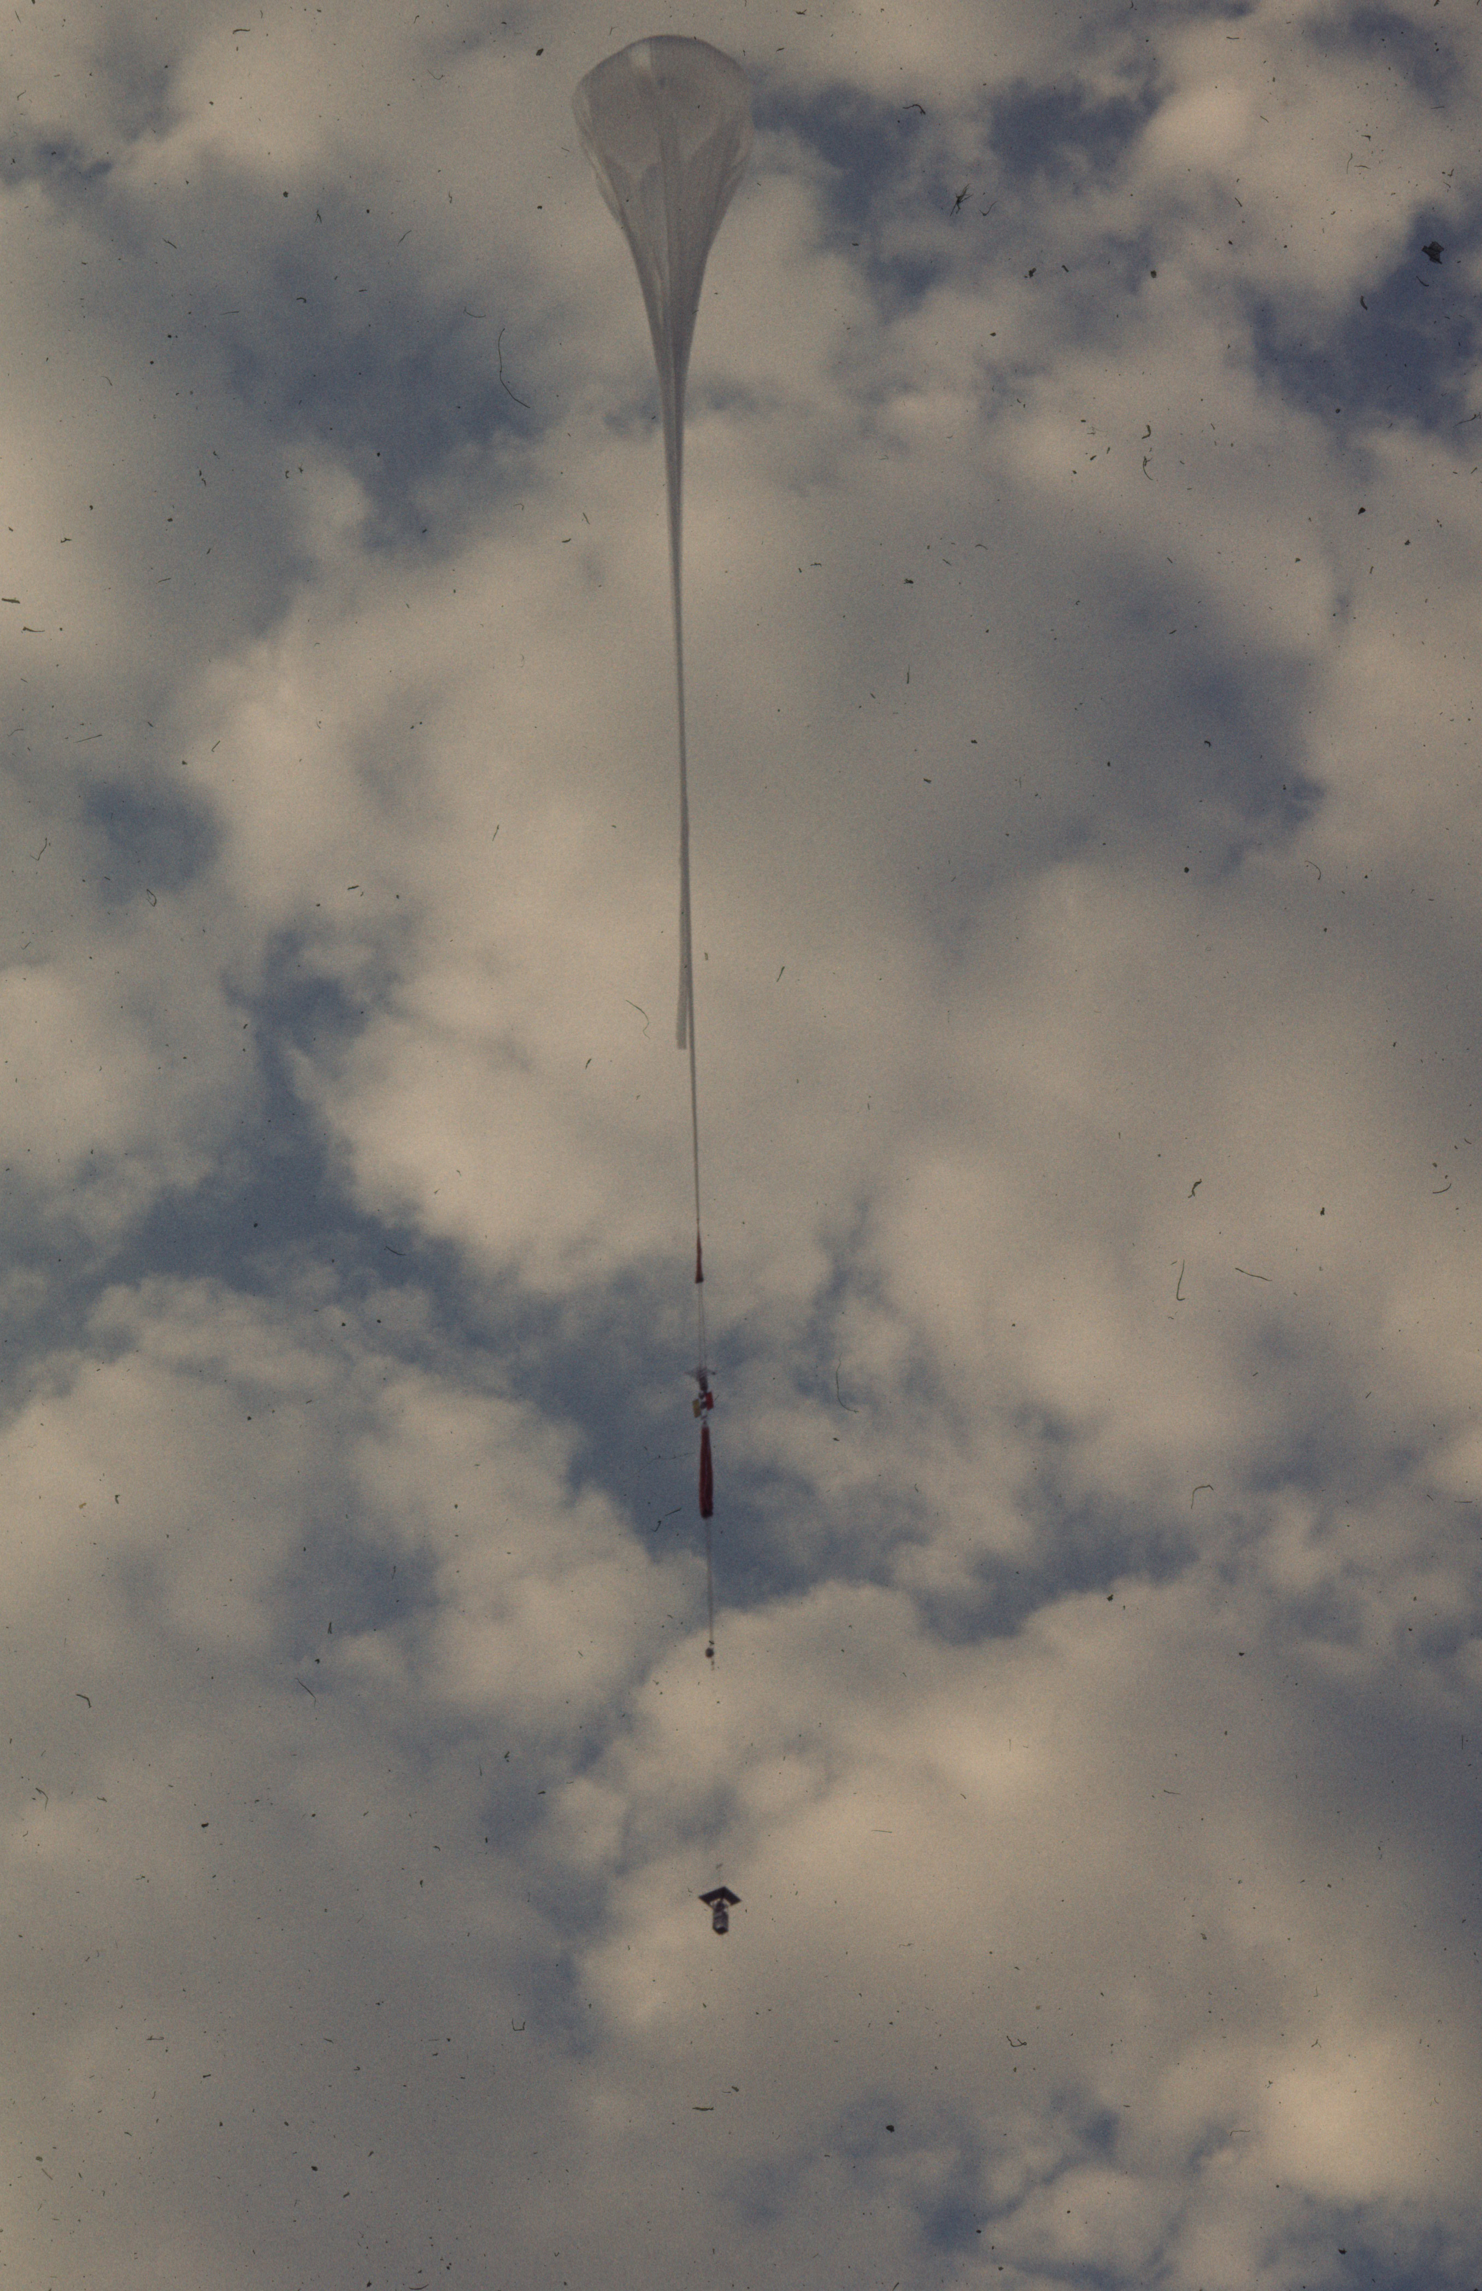
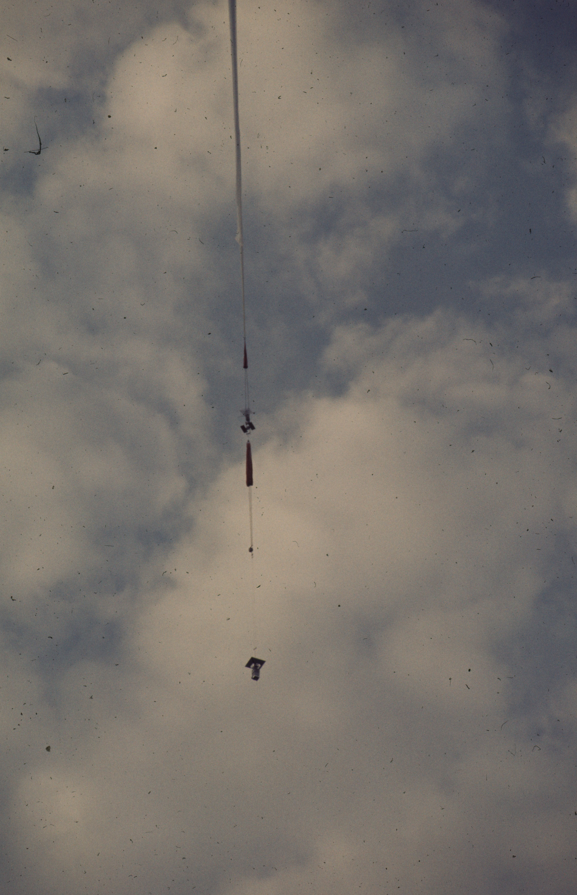

Slide 26
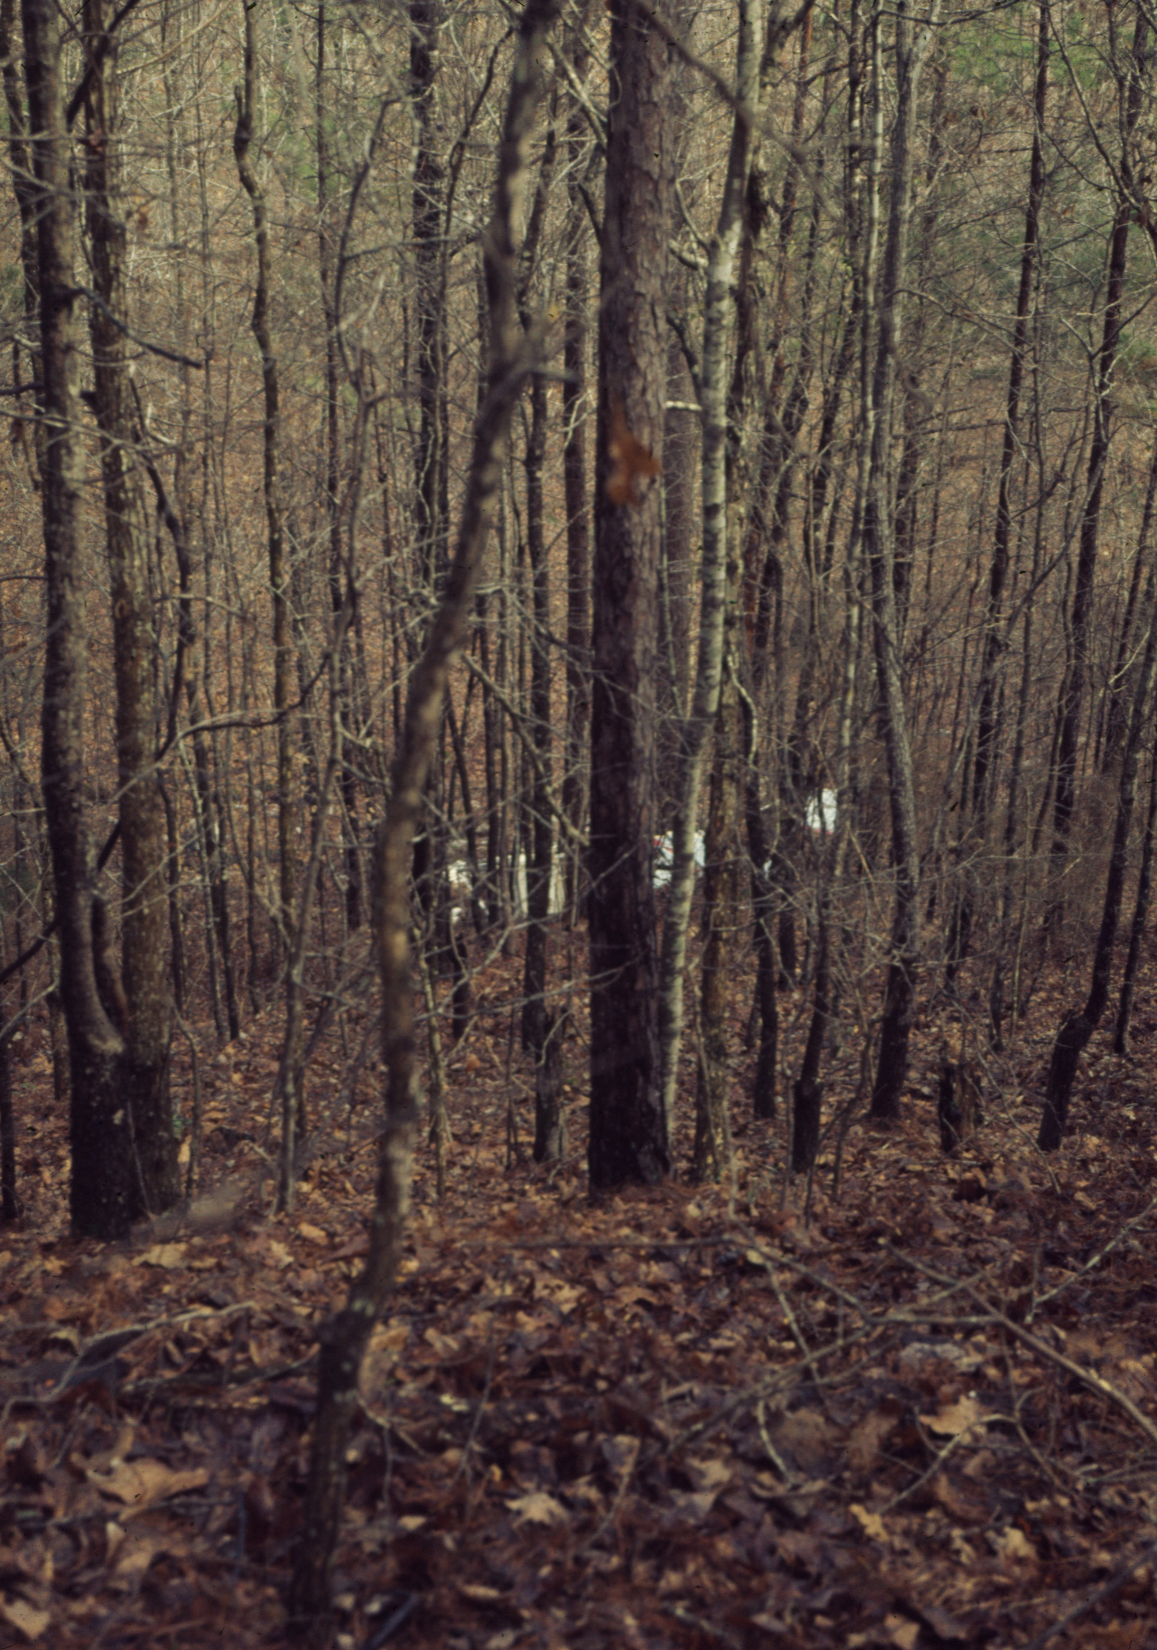
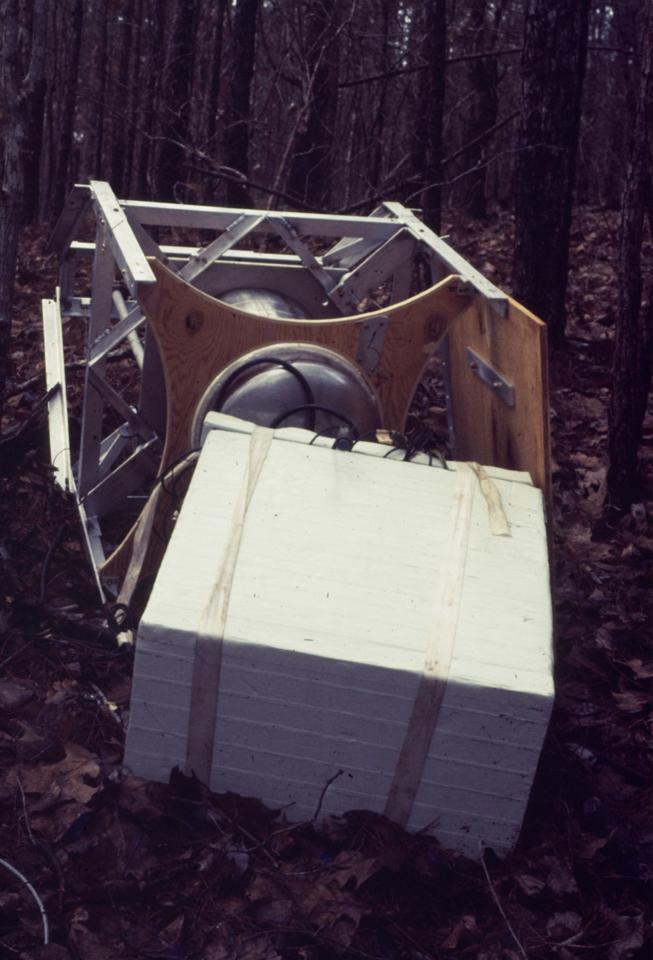

Slide 27
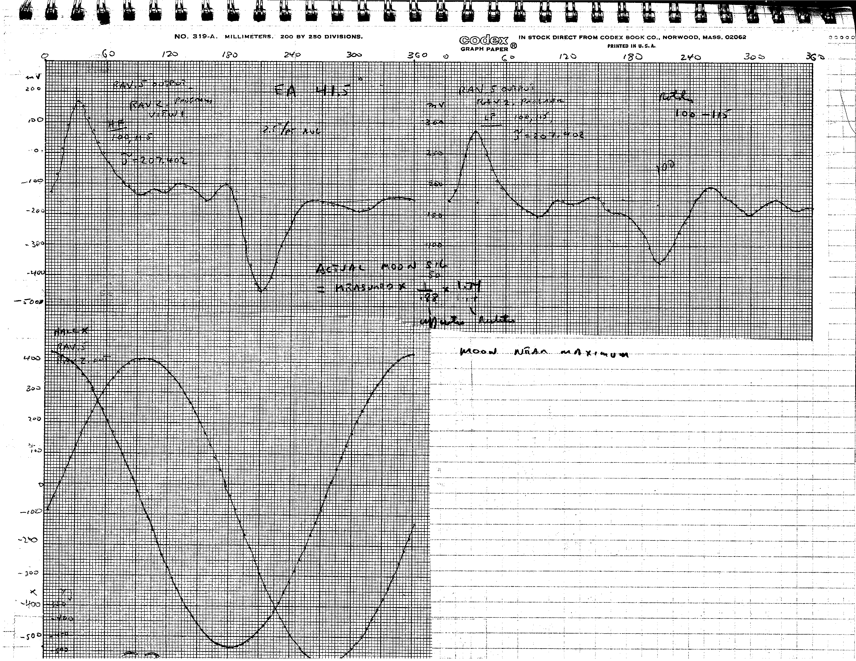
Moon seen in anisotropy instrument

Slide 28
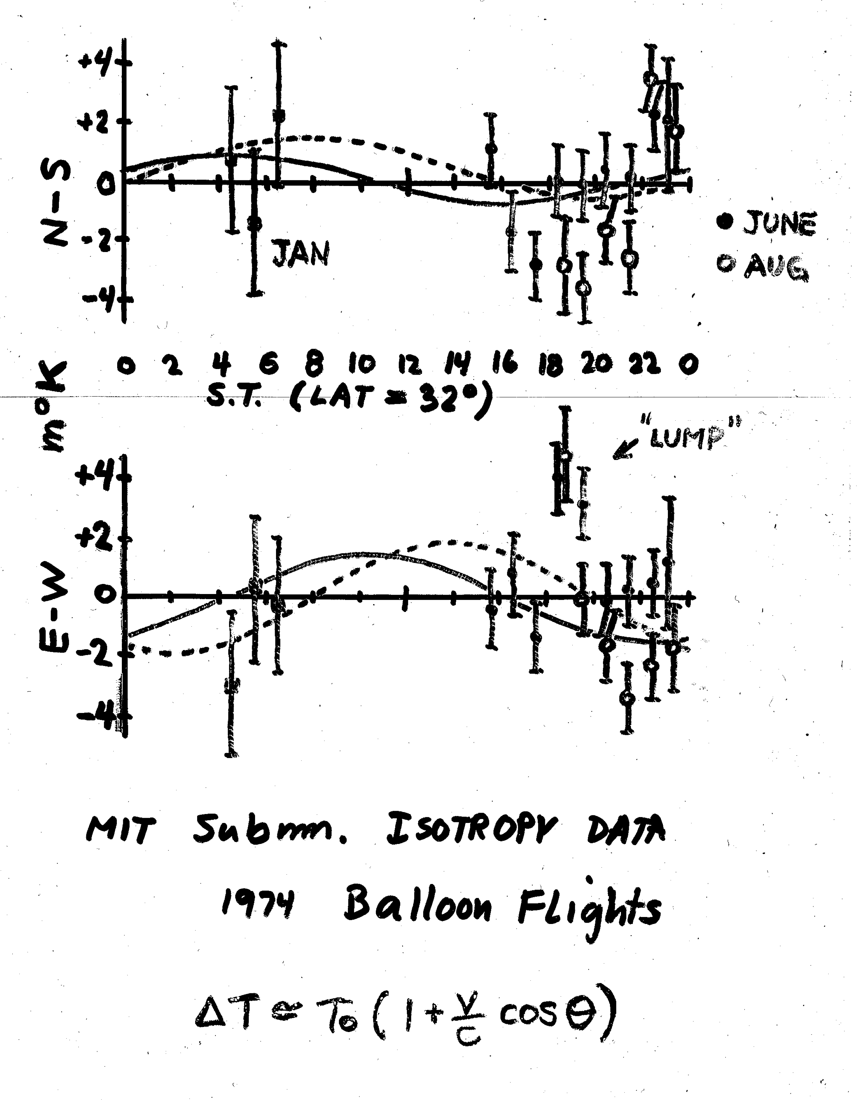
First look and the disaster

Slide 29
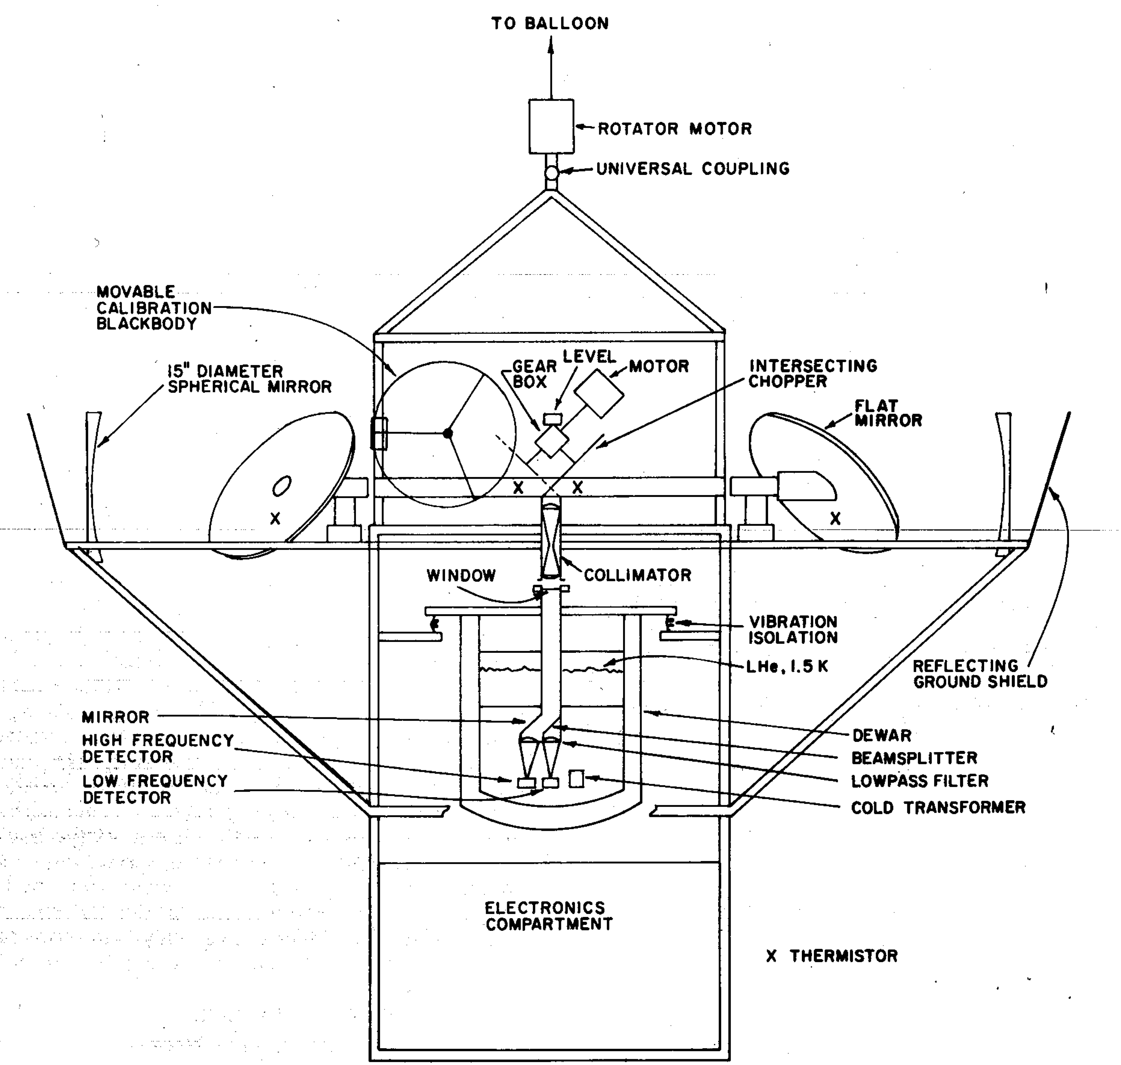
Small beam anisotropy instrument

Slide 30
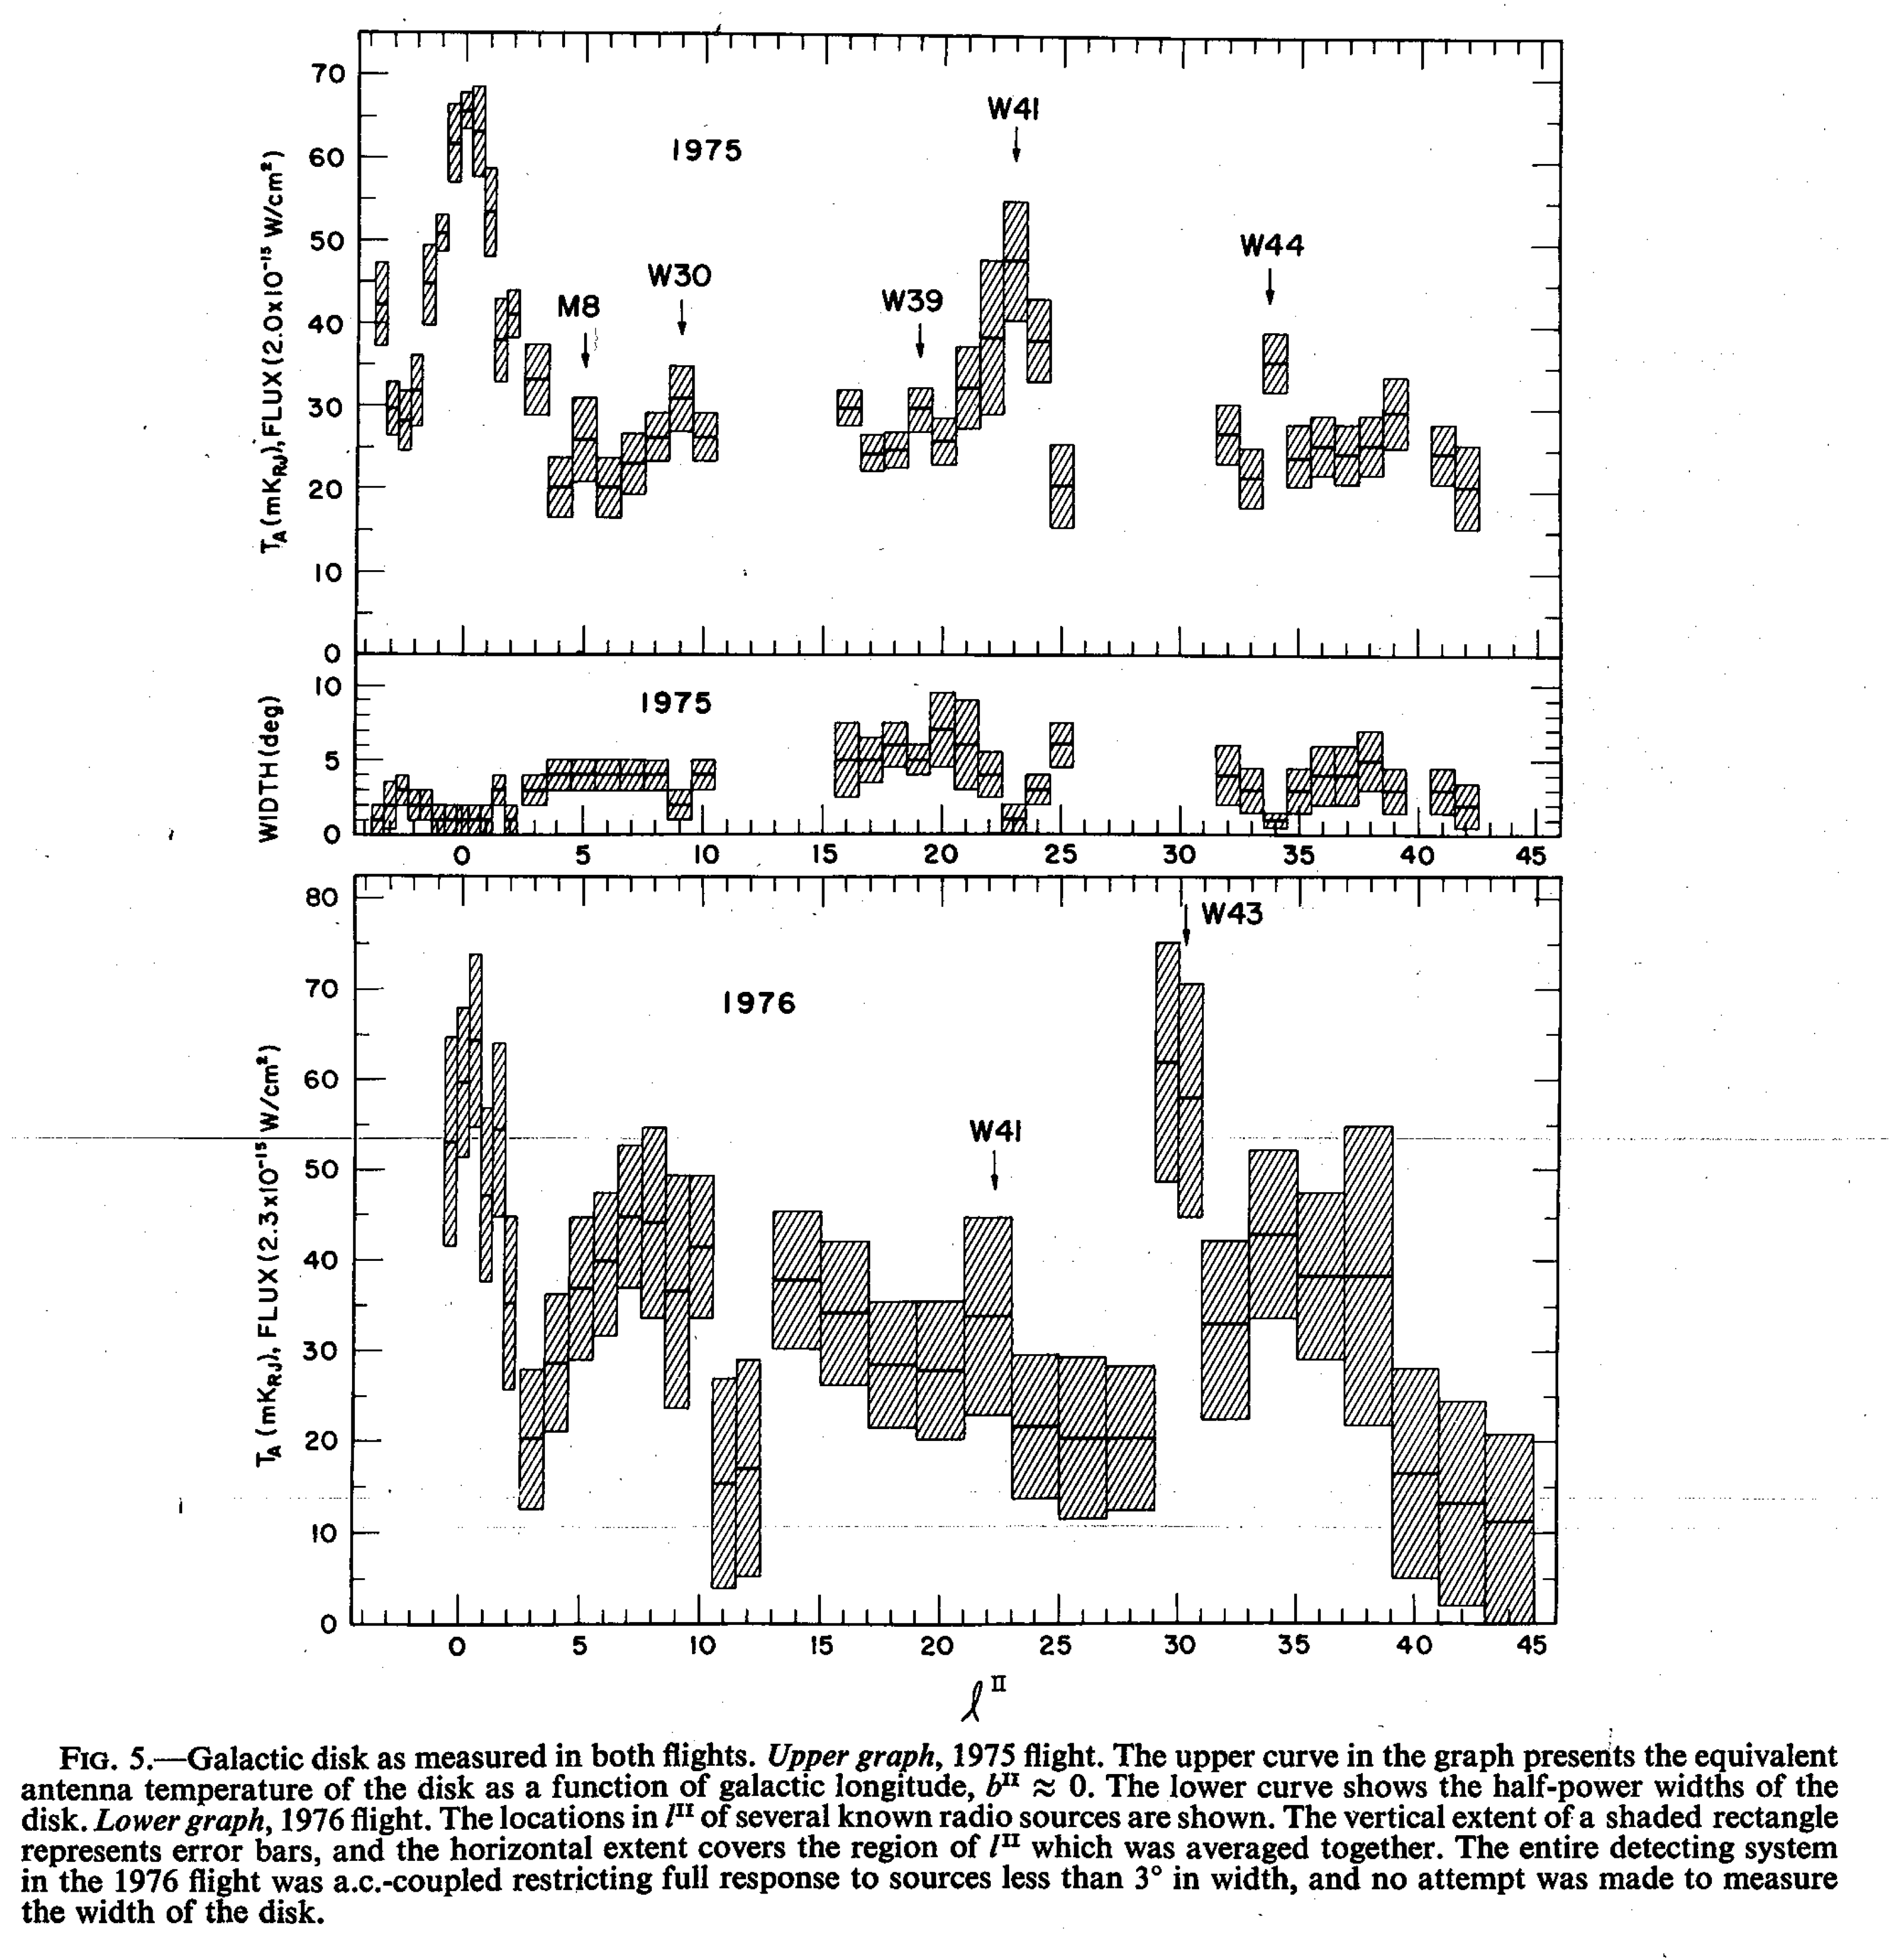
Small beam results
D.K.Owens

Slide 31
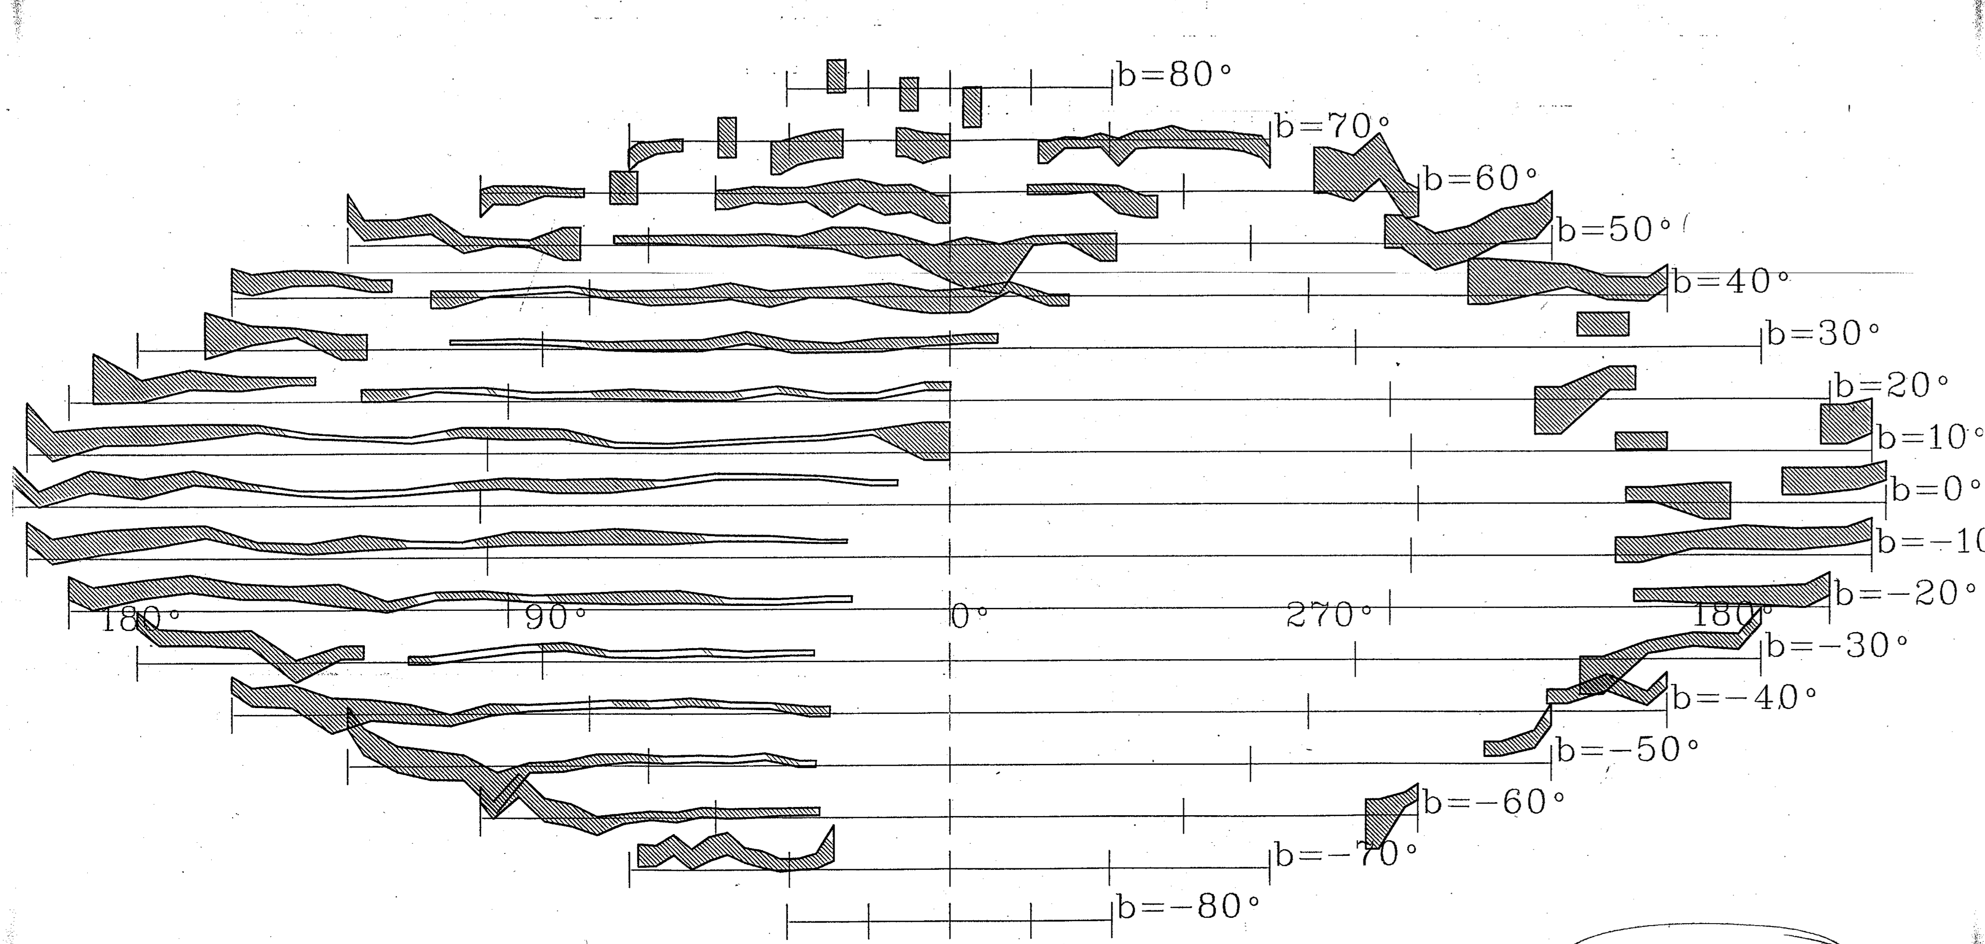
Galactic map of 30 cm⁻¹ data
2mK
M. Halpern

Slide 32
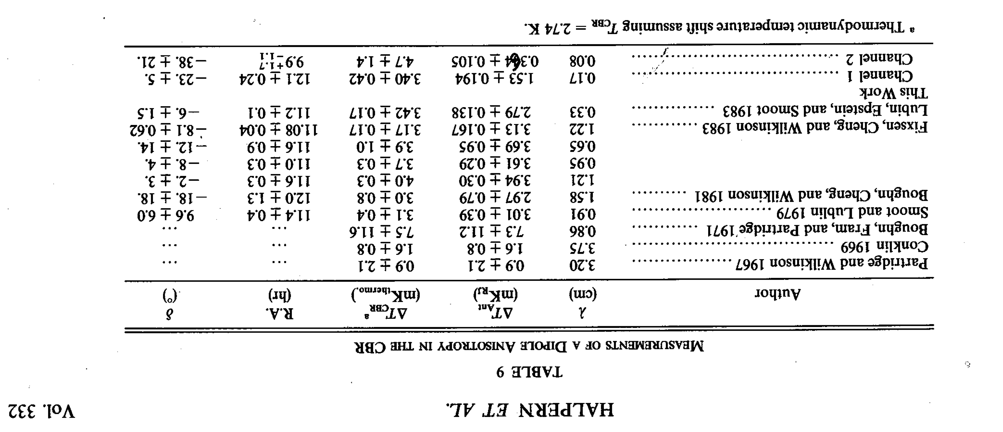
Dipole after much turmoil
(1988)

Slide 33
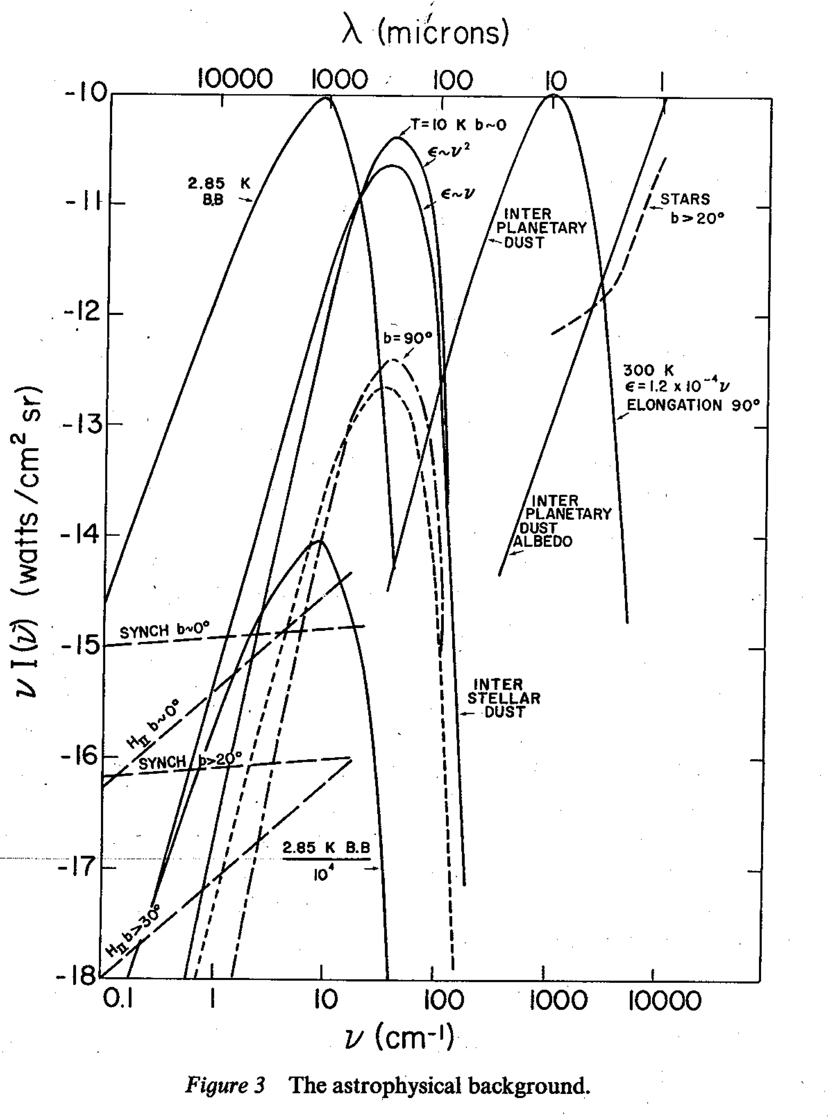
Astrophysical Foregrounds

Slide 34
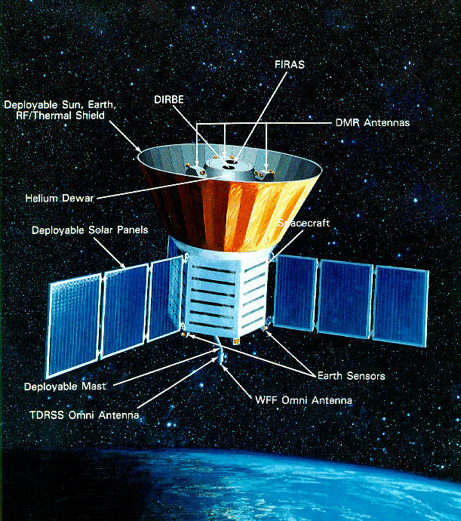
COBE

Slide 35
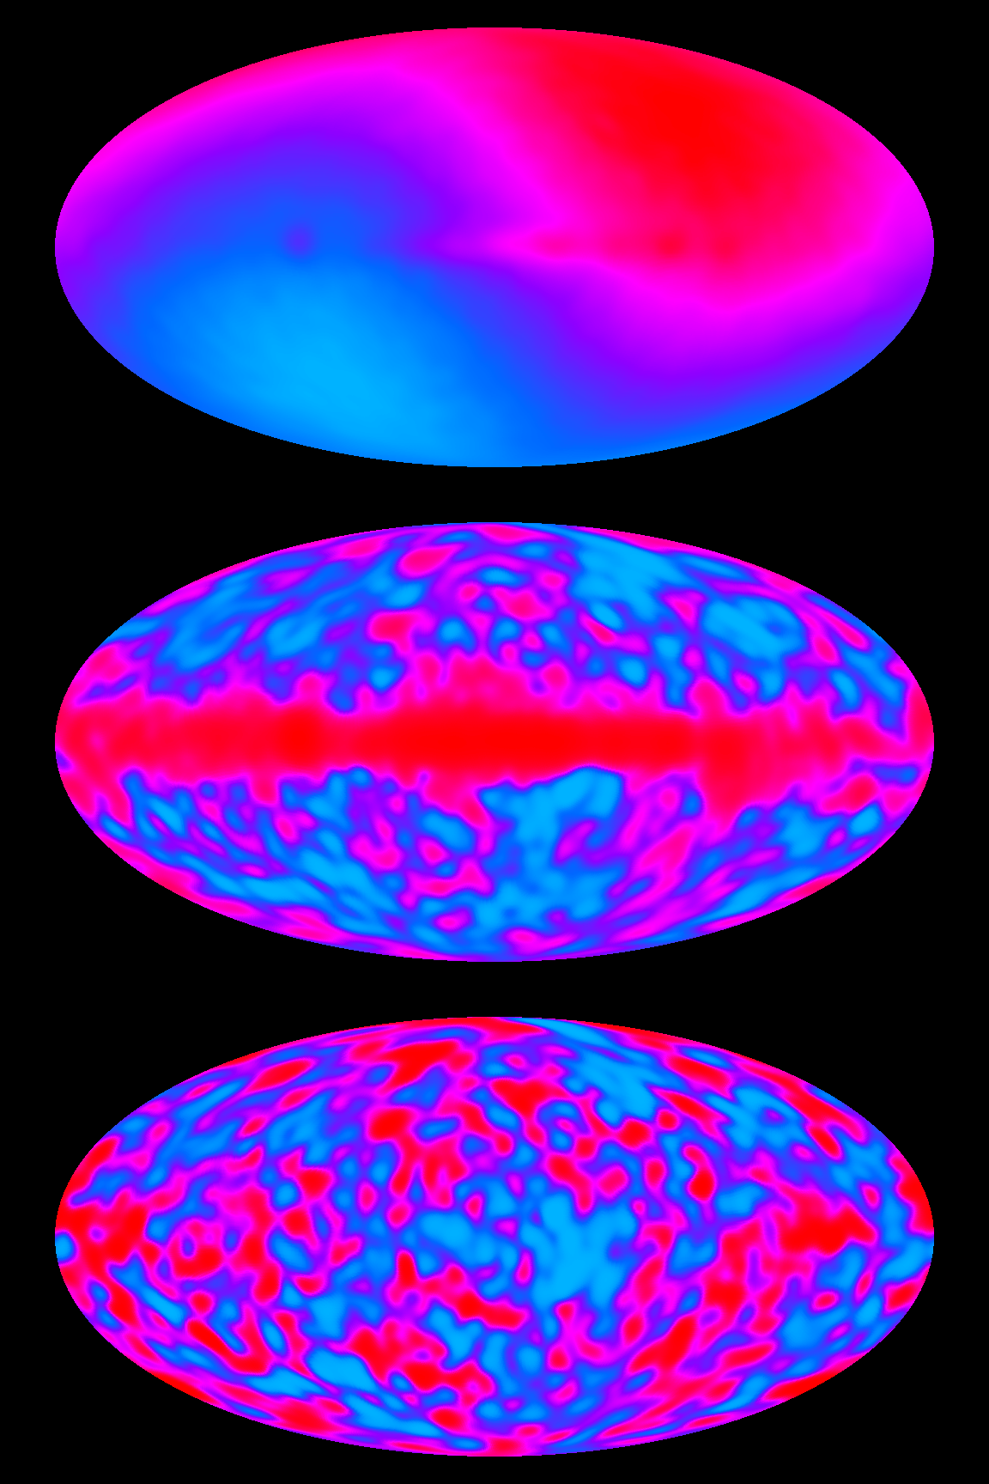
COBE results
First FIRAS data
55 and 90 GHz DMR channels

Slide 36
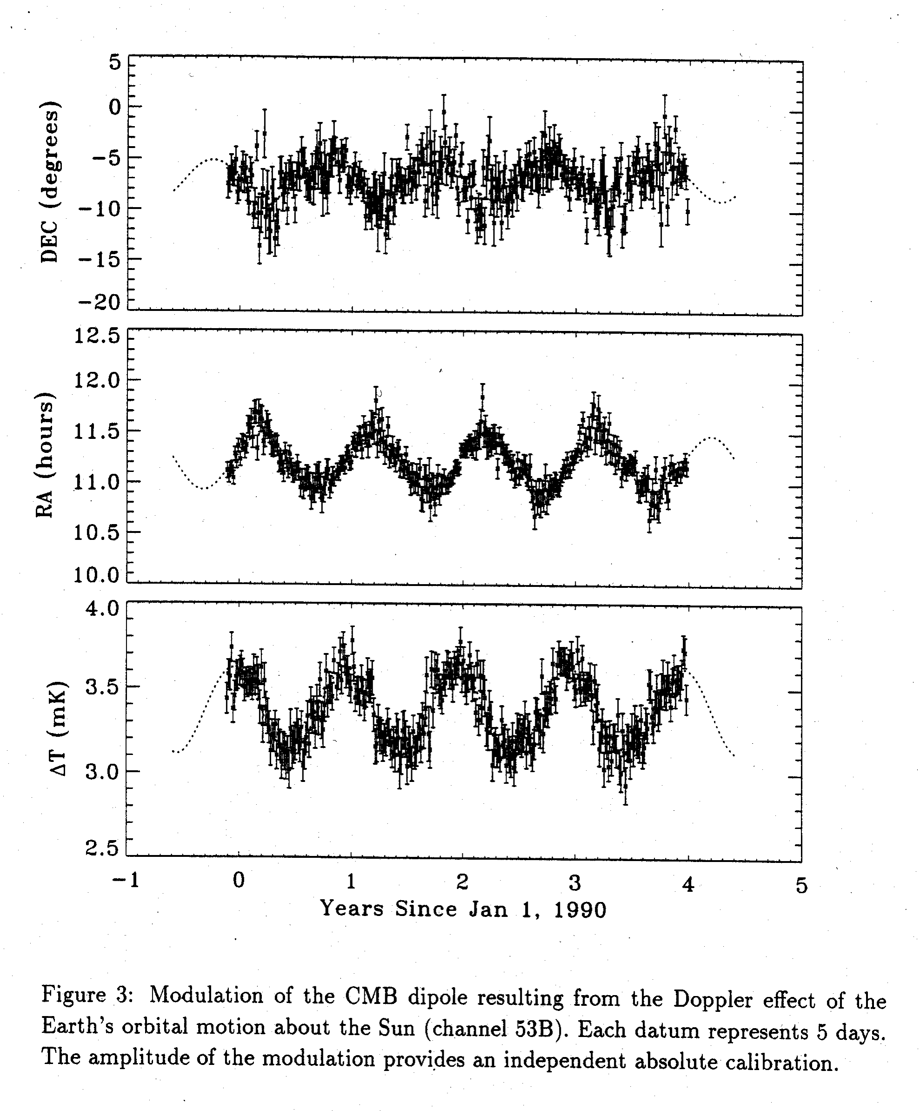
Earth’s velocity around sun

Slide 37
Tired Photons: chipping away by collisions Finlay-Freundlich hypothesis

Slide 38
Quantum electrodynamic photon-photon scattering
photon-photon cross section for in CM system H.Euler (1936)
mean free path of a green photon in the 3K cosmic background radiation
light years
Finlay-Freundlich hypothesis has nothing to do with QED

Slide 39
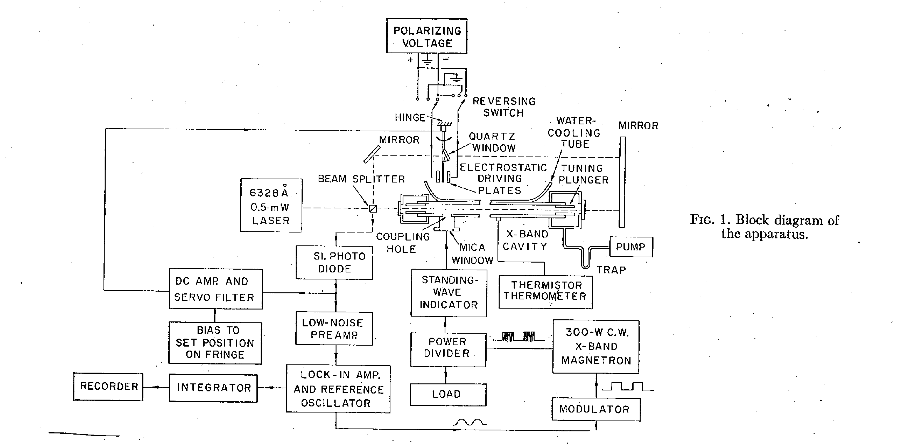
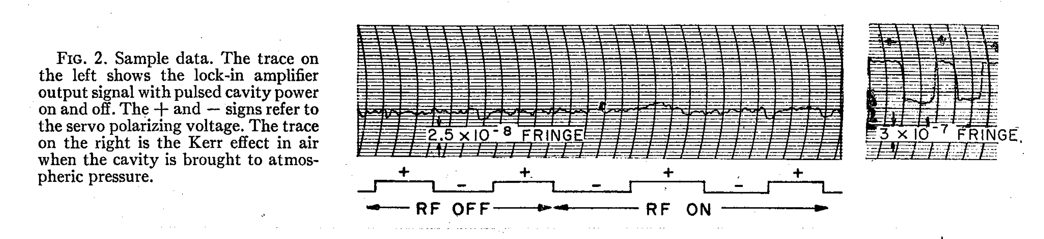
The interferometric test of Finlay-Freundlich
results
G. Blum
K_{hubble}=8.3x10⁻²⁹ /cm
K_{experiment}=3.0x10⁻³⁹ /cm assuming scattering varies as number of photons/cc

Slide 40
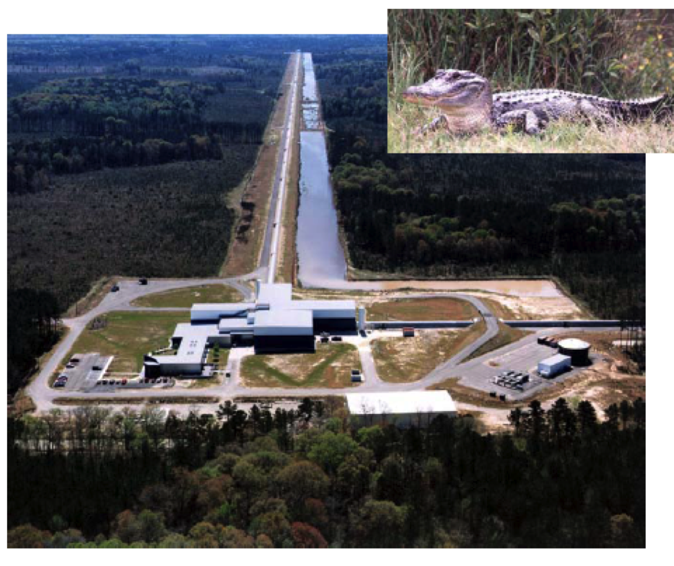
LIGO@Livingston

