Slide 1
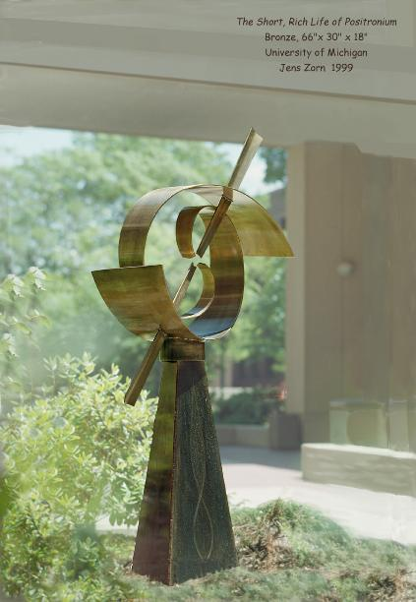
Positronium Decay and Correlated Photons
804
Thursday May 15, 2014

Slide 2
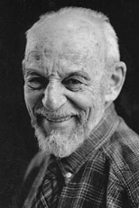
Outline
A little about radioactivity
A little about the atomic physics of positronium
M. Deutsch Phys Rev 82 455 (1951),83 866 (1952),84 601 (1952), 85 1047 (1952)
Positronium two and three photon decay
The positronium correlated two photon state and polarization
Change of photon basis states
The parity of Positronium in the ground state
Demonstration of Positronium annhilation and photon correlations
Modified Wu & Shaknov experiment Phys Rev 77 136 (1950)
Einstein Podolsky Rosen (non)paradox
A. Einstein, B. Podolsky, N.Rosen Phys Rev 47 777 (1935)
N. Bohr Phys Rev 48 696 (1935)
Why Junior Physics Lab
Martin Deutsch

Slide 3
Radioactivity Primer
Definition: Curie = 3.7 x 10¹⁰ decays/sec
The Na₂₂ source in experiment 1 x 10⁻⁴ C: 2, 0.5 Mev → 1 x 10⁻⁶ watts
Definition: Roentgen Equivalent Man REM = 10⁻² Joules(absorbed)/kg = 10⁻² Sieverts Eq Man
Background at sea level: 2 x 10⁻⁵ REM/hr --> 5 x 10⁻⁴ REM one day of exposure
Background in jet plane at 30kft: 5 x 10⁻⁴ REM/hr
Dose from chest X-ray: 10⁻² REM
Allowed dose in a year REM
Whole body | 5
extremities | 50
eye | 15
Baby whole body | 0.5
Full body dose from unshielded Na₂₂ source at 2 meters ~ 1 x 10⁻⁴ REM/hr
Full body dose with lead shielding is indistinguishable from background

Slide 4
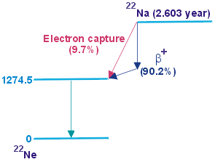
Na₂₂ production and decay scheme
Production: Bombard magnesium with 66MeV Protons for days at 100 microamps. Converts proton to neutron and emission of positron. Then, chemistry to separate sodium from other elements and time to allow for decay of short lived nuclei.
Subsequent decay of Positronium 2 x 0.51Mev gammas
Z=10
Z = 11

Slide 5
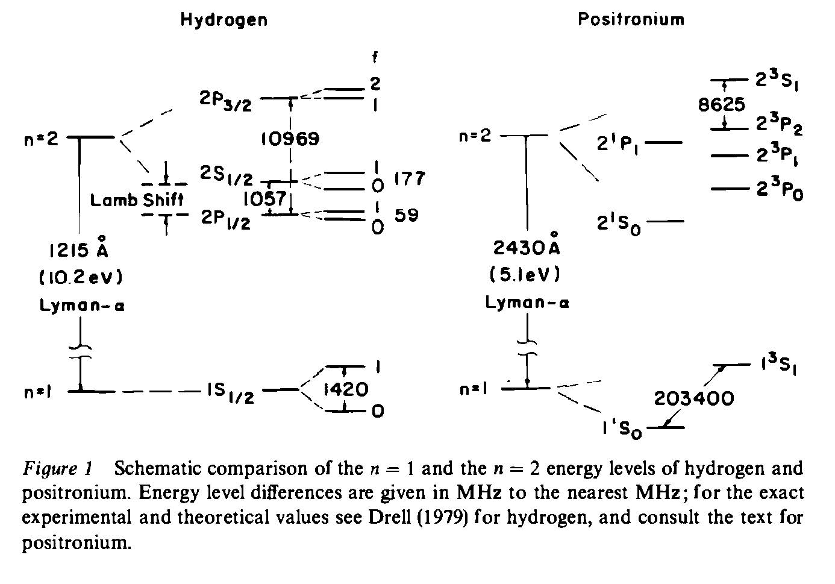
Positronium and Hydrogen energy levels
Electron –e m_{e} s = ½
Proton +e 1836m_{e} I = ½
Electron -e m_{e} s = 1/2
Positron +e m_{e} s = 1/2
S,Berko ,H.Pendelton Ann Rev Nucl Part Sci 30 543 (1980)

Slide 6
Positronium decay
S=0 state decays from s state: two photons
S=1 state decays from s state: three photons
The two photon state of positronium
Zero momentum, angular momentum, rest mass
Only possibility back to back equal energy photons with total angular momentum zero

Slide 7
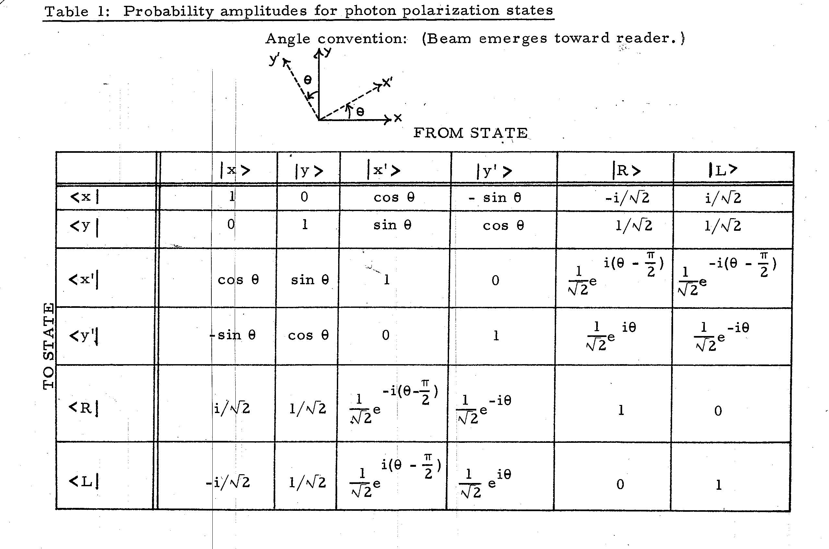
Polarization algebra
Need to express two photon states RR> and LL> in linear polarization x and y basis rather than circular polarization basis to couple to demonstration.
MIT 804 Kerman, Sartori

Slide 8
Change of Basis
U
Example matrix element :
assumes independent operations on the two photons
U =
even parity
odd parity

Slide 9
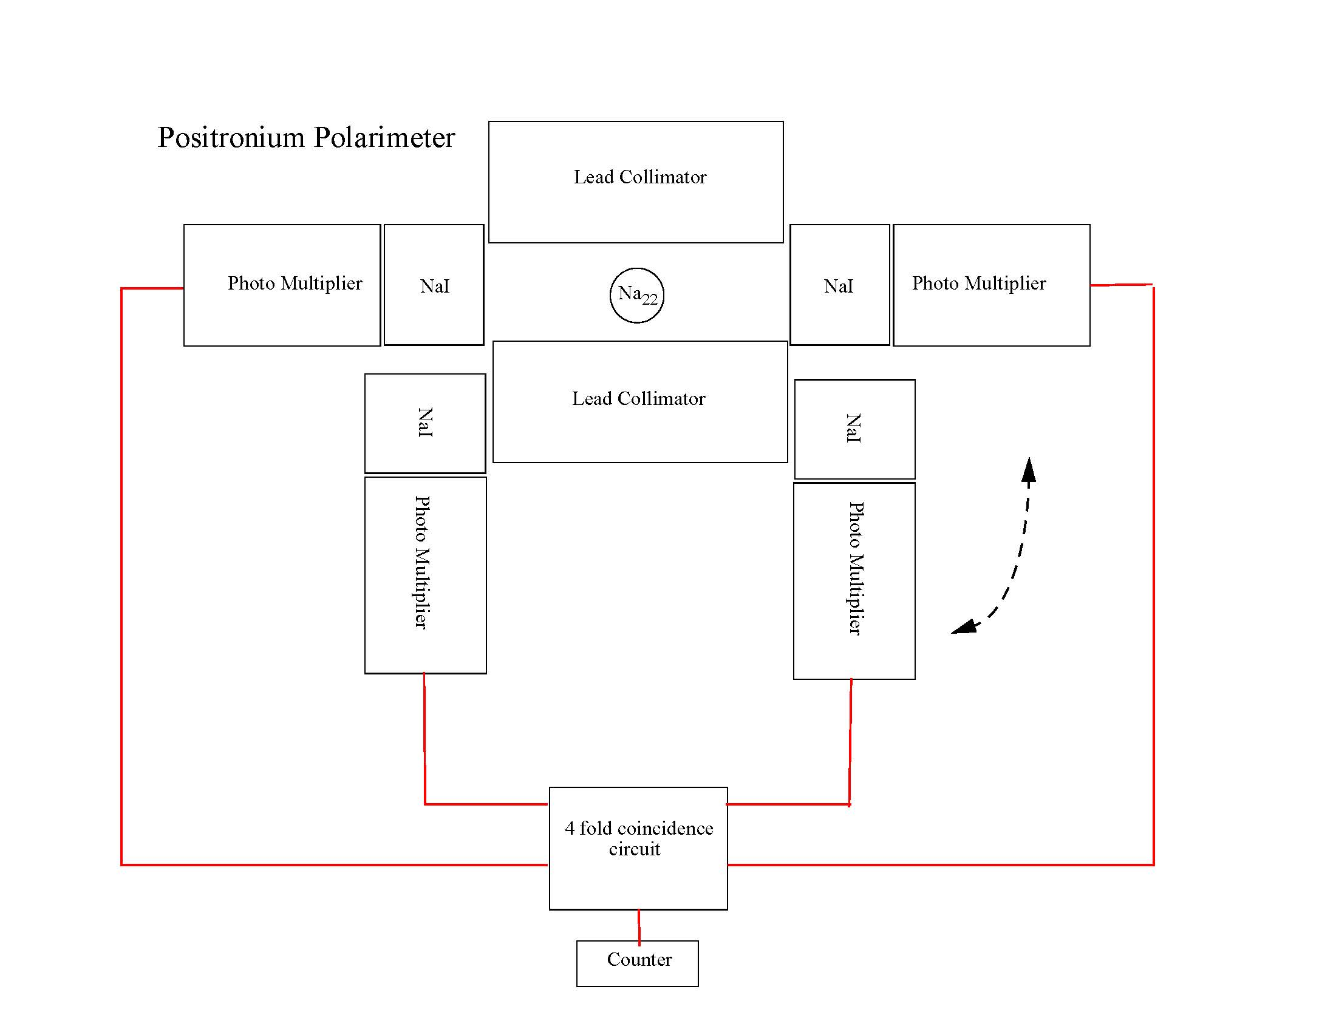
Positronium Polarimeter

Slide 10
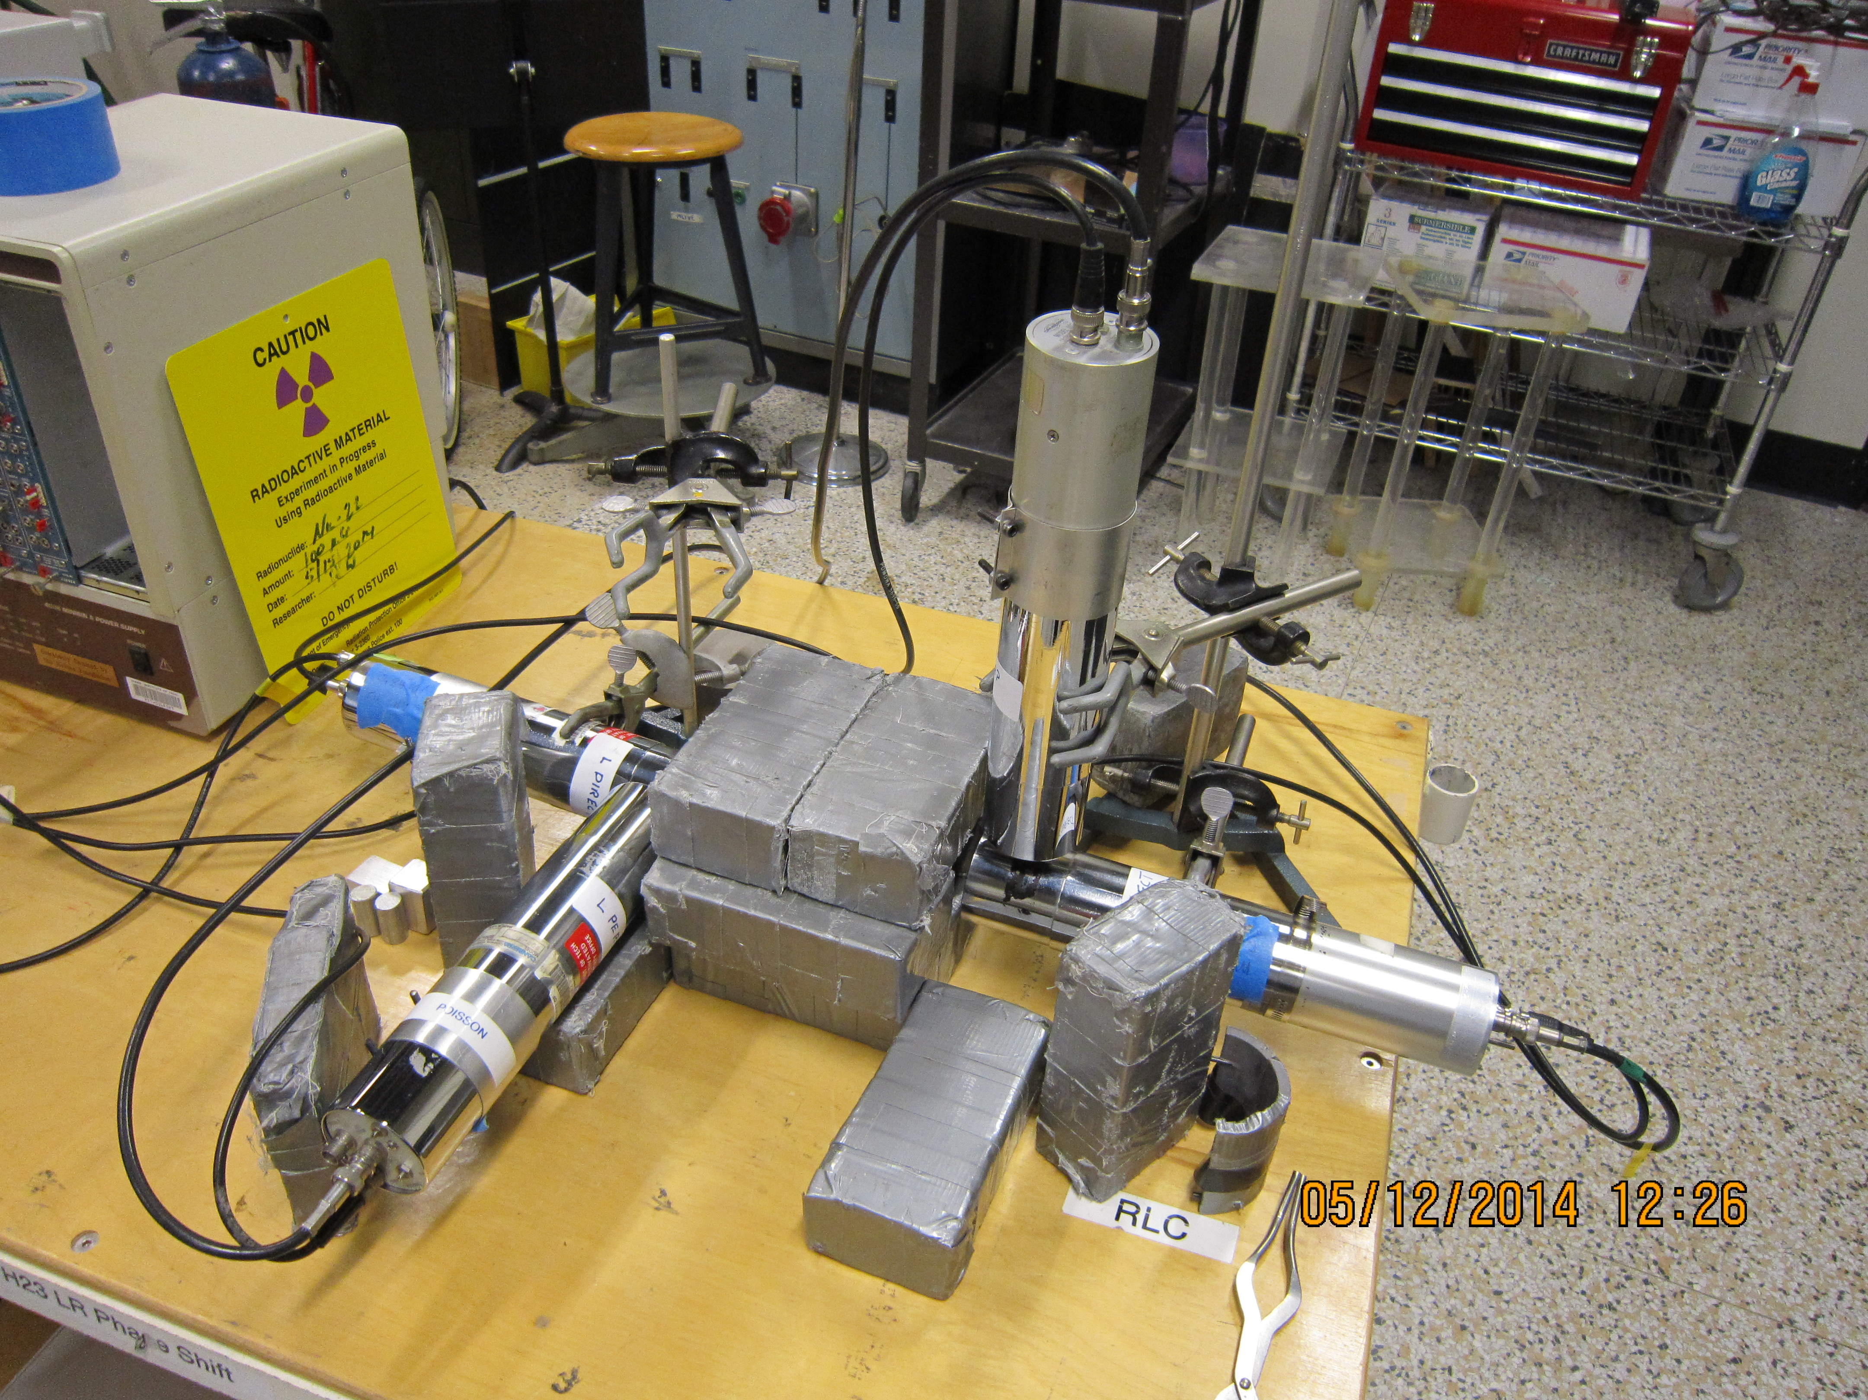
Polarimeter

Slide 11
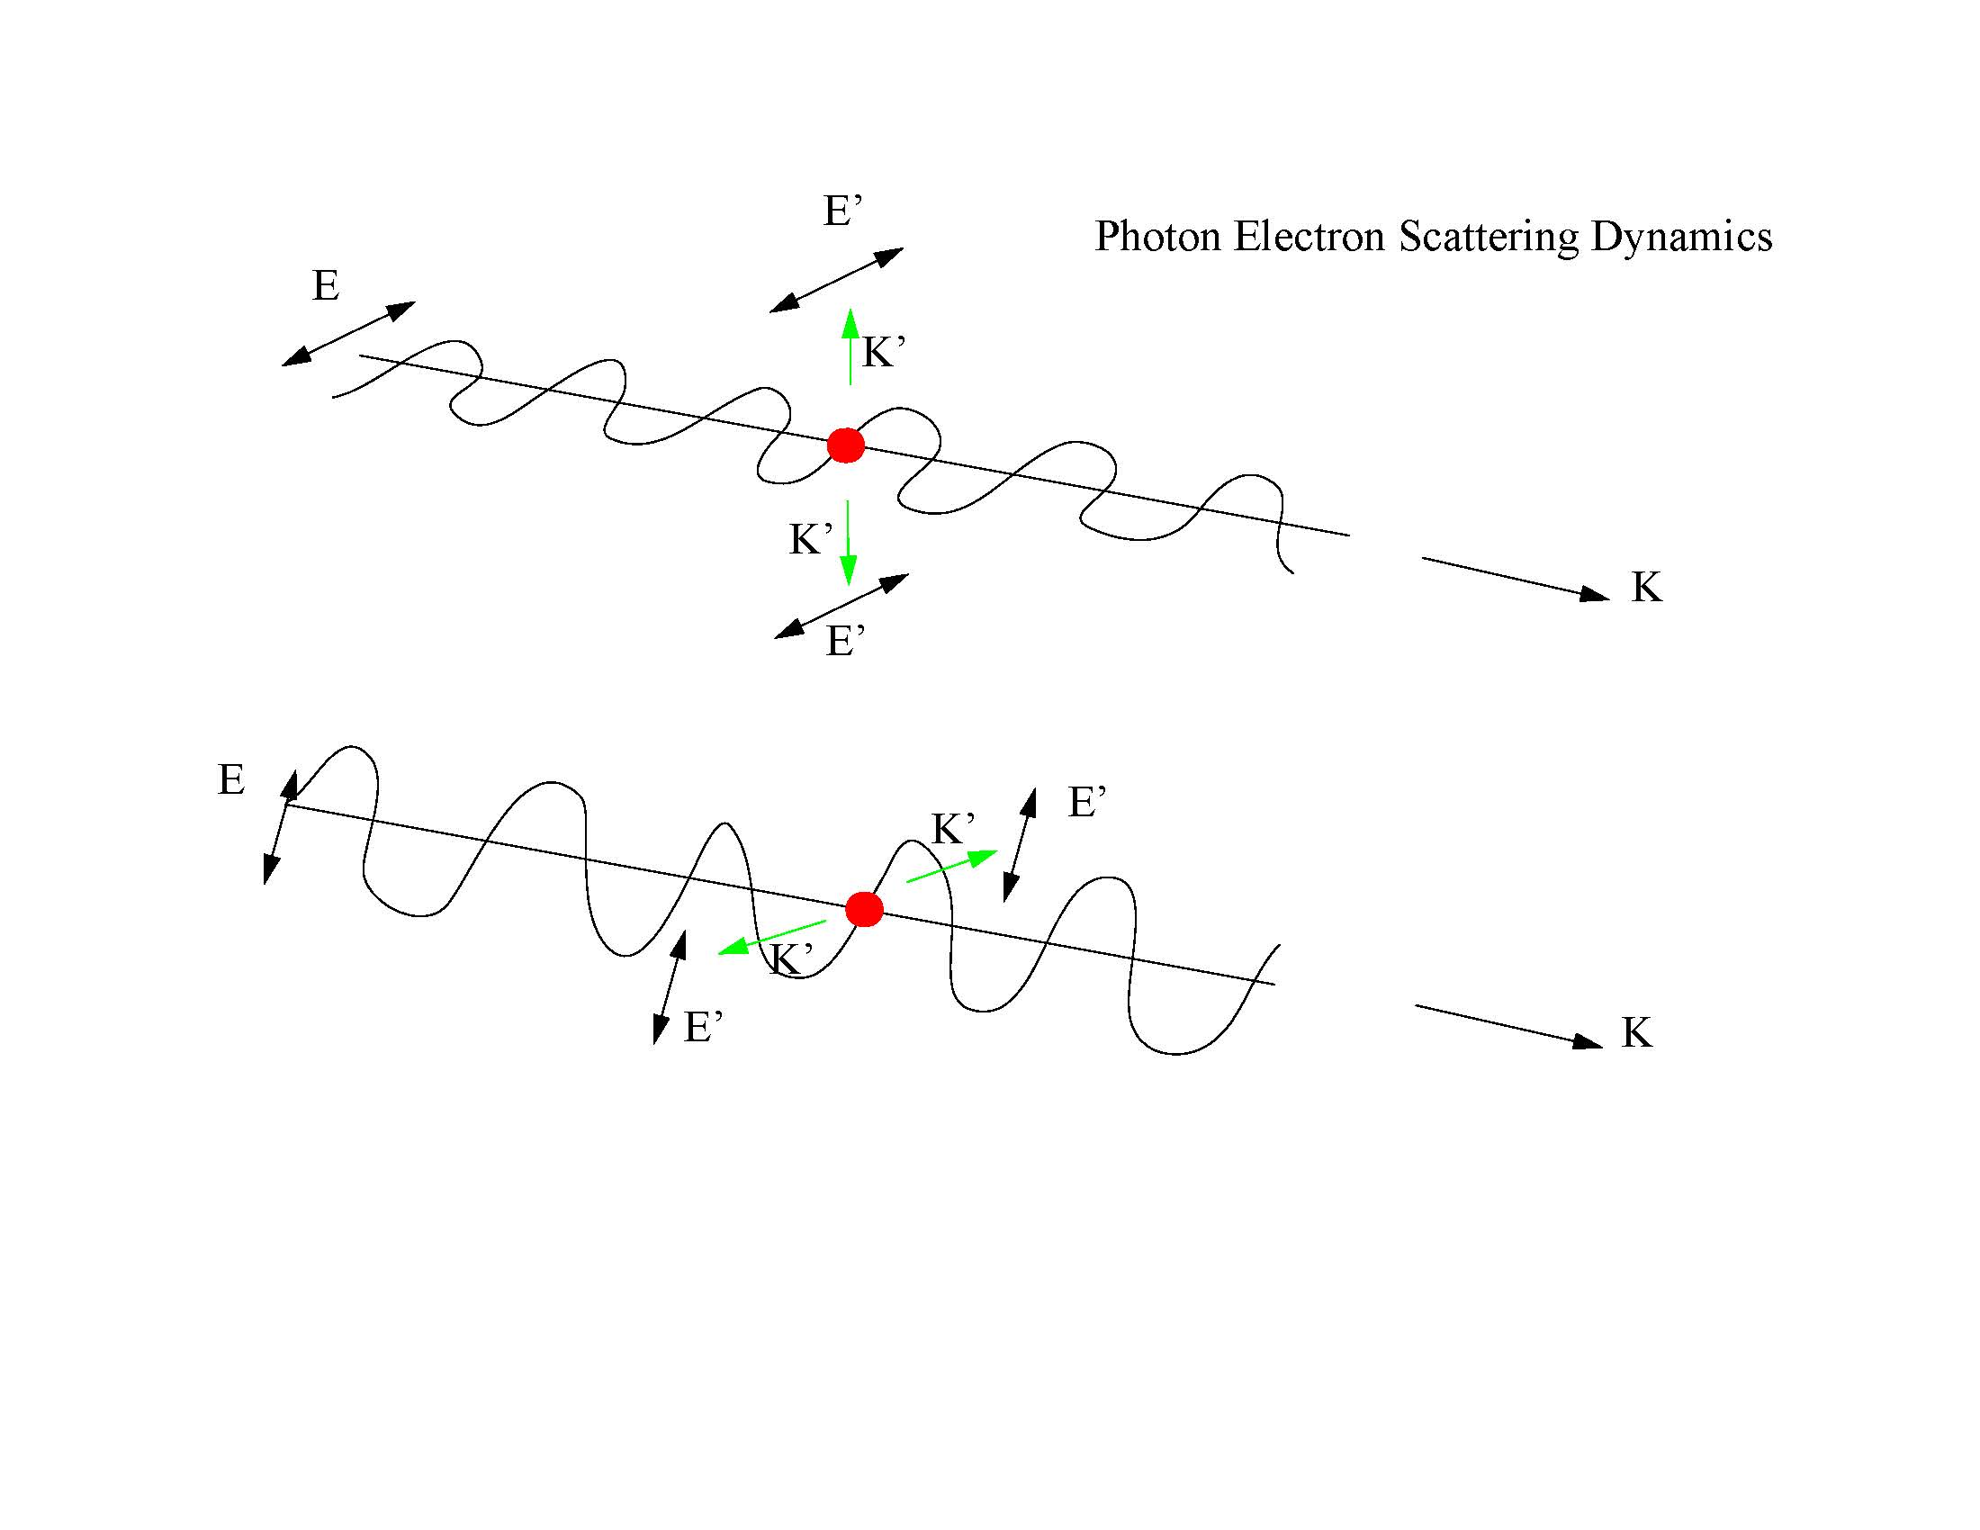
Photon electron scattering dynamics

Slide 12
Electric dipole radiation
John Belcher

Slide 13
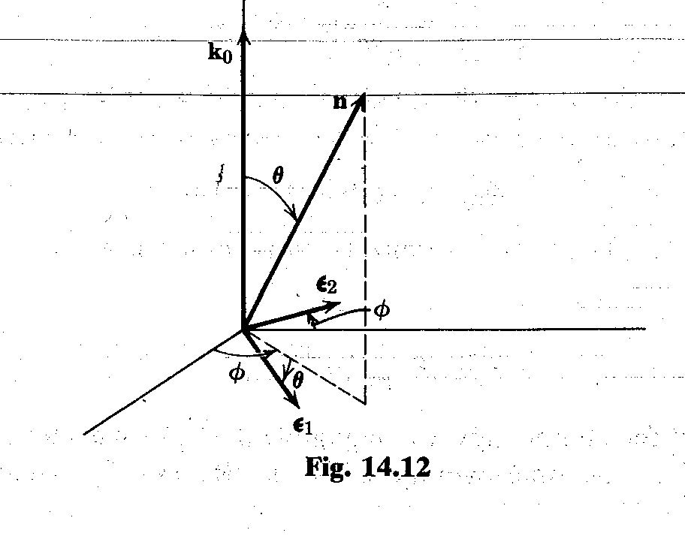
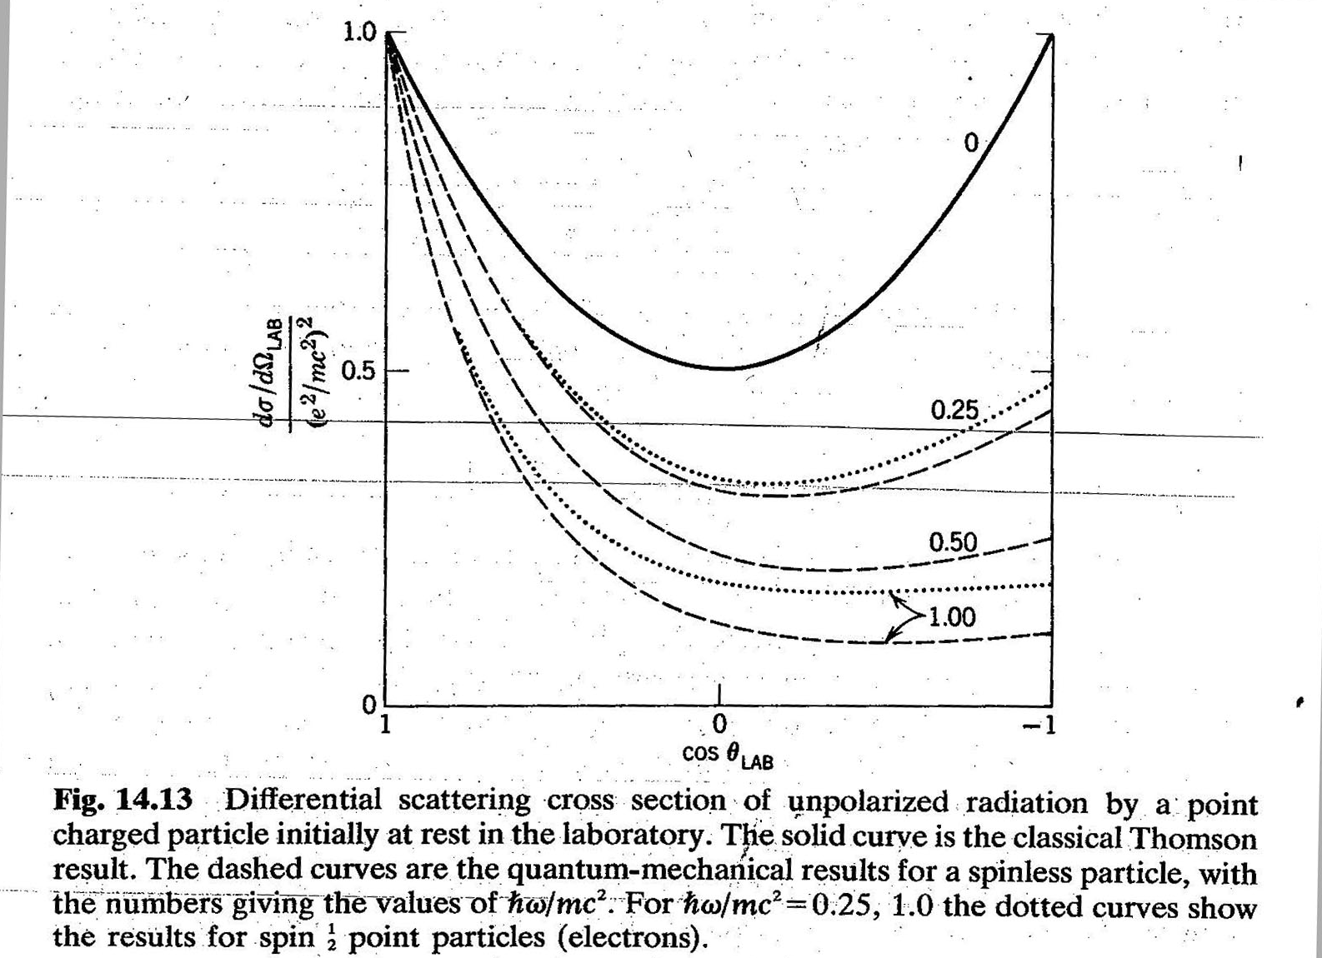
Photon – electron scattering : Compton scattering cross section and angular distribution
Compton scattering
Jackson Classical Electrodynamics

Slide 14
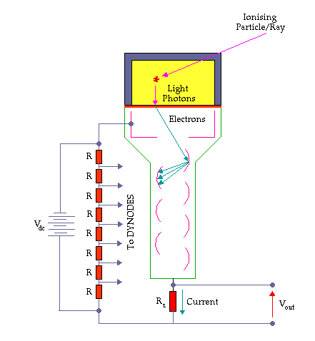
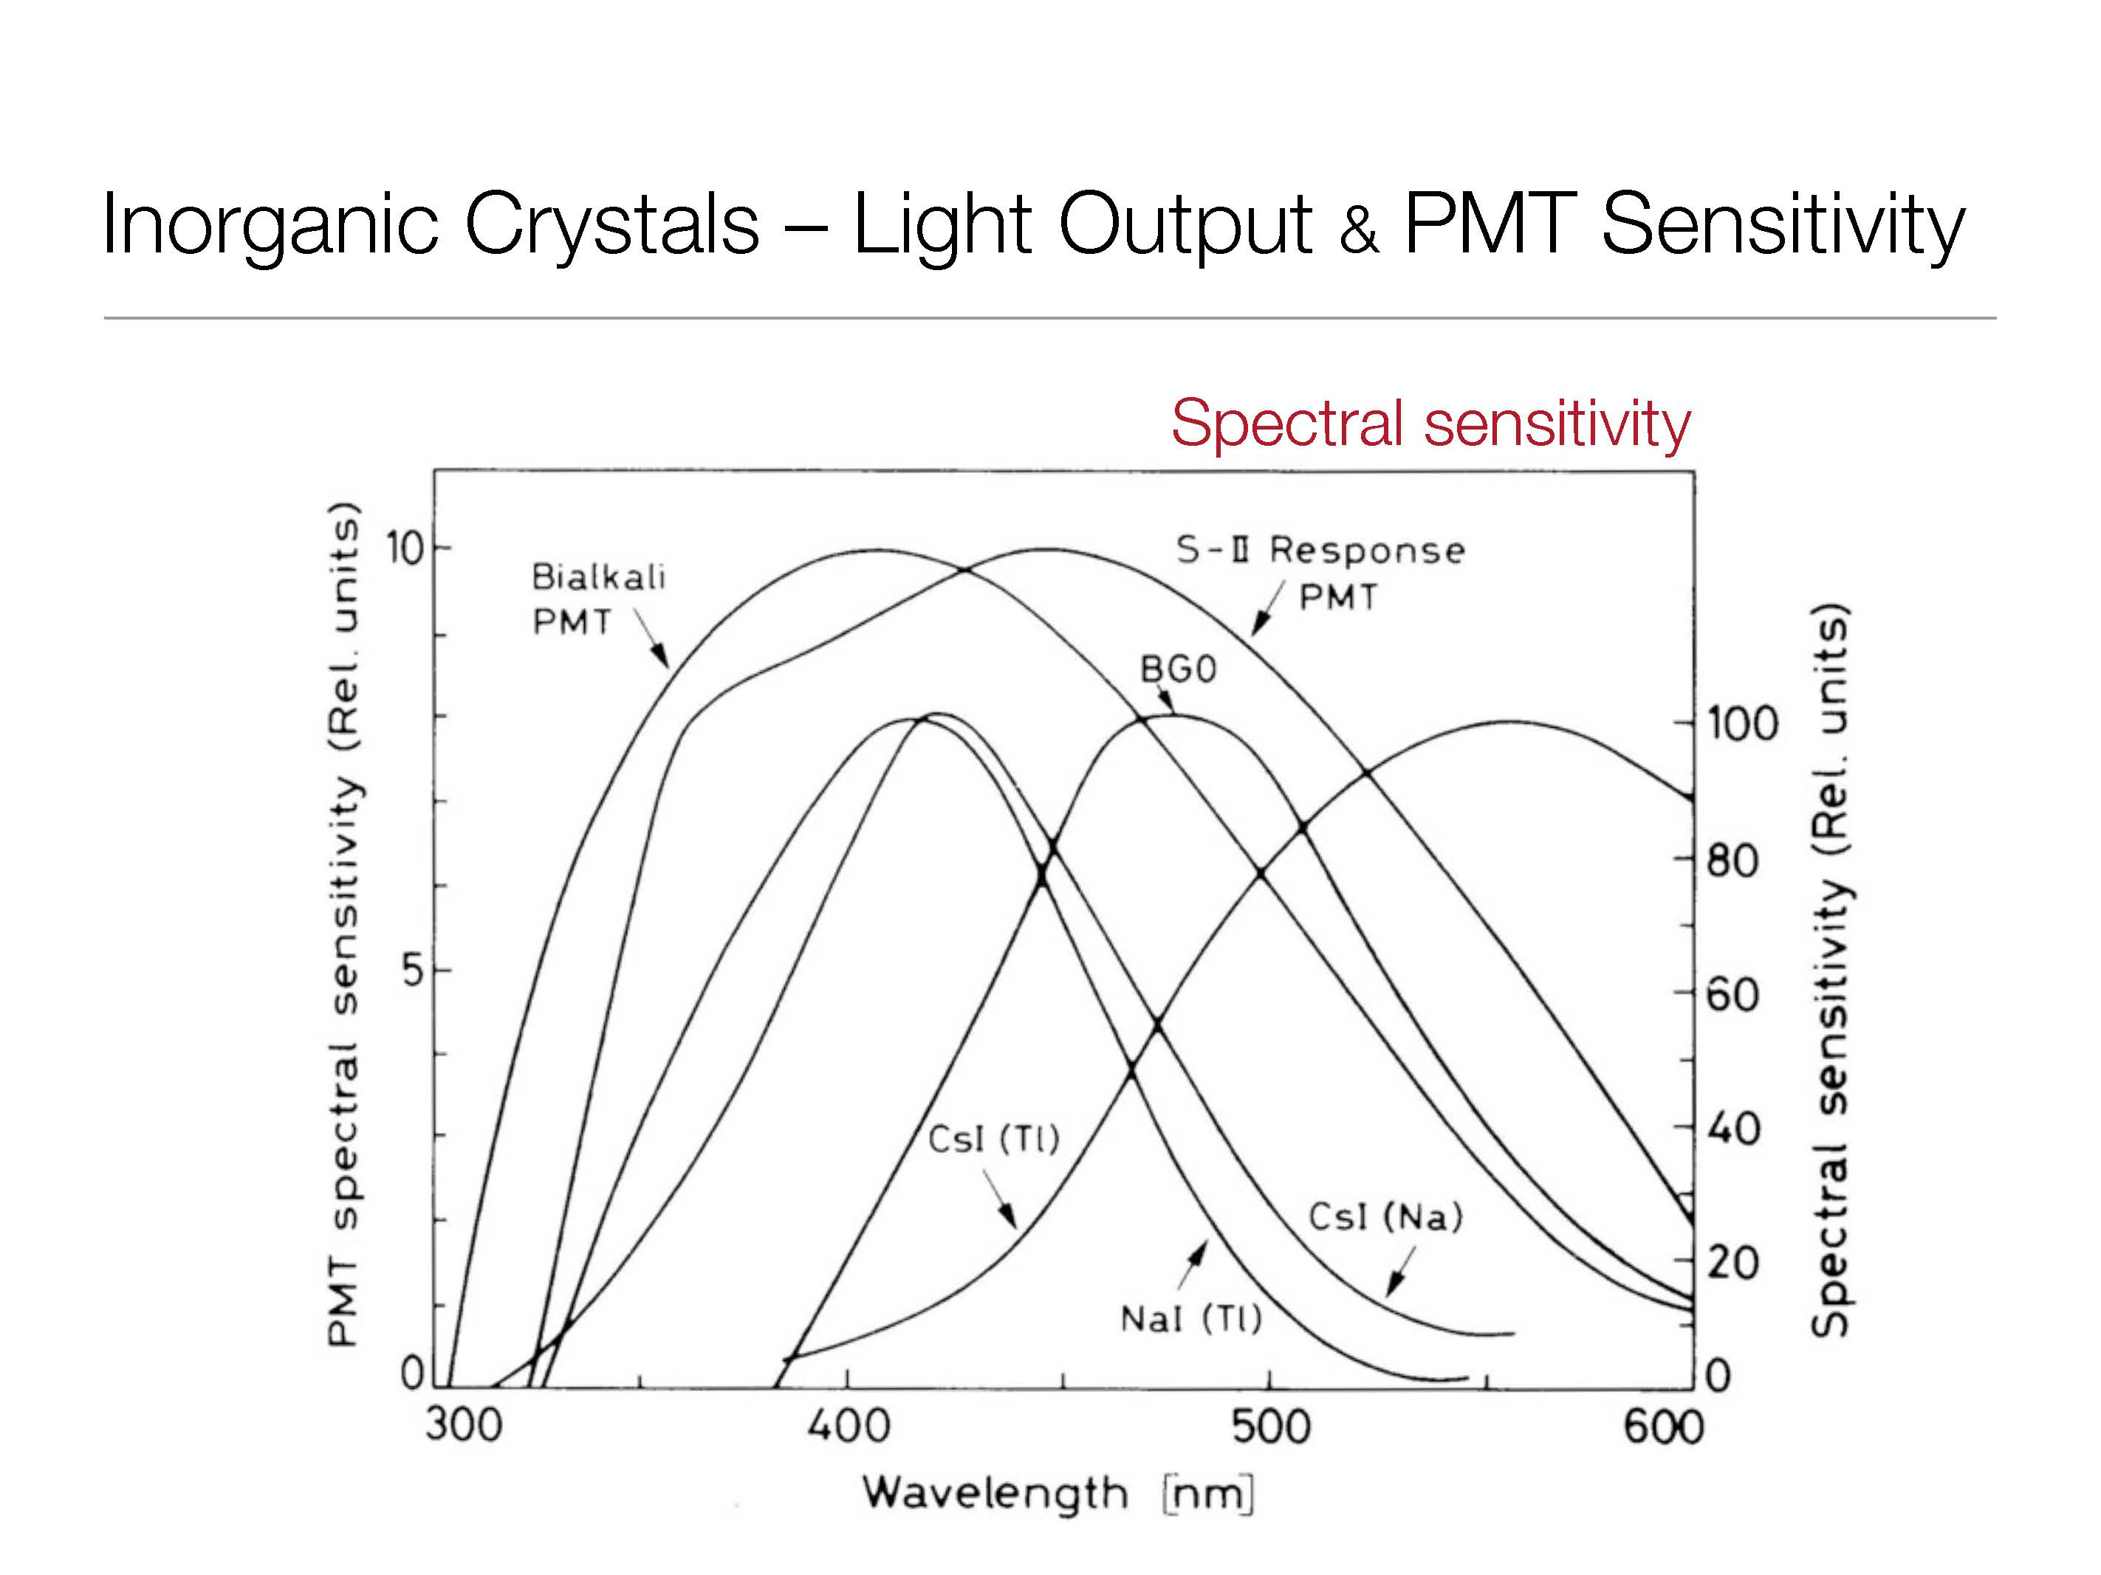
Gamma ray detector
Scintillator NaI
Photo Multiplier
Negative pulses out

Slide 16
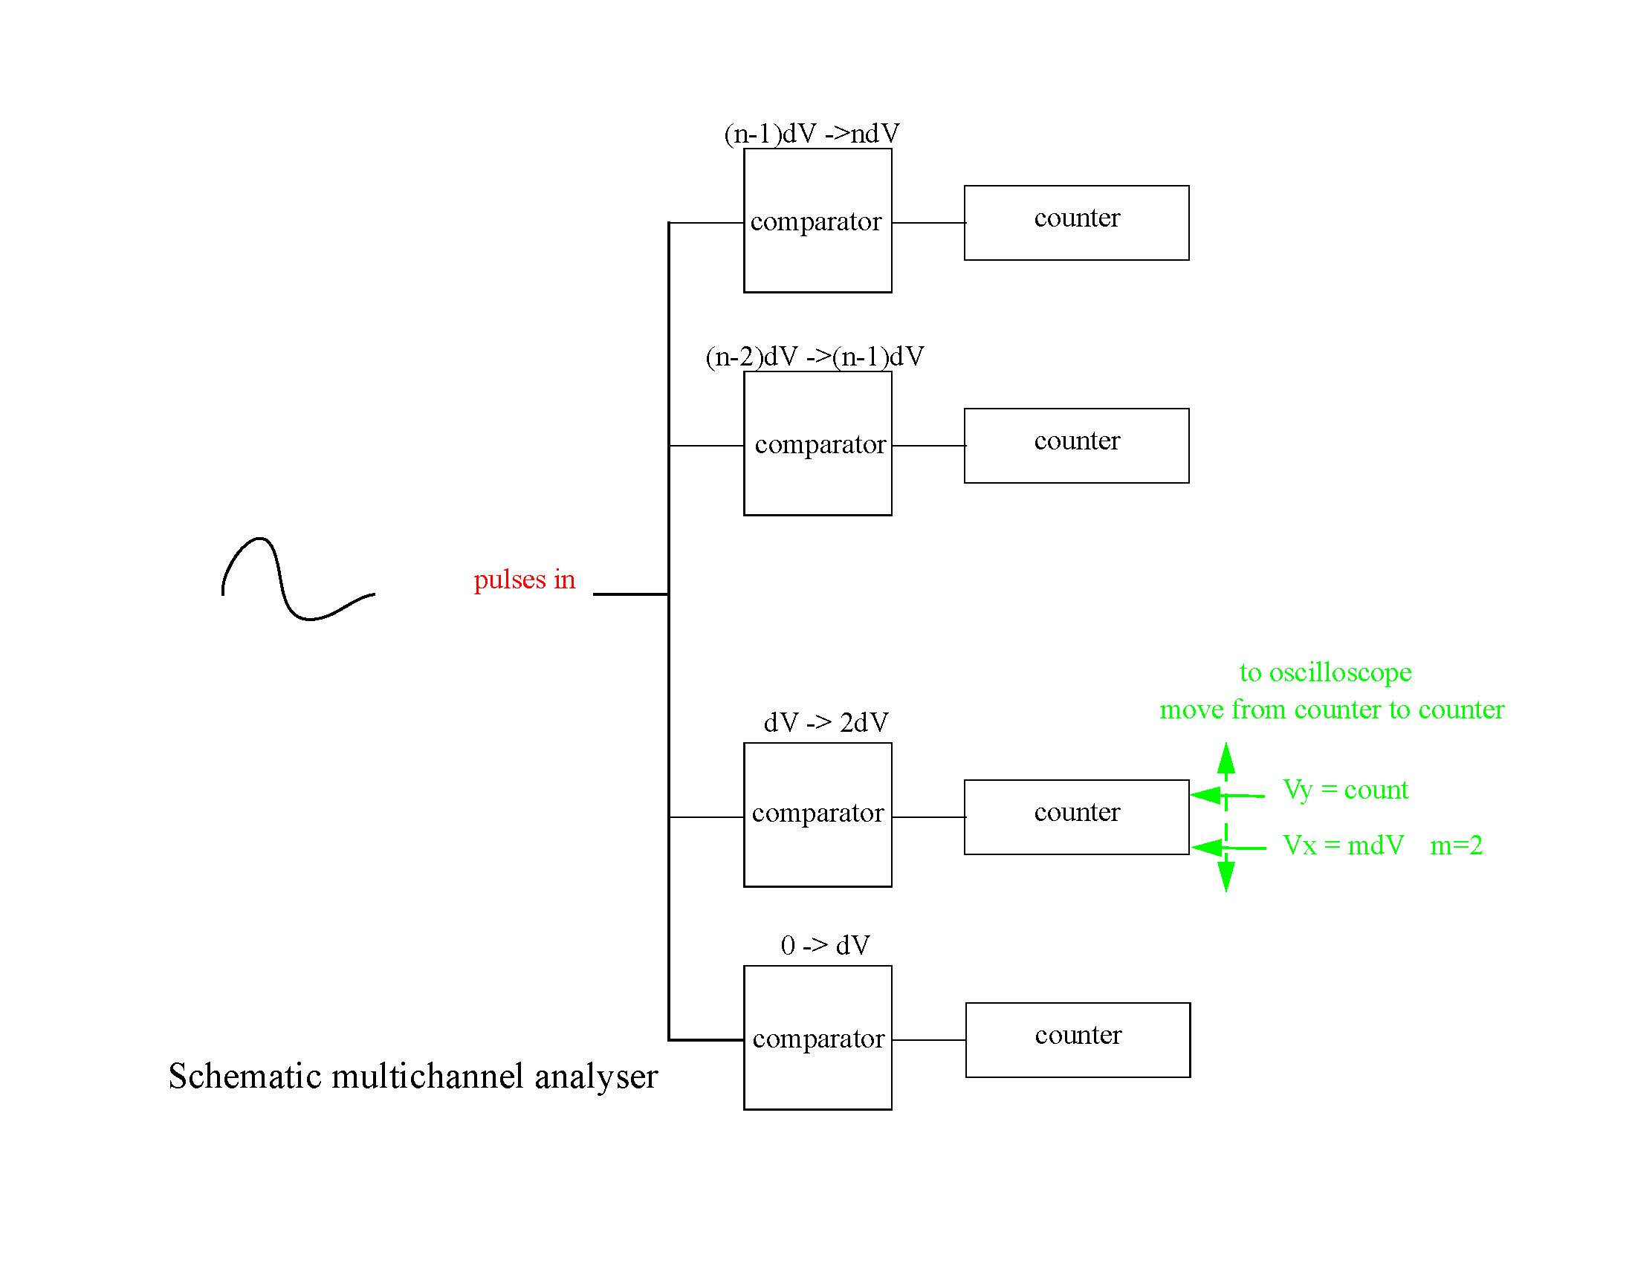

Slide 17
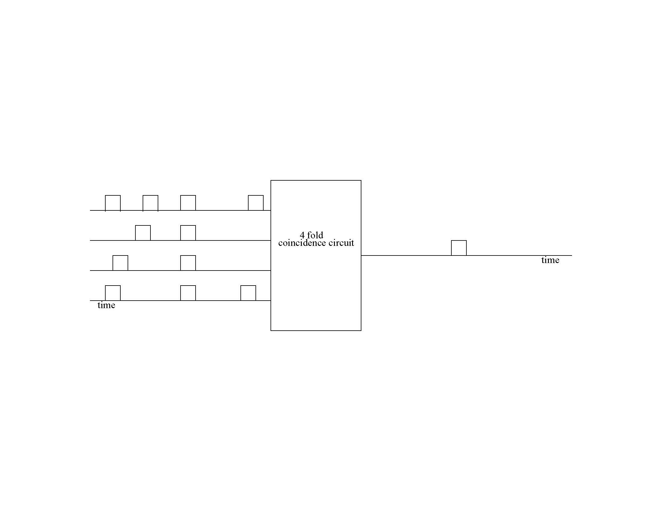
Coincidence circuit schematic
input
output
Time resolution is 2 * width of pulse

Slide 18
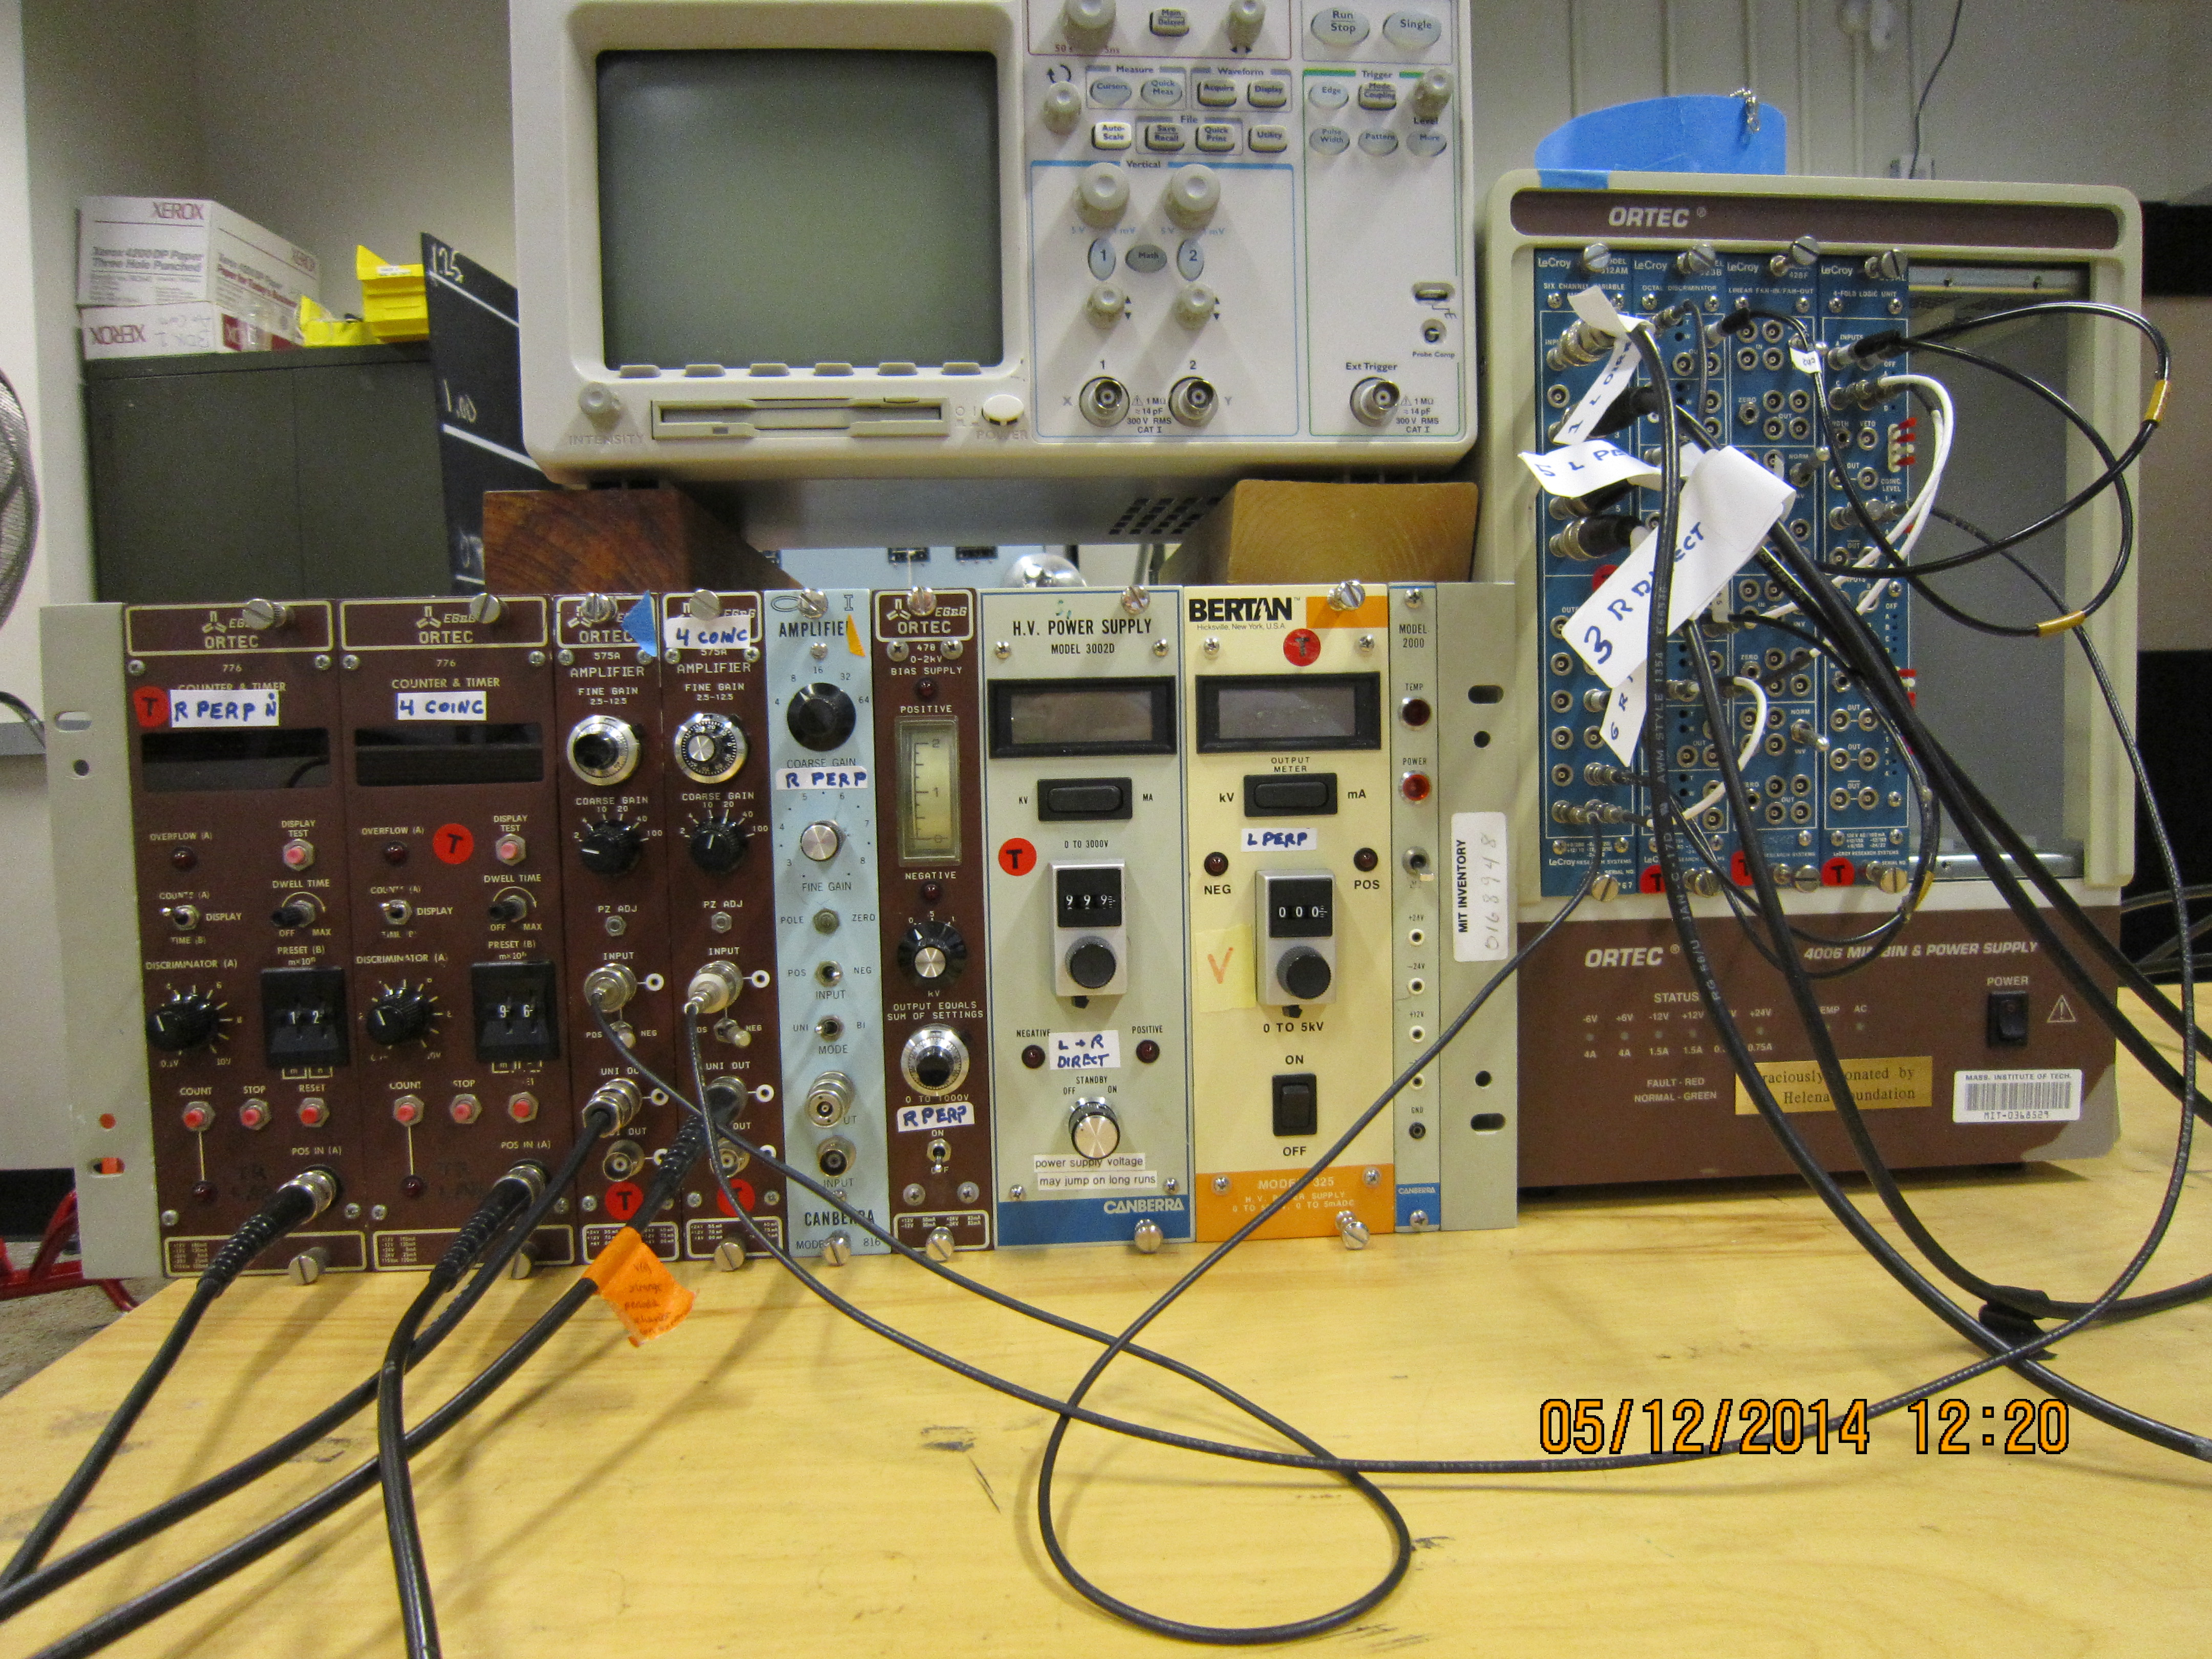
Electronics

Slide 19
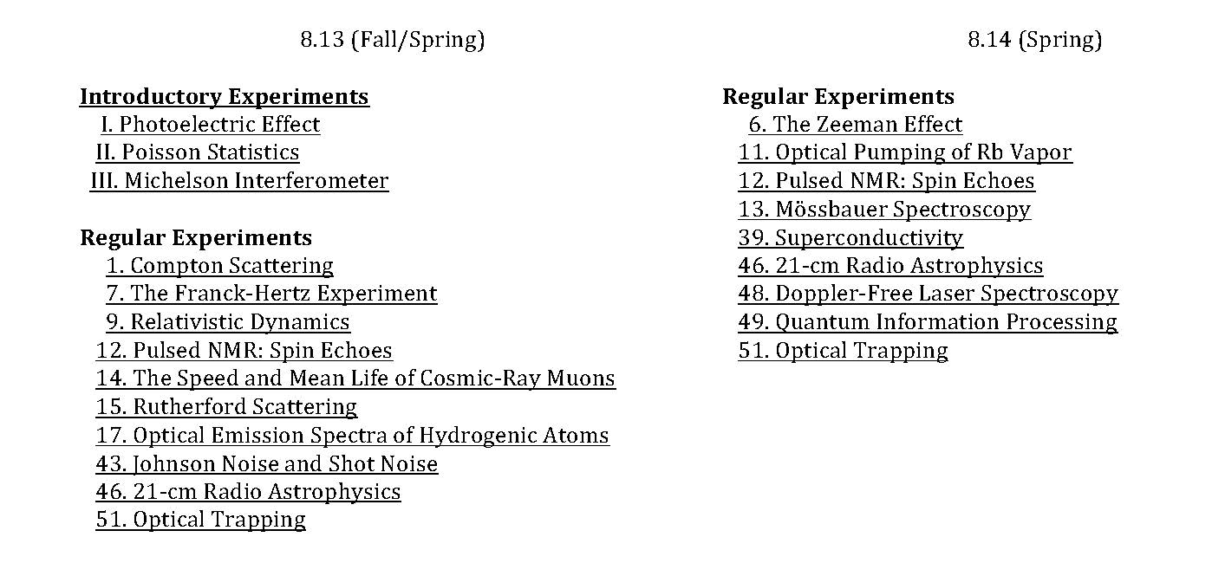
Junior Physics Laboratory Experiments

Slide 20
Acknowledgements
Beth Roberts Lecture Preparation Group
Charles Bosse Junior Physics Lab
Andrew Birkel Junior Physics Lab
Sean Robinson Junior Physics Lab
Mitch Galanek Environmental Safety
Ryan Toolin Environmental Safety
Joshua Millings 2nd Year Physics Major
Ulrich Becker Professor of Physics

