Slide 1
Technical Management of CBI
How LIGO Got The Beam Tubes
That Suited What Was Needed (Contractually)

Slide 2
Developed the BT Requirements
Quantity & Geometry for module installation
Sections, Expansion Joints, Supports, Expansion Joints, Baffles & Pumping Ports
Leak Rate, Clear Aperture & Outgassing Rate
Design to ASME Code, insulation load & ASCE seismic loads; metal pump port seals, welded section joints; 20 year minimum life
TIG, full penetration welds without virtual leaks
Finish roughness & cleaning of vacuum surfaces

Slide 3
Developed BT Requirements (cont’d.)
Vacuum service materials and processing:
Tube wall: Type 304L Stainless Steel, 0.13” max. thickness
Air bake all materials at 440 +/- 8C, 36 hours prior to fabrication
TIG welding without filler wire (later allowed)
Cleaned per approved procedure

Slide 4
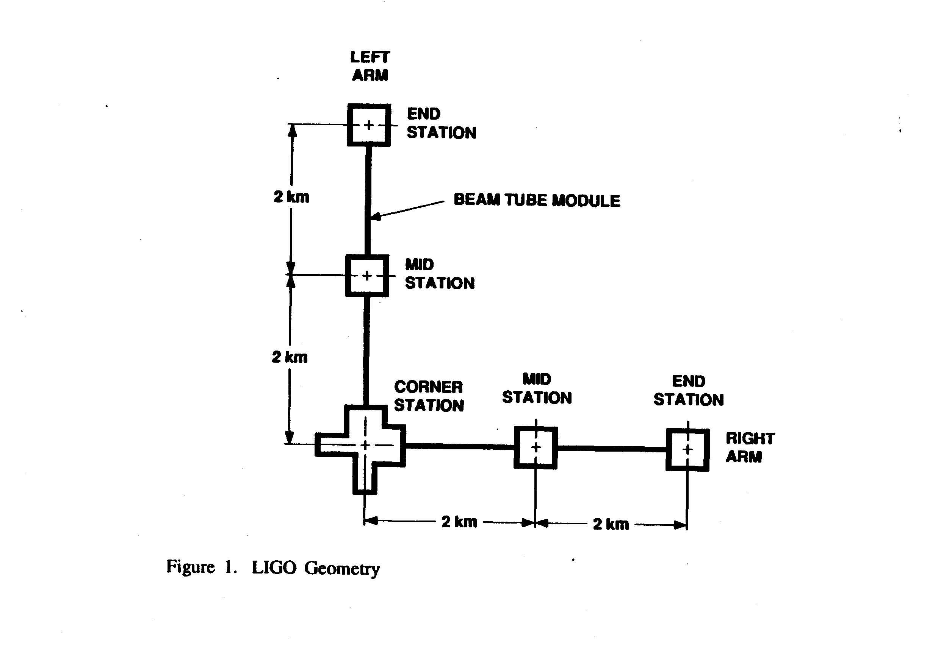
BT Module Geometry

Slide 5
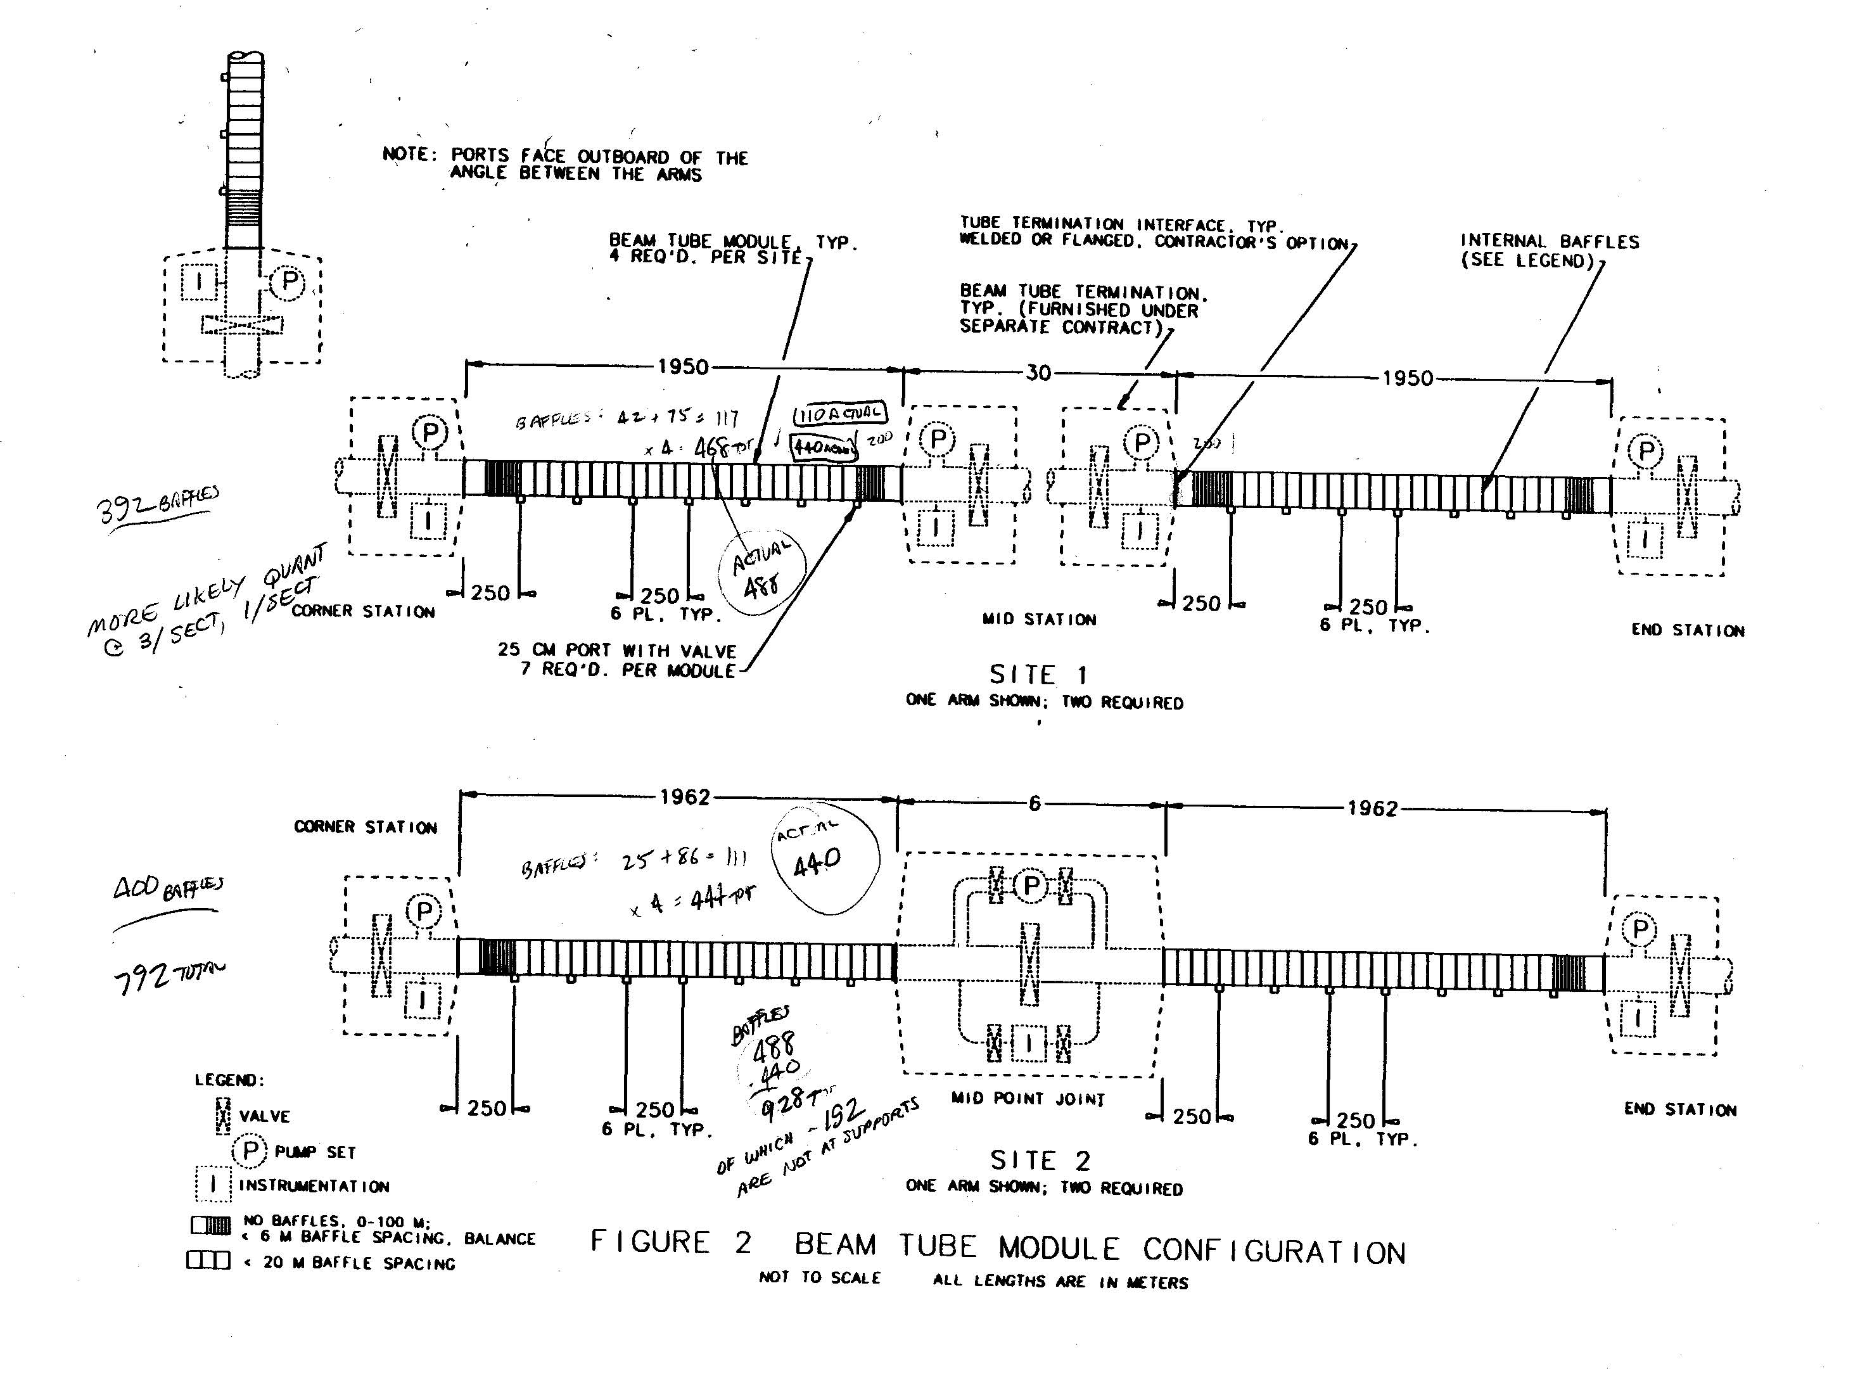
BT Module Elements

Slide 6
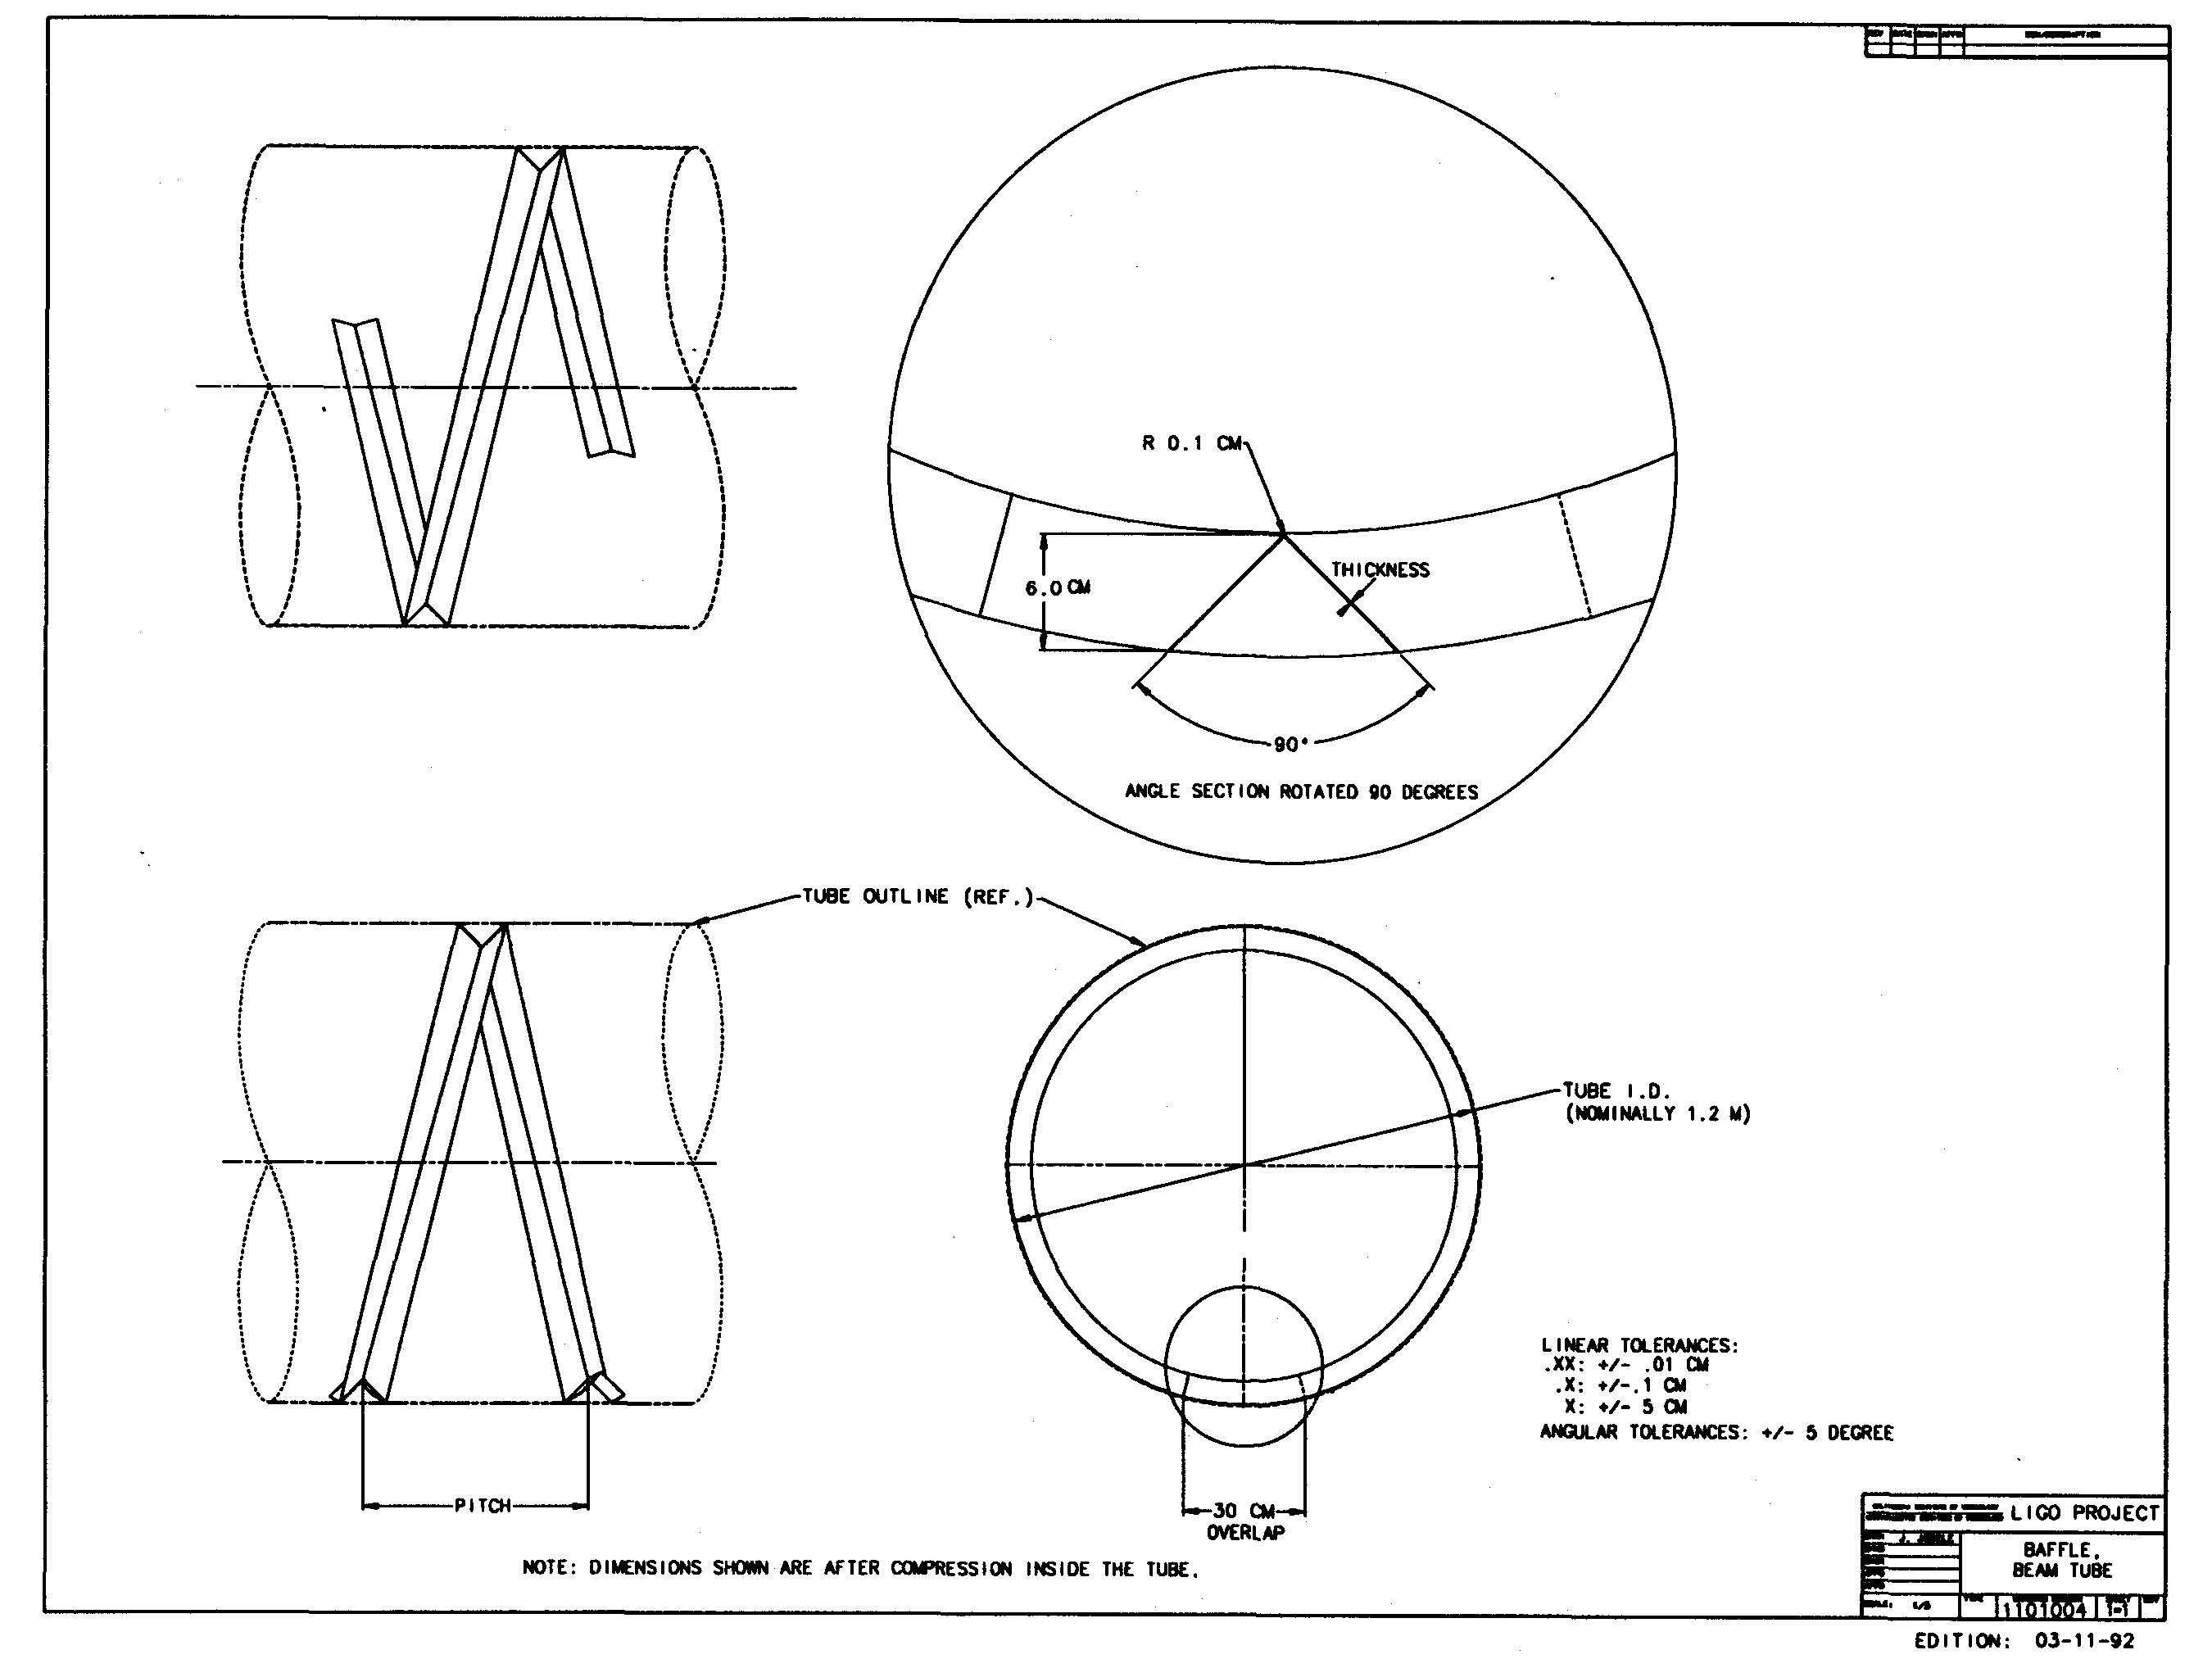
BT Baffle

Slide 7
Wrote the Request for Proposal
Made the general text to suit the campus policies
Set up the task into two phases:
Design & Qualification Test: firm, fixed price
Option: Fabricate/Install/Test estimate for budgeting purpose (Caltech had the right to exercise the Option on a unilateral basis)
Setup payment for the D& QT phase at each of 5 milestones
Deliverable Documentation

Slide 8
Requests for Proposal; Awarding
Identified the potential contractors that had the skills and experience with a task this size
Held a Bidders Conference to explain the project and answer bidders’ questions; 48 came, resulting in 4 bids
Bids were evaluated; CBI was chosen and awarding the contract after negotiations

Slide 9
Made Use of the Contract Tools
Technical Direction Memorandum (TDM)
Contract Data Requirements List (CDRL)
Data Requirements Description (DRD)
Change Requests
Change Orders
Daily (or more) telephone calls
LIGO visits as appropriate to both the CB&I facilities and their suppliers
Project and/or Document Control Plan ??????

Slide 10
Science & Engineering Team
BT Scientist and BT Engineer worked together, supporting each other so that the outcome met our needs: important throughout development.
The Scientist made sure that all science requirements were met, tutored the contractor on scientific principles, anticipated new problems and led the problem solving.
The Engineer handled all day-to-day activities, made sure all engineering requirements were met and helped with the problem solving.

Slide 11
Reviewed the Contractor’s Work
Monthly Progress Reviews: progress, schedule & concerns
Except for the months with special reviews, which were called:
System Requirements Review
Preliminary Design Review
Final Design Review
Qualification Test Review
Meetings were generally at the contractor’s facility; he made the presentations, with supporting analyses and data, and kept the minutes
Reviewers at special reviews used “Recommendation for Action” forms to express concern and possible action
CBI made periodical calculations of the cost for terminating the contract, at our request

Slide 12
The Design & QT Phase
LIGO took the cost risk of rejecting SS coils
The cleaning of the BT sections an its acceptability test was open, to be developed by CBI and approved by LIGO
The leak checking of the BT modules was open, to be developed by CBI and approved by LIGO
LIGO reduced the requirement for module leak limit from 1E-10 to 1E-9 atm cc/s, per module
LIGO increased tube sections in QT from 2 to 3

Slide 13
The Option Phase
Estimate in original proposal was updated by CBI at the end of the Design & QT phase
LIGO considered re-competing the task
Content and risk was reduced during negotiations:
Baffle became installation only
Caltech took on the risk of cost changes in BT material, labor rate & cost of leak location beyond XXX hours
BT water bake was dropped from CBI task
50/50 Sharing on approved cost reduction design changes

Slide 14
Payments During Option Phase
To be added

