Slide 1
The LIGO Beam Tube
In-House Work &
The Design & QT Phase
of the CBI Contract

Slide 2
Early In-House Beam Tube (BT) Work (primarily a study of the tube element)
Mechanical design, cost tradeoffs
Material choice based on corrosion, permeability: Type 304L HRAP Stainless Steel
Water bake out: 115C, 8 days
LIGO requirements for (4) 4 KM arms put a large multiplier for: material cost (3.5 M lb), fabrication cost, installation cost, leak check cost, bake out cost, pumping cost (outgassing)

Slide 3
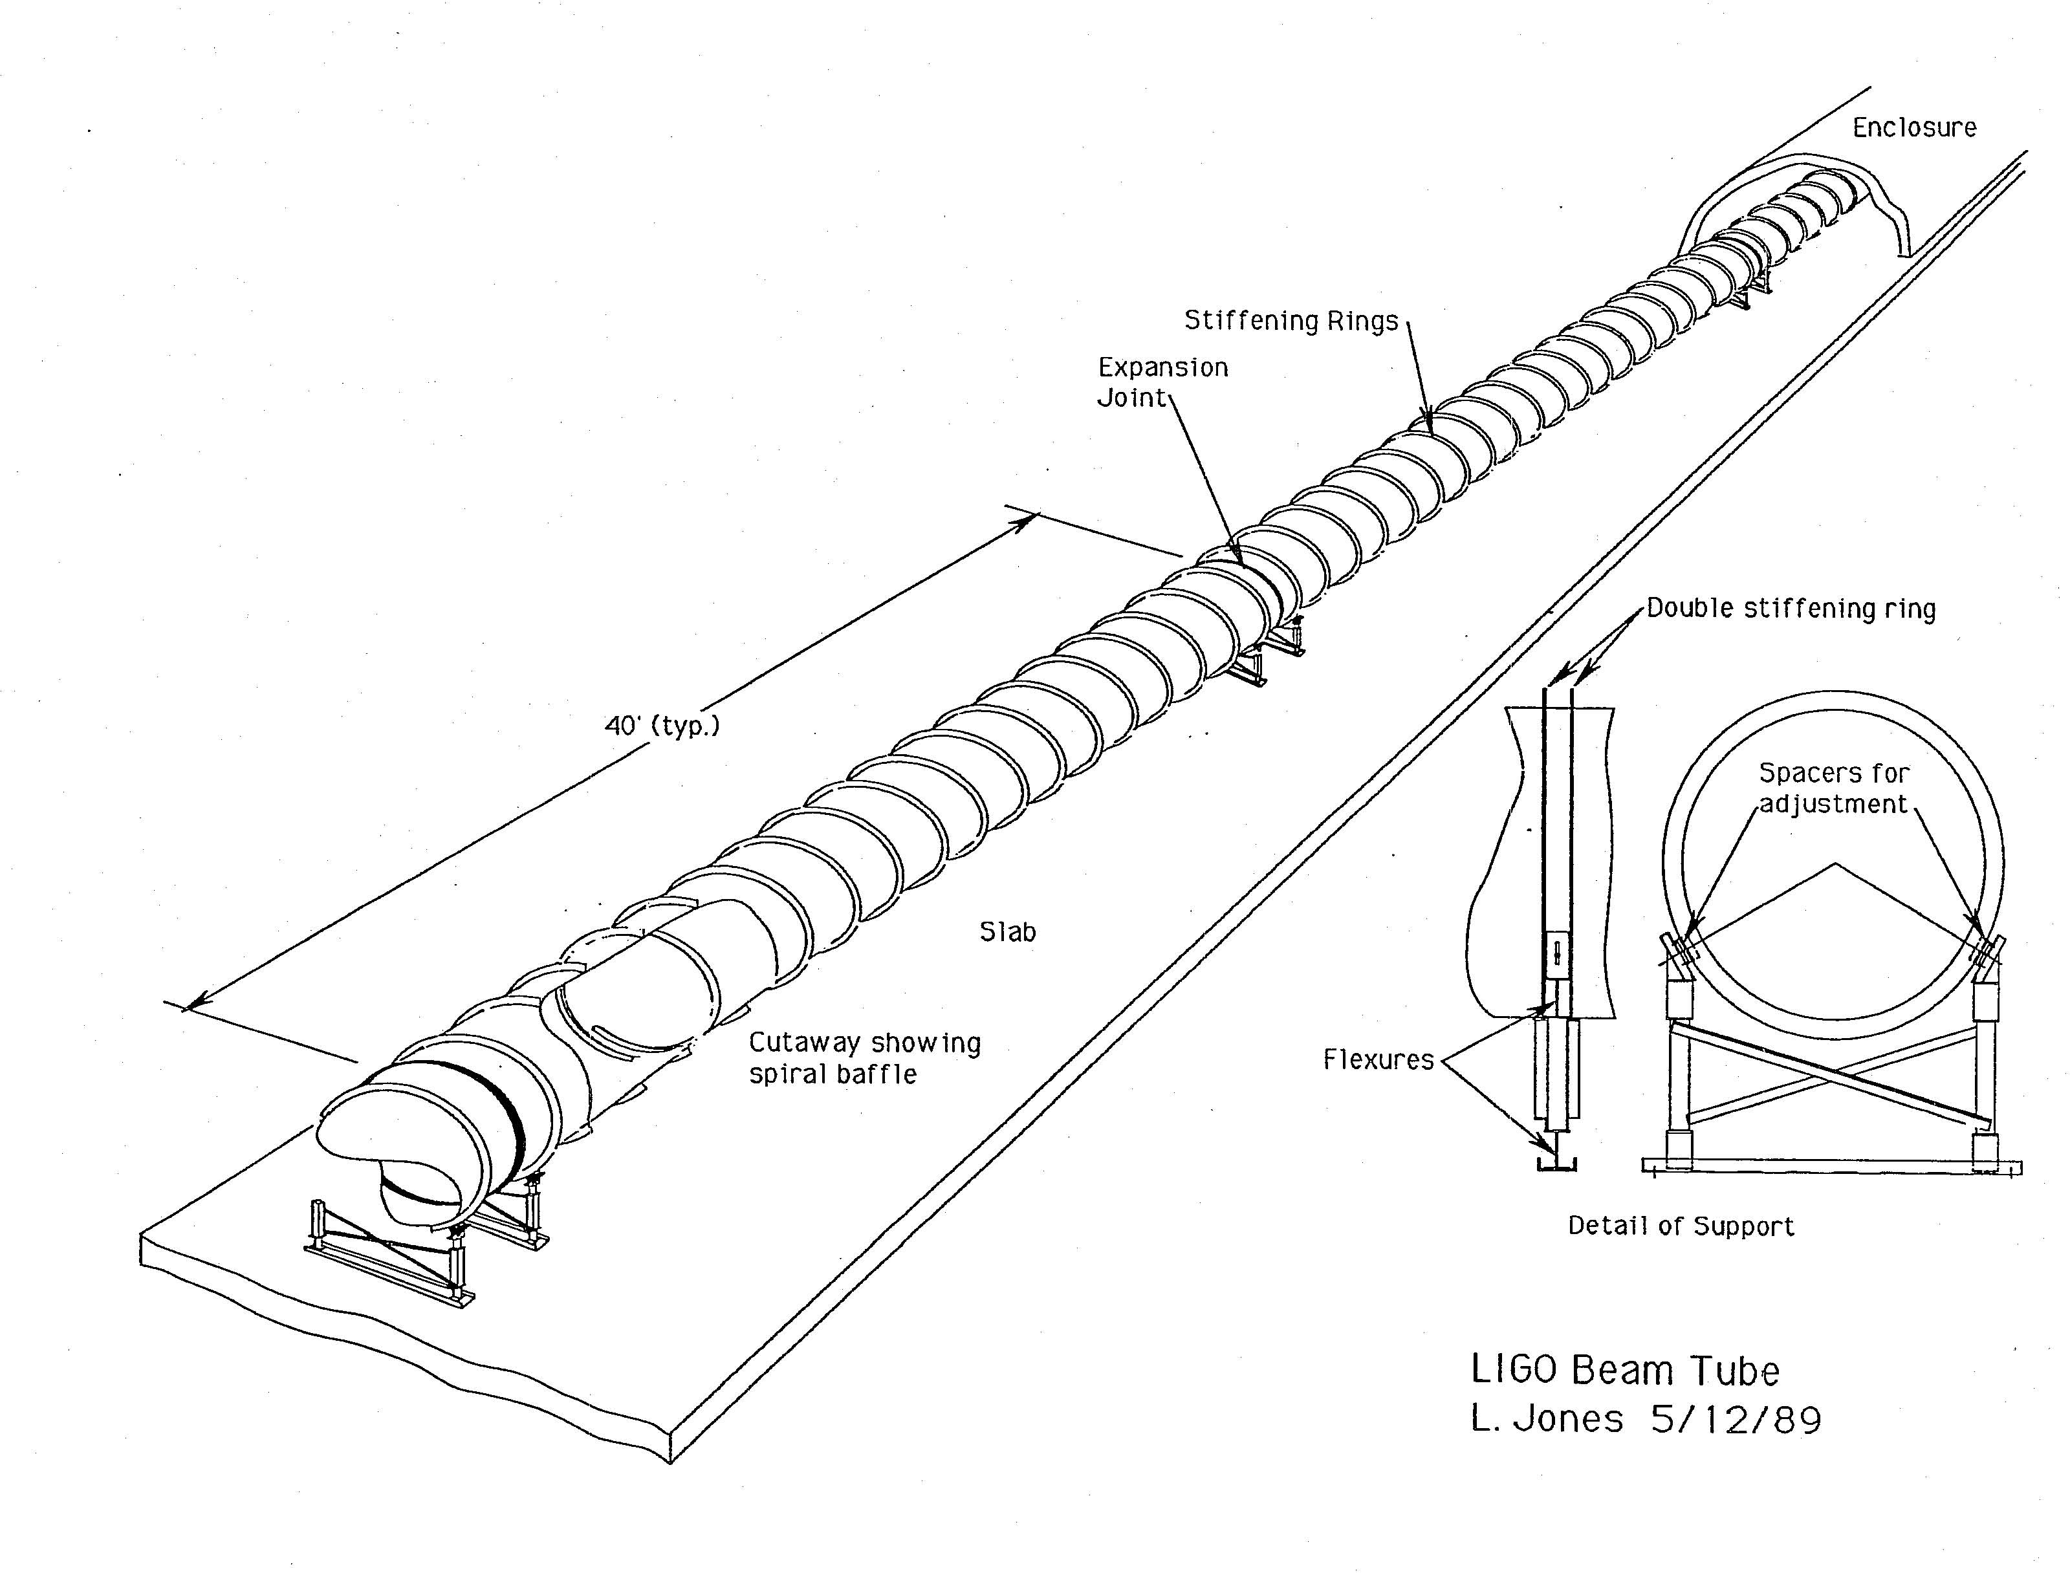

Slide 4
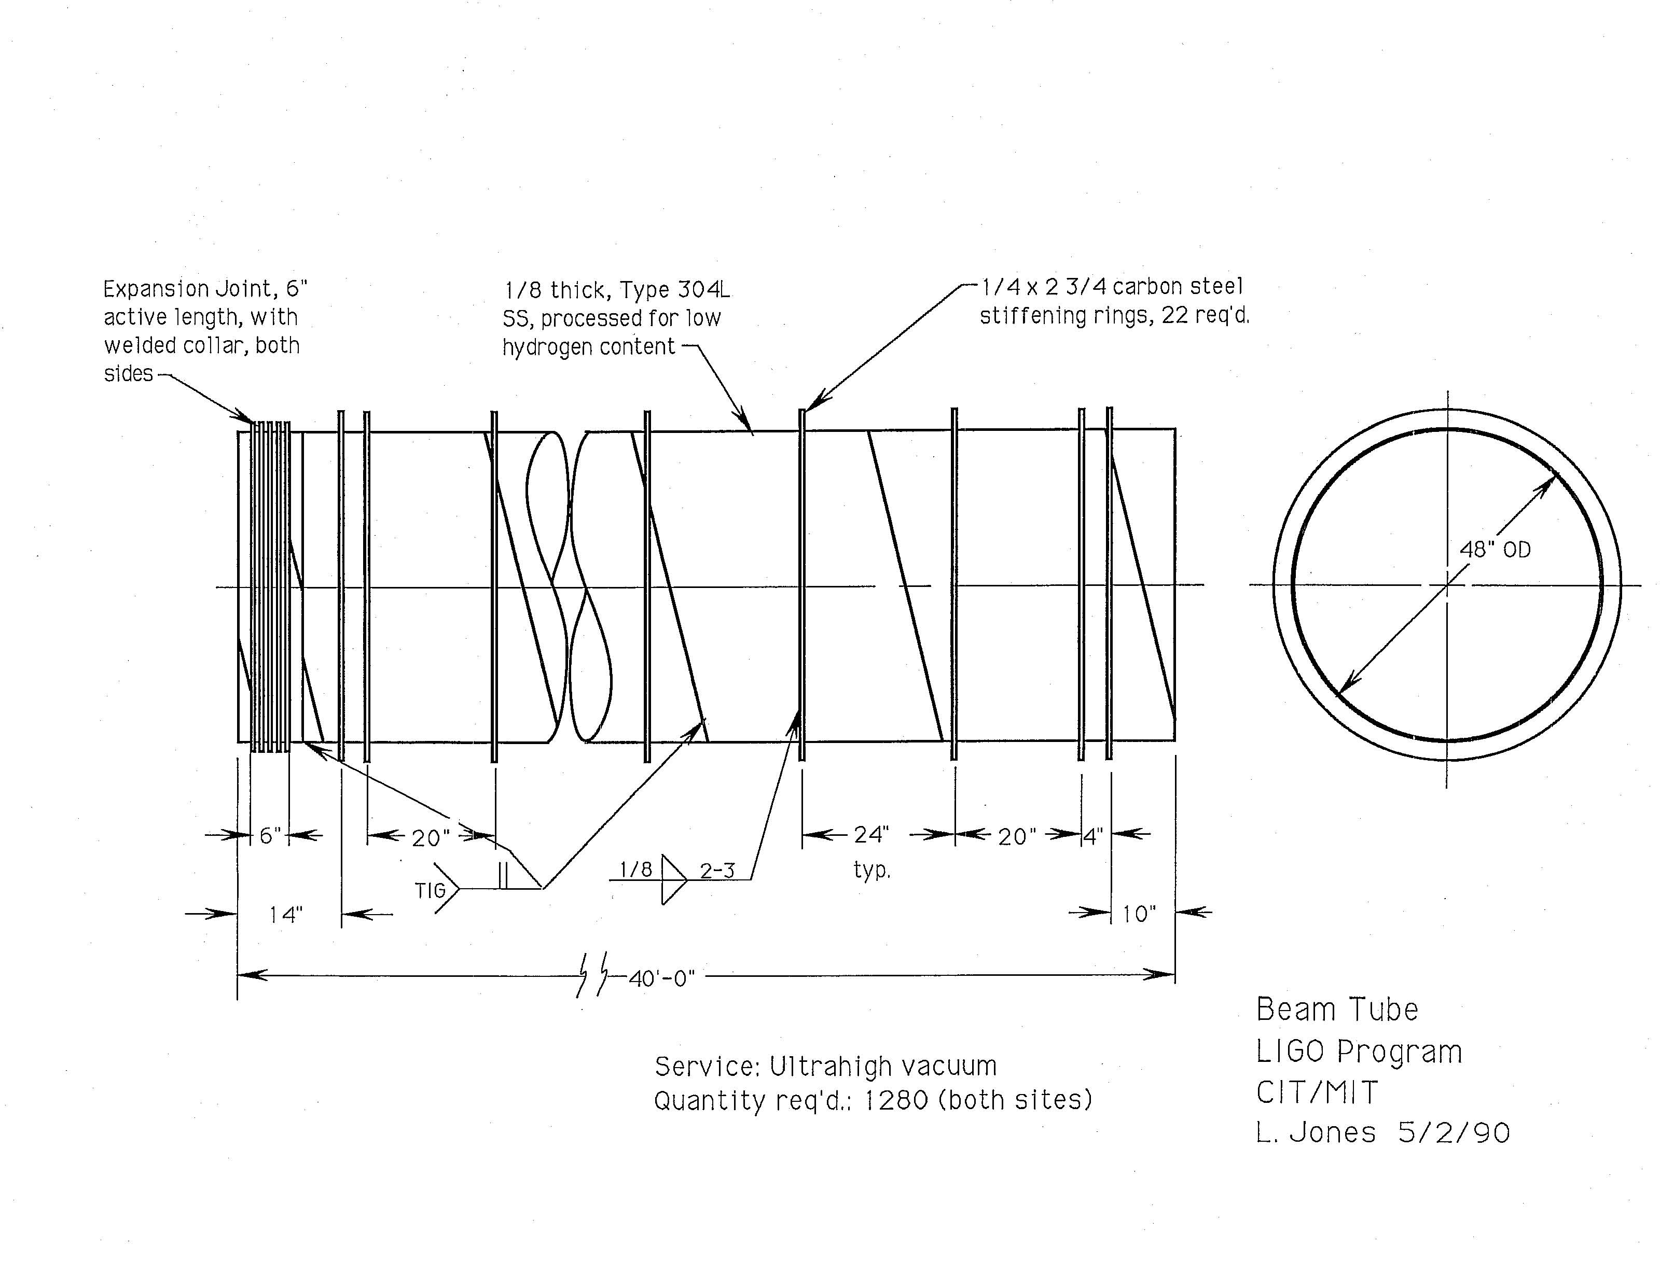

Slide 5
The In-House BT Demo Task
Planning
Coil processing: 463C, 36 hr air bake (carbide precipitation concerns)
Cleaning: hot water & Oakite detergent from mobile sprayer
Assembly & pump down
Tube bake: 100C, 30 days
Leak problems, RGA operational problems

Slide 6
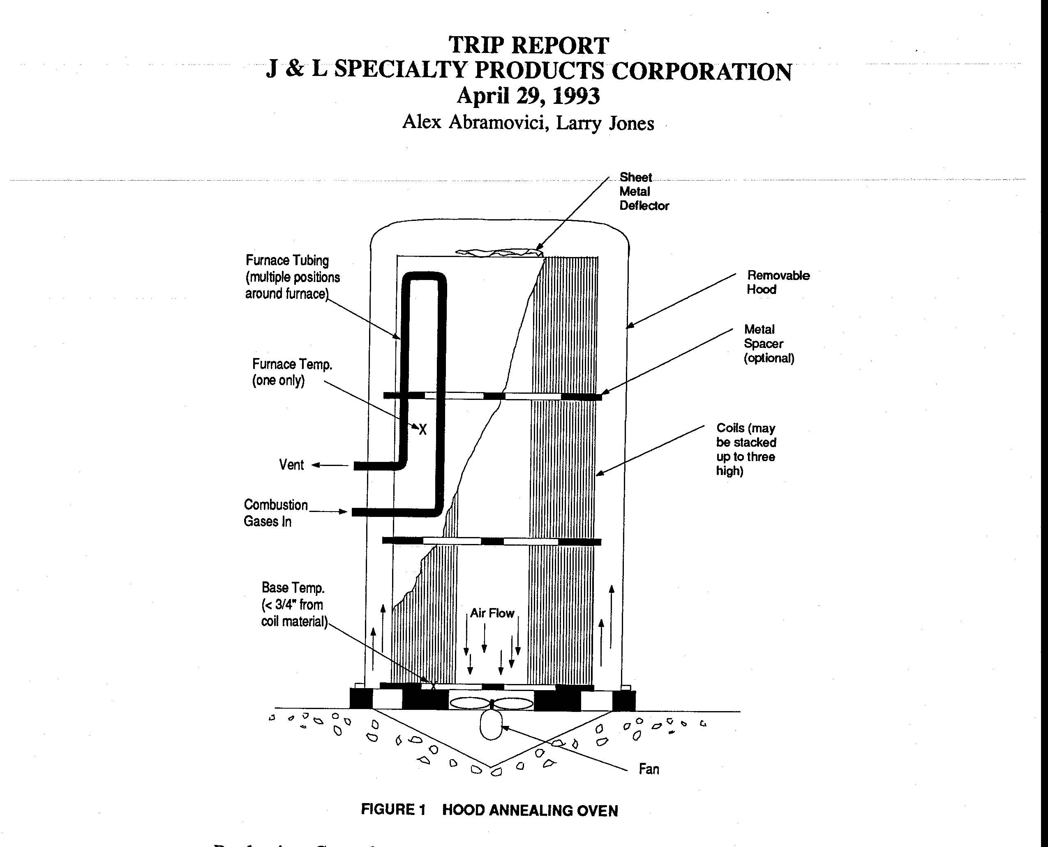

Slide 7
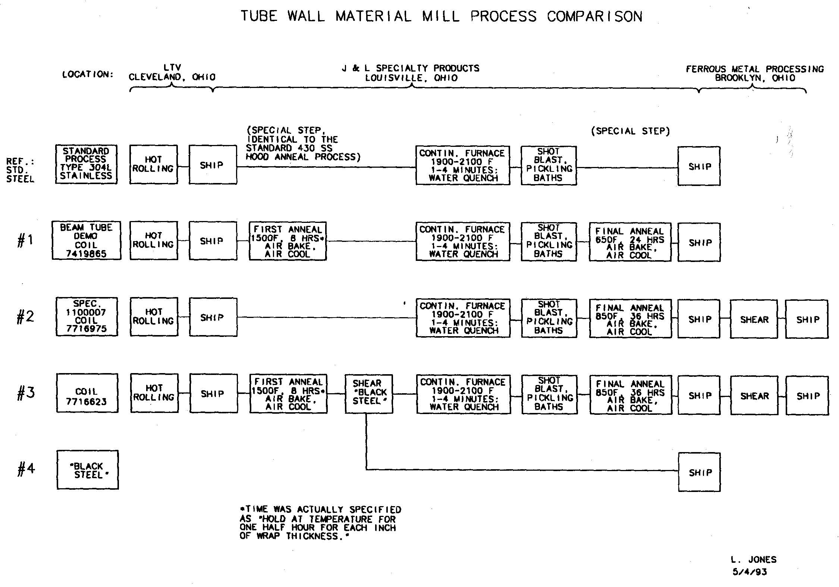

Slide 8
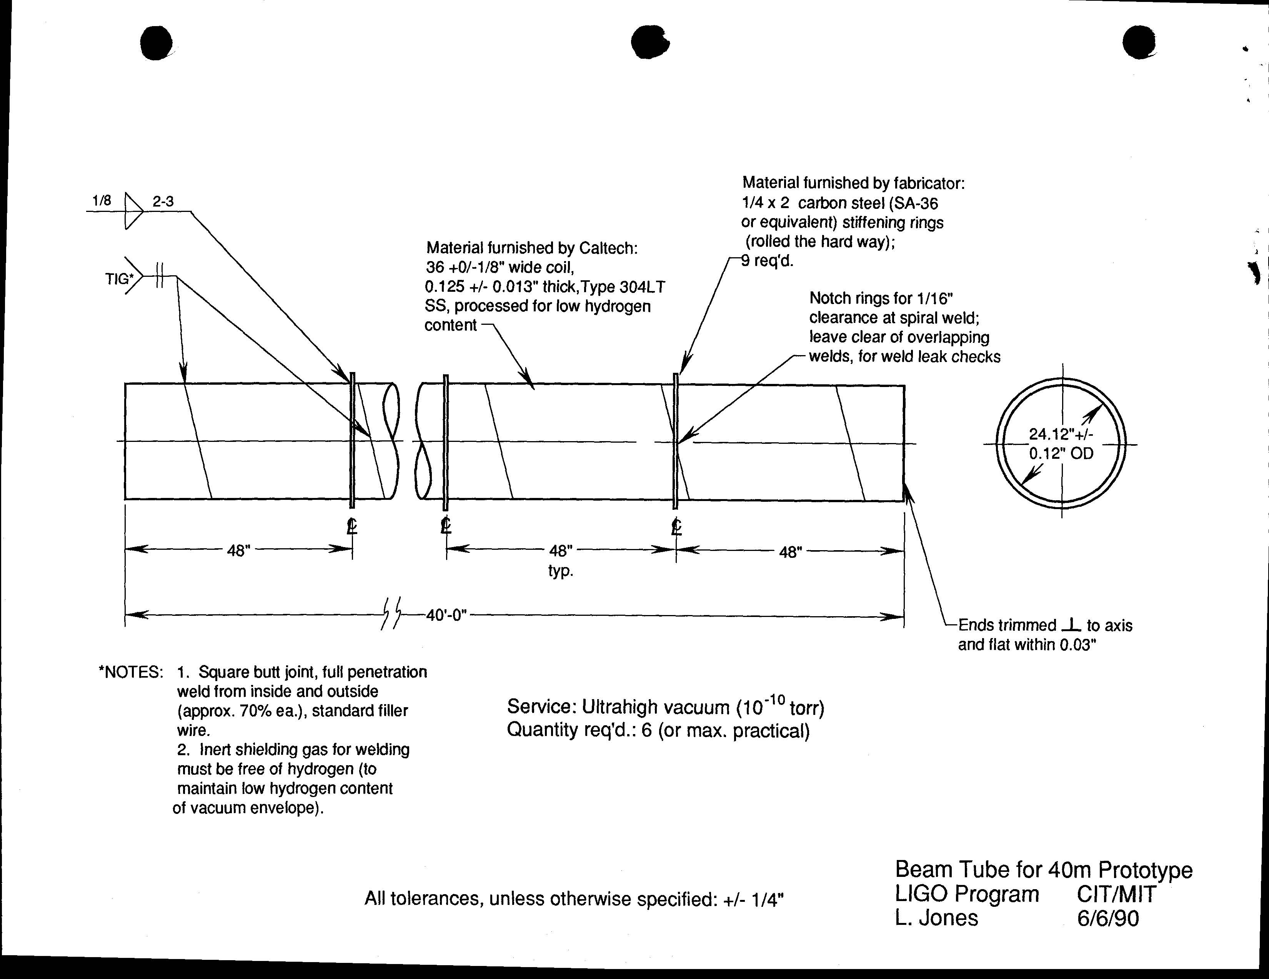

Slide 9
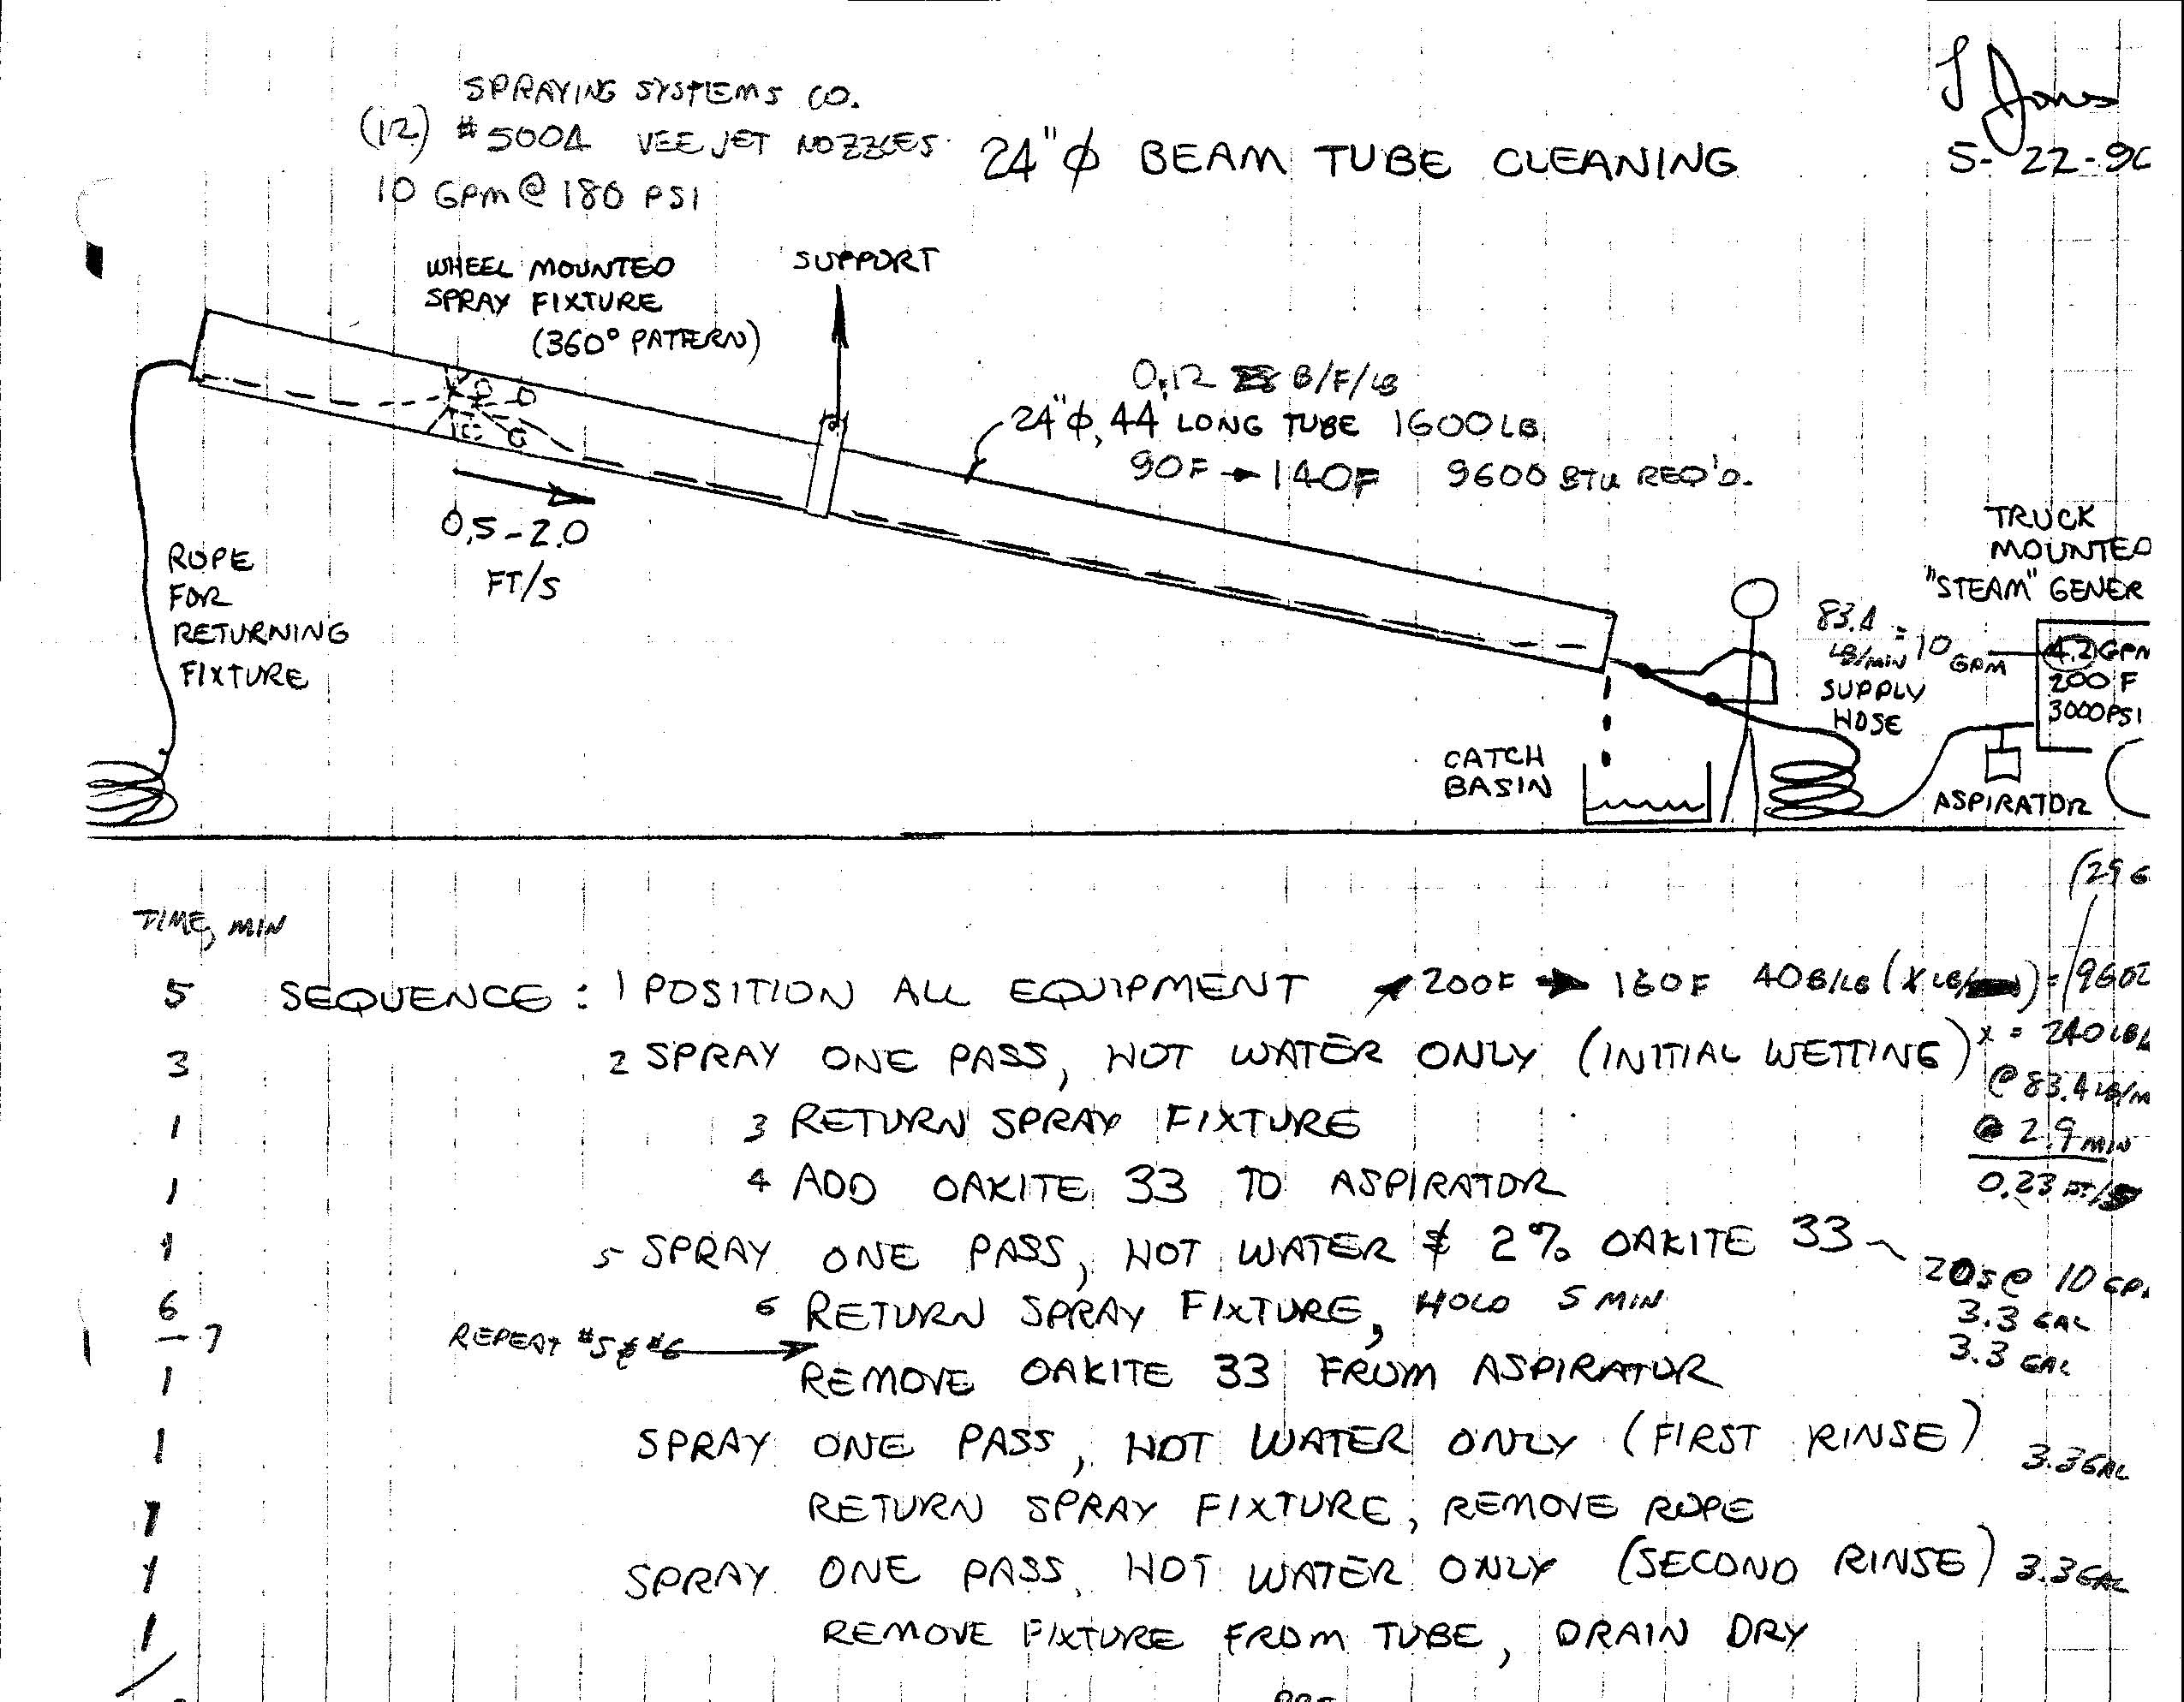

Slide 10
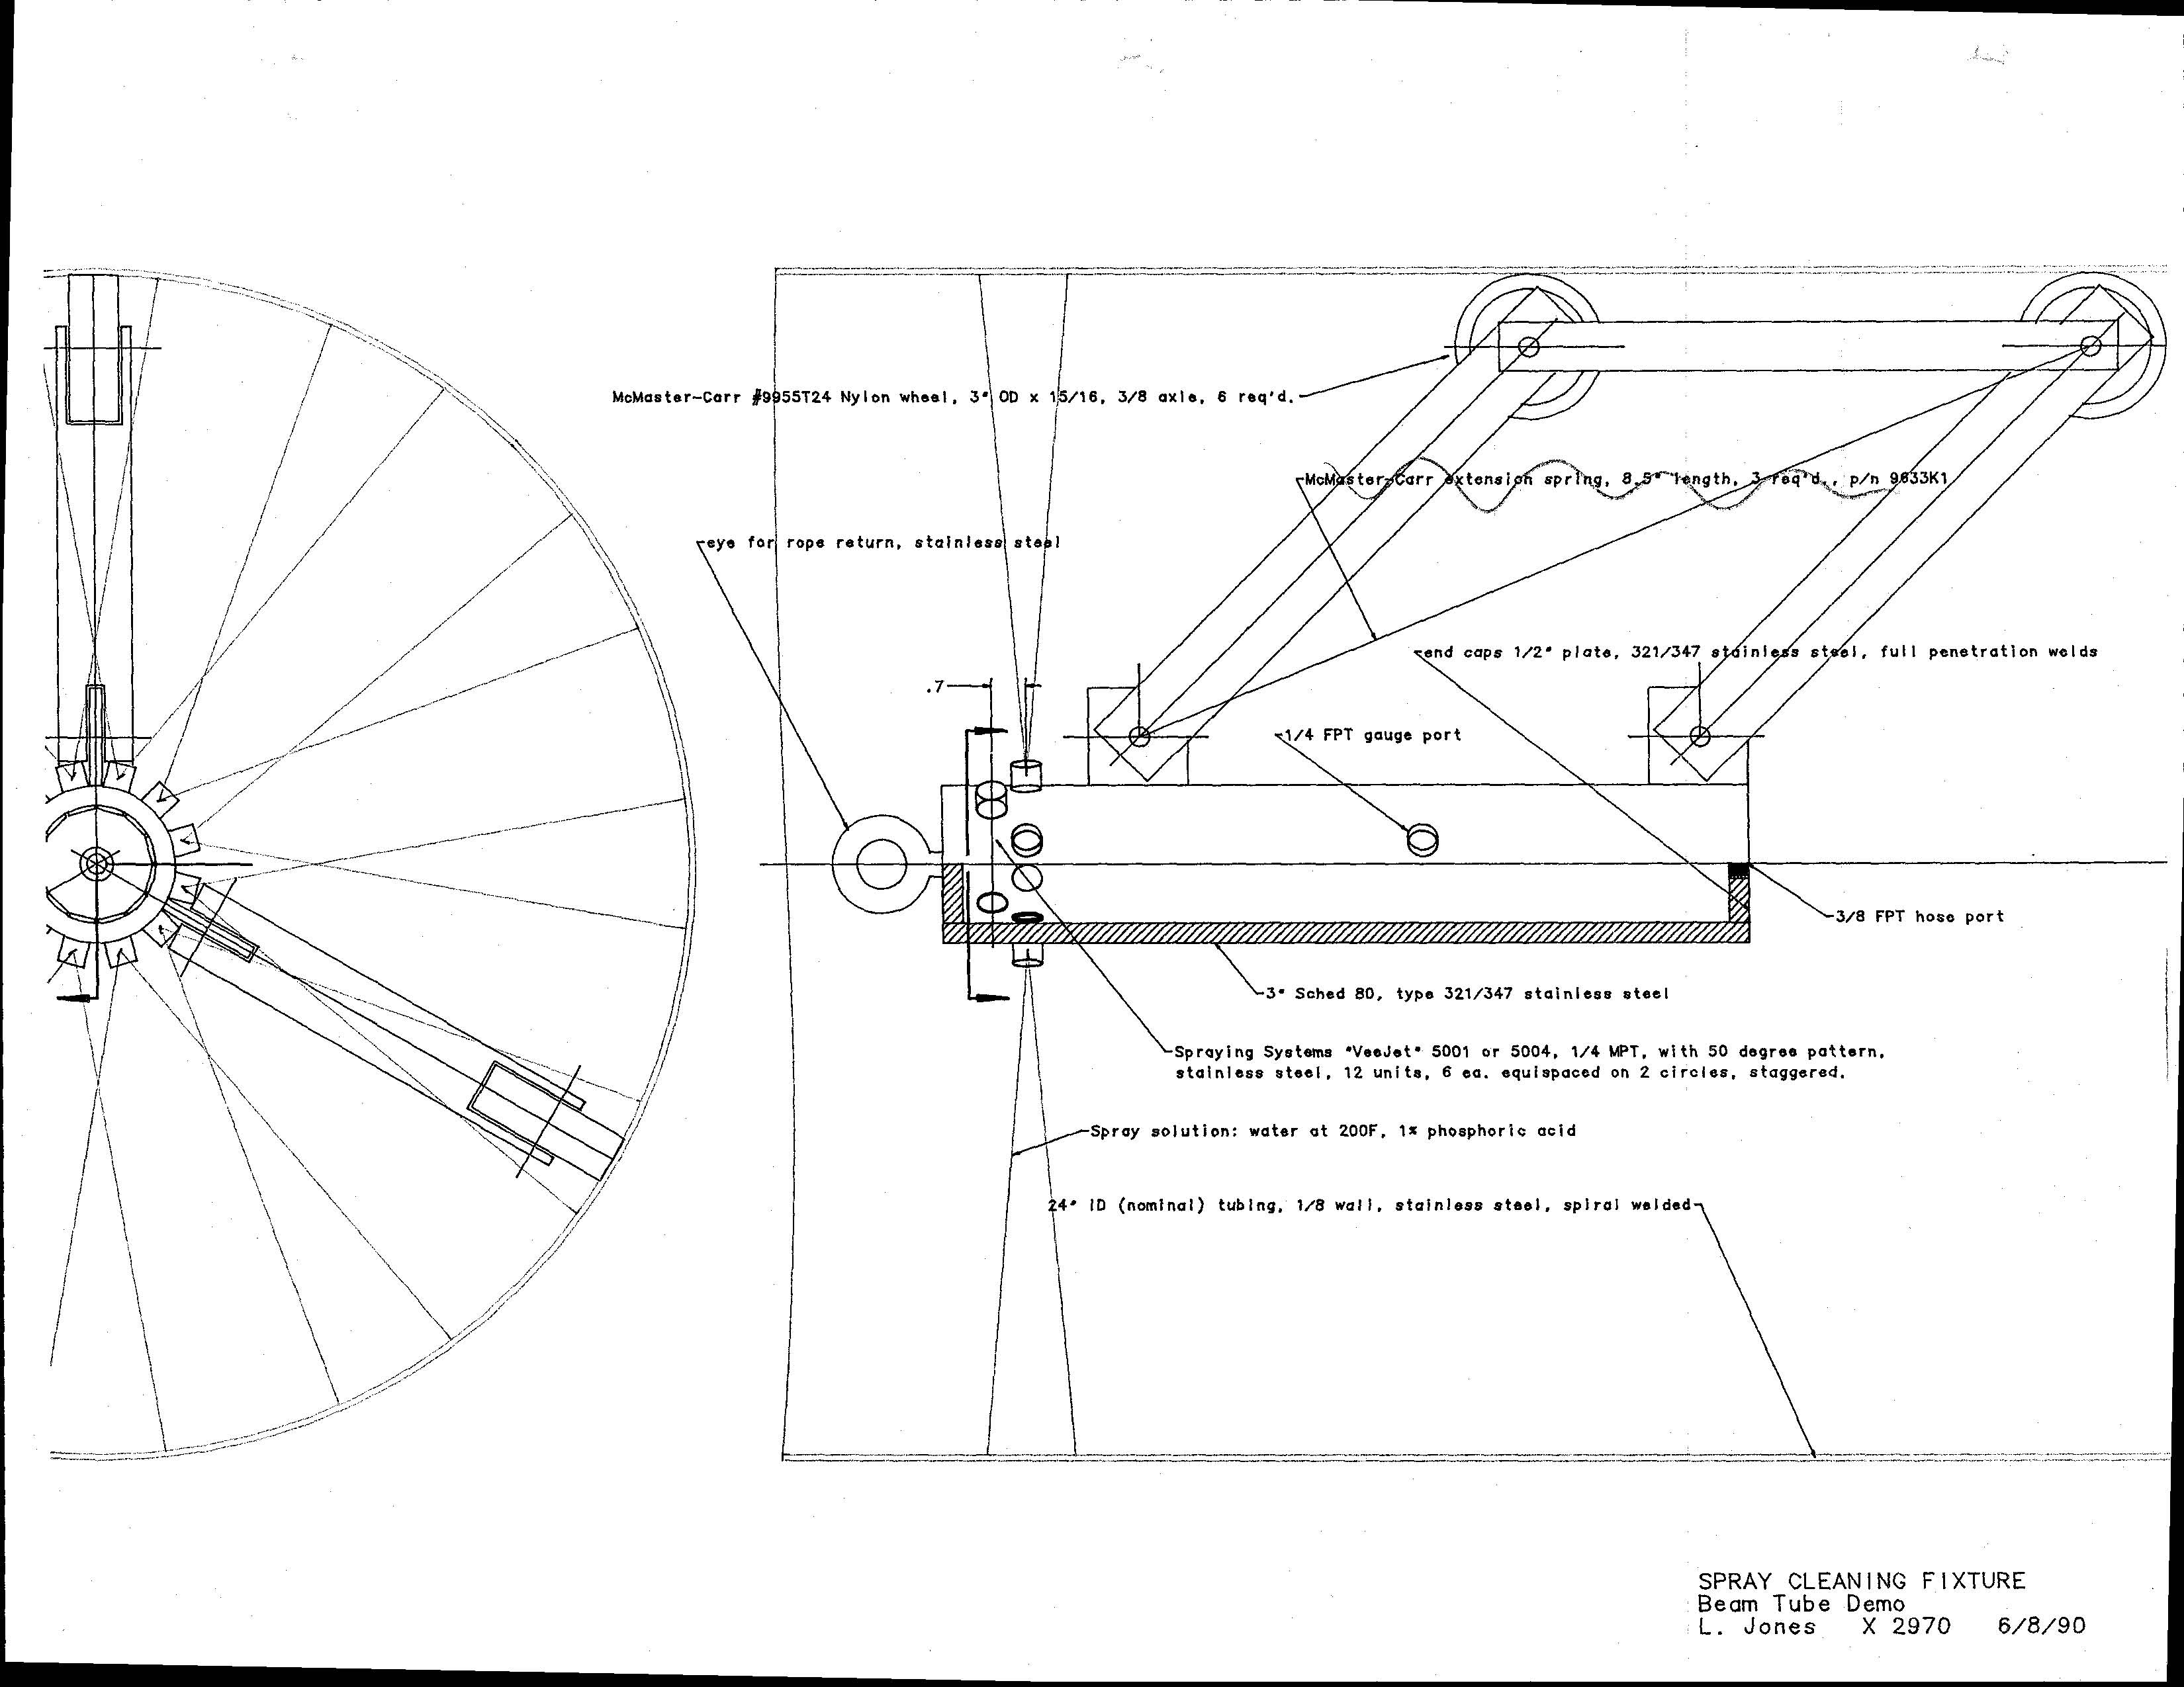

Slide 11
The Design & QT Phase of the CBI Contract, 8/17/93
CBI chosen as BT contractor & awarded contract
System Requirements Review
Preliminary Design Review
Final Design Review
Qualification Test Review
CBI updates the cost for the Option phase

Slide 12
System Requirements Review, 9/28/93
Spiral tube requirements would be a stretch for existing suppliers: thickness, weld quality
CBI asked for LIGO’s safety factor; ASME code is 3.0; on some jobs CBI uses 2.5
LIGO said to optimize plans for cost, not schedule
CBI preferred two pass, external weld with filler wire on spiral mill
CBI was concerned about finding module leaks after bake, due to low system sensitivity

Slide 13
Project Status Report, 10/12/93
Chose 18-20m BT section length as likely
Working with bellows manufacturers
Developing coupon H2 outgas test system
Developing BT section leak test procedure
Developing alternative cleaning procedures
Developing cleaning maintenance concepts
Developing weld procedures
Working with vendor on special welding fit up

Slide 14
Monthly Progress Meeting, 10/28/93
Chose 0.19” thick, 1.75” deep, SS, 23K stiffeners
Bellows vendors have problems in achieving 1E-11 cm³/s leak rate
CBI was concerned about achieving 1E-10 cm³/s leak rate on BT sections
Spiral tube vendors are not well suited to LIGO
CBI stated that BT grounding is needed
BT interior access is needed for important tasks
Alignment plans were in process

Slide 15
Monthly Progress Meeting, 10/28/93 (cont’d.)
CBI planning to procure pre-QT, 20’ BT sections
CBI says their most difficult areas of BT mfg. are weld process & carbon steel contamination
1st pass autogenous weld, 2nd pass filler metal weld can achieve the necessary quality
Dimetrics Gold Track II chosen for BT end joints; synergic power unit, requires 18” BT to slab
Field installation plans are in process

Slide 16
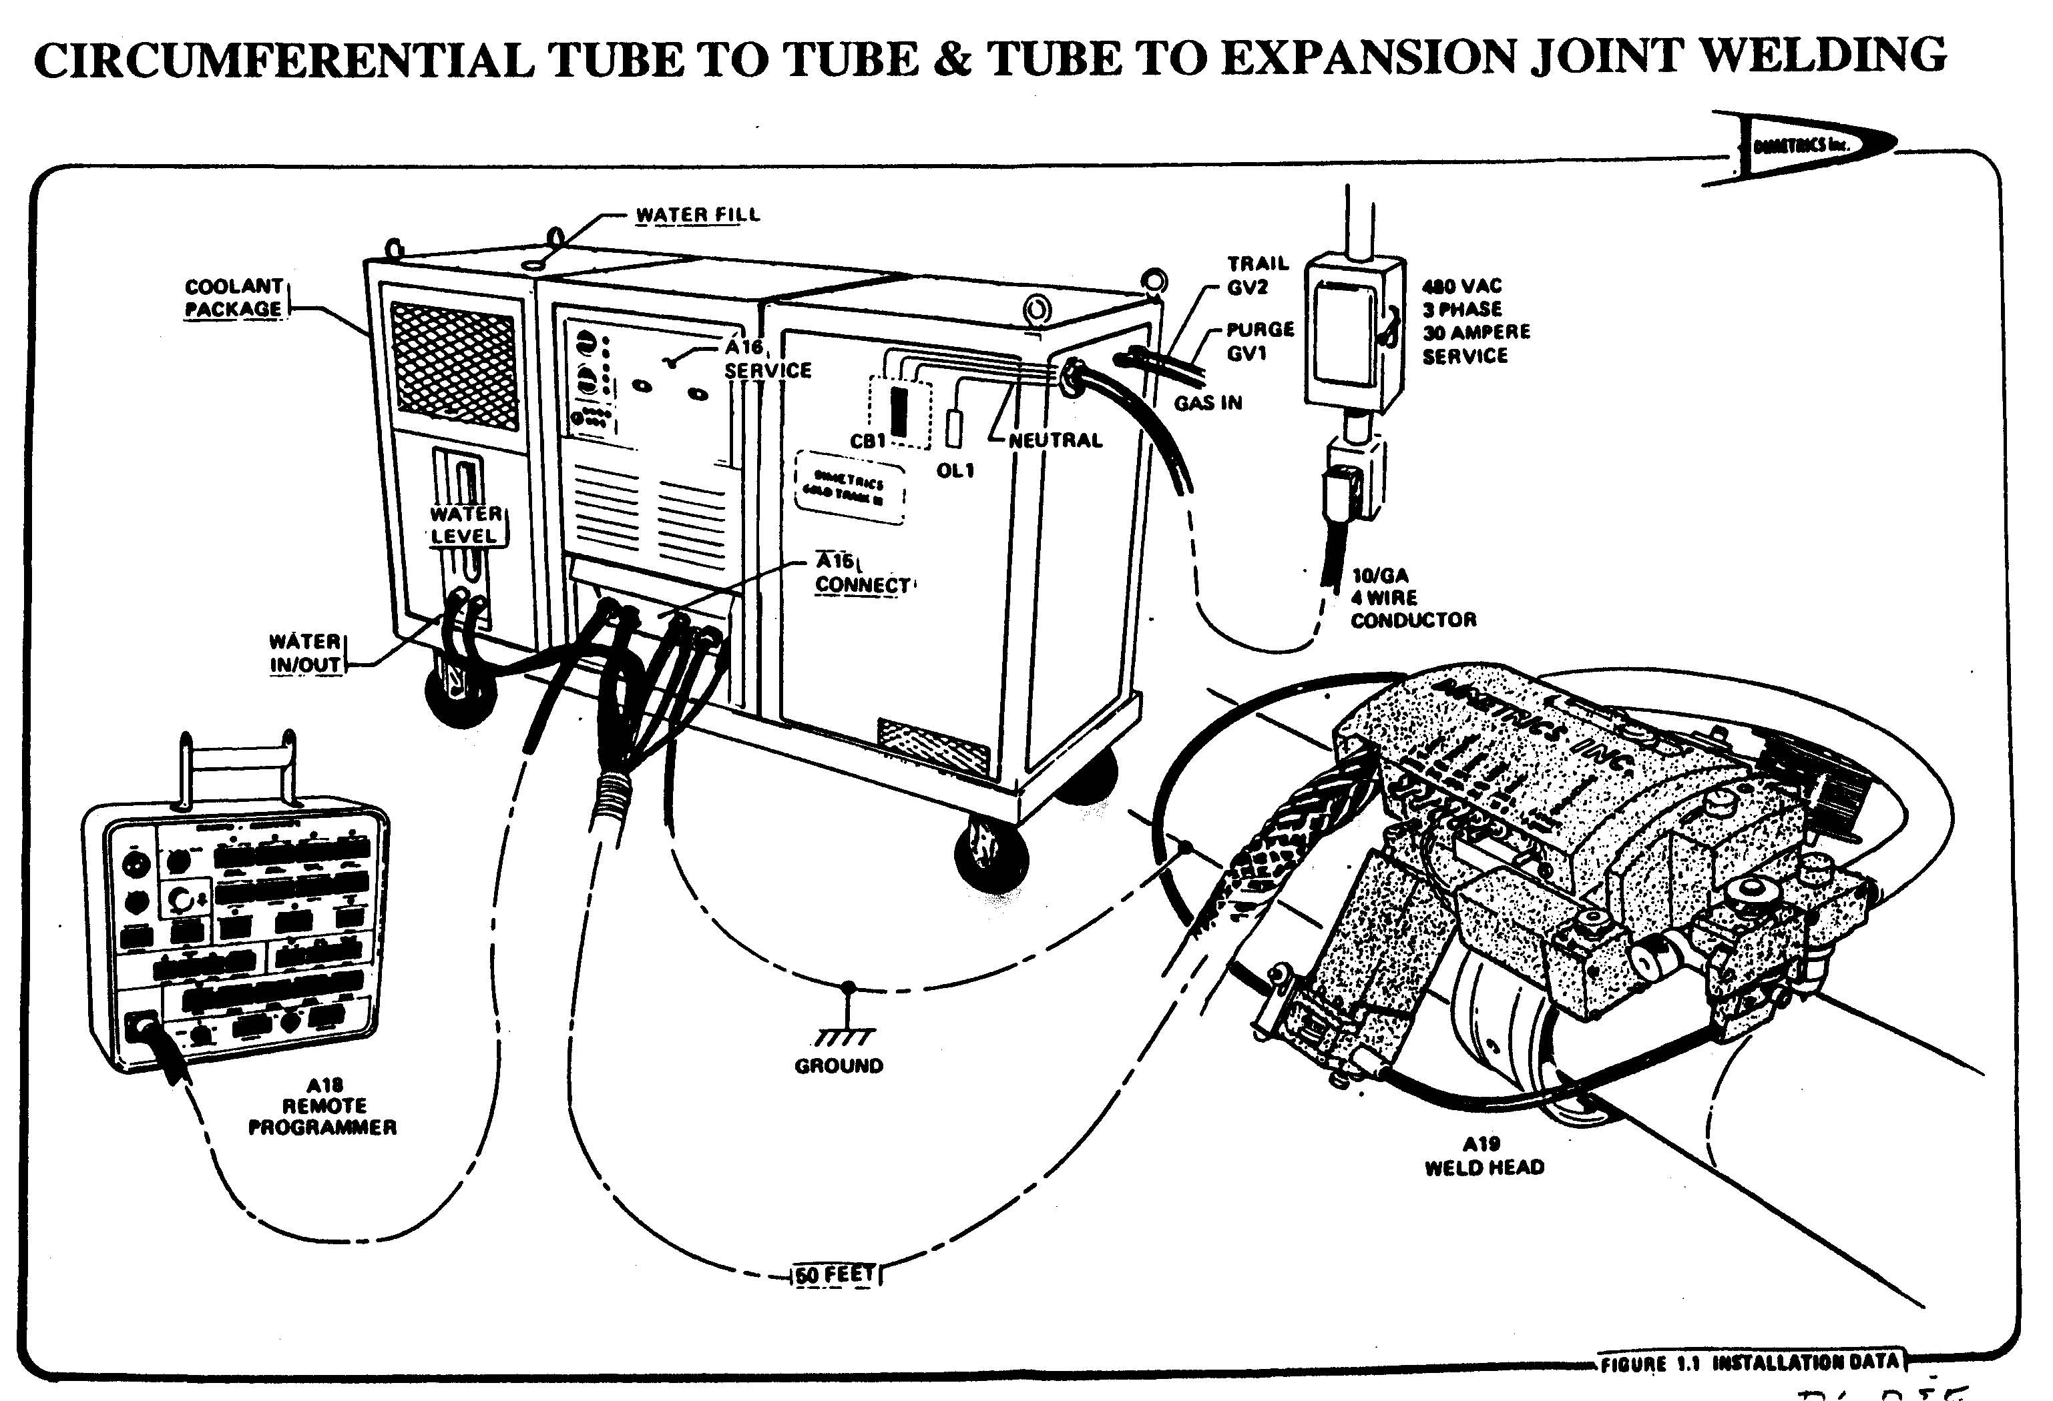

Slide 17
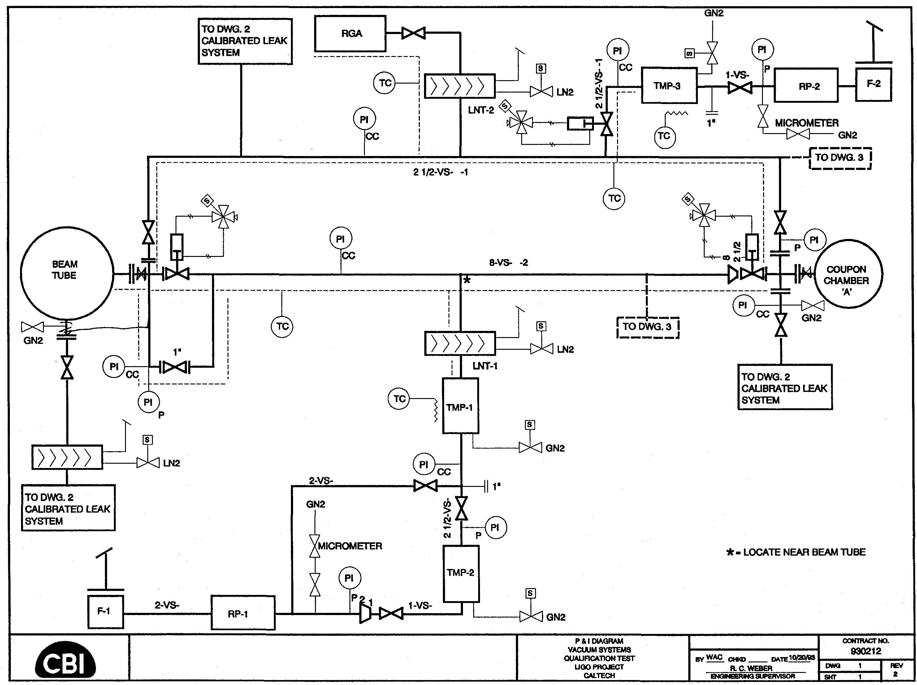

Slide 18
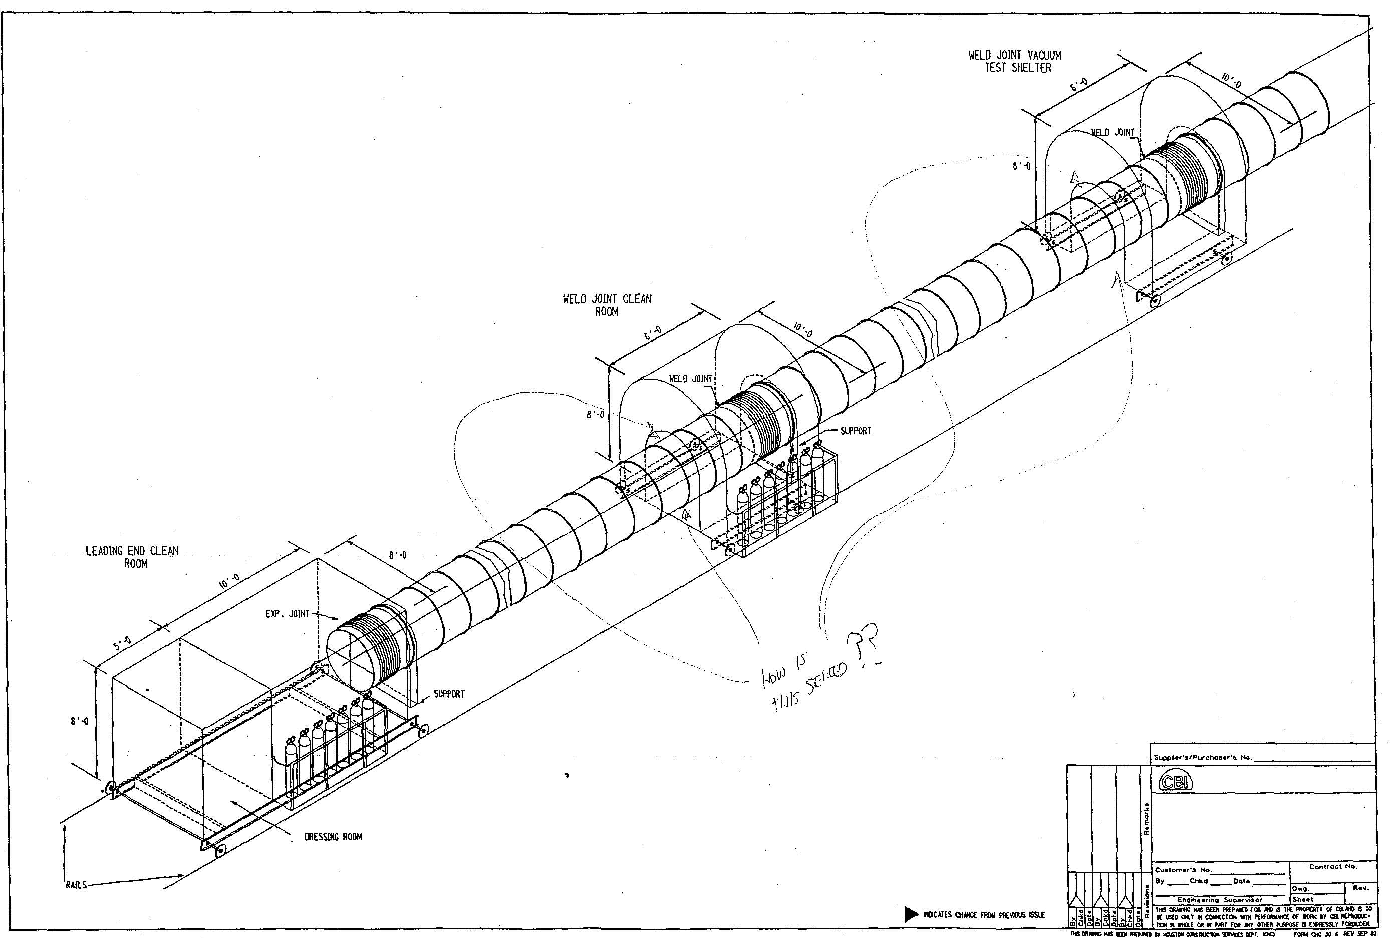

Slide 19
Preliminary Design Review, 11/30/93
Air signature test can measure 1E-9 scc/s before module bake, 1E-12 scc/s after the bake
CBI identified 3 suppliers of 304L HRAP SS in US
It may help the degas bake cycle to have a dry air atmosphere rather than an air purge
CBI identified cycle time of the coupon test as a potential problem on a critical path item
CBI should consider a design with fewer bellows
LIGO should reduce module leak rate requirement from 1E-10 scc/s to 1E-9 scc/s

Slide 20
Preliminary Design Review, 11/30/93 (cont’d.)
LIGO should allow BT module leak test to be performed after completion of module bake
CBI should check on possibility of using I²R bake heating on the QT
Both CBI and JPL determined through weld studies that filler metal should be used on BT
CBI & LIGO together should develop a strategy for overall module leak assay & location after bake

Slide 21
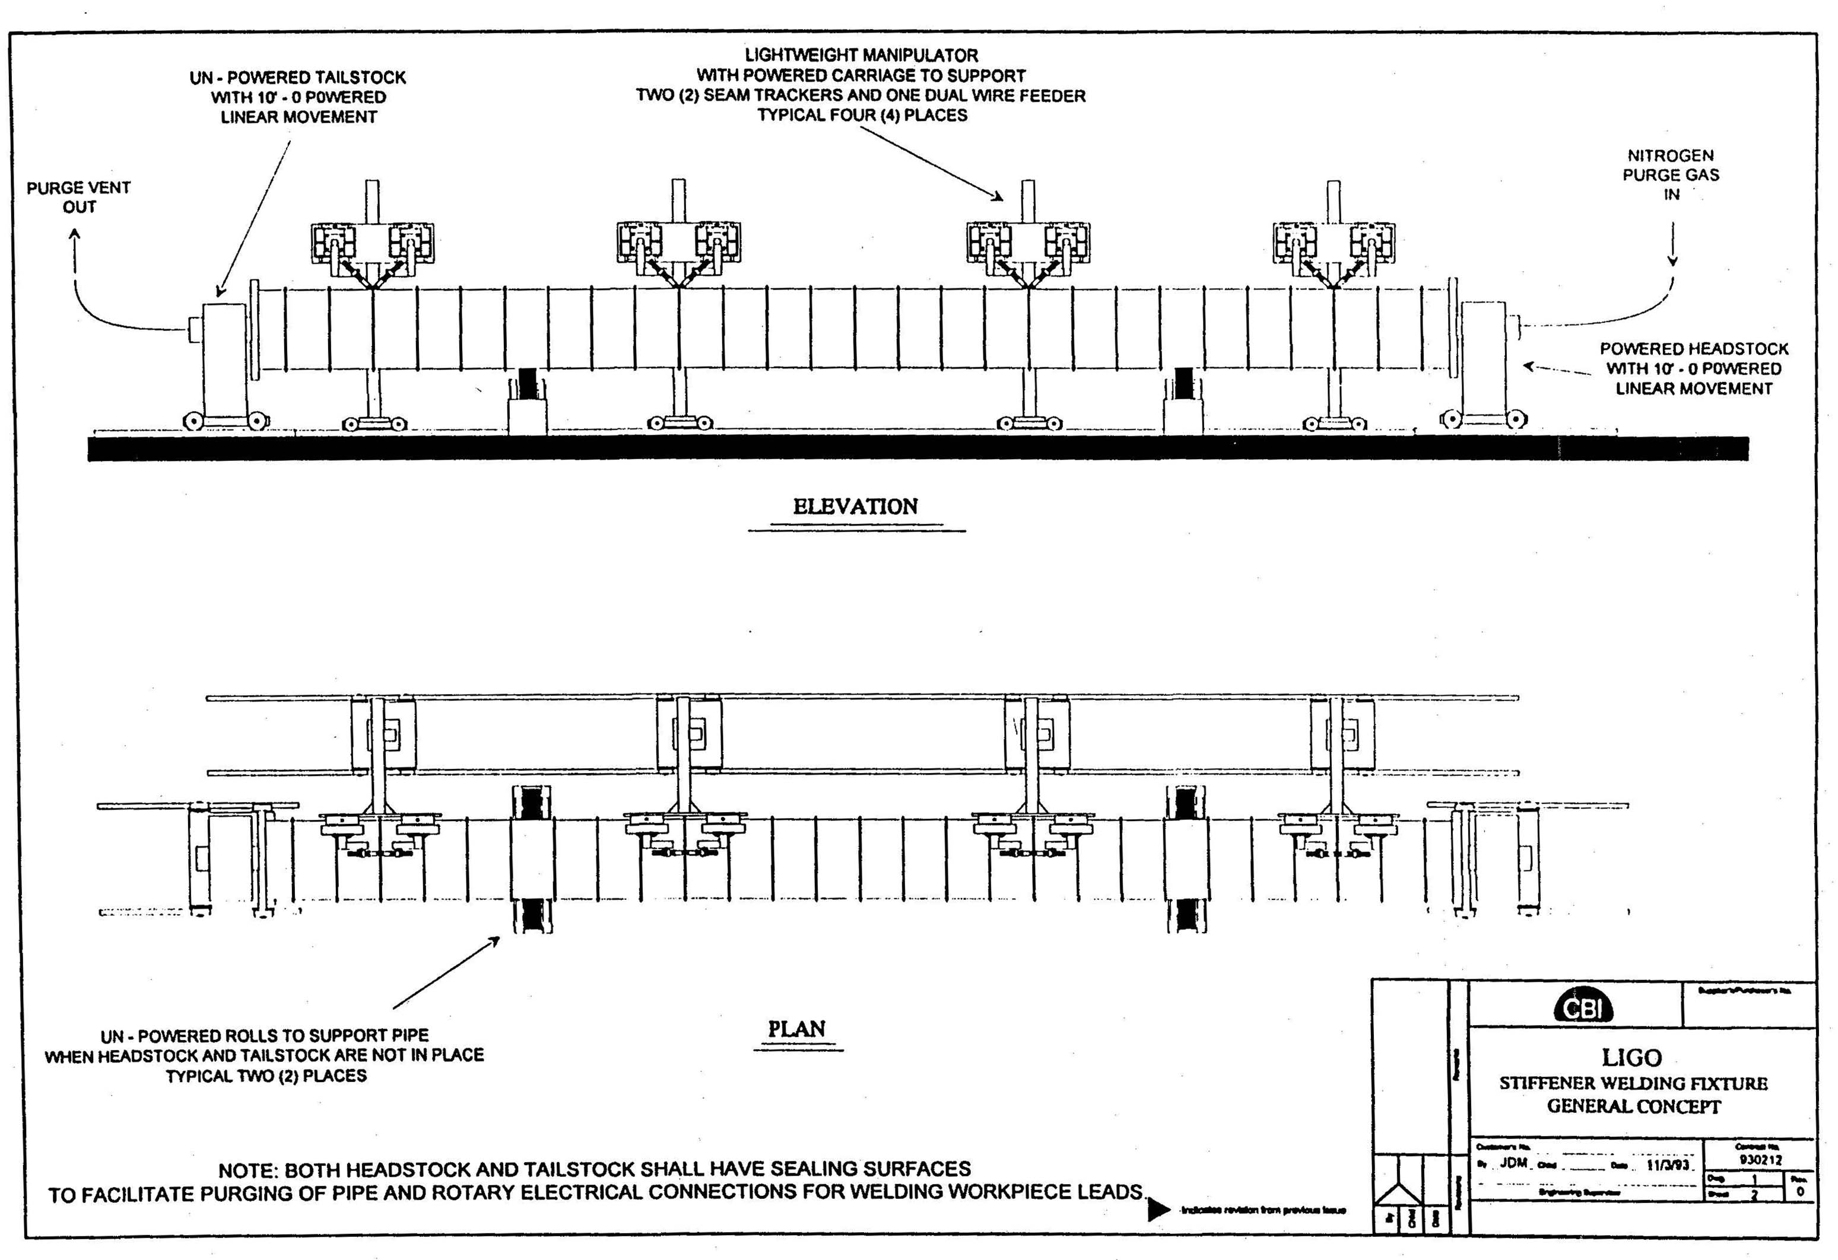

Slide 22
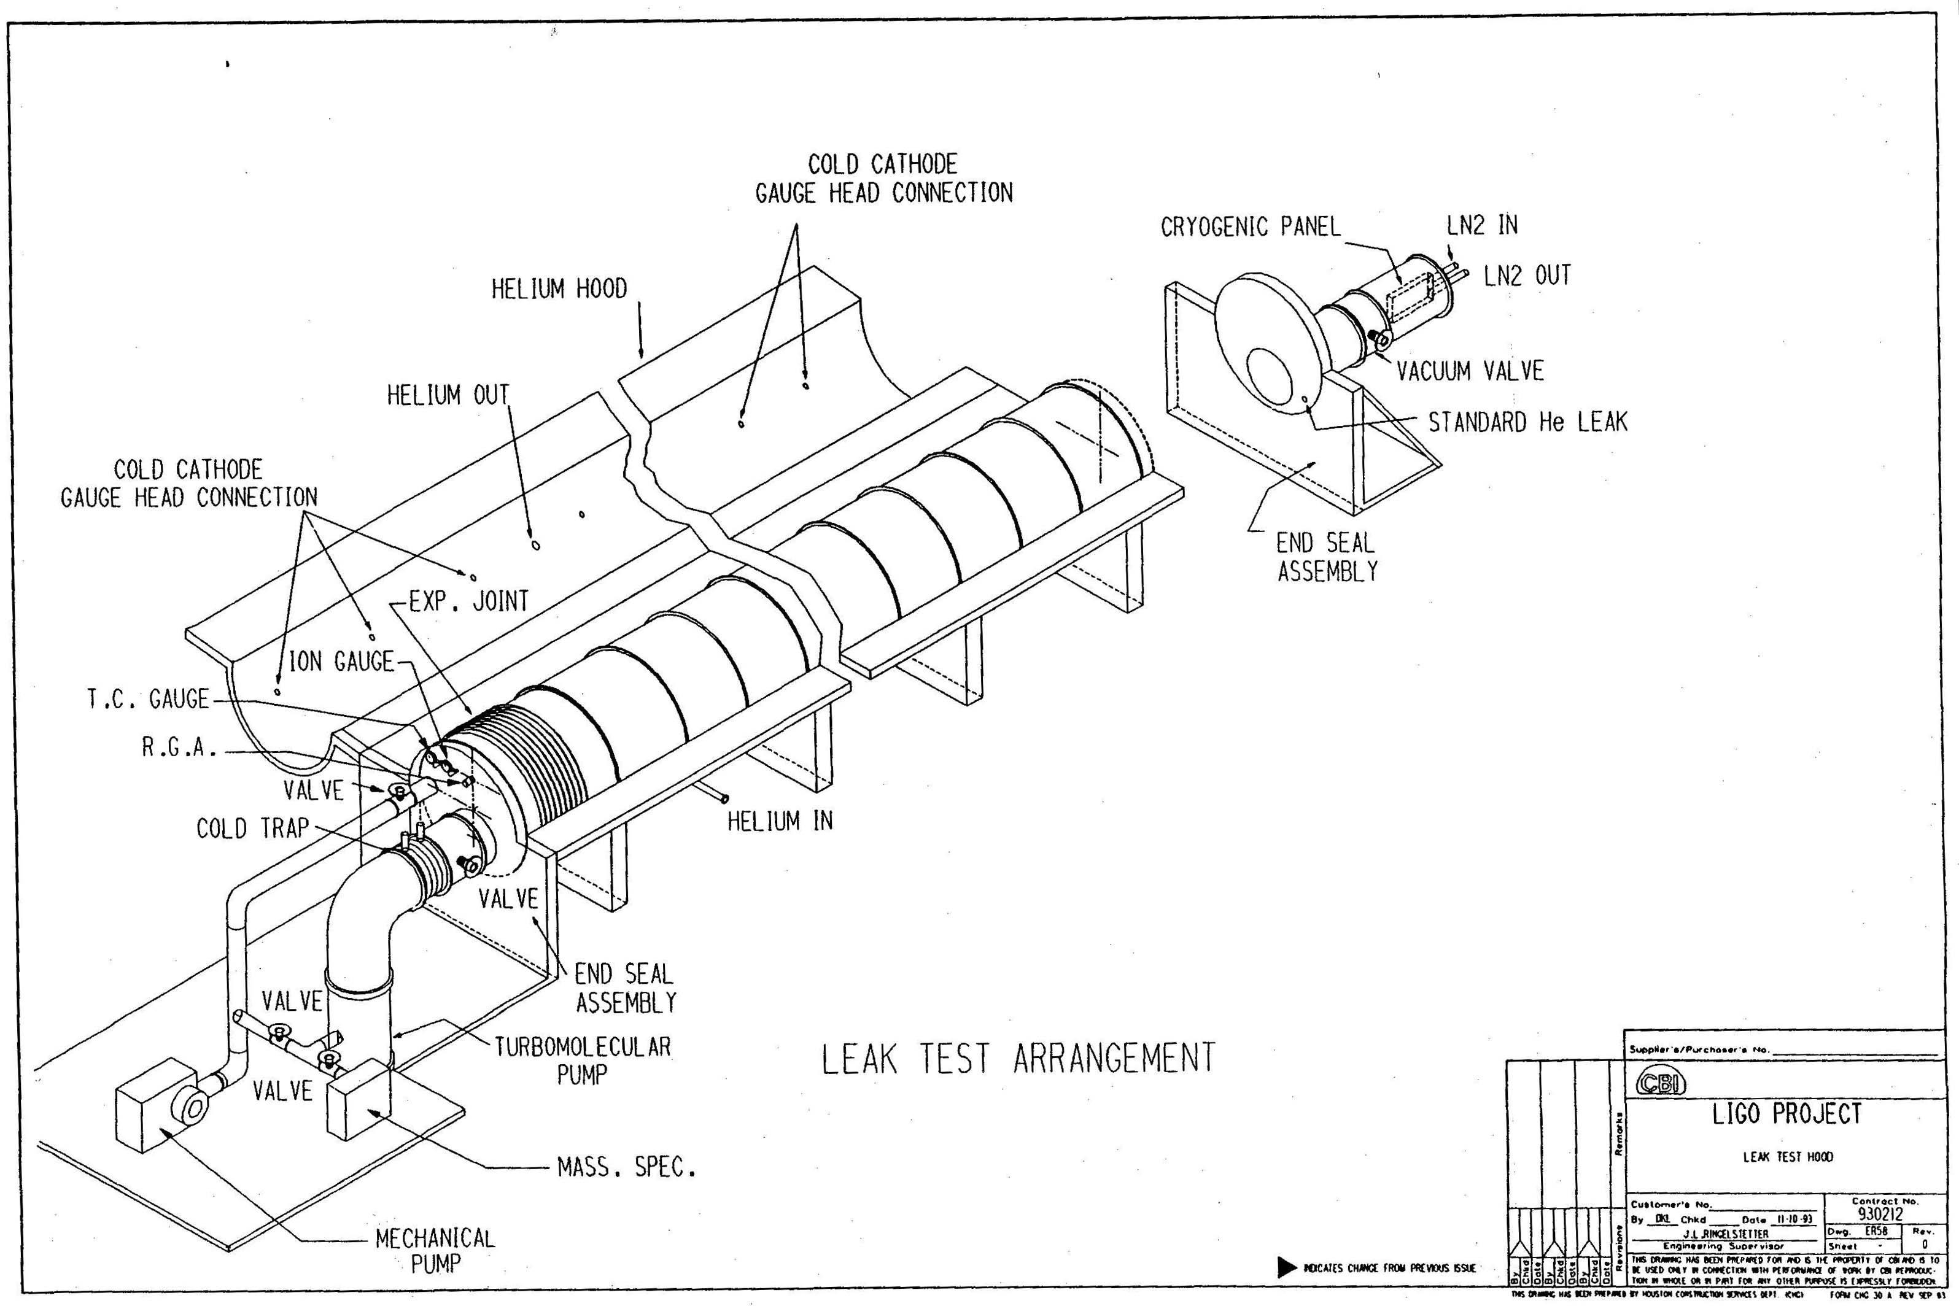

Slide 23
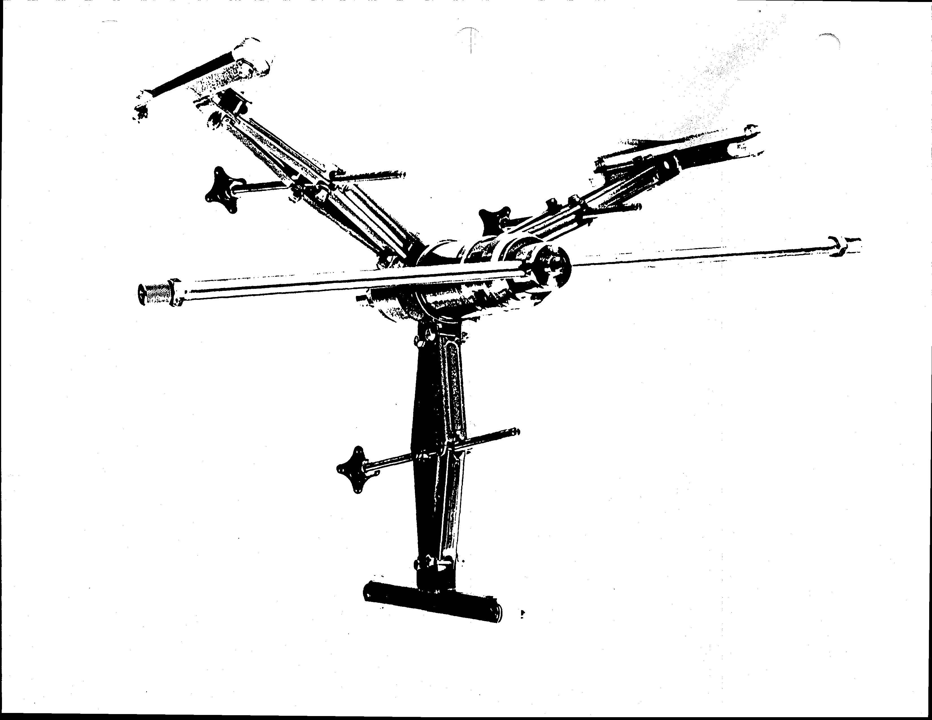

Slide 24
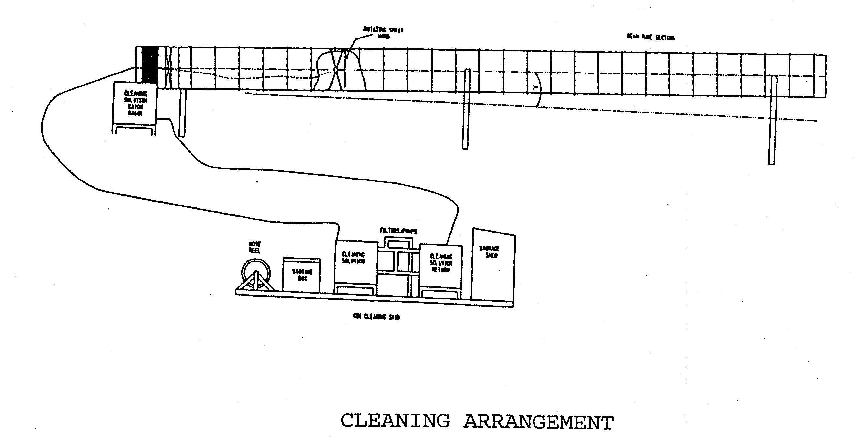

Slide 25
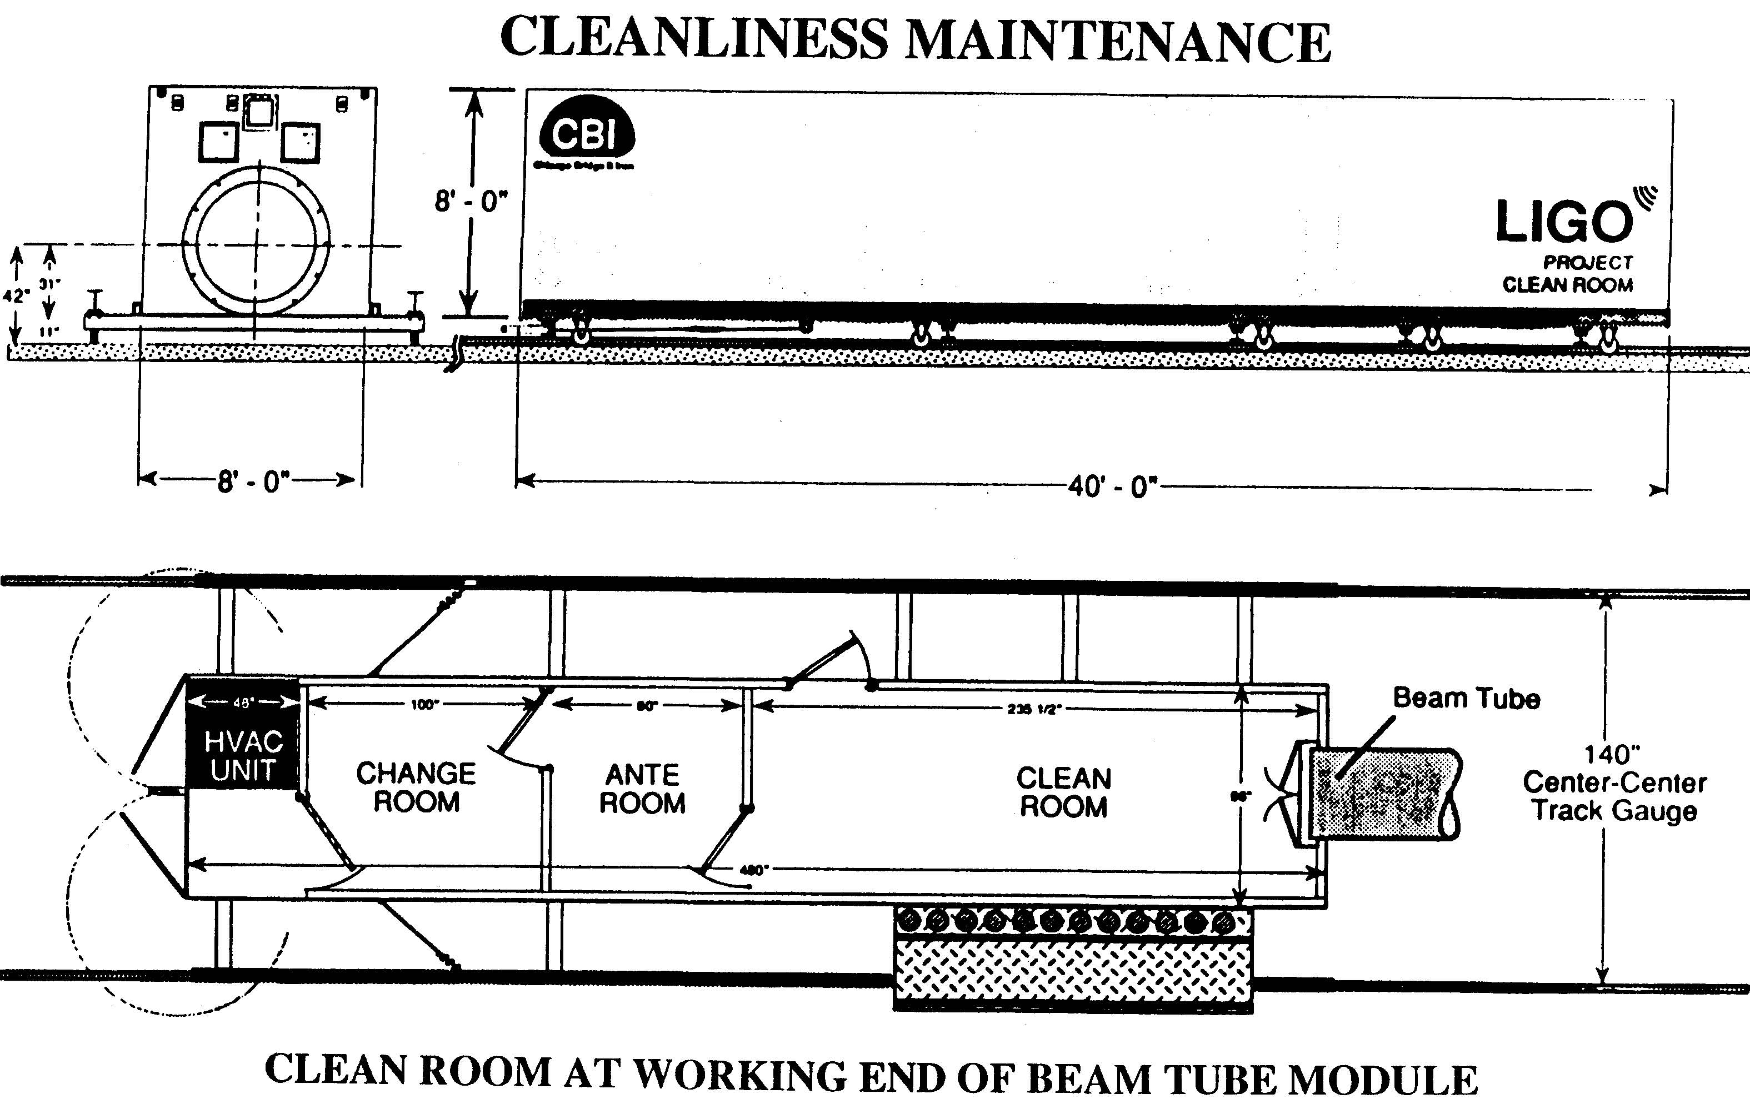

Slide 26
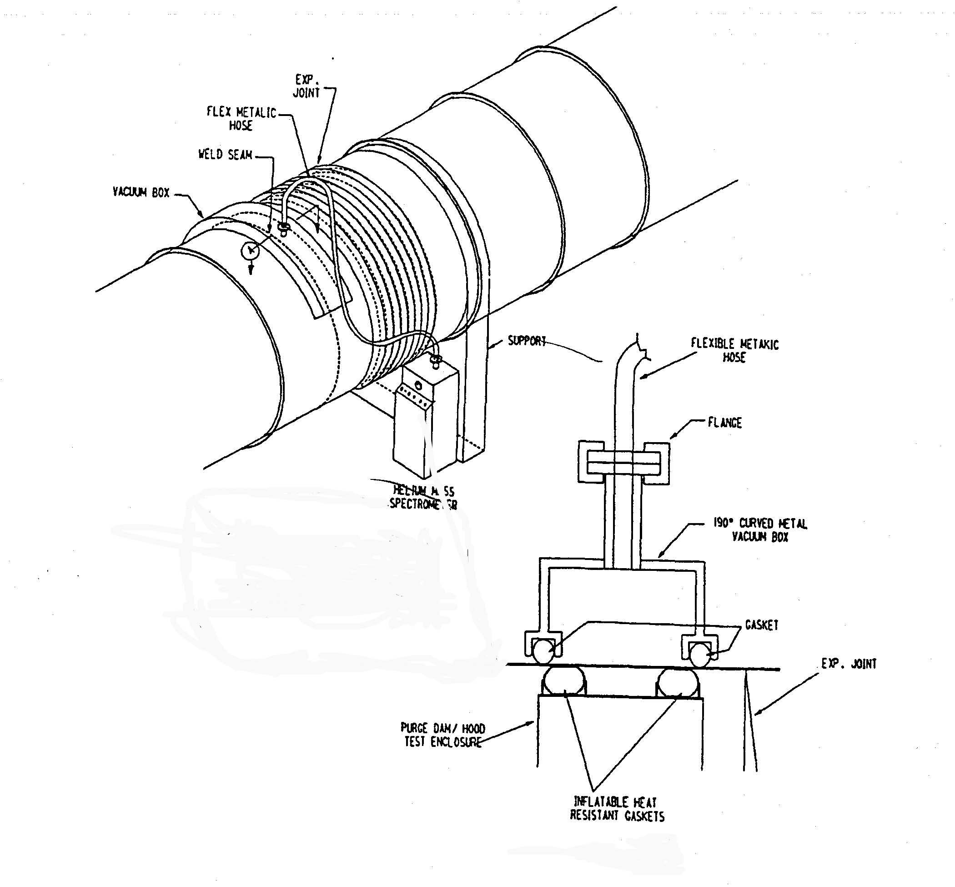

Slide 27
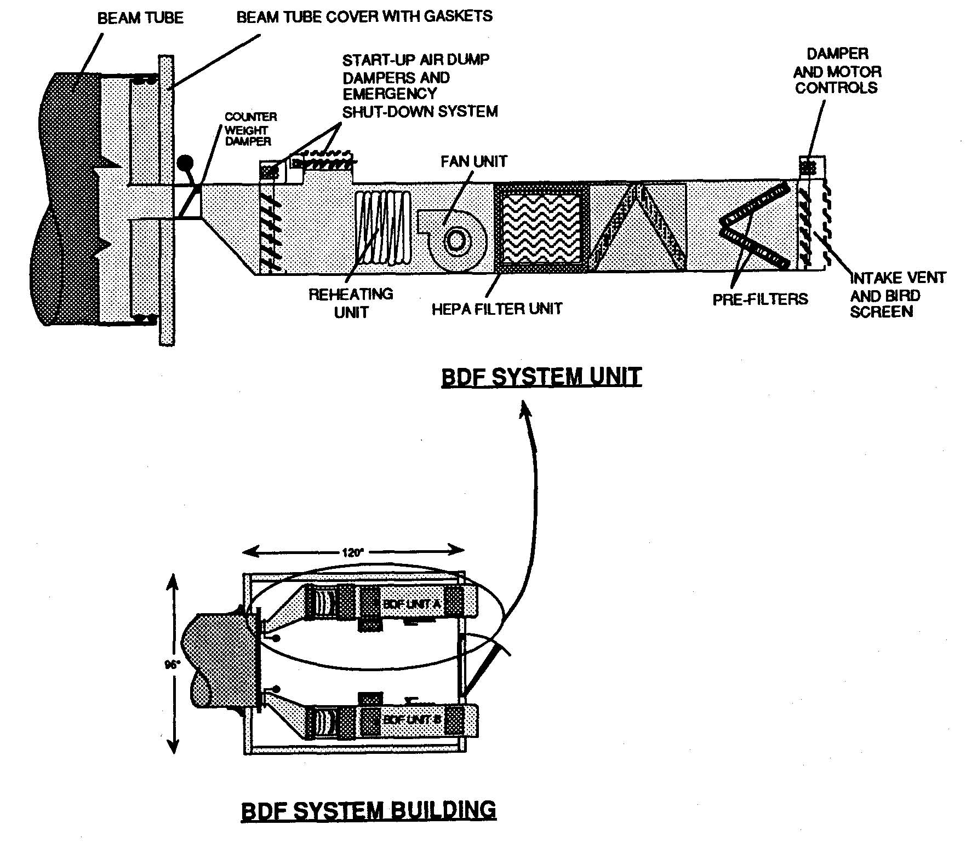

Slide 28
Monthly Progress Reviews, 12/9/93 thru 1/11/94
Spiral tube samples were received by CBI, with various poor weld examples
CBI recommends a GPS alignment technique
CBI requests that we test alternative cleaning techniques: steam, Mirachem, RBS 35, etc.
Bellows load is a function of temperature, but also of the temperature at the time of install
CBI considering alternate guided and fixed supports to reduce bellows quantity by 50%

Slide 29
Monthly Progress Reviews, 12/8/93 thru 1/11/94 (cont’d.)
CBI planning on designing BT wall to ASME requirements, then to alternative design rules
CBI did a cost trade study, fixing the best BT wall as 0.127” (+0.003”, -0.007”)
CBI is doing trade study in tolerances to maintain a clear aperture of 1.07m
CBI had good discussions on spiral mill vendors and SS material suppliers
CBI is again considering full thickness bellows

Slide 30
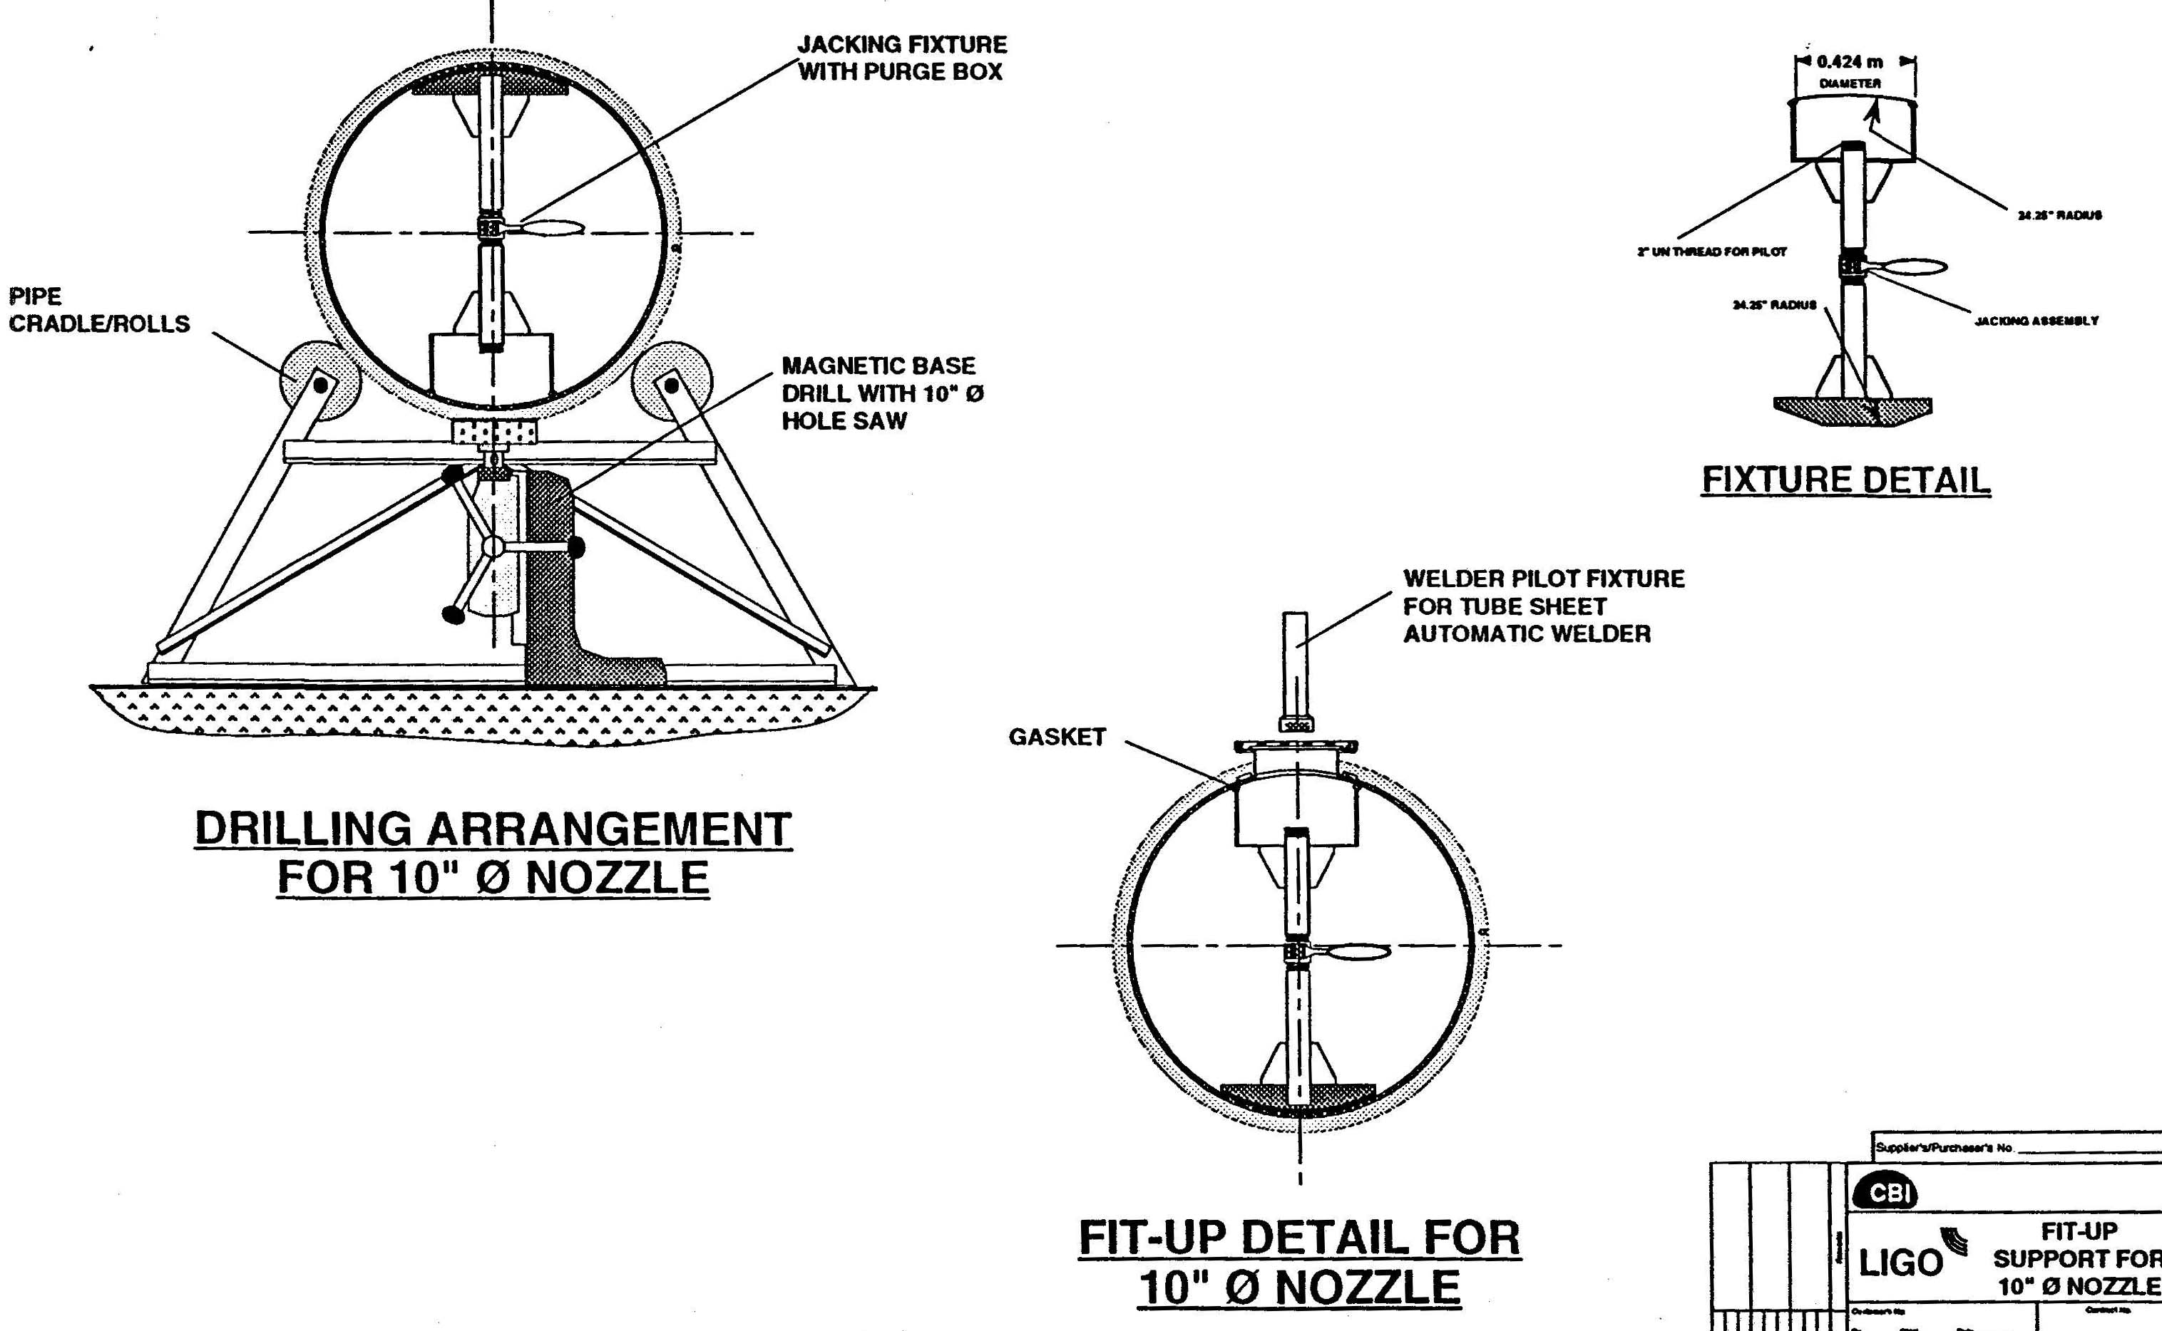

Slide 31
Monthly Progress Review, 2/9/94
Design of stiffeners reduced cost by $2M
CBI decided on alternating guided and fixed supports, with bellows at each guided support
Reduction in number of bellows saved $1M
Support cost has greatly increased; LIGO requested a value engineering task to reduce
Cleaning, baking & cleaning weld would increase wire cost 60X; LIGO will check H2 outgassing of standard wire

Slide 32
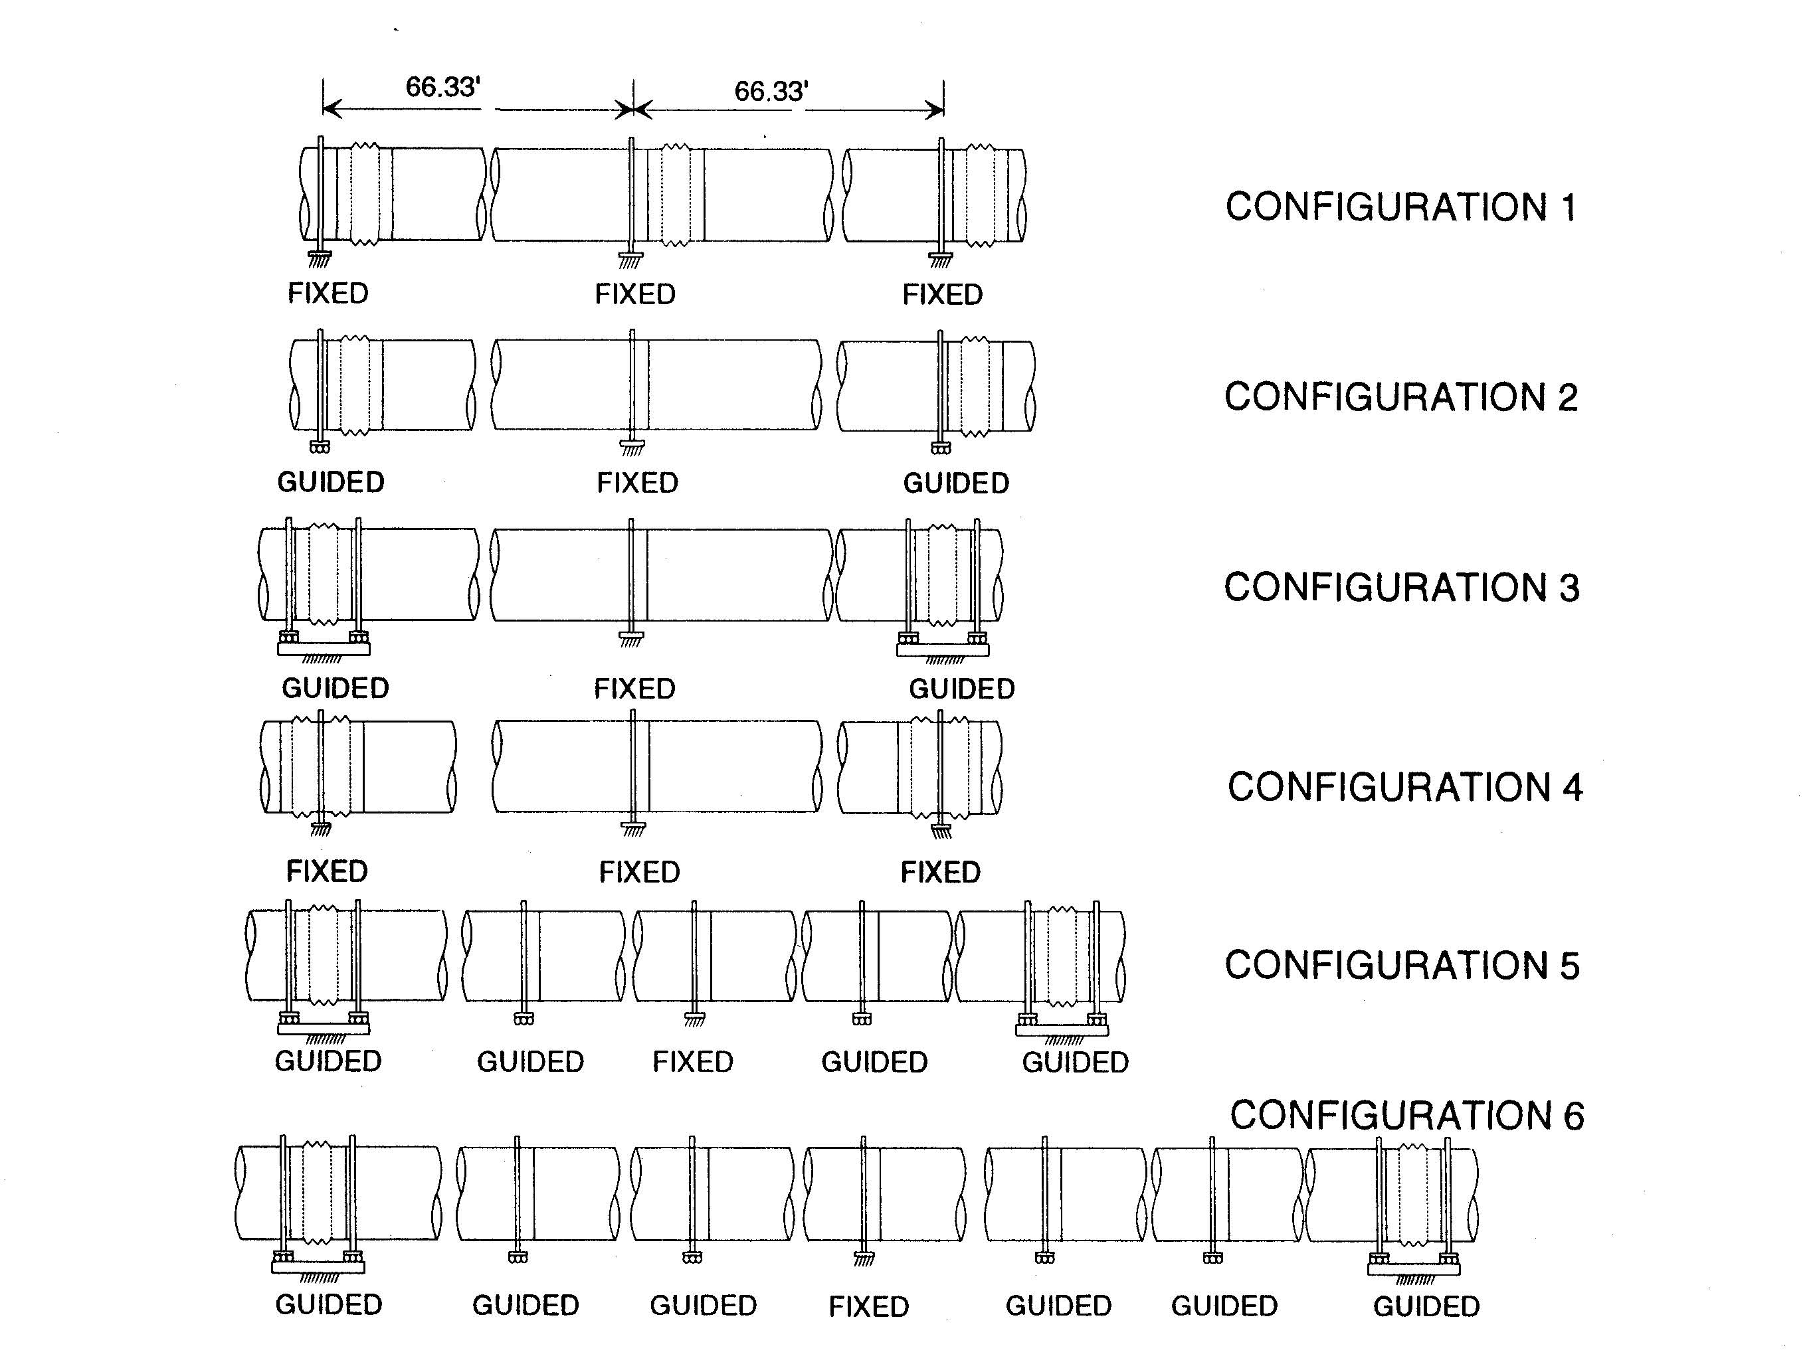

Slide 35
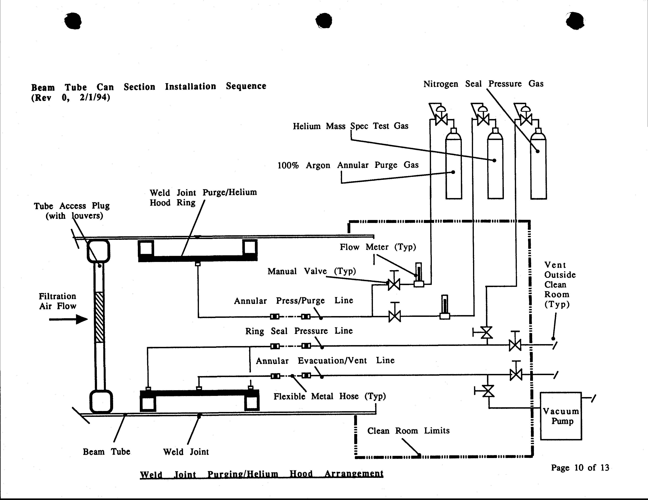

Slide 36
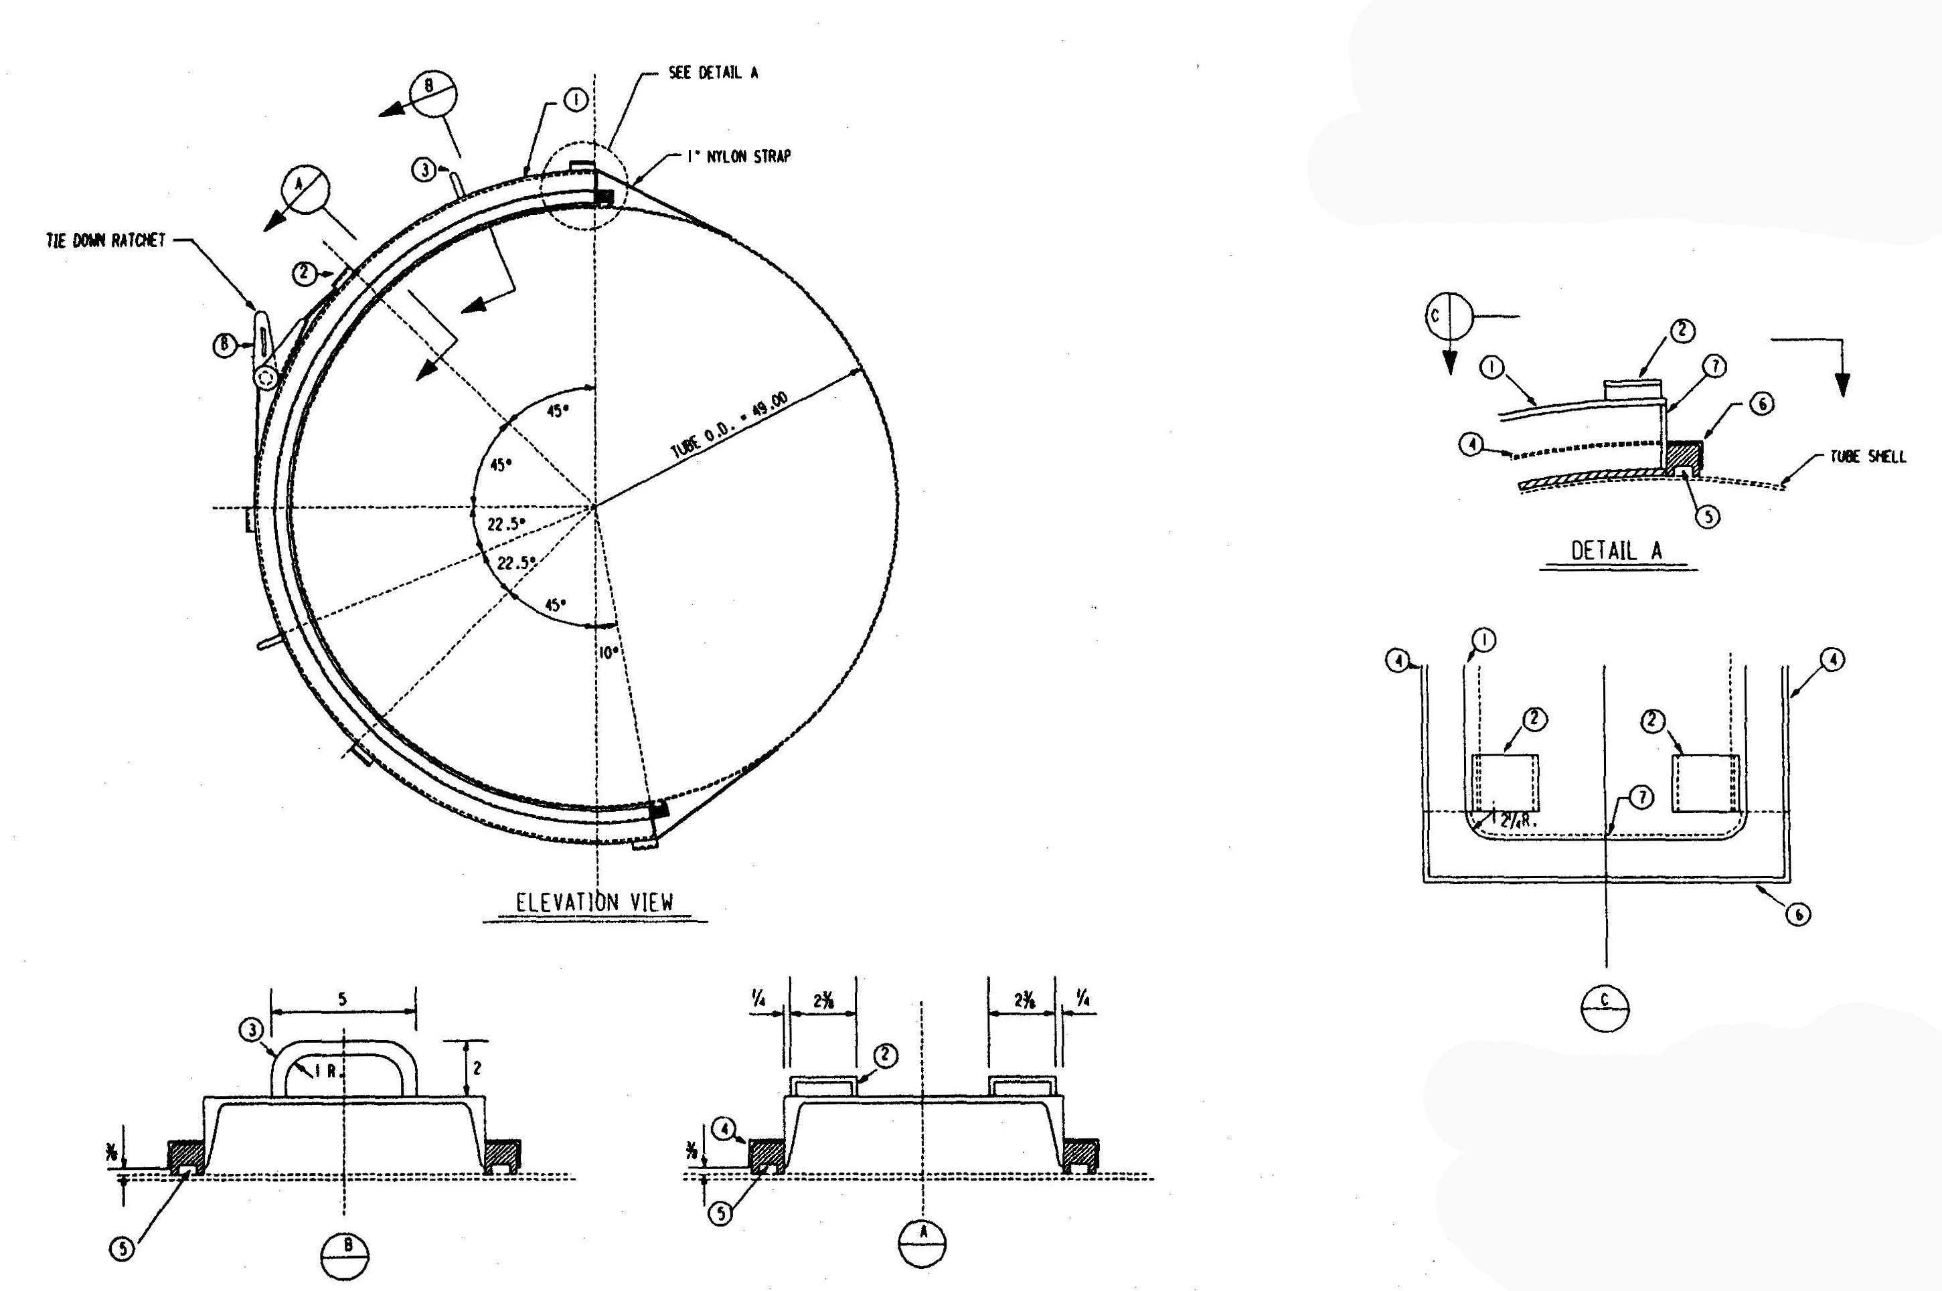

Slide 37
Monthly Progress Review, 3/17/94
Redesigned supports should cost 30-40% less and meet 10C temperature differential limit
We need to specify slab settlement limits between fixed supports, for BT design safety factor:
During bake, 1.5 cm: ASME SF, 2.00; API-2U, SF 1.55
Normal opn., 1.5 cm: ASME SF, 2.72; API-2U, SF 1.99
2.5 cm: ASME SF, 2.00; API-2U, SF 1.77

Slide 38
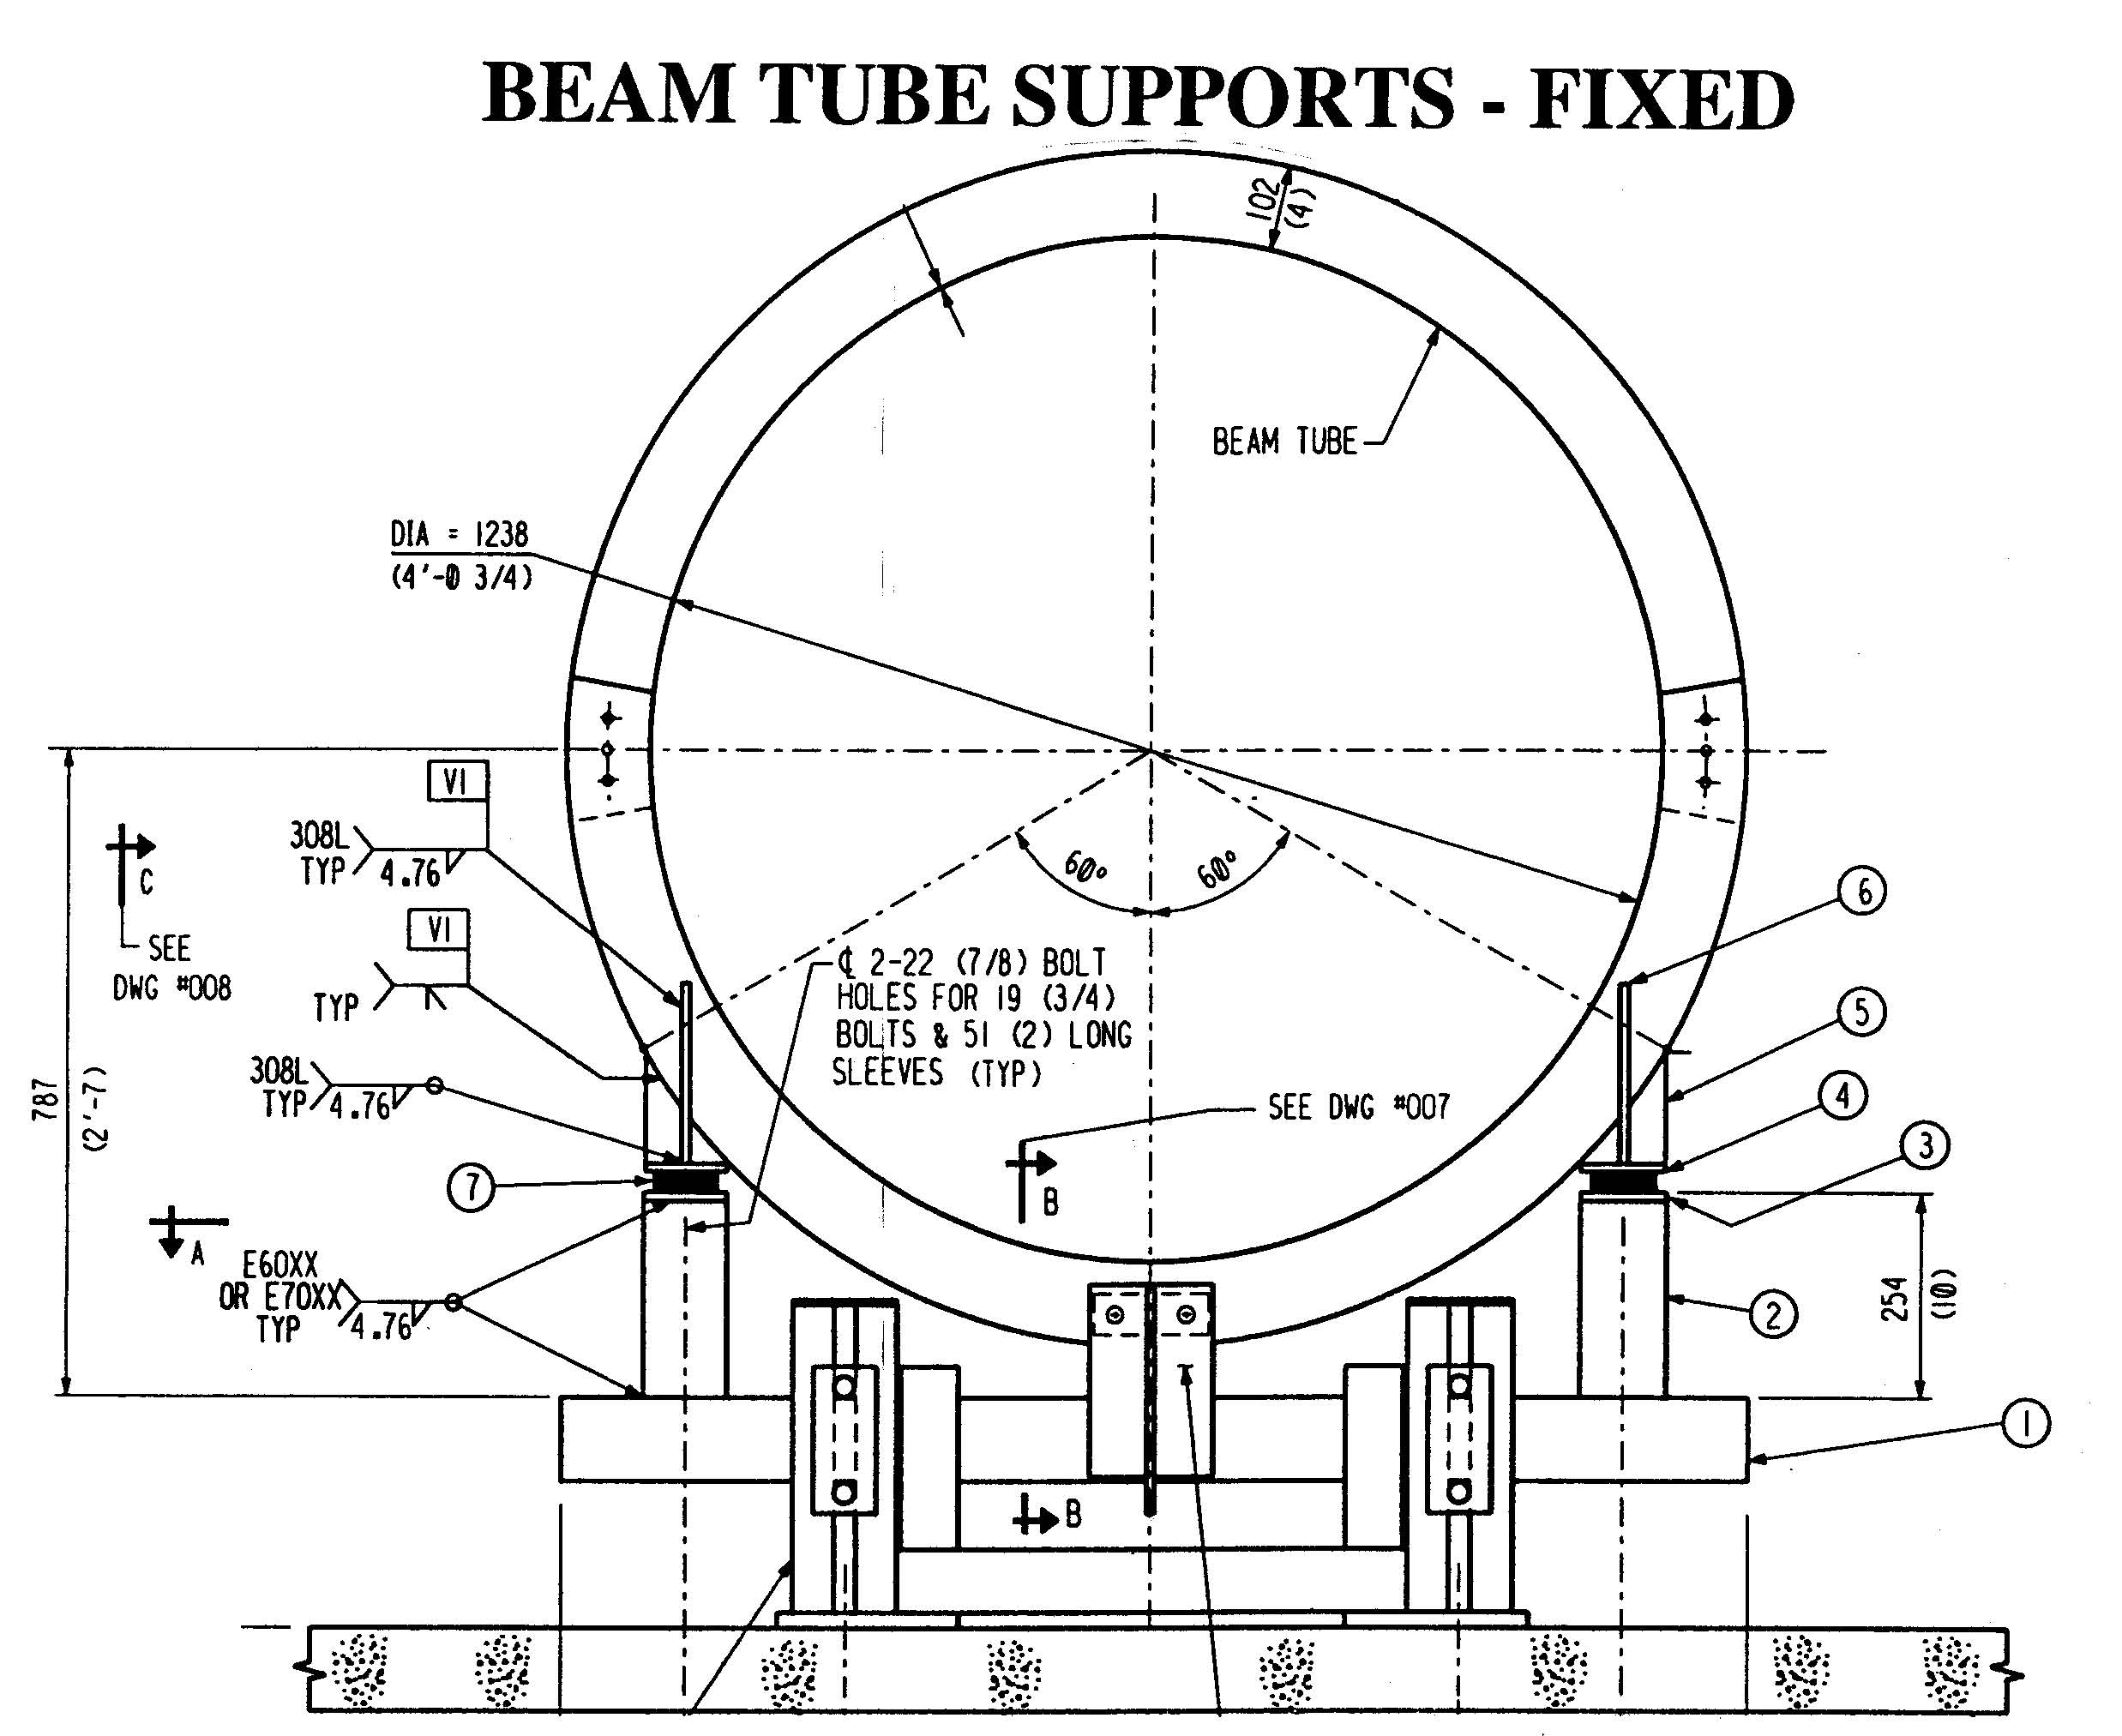

Slide 39
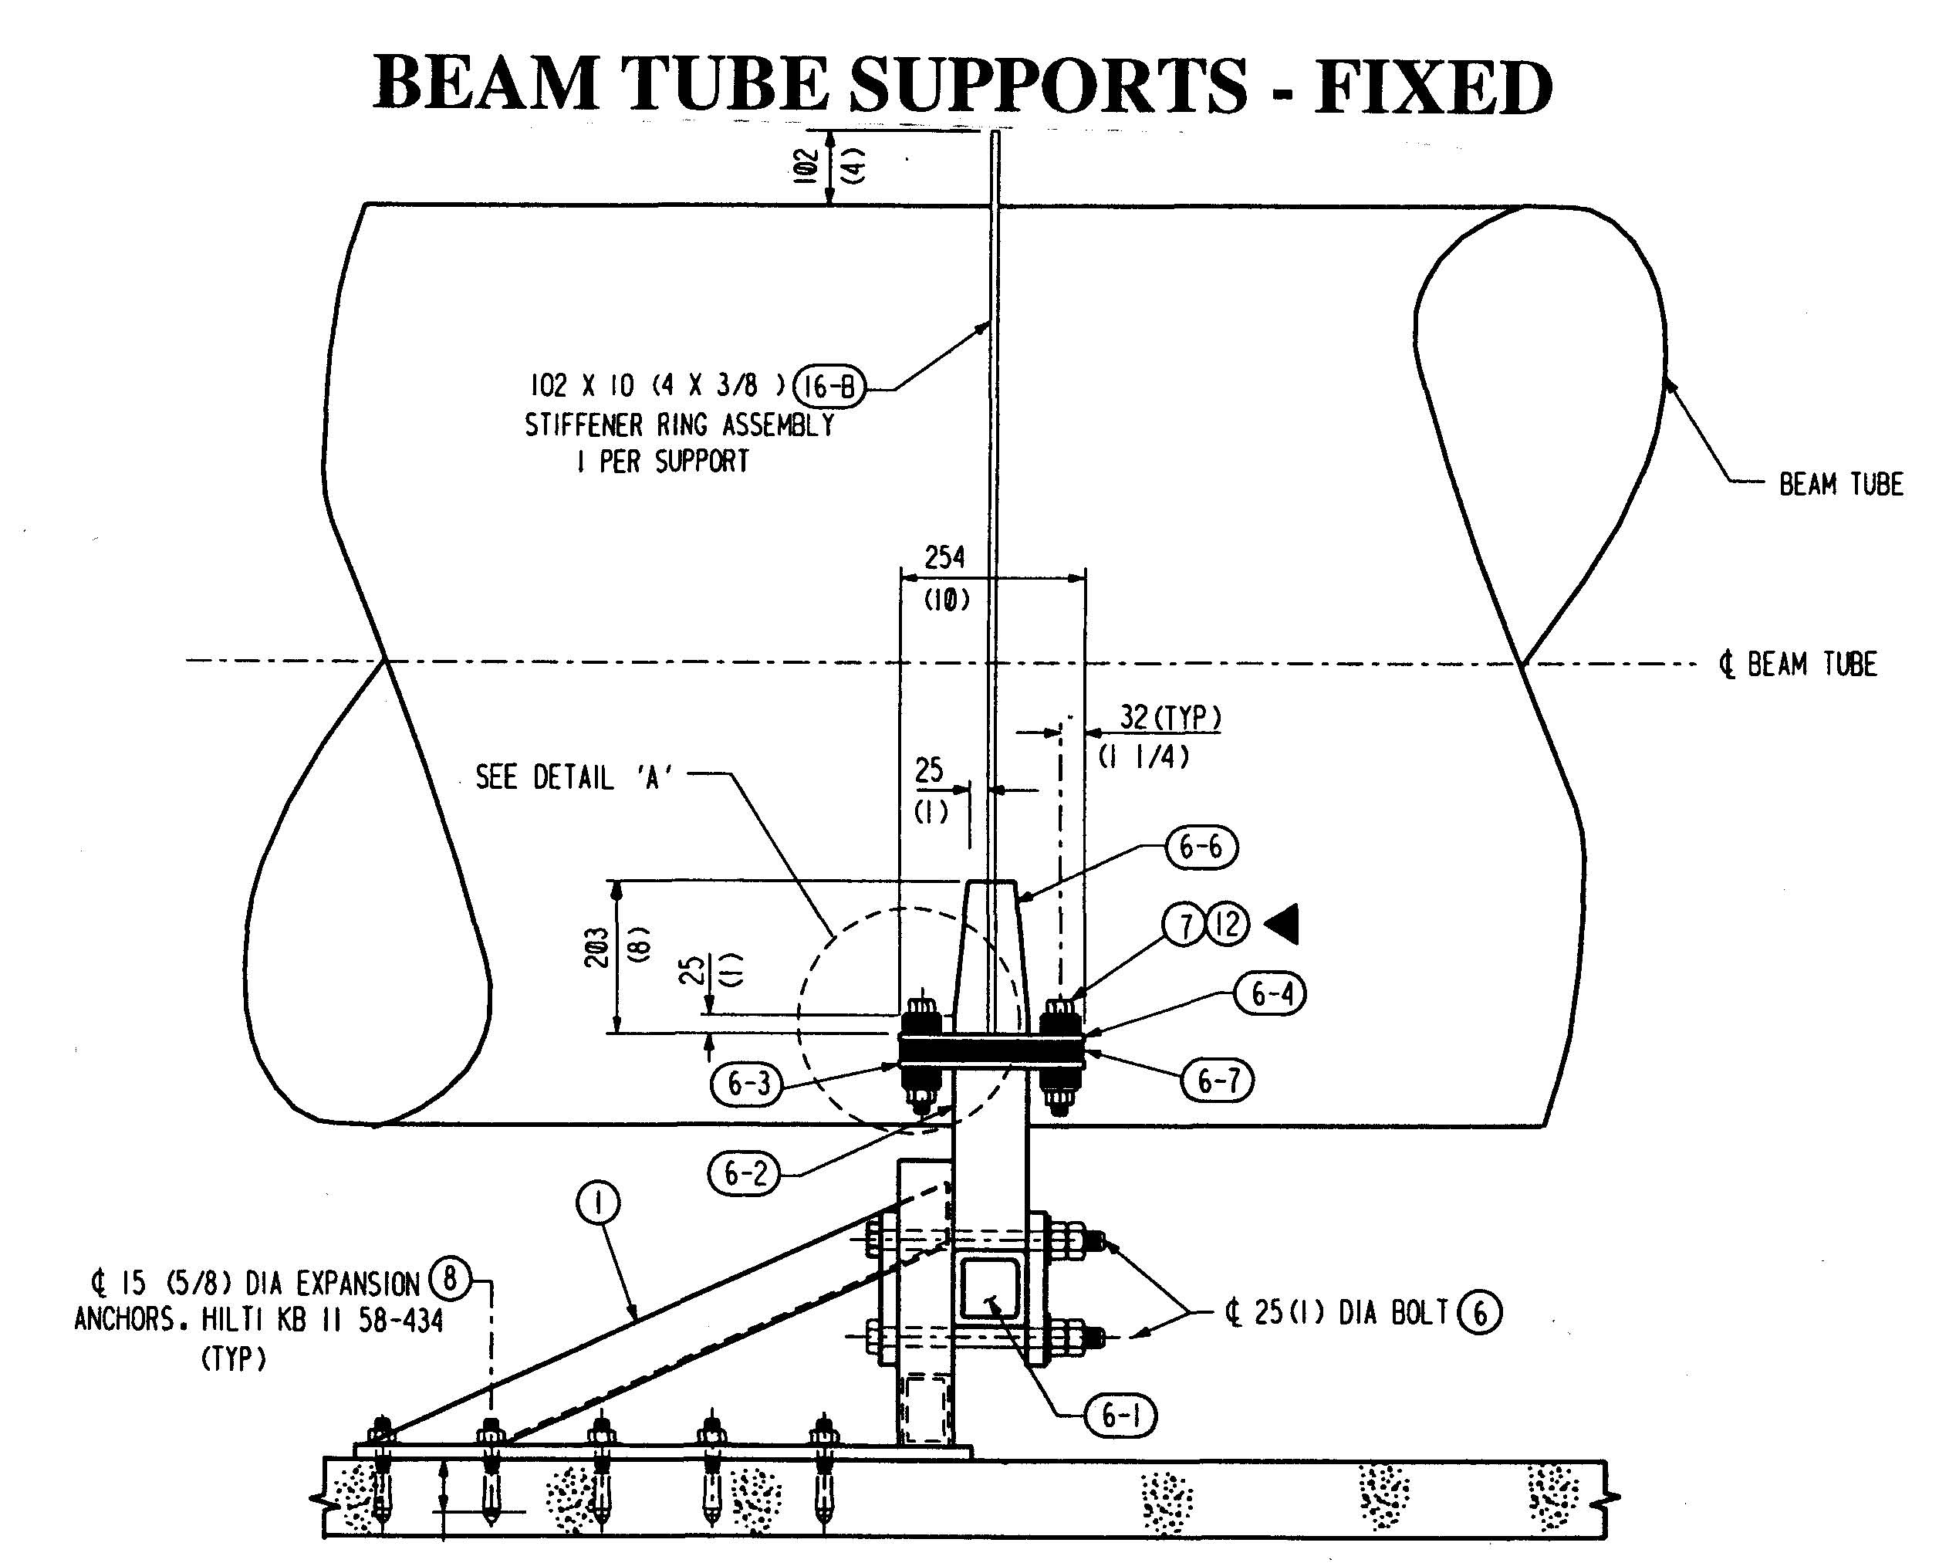

Slide 40
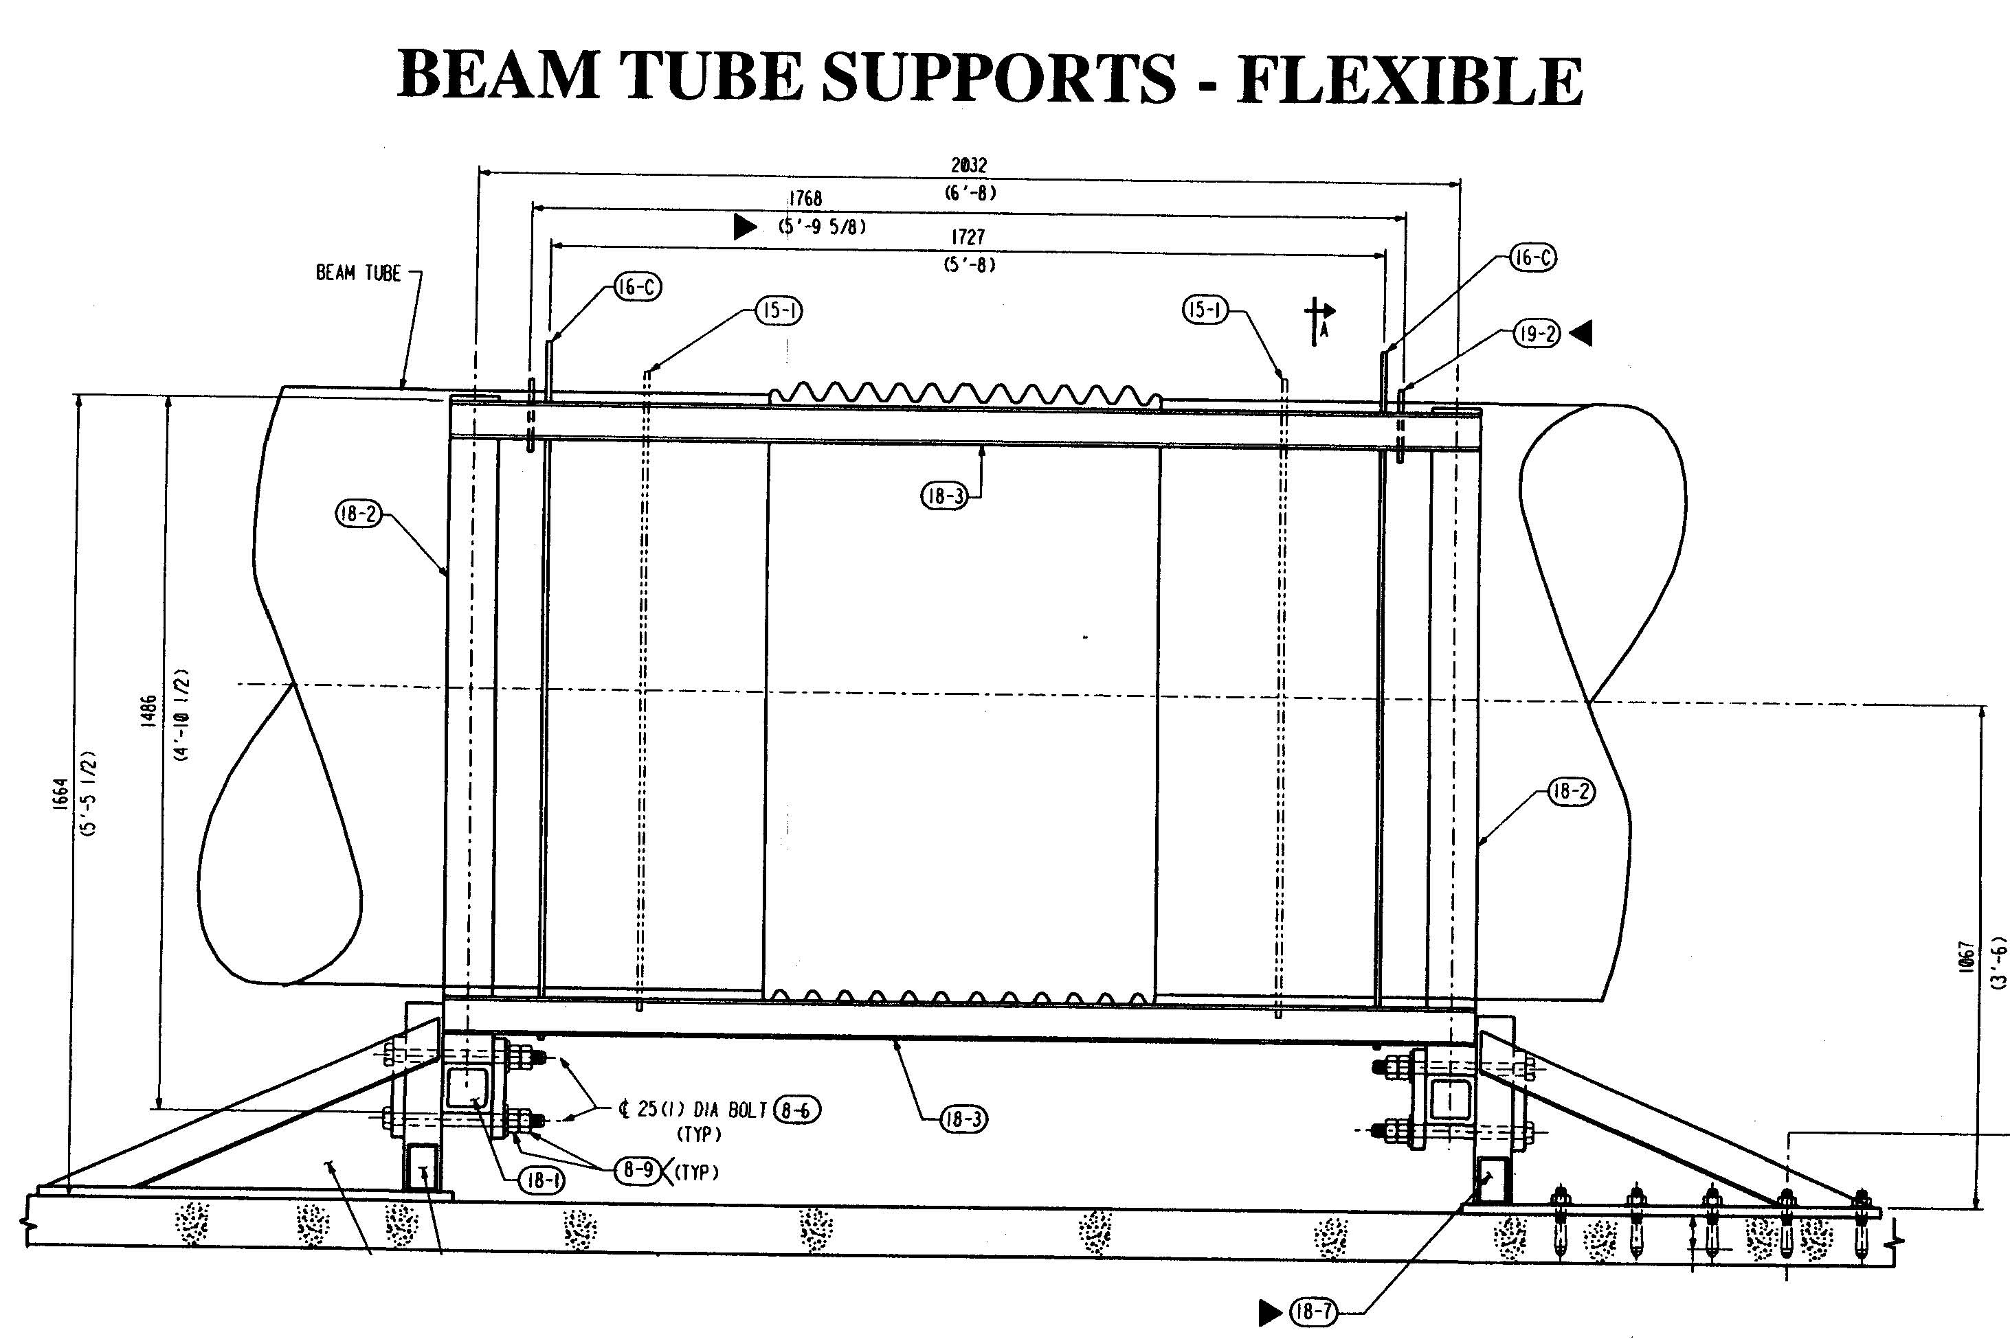

Slide 41
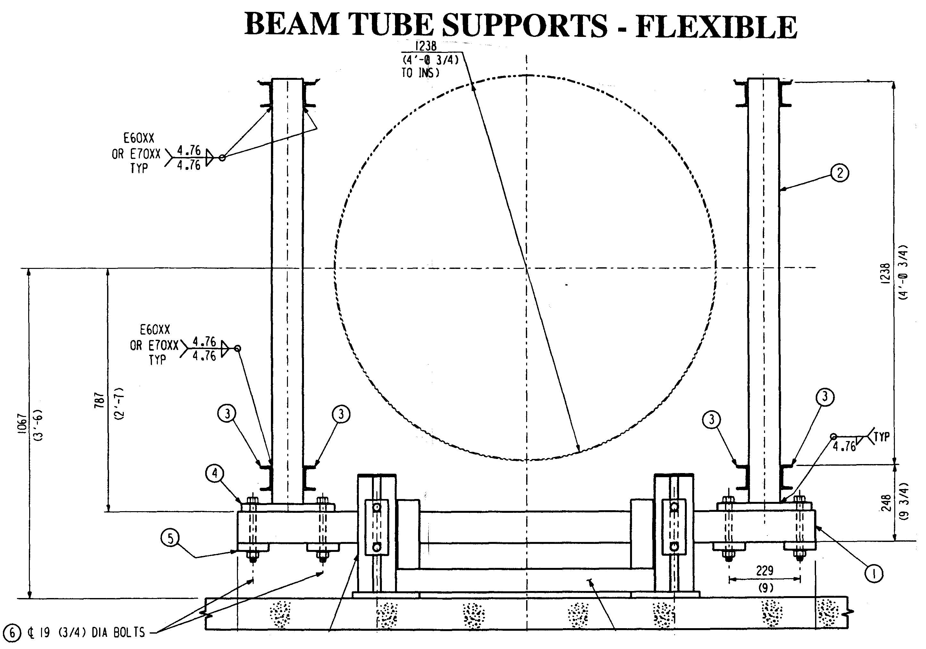

Slide 42
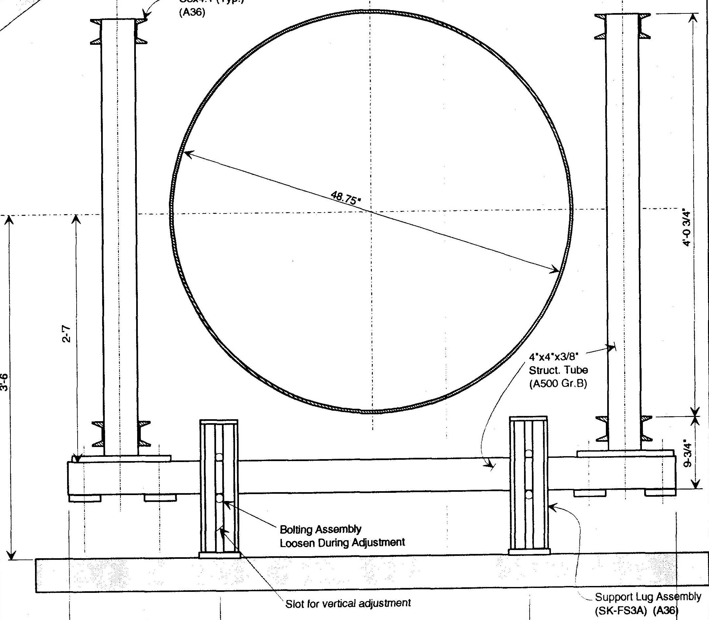

Slide 43
Final Design Review, 4/26/94
CBI will develop a plan to monitor spiral seam penetration (20% overlap minimum)
CBI will make a traceability plan, with serialization of components
Tolerance stackup for clear aperture calculation should use sum of elements, rather than rms
BT section end flatness needs to be 0.005” in order to control weld gap to < 0.010”

Slide 44
Final Design Review 4/26/94, (cont’d.)
QT plan differences from Option plans:
Bellows material fatigue is not demonstrated
Support loadings are higher, supports different
Field Clean Room & Weld Enclosure not used
“Coffin” BT Section leak test fixture not used
BT Section cleaning process has minor mods
BT Module bake details have minor mods
GPS will not be used for alignment
Clear Aperture will not be verified by test

Slide 45
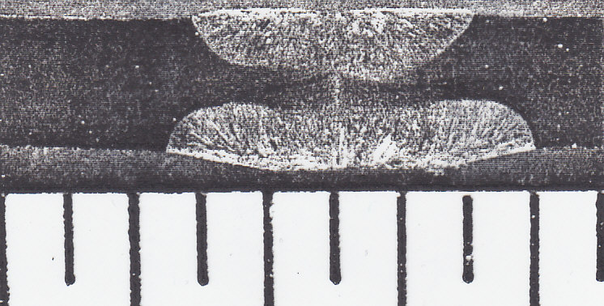

Slide 46
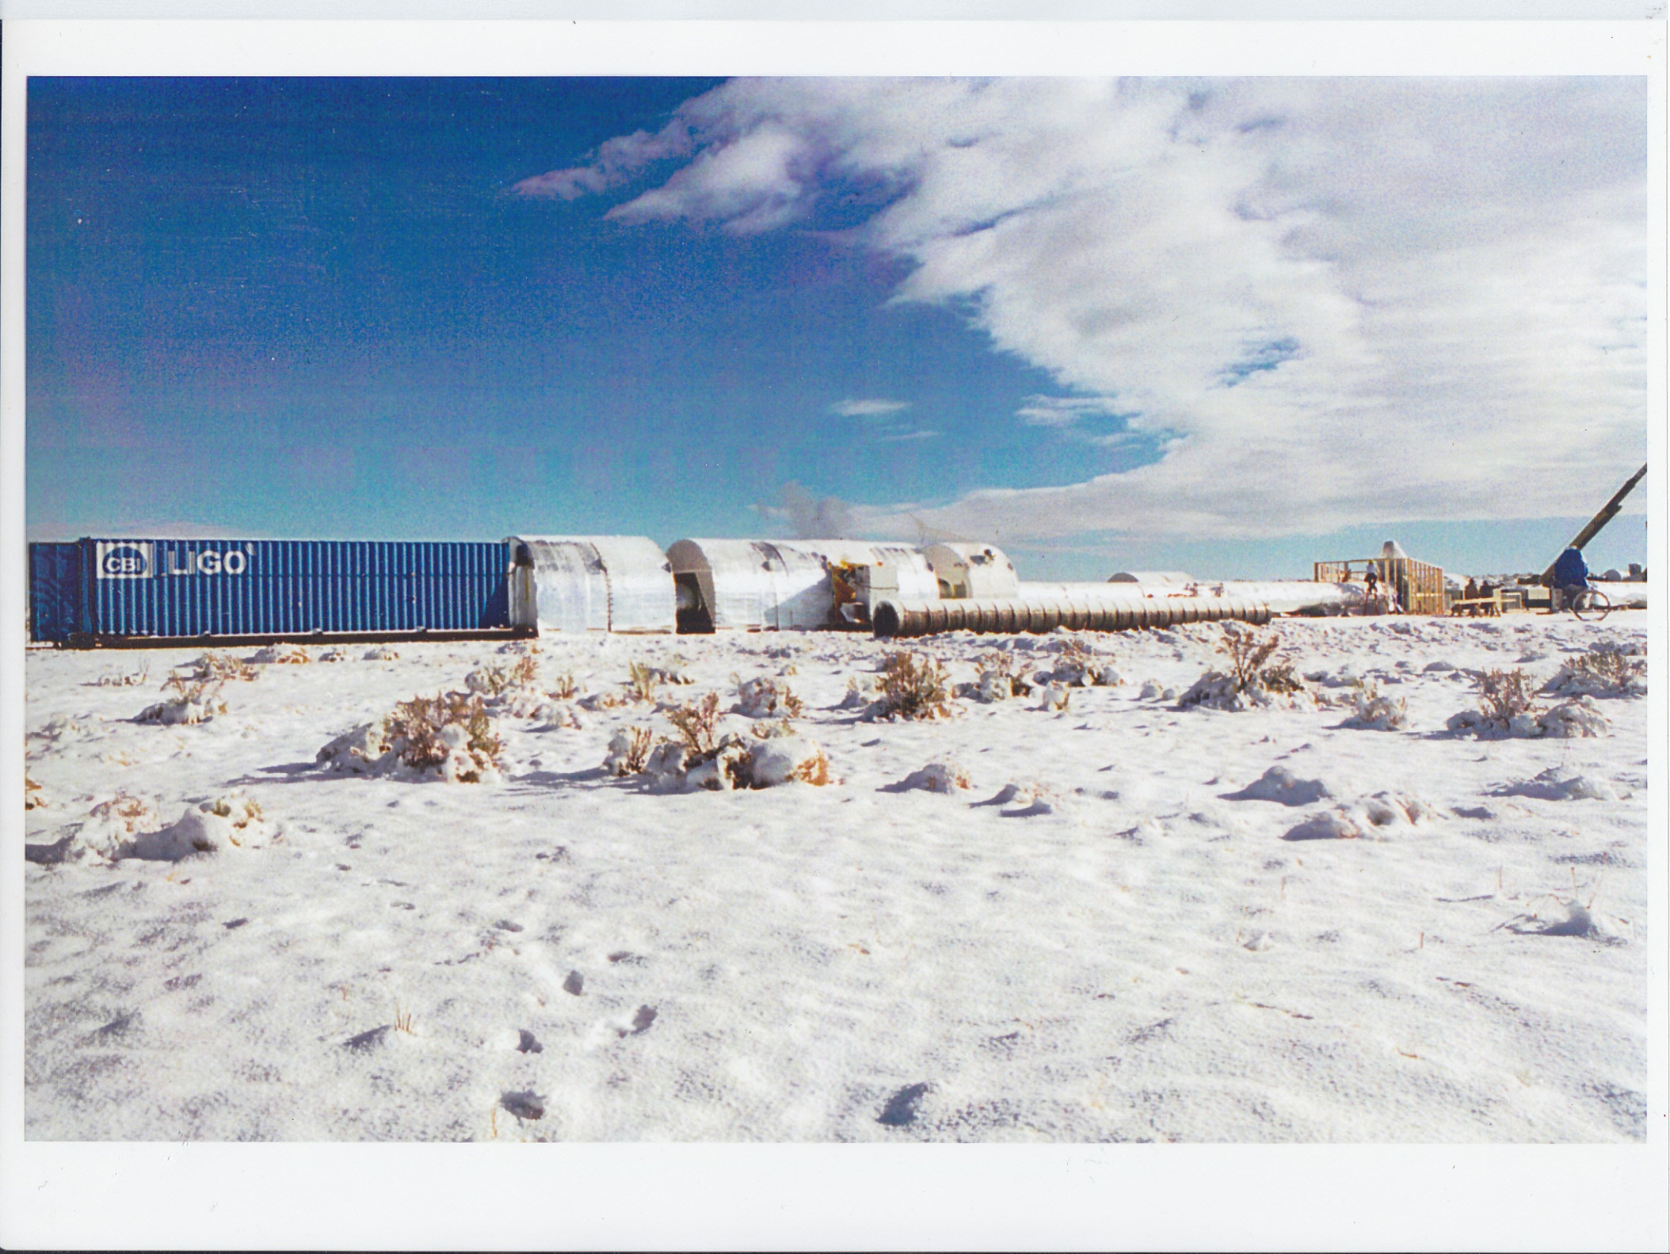

Slide 47
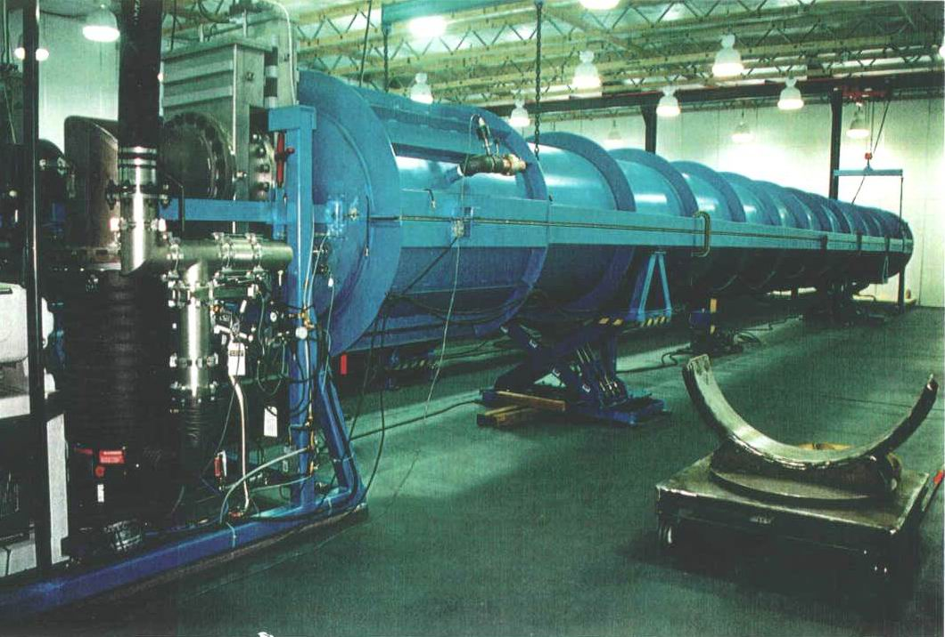

Slide 48
Monthly Progress Review, 5/25/94
Metlab will conduct QT coil bake with a dehumidifier (oil less compressor, desiccant)
LIGO will specify resistivity and chlorine levels acceptable for BT section cleaning water
Bellows will be fatigue tested
QT schedule block diagram shown
Rai’s goals & thermal considerations shown for the QT

Slide 49
Monthly Progress Review, 6/22/94
Both clean room and weld room will probably have exterior prep room extensions added
Field rooms will be hand wiped down and dried before usage; an option: insecticide
Weld room with have vented floor w/ air flow
Added wiper outboard clean room inflatable seal; seal inspected & cleaned prior to mating
Coil bake oven cover was removed at 150C rather than 100C; found to be acceptable

Slide 50
Monthly Progress Review, 7/28/94
CBI will not accept the risk for outgassing rejects of SS coils during the Option
CBI’s updated Option estimate was a high increase over their original estimate
Heat tapes will be needed for the “kicker” supports on the QT module
Sketches shown on section end facing machine, bellows shipping fixture, pump port reinforcing pad, stiffening rings, baffle design
Procedures given on QT Outgas and Leak Test Procedures
Drawings given on BT Module & Supports

Slide 51
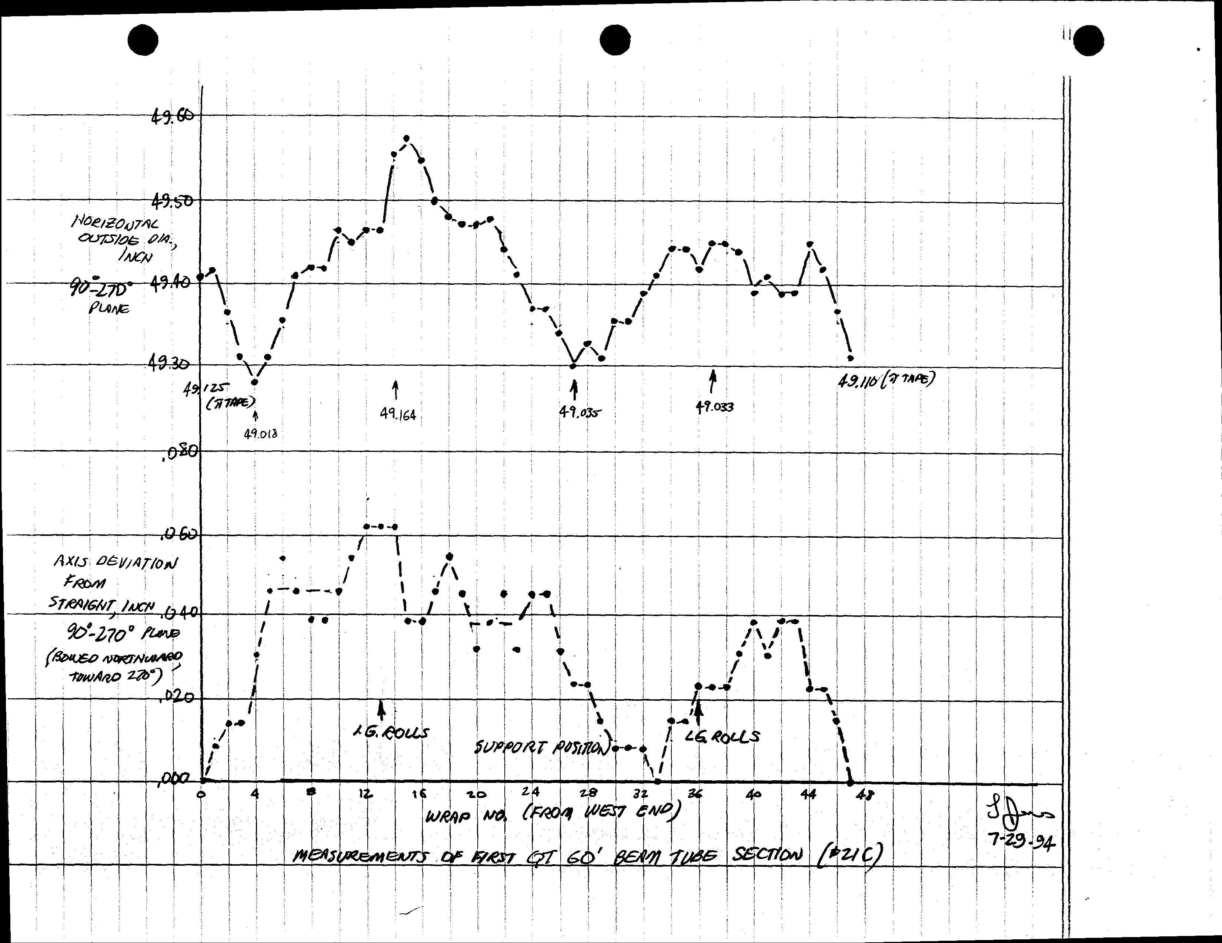

Slide 52
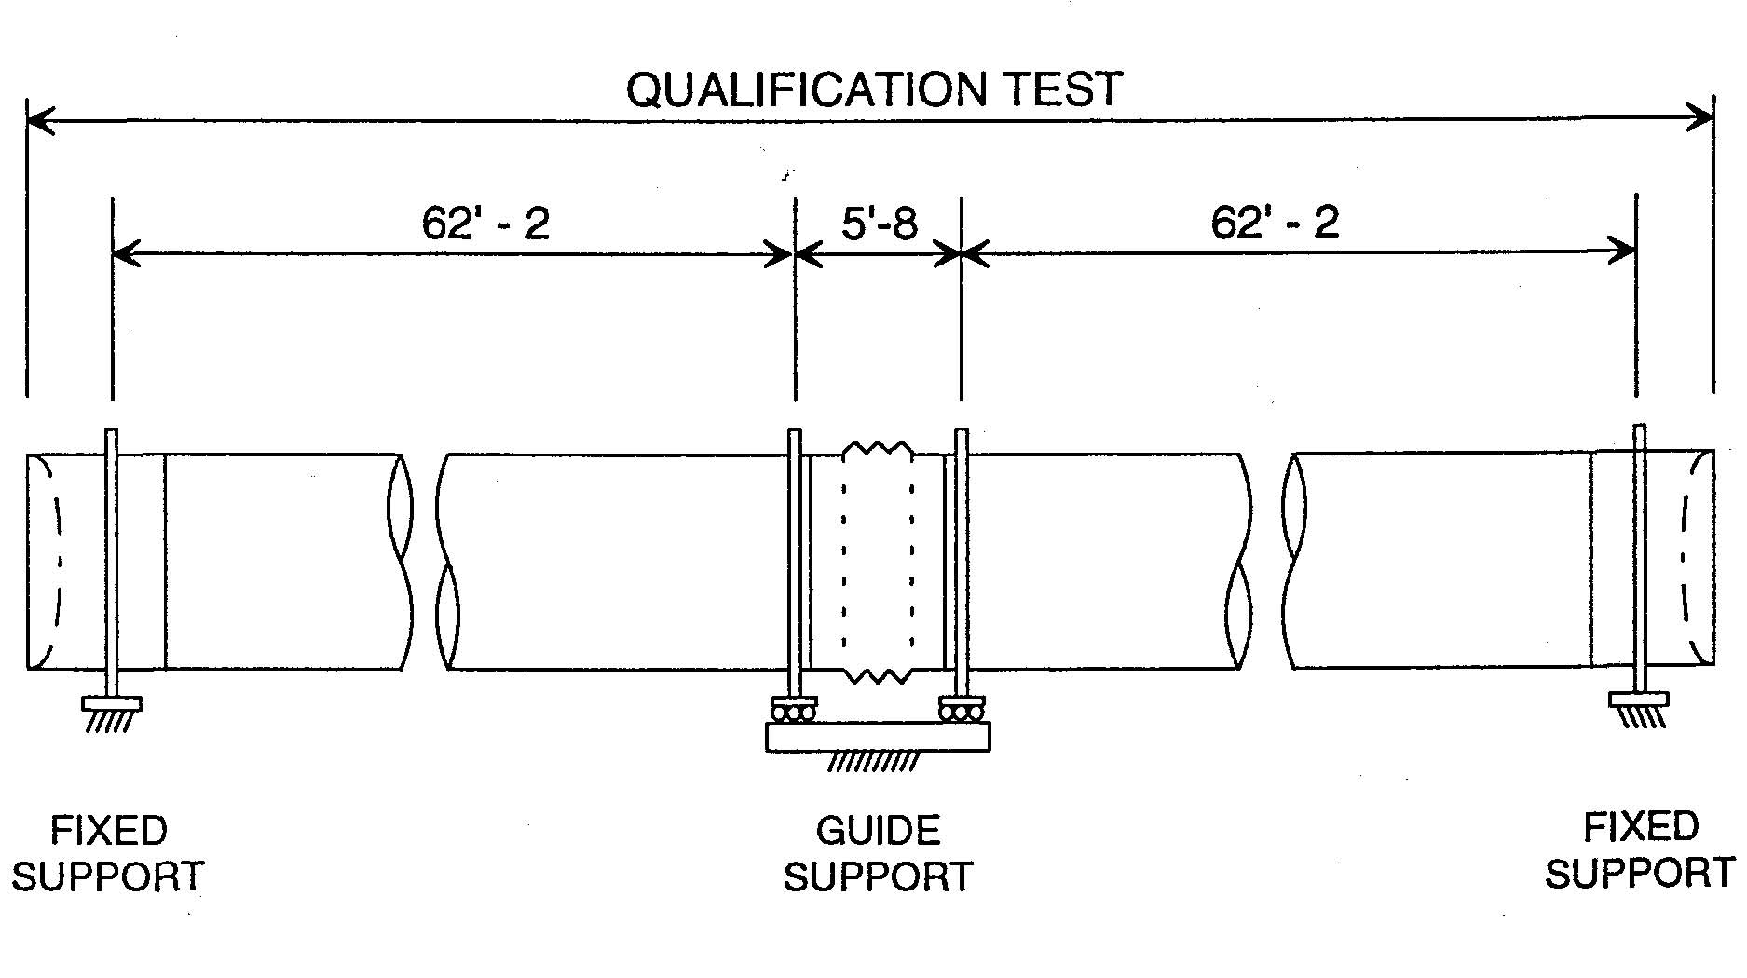

Slide 53
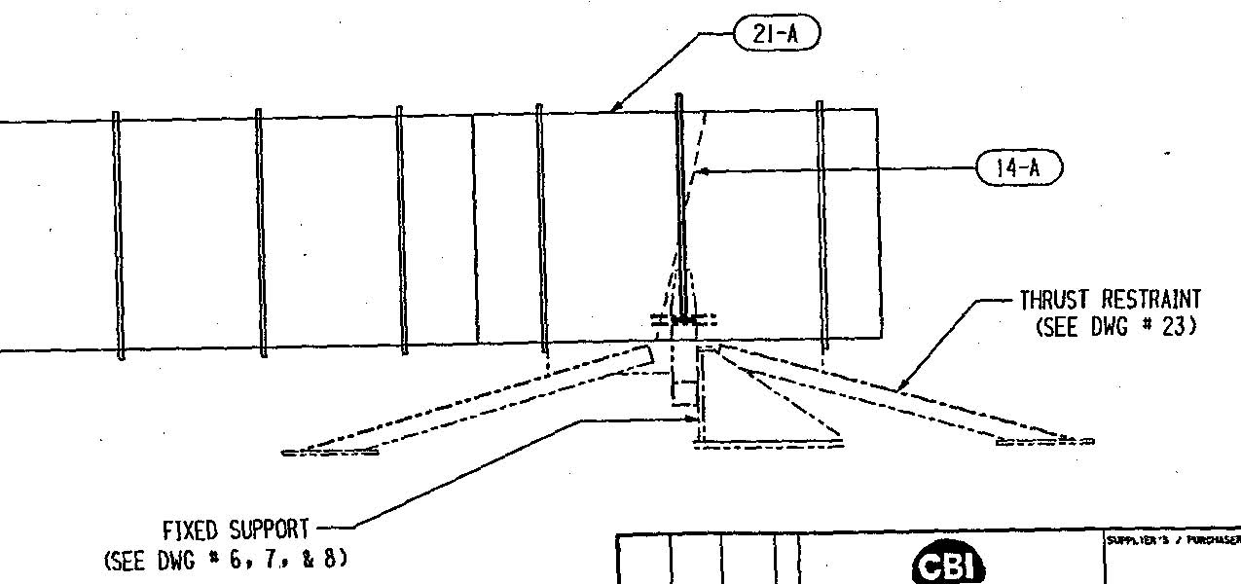

Slide 54
Monthly Progress Review, 8/24/94
Mods being made to coupon chamber to reduce background Hydrogen signal
Internal purge dam made: visible gaps
External vacuum box for BT section end weld leak checking has seal problems
CBI considering TIG “wash pass” test to demo sealing of leaks while under vacuum
CBI wondering if nonweld repairs would be acceptable

Slide 55
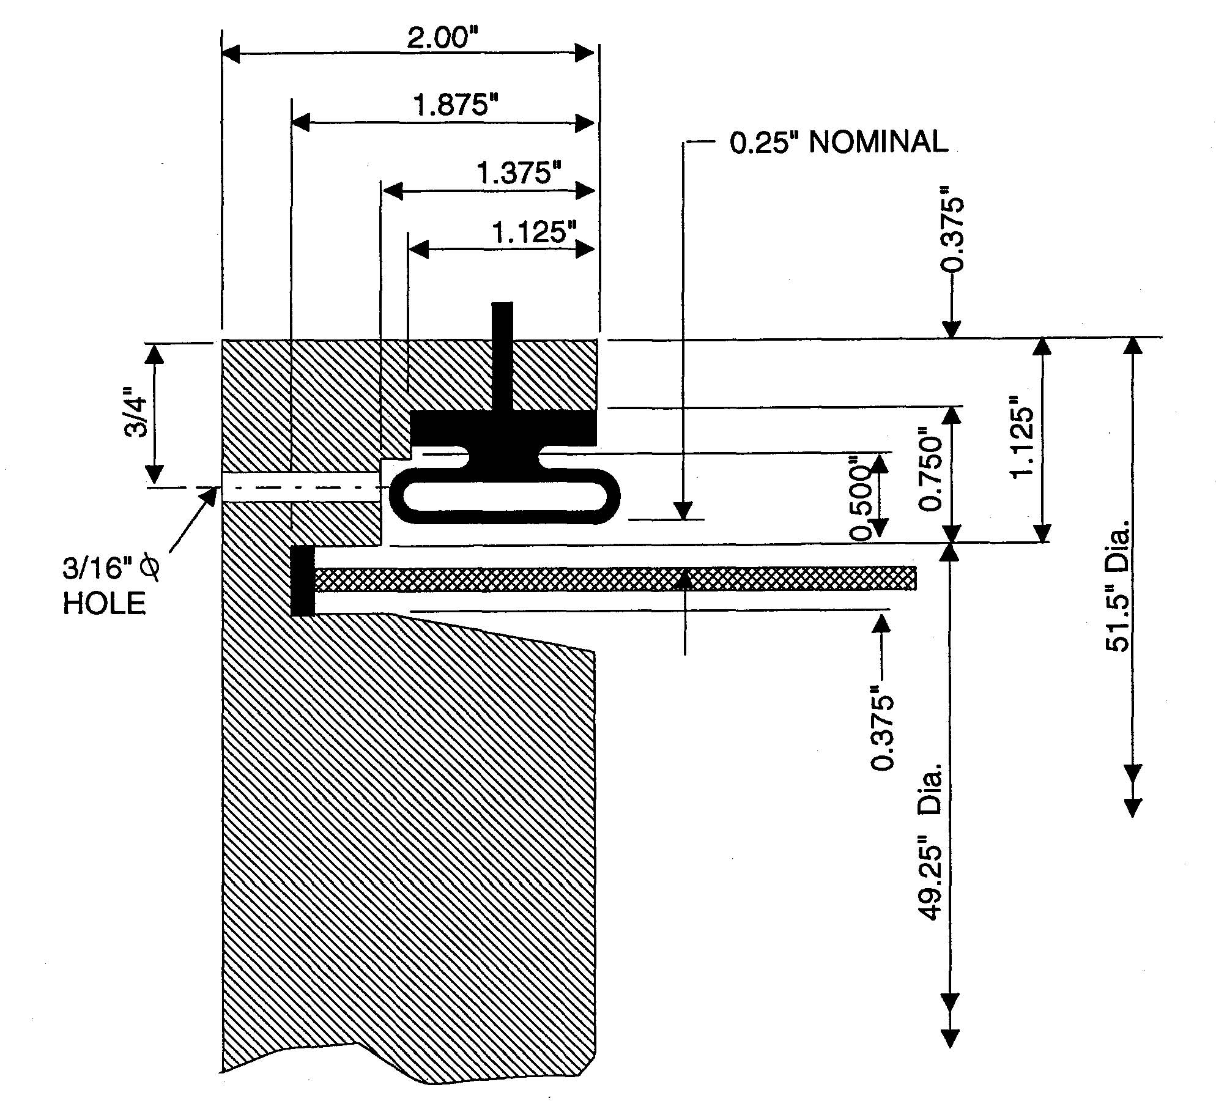

Slide 56
Monthly Progress Meeting, 9/29/94
CBI’s major risks: now include spiral tubes (2)
Leak found in QT BT Section (1 of 2)
Vacuum box still having sealing problems
New baffle design demonstrates poor fit
Black light test not a fool proof check
Purge pressure buildup causing weld problems
18 frames of sequence of using Weld Room in the field shows cleanliness concern addressed

Slide 57
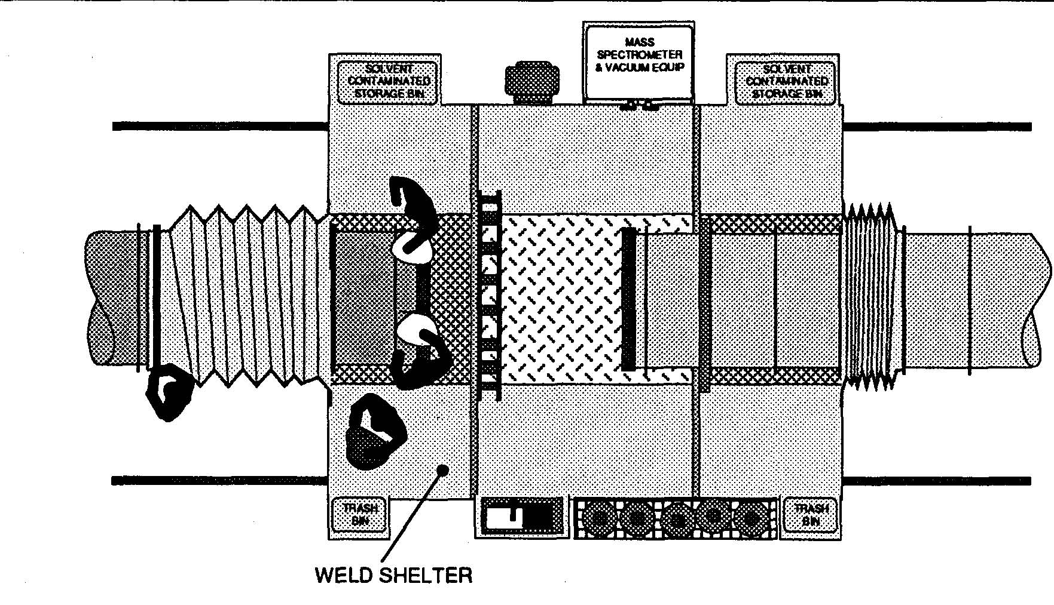

Slide 58
Monthly Progress Meeting, 12/9/94
CBI needs a plan to avoid rebar in slab with anchors
CBI’s outgassing chamber has high hydrogen background
Bellows supplier caused 1.38” permanent set
All 3 bellows received have quality problems
Girth seam welding problem now understood
Causes of 2 leaks found on QT BT sections now understood
Major cleaning problem: cleaning with “full treatment” (5 steps) will be tried on QT BT sections

Slide 59
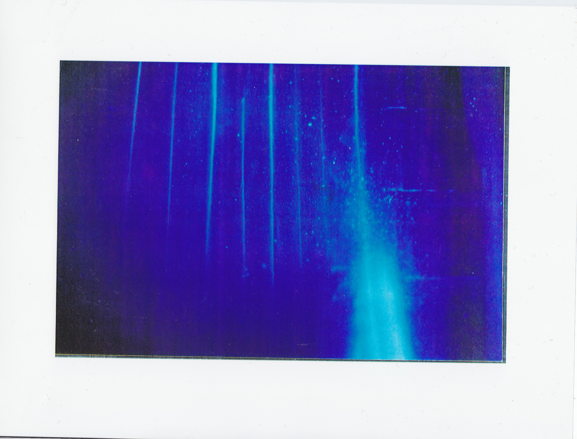

Slide 60
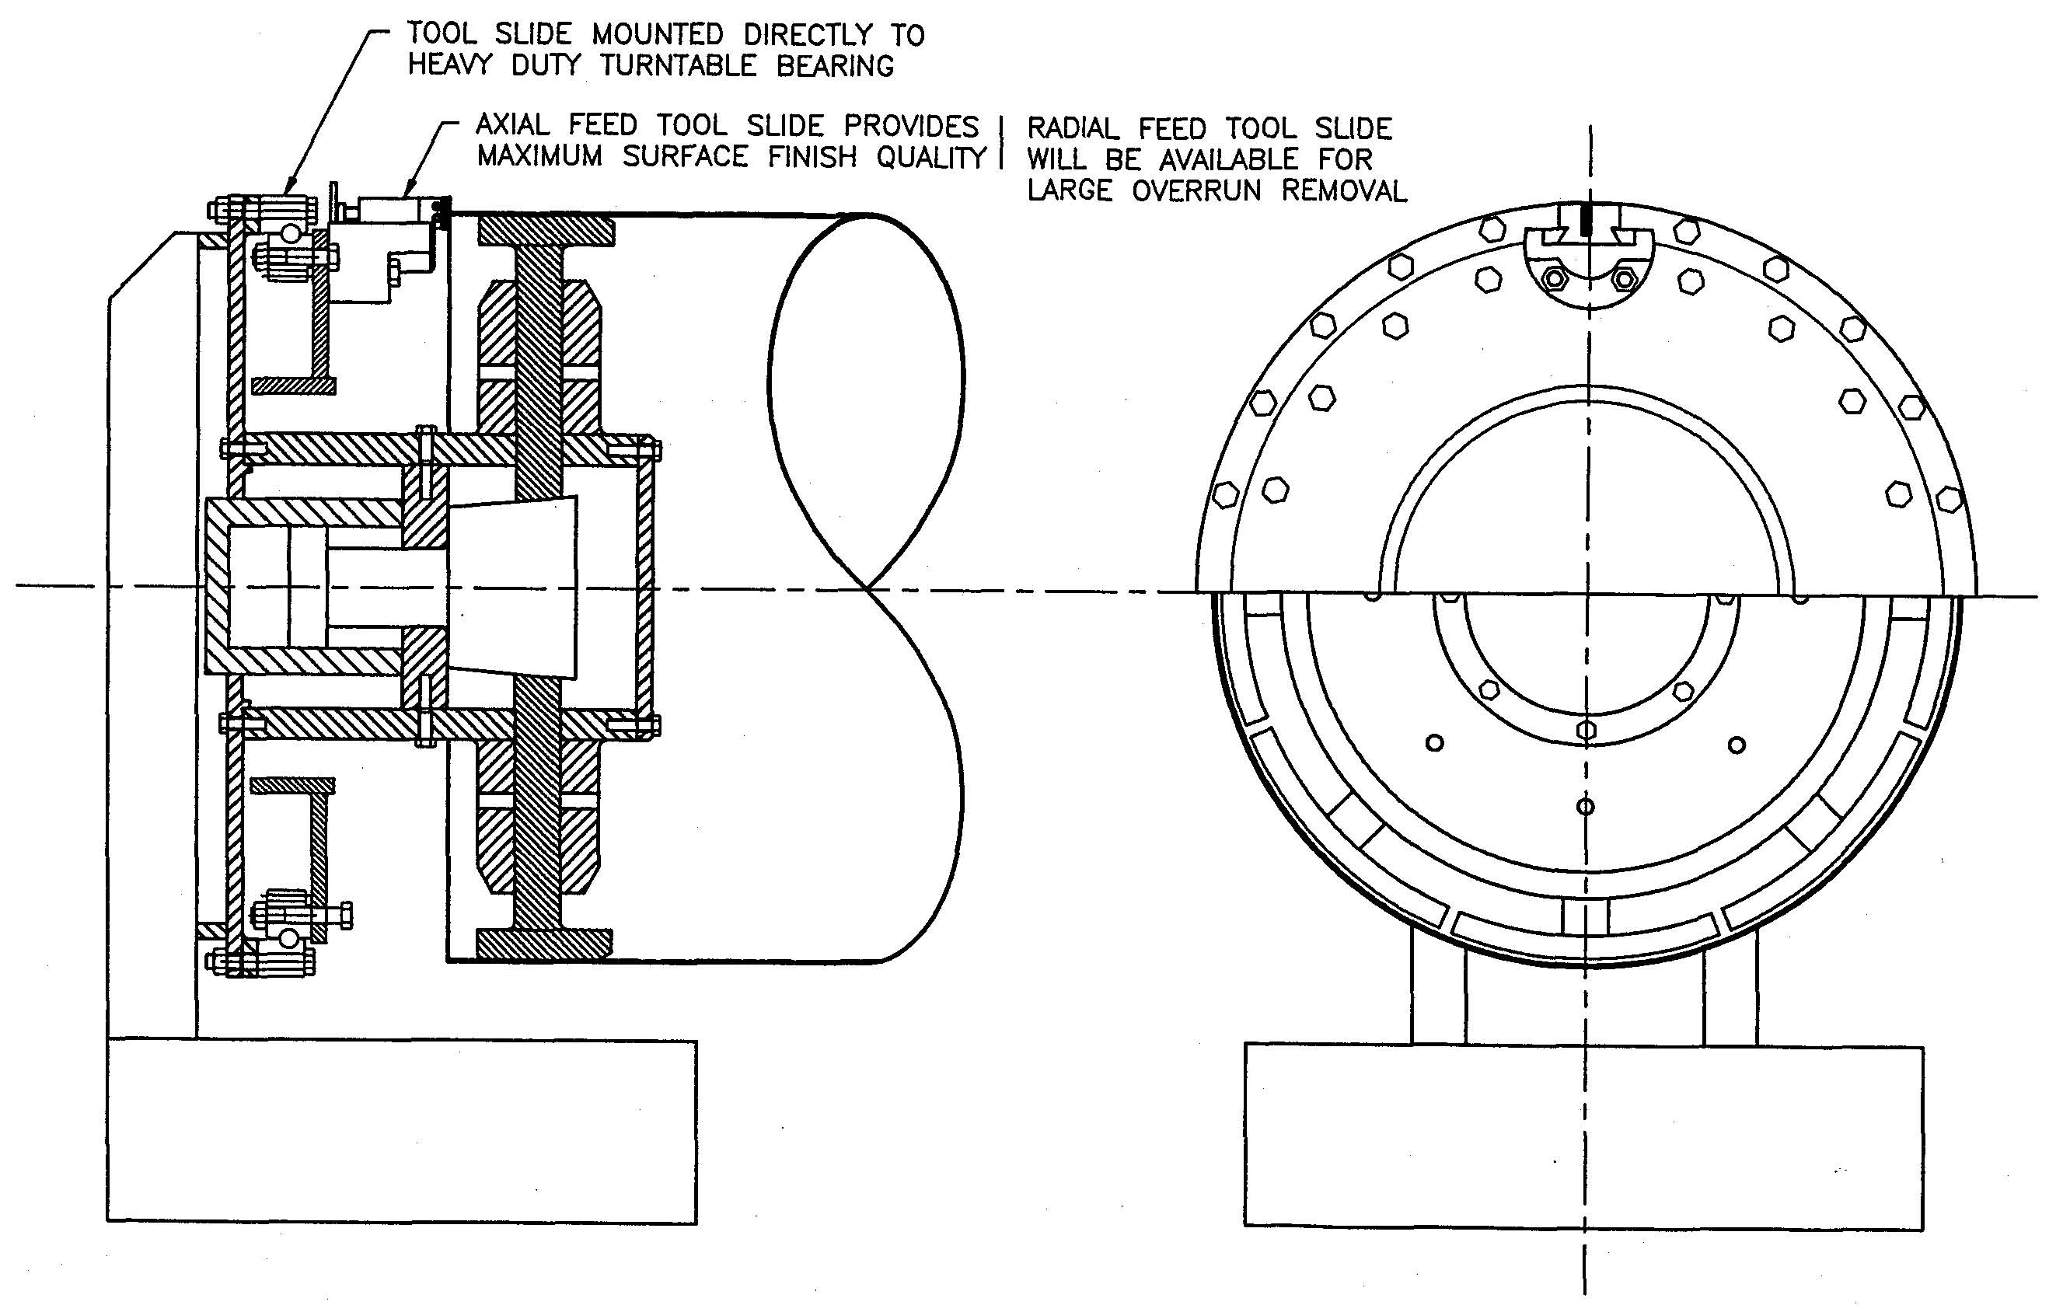

Slide 61
Lessons Learned To Date, 2/21/95
Major Spiral Welded tube weld problems
Purchased component fit problems: stiffening rings, support rings & gussets, pump ports
Tube wall is too flexible for cutoff; must face
Bellows mfr. has poor quality
CBI welder didn’t follow weld procedure (2 x)
Vacuum box is very difficult to seal without putty
BT Section cleaning was a major problem to solve
A Qualification Test is a must for a project like LIGO!

Slide 62
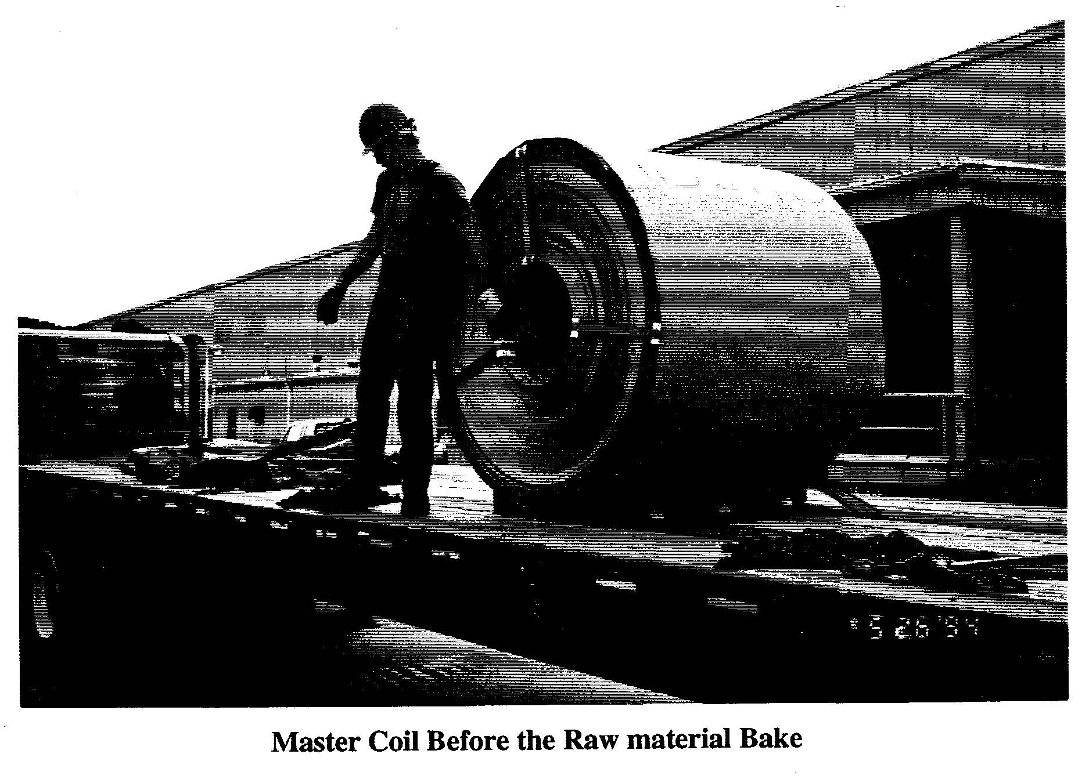
Qualification Test, 4/17/95

Slide 63
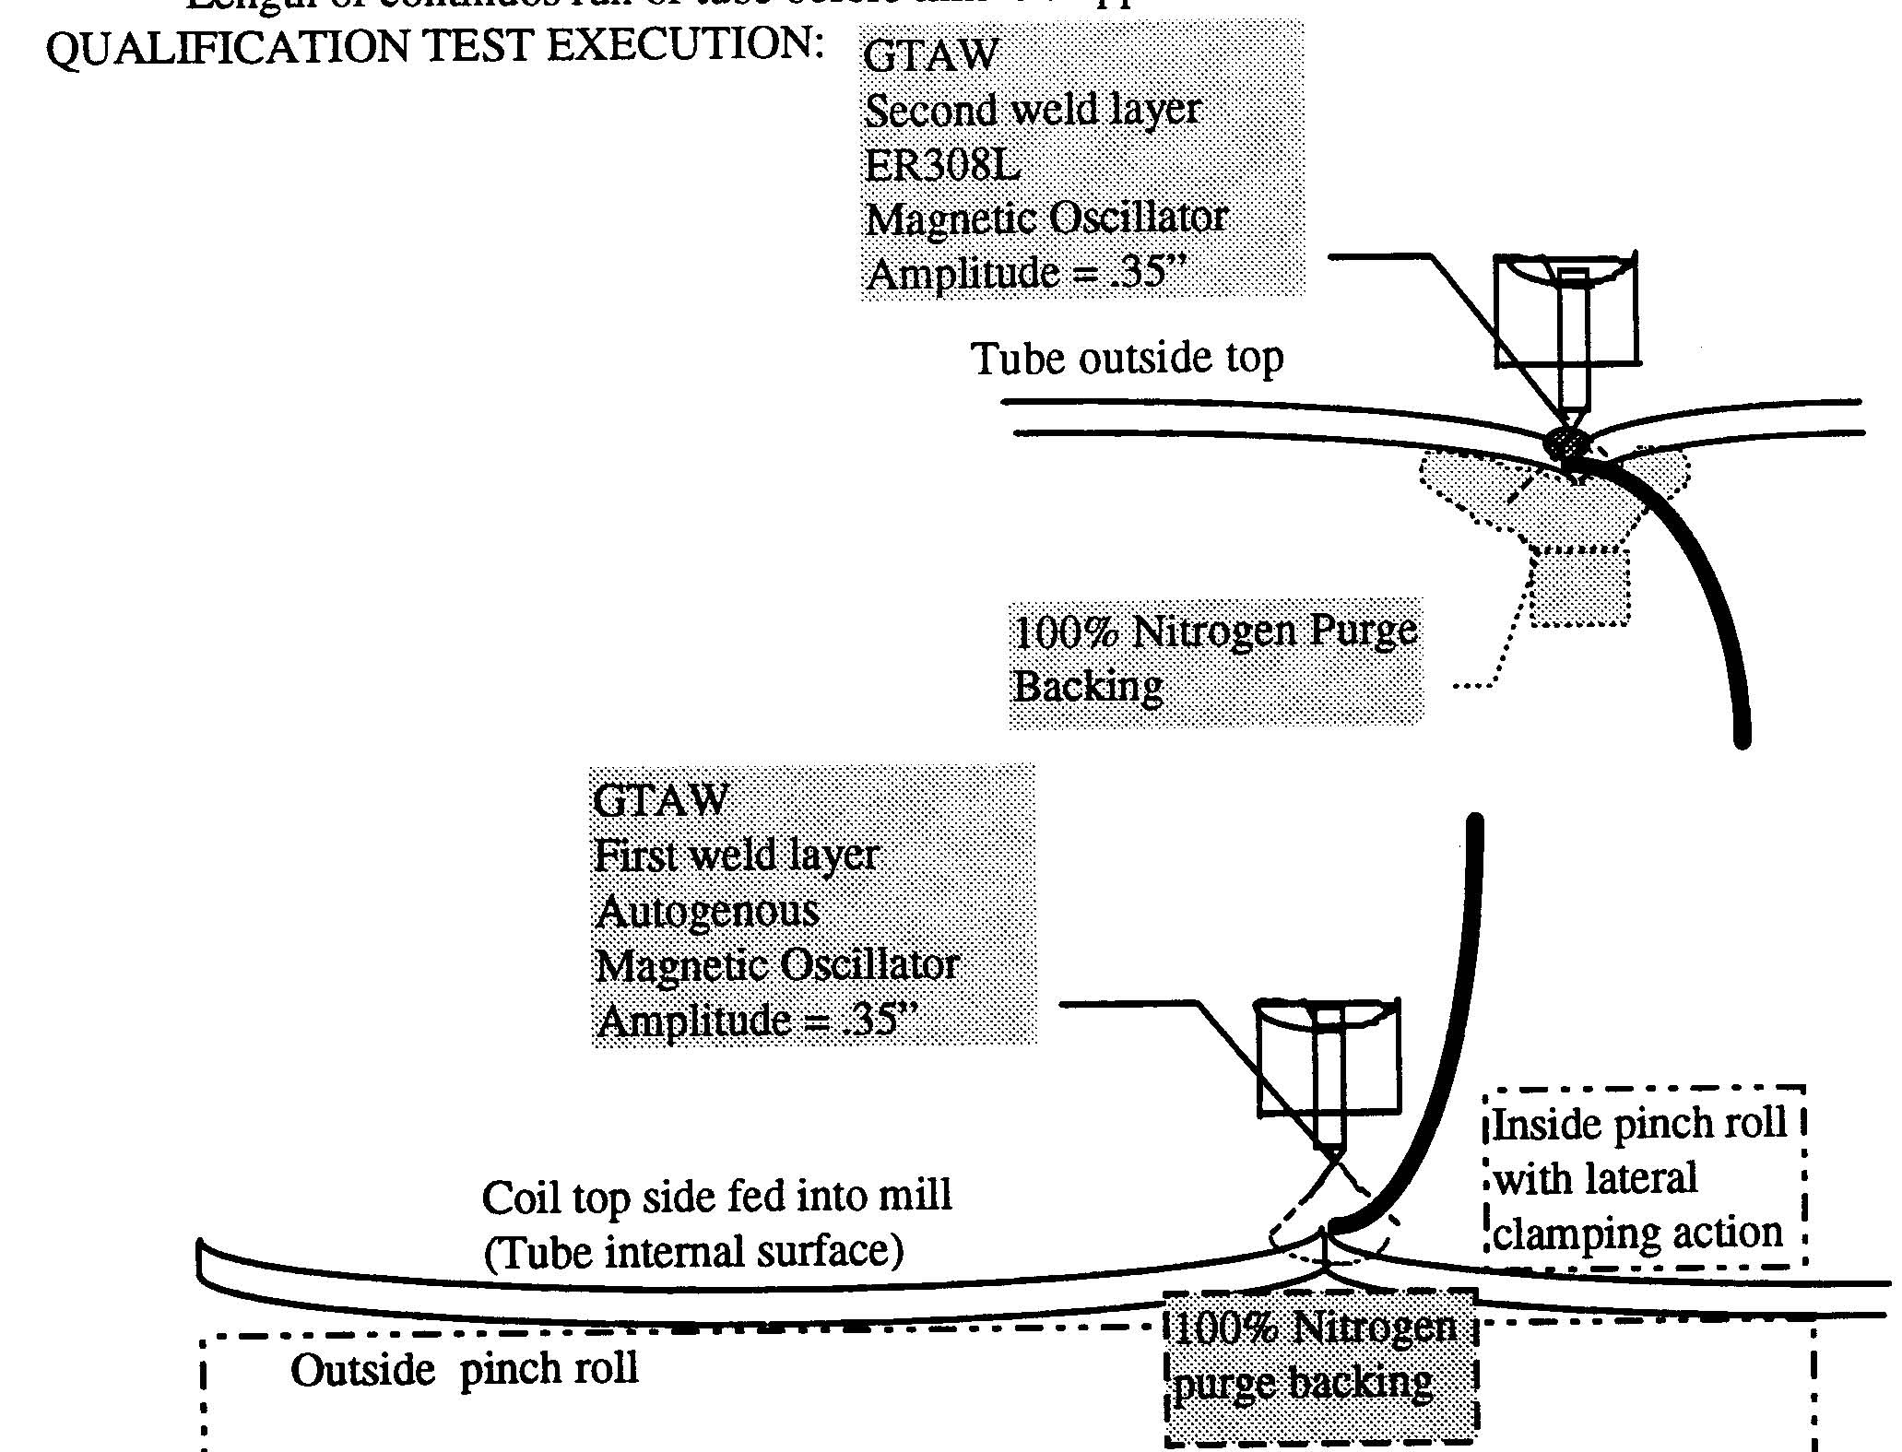

Slide 64
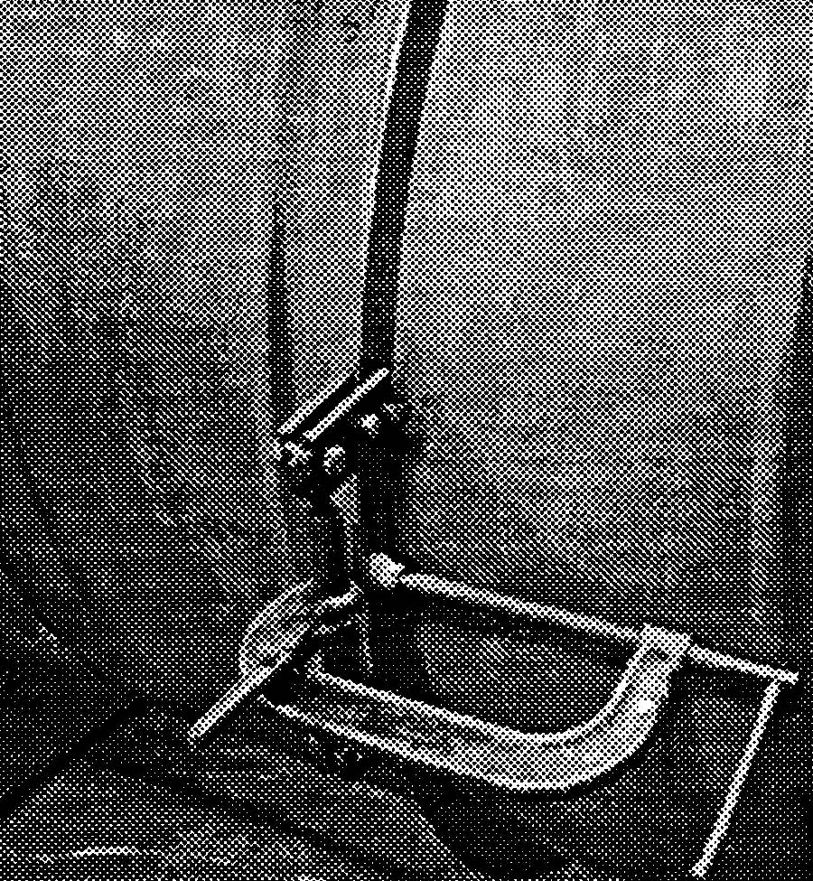
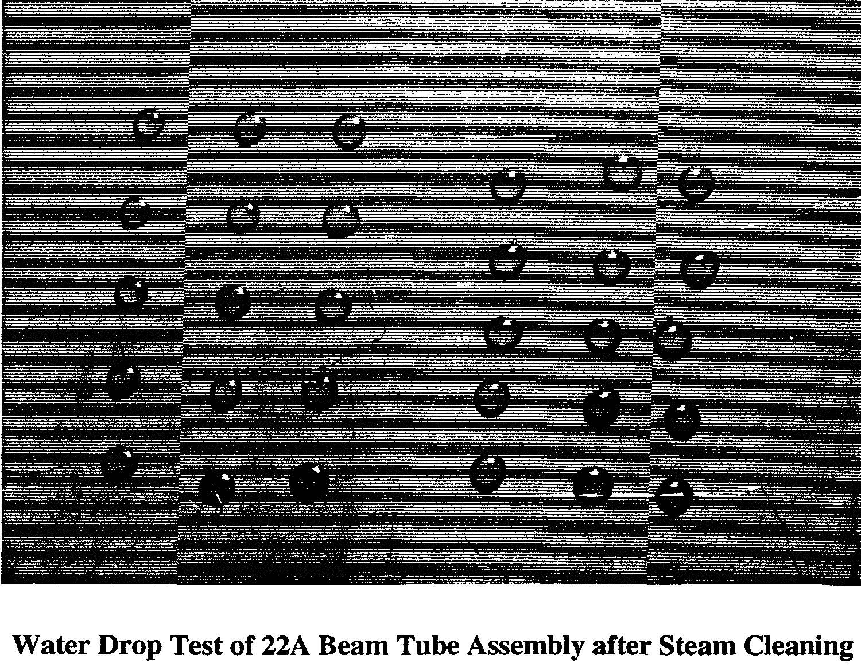

Slide 65
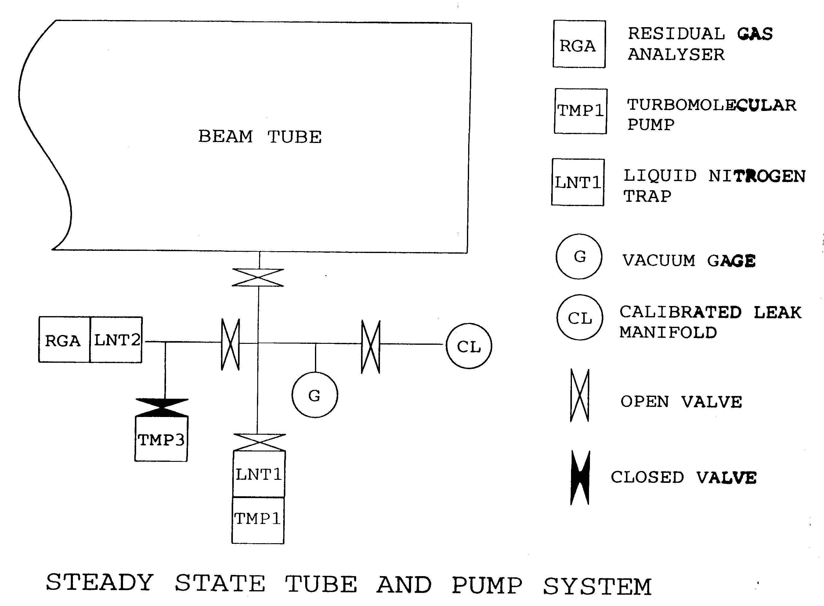

Slide 66
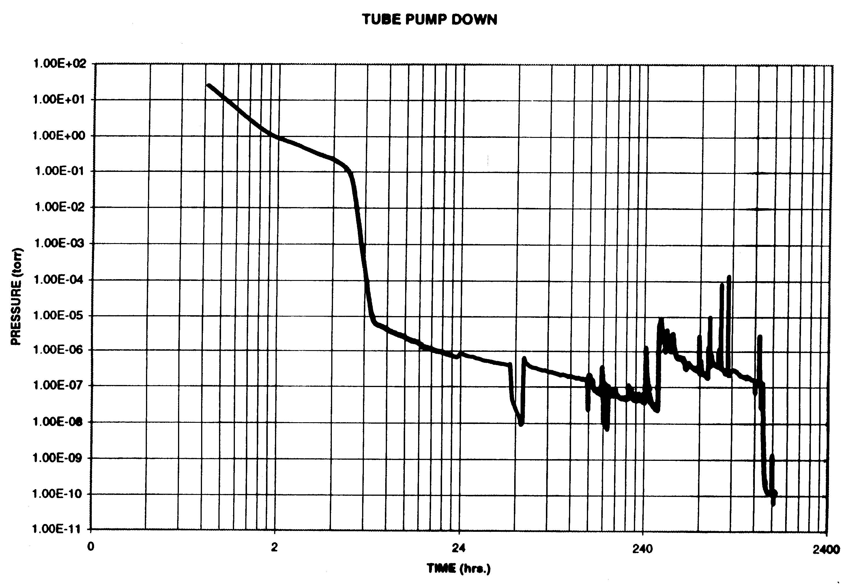

Slide 67
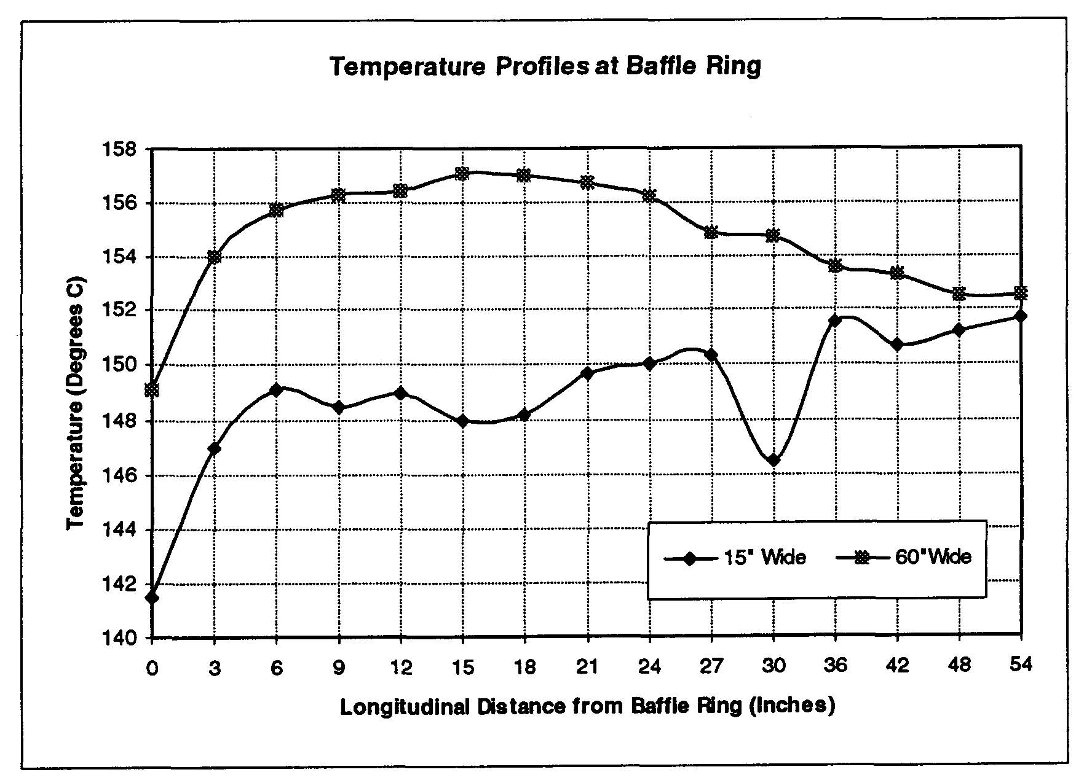

Slide 69
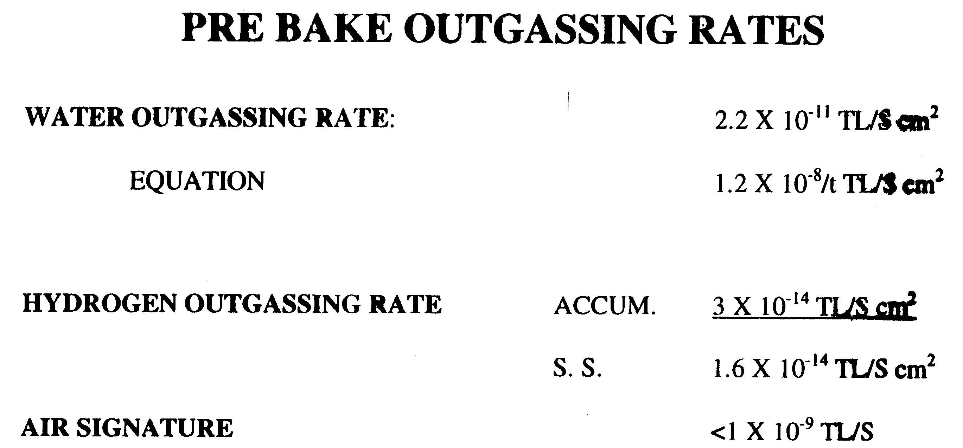
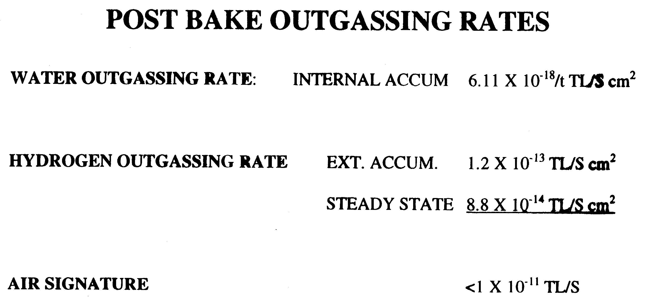

Slide 70
Qualification Test Review, 4/17/95
Significant recommendations:
Revise spiral weld procedures to give adequate overlapping penetration
Develop a quantifiable cleaning performance measurement technique
Develop QA procedures to monitor weld performance in near real time
Have a QA person oversee subcontracted tasks

