Slide 1
The Option Phase
Fabrication, Installation and Testing the LIGO Beam Tube Modules

Slide 2
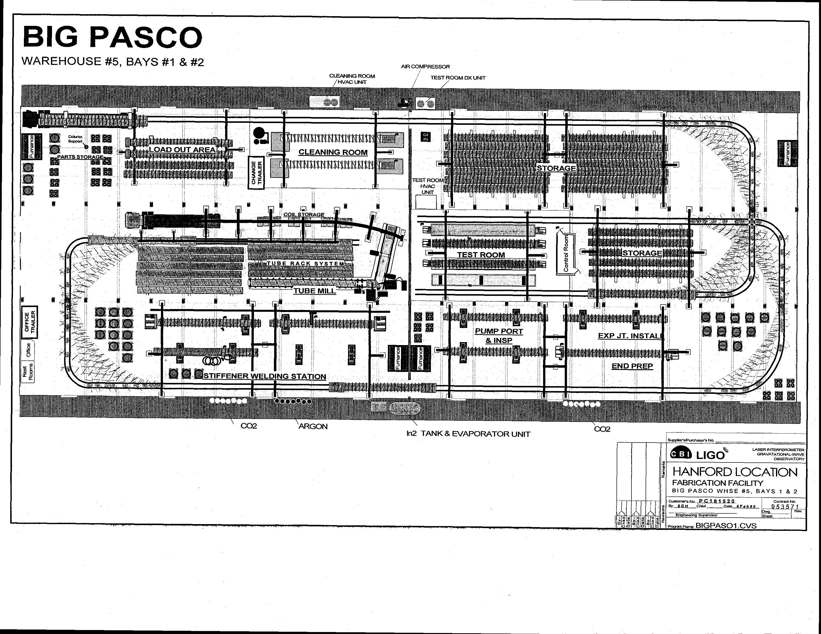

Slide 3
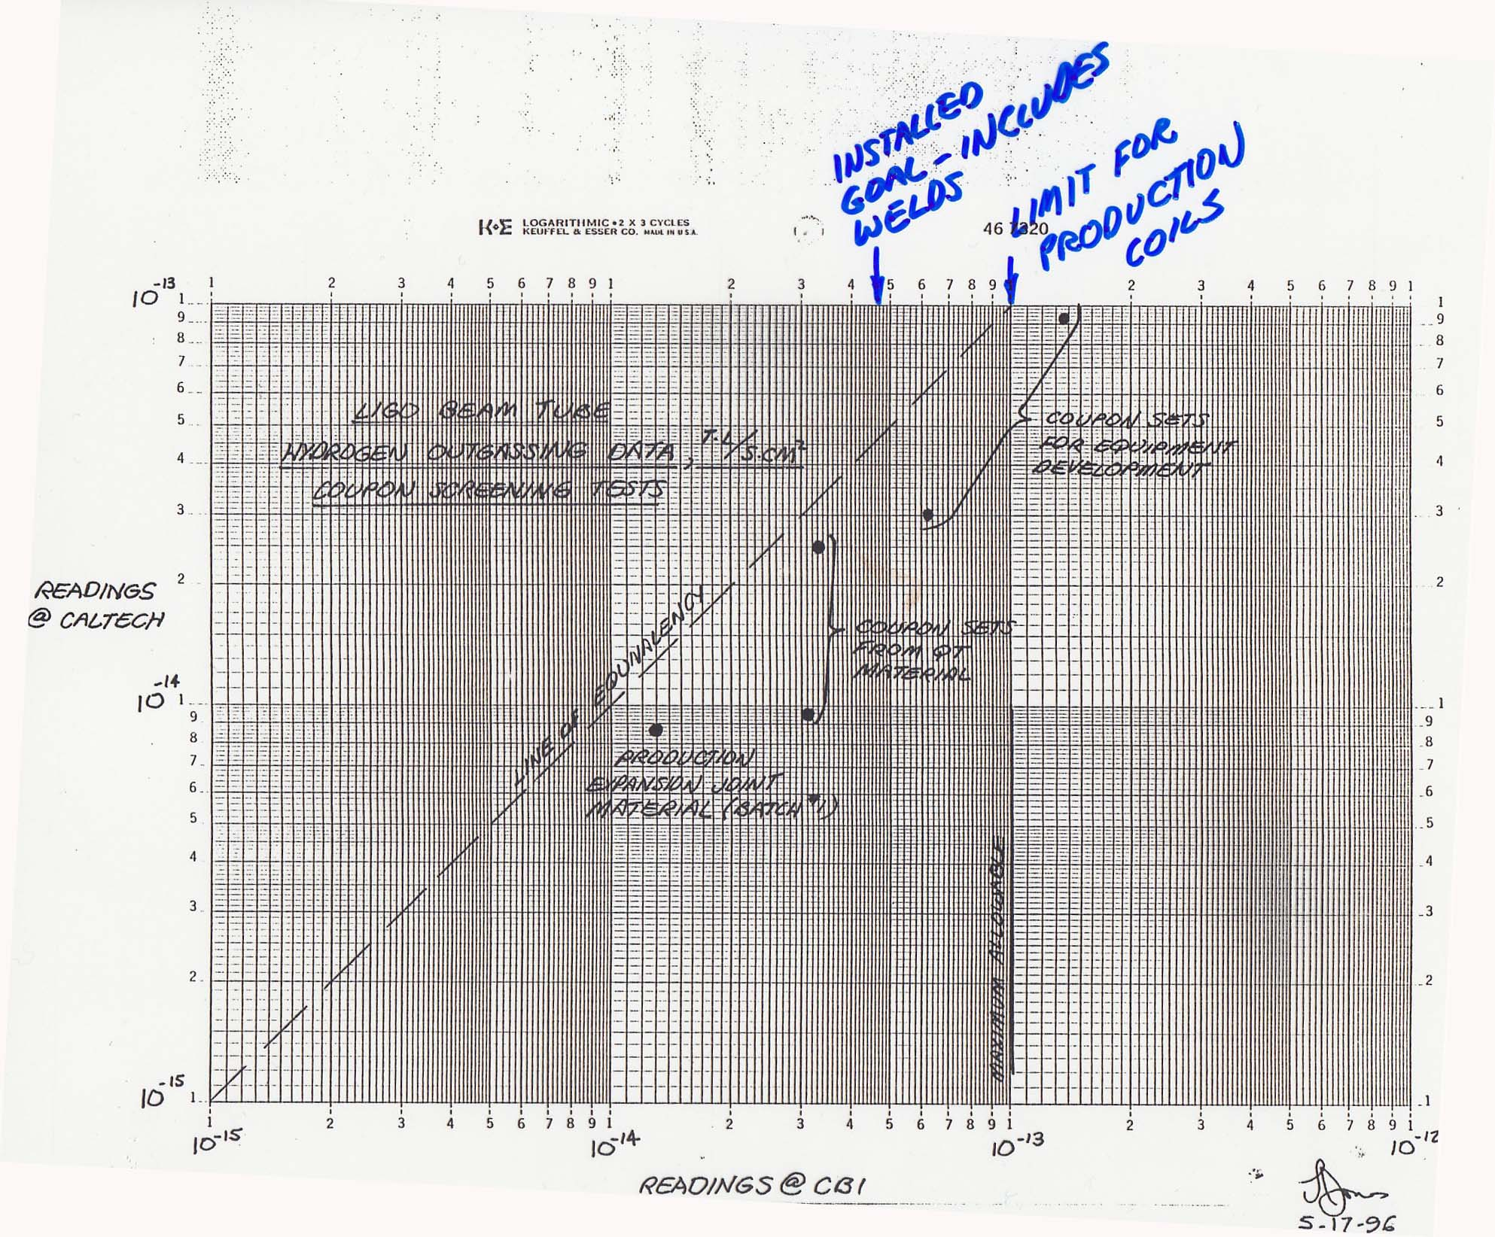

Slide 4
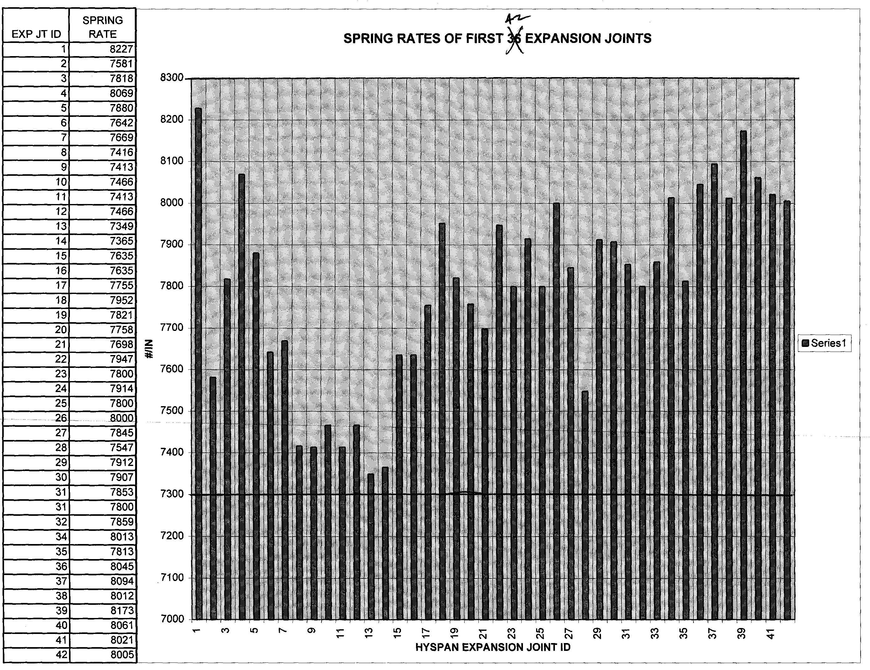

Slide 5
Fabrication Activities
Spiral Mill: flatten & form, inside autogenous weld (TIG) w/ back purge, laser tracking, outside weld (TIG) w/ filler wire & back purge, section cut to length with plasma torch, “A” end etched @ weld to confirm penetration
Inspect section: circumference @ 5 planes; (string) straightness, record; layout details
Purge: clean purge dam seals, flow N2, <2% O2
Fit & tack stiffeners, machine support rings (VBM), weld all rings with Pandjaris MIG equipment
Fit & weld pump port details, TIG & MIG

Slide 6
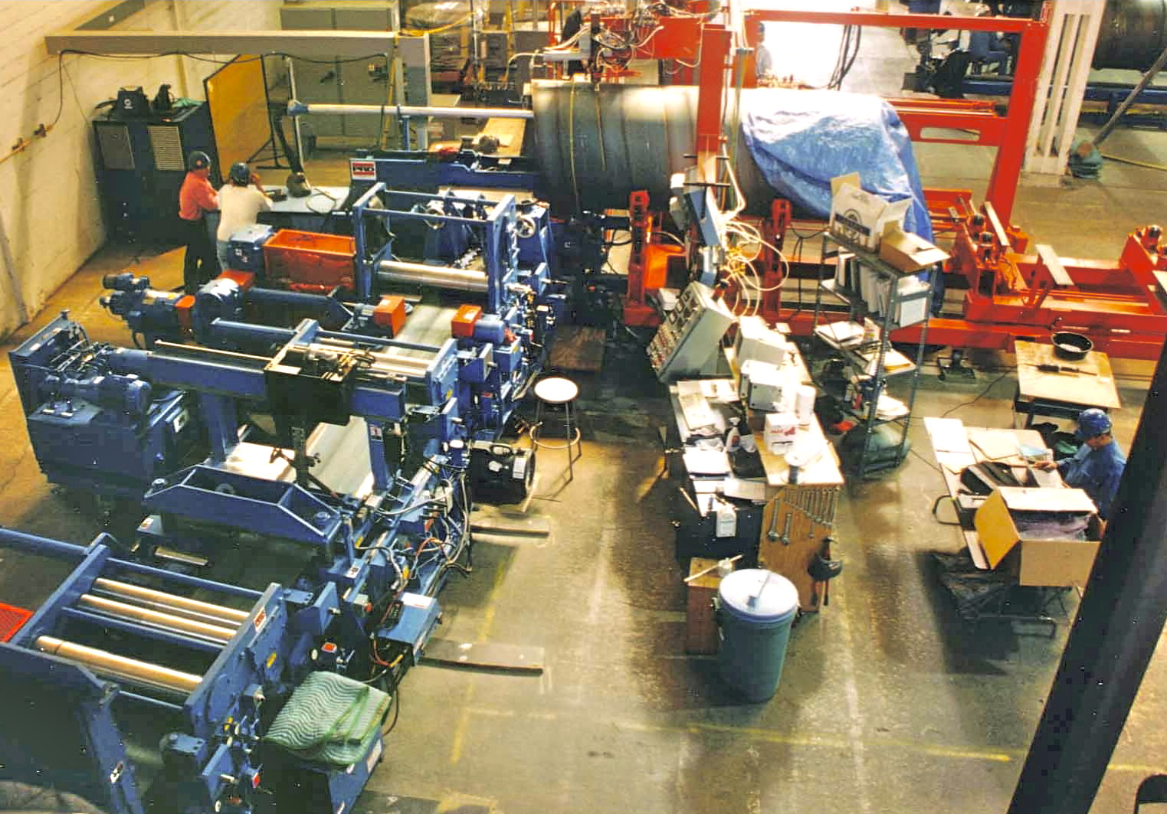

Slide 7
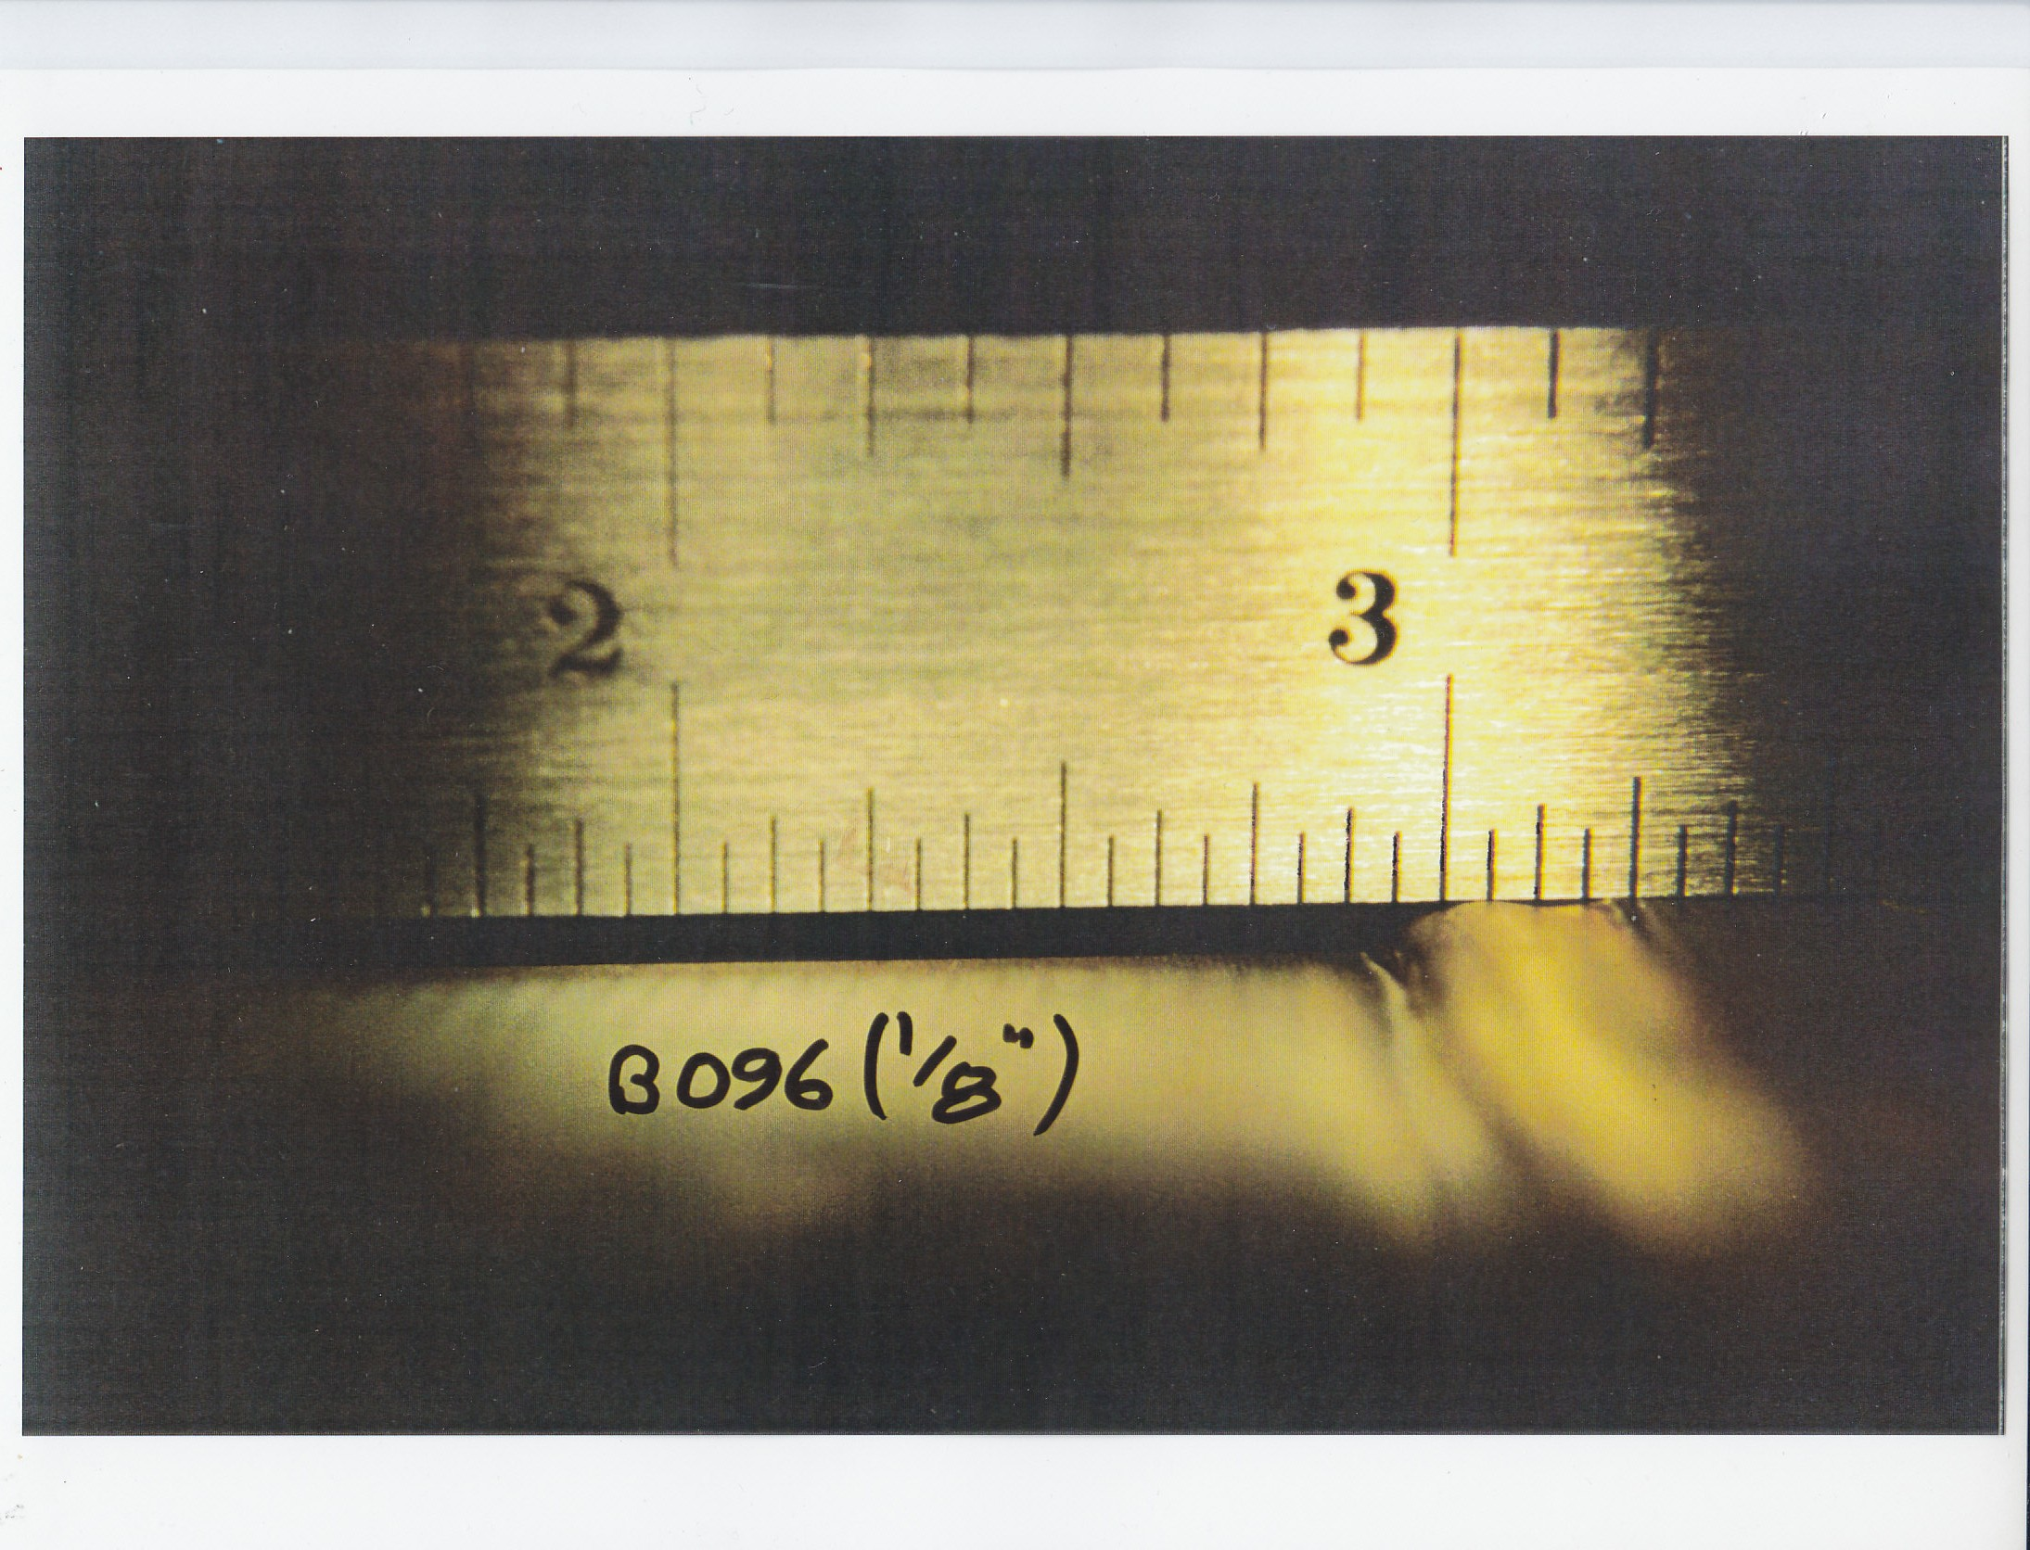

Slide 9
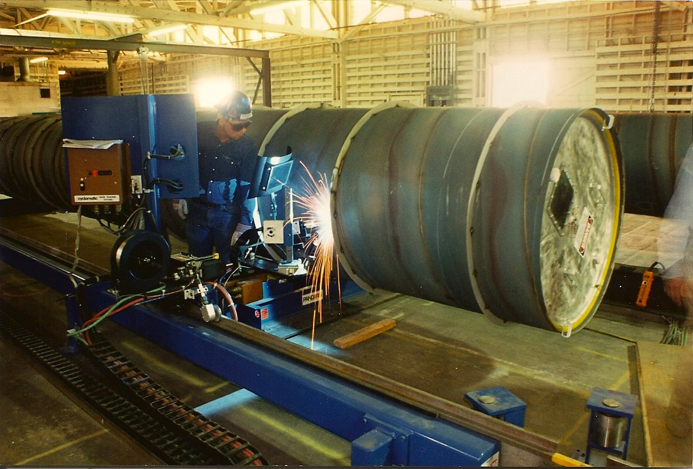

Slide 10
Fabrication Activities (cont’d.)
Expand & machine BT ends w/ Wachs equip.
Fit & weld expansion joint w/ purge, TIG
Pre-clean BT prior to moving into Cleaning Room
Steam clean ends of BT on outside
Clean inside of BT; 1:30 Mirachem 500 spray up travel, steam/water spray down travel, 1 fpm
Take cleanliness assessment sample as req’d.
Steam clean & rinse tube caps; install with bands, double bag each end, band bags
Attach hardware & leak test valve & hardware
Move to load out area

Slide 11
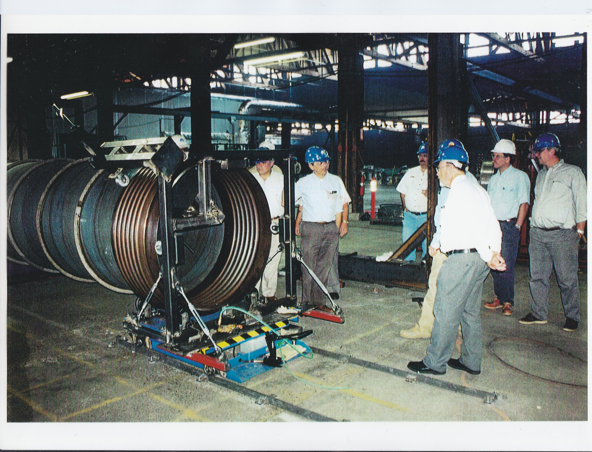

Slide 12
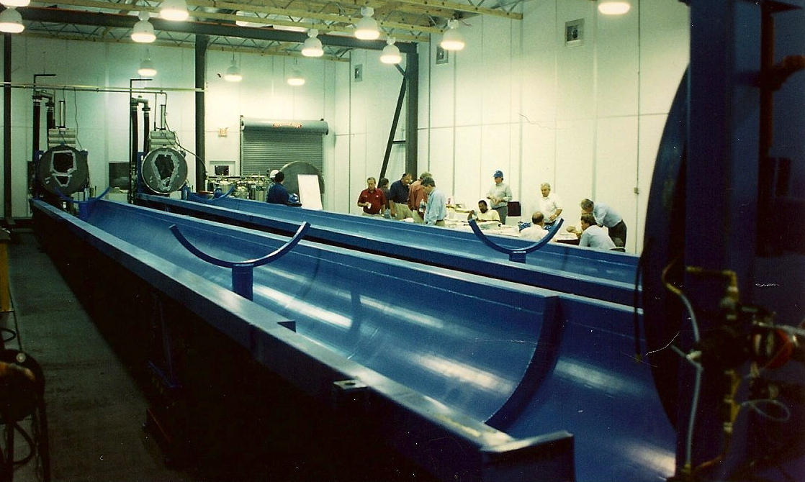

Slide 13
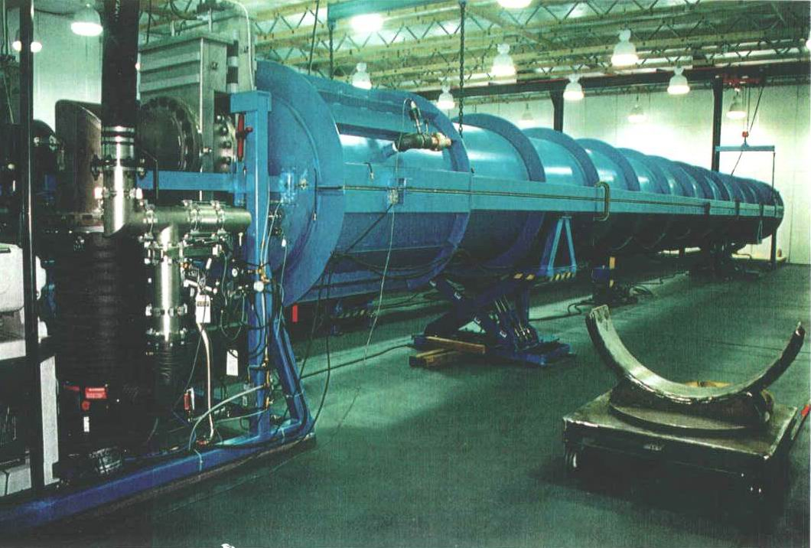

Slide 14
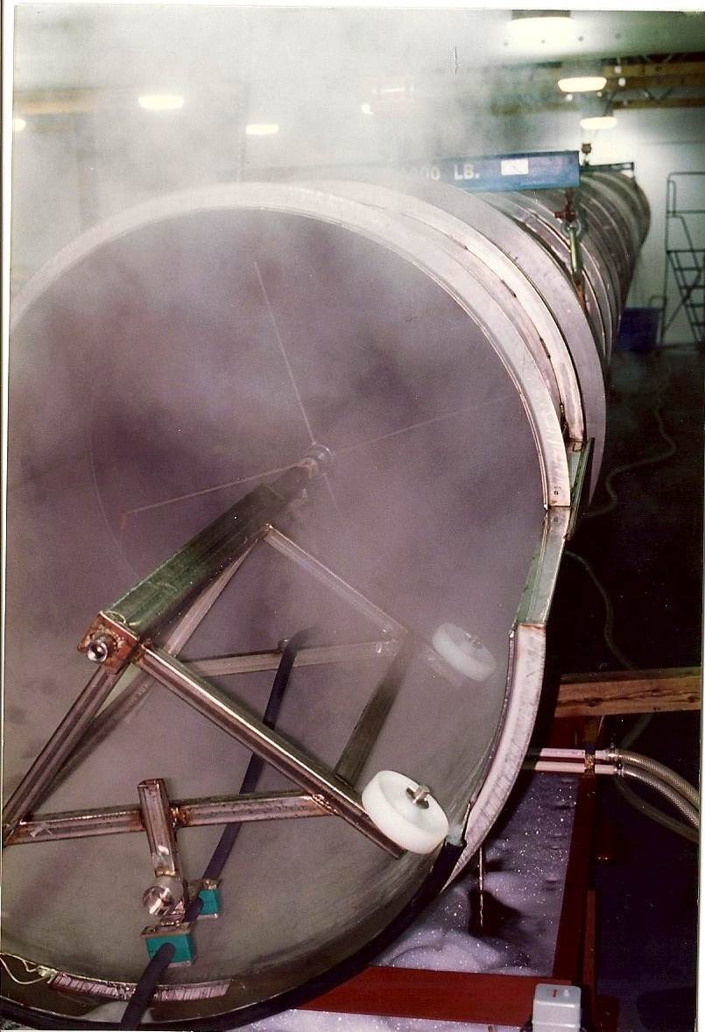

Slide 15
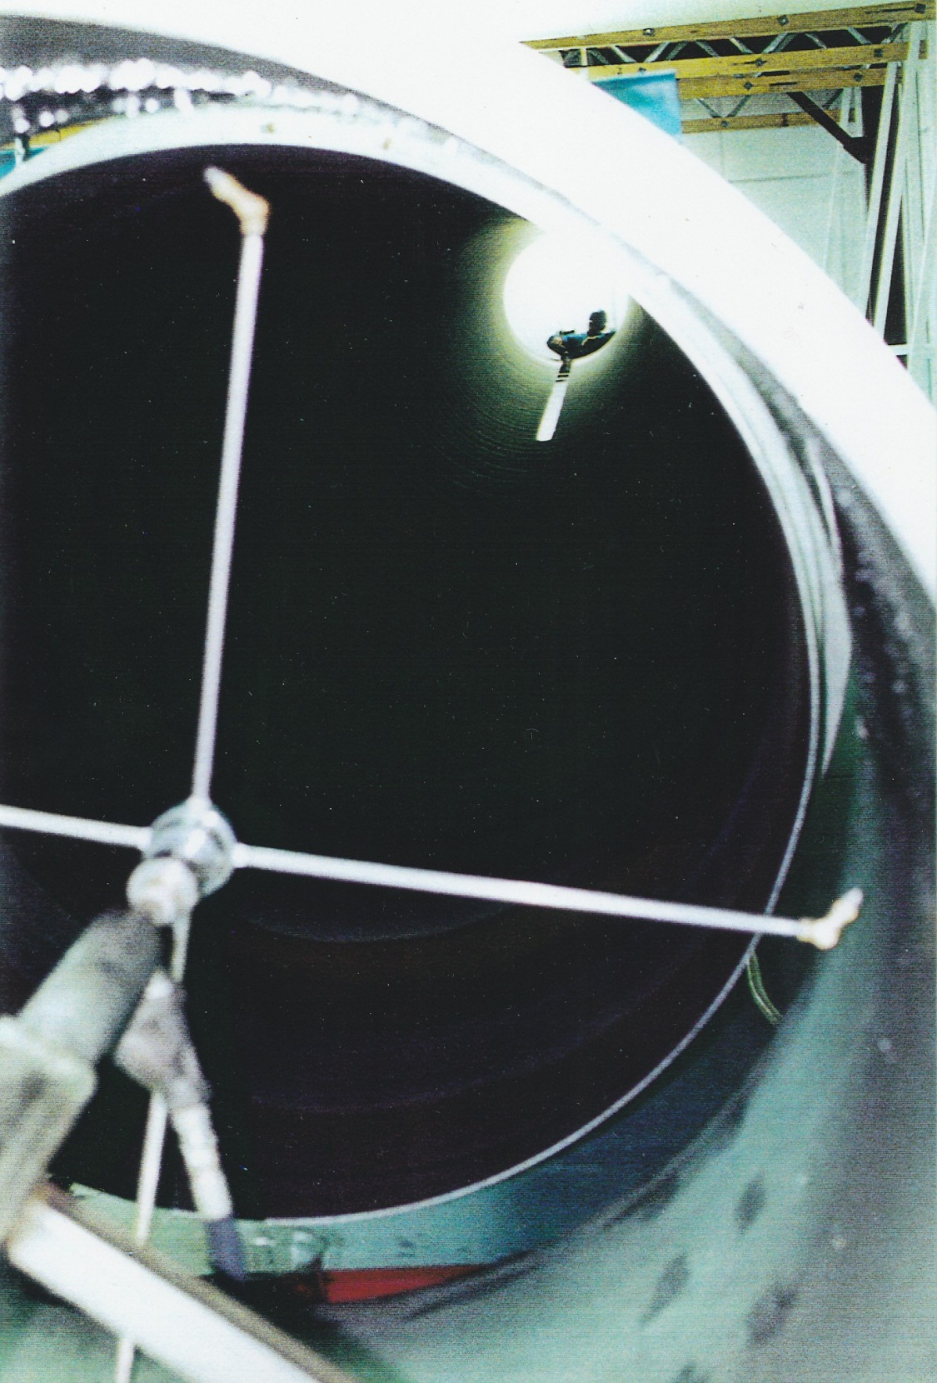

Slide 16
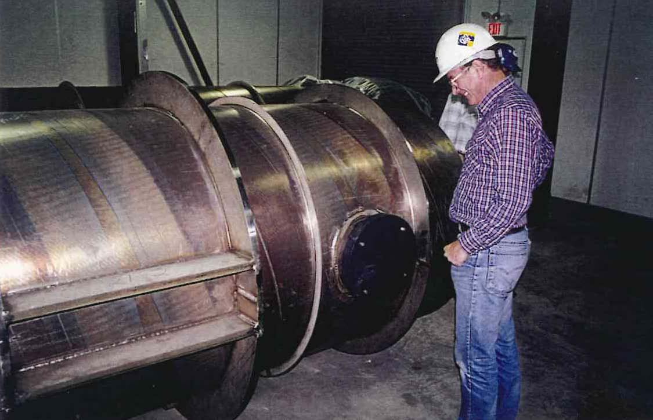

Slide 17
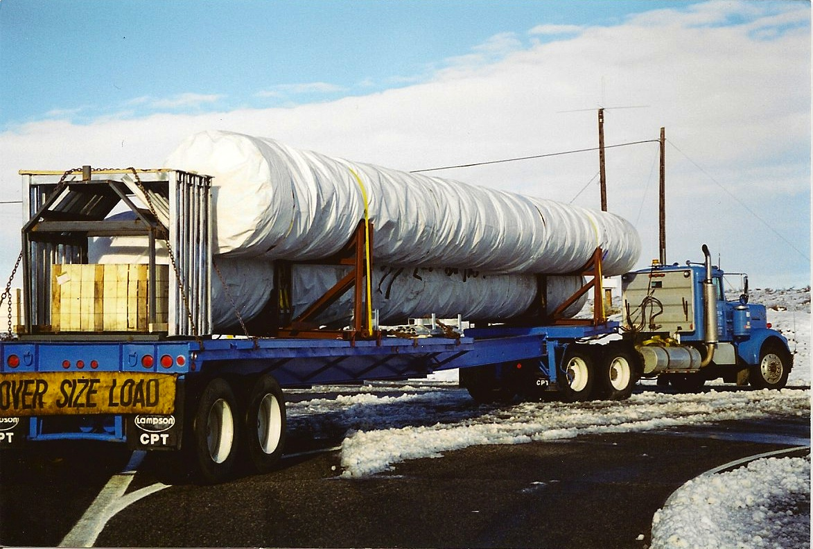

Slide 18
Installation Activities
Receive BT Section; inspect for shipping damage
Clean Section ends in Clean & Weld Ante Rooms
Remove end caps at joint to be welded
Remove end cap in clean room; verify air flow
Confirm personnel entering tube meet reqmts.
Inflate purge ring & flow purge gas
Fit up and tack weld joint
Visually inspect as fit condition
Weld circumferential joint
Confirm personnel entering tube meet reqmts.
Visually Inspect closing weld joint
Perform helium mass spectrometer test
Record results of test & examinations on reports & record dwgs.

Slide 19
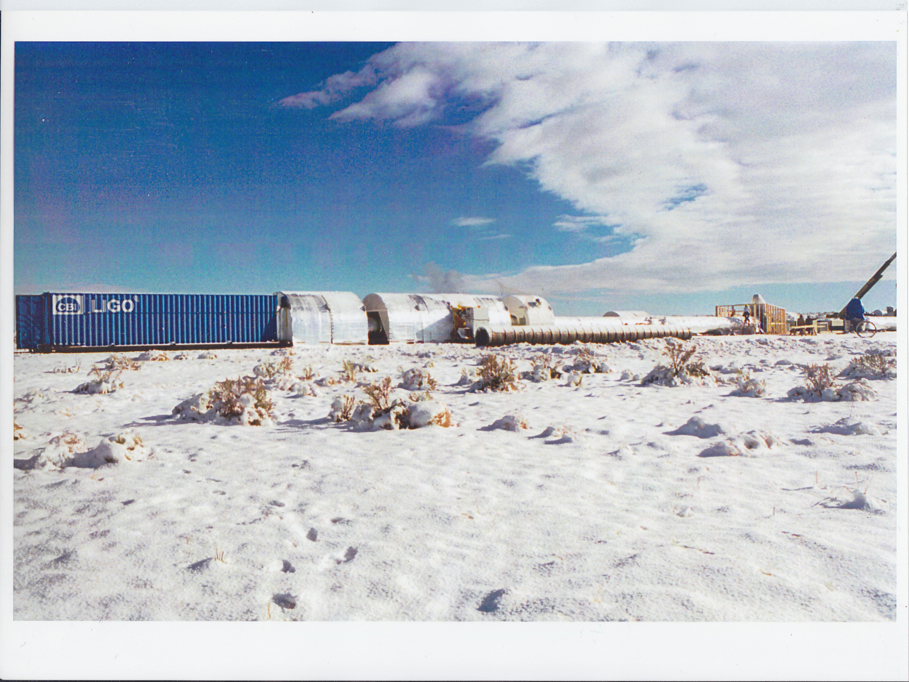

Slide 20
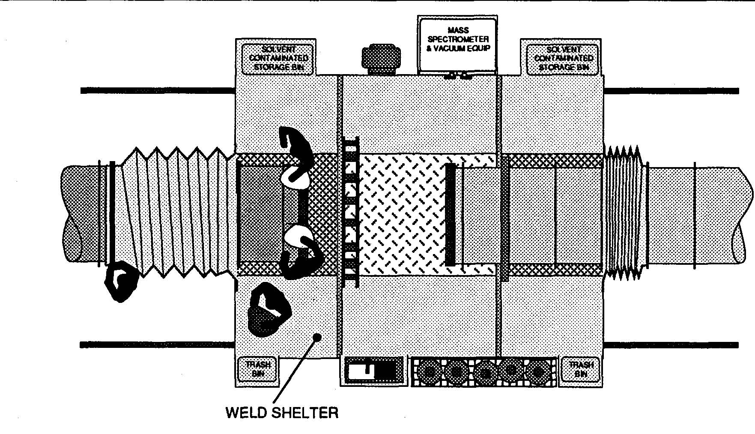

Slide 21
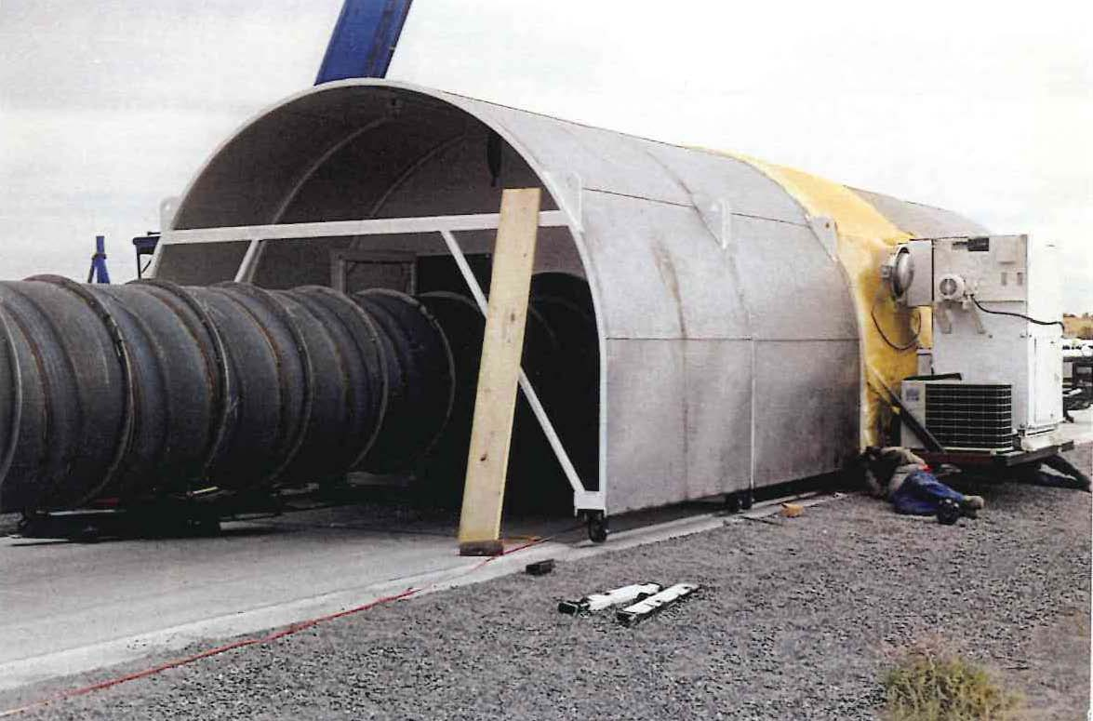

Slide 22
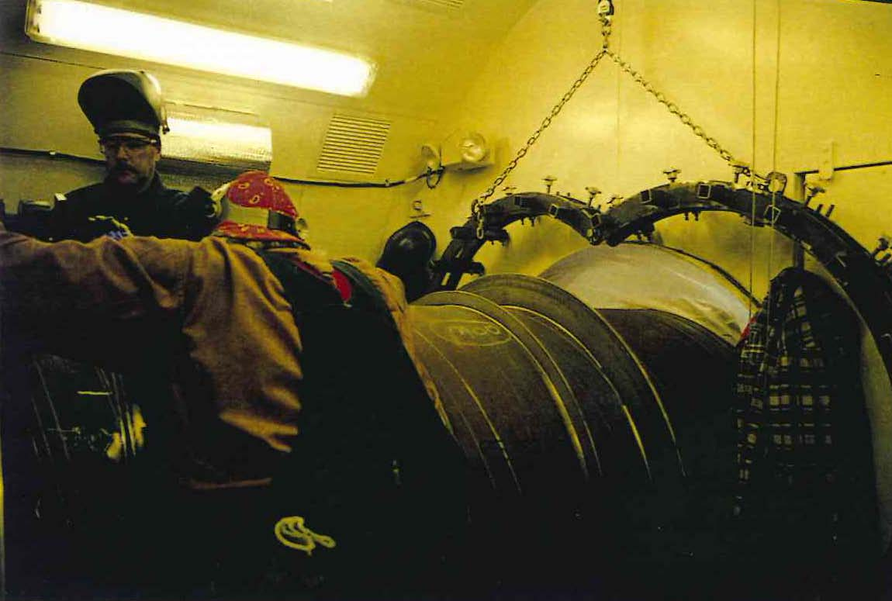

Slide 23
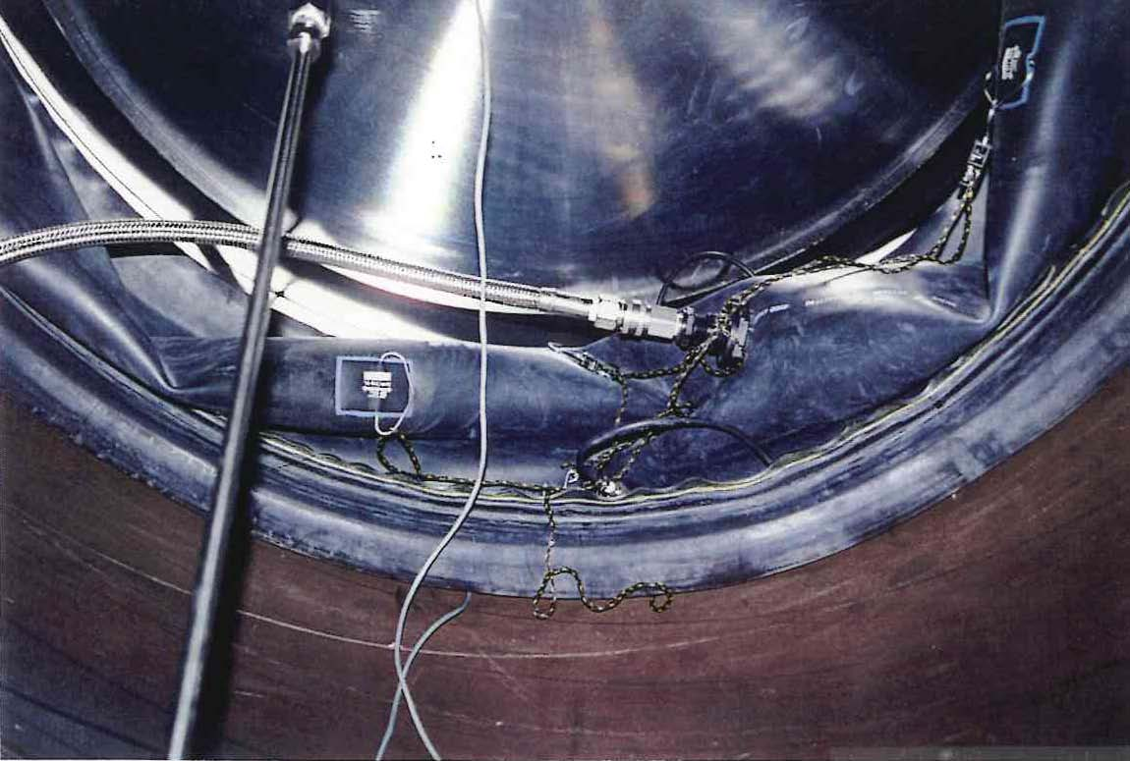

Slide 24
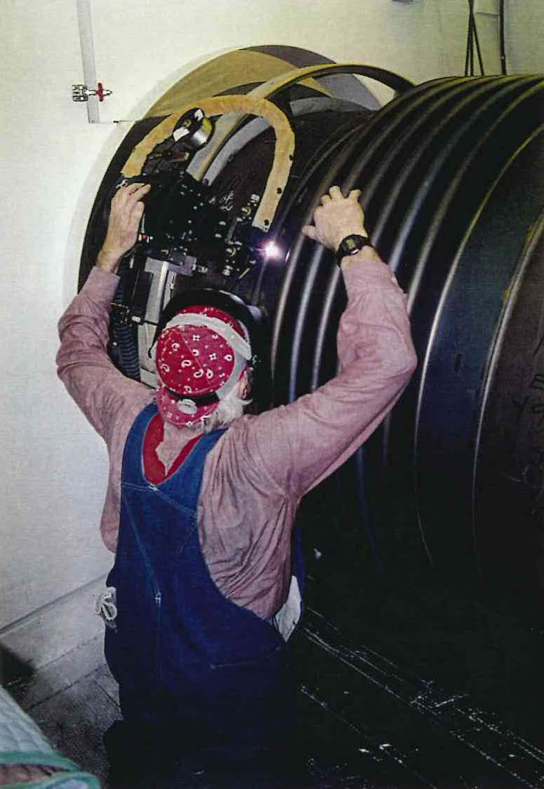

Slide 25
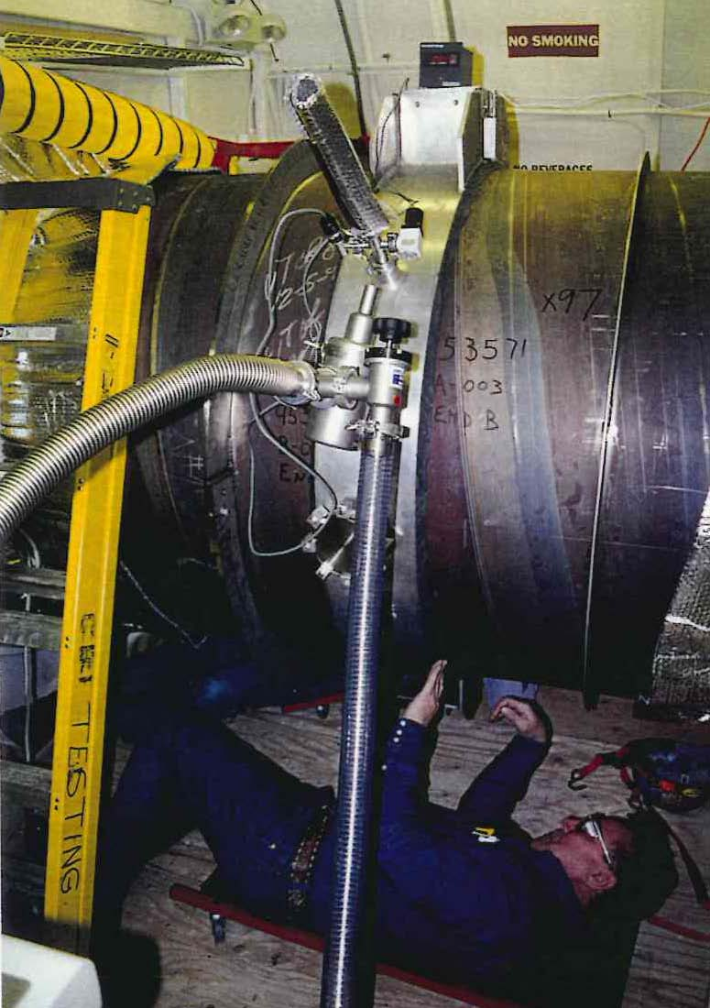

Slide 26
Installation Activities (cont’d.)
Install any required baffles in tube section
Remove access plug from previously cleaned BT
Inspect and clean BT interior
Install Clean Room end cap & double bag the end
Perform initial alignment of BT section
Install & tack structural supports
Weld structural supports to stiffeners & support gussets
Visually examine support attachment welds
Remove temporary supports
Remove expansion bellows restraints

Slide 27
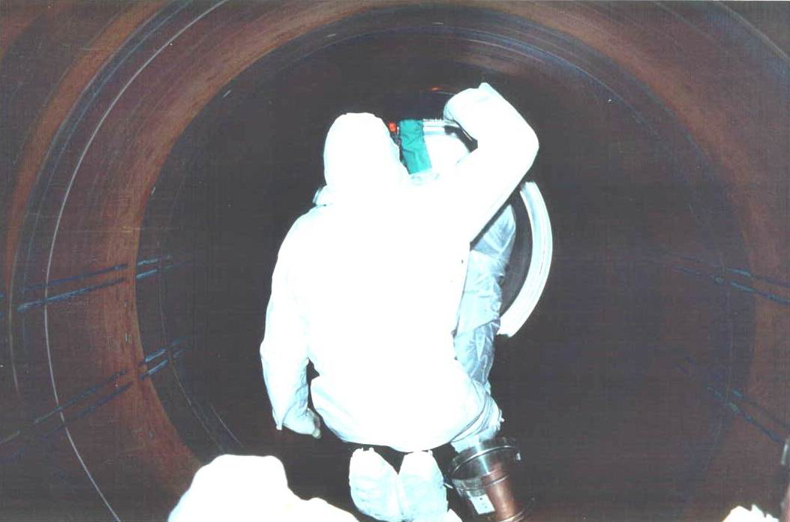

Slide 28
Installation Activities (cont’d.)
Other Tasks:
Special steps for BT Termination sections
Special steps for circumferential weld repairs
Verify BDF flow is sufficient, clean & dry
Clean work rooms before each day of work
Verify clean room air isolation from outside
Verify positive air flow from clean room HVAC
Verify adequate balancing from clean room exhaust system to compensate for BDF flow

Slide 29
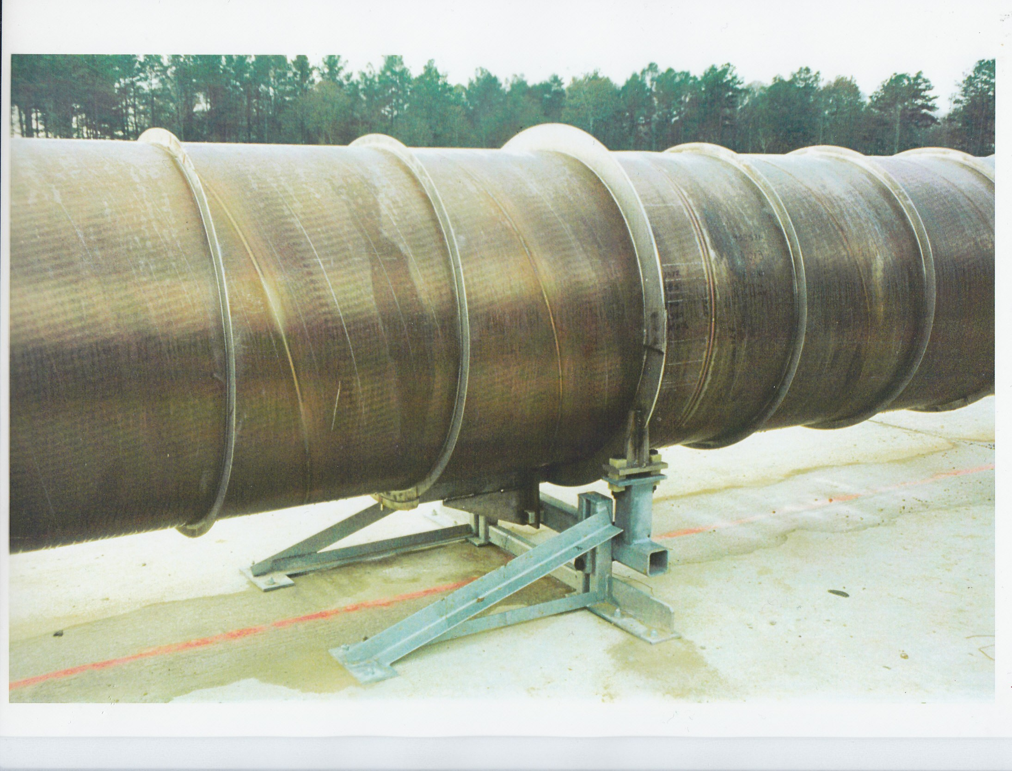

Slide 30
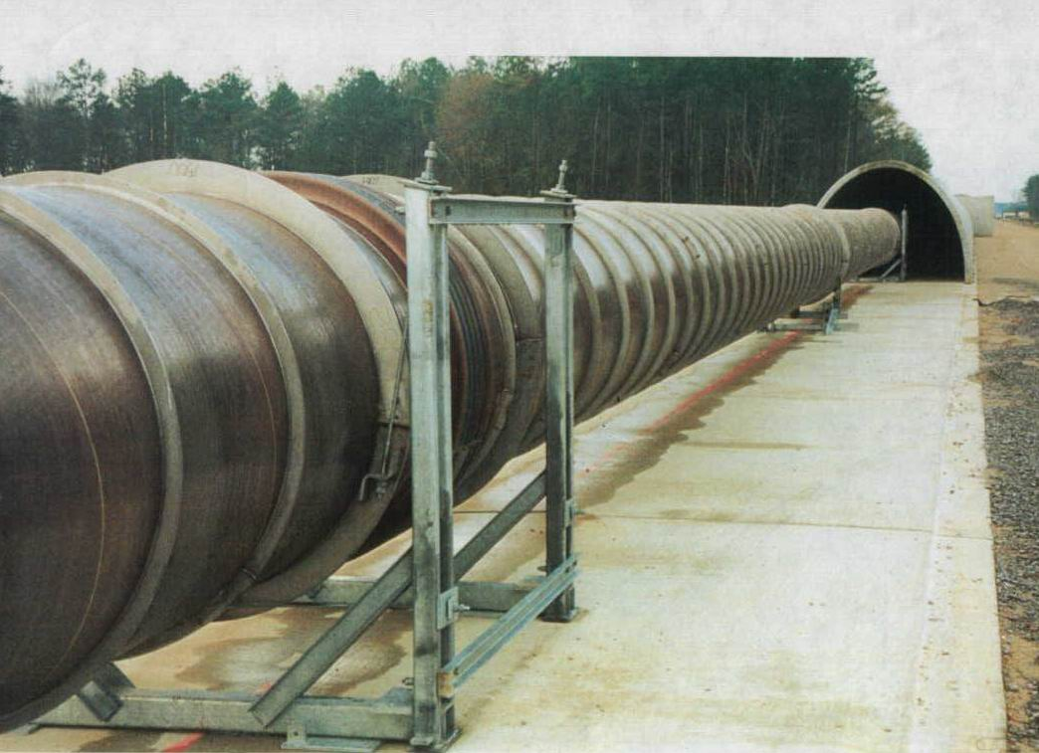

Slide 31
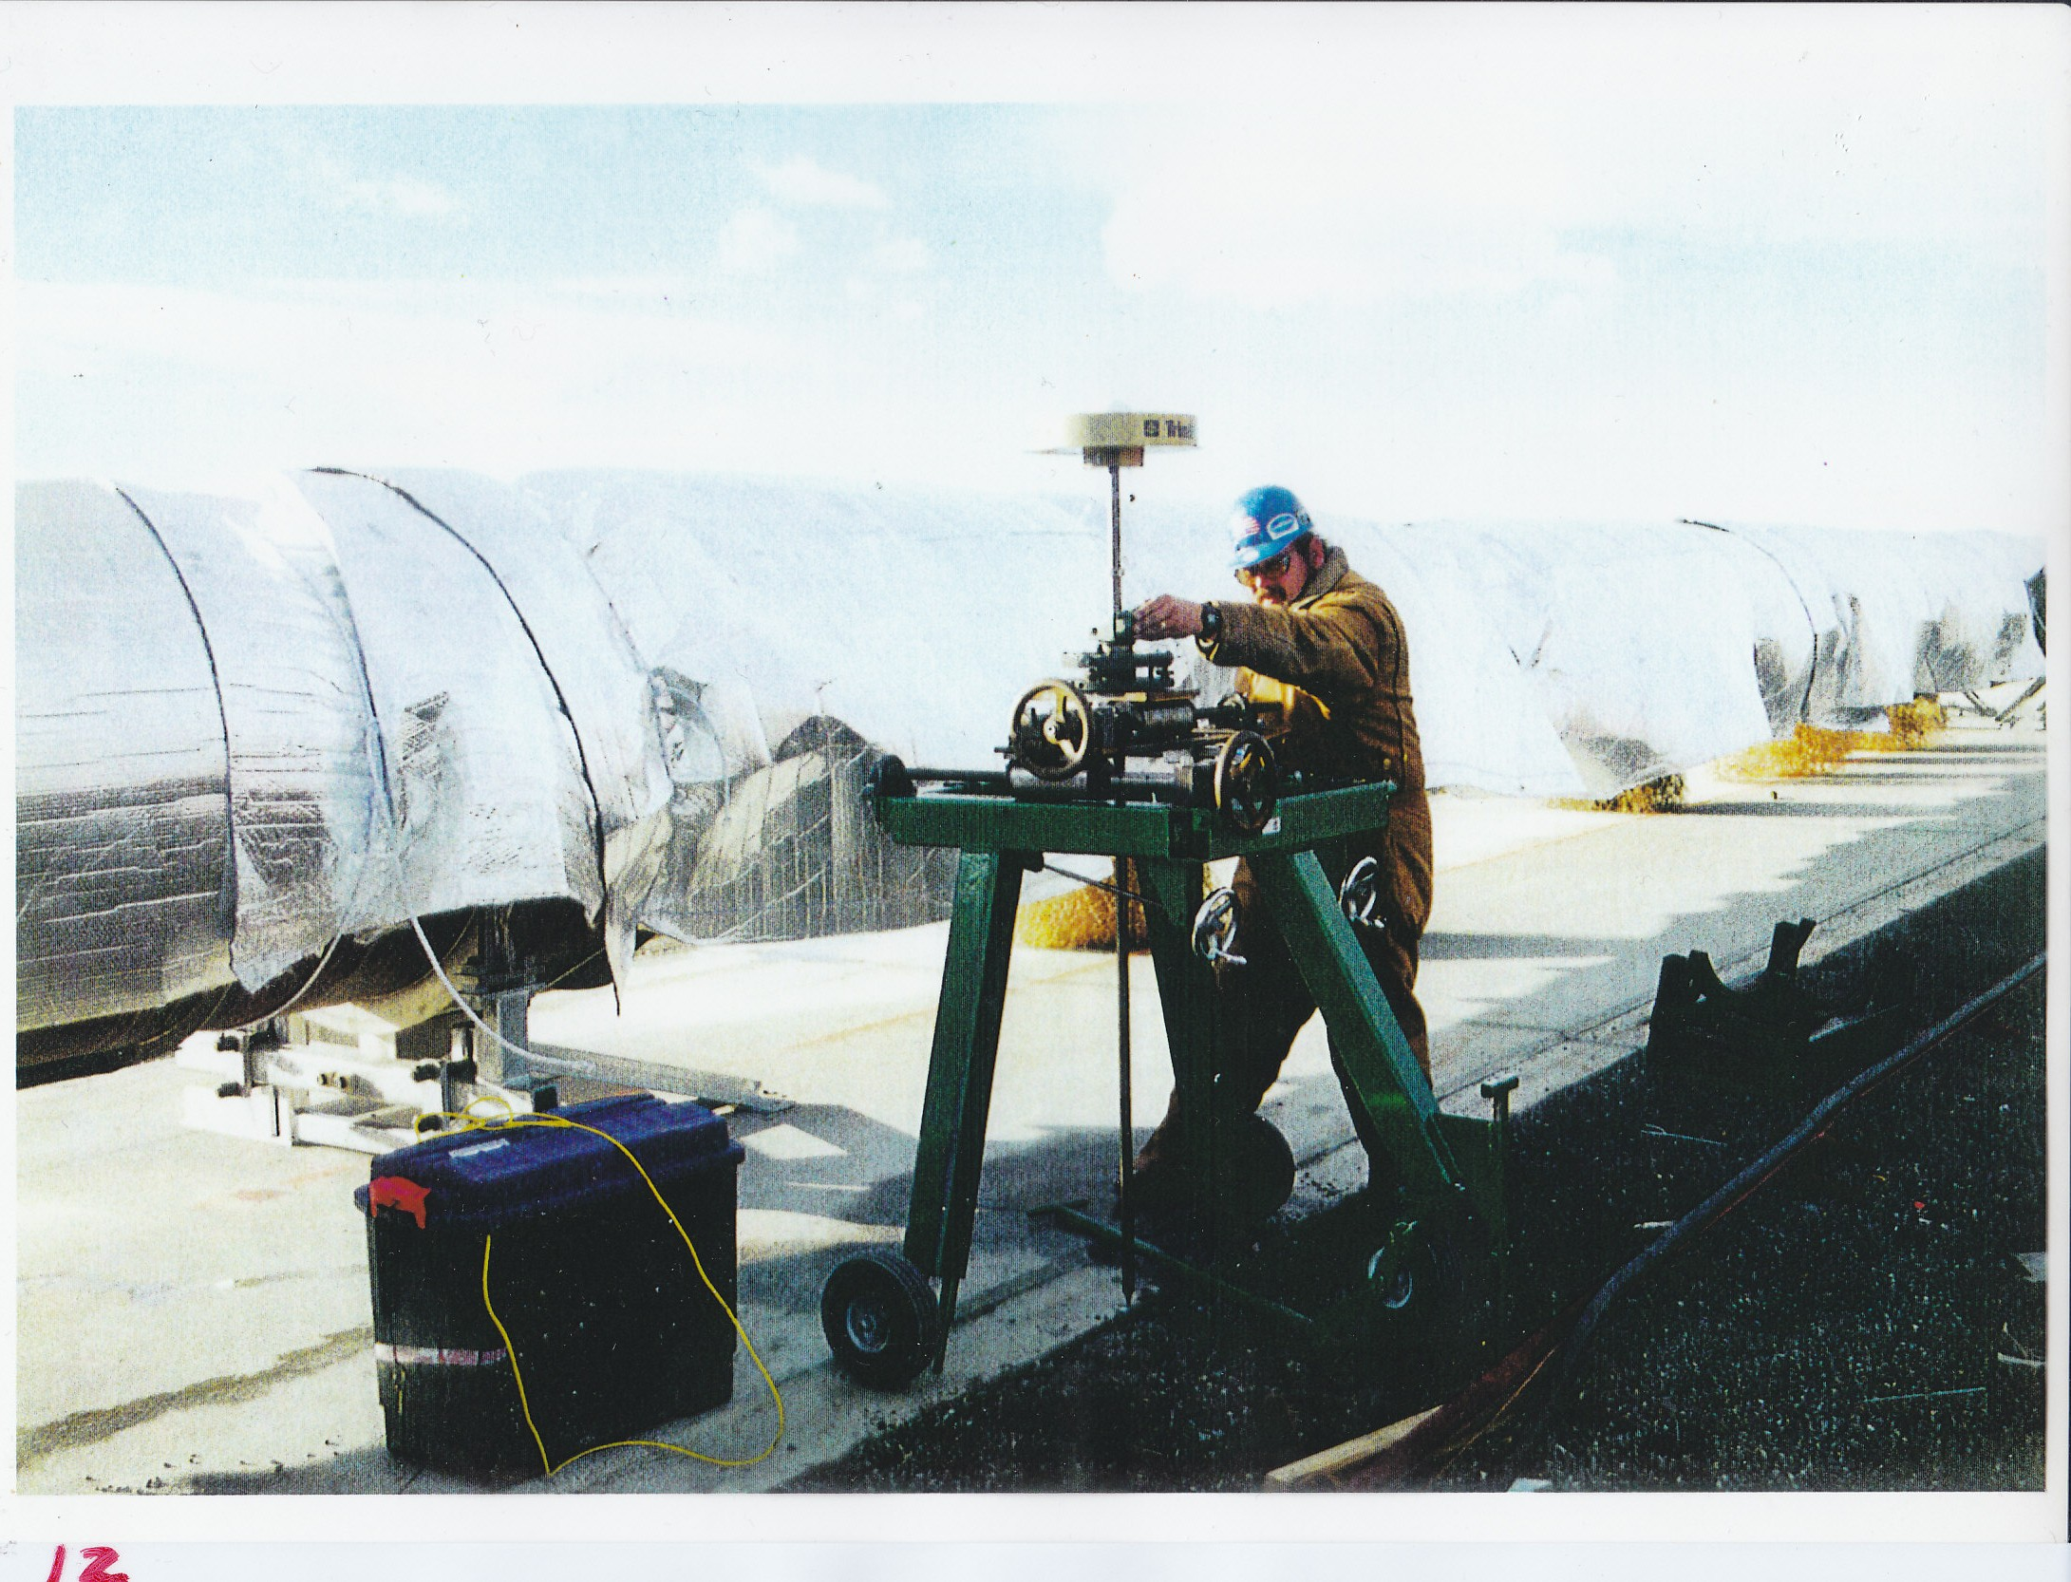

Slide 32
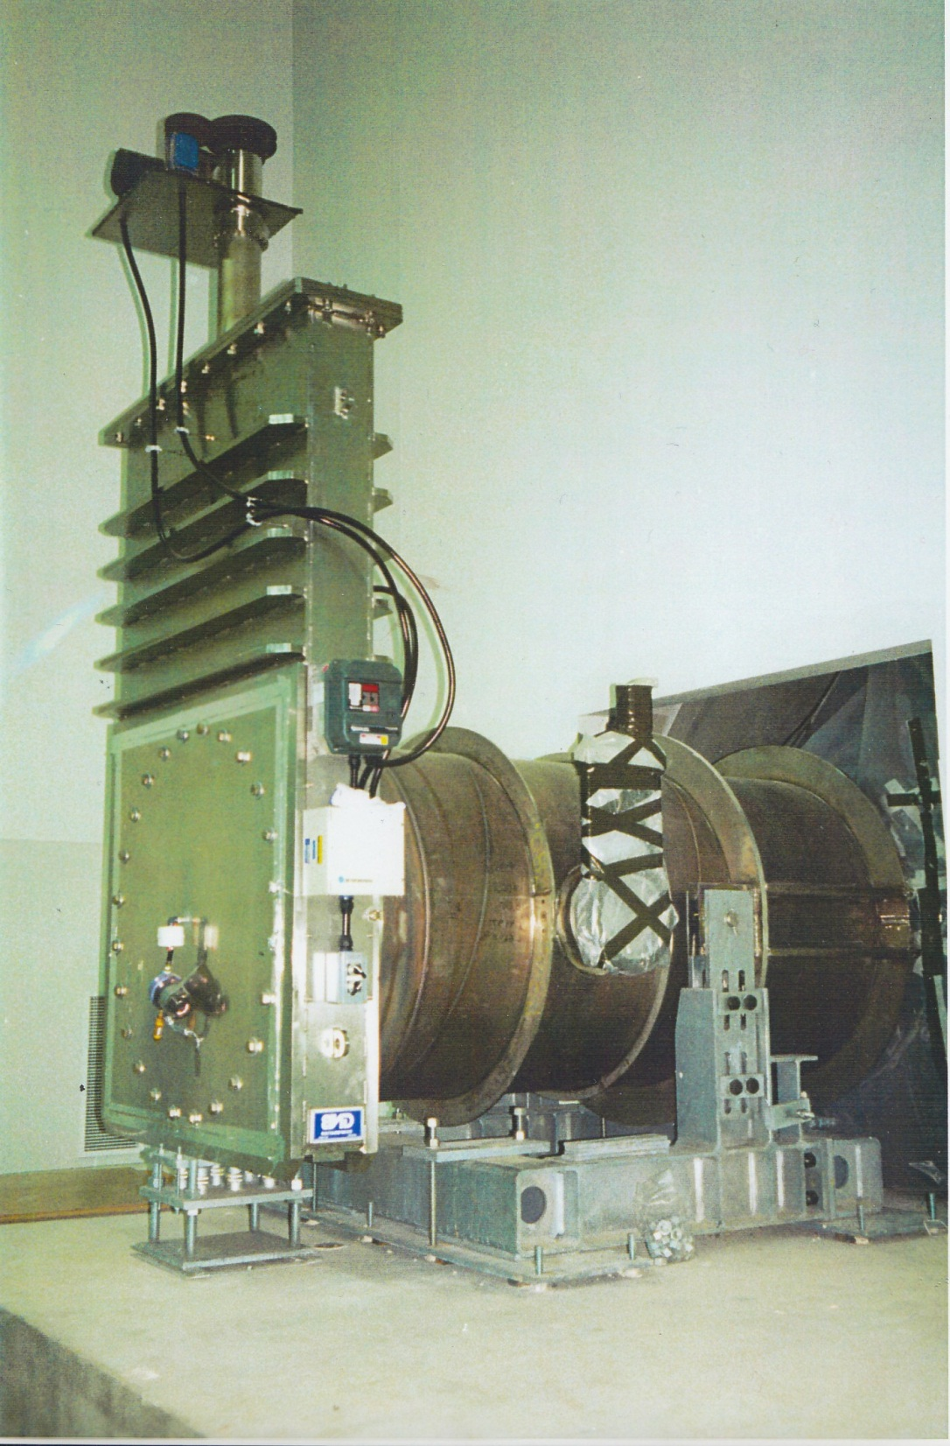

Slide 33
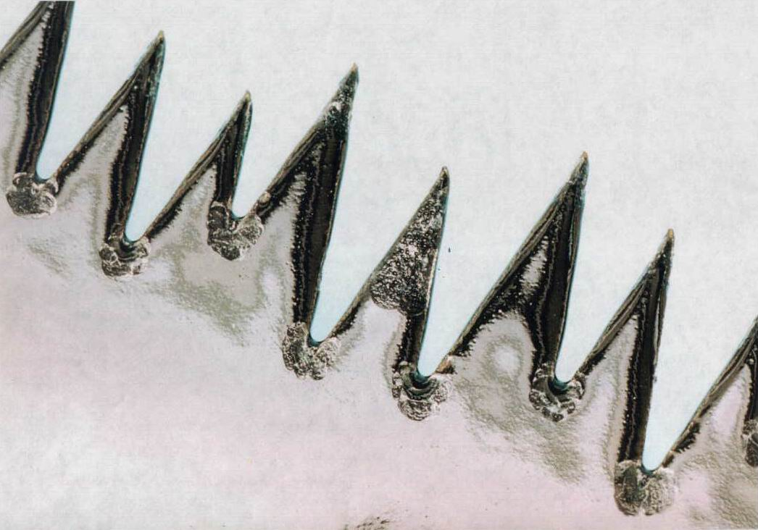

Slide 34
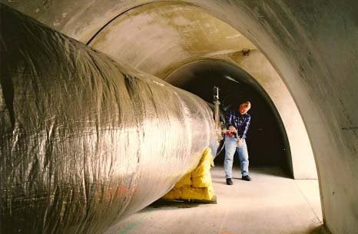

Slide 35
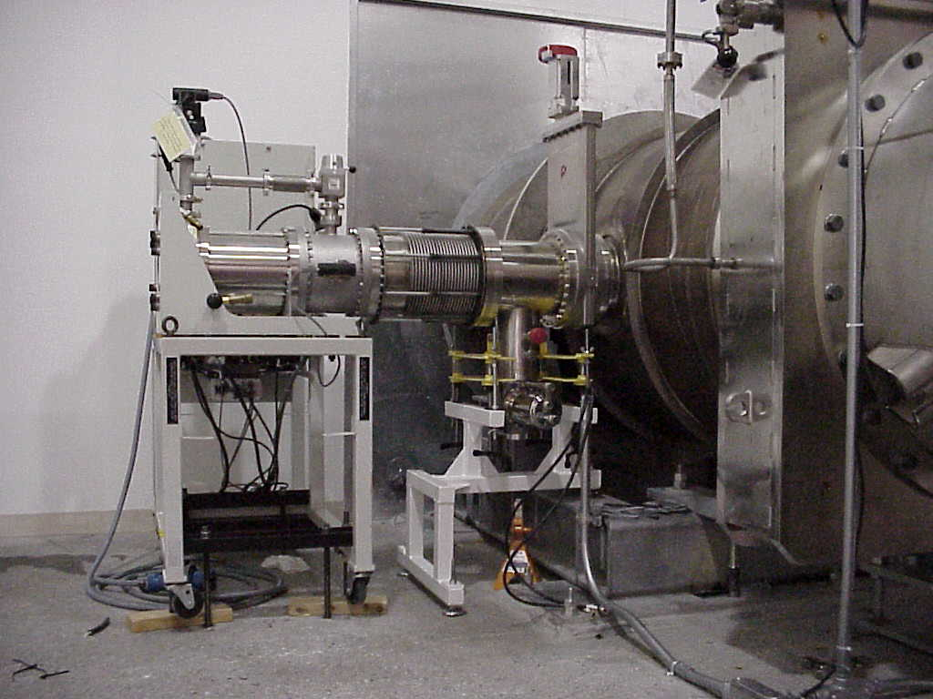

Slide 36
Acceptance Test Results, Post Bake

Slide 37
