Slide 1
Some History and Prospects
R.Weiss, MIT
Multi-Messenger Astronomy in the Era of LIGO-India
Khandala, India
January 17, 2019

Slide 2
Einstein 1916

Slide 3
Einstein 1916

Slide 4
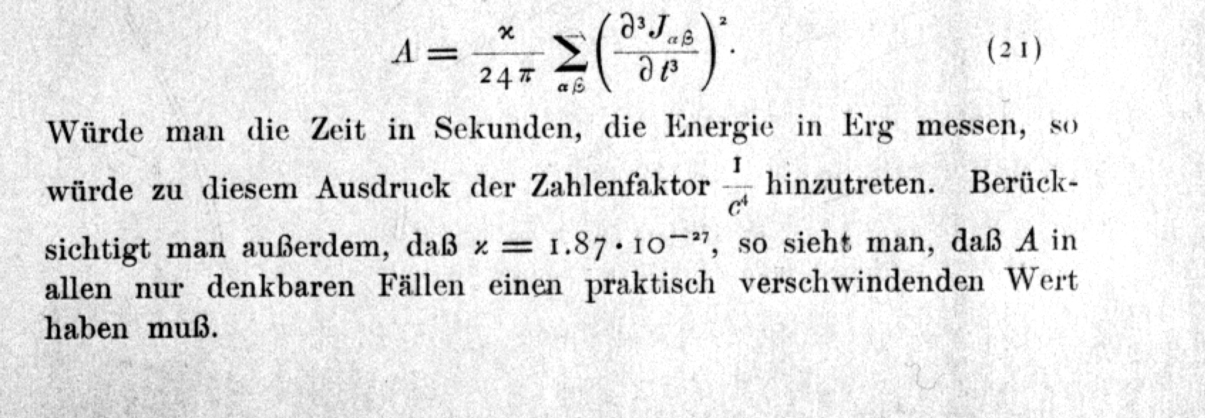
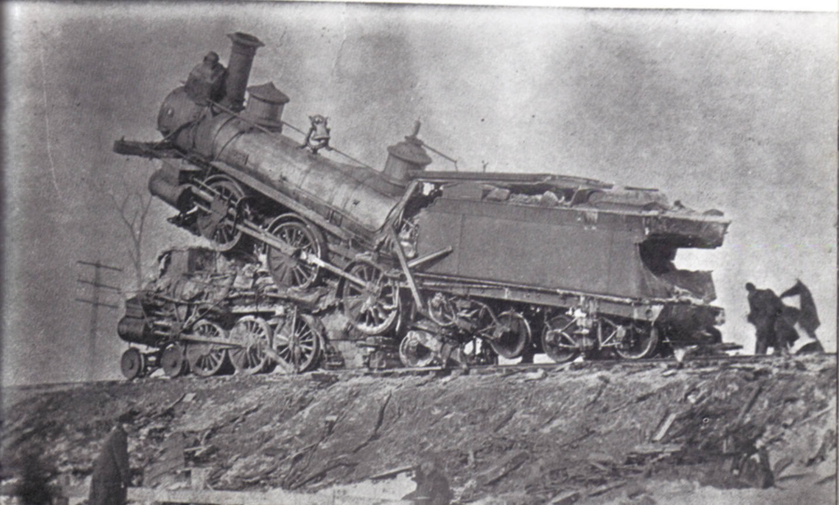
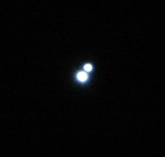
Einstein 1916
“…..in any case one can think of A will have a practically
vanishing value.”
1916 examples: train colllision binary star decay
m = 10⁵ kg
v = 100km/hr
T_{collision} = 1/3 sec
R_{radiation}= 300km
h ~ 10⁻⁴²
m₁=m₂= 1 solar mass
T_{orbit}= 1 day
R = 10 Kly
h ~ 10⁻²³ @ ½ day period

Slide 5
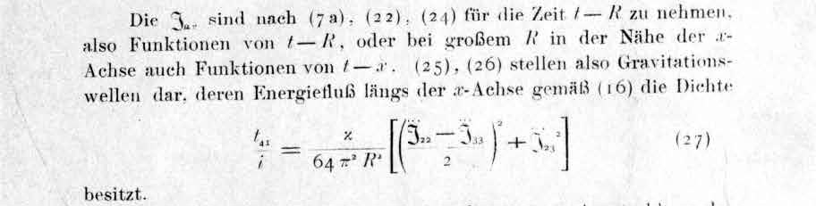
Einstein 1918
The quadrupole formula a factor of 2 too small

Slide 6
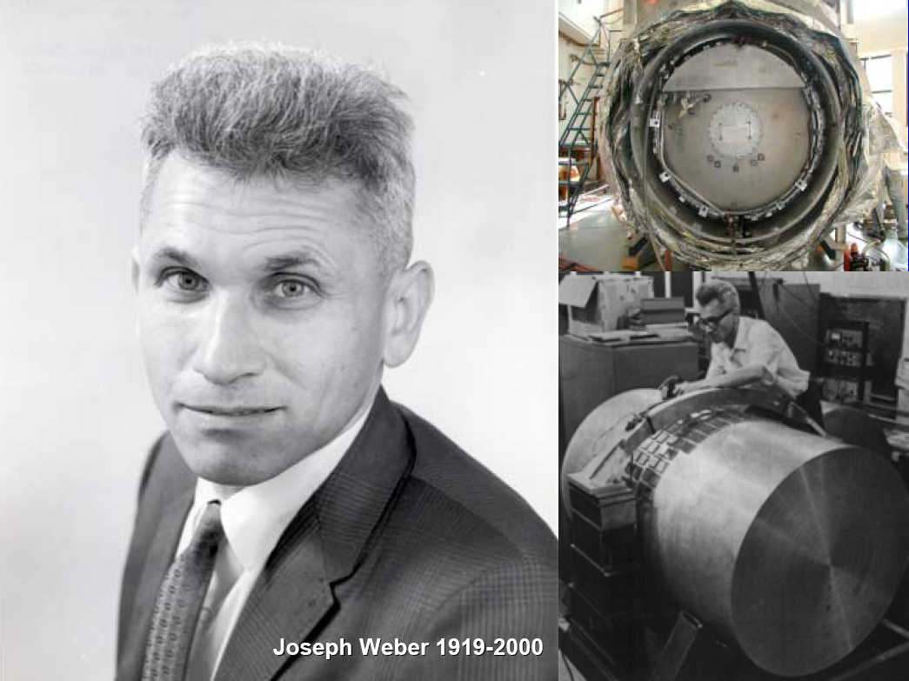

Slide 7
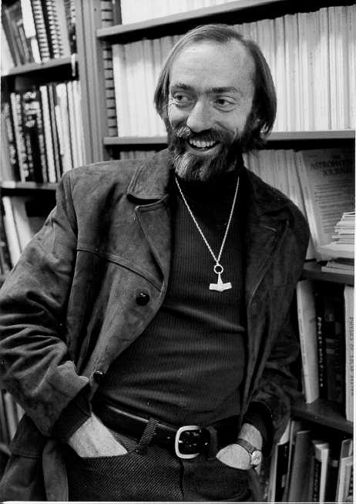
K. Thorne

Slide 8
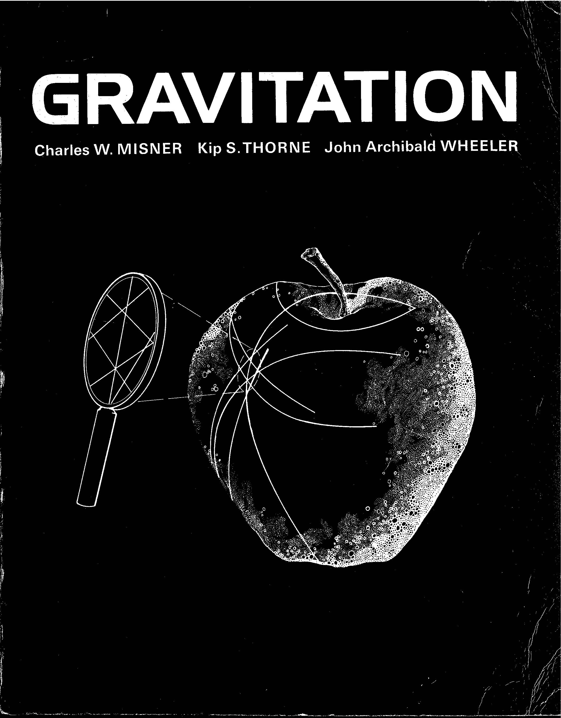

Slide 9
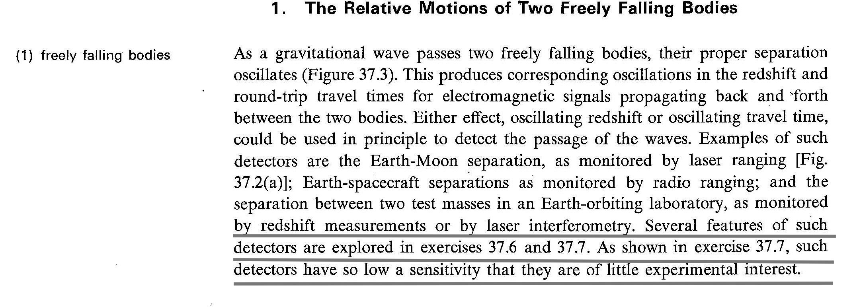
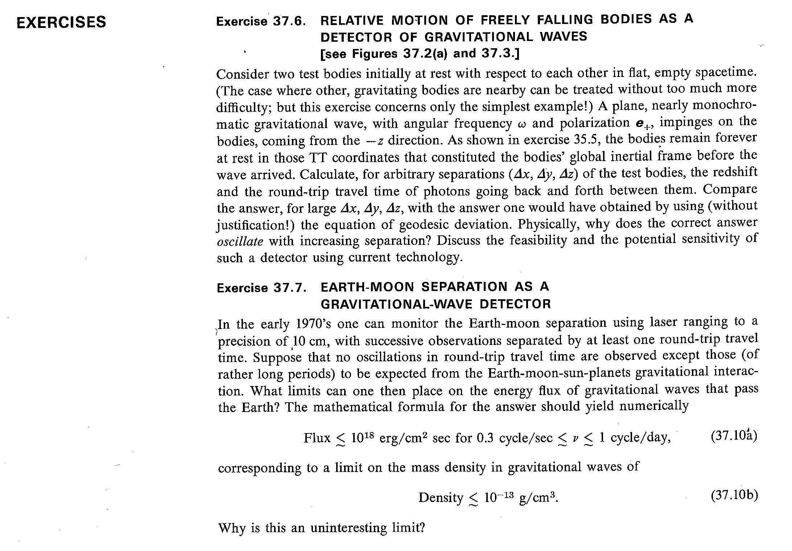

Slide 10
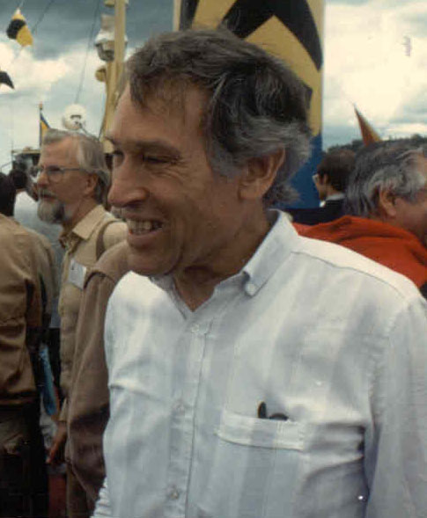
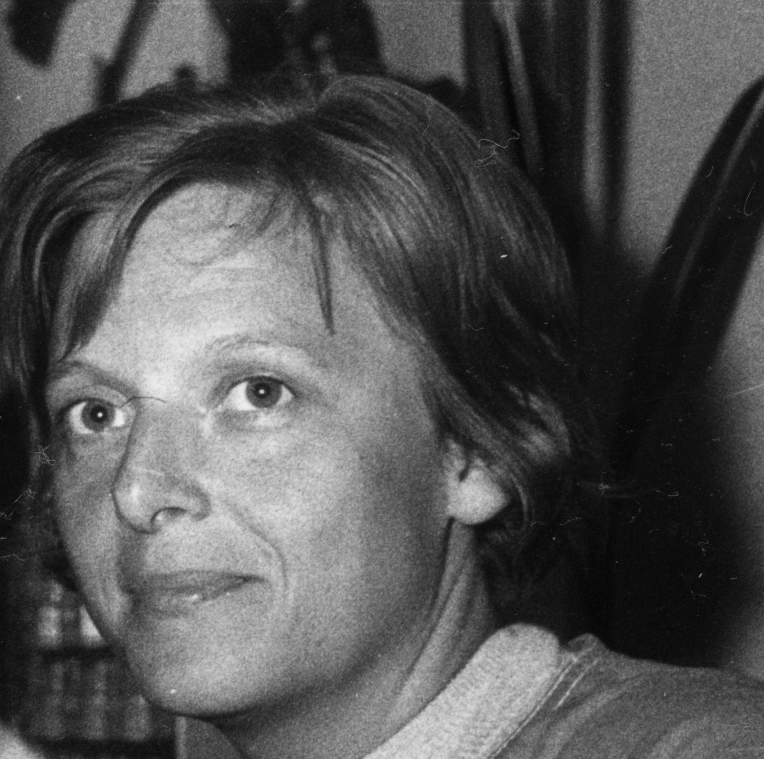

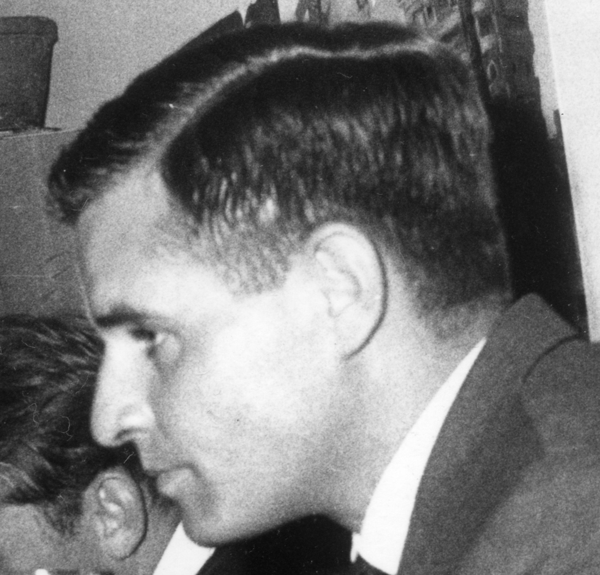
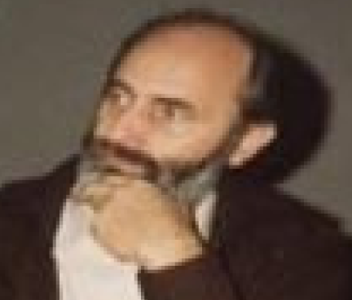
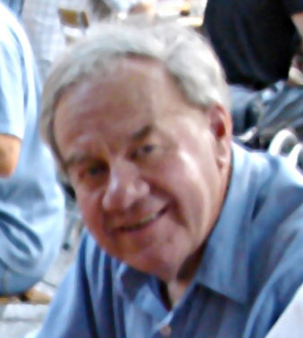
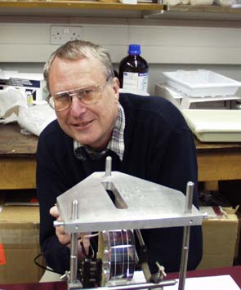
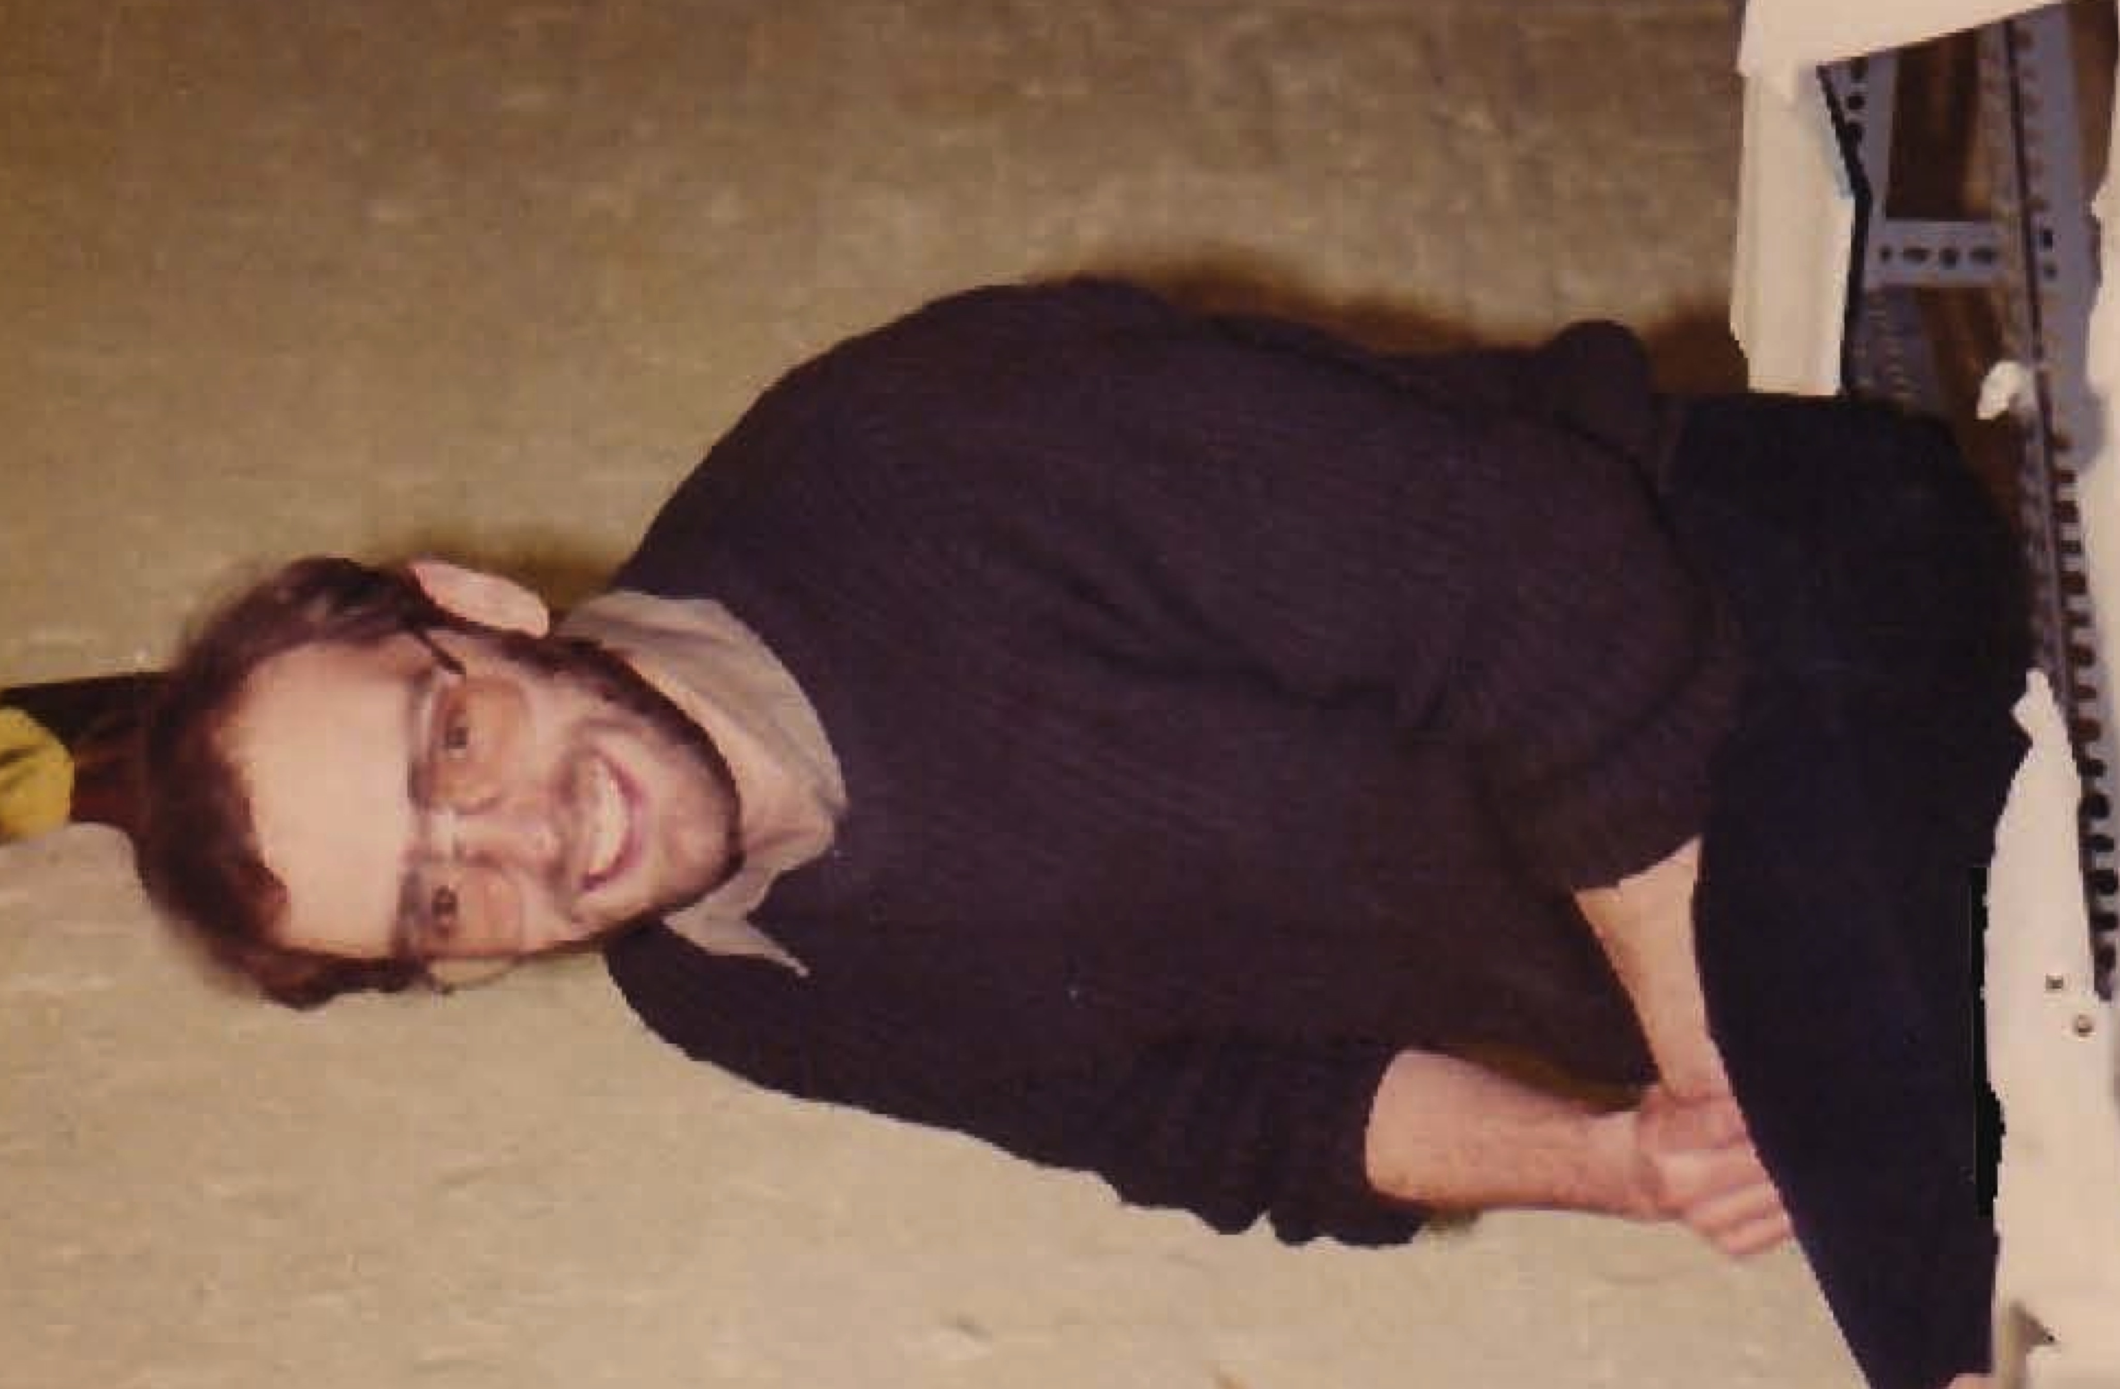
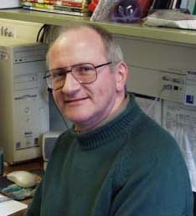
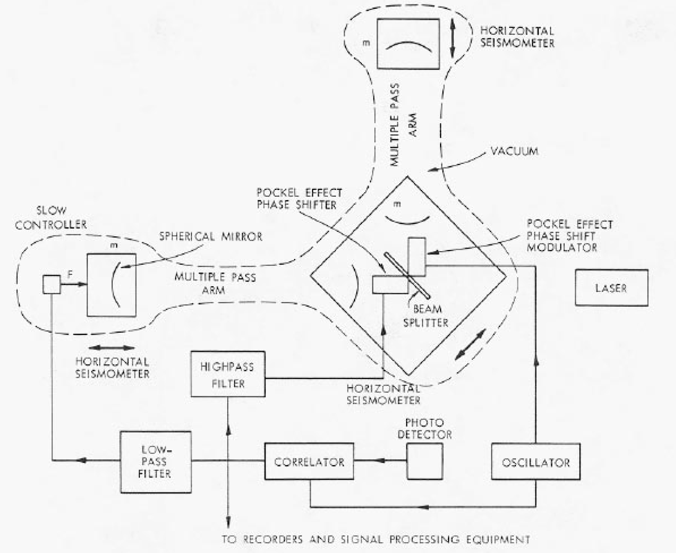
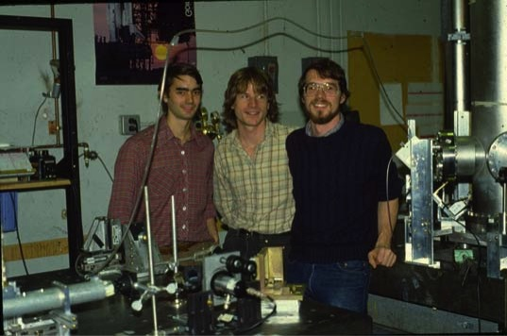
Initial interferometric GW detector groups late 1970’s
H. Billing
L. Schnupp
K. Maischberger
W.Winkler
Max Planck Garching
R. Schilling
A. Rudiger
Glasgow
J. Hough
B. Meers
R. Drever
H. Ward
MIT
J. Livas , D.H. Shoemaker, D. Dewey

Slide 11
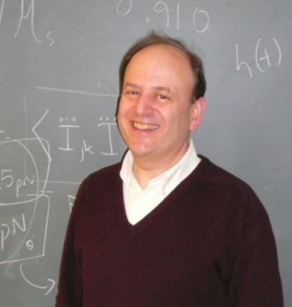
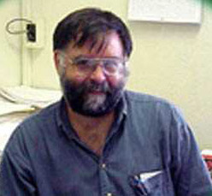
P. Saulson
S. Whitcomb

Slide 12
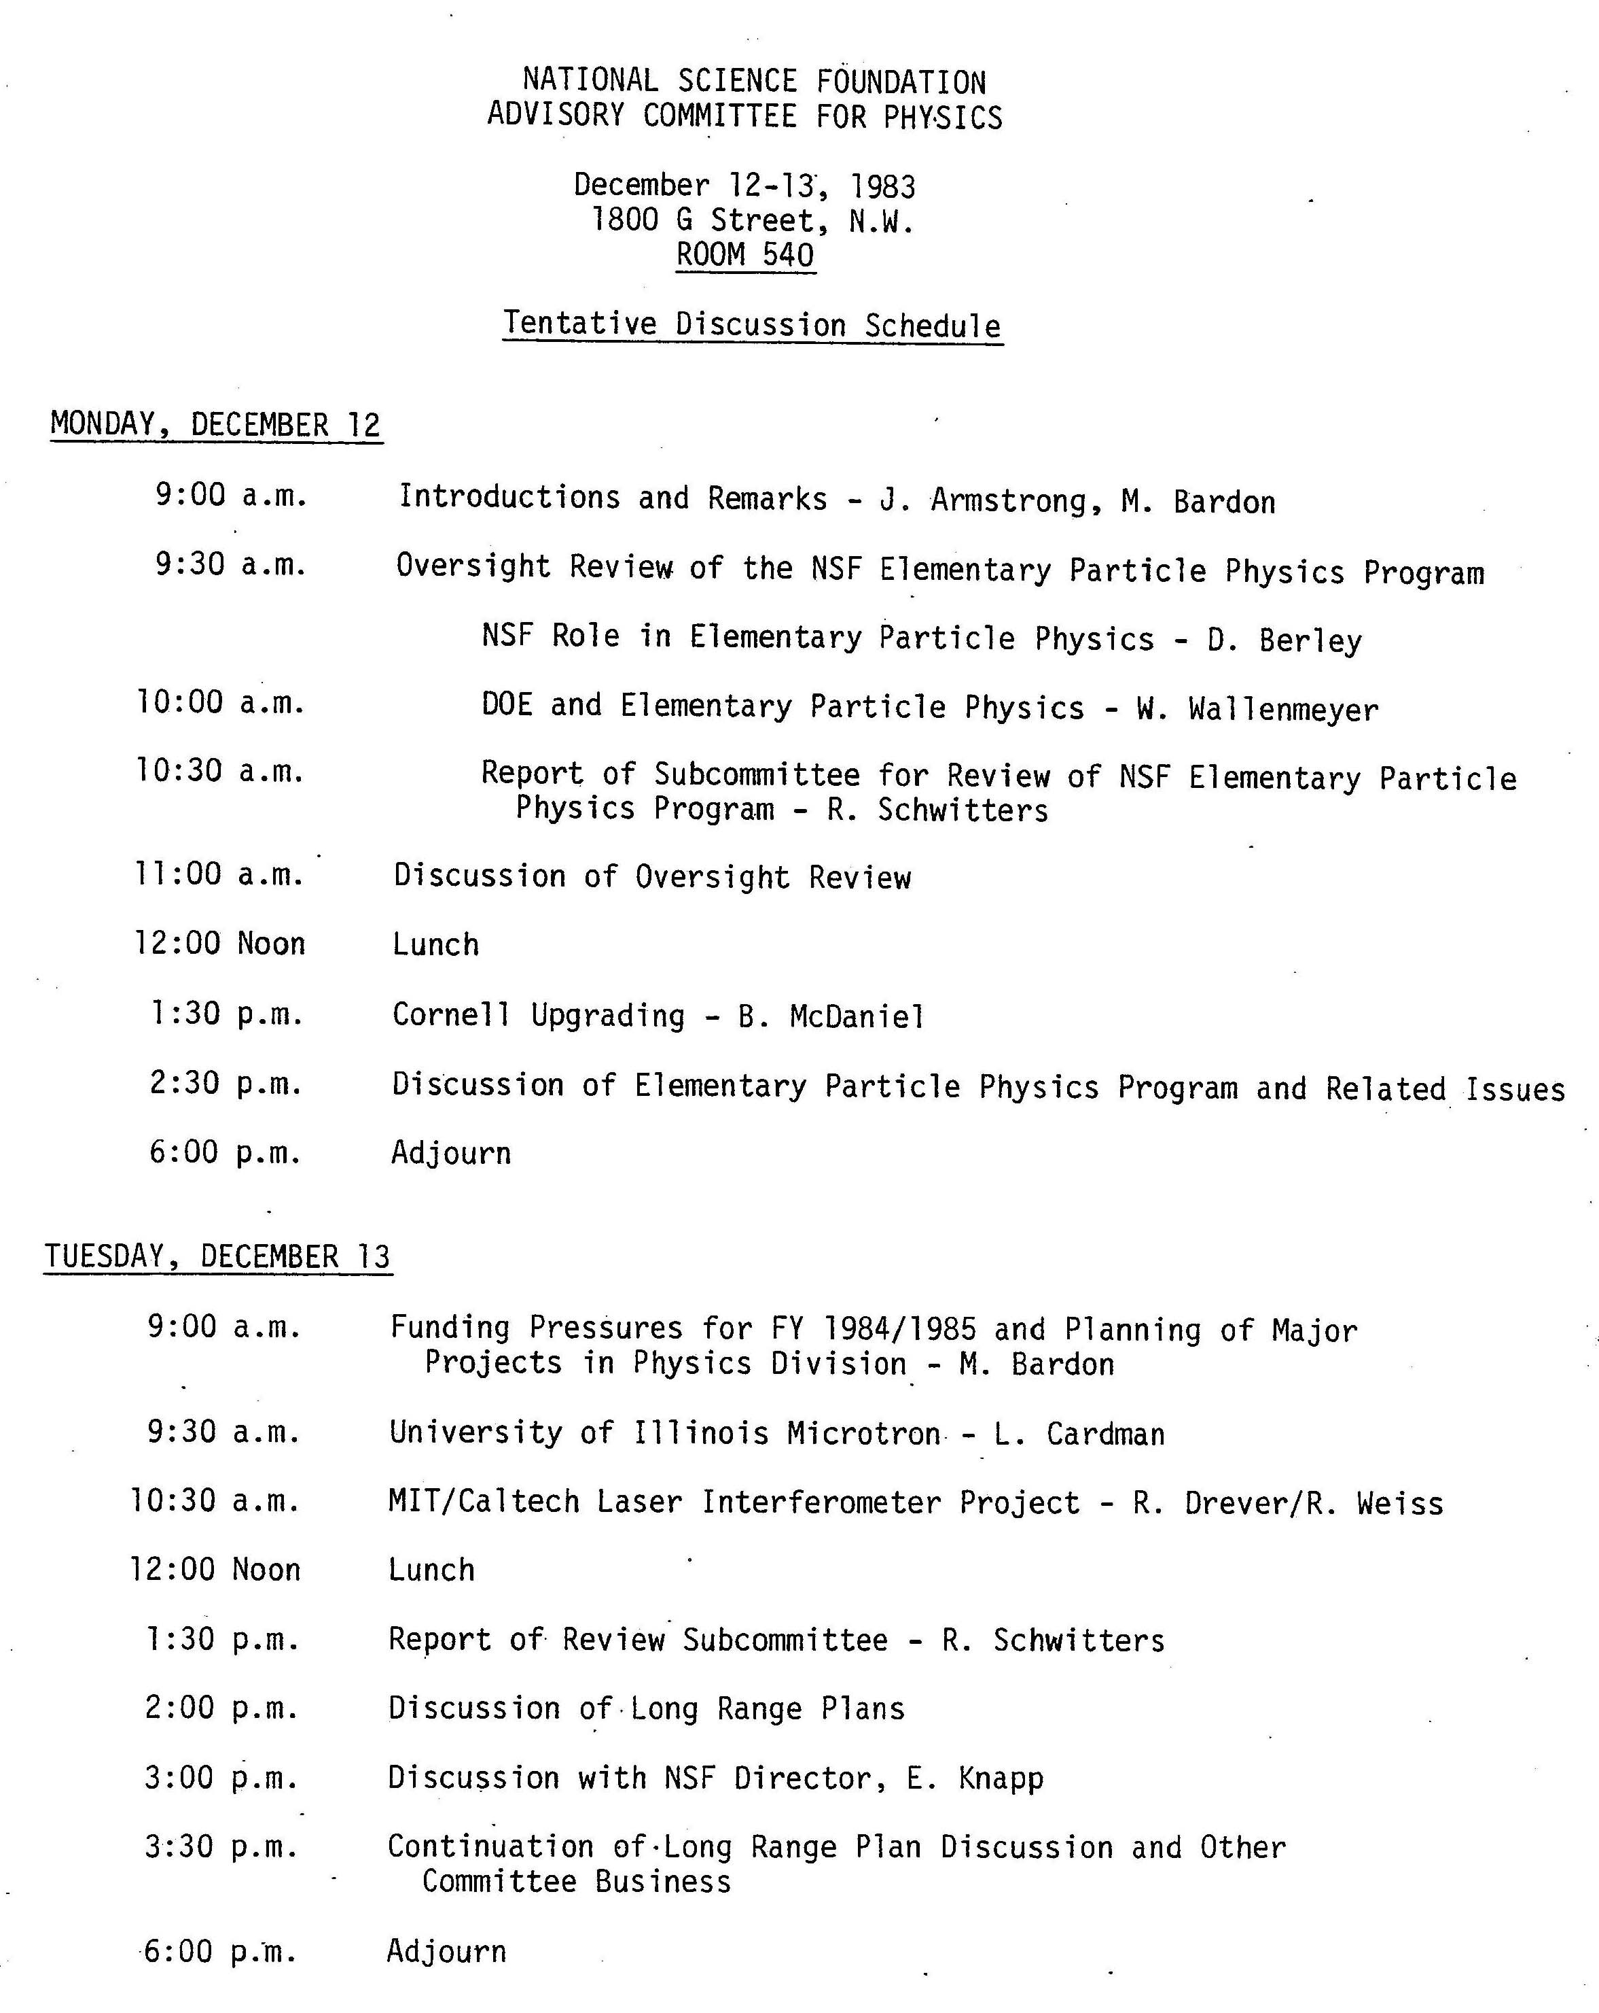

Slide 13
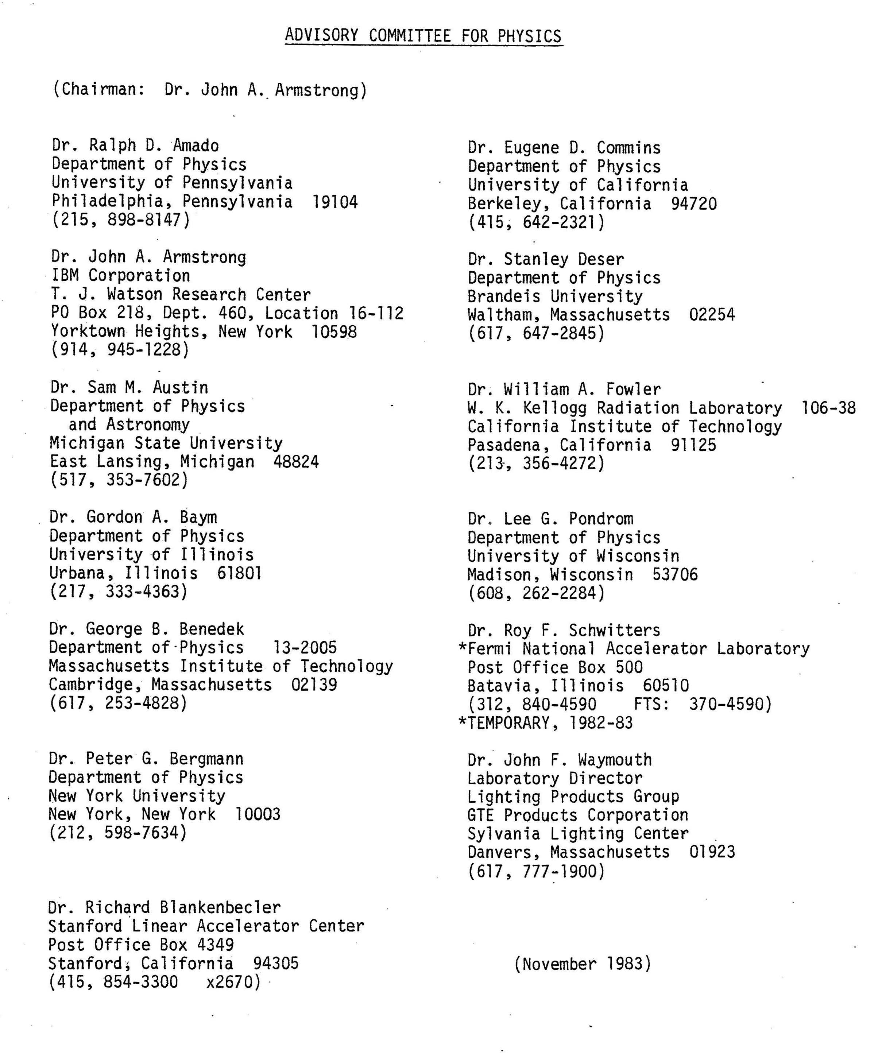

Slide 14
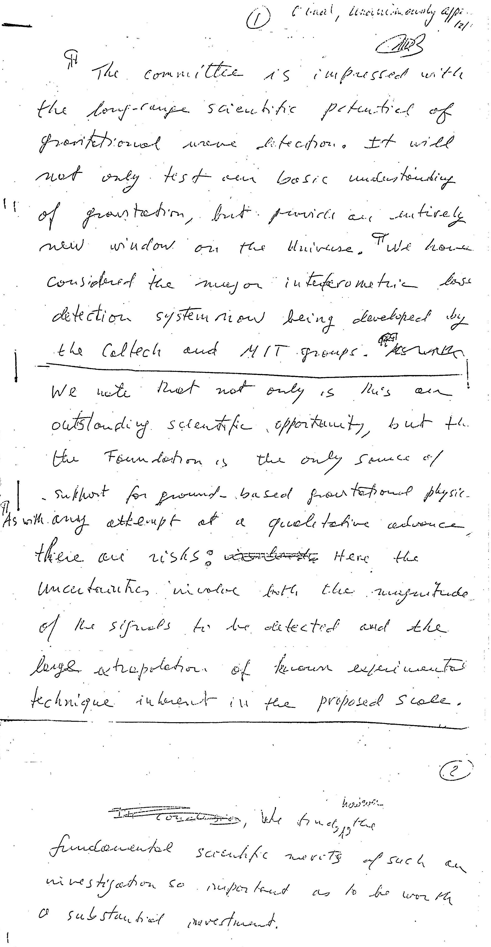
Subcommittee:
G. Baym
S. Deser
R. Schwitters

Slide 16
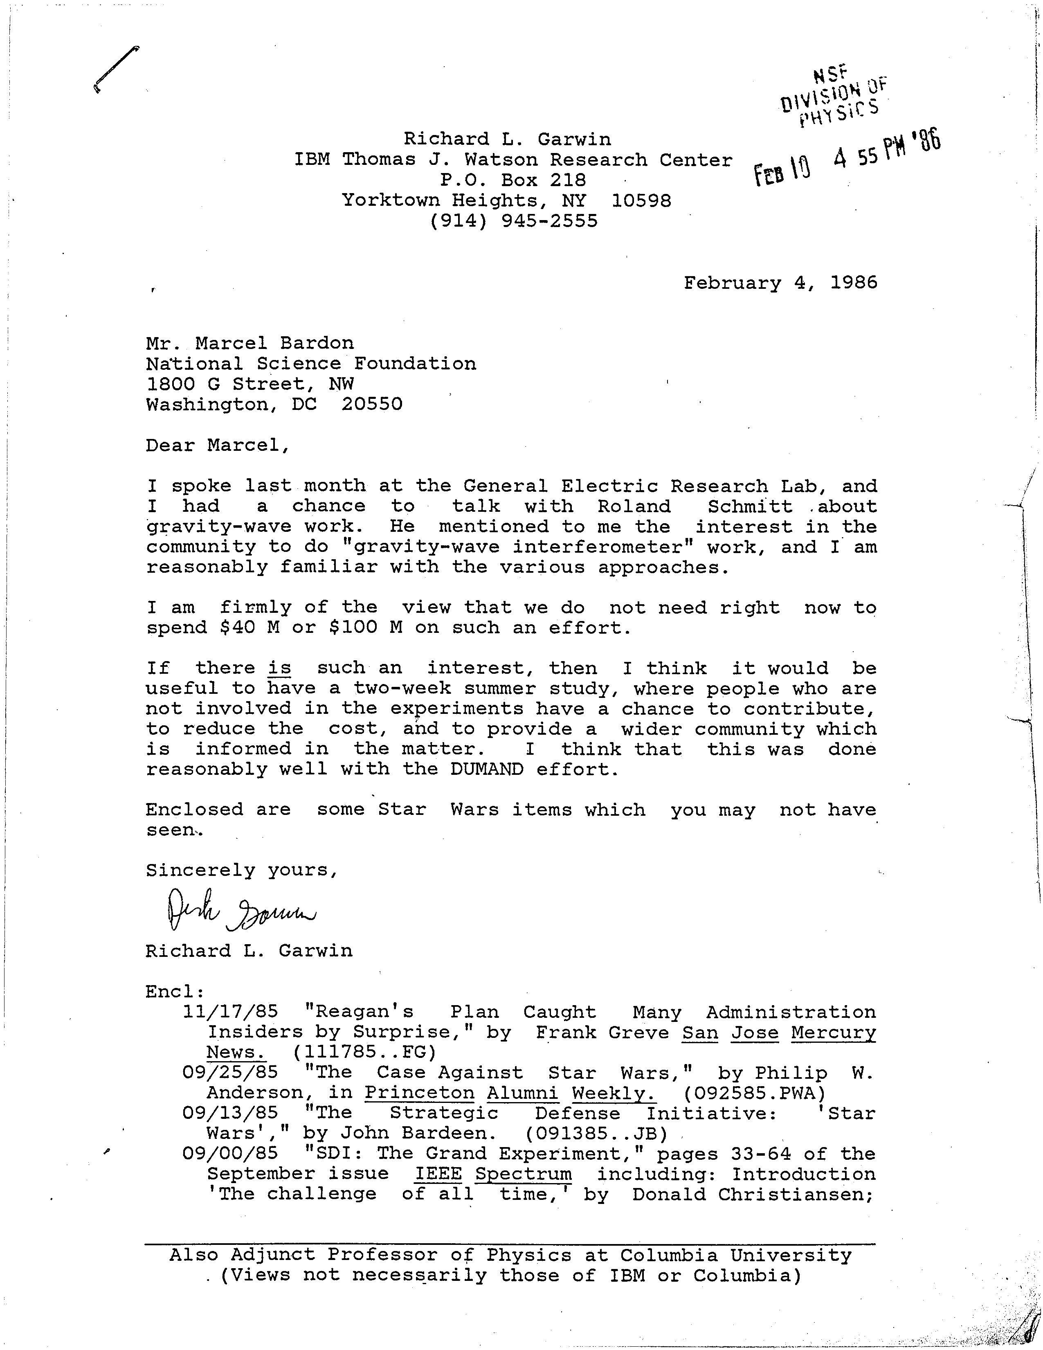

Slide 17
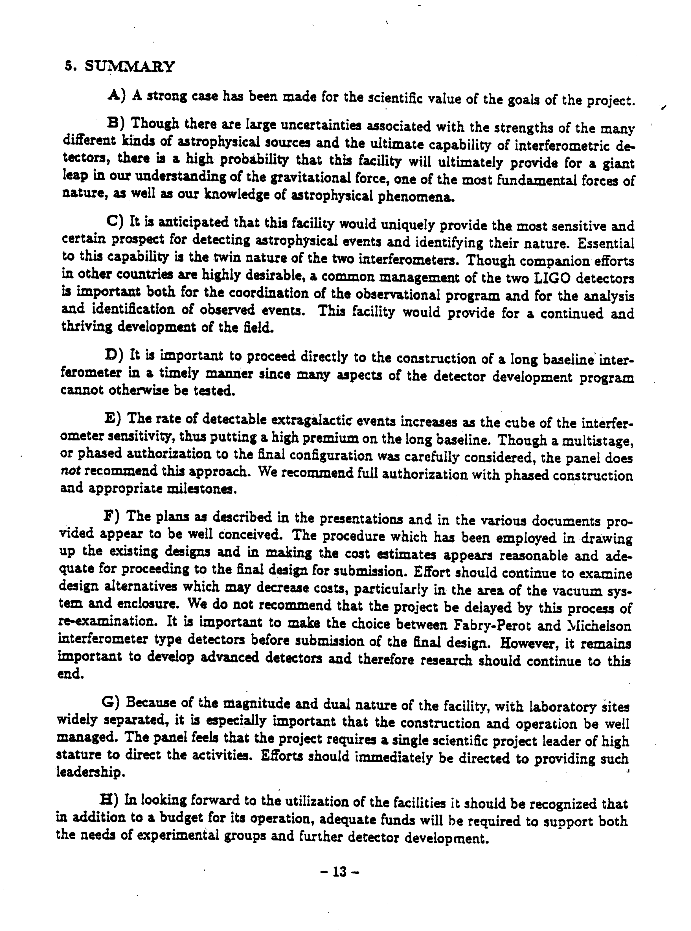
Report to the NSF
Panel on interferometric observatories for
Gravitational waves January 1987

Slide 18
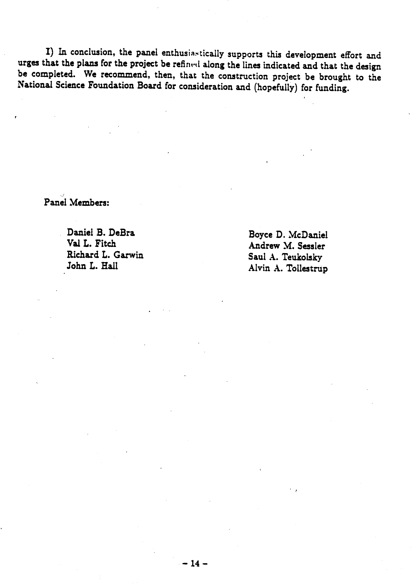
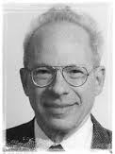
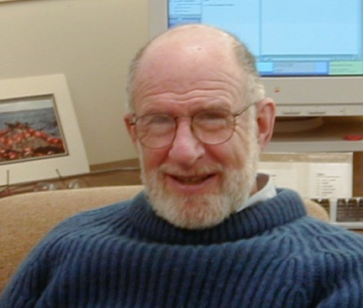
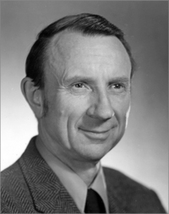
A. Sessler
B. McDaniel
R. Garwin

Slide 19
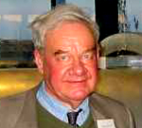
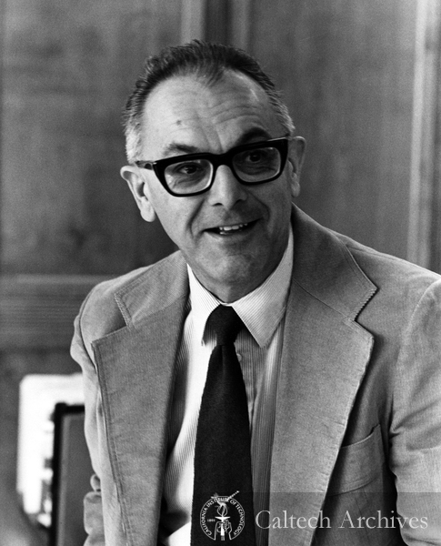
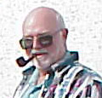
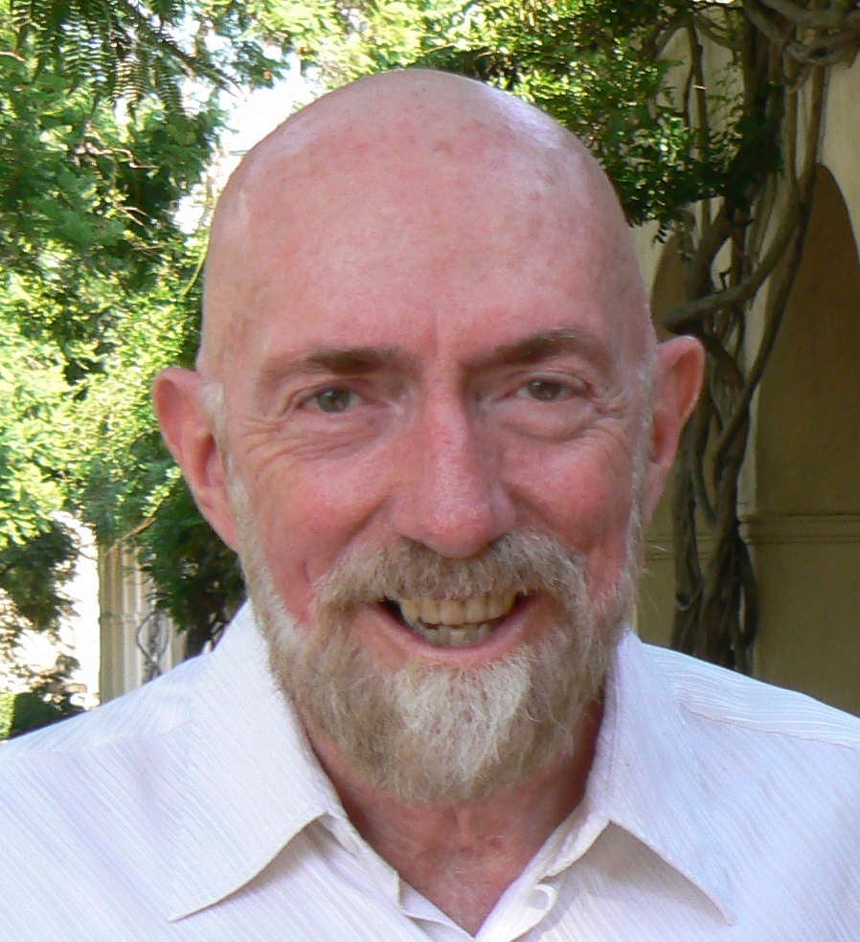
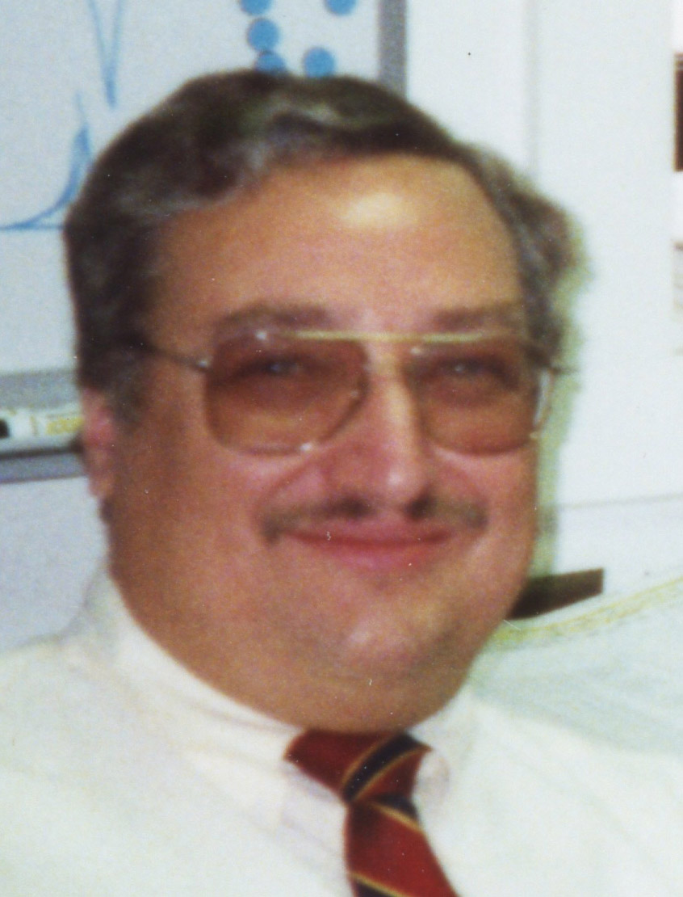
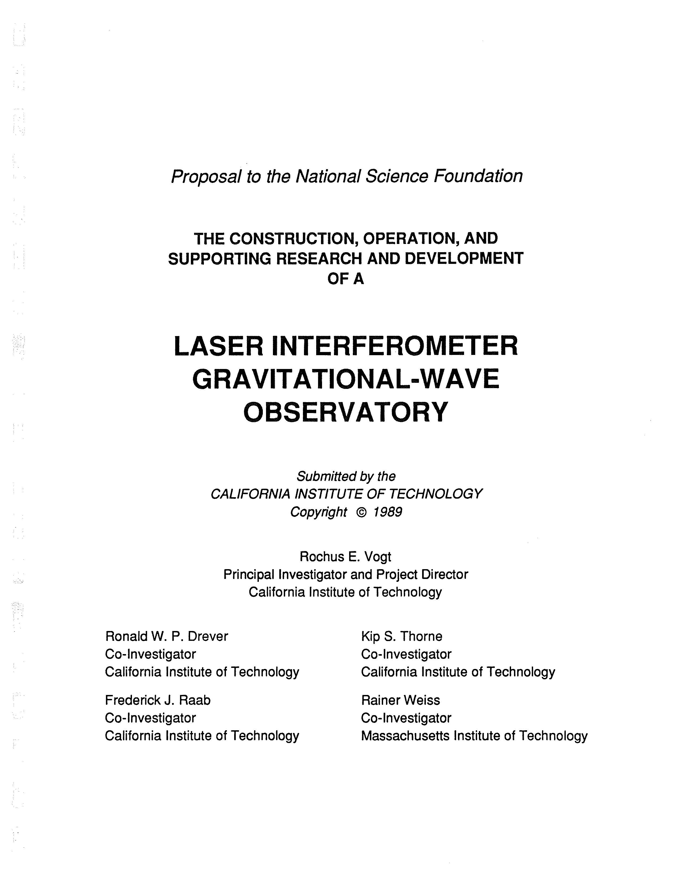
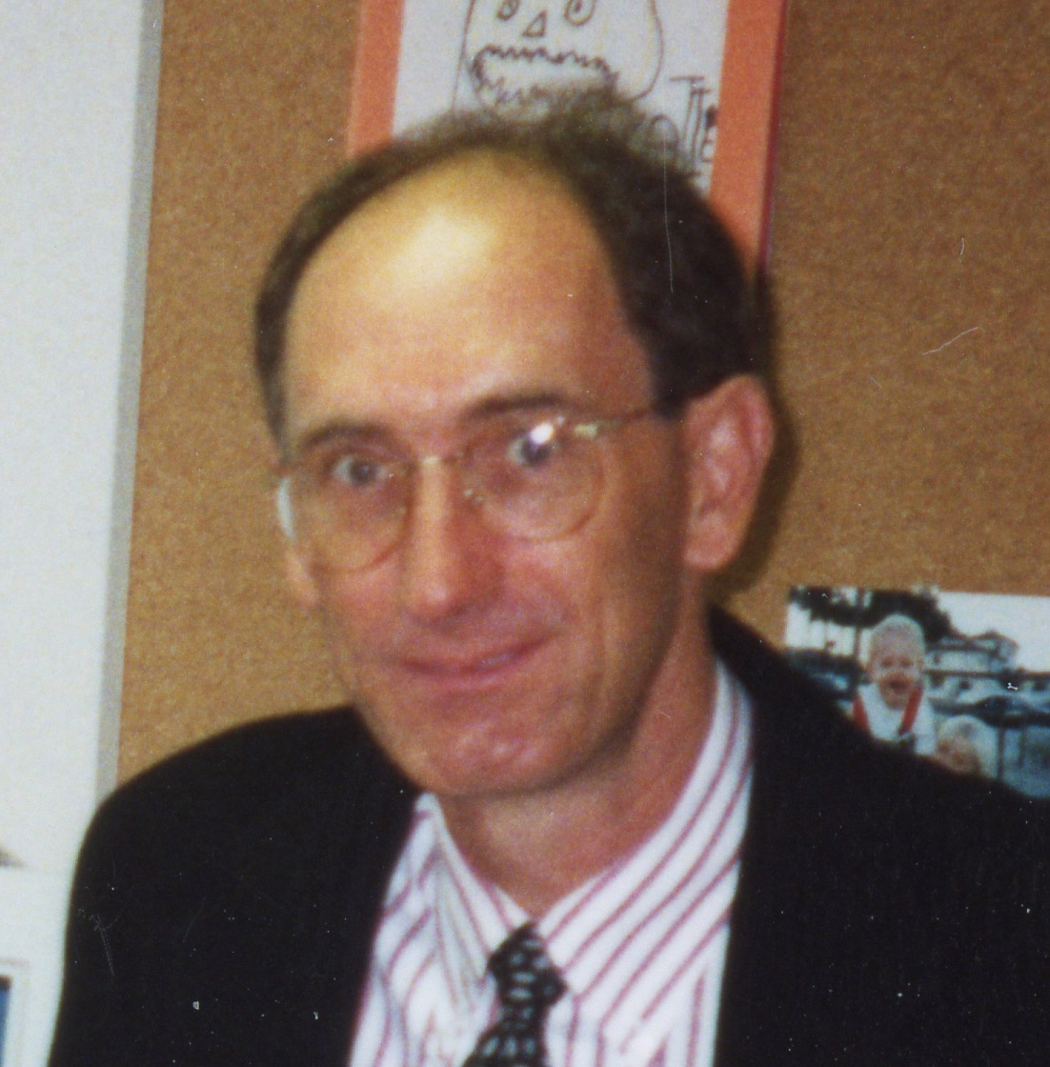
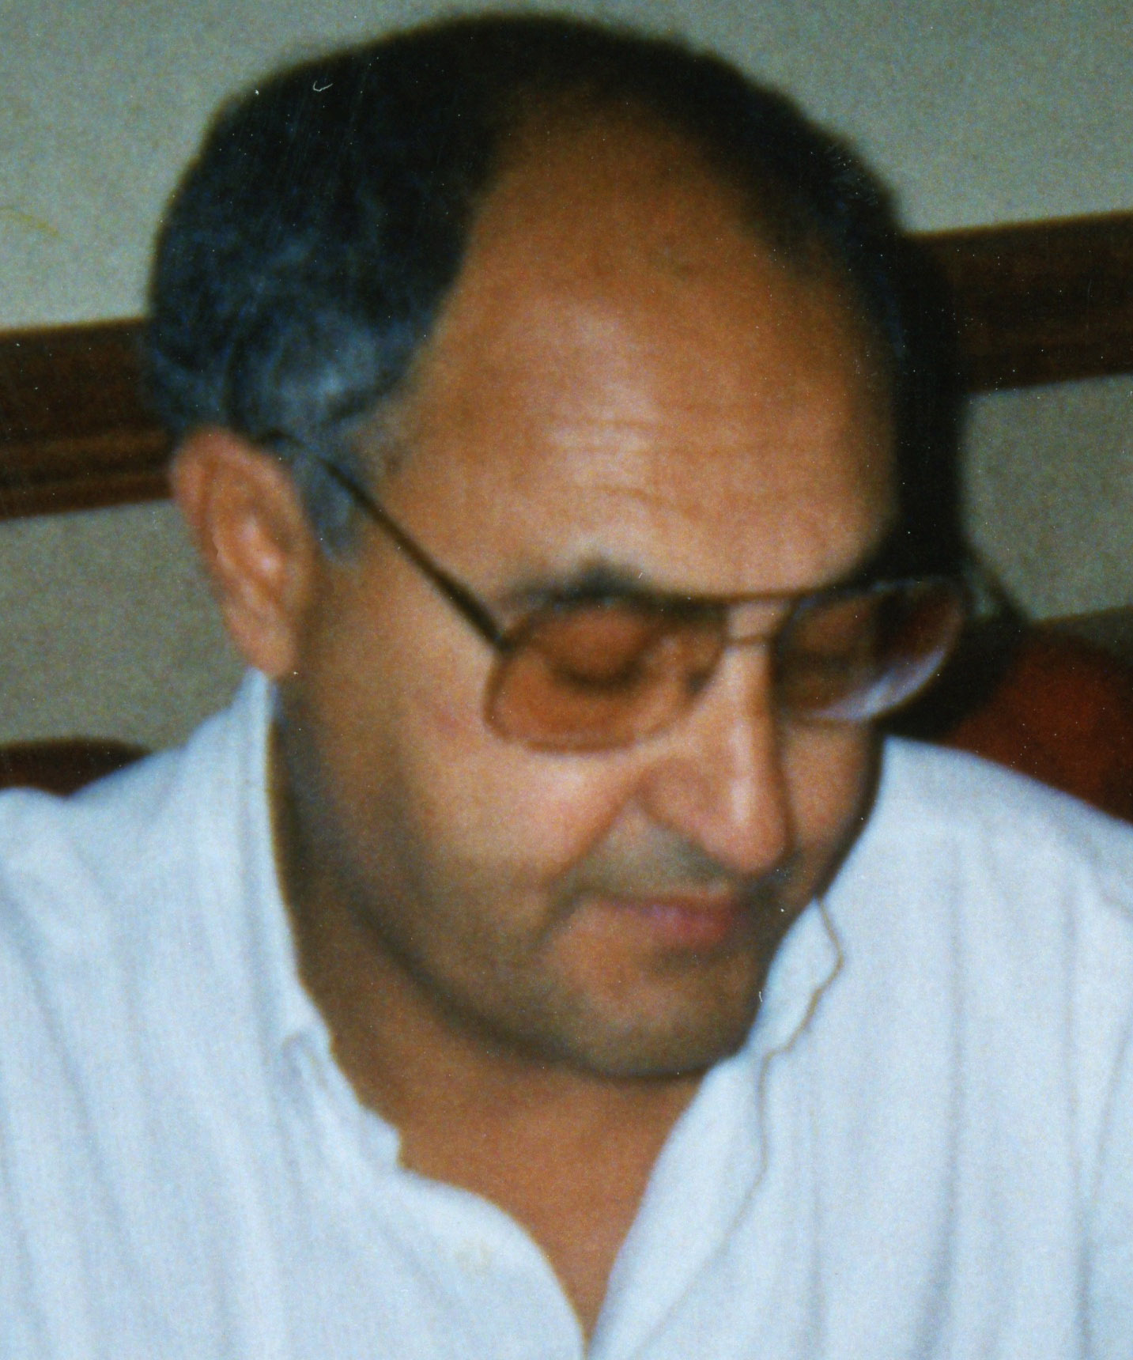
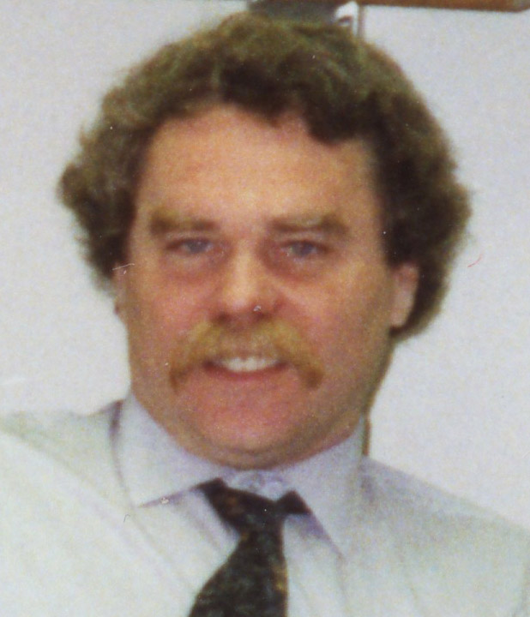
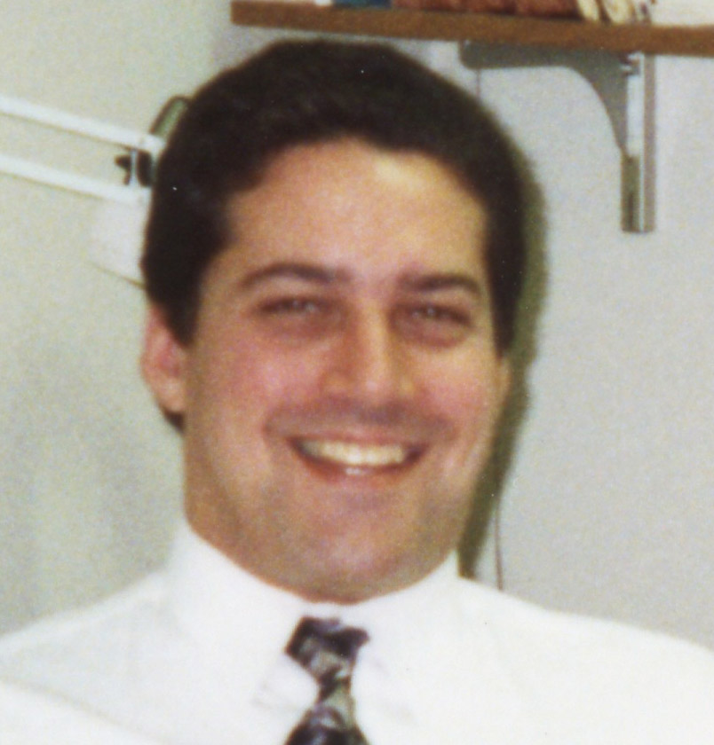
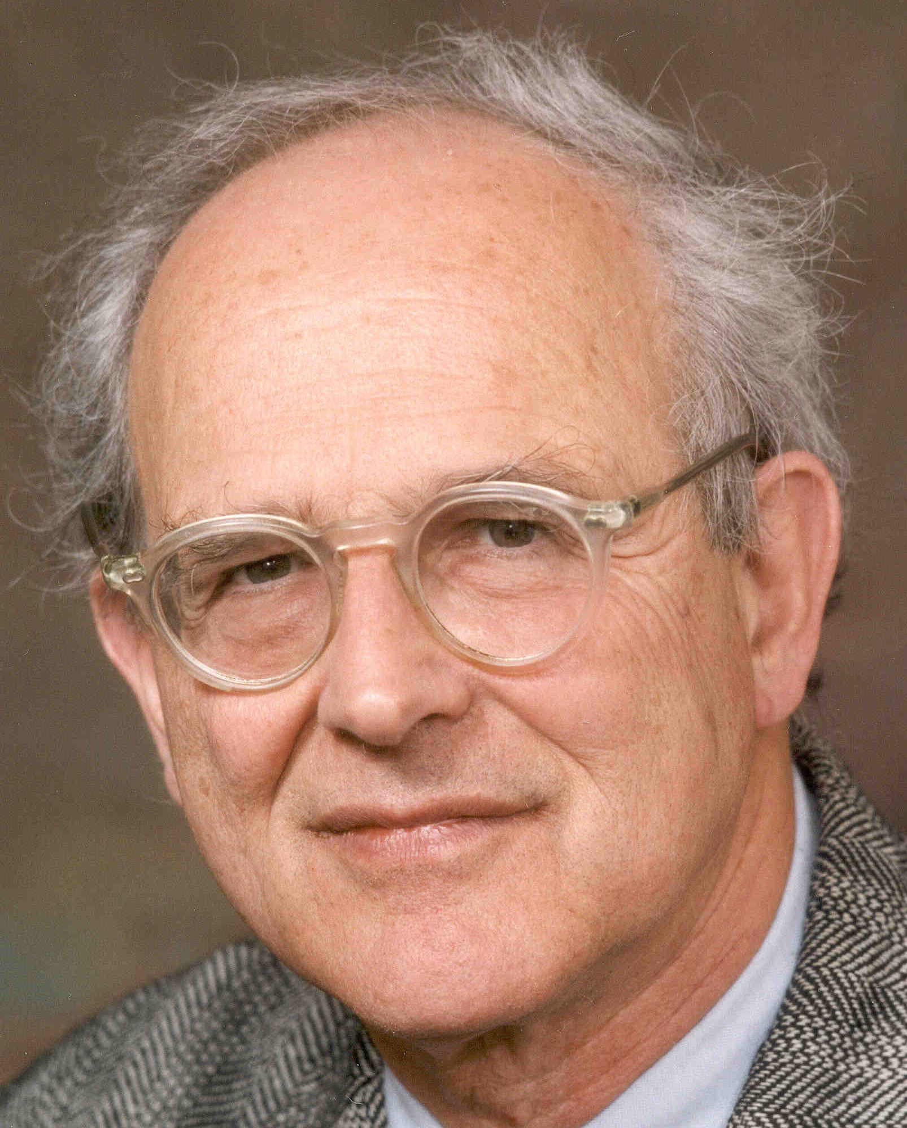
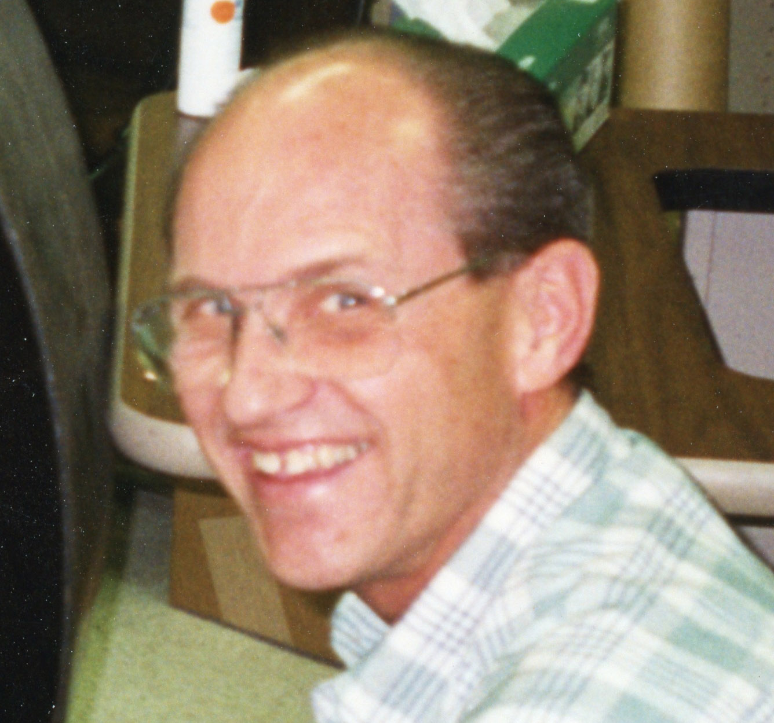
R.Drever
W. Althouse
R. Vogt
K. Thorne
F. Asiri
R. Savage
F. Raab
J. Worden
M. Zucker
R. Weiss
L.Jones

Slide 20
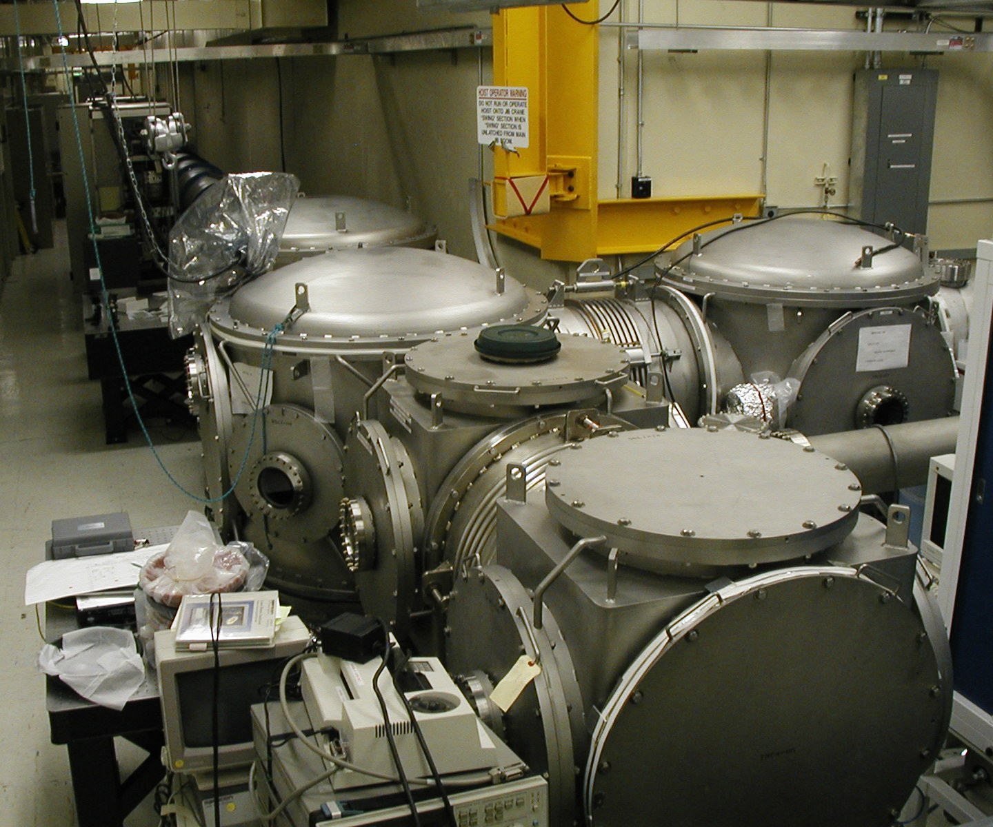
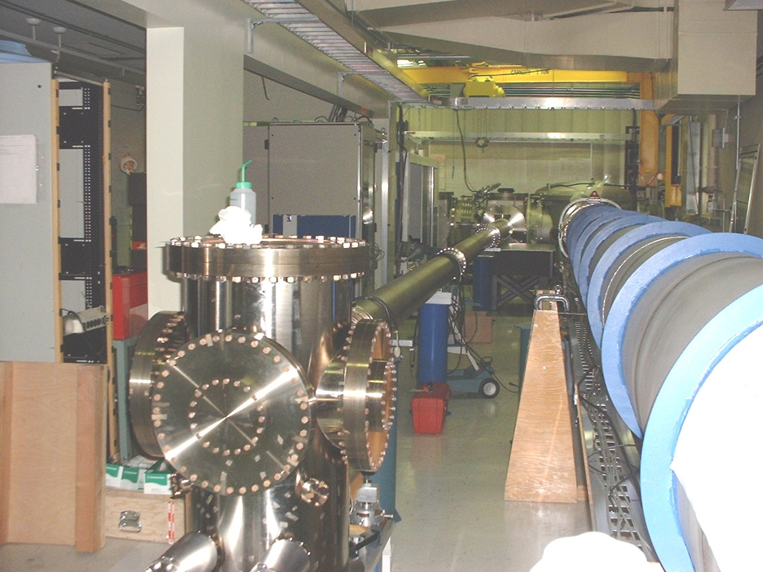
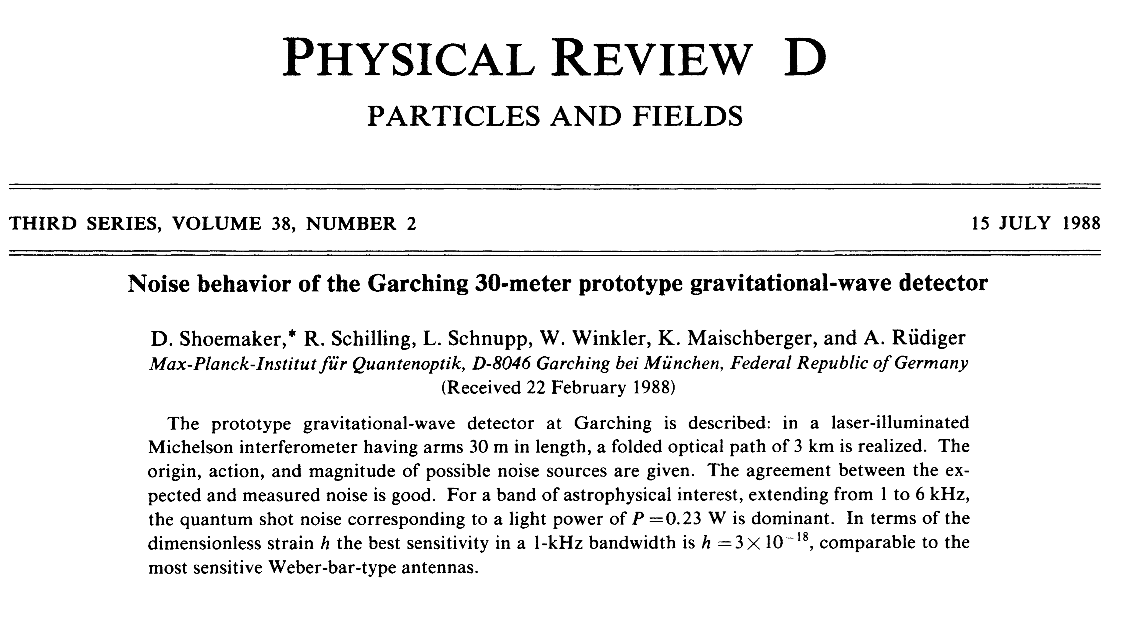
40 meter prototype at Caltech

Slide 21
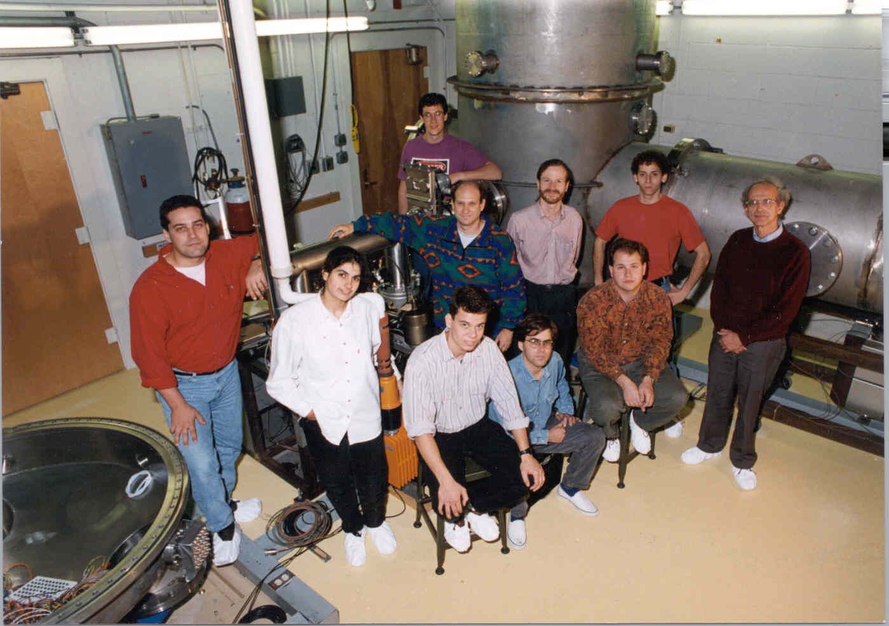
5 Meter Prototype at MIT
Test of LIGO alignment system
Test of power recycled Michelson-Fabry Perot interferometer @ 0.5 and 1.06 microns
Test of suspended power recycled Michelson
Perturbed Optics Modeling

Slide 22
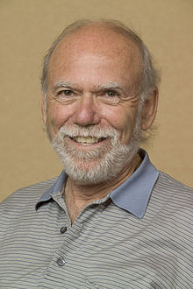
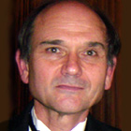
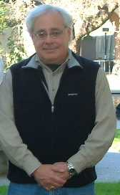
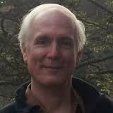
The real start
1994
A. Lazzarini
B. Barish
D. Coyne
G. Sanders

Slide 23












































































LIGO Scientific Collaboration

Slide 24






GEO
KAGRA
LHO
VIRGO
LIGO INDIA
LLO

Slide 25
Evolution of the initial detector 2001 - 2006
A clean non-detection

Slide 26







LSC
LIGO Laboratory
Advanced LIGO Project
P. Saulson
2nd Spokesperson
J. Marx
3rd LIGO Director
D. Coyne
D. Shoemaker
D. Reitze
3rd LSC Spokesperson
4th LIGO Director
P. Fritschel
V. Frolov
G. Gonzalez
4th Spokesperson
D. Sigg

Slide 27
Black Hole Catalog

Slide 28



Slide 29

NGC4493

Slide 30


Localization with more detectors

Slide 31

age of universe years hours minutes 1/10 to 1/1000 sec

