Slide 1
A retrospective on the first 25 years of LIGO
R. Weiss MIT
Advanced LIGO Dedication
LIGO Hanford Observatory
May 19, 2015

Slide 2
Outline
How Caltech and MIT got together on LIGO
  Basic ideas and some misconceptions
The transition from table top to big science
The advocacy and strategic thinking at the NSF
The first committee recommendation
The second committee recommendations
Beginnings of a project
A real project and two good things LIGO did
Part of a legacy

Slide 3
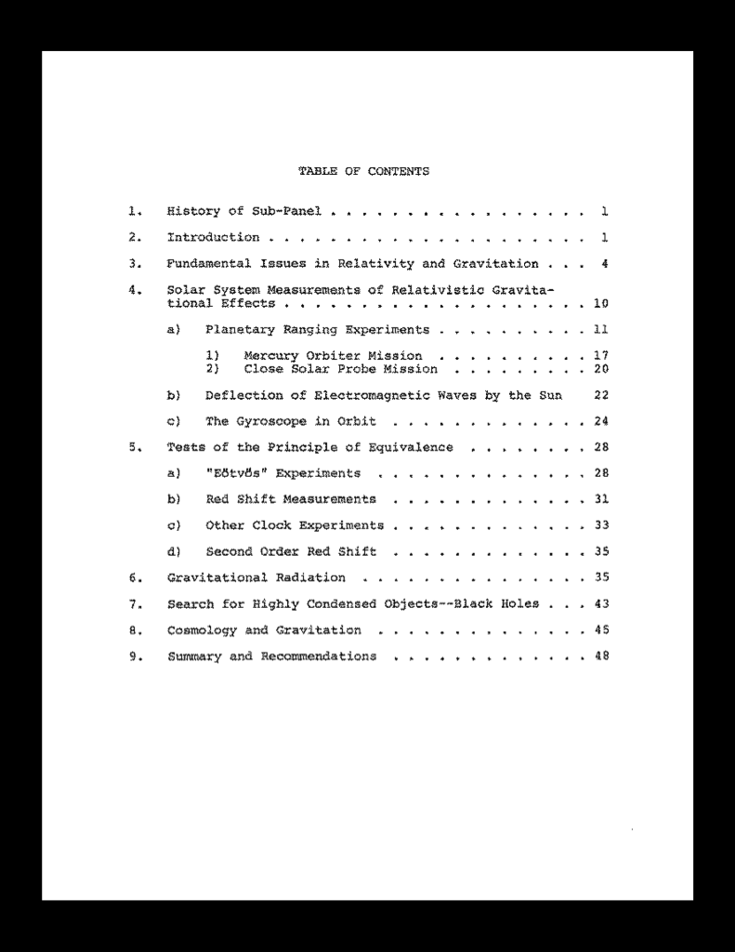
Management and Operations
Working Group for Shuttle
Astronomy
Report of the sub-panel on
Relativity and Gravitation
October 1975

Slide 4
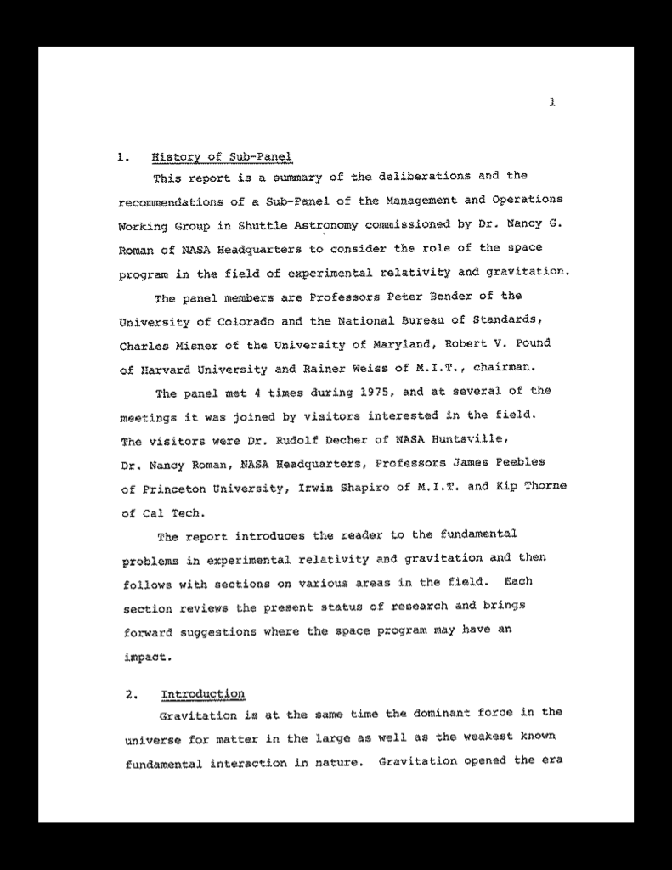

Slide 5
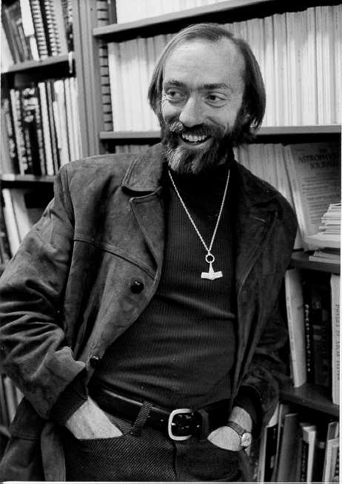
K. Thorne

Slide 6
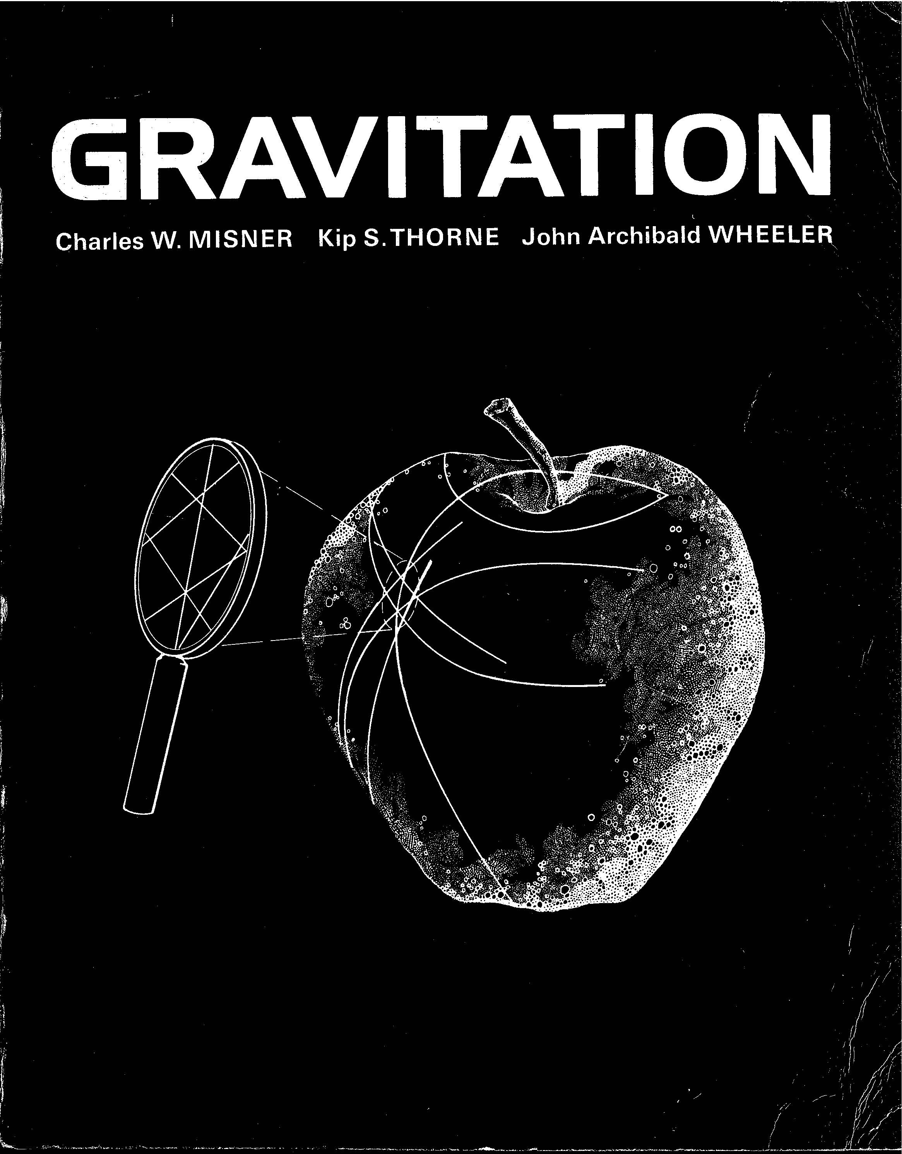

Slide 7
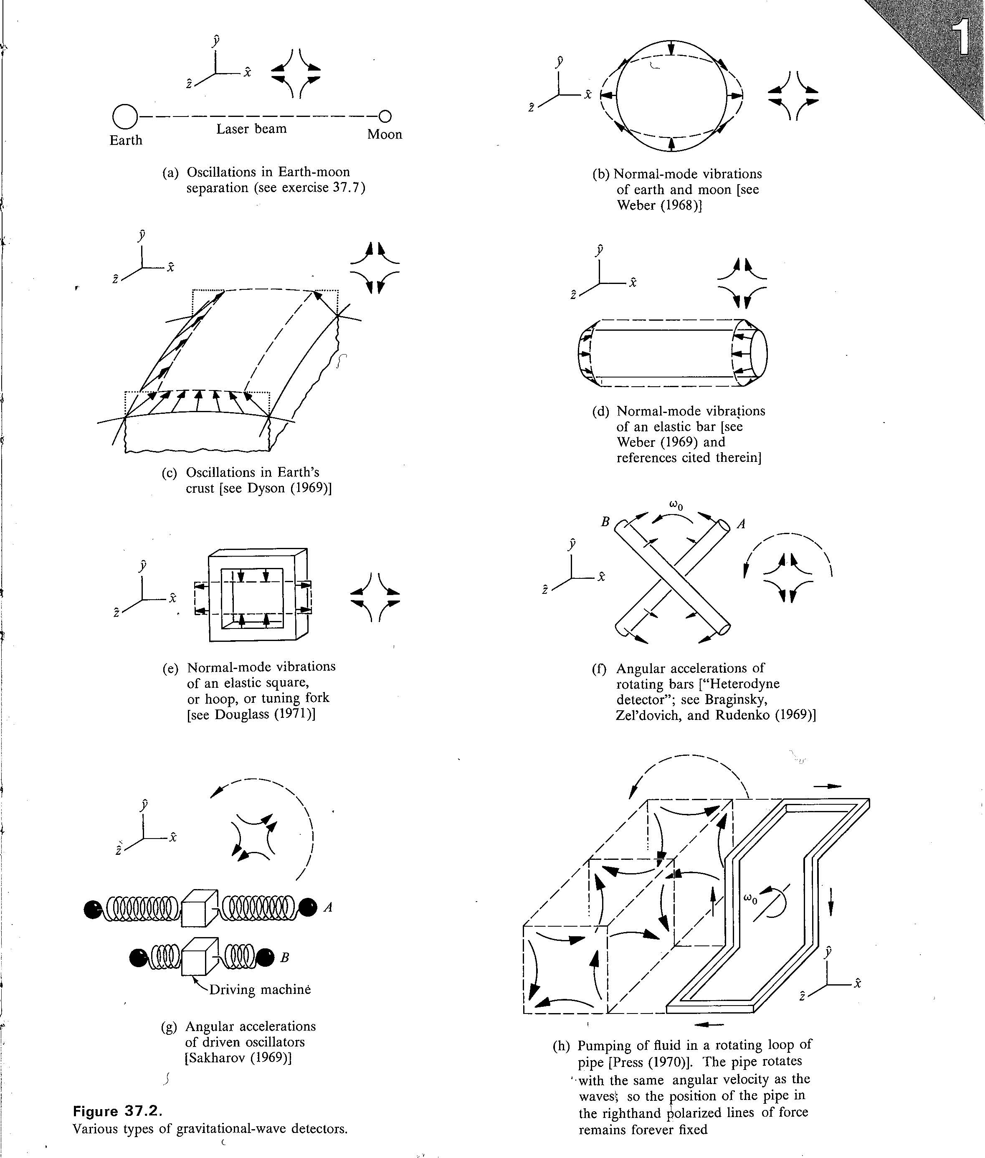
Types of GW detectors
MTW (1973)

Slide 8
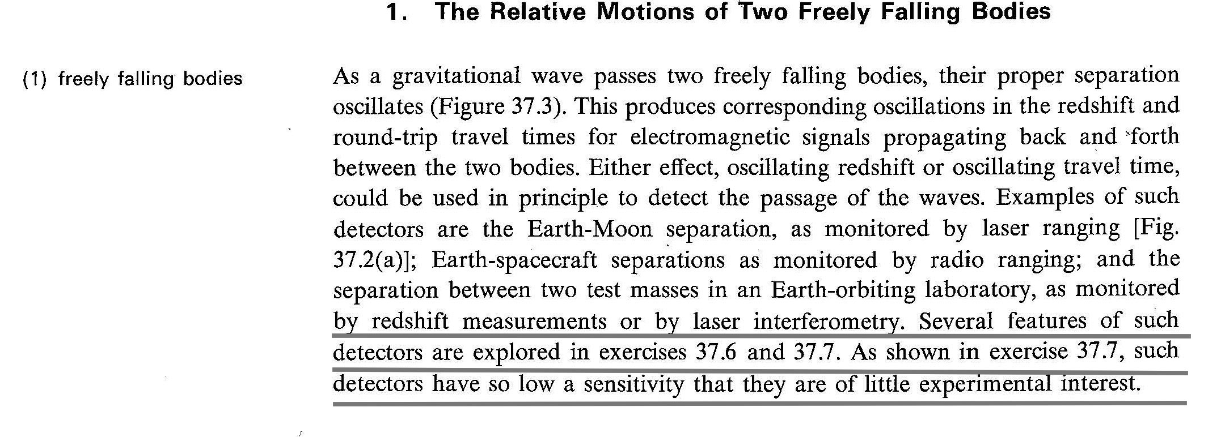
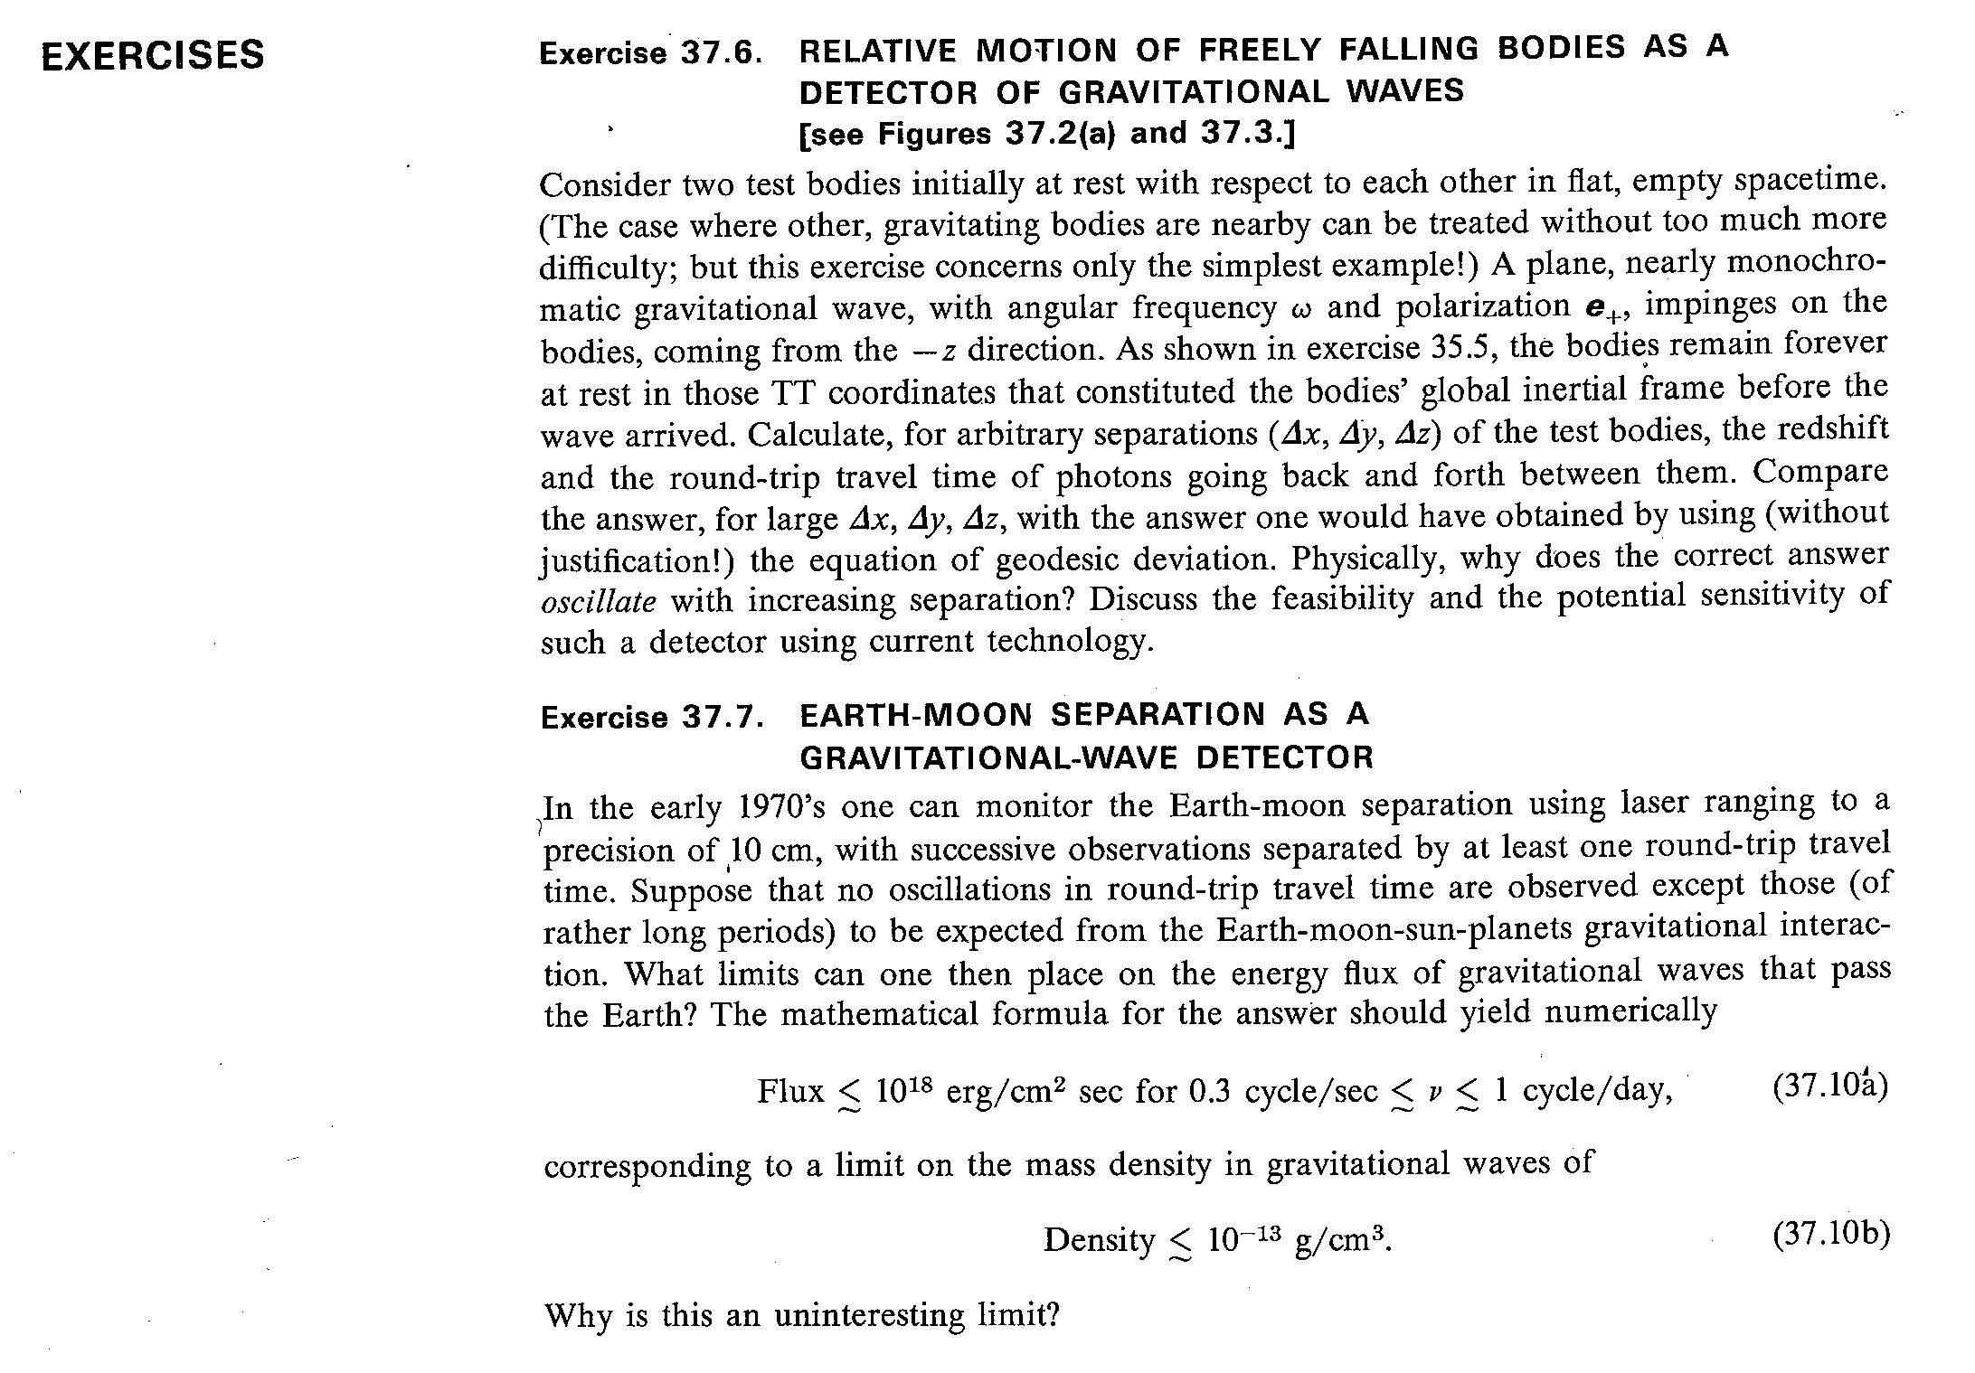

Slide 9
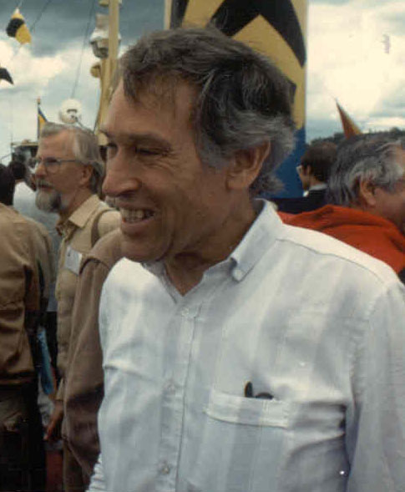
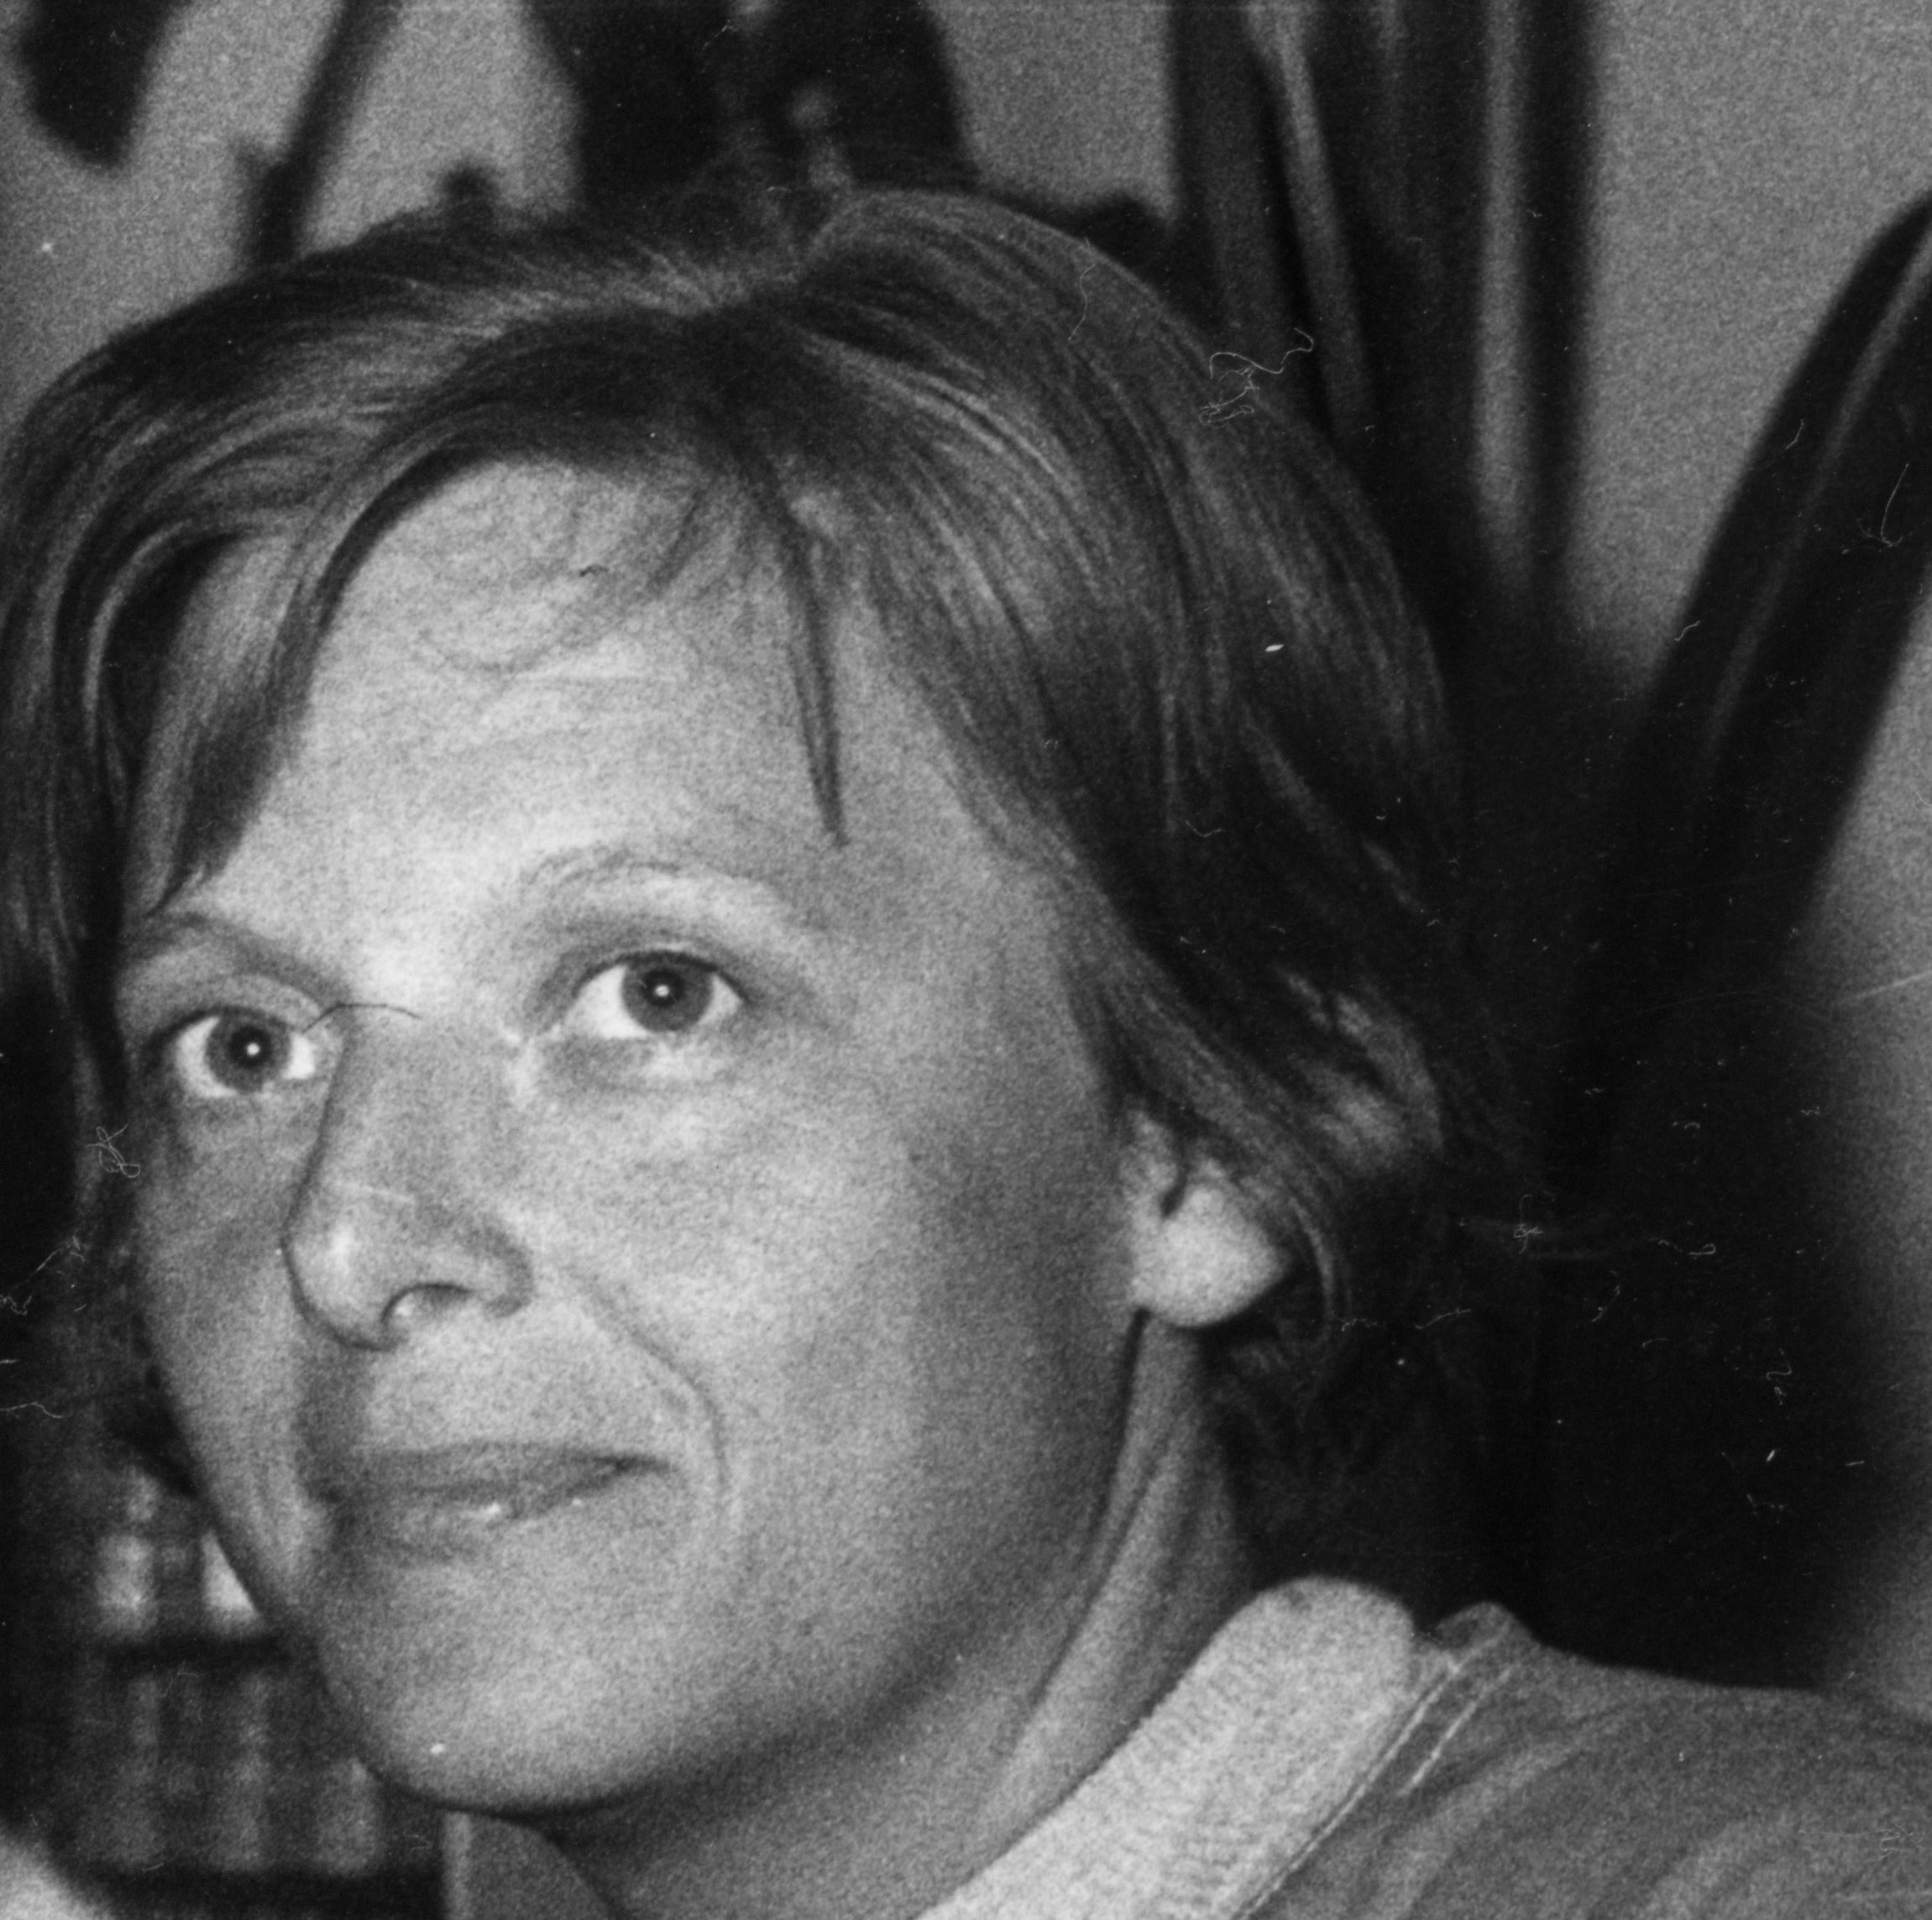
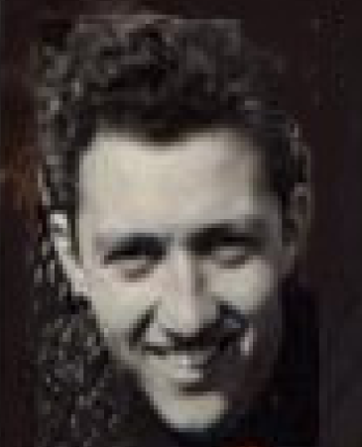
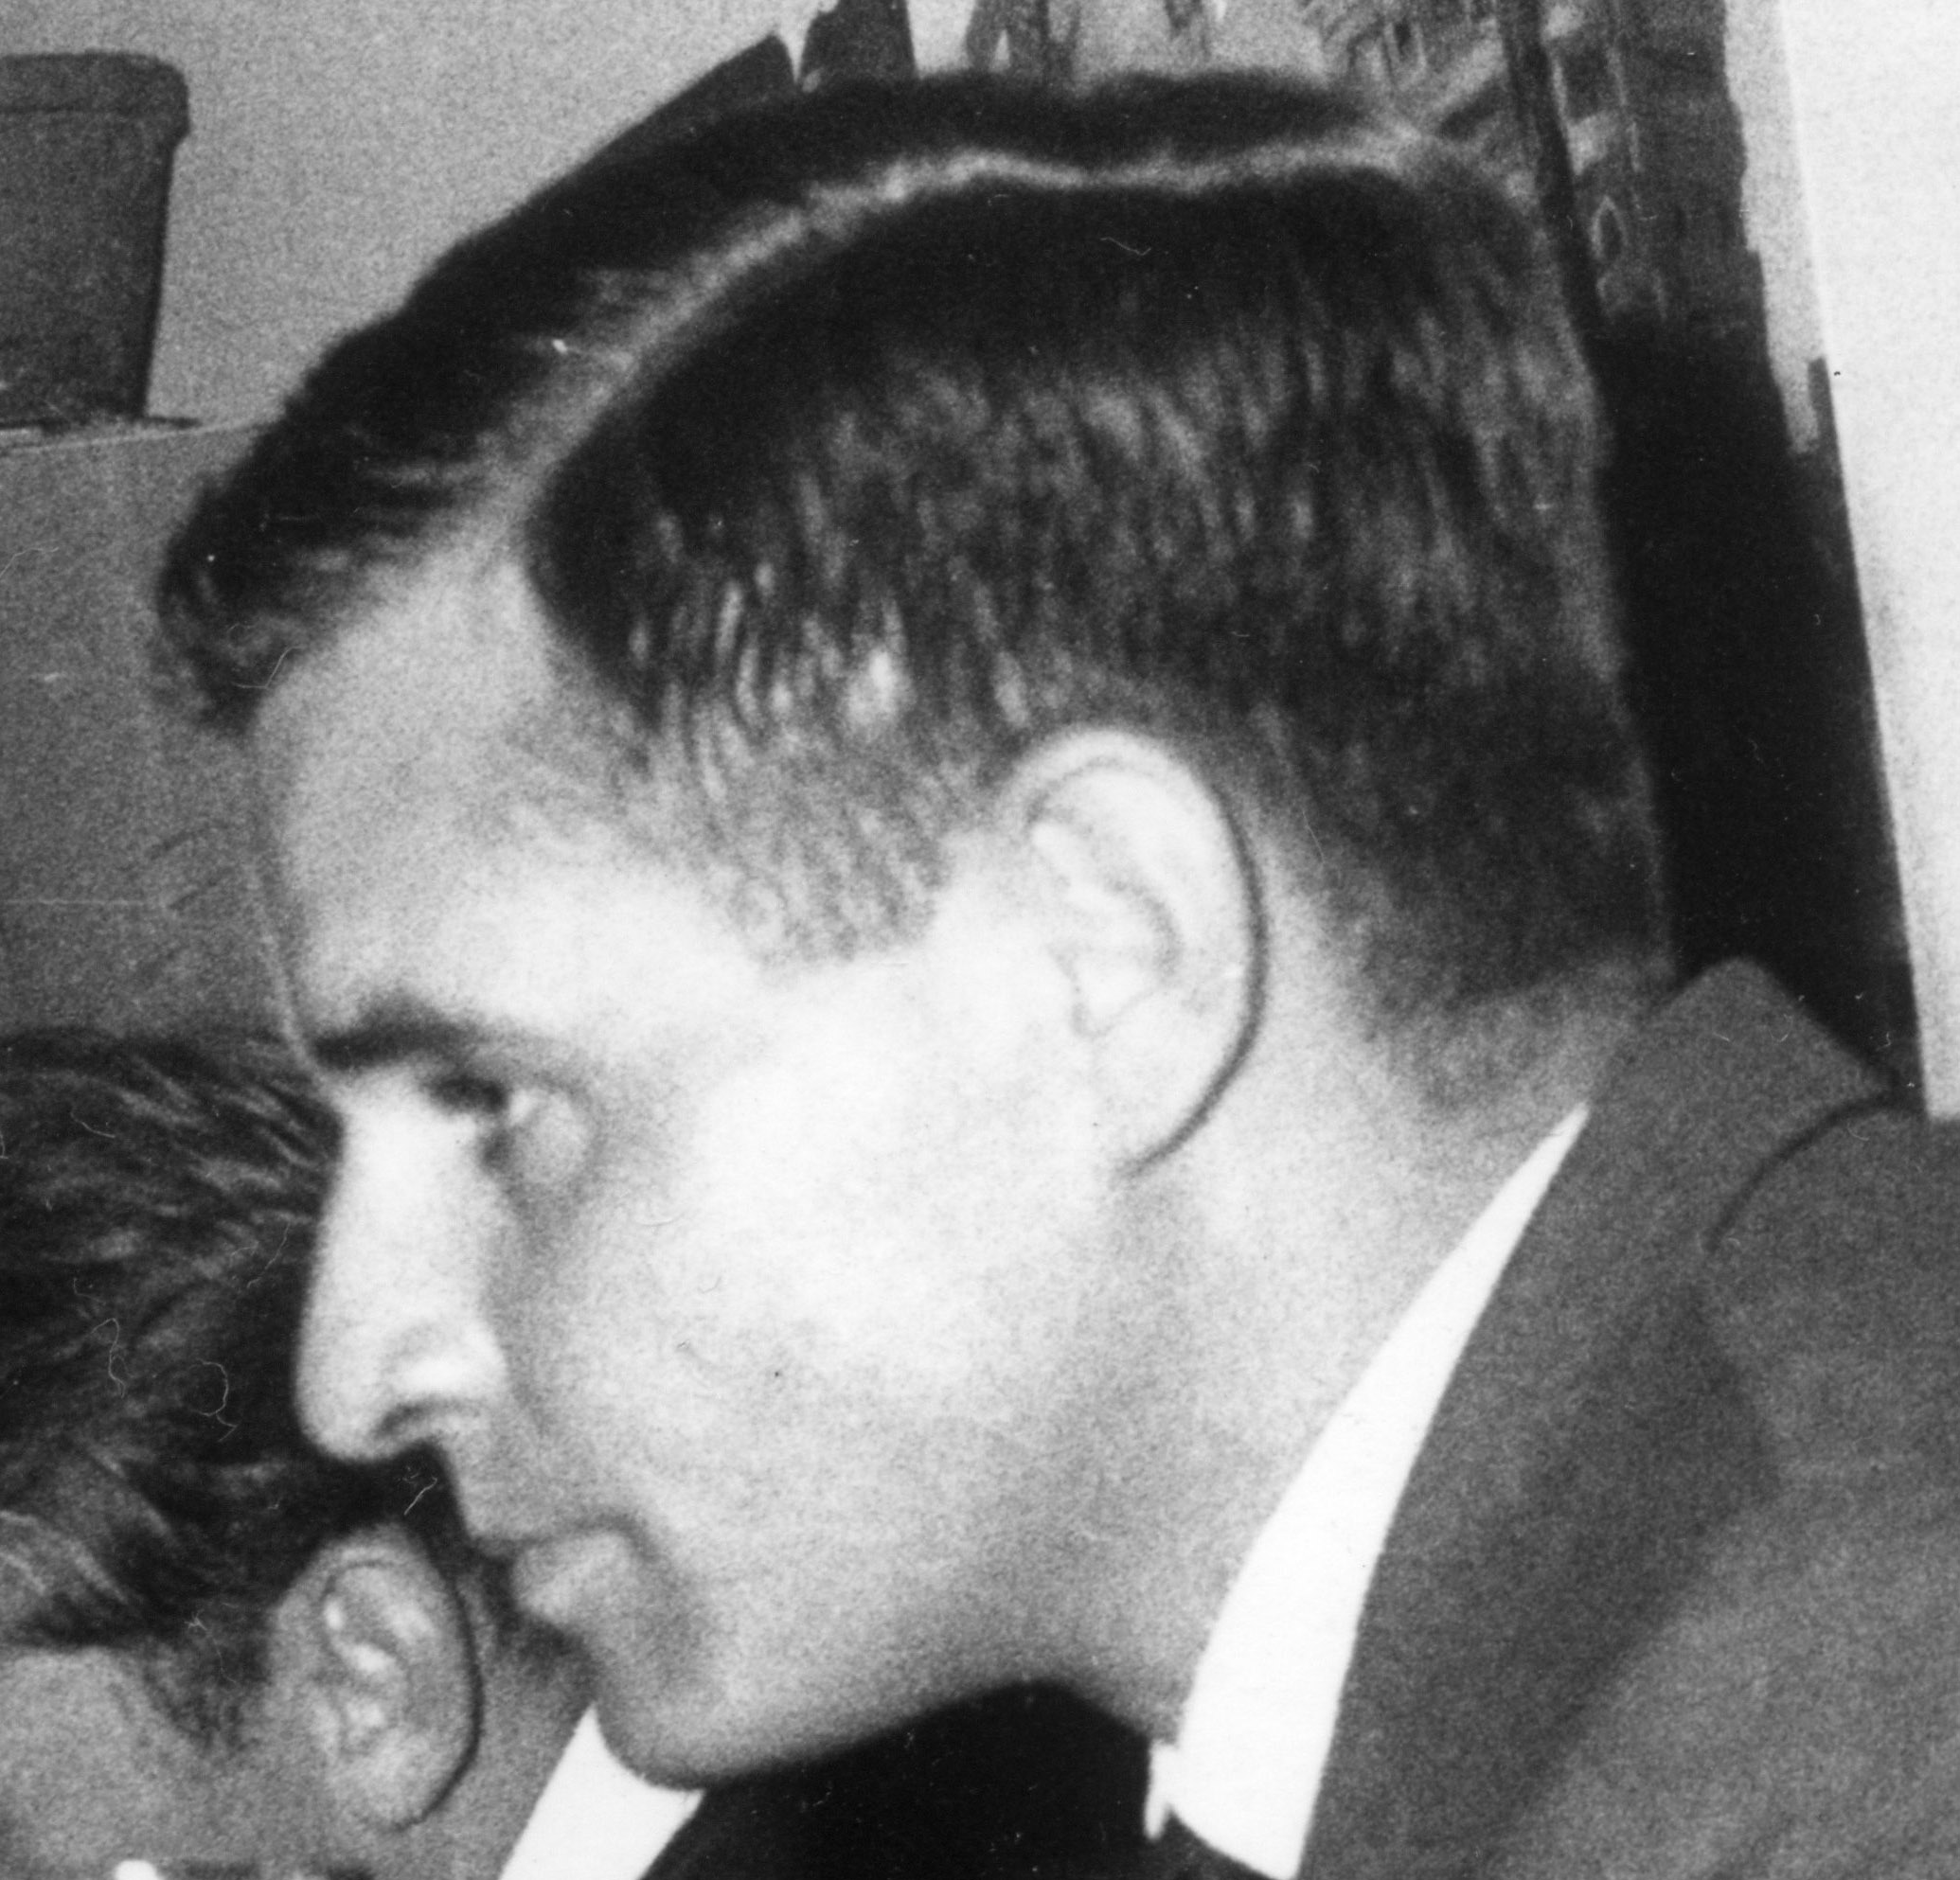
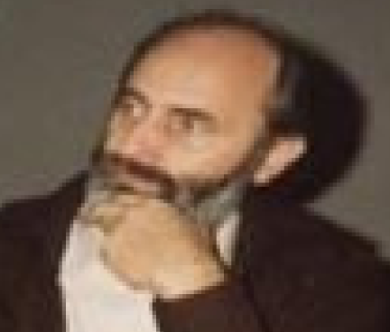
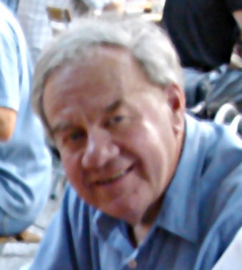
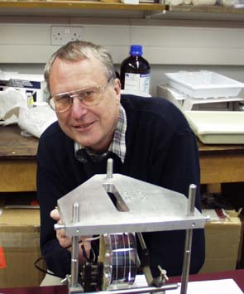
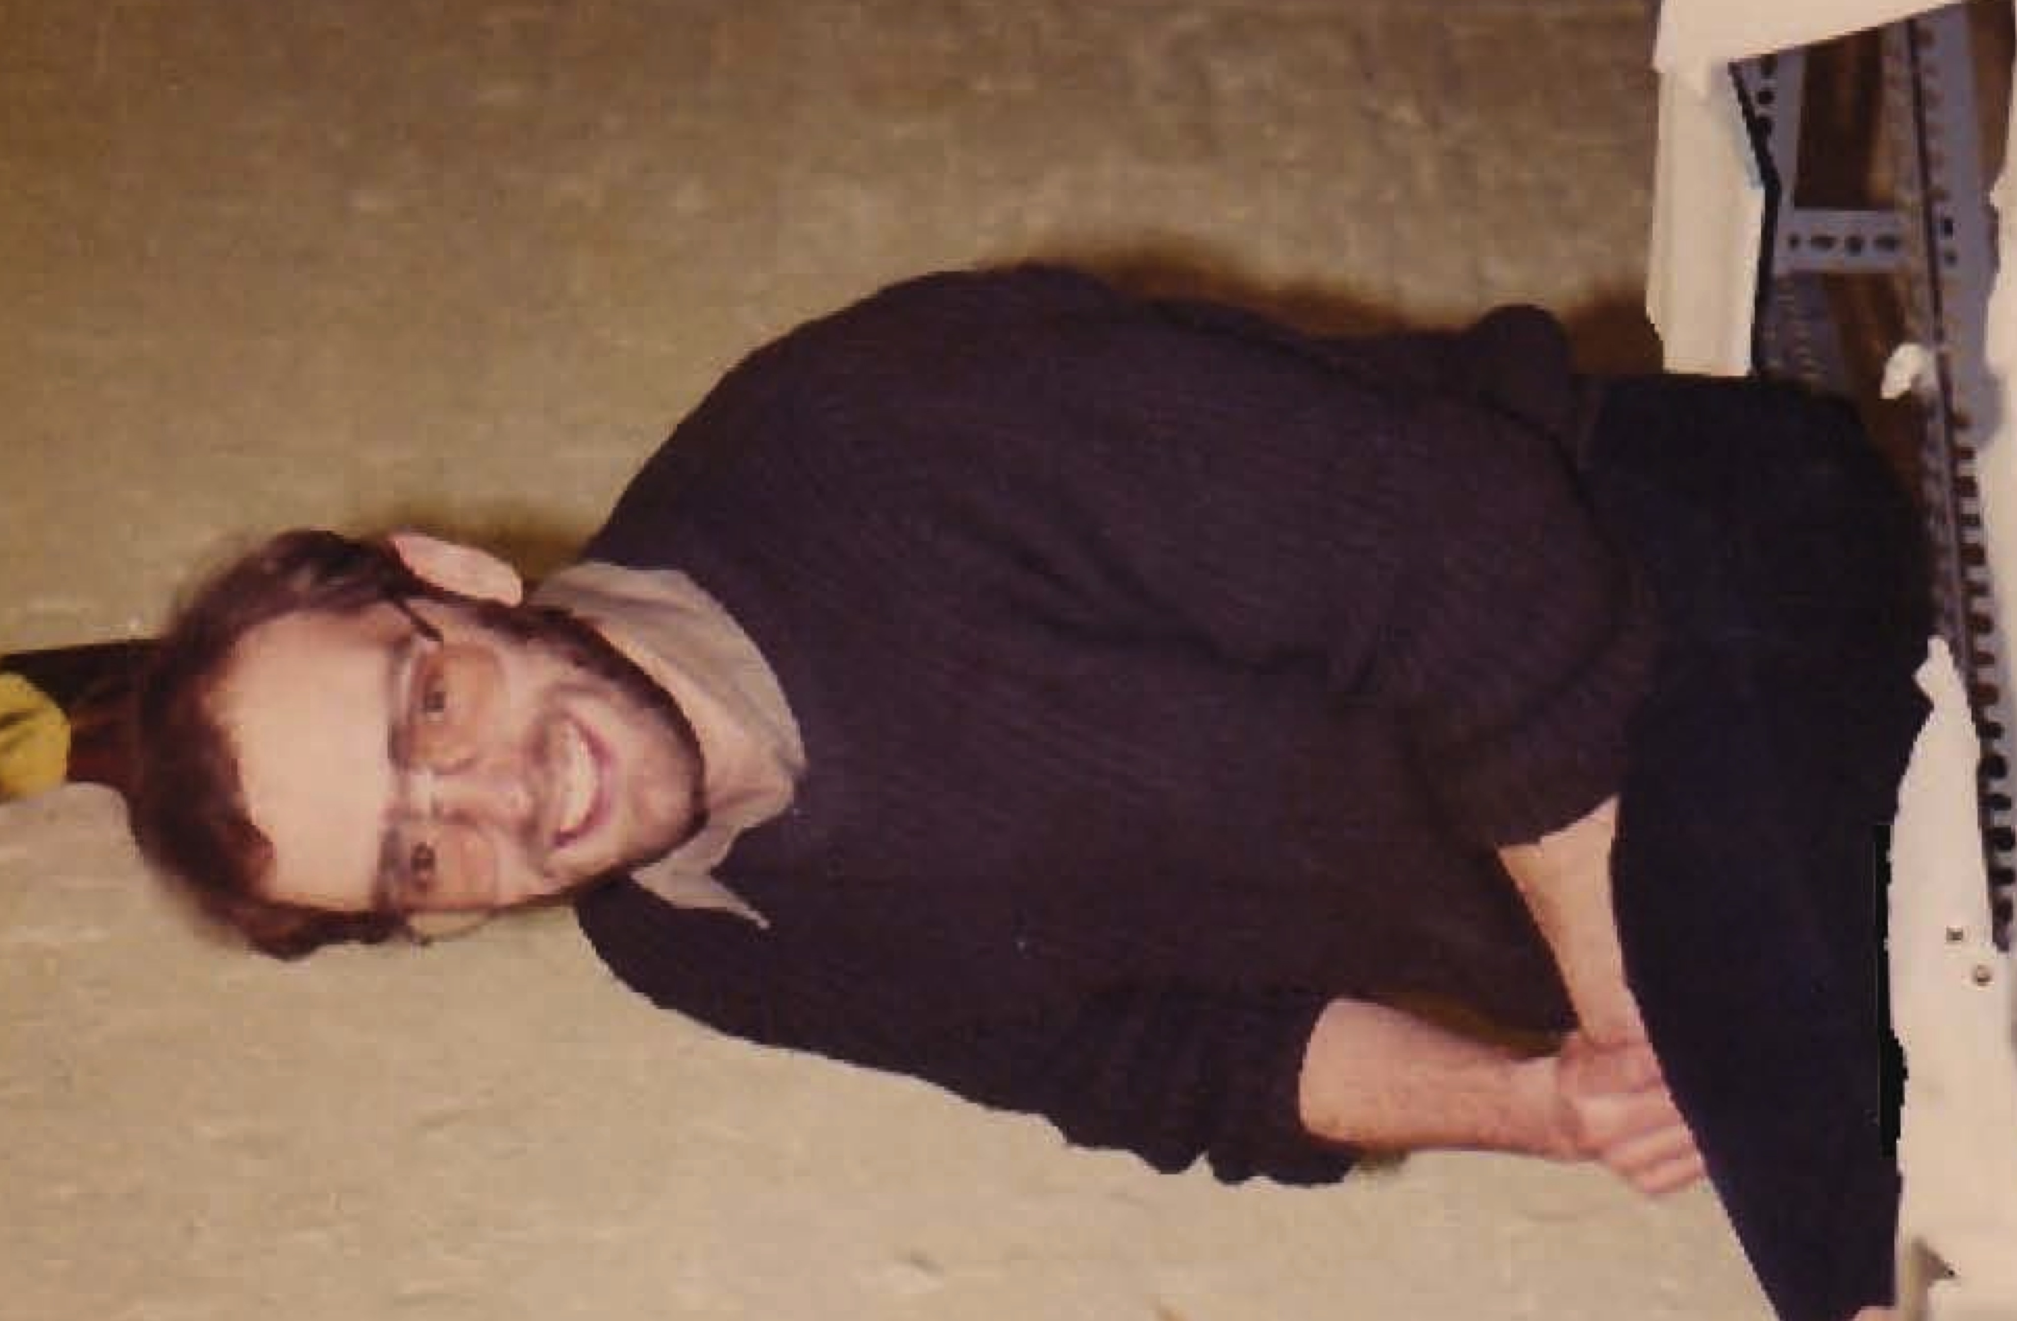
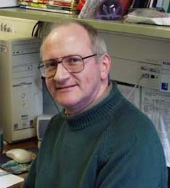
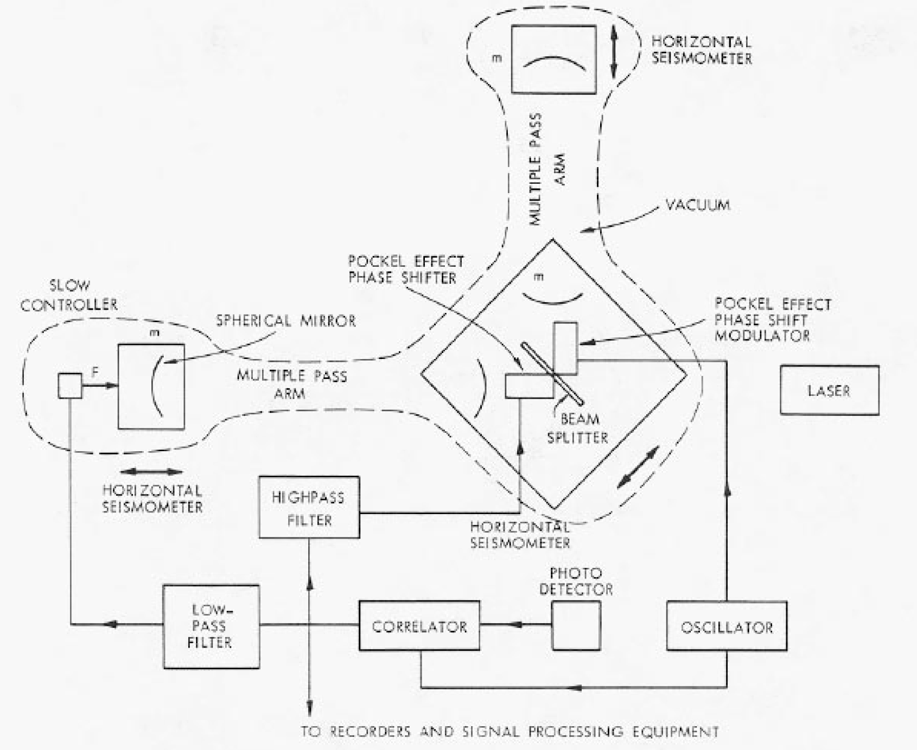
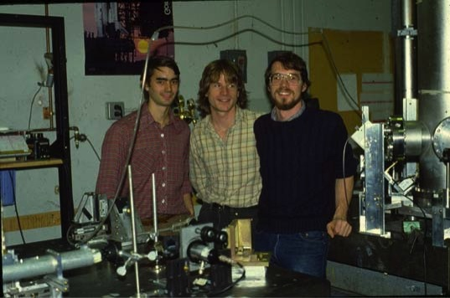
Initial interferometric GW detector groups late 1970’s
H. Billing
L. Schnupp
K. Maischberger
W.Winkler
Max Planck Garching
R. Schilling
A. Rudiger
Glasgow
J. Hough
B. Meers
R. Drever
H. Ward
MIT
J. Livas , D.H. Shoemaker, D. Dewey

Slide 10
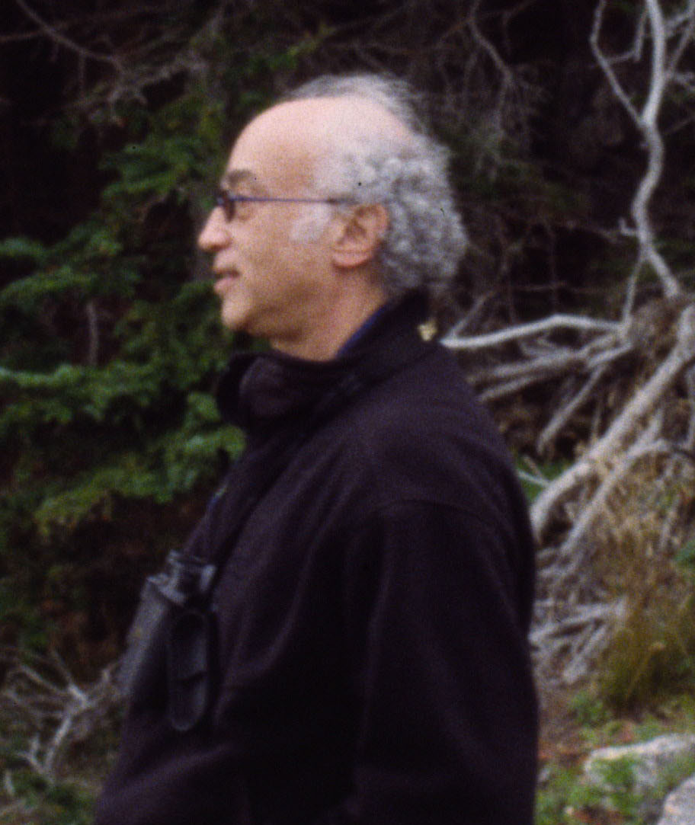
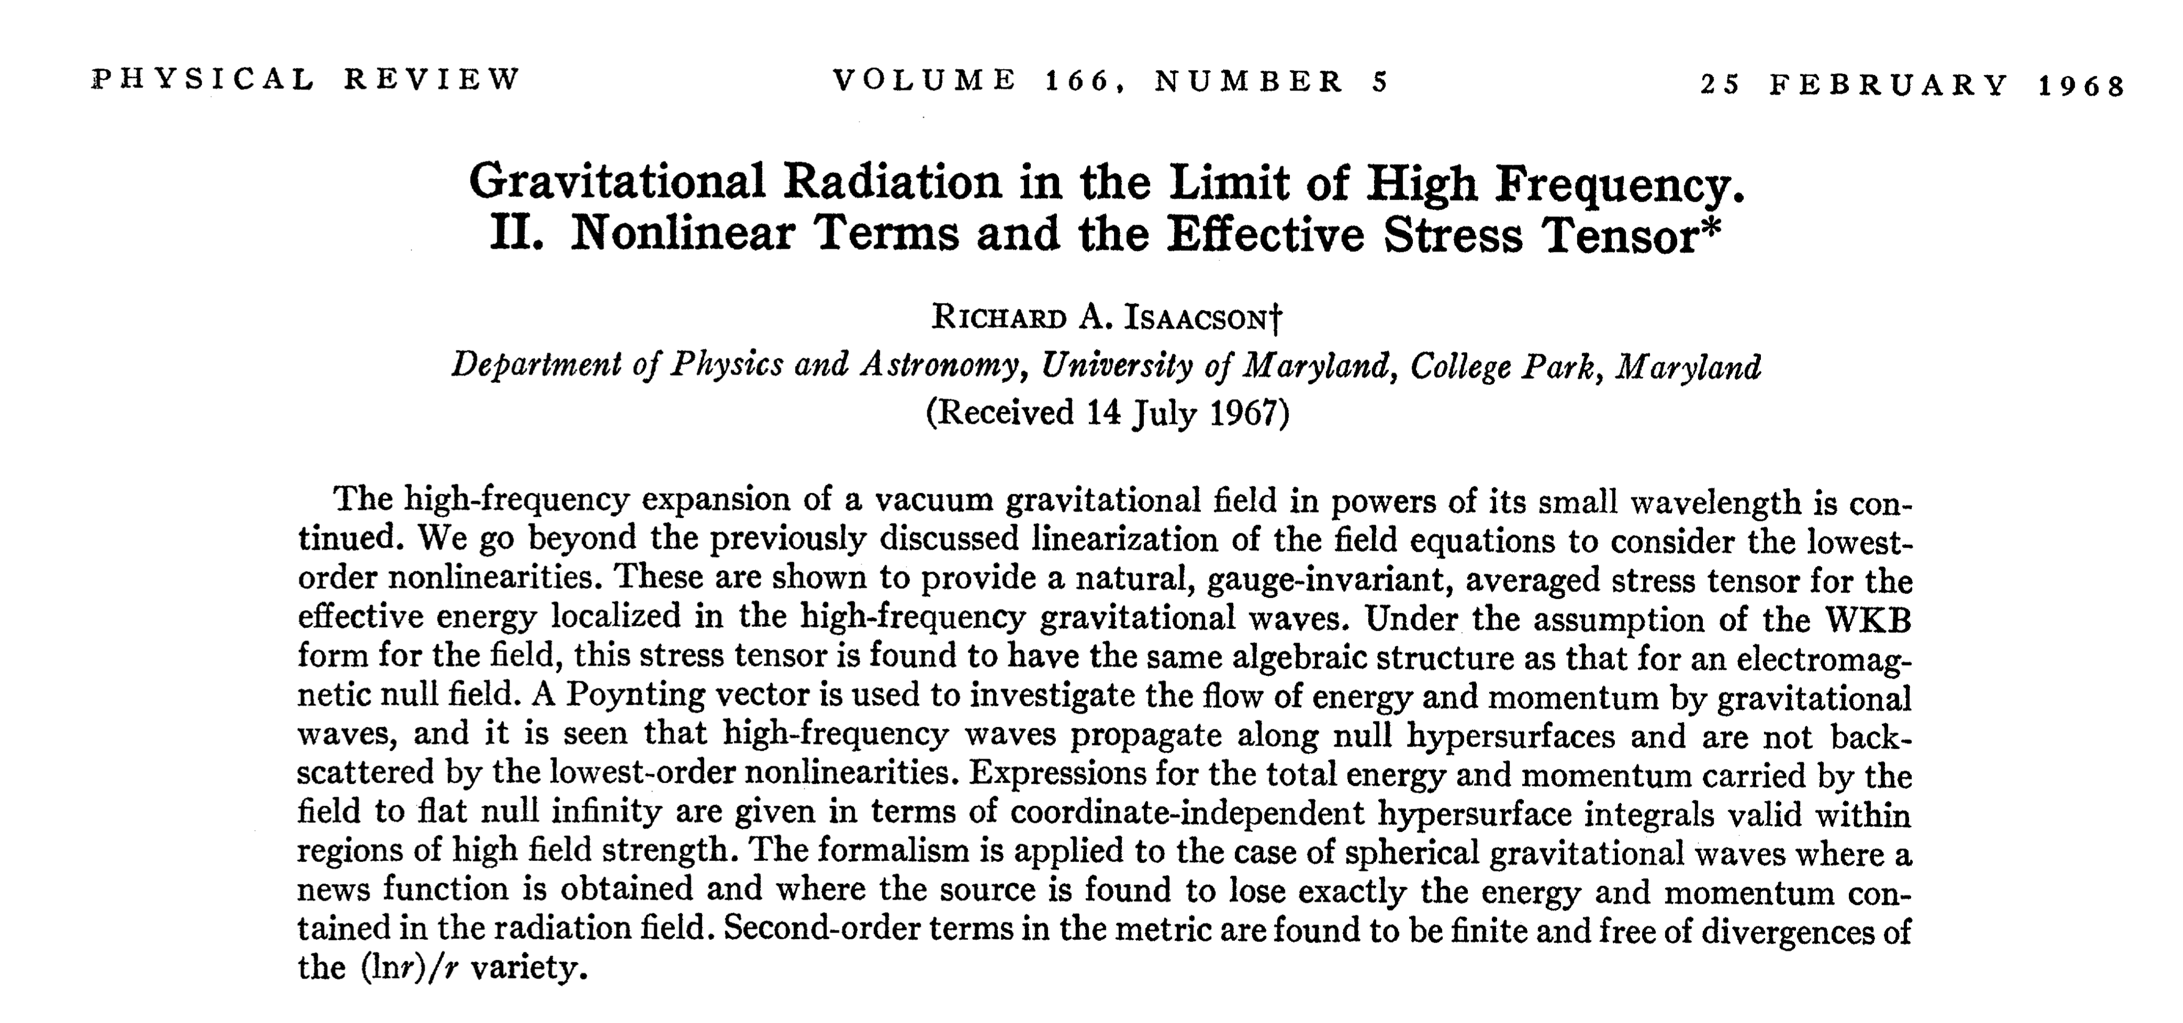
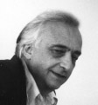
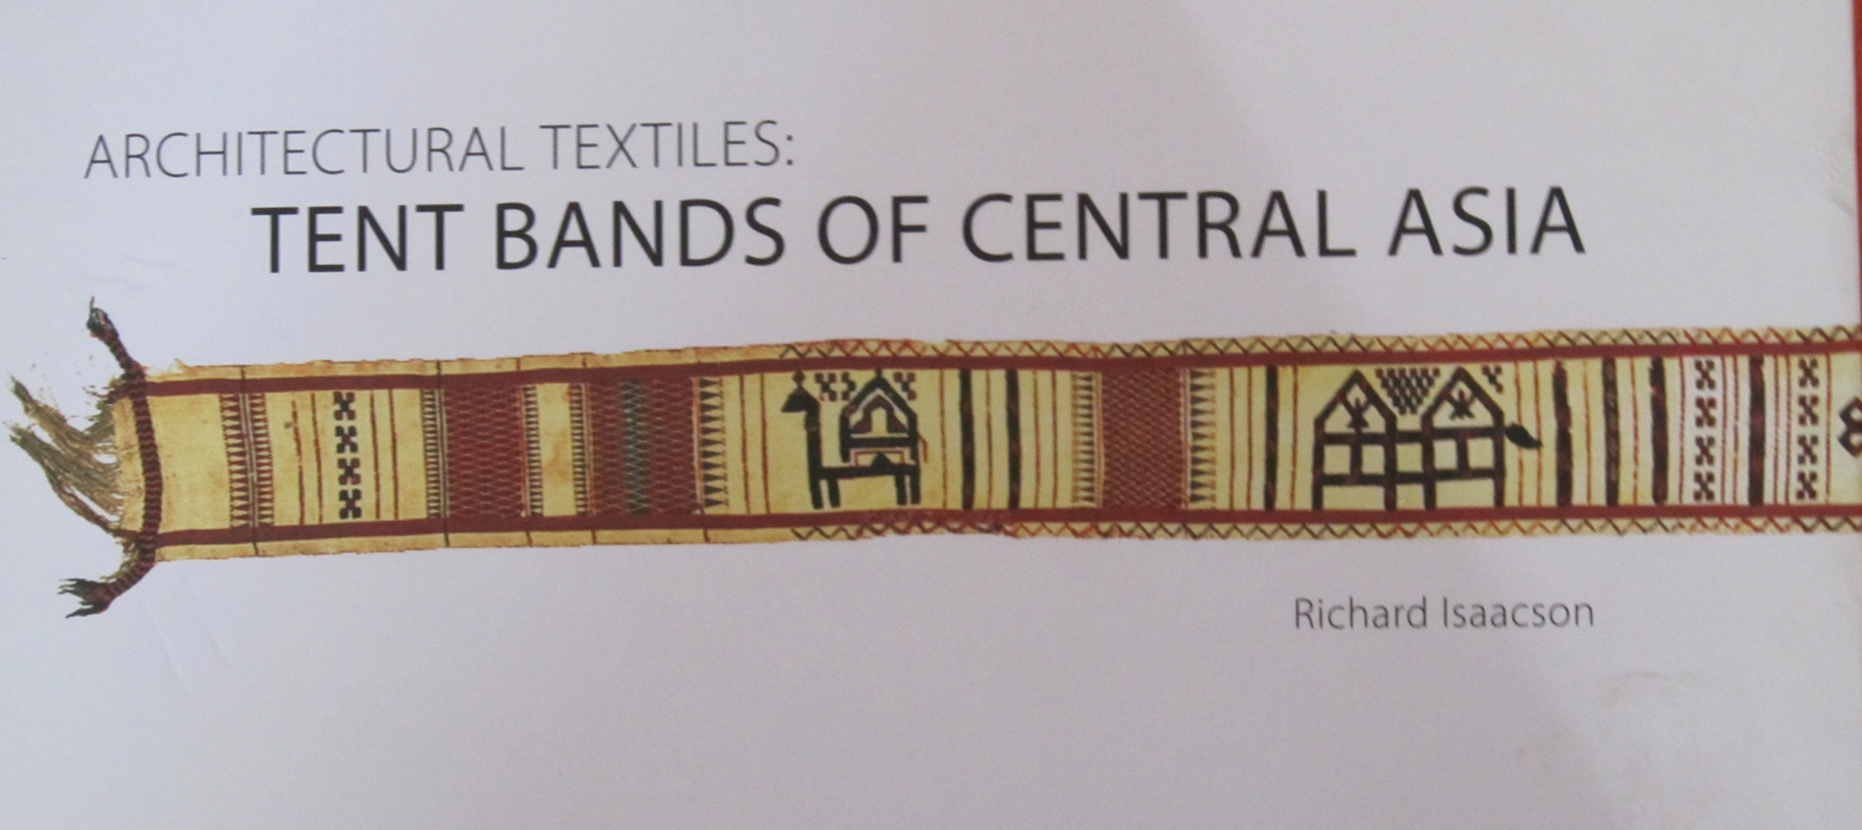
R. Isaacson (Gravitation at NSF)
M. Bardon (Director of Physics NSF)

Slide 11
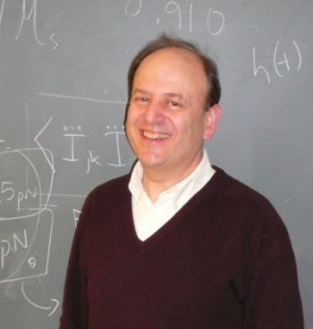
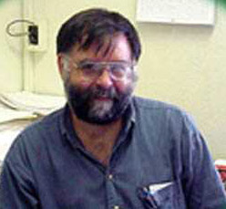
P. Saulson
S. Whitcomb

Slide 13
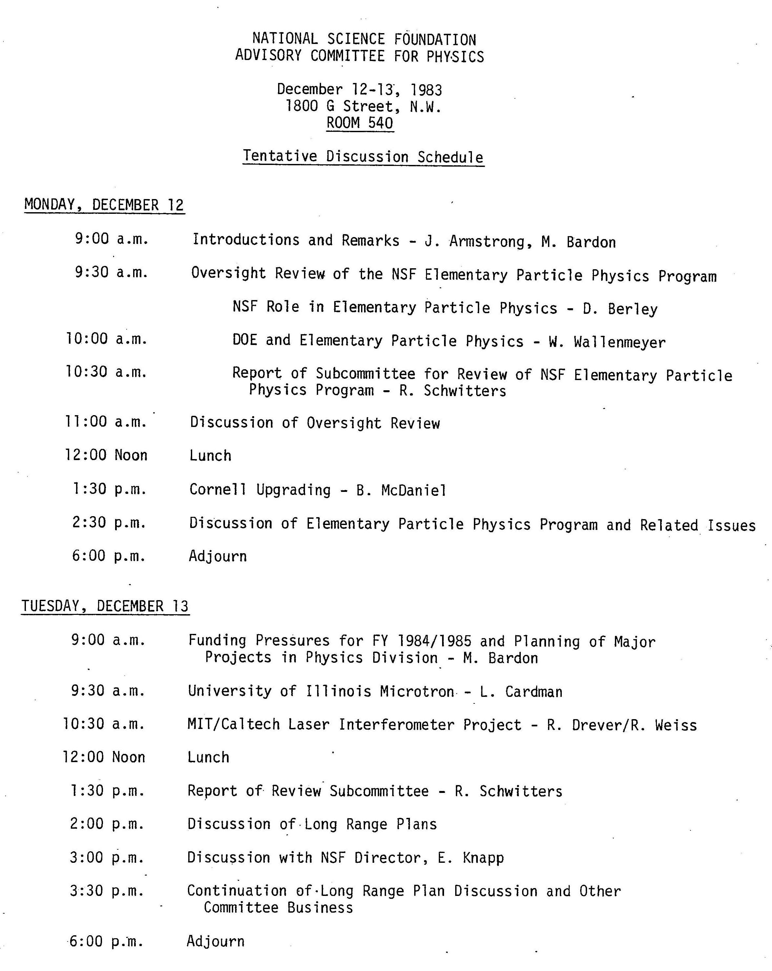

Slide 14
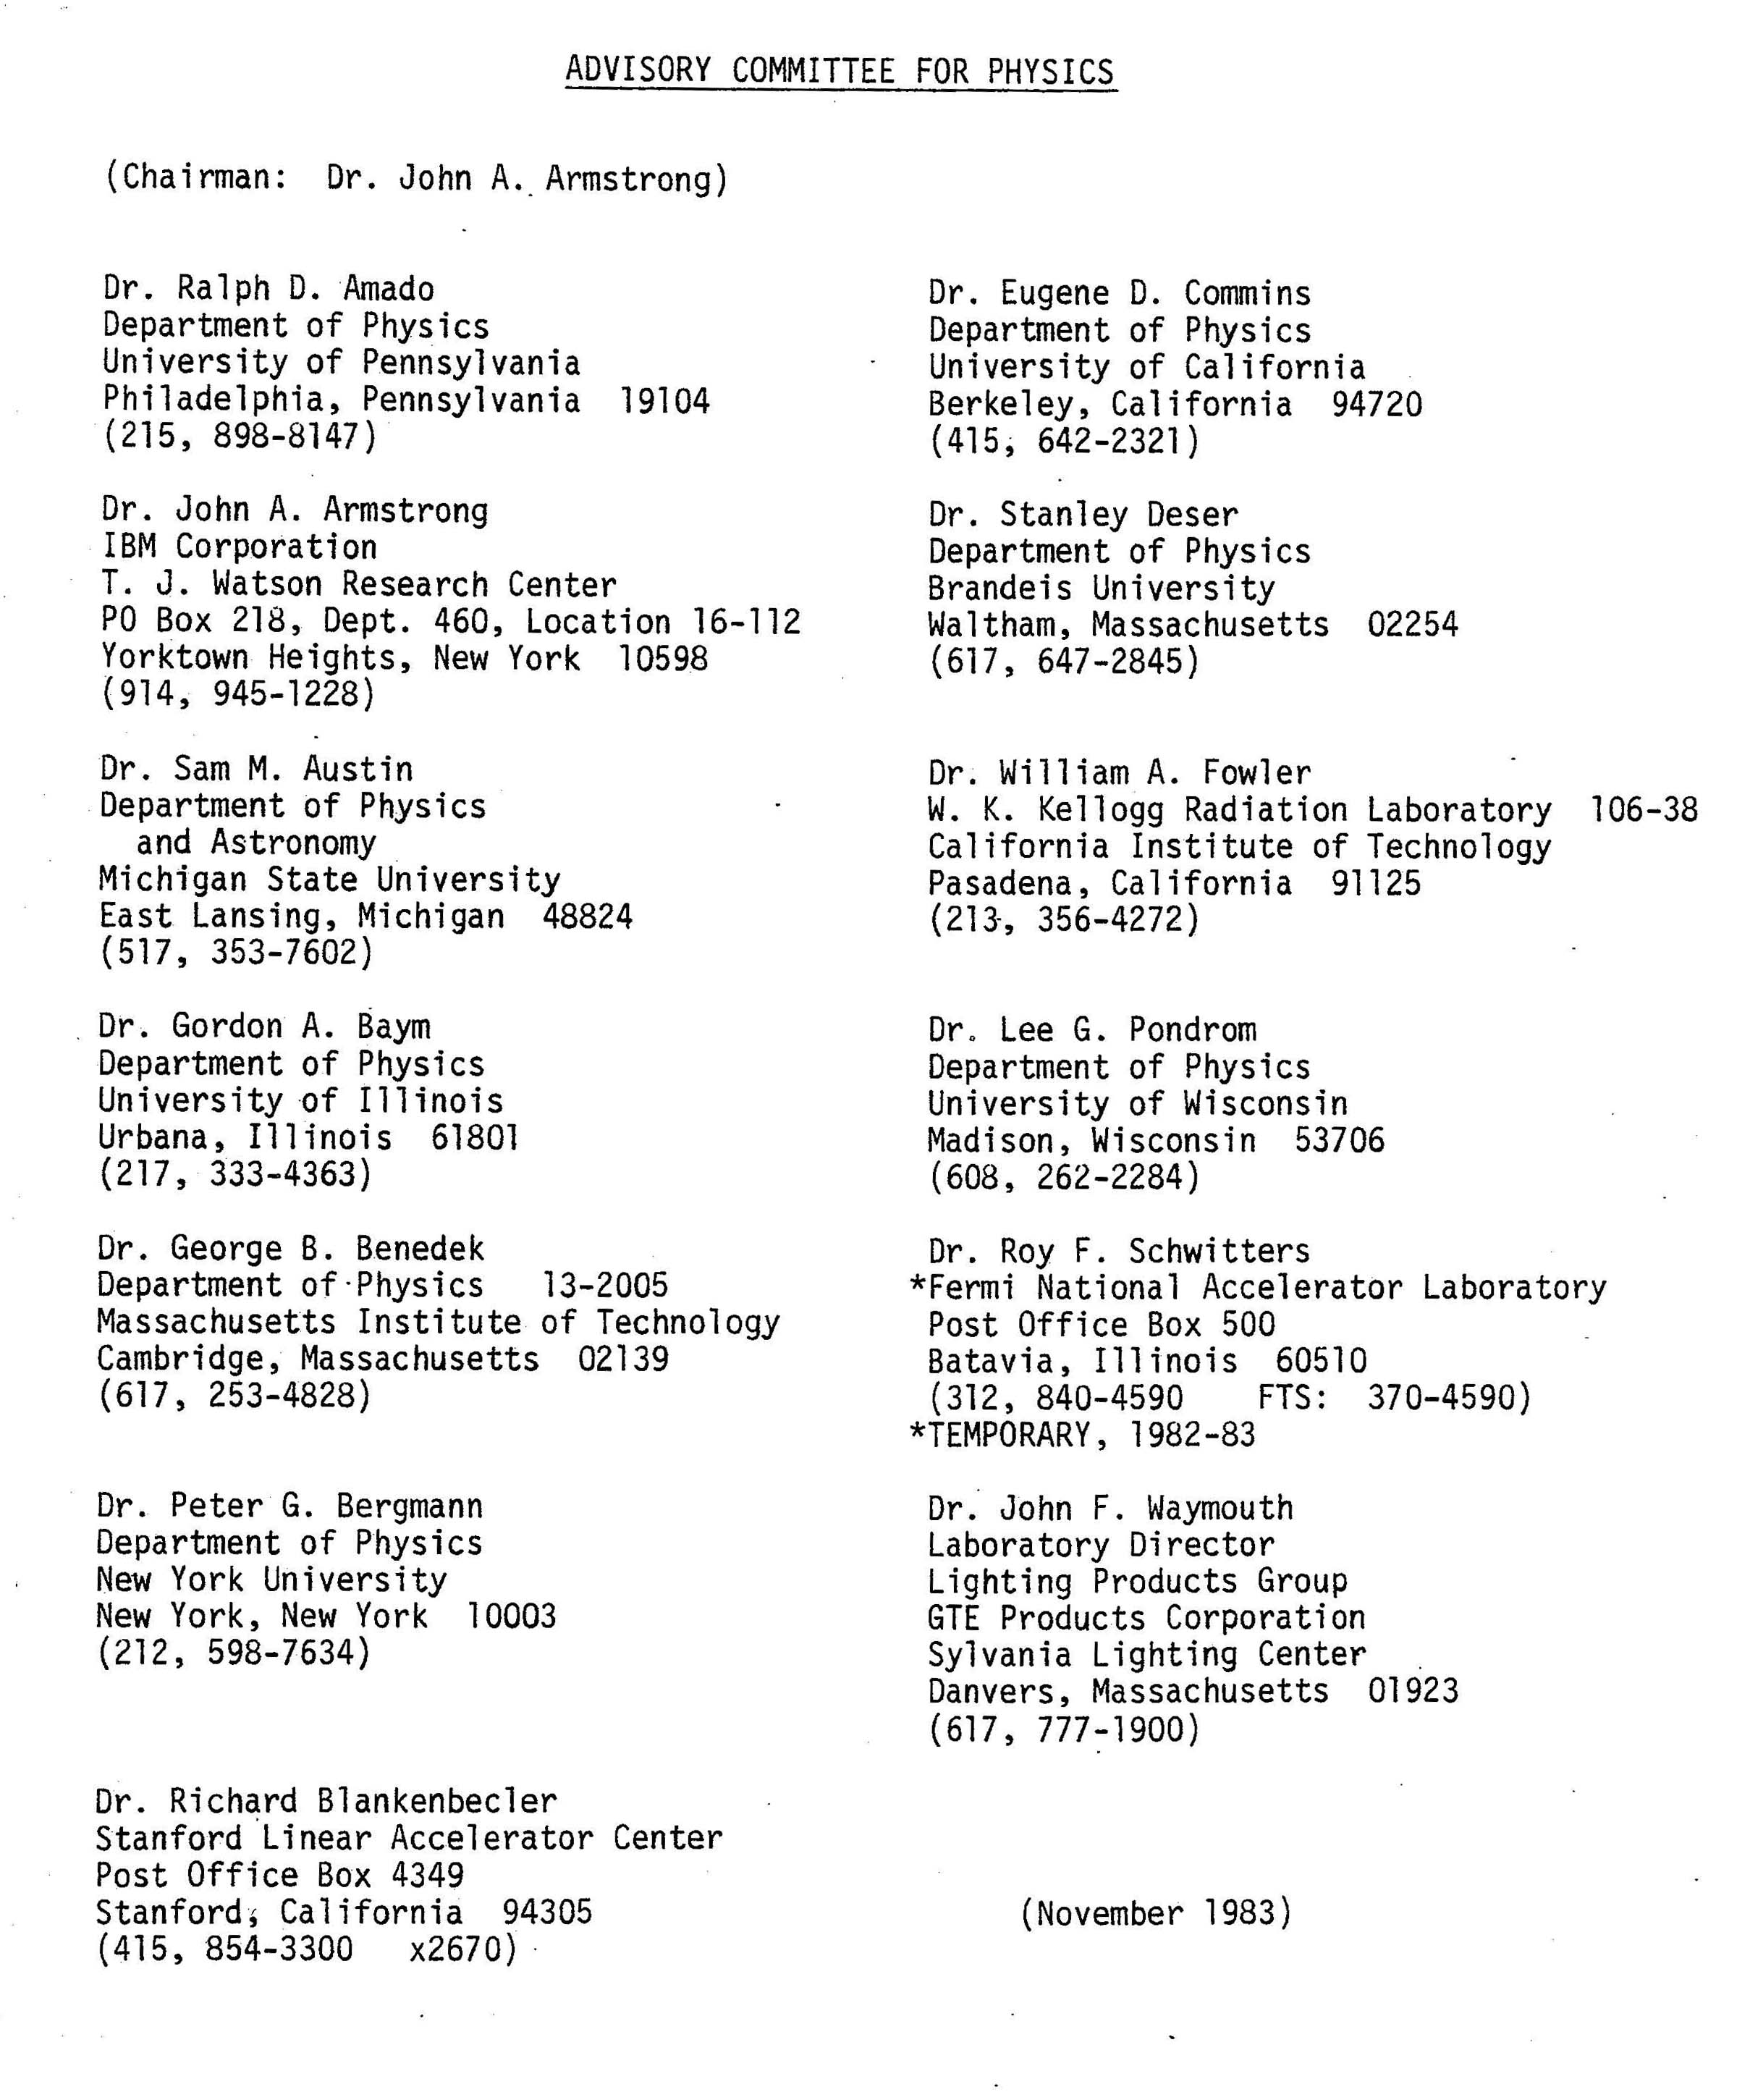

Slide 15
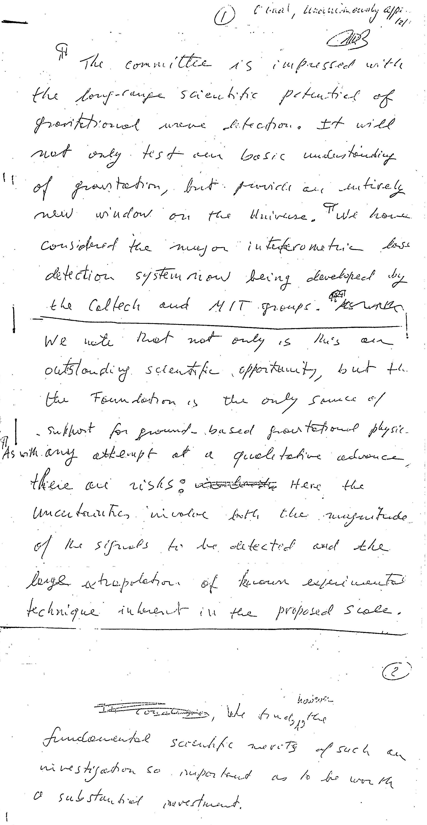
Subcommittee:
G. Baym
S. Deser
R. Schwitters

Slide 17
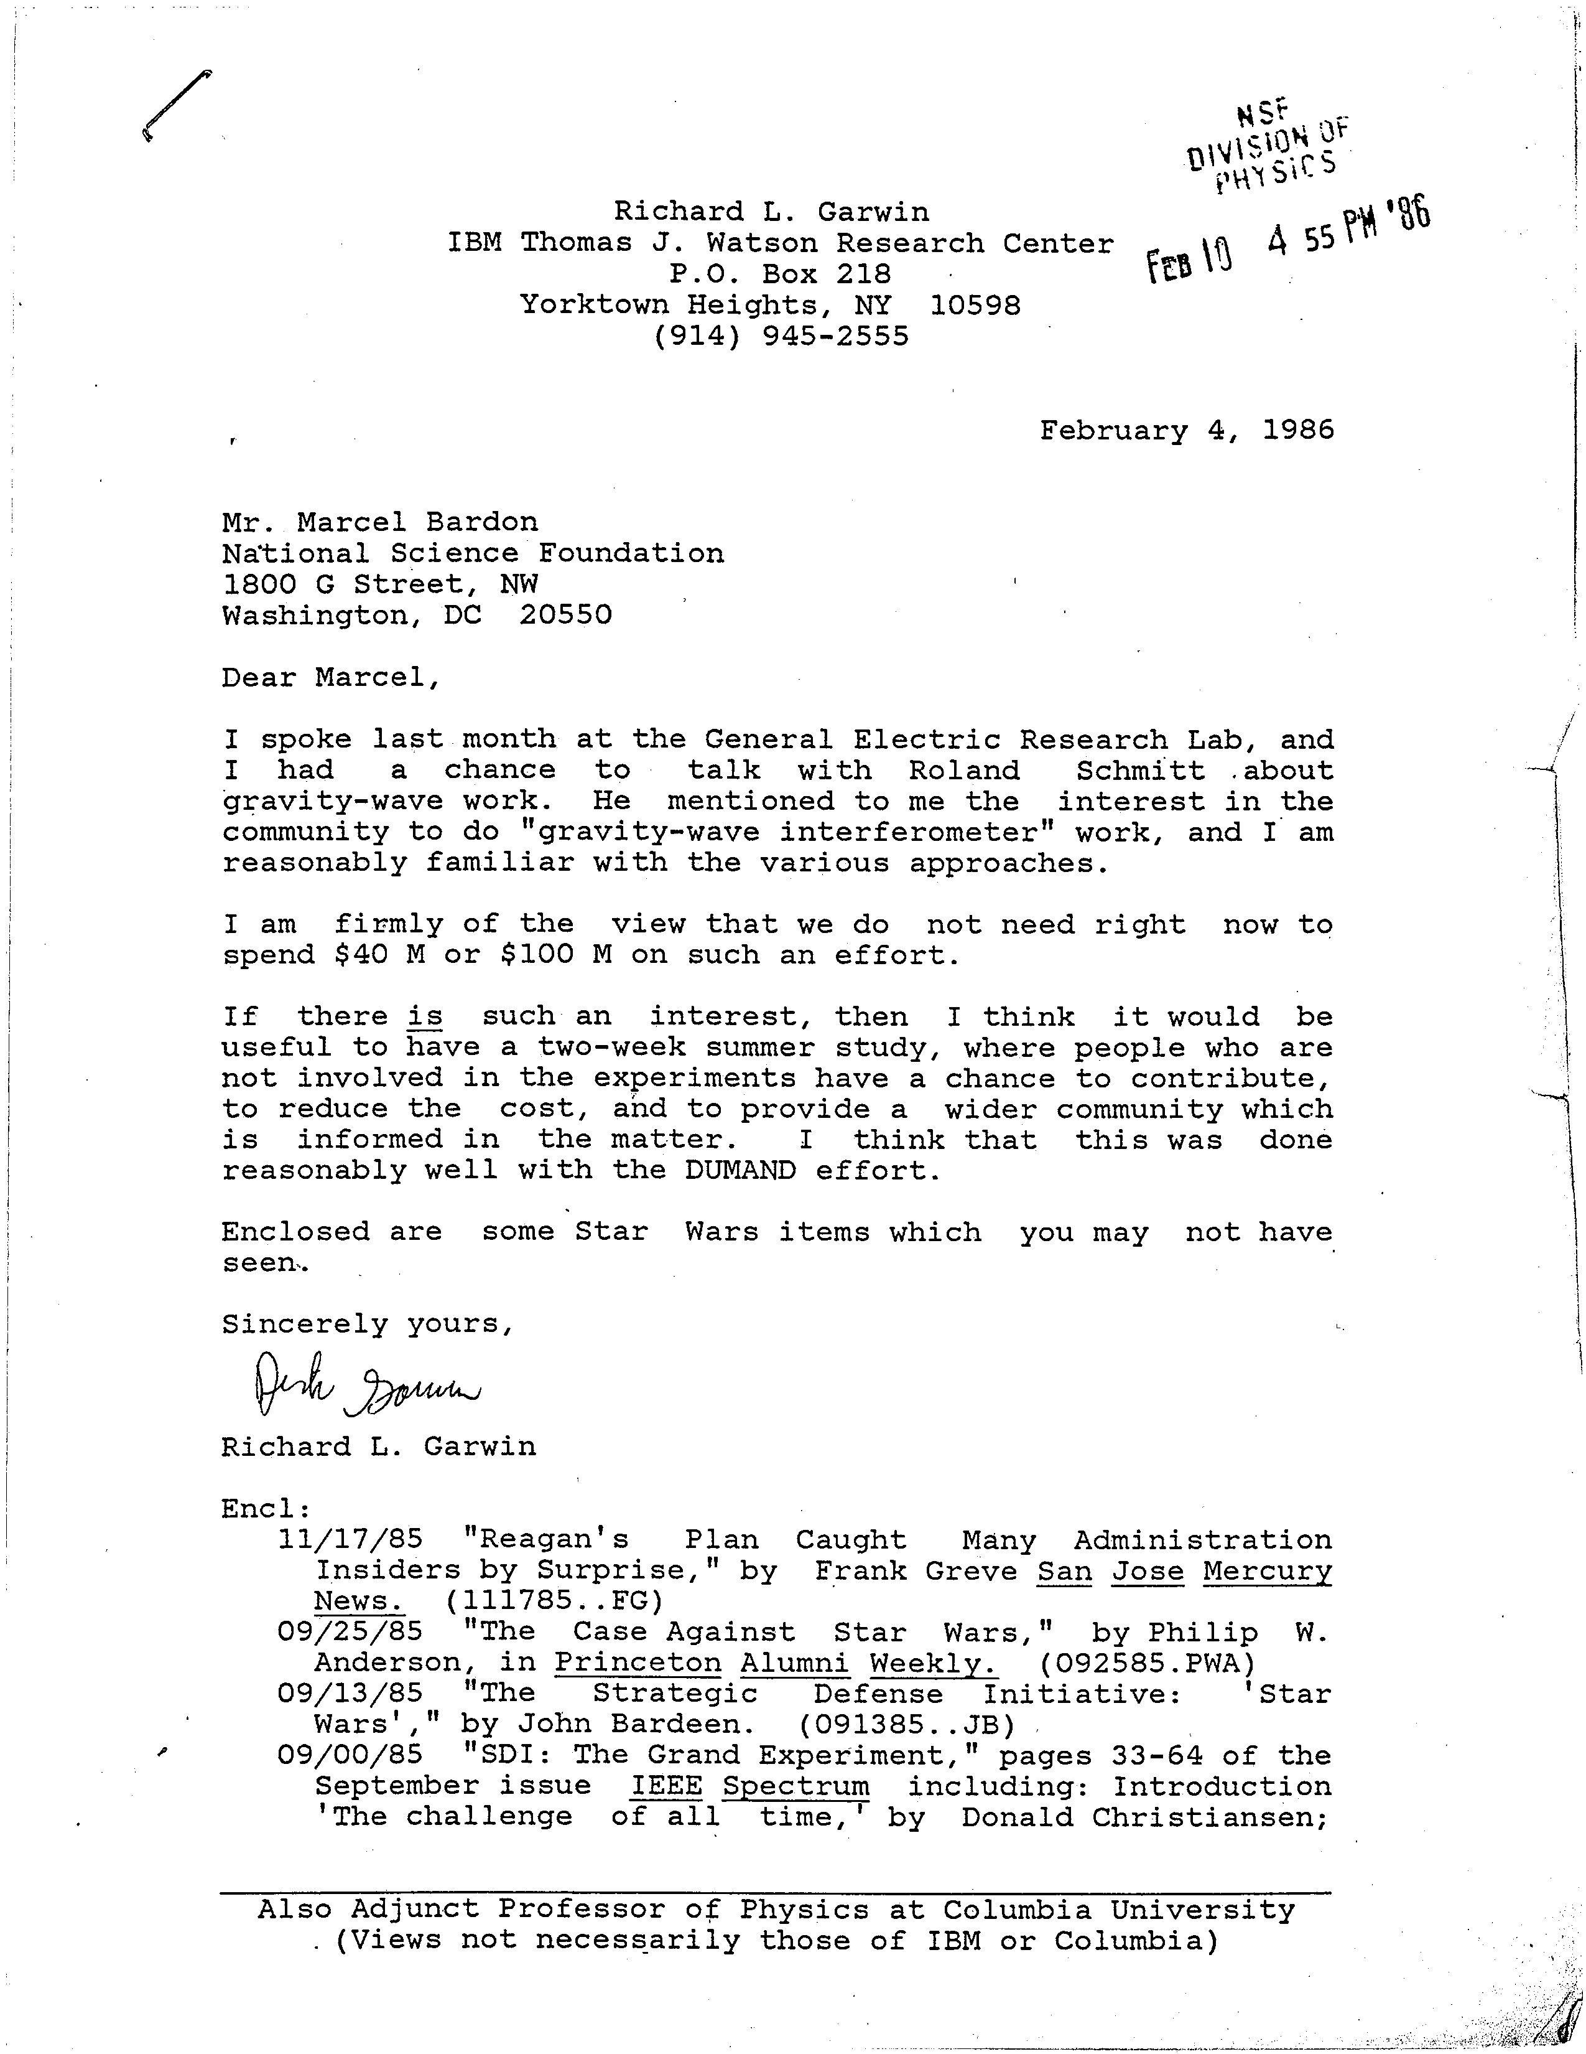

Slide 18
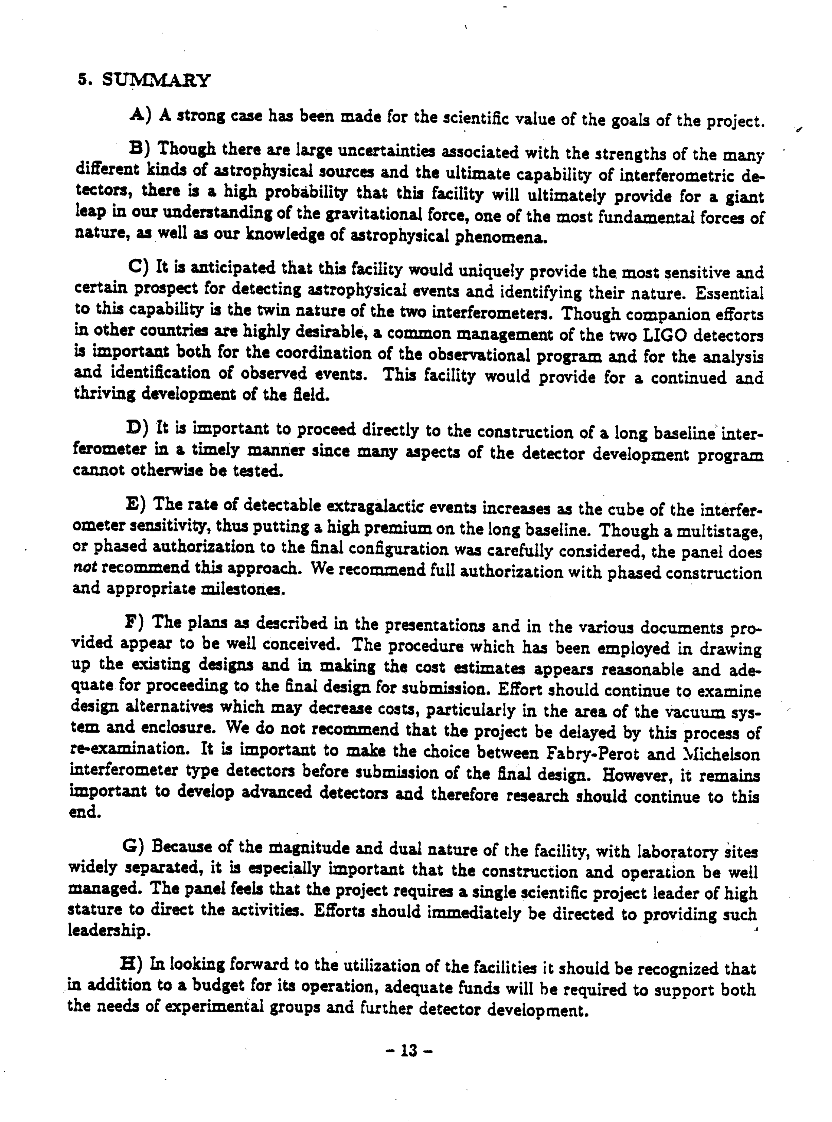
Report to the NSF
Panel on interferometric observatories for
Gravitational waves January 1987

Slide 19
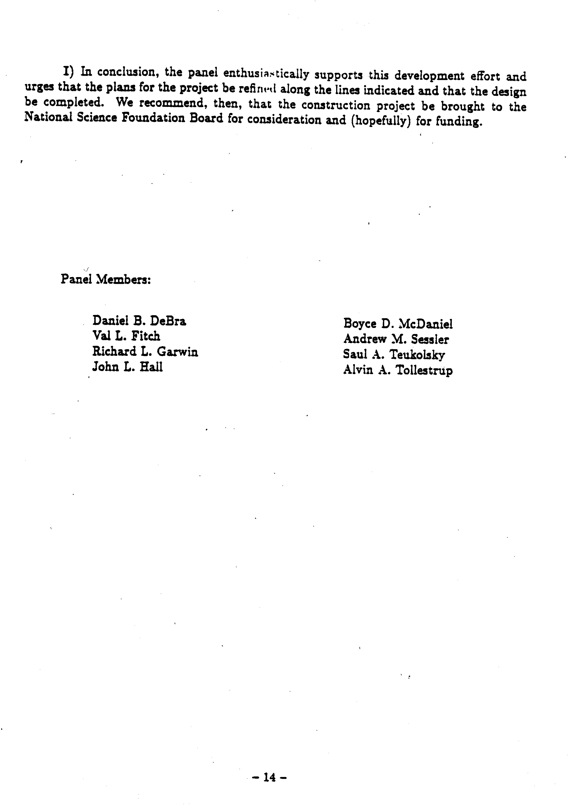
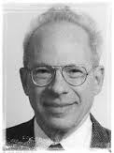
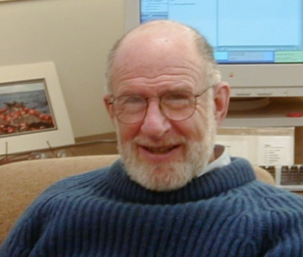
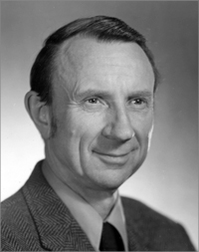
A. Sessler
B. McDaniel
R. Garwin

Slide 20
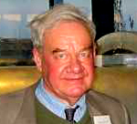
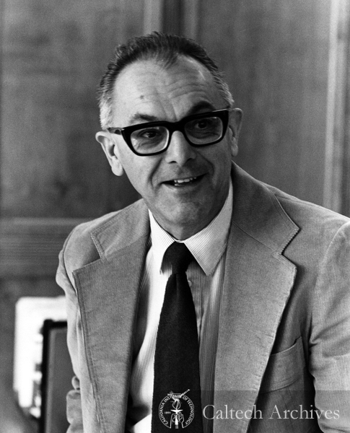
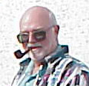
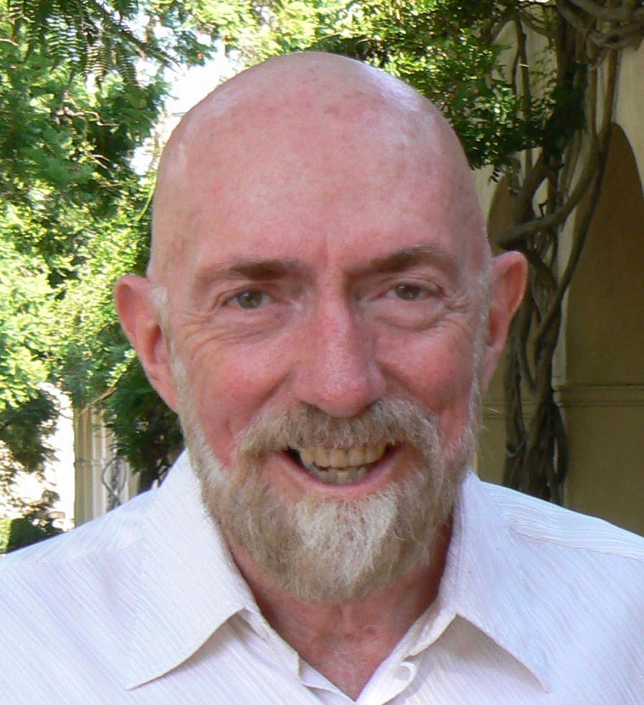
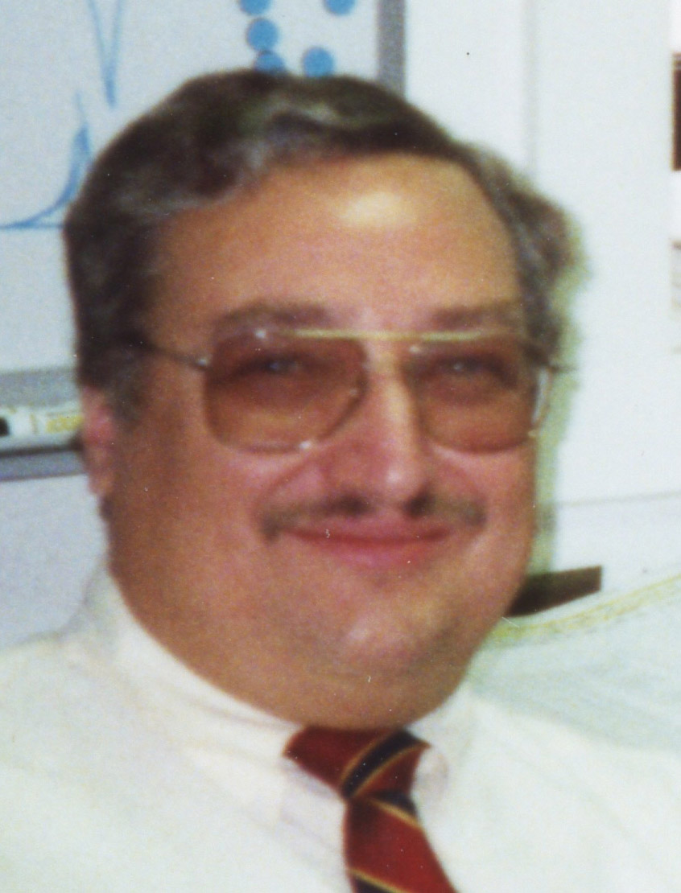
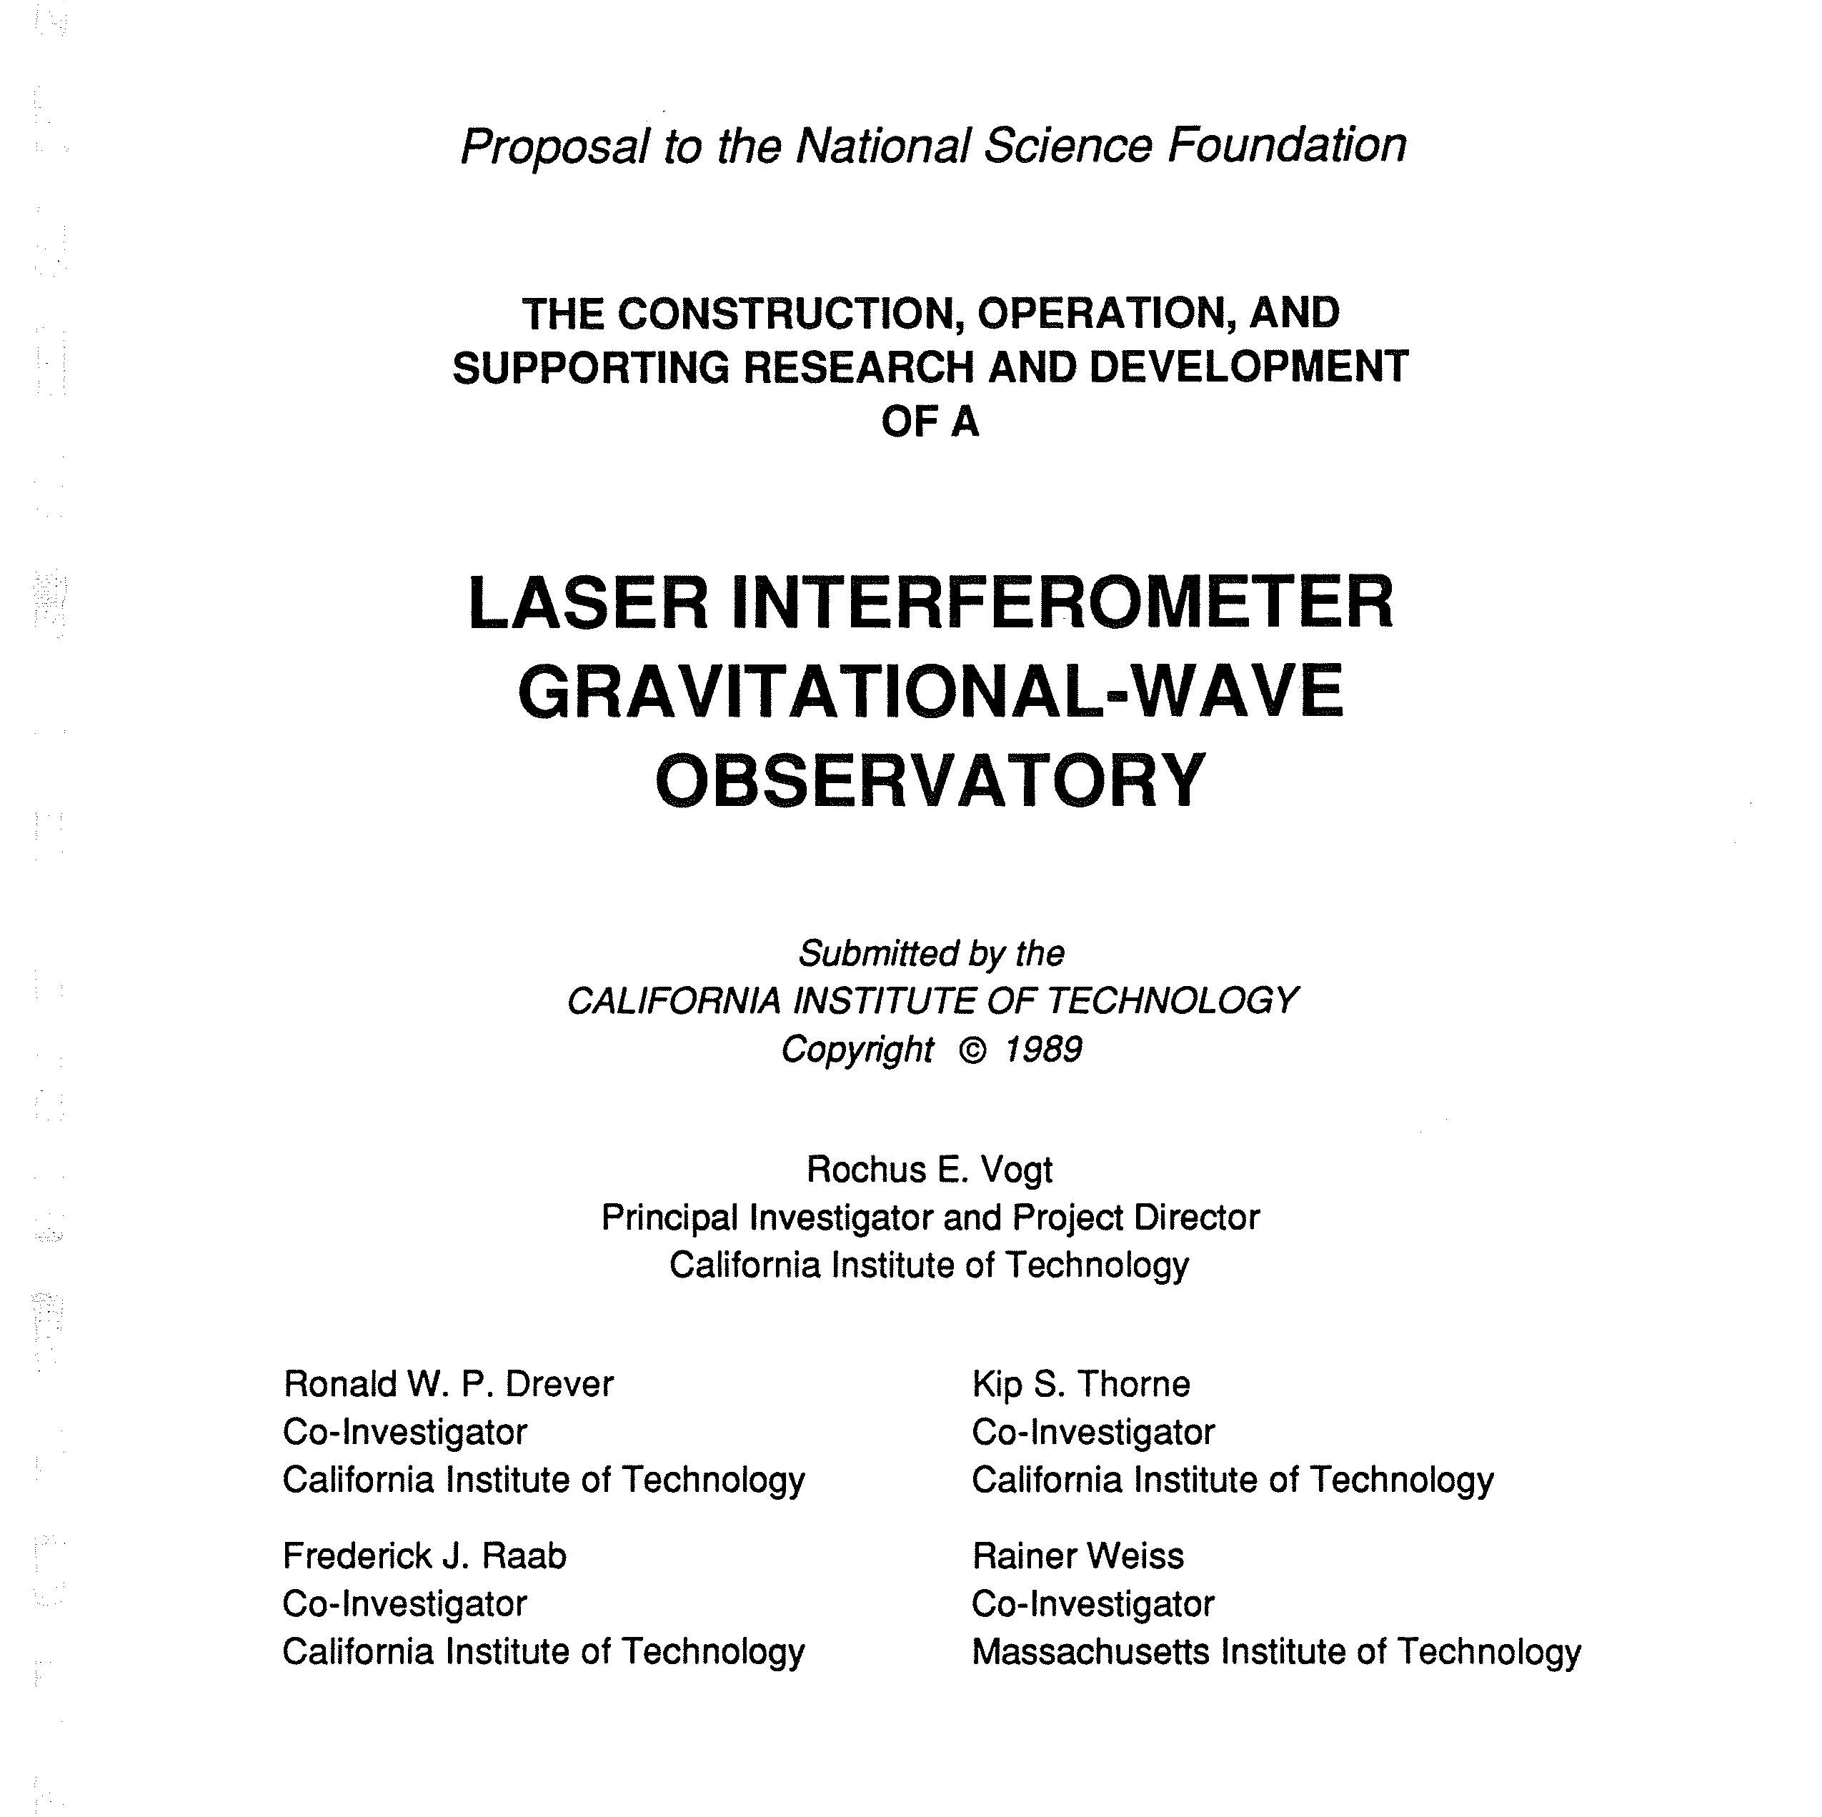
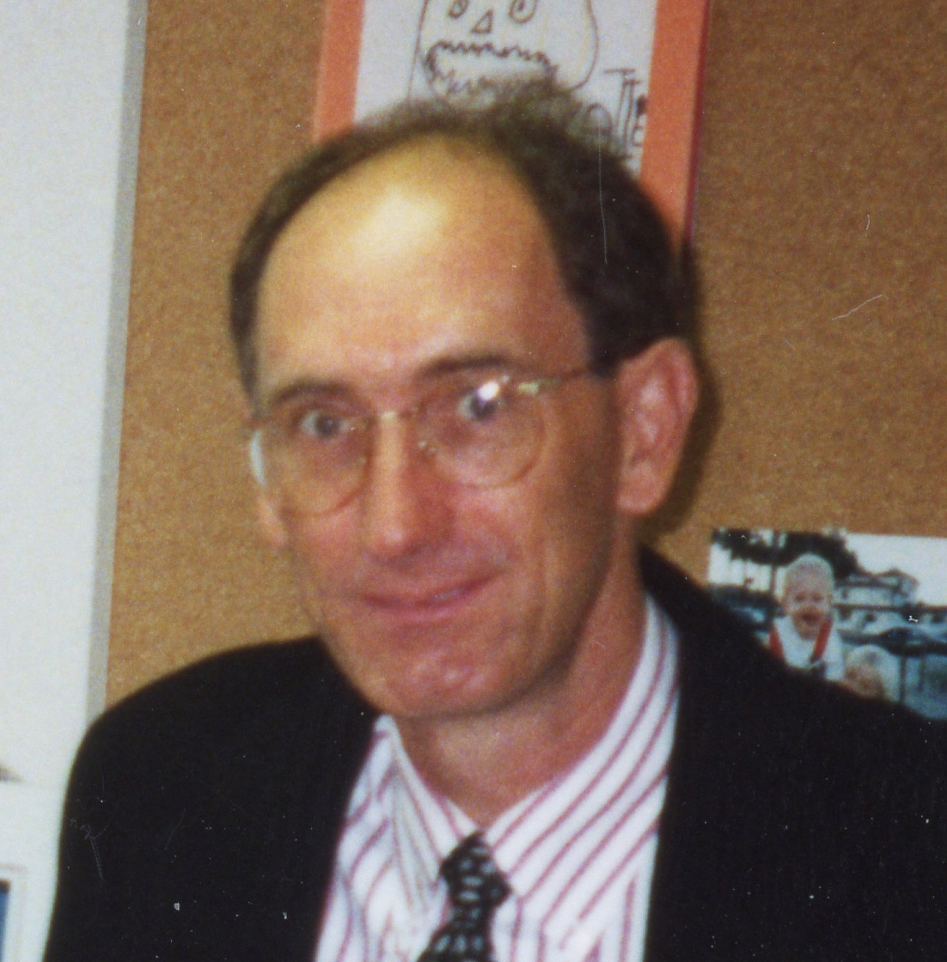
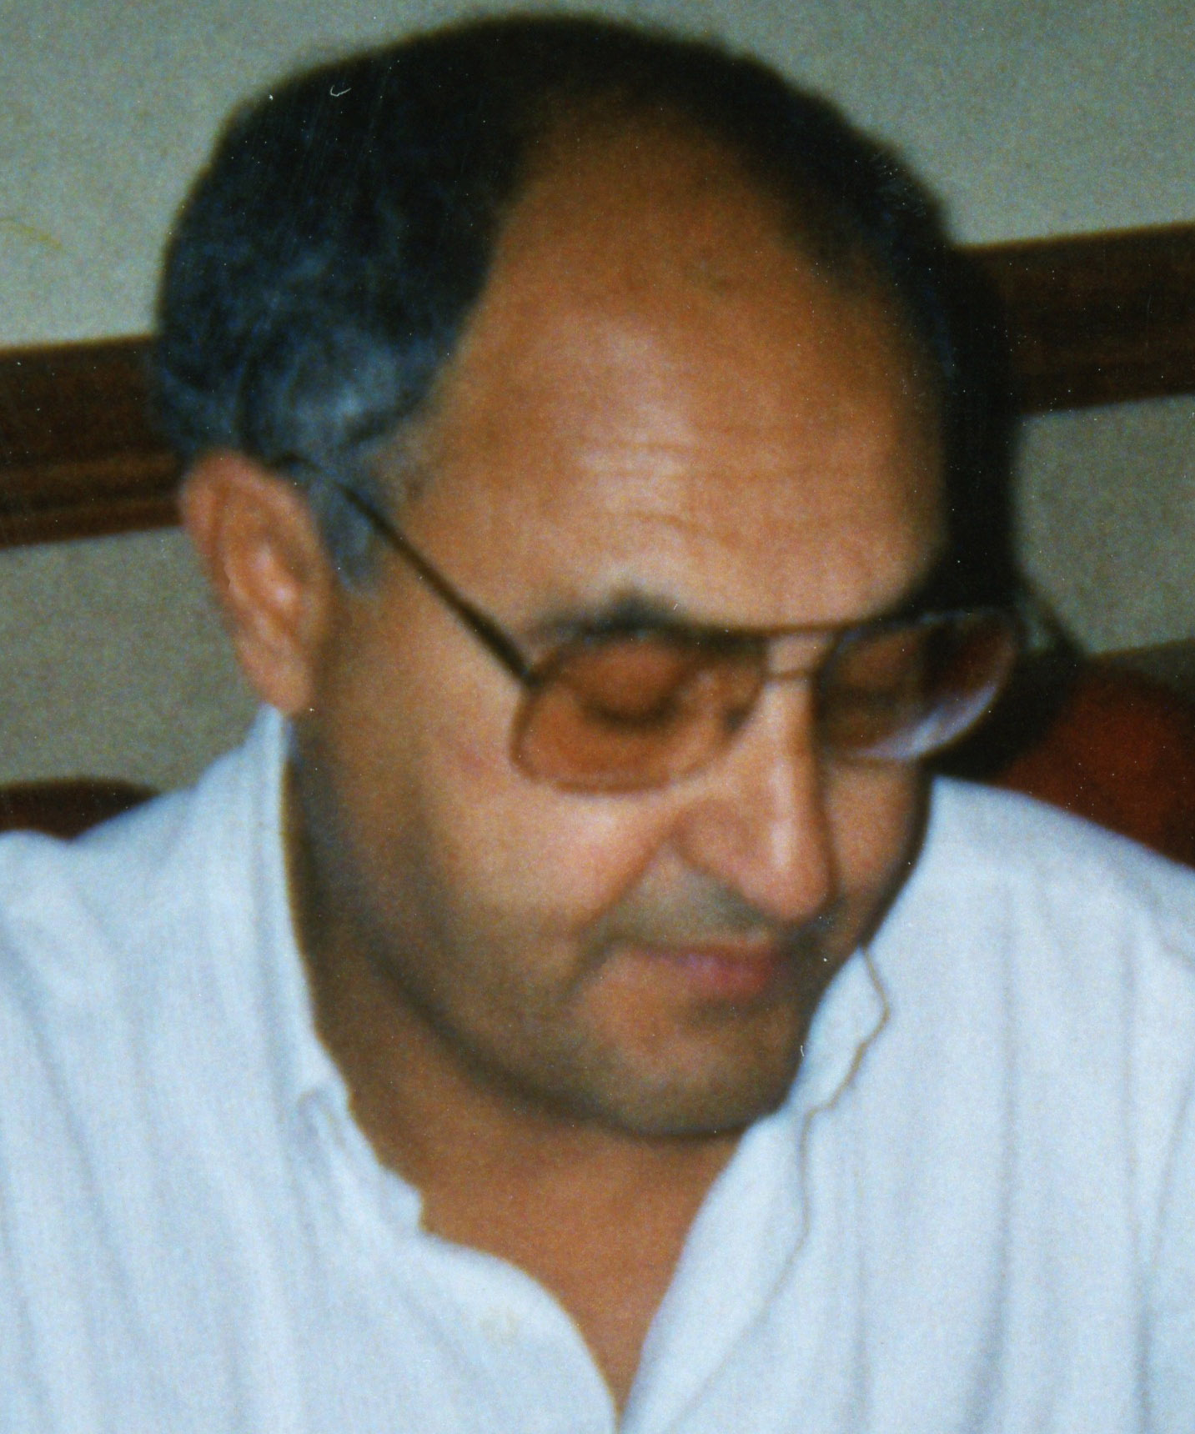
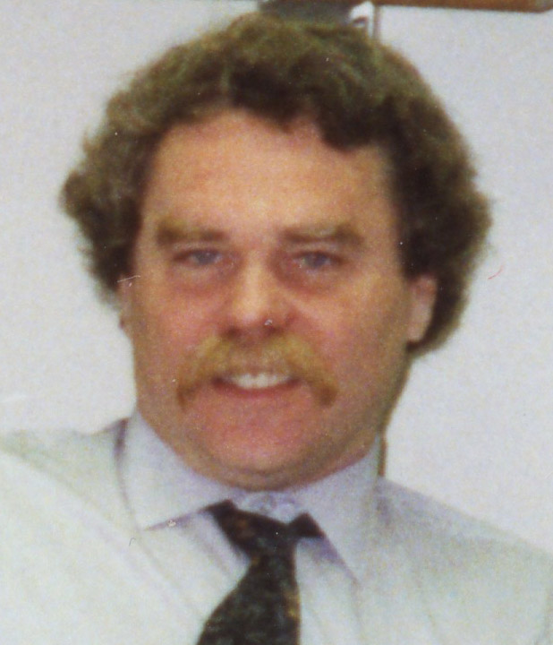
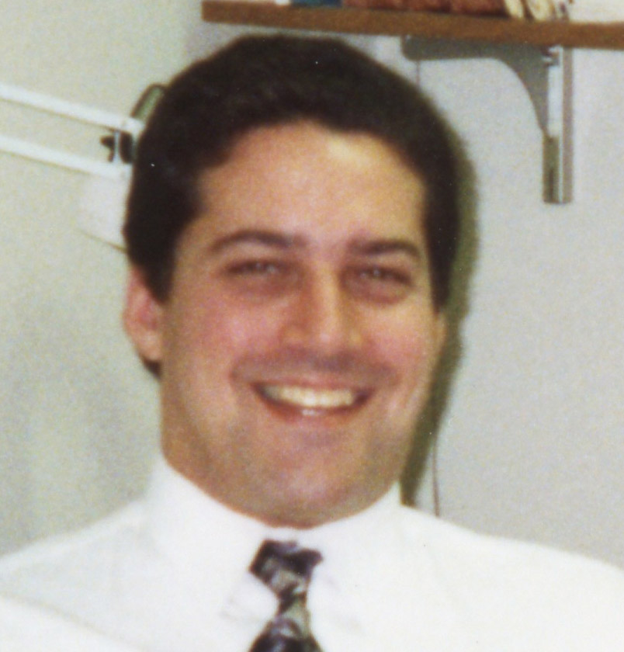
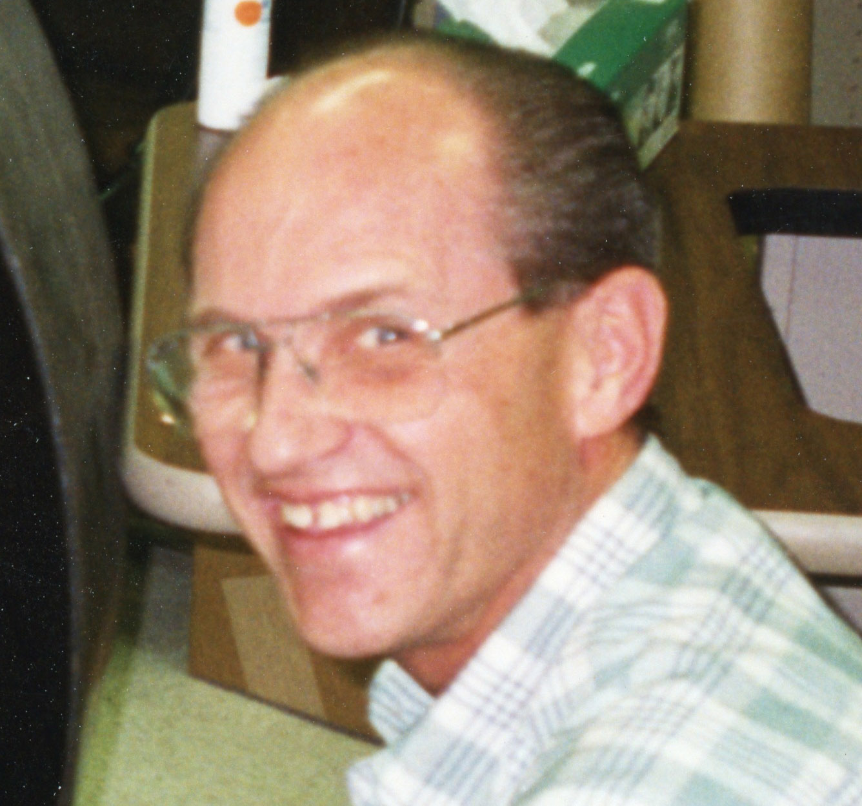
R.Drever
W. Althouse
R. Vogt
K. Thorne
F. Asiri
R. Savage
F. Raab
J. Worden
M. Zucker
L.Jones

Slide 21
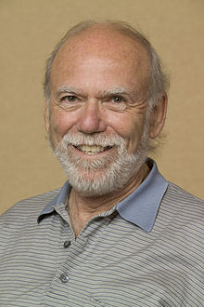
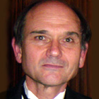
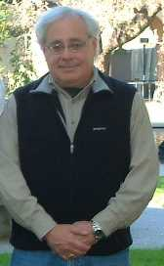
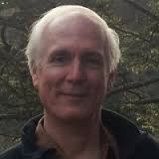
The real start
1994
A. Lazzarini
B. Barish
D. Coyne
G. Sanders

Slide 22
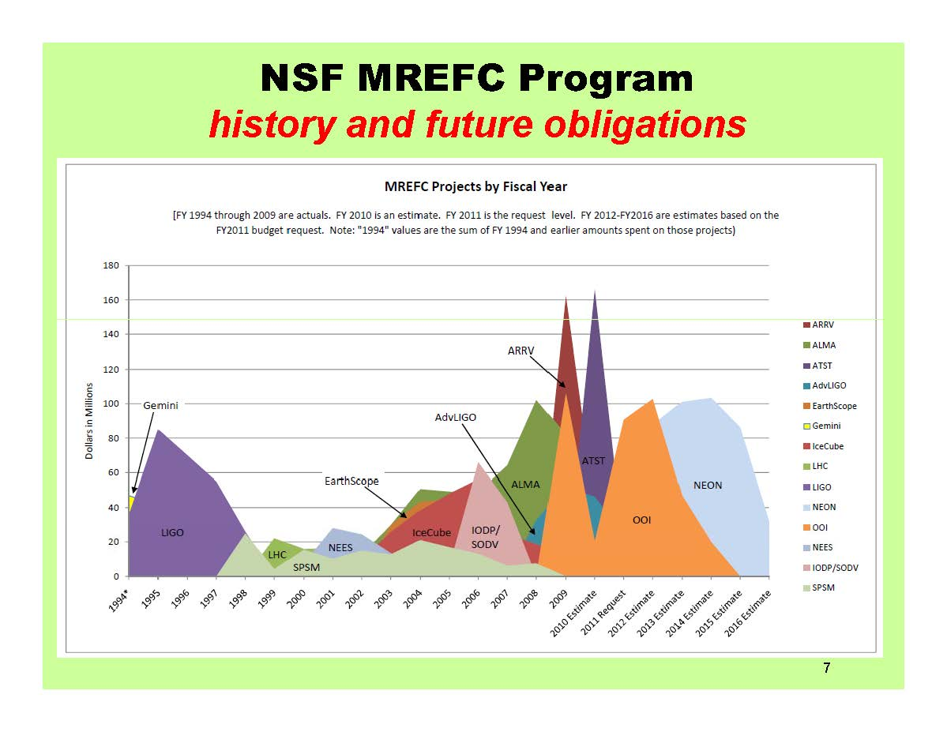
Barish: MREFC Program NSB Report

Slide 23































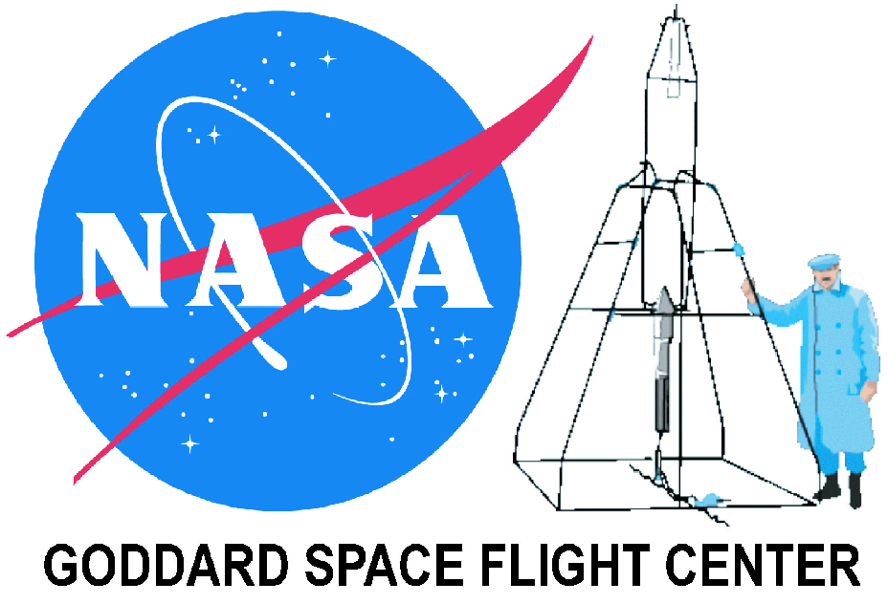












































LIGO Scientific Collaboration

