Slide 1
The origins of LIGO
Rainer Weiss, MIT
Kavli 10th Anniversary Celebration
June 18, 2015

Slide 2
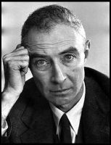
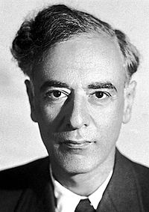
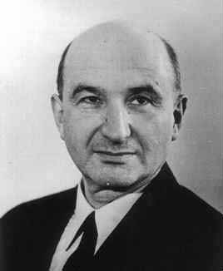

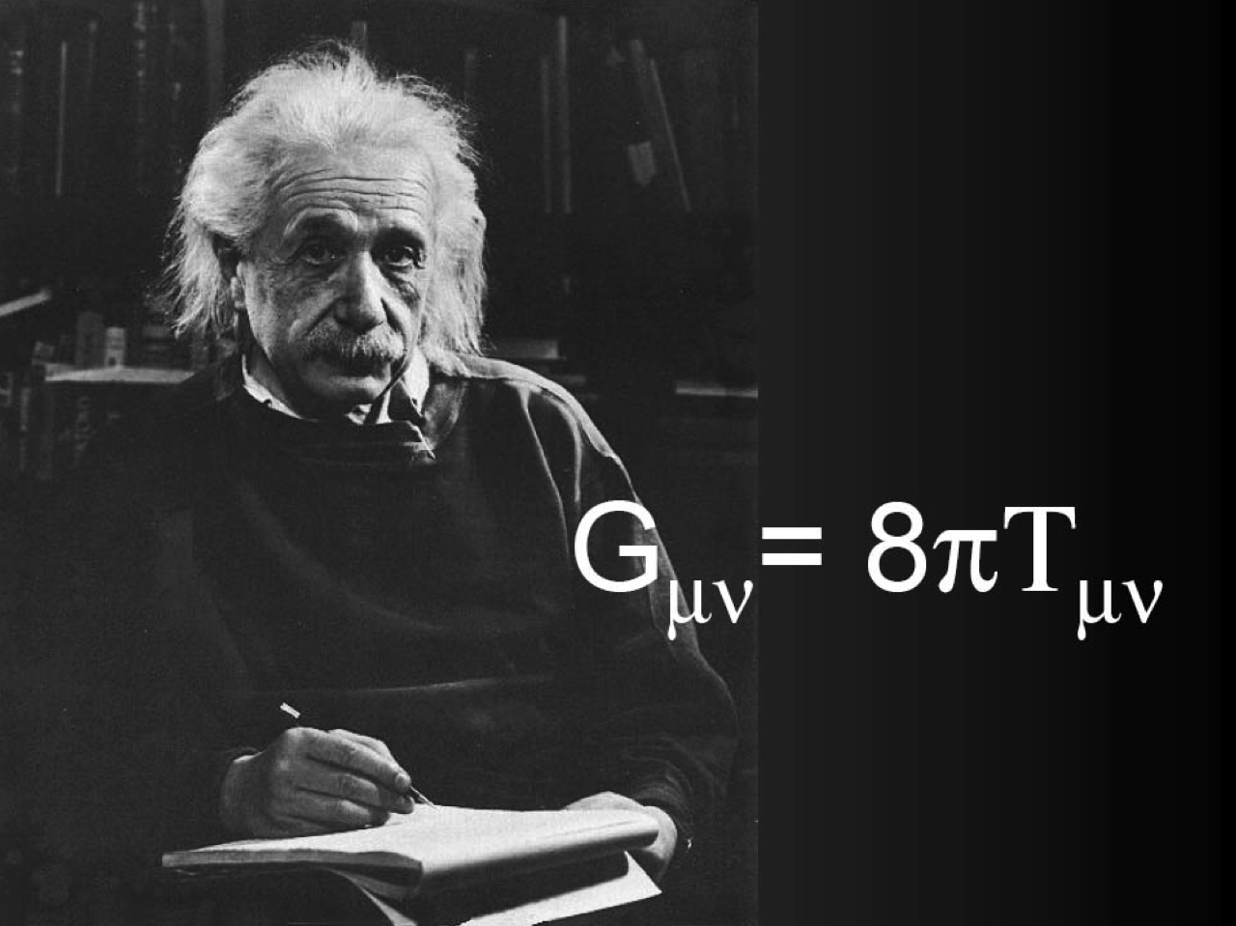

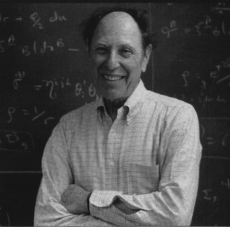
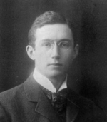
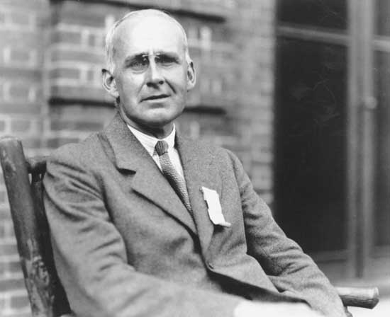
theory
observation
technology
L. Landau & E. Lifshitz
Classical Theory of Fields
J.R. Oppenheimer
H. Snyder
Gravitational collapse to a BH
A. Einstein
Special Relativity
Random processes
N.Rosen & A.Einstein
Doubt cylindrical exact wave
solution
Atomic clock
A. Einstein
General Relativistic waves
R.V.Pound
Cavity freq.
stabilization
Chapel Hill meeting
Wiener-Kinchin
Hubble expansion
1900
Vacuum triode
1920
Lock-in amplifier
1940
Mt Palomar 5.1m
maser
1960
Mt Wilson 2.5m
mostly mathematics
Feynman comments the field needs experiment, less mathematics
E. Hubble
External galaxies
A.S. Eddington
skeptic: about pseudo tensor, inability to solve binary system,
coordinate waves that propagate with the speed of thought also ones that might carry energy
M. Abraham
Electromagnetic analog
K. Jansky
Radio astronomy
Understanding servoes
H. Bode
H. Nyquist
C. Shannon
Josh Goldberg
US AirForce

Slide 3
Einstein 1916

Slide 4
Einstein 1916
CONTROVERSIAL GRAVITATIONAL ENERGY – MOMENTUM PSEUDO TENSOR

Slide 5
Einstein 1916

Slide 6
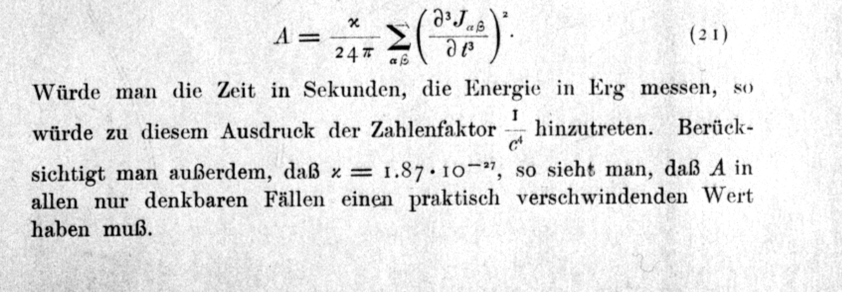
Einstein 1916
“…..in any case one can think of A will have a practically
vanishing value.”

Slide 7
Einstein 2018

Slide 8
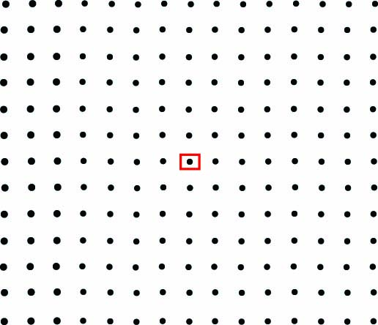

Slide 9
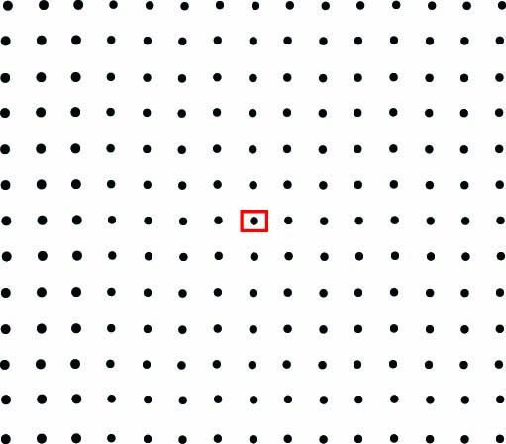

Slide 10
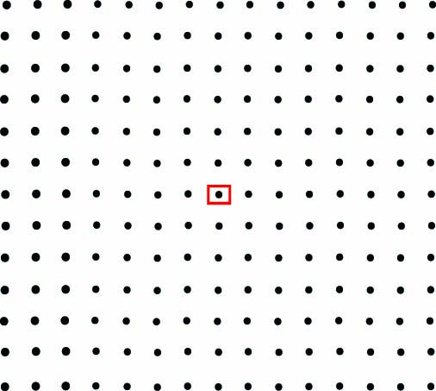

Slide 11
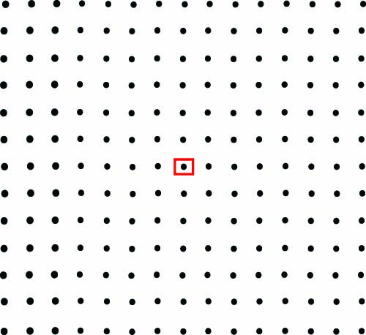

Slide 12
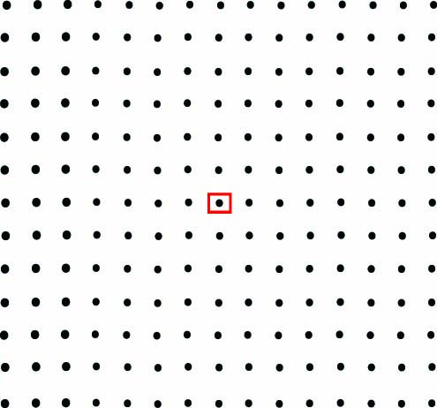

Slide 13
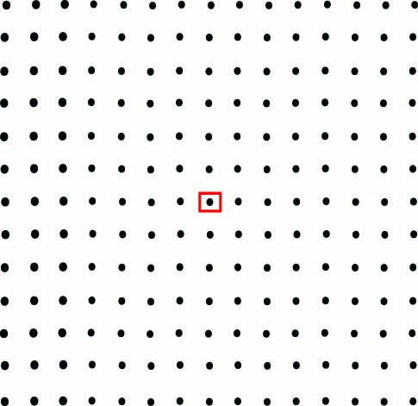

Slide 14
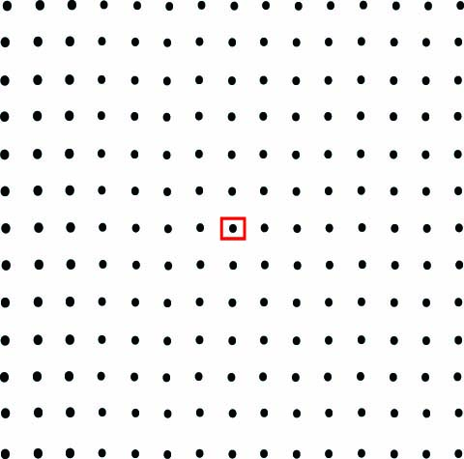

Slide 15
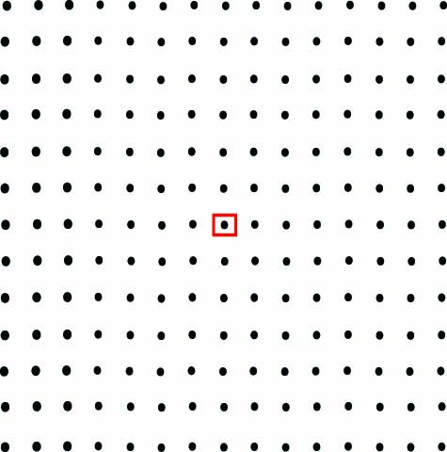

Slide 16
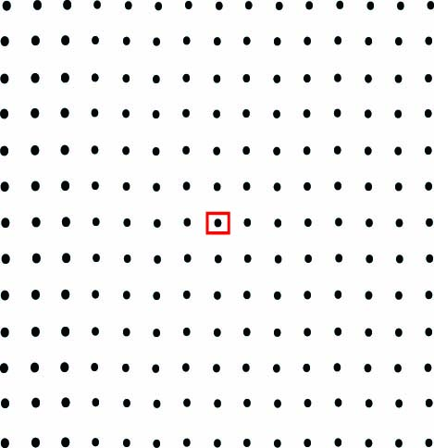

Slide 27
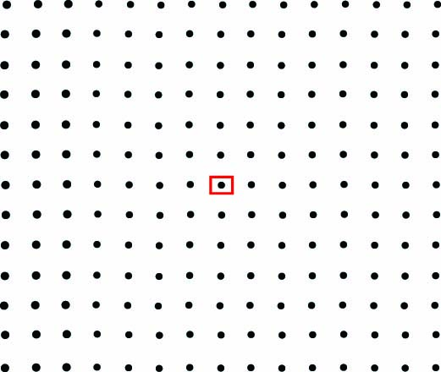

Slide 28
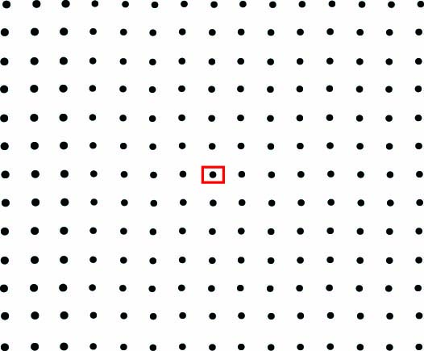

Slide 29
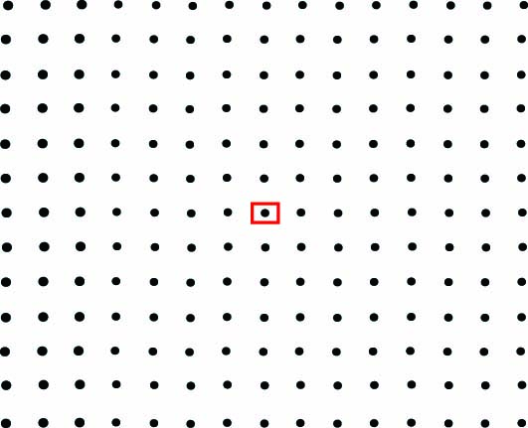

Slide 30
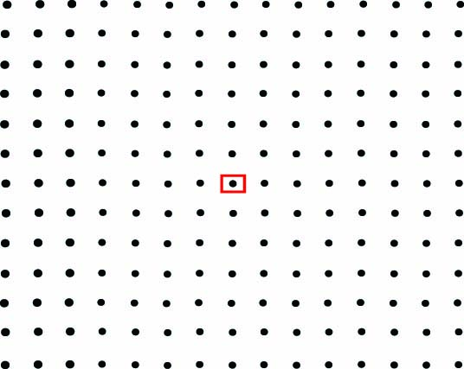

Slide 31
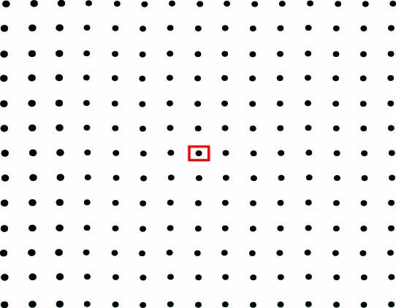

Slide 32
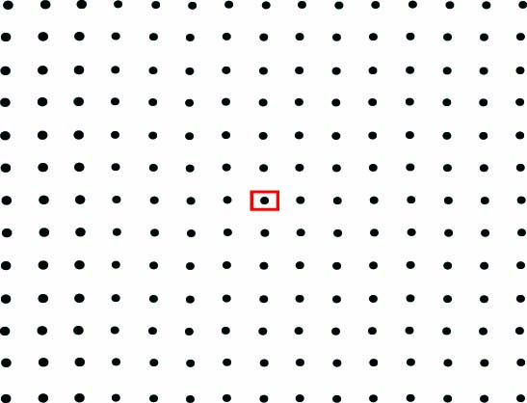

Slide 33
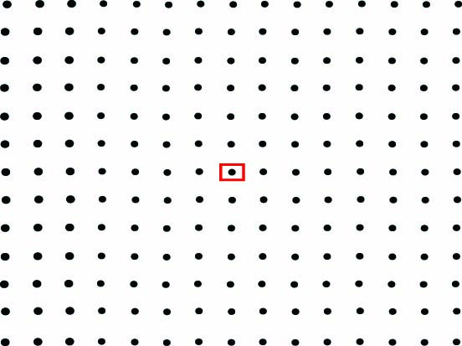

Slide 34
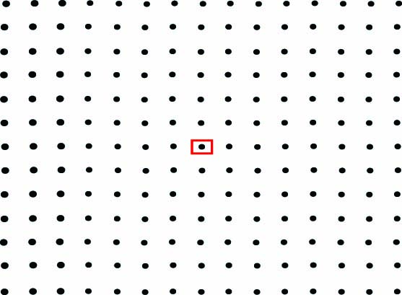

Slide 35
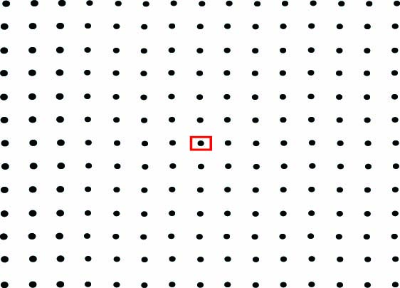

Slide 36
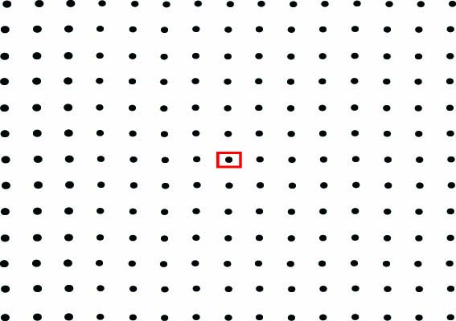

Slide 46
Relations for gravitational waves in modern notation
Intensity:
pseudo tensor
Power radiated:
quadrupole formula
Relation to estimate GW amplitude:
m₁=m₂= 1 solar mass
T_{orbit}= 1 day
R = 10 Kly
1916 example: binary star system
h ~ 10⁻²³ @ ½ day period
scaling

Slide 47
theory
observation
technology
L. Landau & E. Lifshitz
Classical Theory of Fields
J.R. Oppenheimer
H. Snyder
Gravitational collapse to a BH
A. Einstein
Special Relativity
Random processes
N.Rosen & A.Einstein
Doubt cylindrical exact wave
solution
Atomic clock
A. Einstein
General Relativistic waves
R.V.Pound
Cavity freq.
stabilization
Chapel Hill meeting
Wiener-Kinchin
Hubble expansion
1900
Vacuum triode
1920
Lock-in amplifier
1940
Mt Palomar 5.1m
maser
1960
Mt Wilson 2.5m
mostly mathematics
Feynman comments the field needs experiment, less mathematics
E. Hubble
External galaxies
A.S. Eddington
skeptic: about pseudo tensor, inability to solve binary system,
coordinate waves that propagate with the speed of thought also ones that might carry energy
M. Abraham
Electromagnetic analog
K. Jansky
Radio astronomy
Understanding servoes
H. Bode
H. Nyquist
C. Shannon
Josh Goldberg
US AirForce

Slide 48
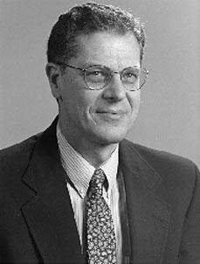
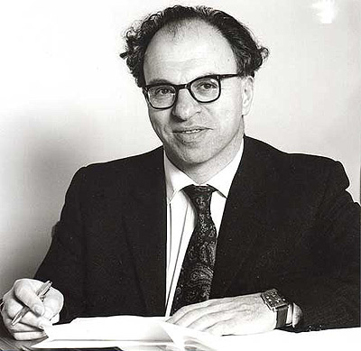
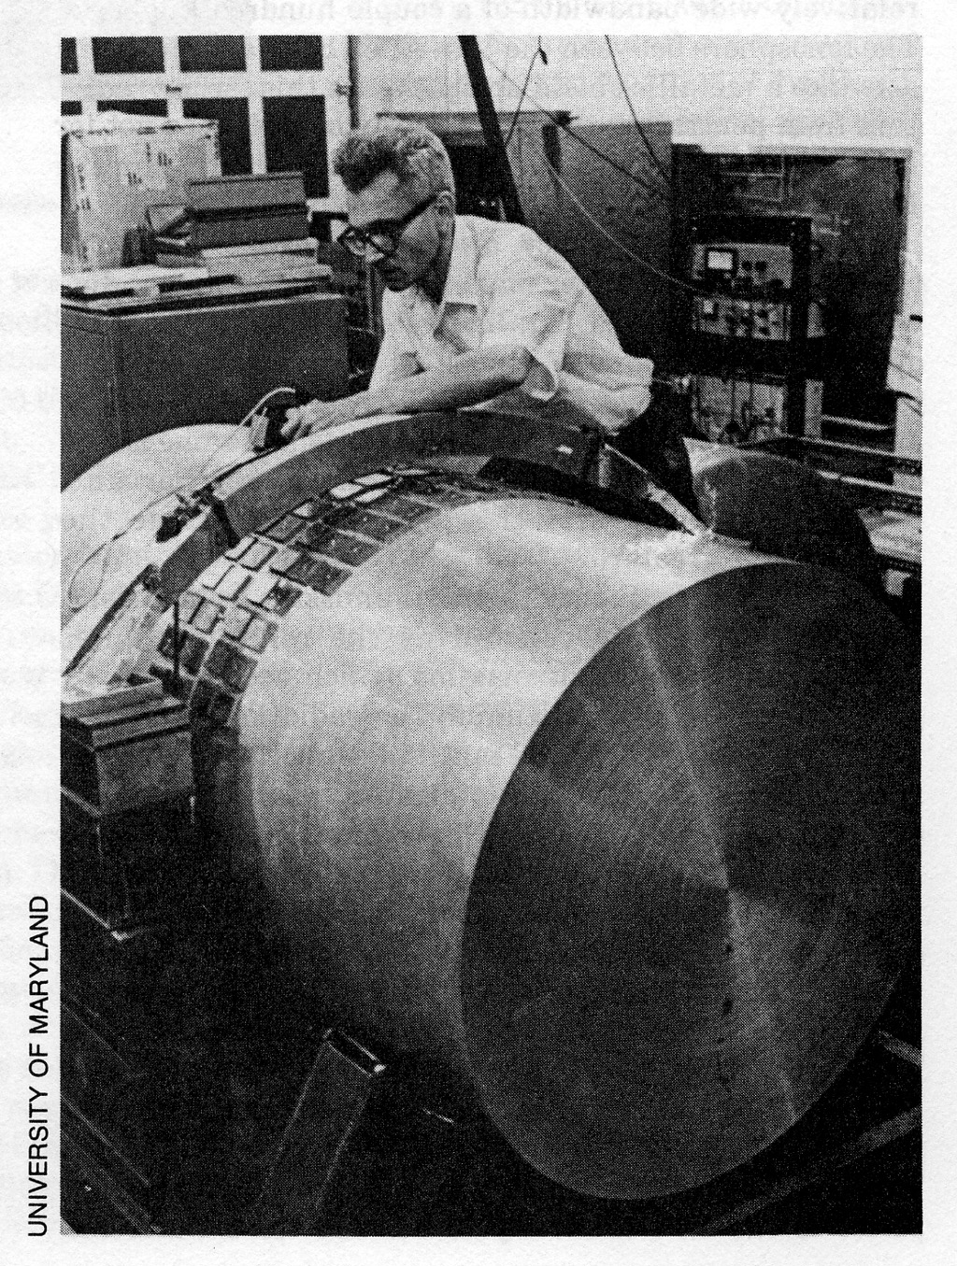
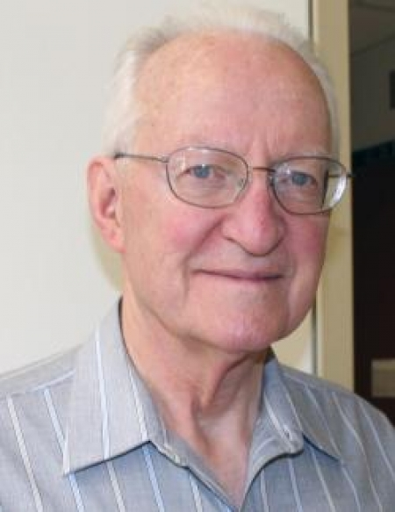
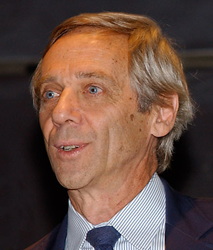
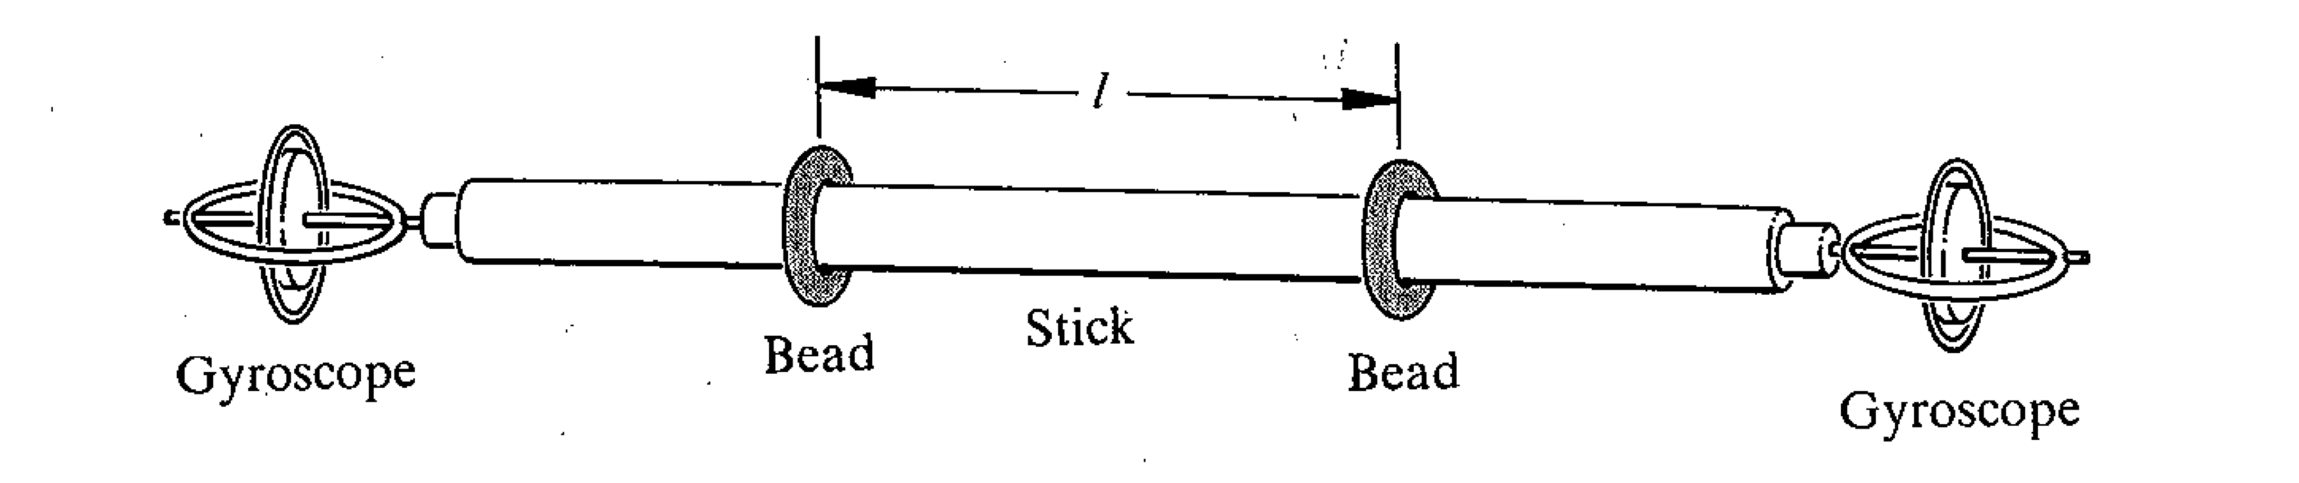
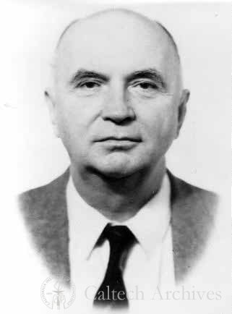
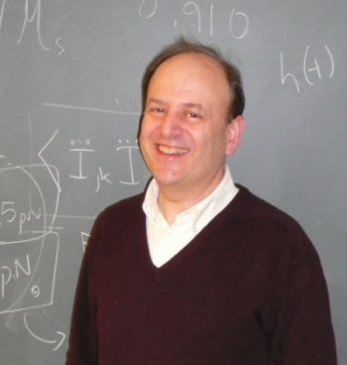
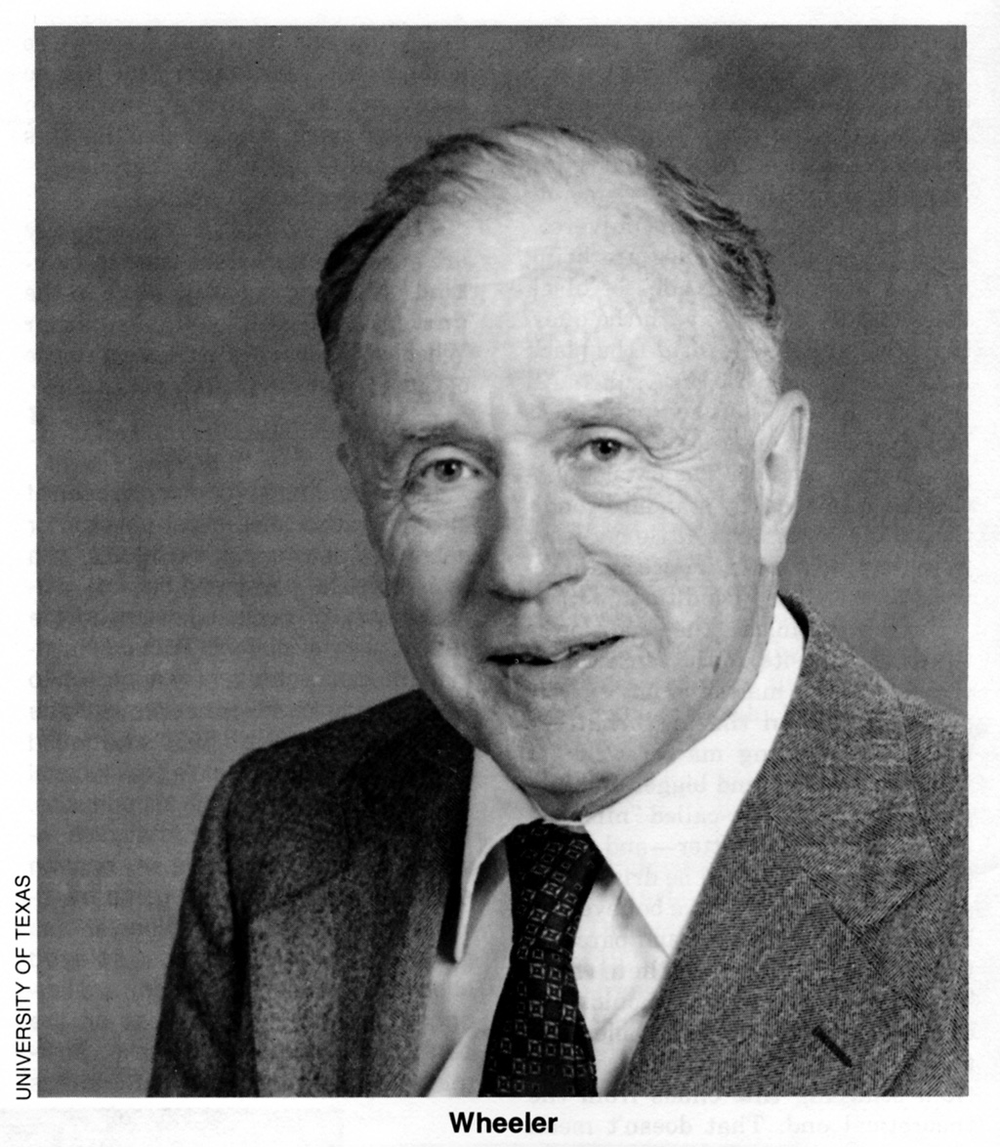
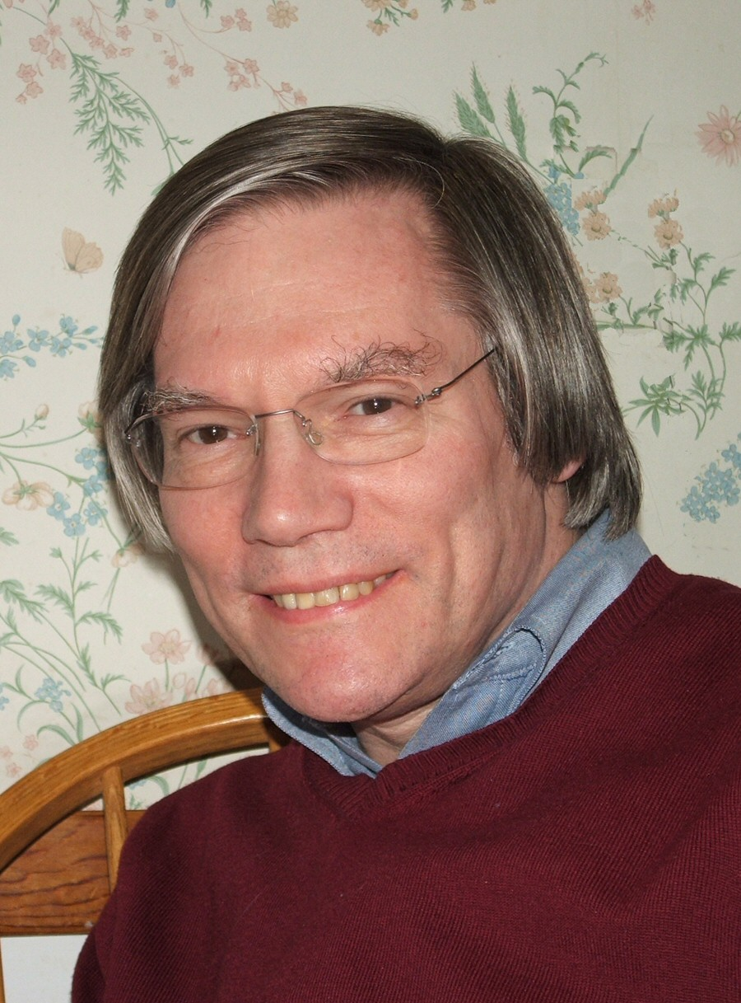
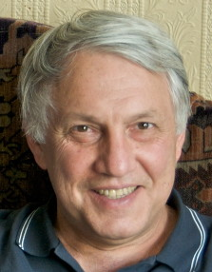
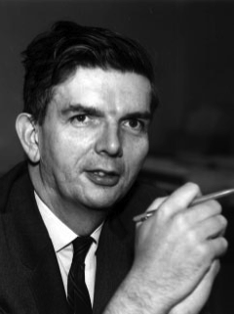
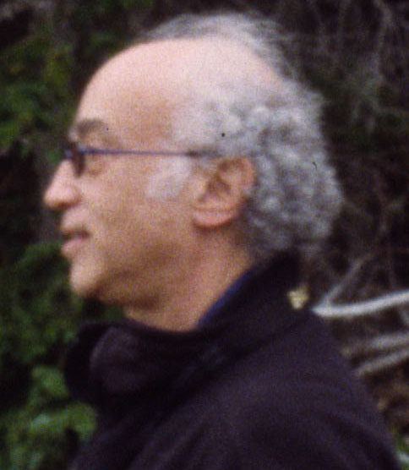
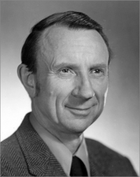
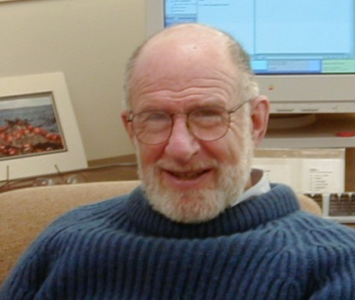
F.A.E. Pirani,
GW geodesic deviation
H. Bondi : beads on
rod, energy in GW
J. Weber
Acoustic resonant bar
GW detectors
P.Bender
LISA (1975)
J. Taylor &R. Hulse
binary pulsar
M.Gertsenshtein
GW interaction with EM waves
Space program:
C.Misner,R.V.Pound,
P.Bender, RW
Laser GW detector,
X and K band ranging
Chapel Hill meeting
J. Goldberg
GW from inflation
D.C Backer
Kerr metric
Integrated circuit
Kruskal
coordinates
X-ray
astronomy
millisecond pulsars
Millisecond pulsar timing GW detection
Laser
V. Braginsky (1974)
quantum limit
transistor
1960
1970
1980
NSF report 1983
LIGO
1990
J.Bell&A.Hewish
pulsars
Electromagnetically
coupled GW detector (RW)
Battelle Seattle
workshop
COBE
cosmic structure
J. Wheeler: Physical
reality of GW, Weber
bar
CMB discovery
F. Estabrook
H. Wahlquist
space craft ranging
BH in
Cygnus X-1
R. Vogt becomes 1st
Director of LIGO
PDP 11
Lab computer
R.H.Dicke: Eotvos experiment,
electronic cooling of mechanical
instrument
Cosmic inflation
NSF Study Committee on
Interferometric GW detection
P. Saulson
A.Guth A.Linde
R. Isaacson
B.McDaniel A. Sessler

Slide 51
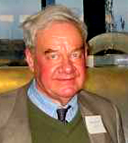
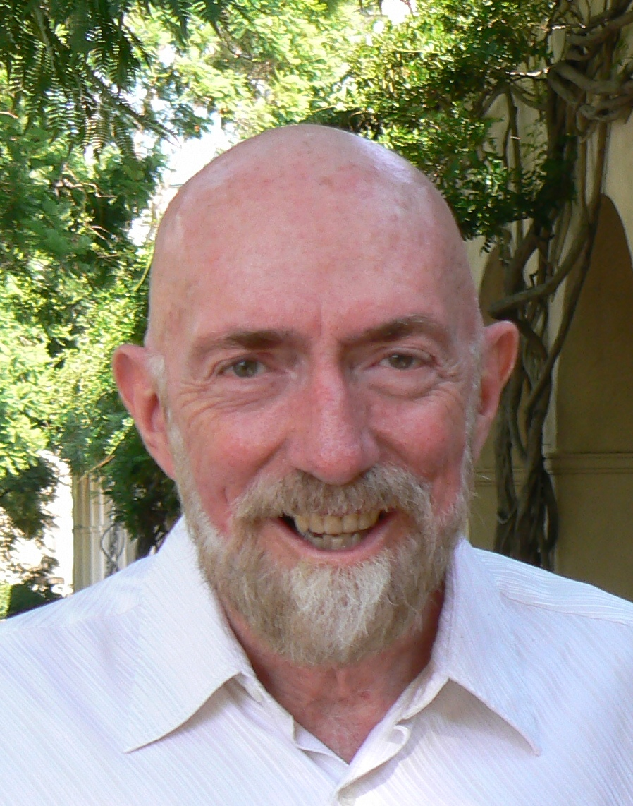
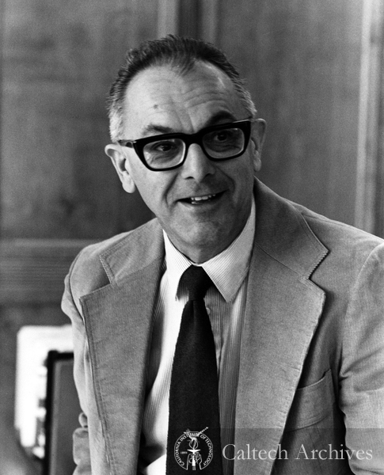
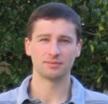
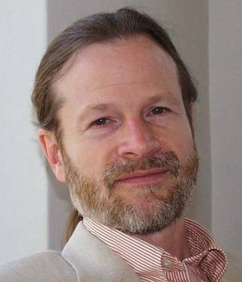
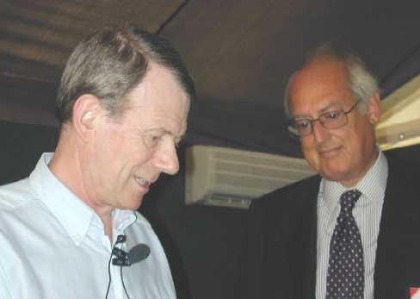
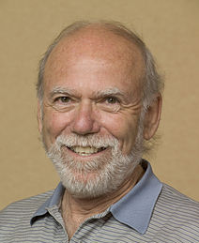
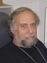


R.Drever
K. Thorne
R. Vogt
F. Pretorius
Numerical relativity waveforms
LIGO 1989
Proposal to NSF
Gamma ray burst
afterglows
WMAP
CMB polarization
1990
2000
2010
D. H. Shoemaker
2020
Advanced LIGO
construction begins
LIGO construction
begins
CMB polarization
from GW
Joint LIGO, VIRGO, GEO runs
clean null: No NS/NS to 20Mpc
in one year observation
A.Brillet & A. Giazotto
VIRGO 1990
J. Marx 3rd
LIGO Director
D. Reitze 4th
LIGO Director
B. Barish 2nd LIGO director
K.Danzmann
GEO 1995 & LISA

Slide 52
Gravitational wave spectrum

Slide 53
References
Traveling at the speed of thought
Daniel Kennefick
Princeton University Press 2007
Subtle is the Lord: The Science and Life of Albert Einstein
Abraham Pais
Clarendon Press 1982

