Slide 1
Einstein 1916

Slide 2
Einstein 1916
CONTROVERSIAL GRAVITATIONAL ENERGY – MOMENTUM PSEUDO TENSOR

Slide 3
Einstein 1916

Slide 4
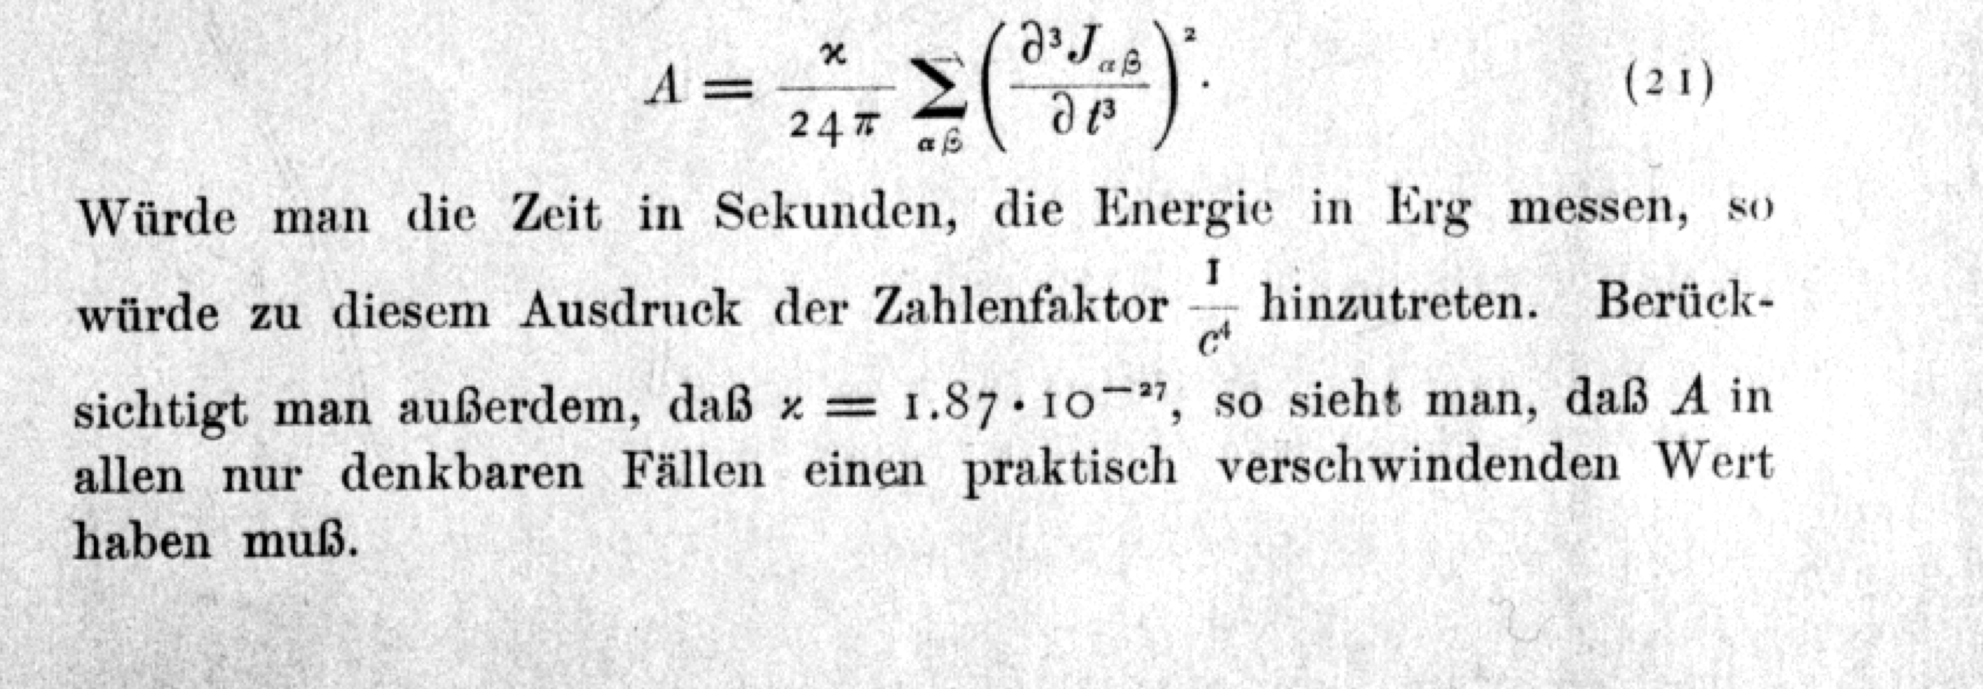
Einstein 1916
“…..in any case one can think of A will have a practically
vanishing value.”

Slide 5
Einstein 2018

Slide 6
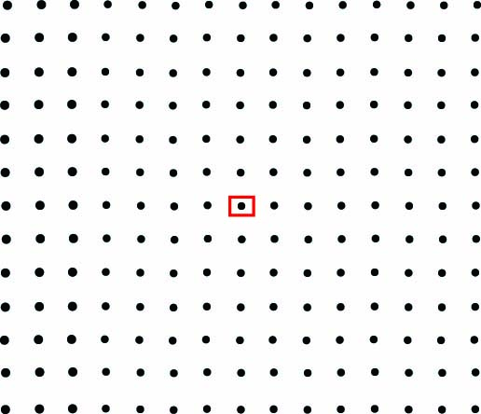

Slide 7
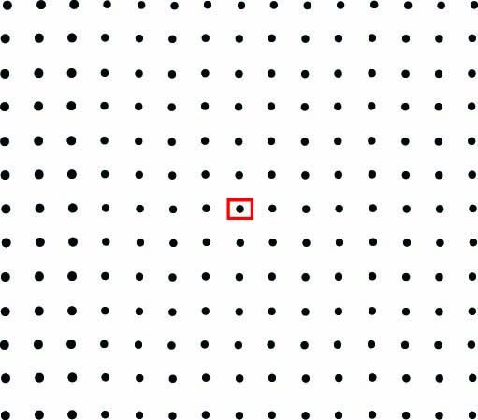

Slide 8
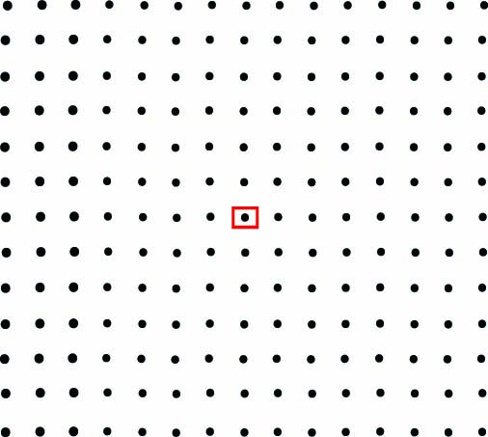

Slide 9
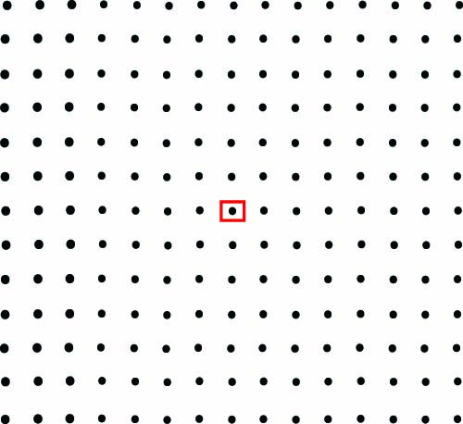

Slide 10
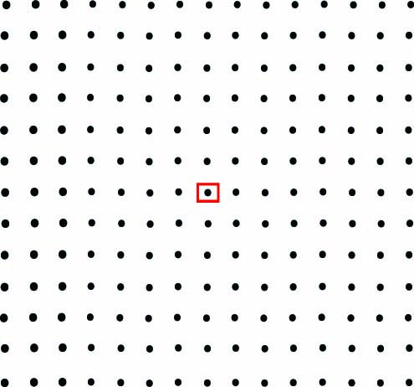

Slide 11
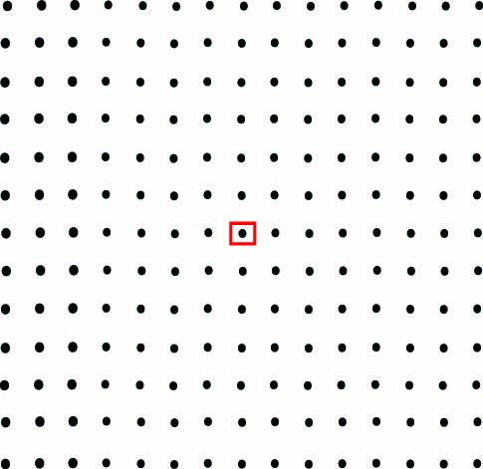

Slide 12
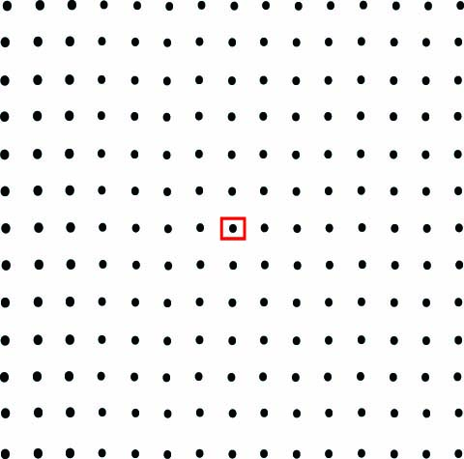

Slide 13
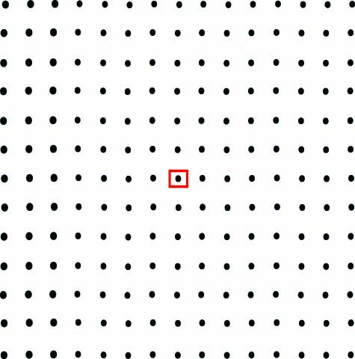

Slide 14
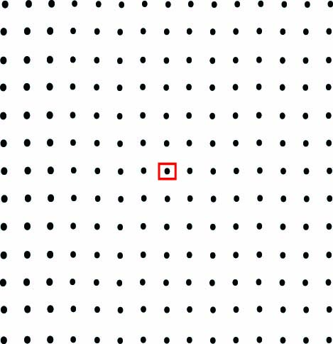

Slide 25
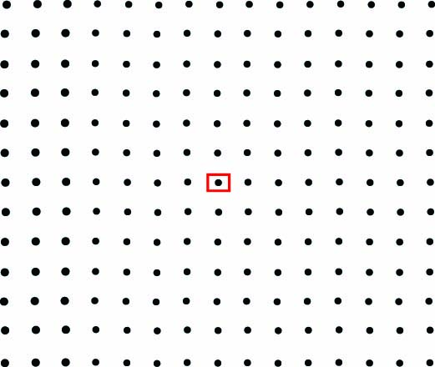

Slide 26
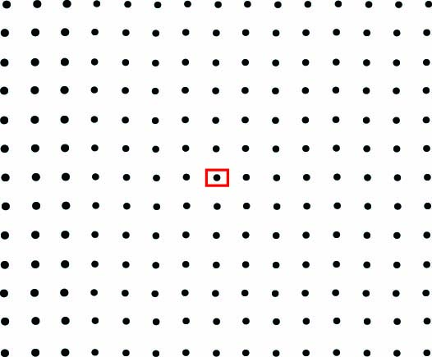

Slide 27
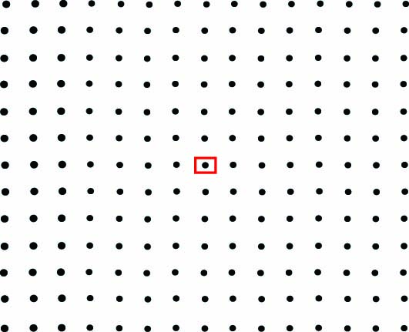

Slide 28
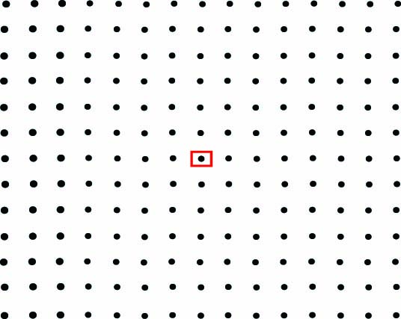

Slide 29
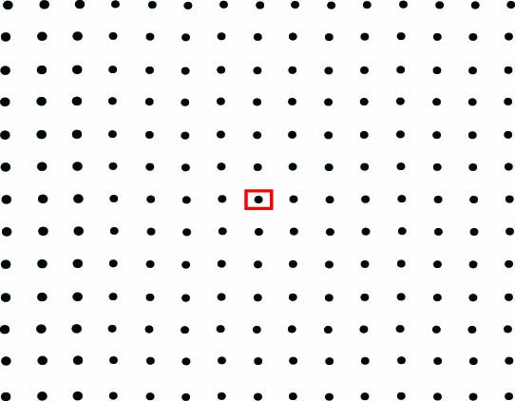

Slide 30
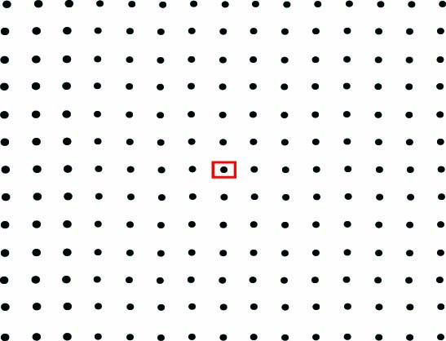

Slide 31
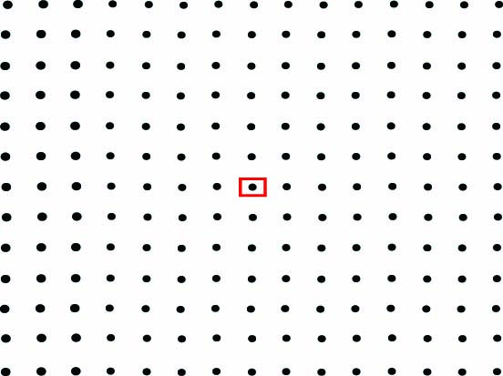

Slide 32
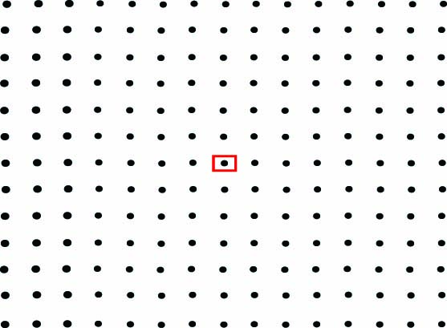

Slide 33
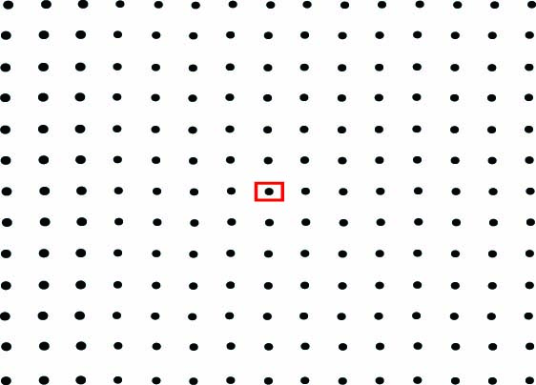

Slide 34
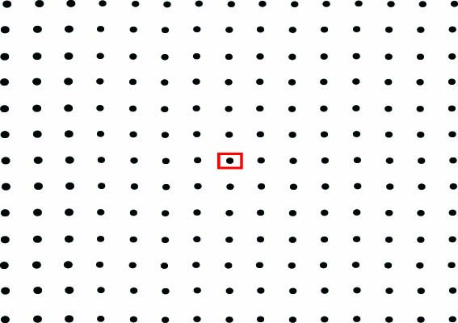

Slide 44
Relations for gravitational waves in modern notation
Intensity:
pseudo tensor
Power radiated:
quadrupole formula
Relation to estimate GW amplitude:
m₁=m₂= 1 solar mass
T_{orbit}= 1 day
R = 10 Kly
1916 example: binary star system
h ~ 10⁻²³ @ ½ day period
scaling

Slide 45
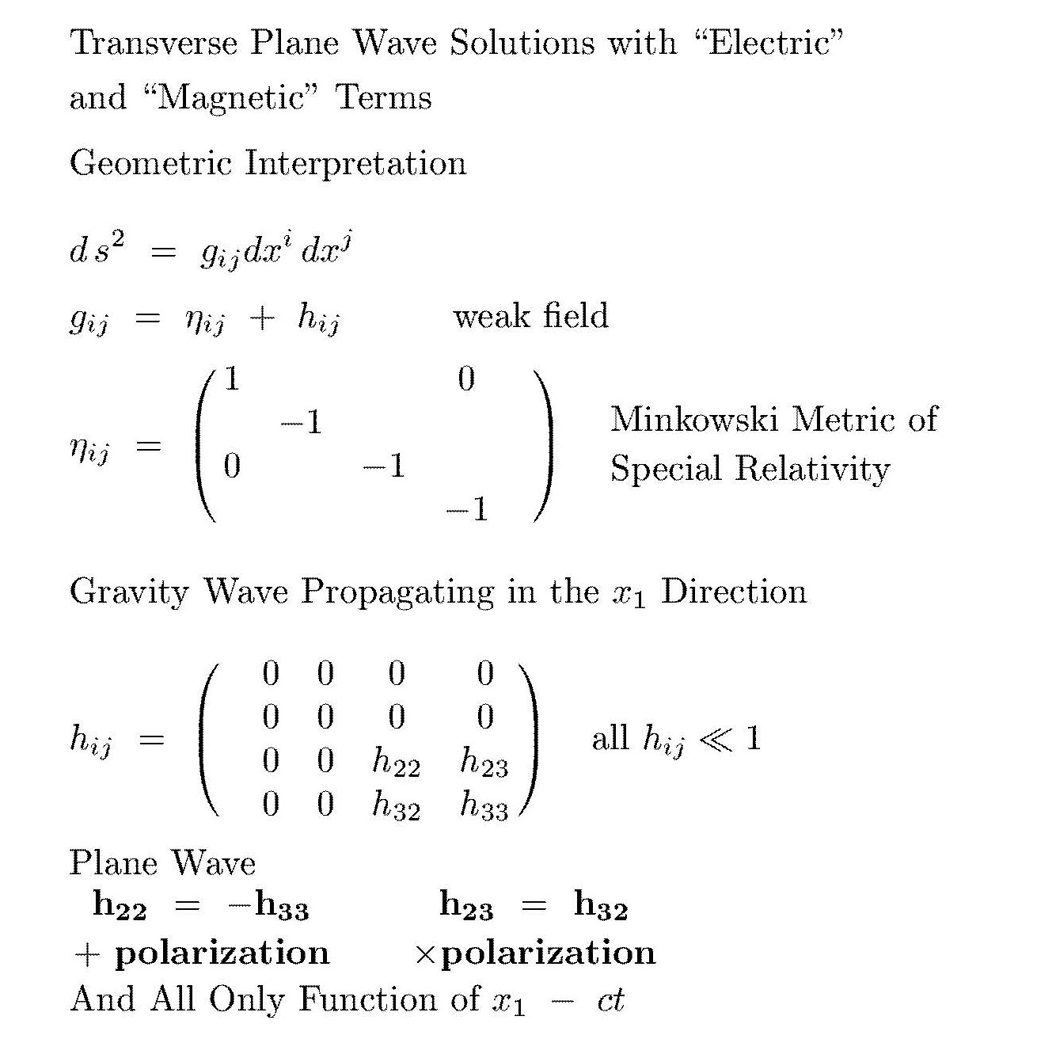
Plane gravitational waves

Slide 46
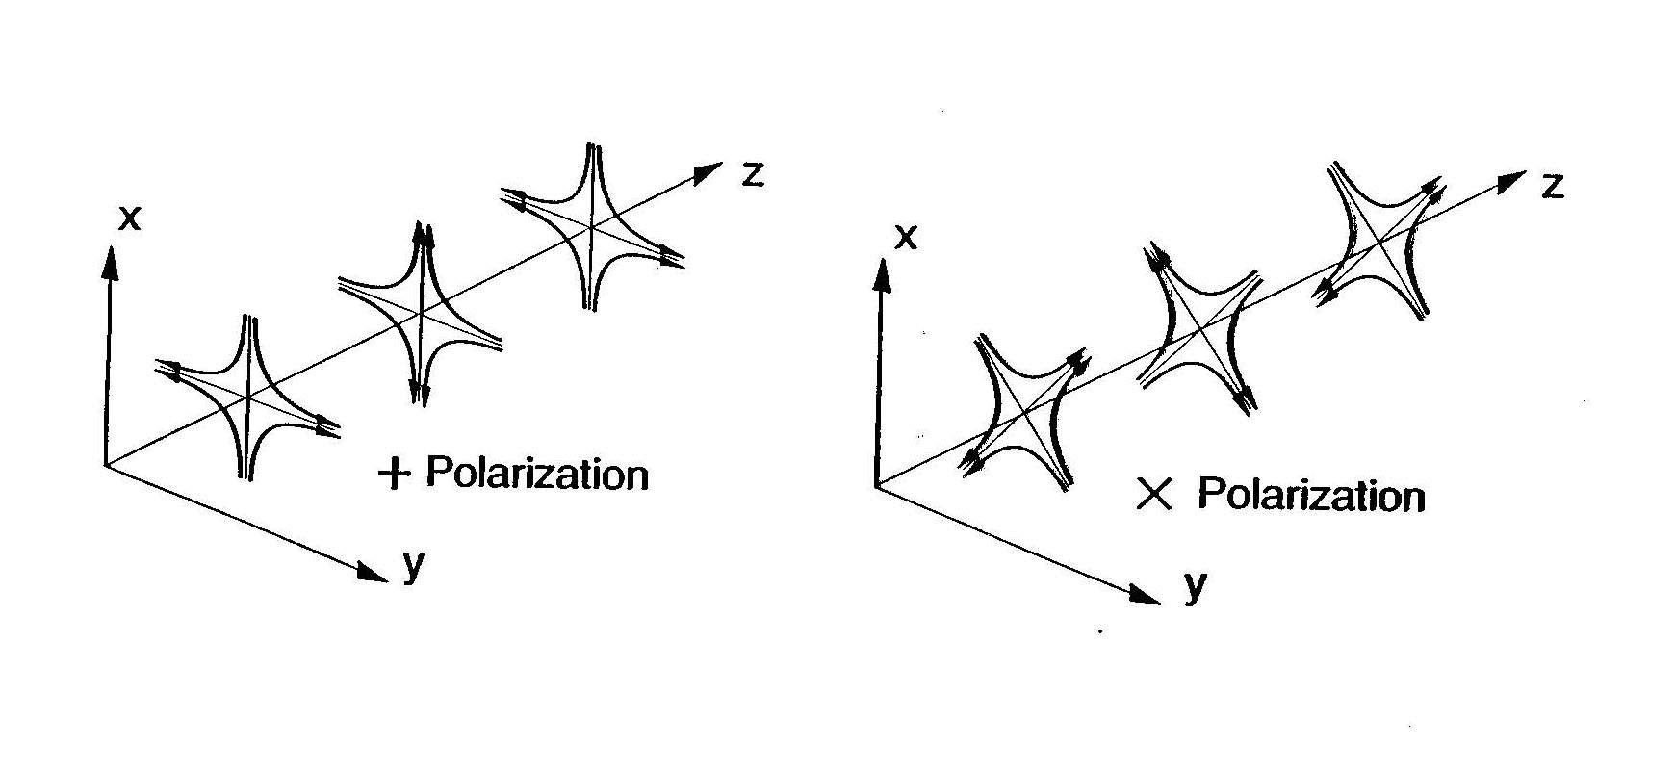
Polarization states

Slide 47
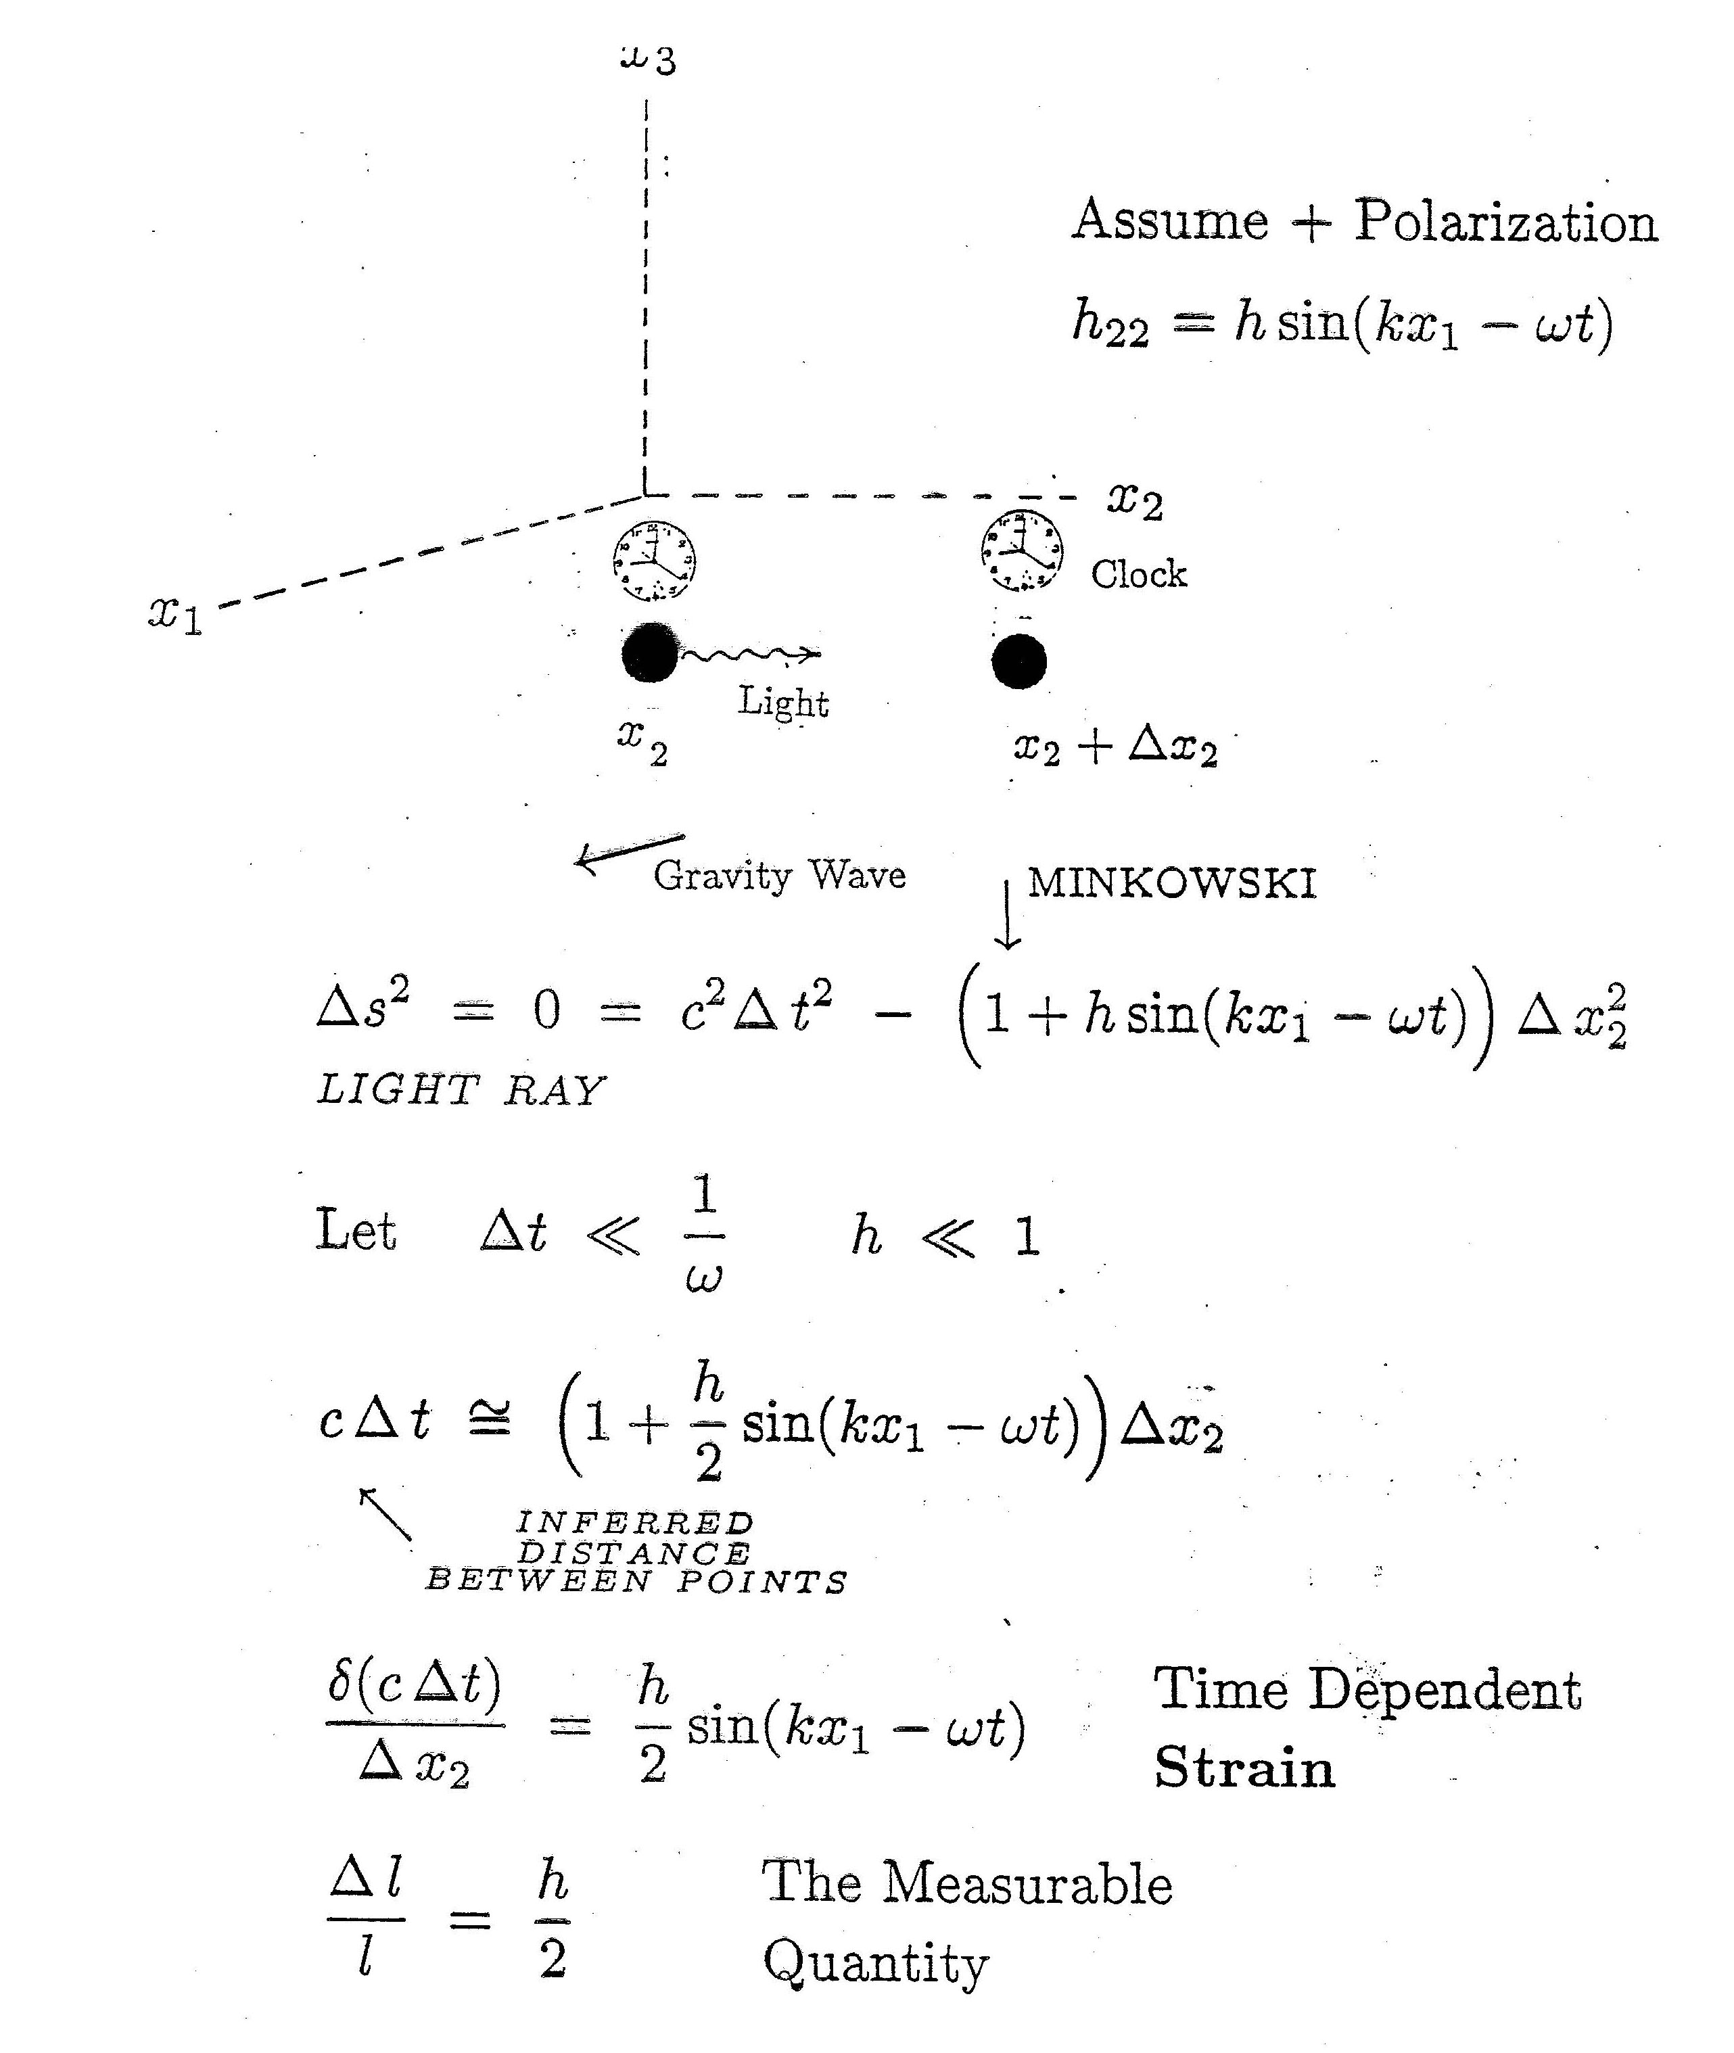
Timing light in the gravitational wave

