Slide 1
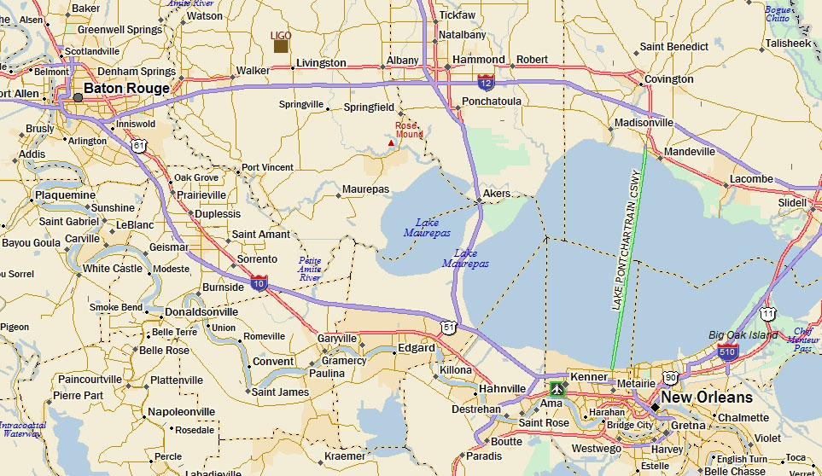
Tour to LIGO Saturday May 26
Leave Morial Convention Ct 12:30PM return before7:00PM
Bus tickets available at the Conference Registration Desk

