Slide 1
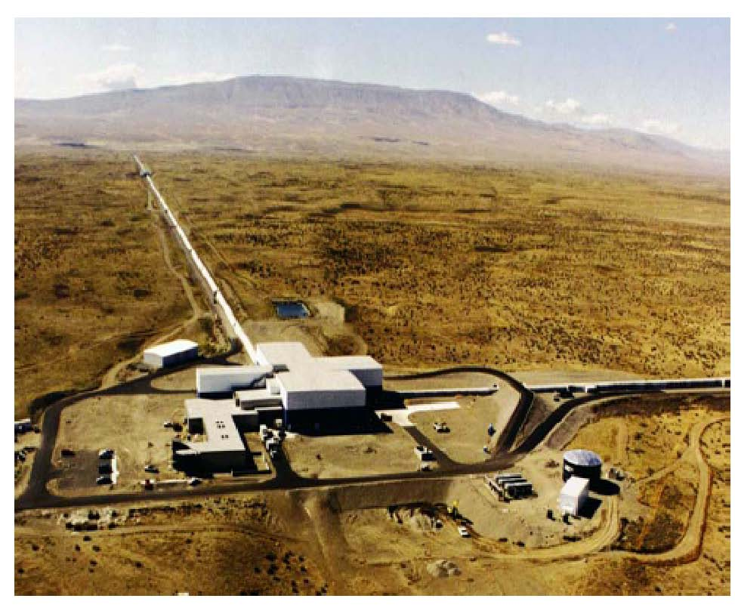
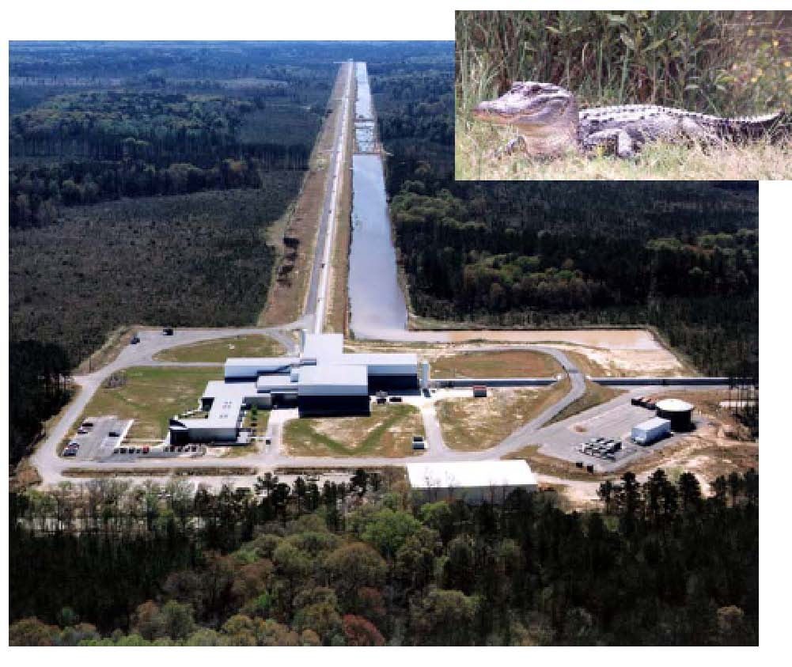
LIGO, the Laser Interferometer Gravitational-wave Observatory
Rainer Weiss, MIT
on behalf of the LIGO/GEO/VIRGO Collaboration
IPAC 12
New Orleans
May 25,2012

Slide 2
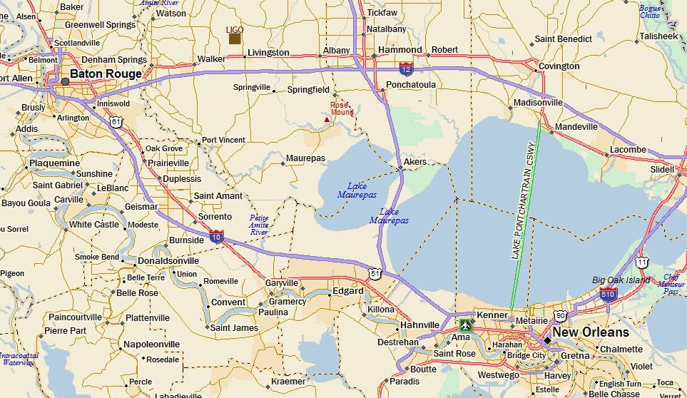
Tour to LIGO Saturday May 26
Leave Morial Convention Ct 12:30PM return before7:00PM
Bus tickets available at the Conference Registration Desk

Slide 3


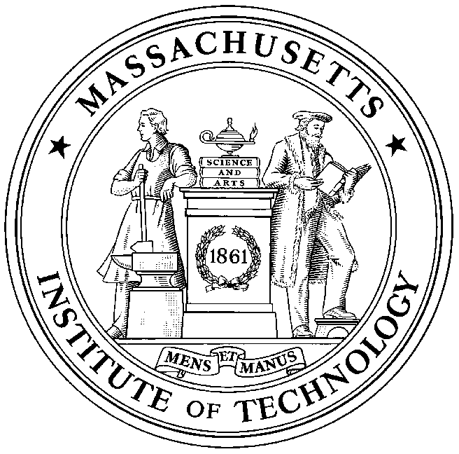


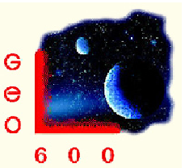





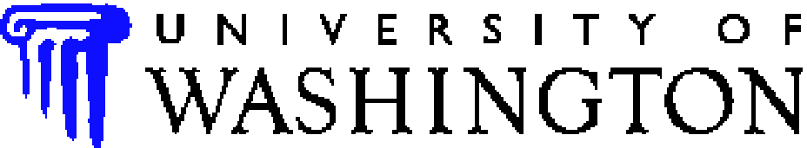

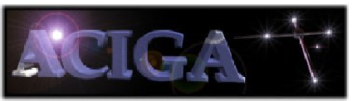



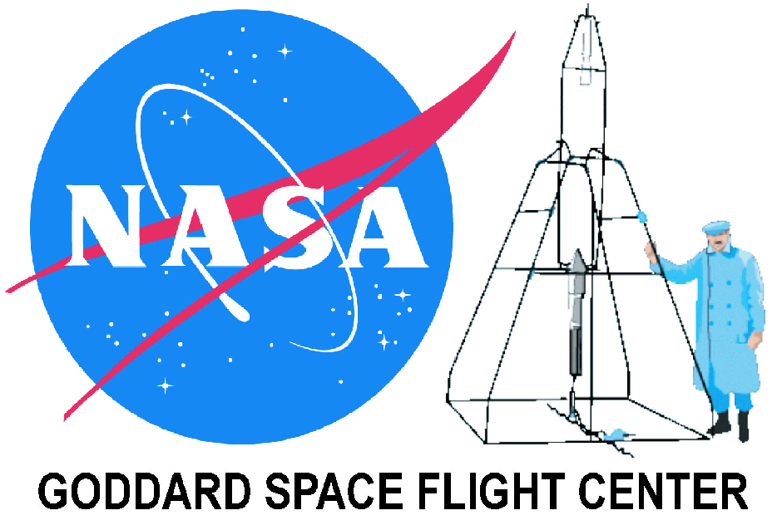













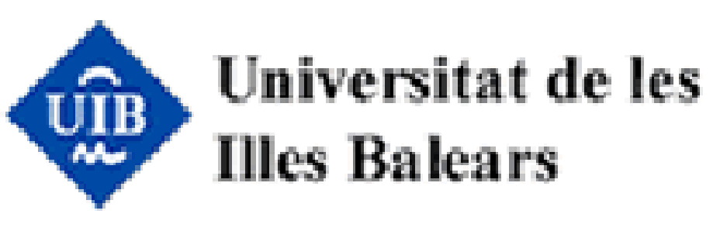



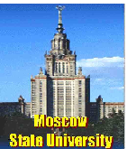























LIGO Scientific Collaboration
University of Michigan
University of Minnesota
The University of Mississippi
Massachusetts Inst. of Technology
Monash University
Montana State University
Moscow State University
National Astronomical Observatory of Japan
Northwestern University
University of Oregon
Pennsylvania State University
Rochester Inst. of Technology
Rutherford Appleton Lab
University of Rochester
San Jose State University
Univ. of Sannio at Benevento,
and Univ. of Salerno
University of Sheffield
University of Southampton
Southeastern Louisiana Univ.
Southern Univ. and A&M College
Stanford University
University of Strathclyde
Syracuse University
Univ. of Texas at Austin
Univ. of Texas at Brownsville
Trinity University
Universitat de les Illes Balears
Univ. of Massachusetts Amherst
University of Western Australia
Univ. of Wisconsin-Milwaukee
Washington State University
University of Washington
Australian Consortium
for Interferometric
Gravitational Astronomy
The Univ. of Adelaide
Andrews University
The Australian National Univ.
The University of Birmingham
California Inst. of Technology
Cardiff University
Carleton College
Charles Sturt Univ.
Columbia University
Embry Riddle Aeronautical Univ.
Eötvös Loránd University
University of Florida
German/British Collaboration for
the Detection of Gravitational Waves
University of Glasgow
Goddard Space Flight Center
Leibniz Universität Hannover
Hobart & William Smith Colleges
Inst. of Applied Physics of the Russian Academy of Sciences
Polish Academy of Sciences
India Inter-University Centre
for Astronomy and Astrophysics
Louisiana State University
Louisiana Tech University
Loyola University New Orleans
University of Maryland
Max Planck Institute for Gravitational Physics

Slide 4
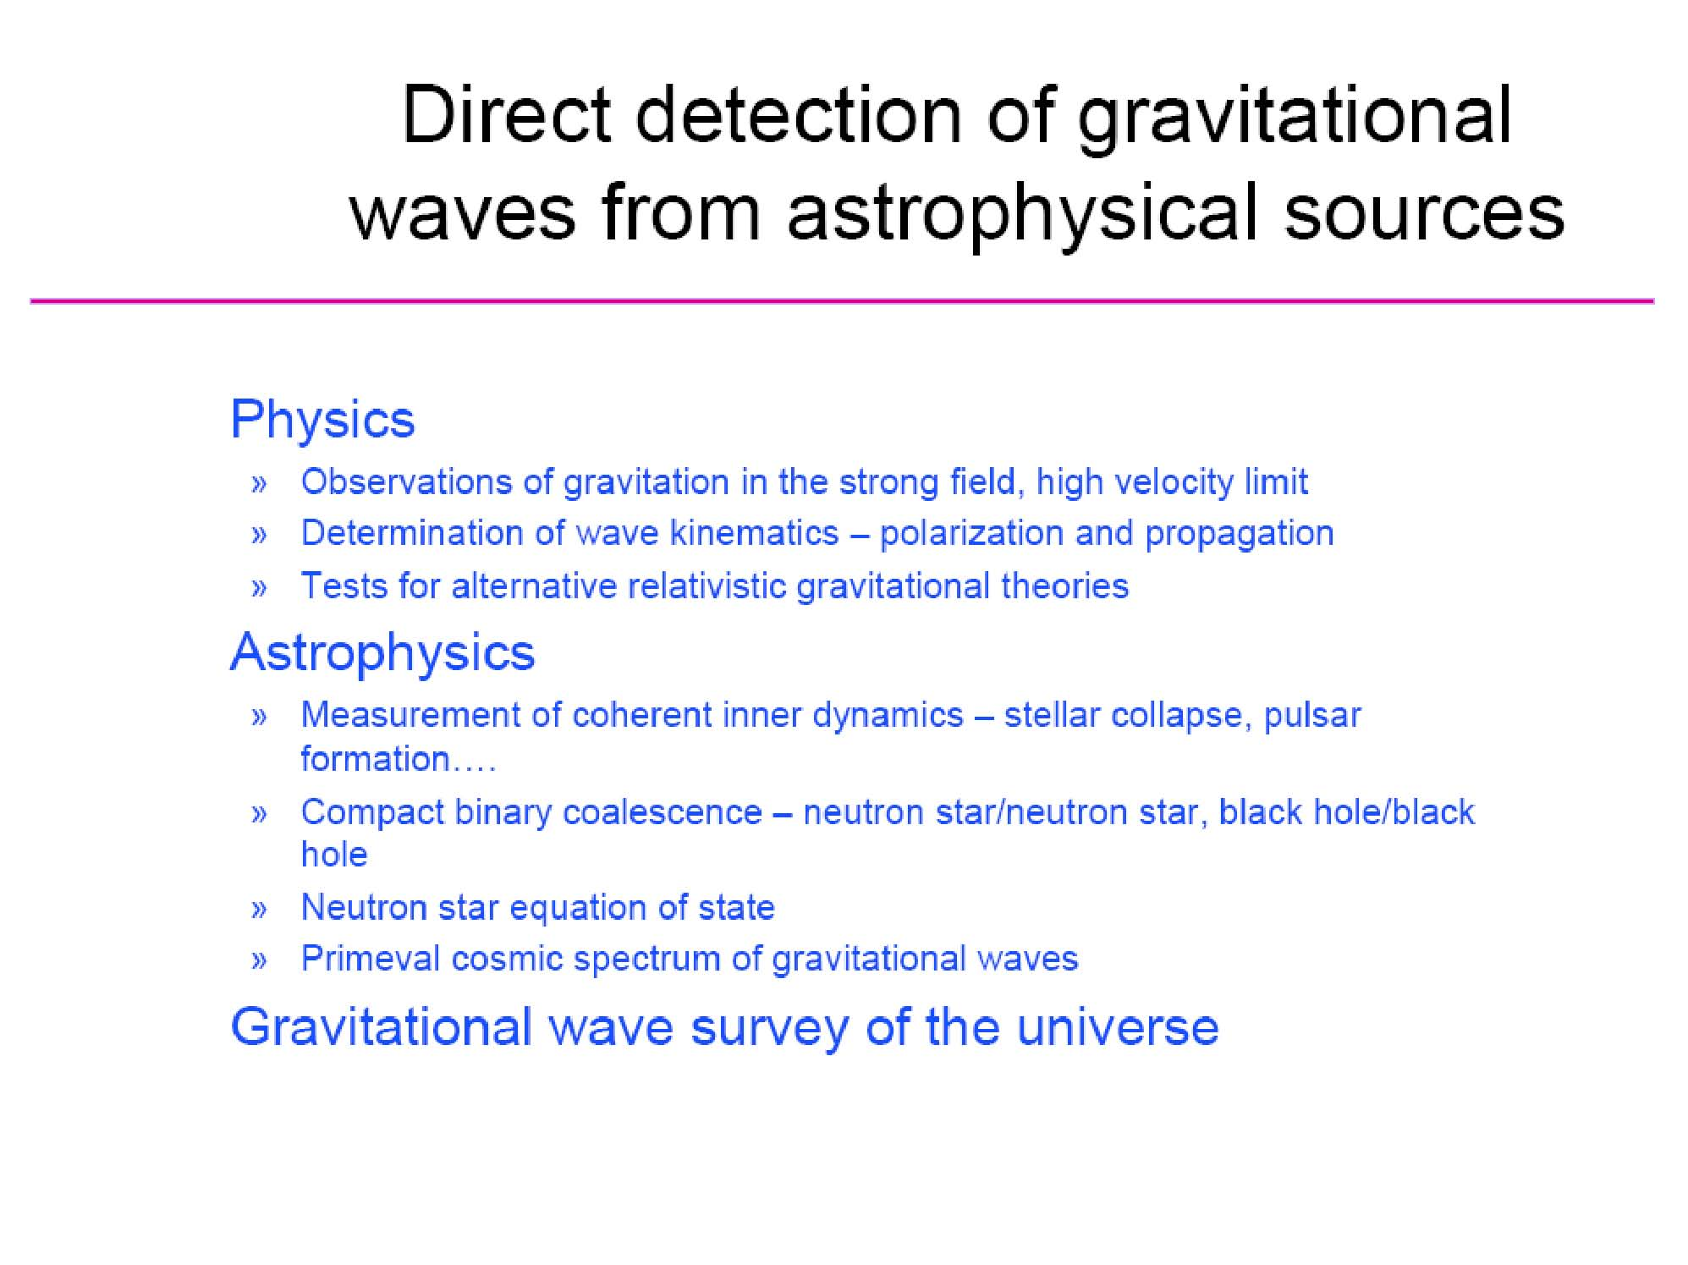

Slide 5
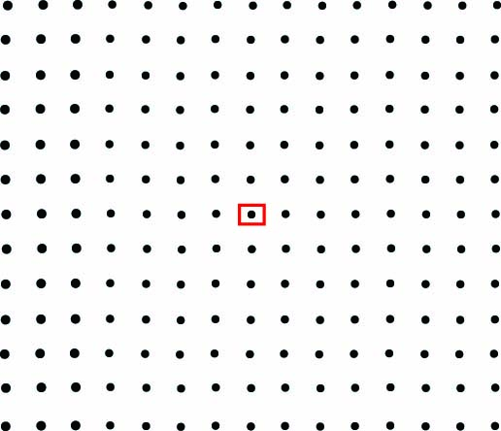

Slide 6
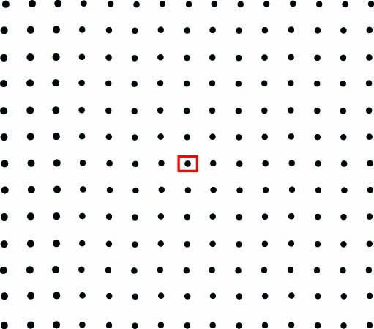

Slide 7
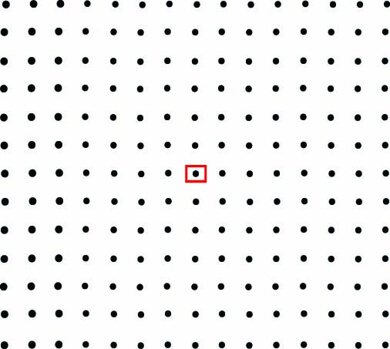

Slide 8
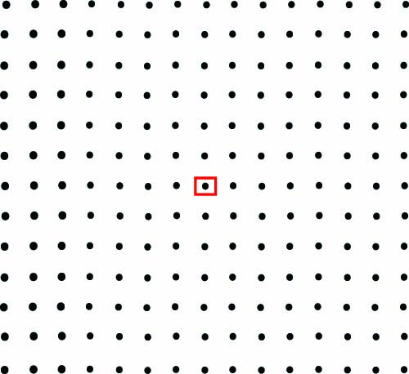

Slide 9
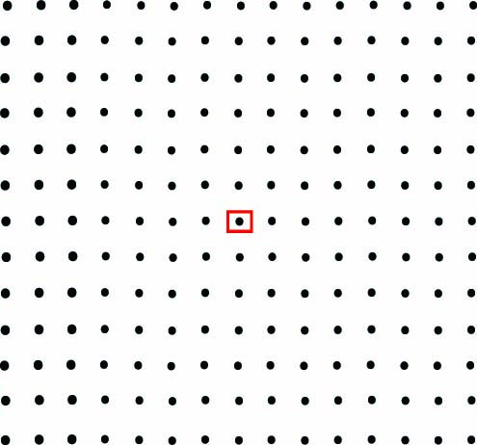

Slide 10
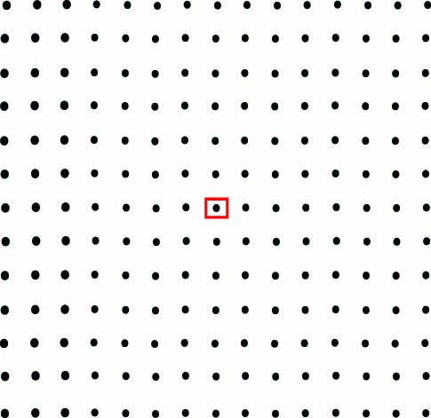

Slide 11
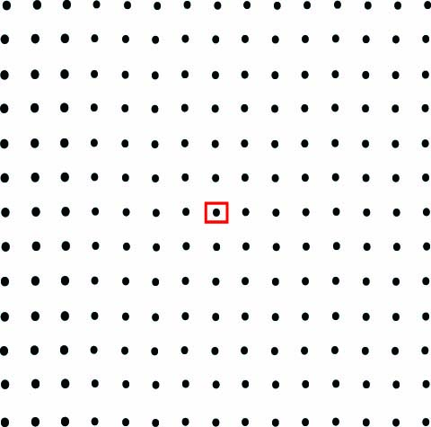

Slide 12
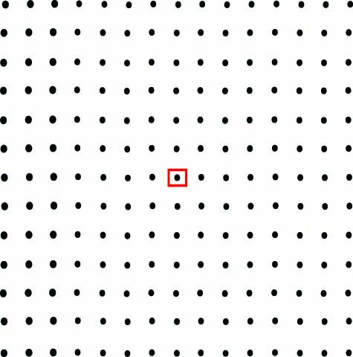

Slide 13
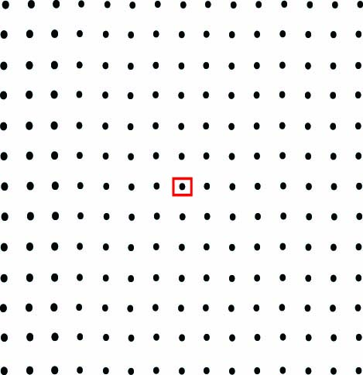

Slide 24
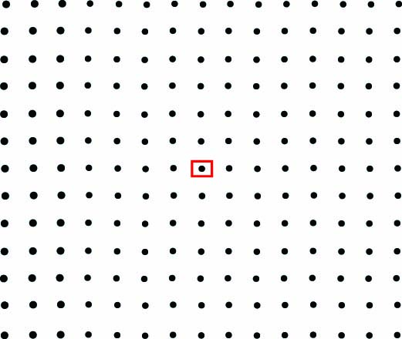

Slide 25
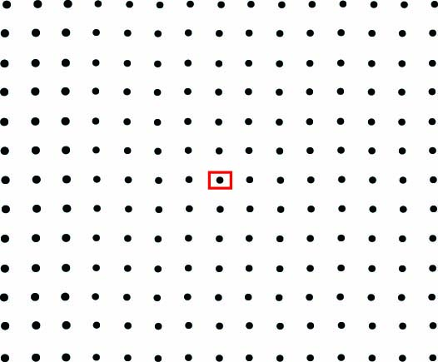

Slide 26
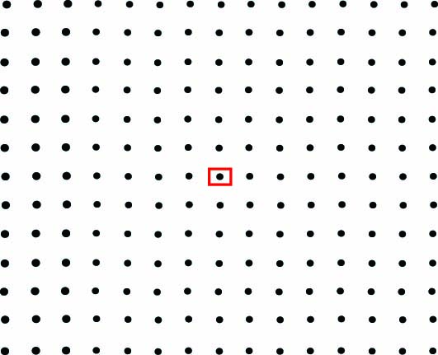

Slide 27
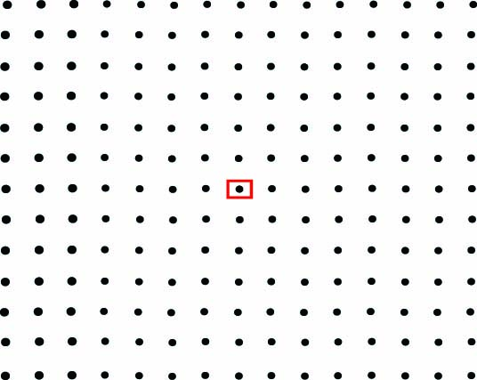

Slide 28
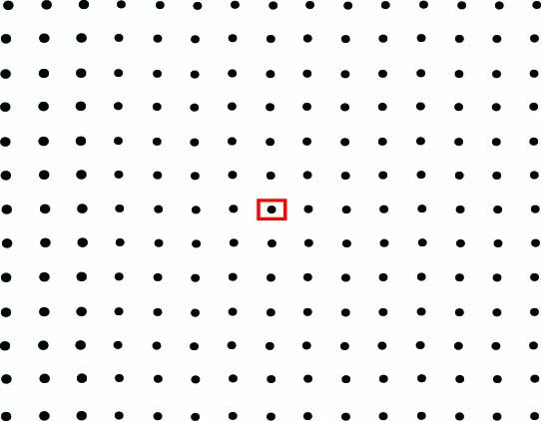

Slide 29
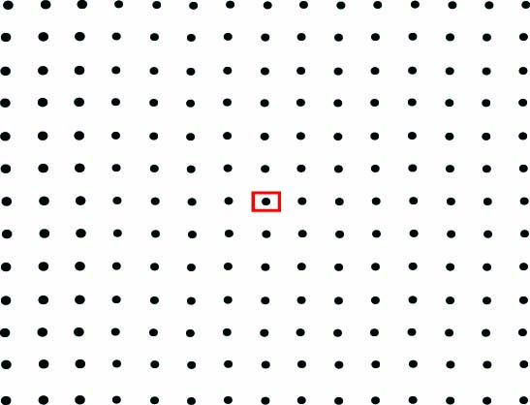

Slide 30
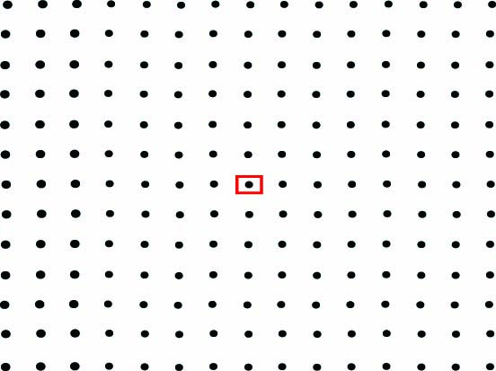

Slide 31
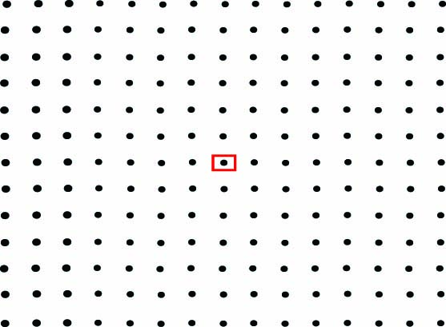

Slide 32
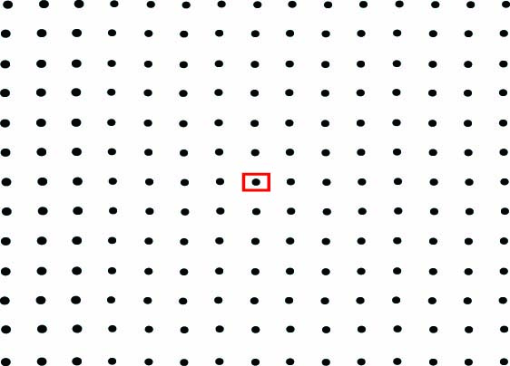

Slide 33
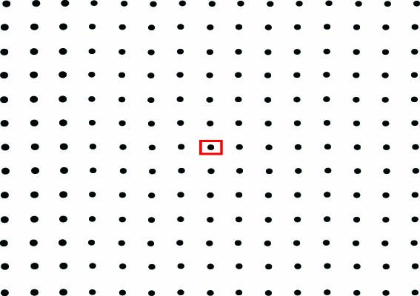

Slide 43
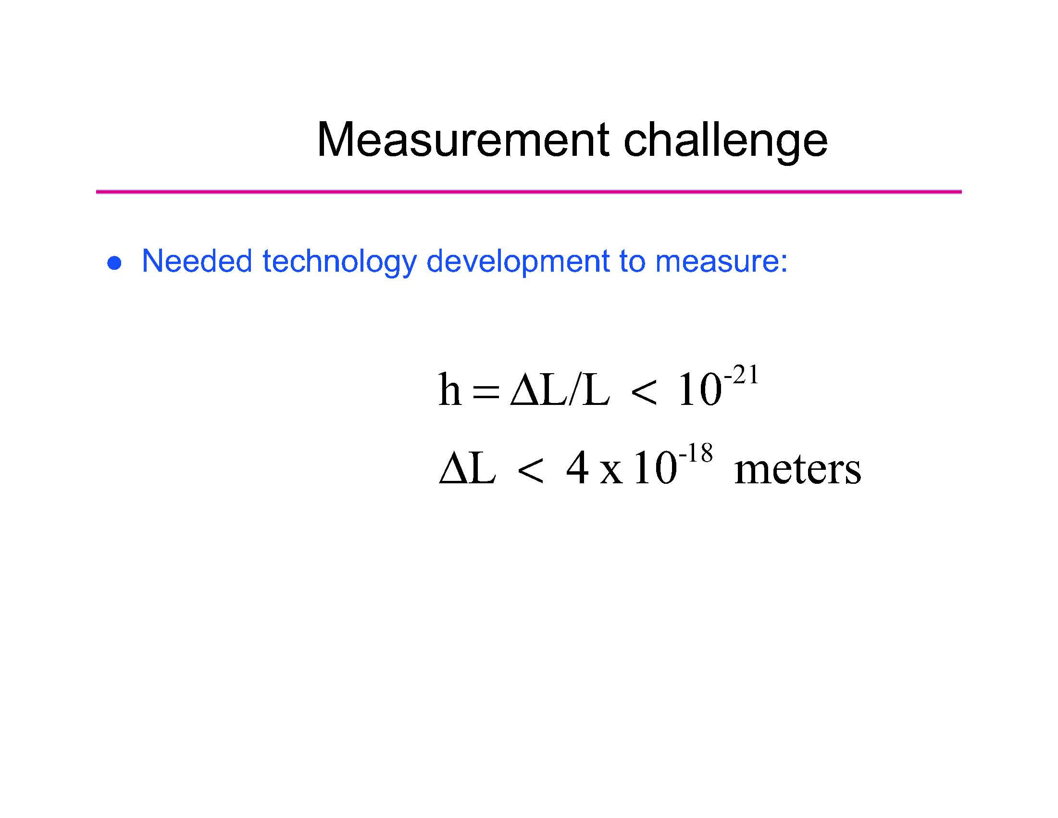

Slide 44
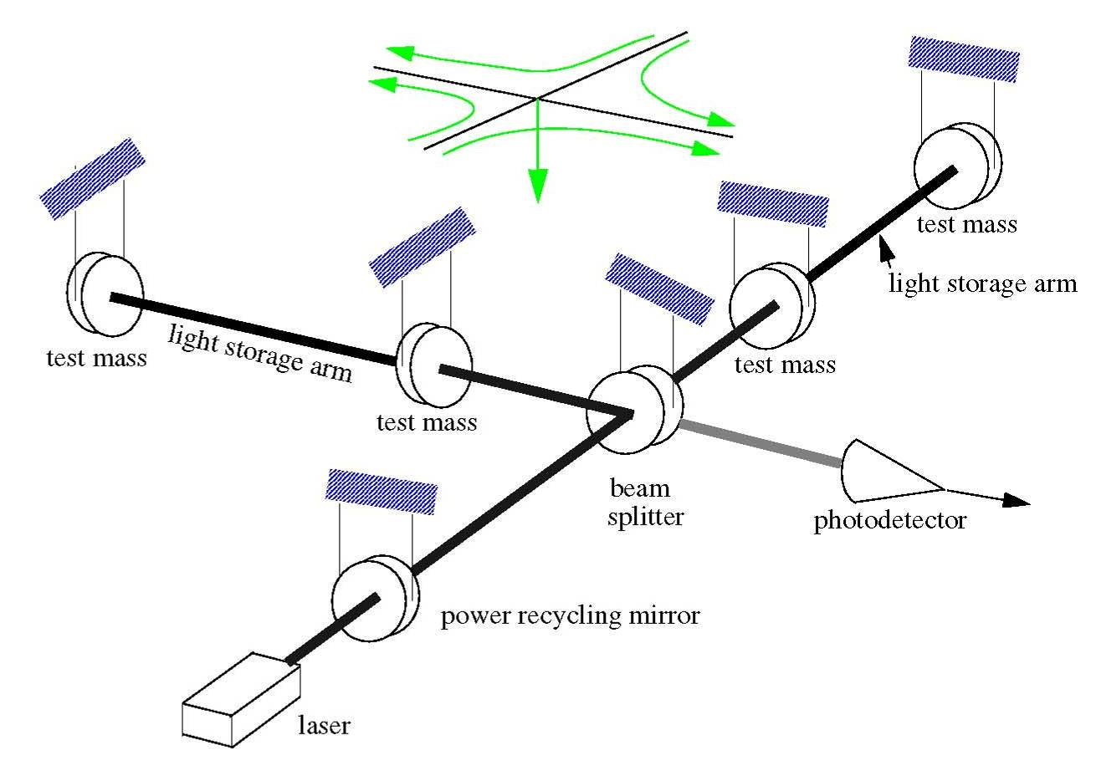
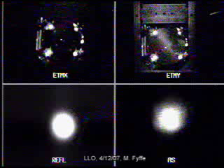

Slide 45
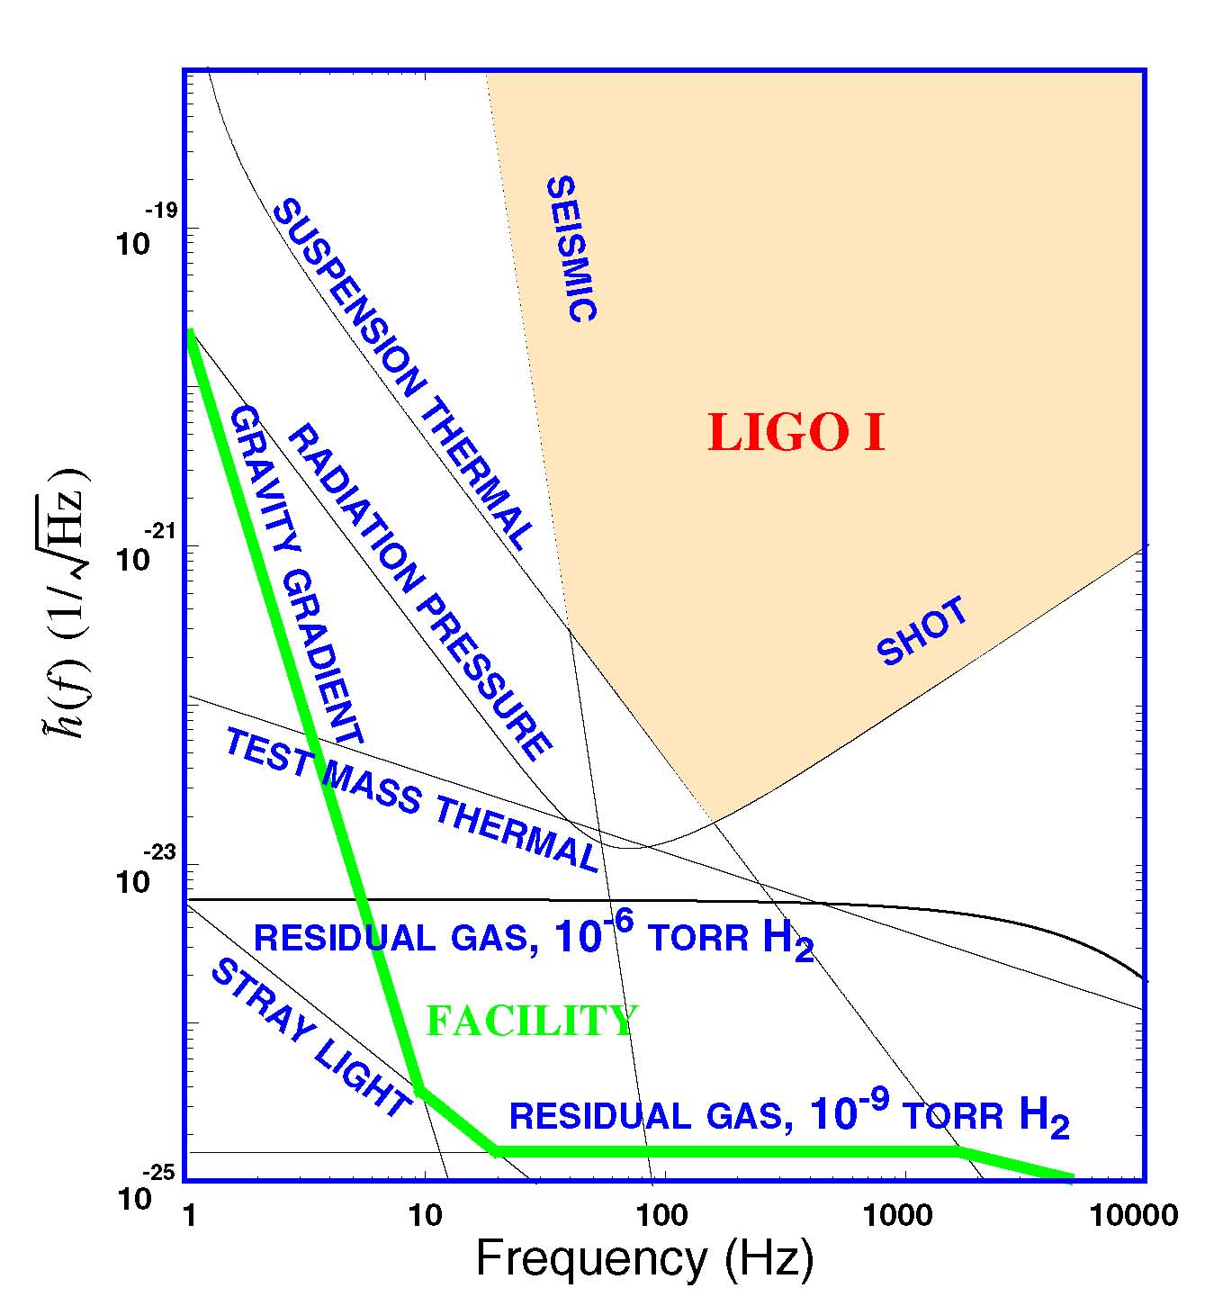

Slide 46
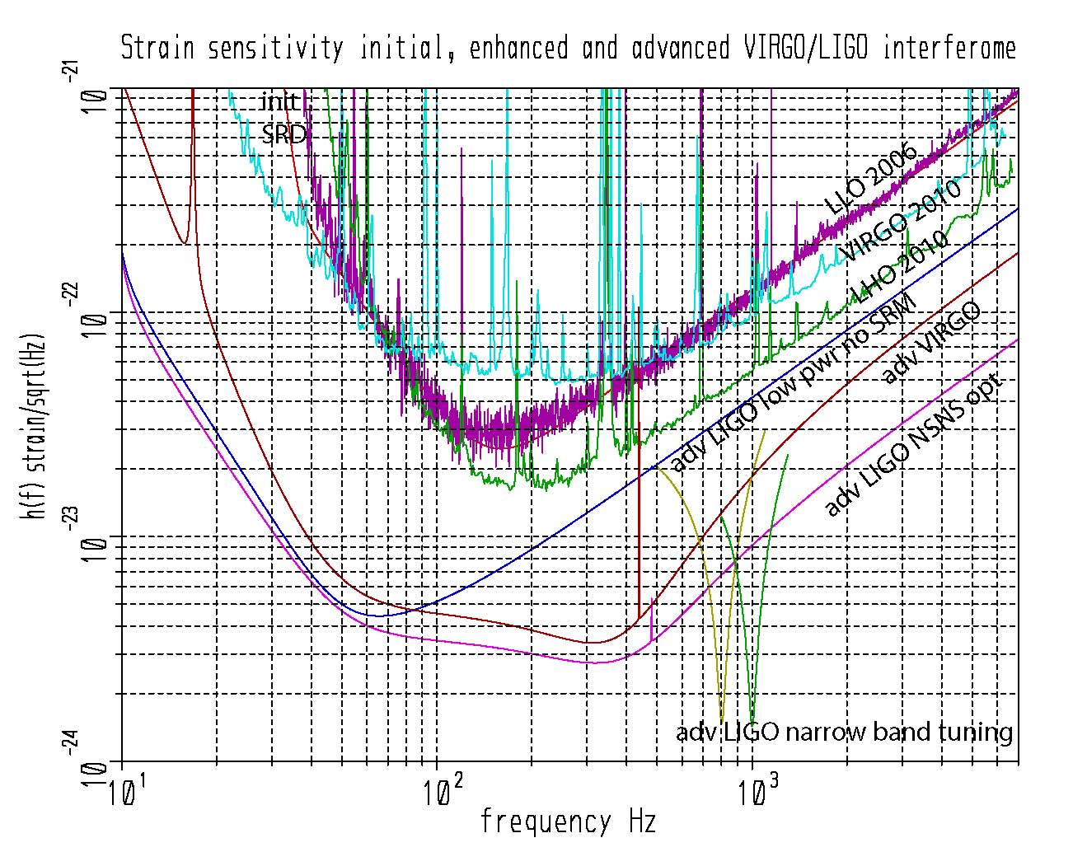
grav grad
suspension thermal
coating thermal

Slide 47

Classes of sources and searches
inspiral
S5
Compact binary inspiral: template search
  BH/BH
  NS/NS and BH/NS
Low duty cycle transients: wavelets,T/f clusters
  Supernova
  BH normal modes
  Unknown types of sources
Externally triggered searches
  Gamma bursts
  EM transients
Periodic CW sources
  Pulsars
  Low mass x-ray binaries (quasi periodic)
Stochastic background
  Cosmological isotropic background
  Foreground sources : gravitational wave radiometry

Slide 48

Systems: Interferometer Design
Parameter | Initial LIGO | Advanced LIGO
Input Laser Power | 10 W (10 kW arm) | 180 W (>700 kW arm)
Mirror Mass | 10 kg | 40 kg
Interferometer Topology | Power-recycled Fabry-Perot arm cavity Michelson | Dual-recycled Fabry-Perot arm cavity Michelson (stable recycling cavities)
GW Readout Method | RF heterodyne | DC homodyne
Optimal Strain Sensitivity | 3 x 10⁻²³ / rHz | Tunable, better than 5 x 10⁻²⁴ / rHz in broadband
Seismic Isolation Performance | f_{low} ~ 50 Hz | f_{low} ~ 12 Hz
Mirror Suspensions | Single Pendulum | Quadruple pendulum

Slide 49
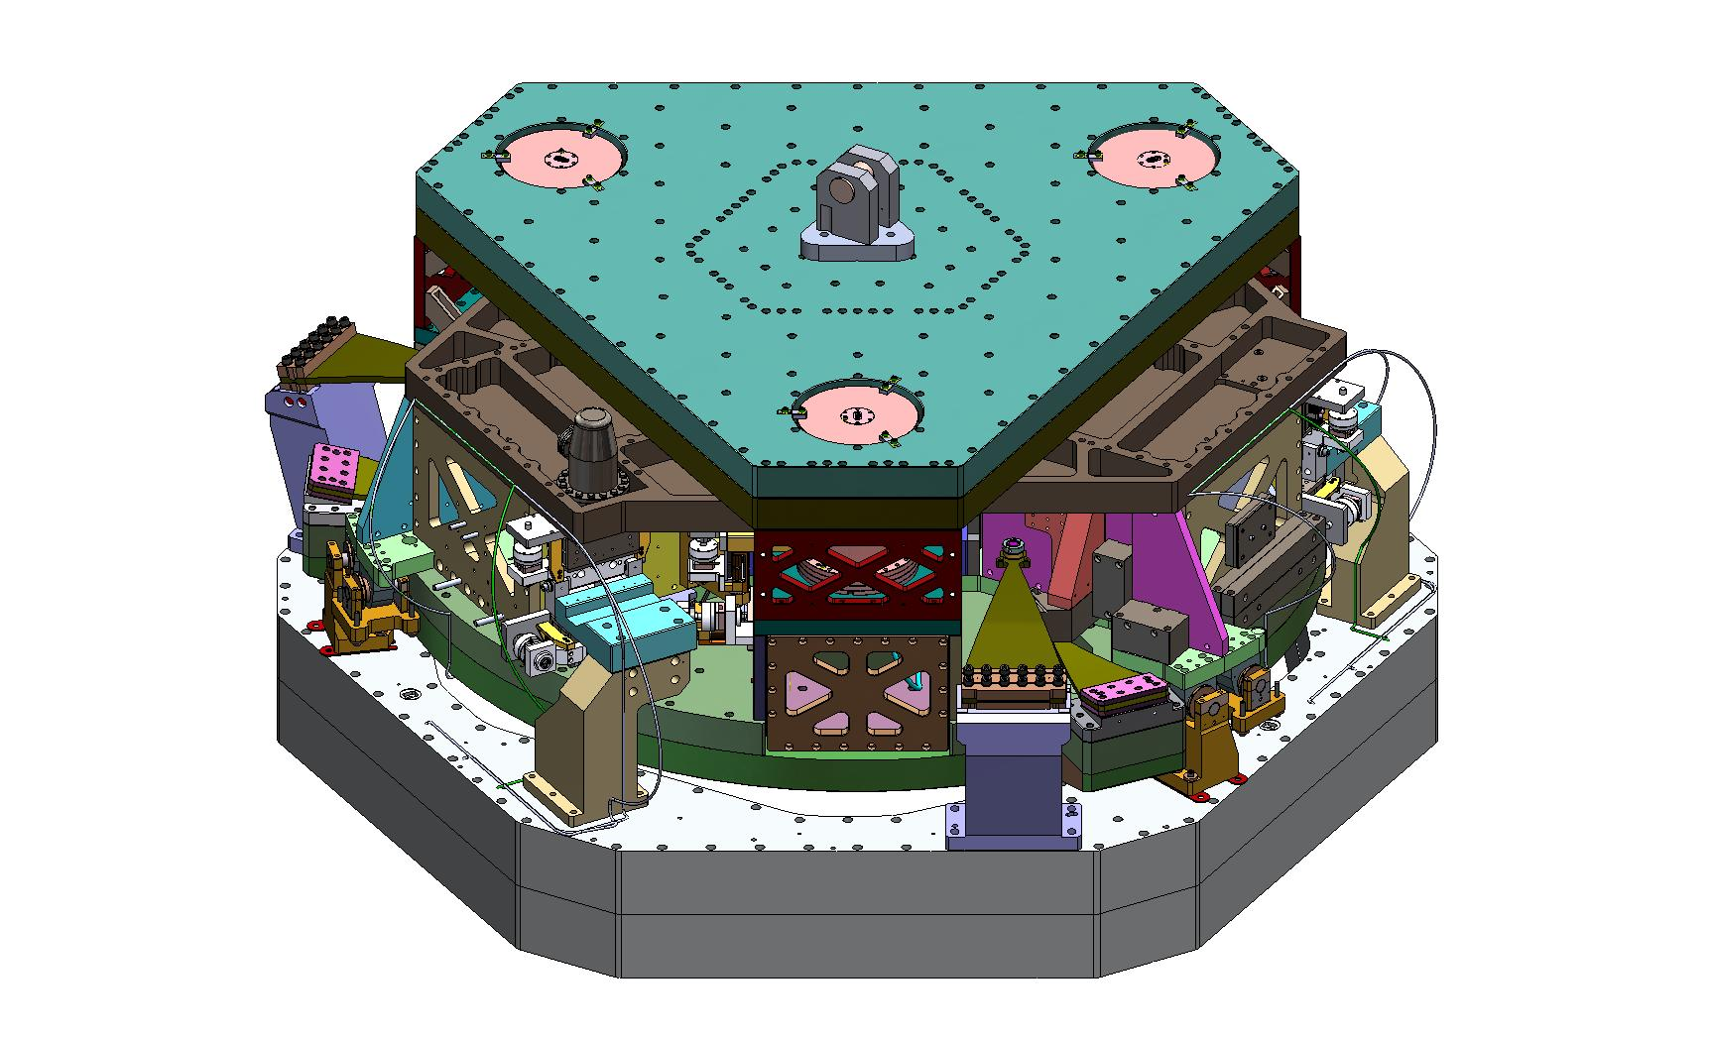

Slide 50
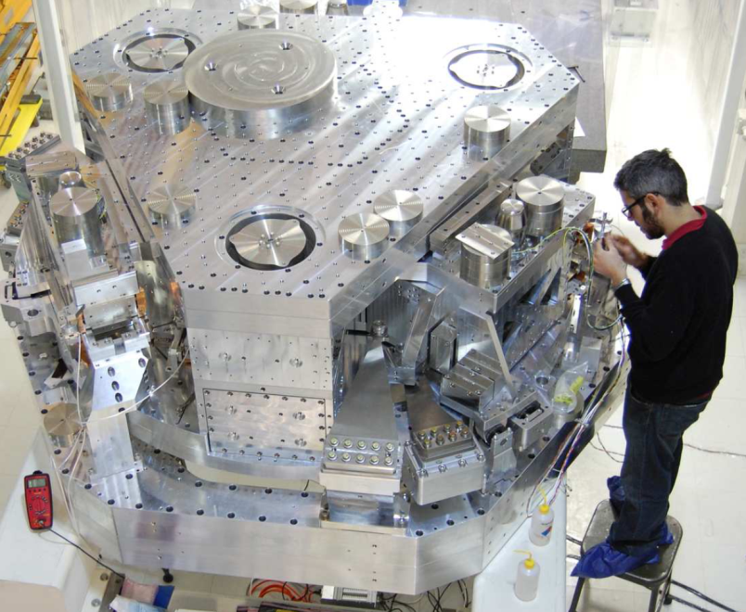
Advanced LIGO seismic isolation system

Slide 51
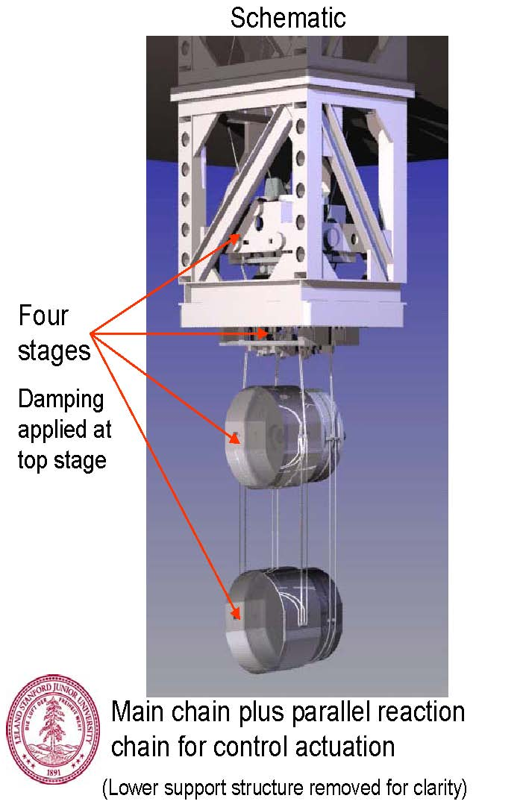

Slide 52
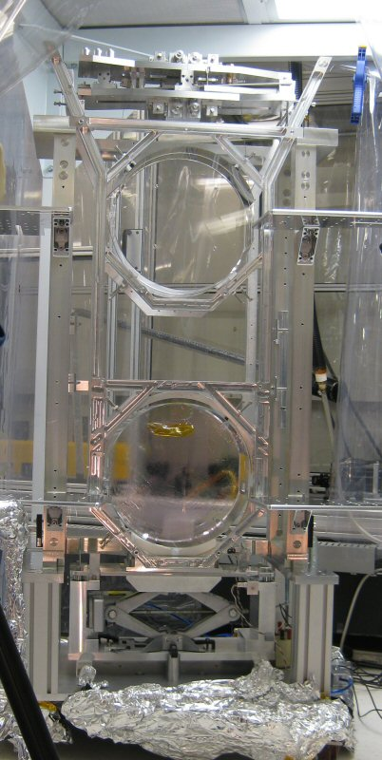

Slide 53
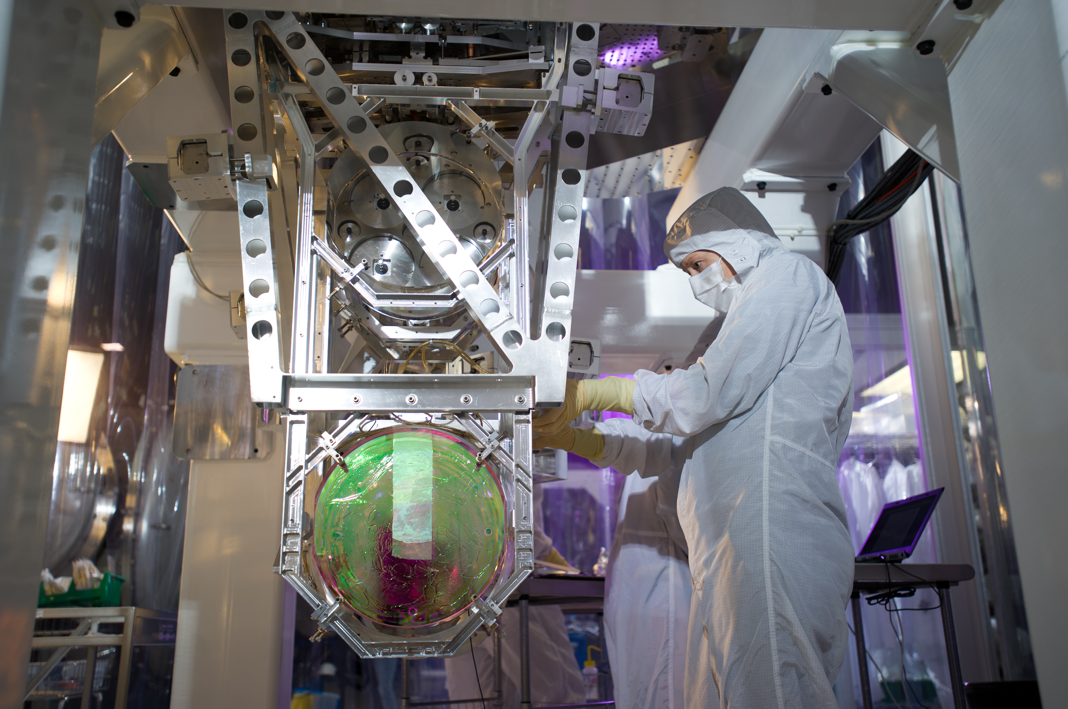
Suspension and isolation system

Slide 54
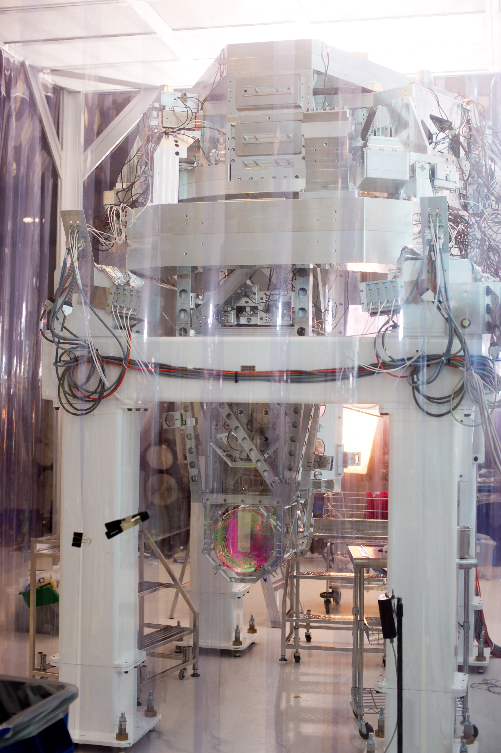

Slide 55
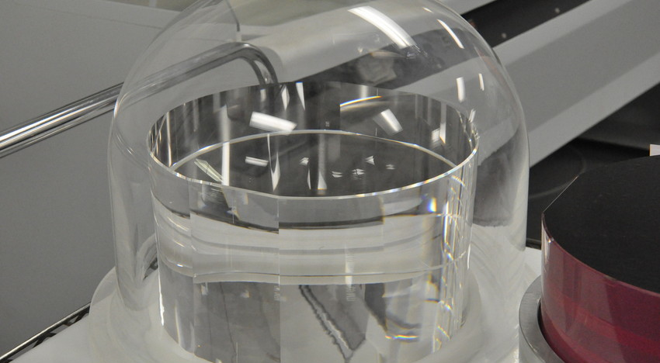
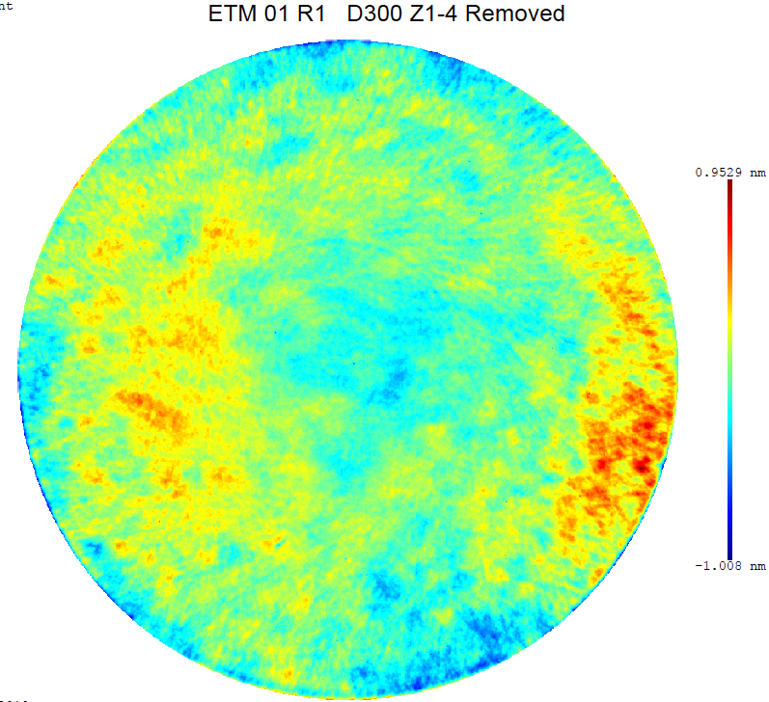
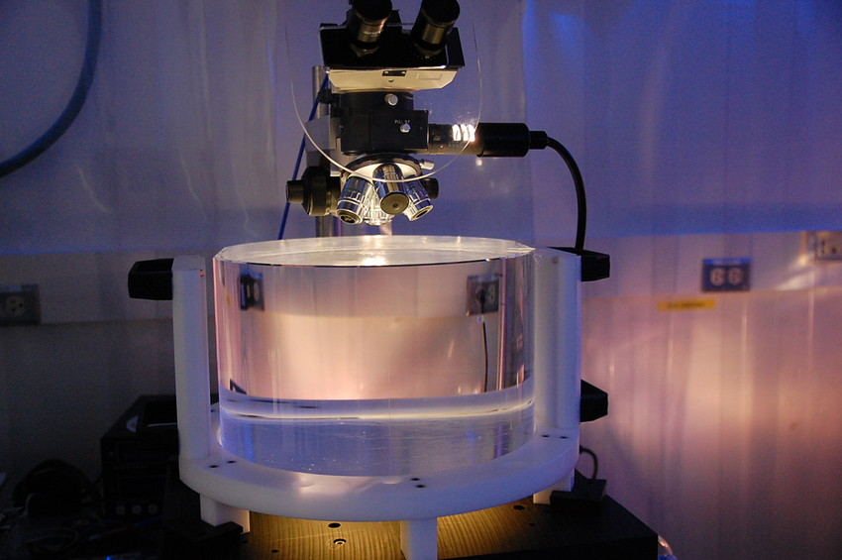
Advanced LIGO Core Optics

Slide 56
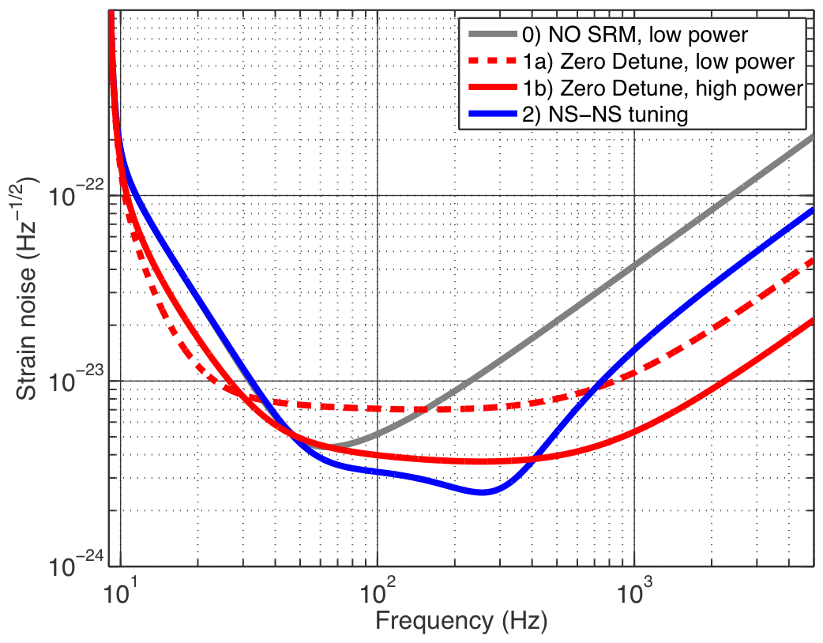
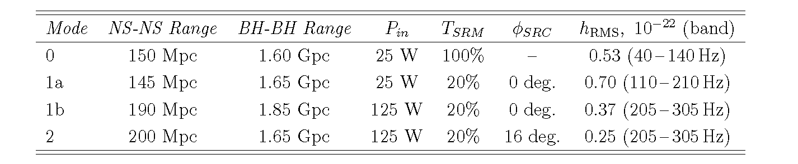
Advanced LIGO broadband operational modes
P.Fritschel Advanced LIGO Systems Design (2009)

Slide 57
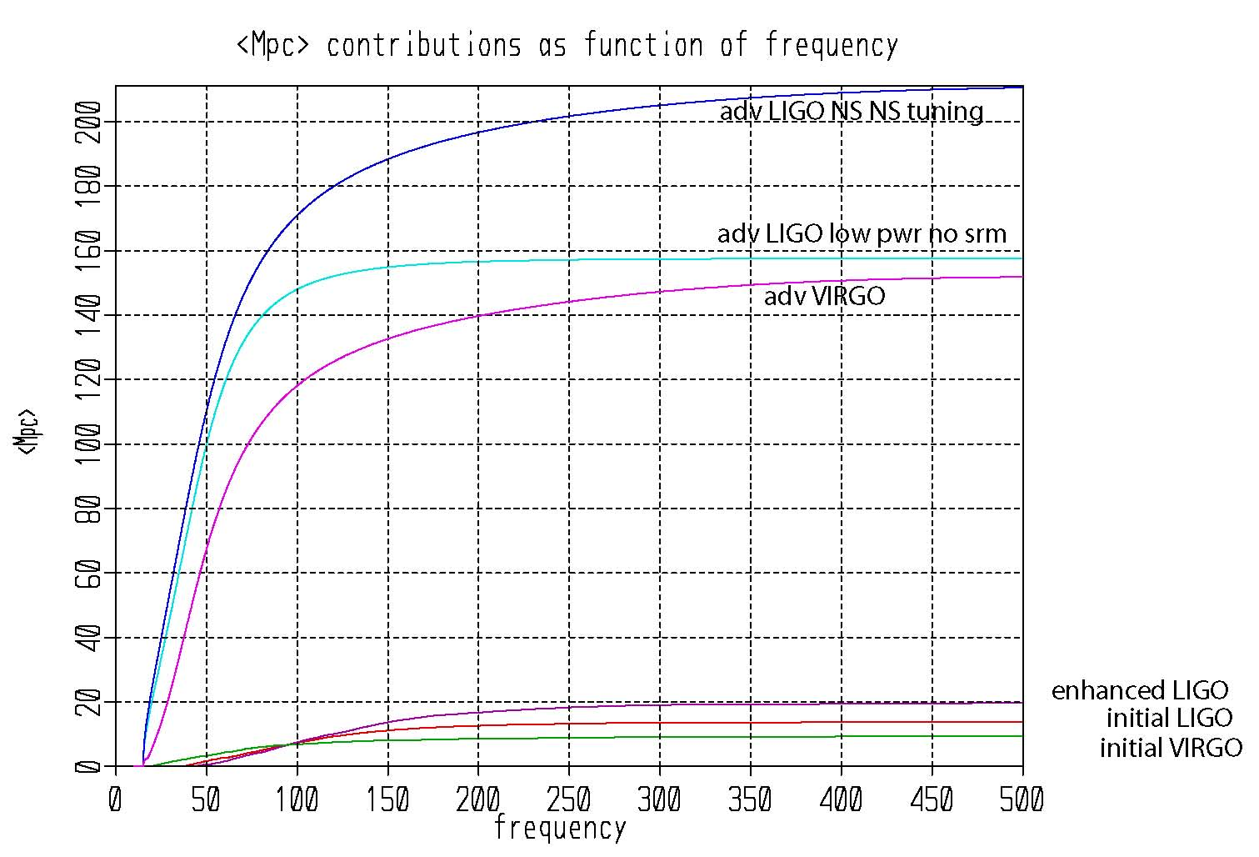

Slide 58
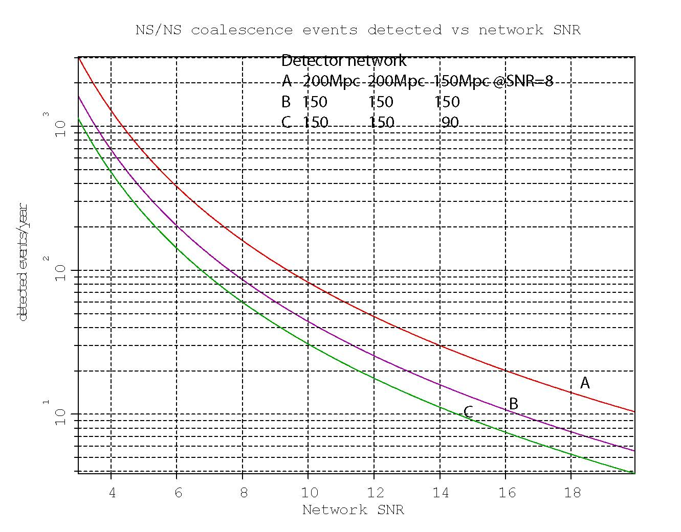
Conditions:
False alarm rates reduced to Gaussian statistics.
Coherent detection
MWEG/Mpc³ = 0.012
#NS/NS insp/MWEG/yr = 10⁻⁴
SNR = 8/det

Slide 59

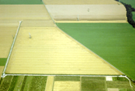


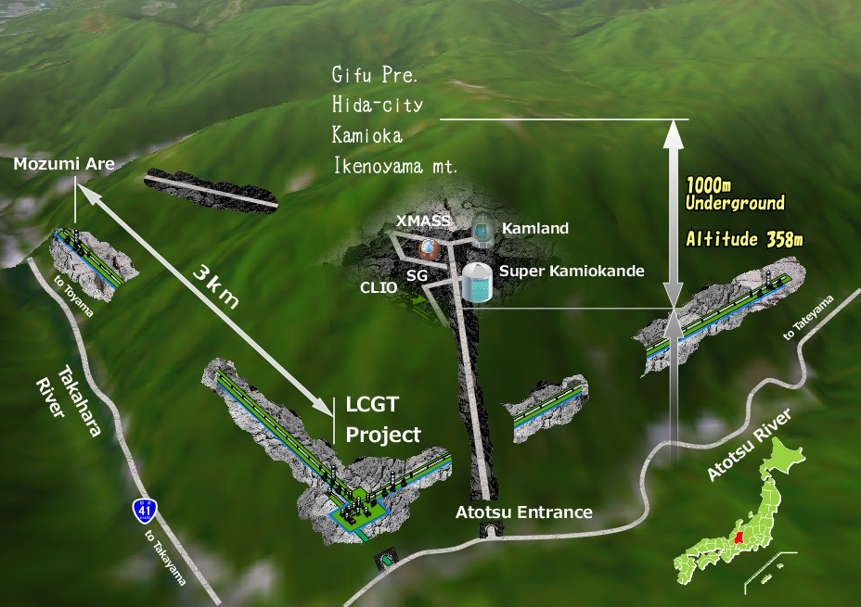



The Advanced GW Detector Network
GEO600 (HF)
Advanced LIGO
Hanford
LCGT
Advanced LIGO
Livingston
Advanced
Virgo
LIGO-India?
59
59

Slide 60


Slide 61


Slide 62


Slide 63


Slide 64


Slide 65
Fairhurst, Veitch, Sathyaprakash 2011

Slide 66


Slide 67


Slide 68


Slide 69


Slide 70



R. Genzel
Hubble Space Telescope

