Slide 1
ORIGINS OF LIGO AT MIT
R. WEISS
FEB 19, 2016

Slide 2
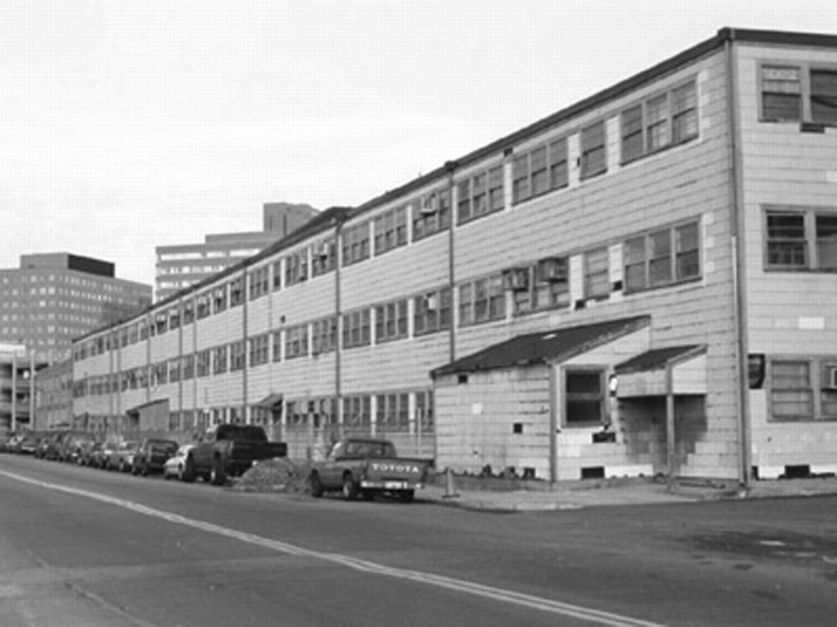
Building 20 1980’s

Slide 3
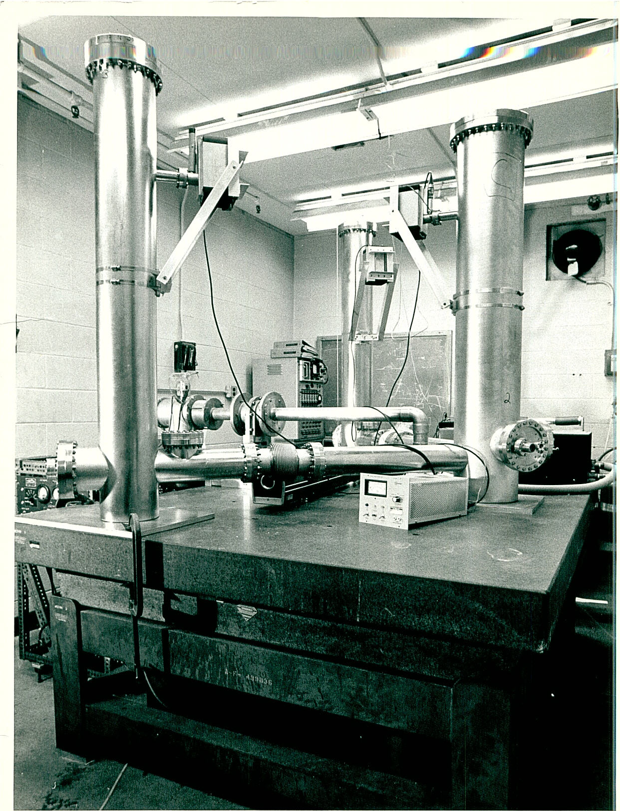
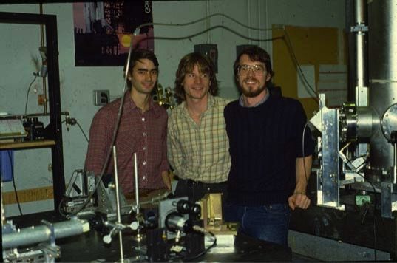
MIT 1.5 meter prototype
~ 1980
Jeff Livas David Shoemaker Daniel Dewey

Slide 4
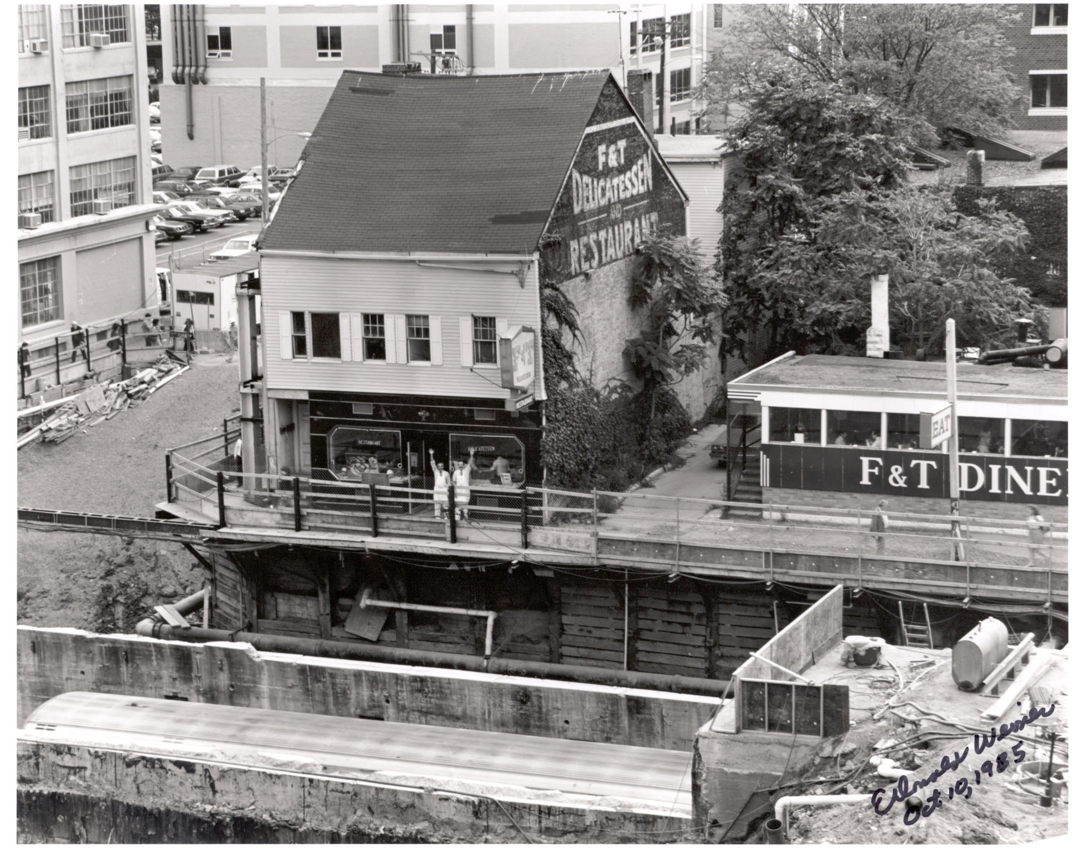

Slide 5
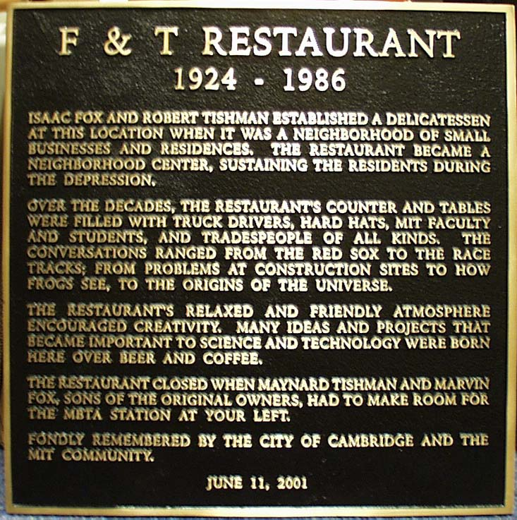
Plaque in Kendall Square at location of F&T Restaurant

Slide 6
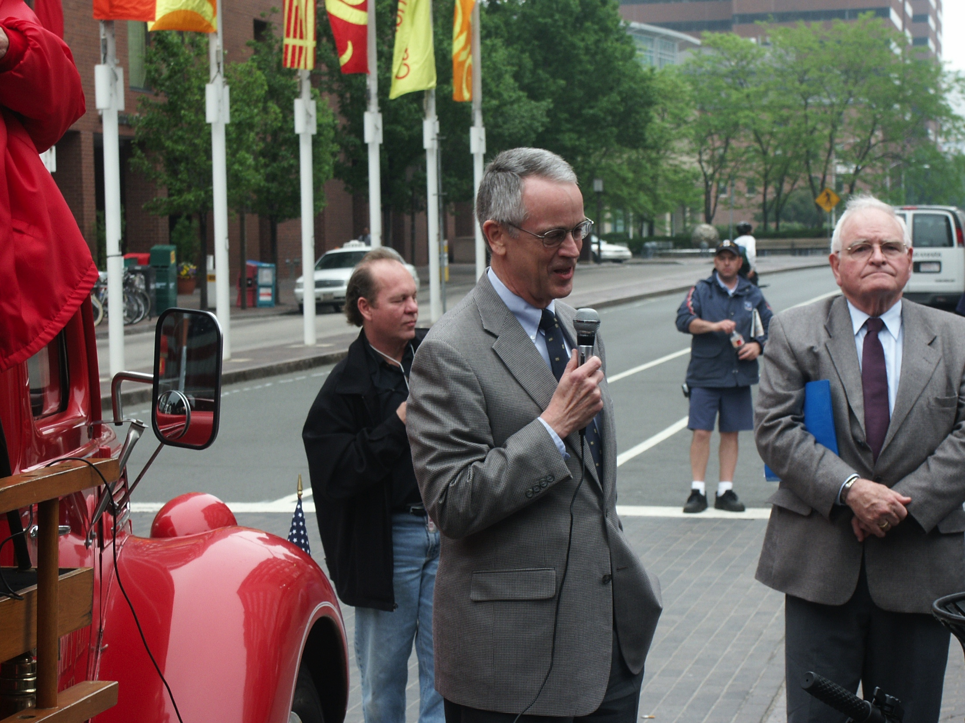
MIT Presidents at F&T Celebration 2001 Charles Vest Paul Gray

Slide 7
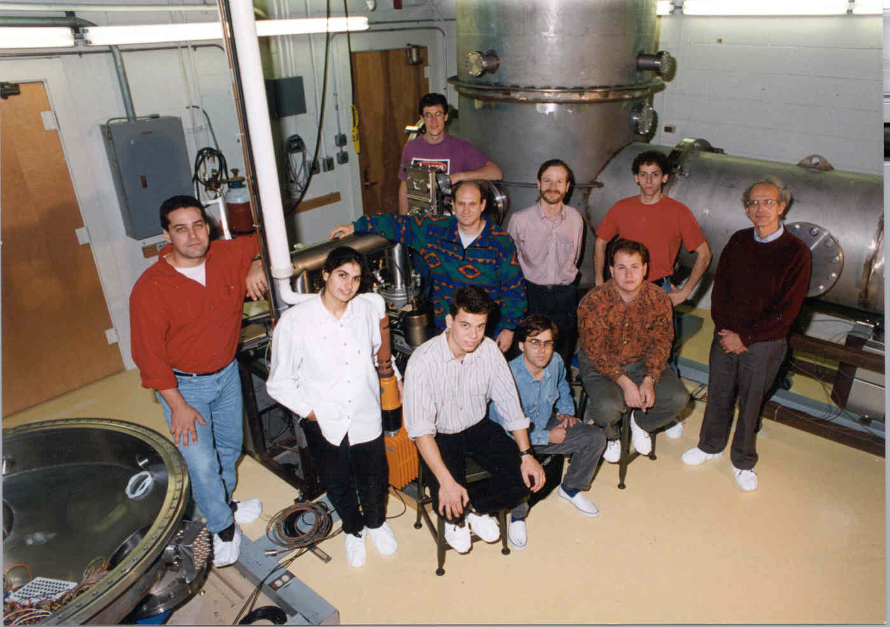
LIGO MIT GROUP ~ 1990

Slide 8
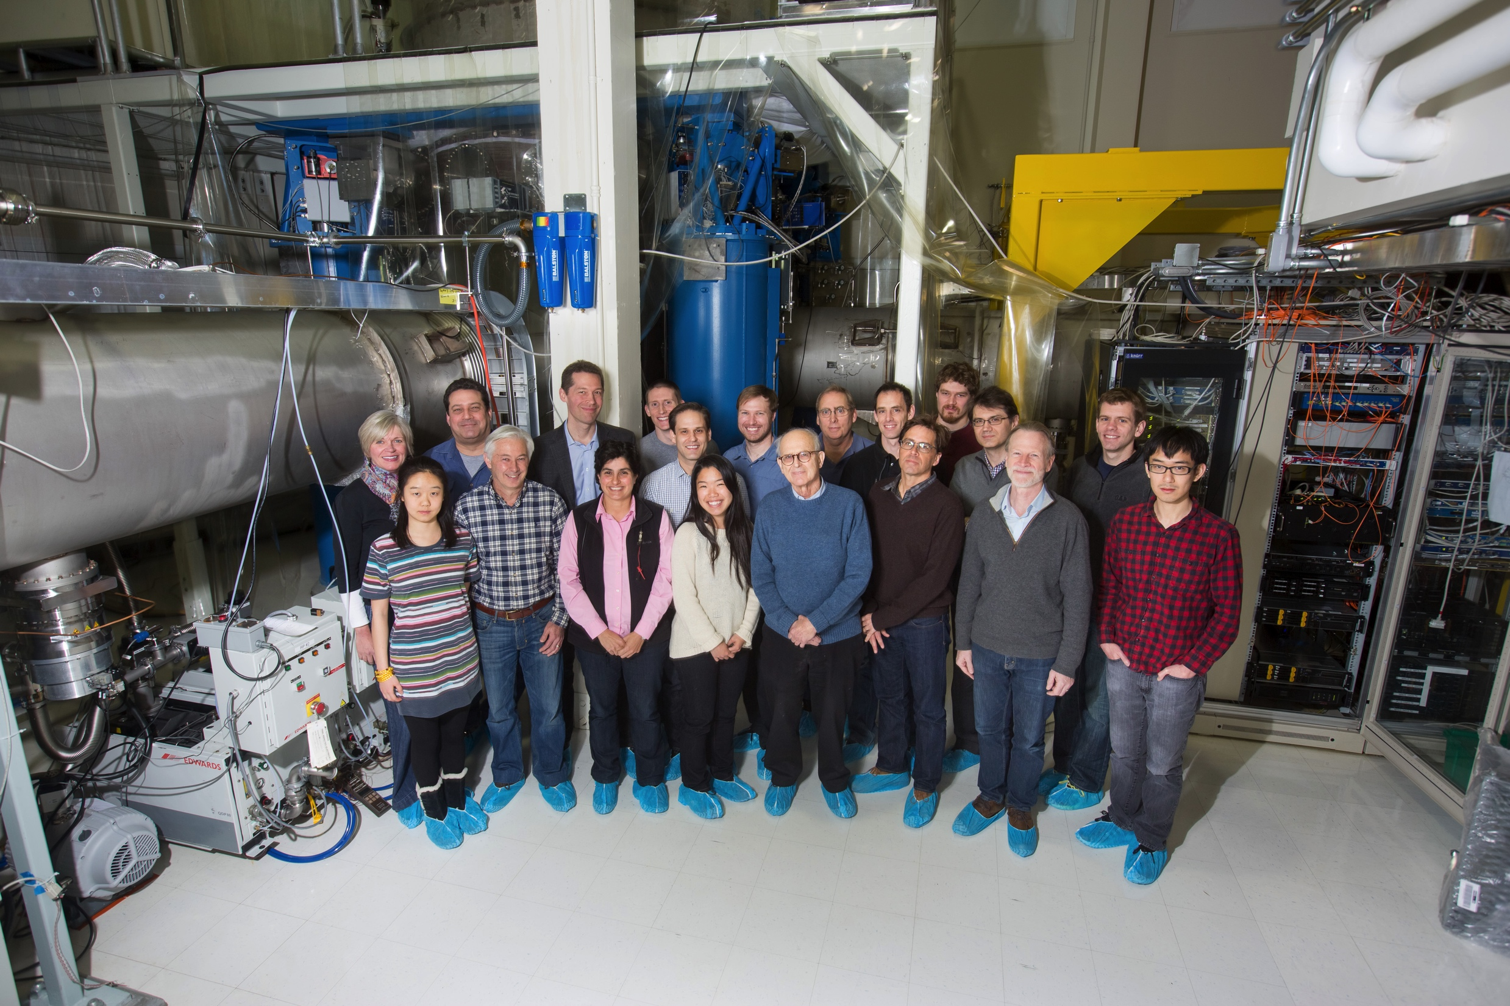
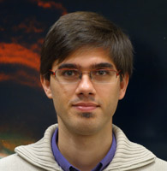
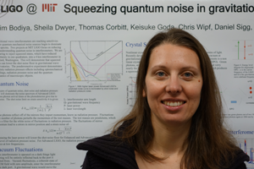
LIGO MIT GROUP 2016

Slide 9
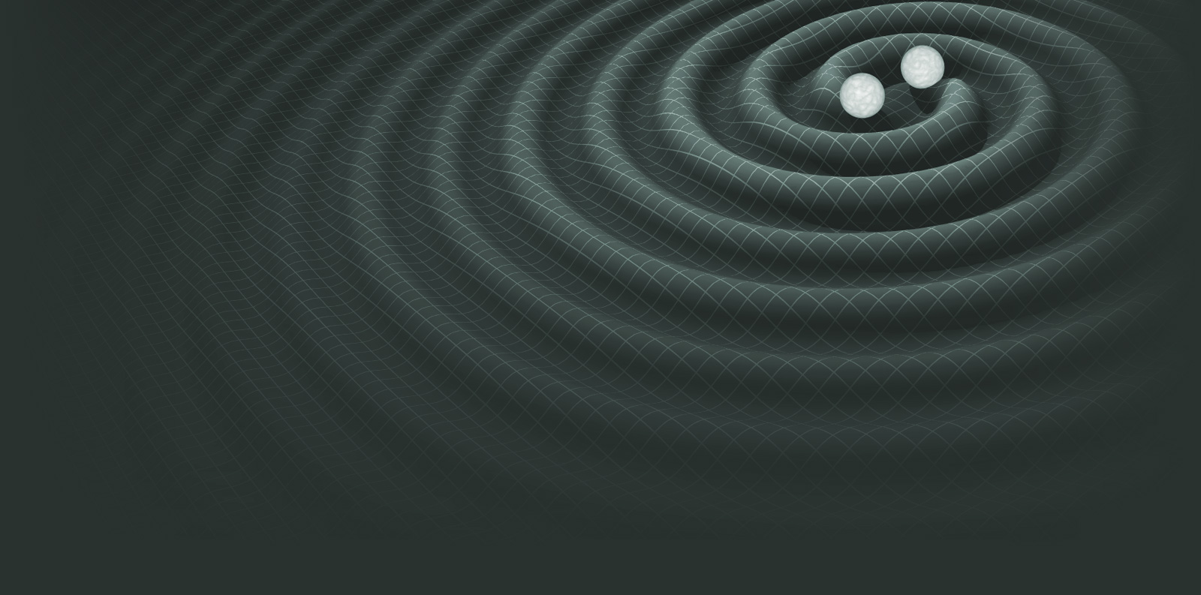
Undergraduates
1968
Edwin Jacobs
Richard Sramek
Thomas Seddon
Michael Wandzilak
Patrick Wallen
Andrew Mazzella
Kingston Owens
Miles Wagner
Michael Gordon
Rosalind Waldron
Fred Ore
David Trivett
George Doerre
Michael Feder
Edward Hildum
Jeffrey Livas
Christopher Lozinski
James Hordern Jr
Martin Offutt
Seth Finkelstein
Gregory Tucker
Daniel Zachary
Paul Kwiat
John Evans
Daniel J. Connelly
Heather Patrick
John Mruz Jr
Yaser Abdel Rehem
Eri Izawa
Brian Lantz
Sarah Veatch
Robert Bennett
Phil Marfuta
Blair Connelly
Andrew Thomas
Caryn Bullard
Jason Pelc
Alex Krull
Emily Davis
Rafael Cervantes
Sarah Ackley
Cassi Hunt
Sharon Rapaport
Natania Antler
David Kelley
Nick Hunter-Jones
Tamara Dordevic
Matthew Heising
Nicolas Brown
Camilo Cela Lopez
Tanner Trickle
Matt Hagan
Sam Jacobs
Sam Moore
2016

Slide 10
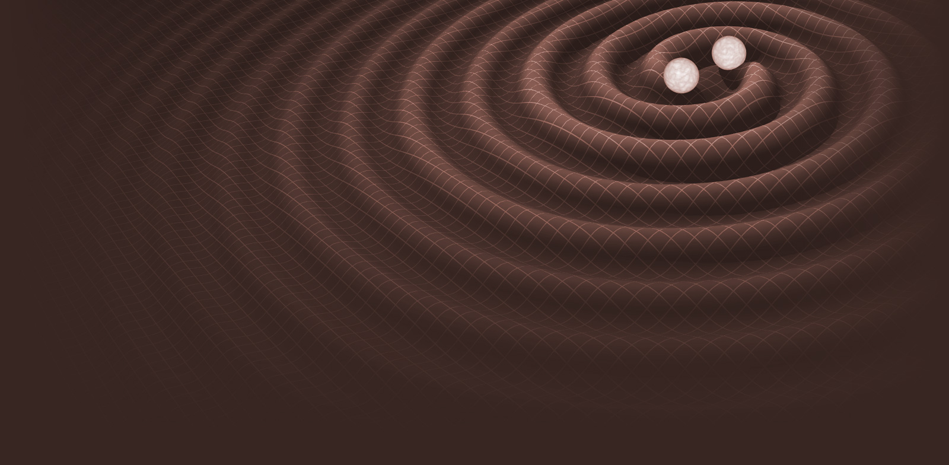
Graduate MS and PhD
1968
Gerald Blum
Kingston Owens
Peter Csatorday
James Rollins
Nickolas Fotopoulas
Brett Shapiro
Gautier Brunet
Timothy Bodiya
Daniel Dewey
Andrew Jeffries
Jeff Livas
Yae Hong Joo
Nelson Christensen
Michelle Eisgruber Stephens
Peter Fritschel
Joseph Kovalik
Joseph Giaime
Nergis Mavalvala
Partha Saha
Brett Bochner
Brian Lantz
Julien Sylvestre
Ryan Lawrence
Rana Adhikari
Stefan Ballmer
Shourov Chatterji
Keisuke Goda
Joseph Betzwiser
Laruent Ruet
Olga Petrova
Thomas Corbitt
Jackie Villadsen
Lindy Blackburn
Nicolas Smith
Sheila Dwyer
Brett Shapiro
Shannon Sankar
Chris Wipf
Tomoki Isogai
Eric Oelker
Reed Essick
Ryan Lynch
Aaron Buikema
Nancy Aggarwal
William Yam
Hang Yu
Maggie Tse
Haocun Yu
Hang Yu
2016

Slide 11
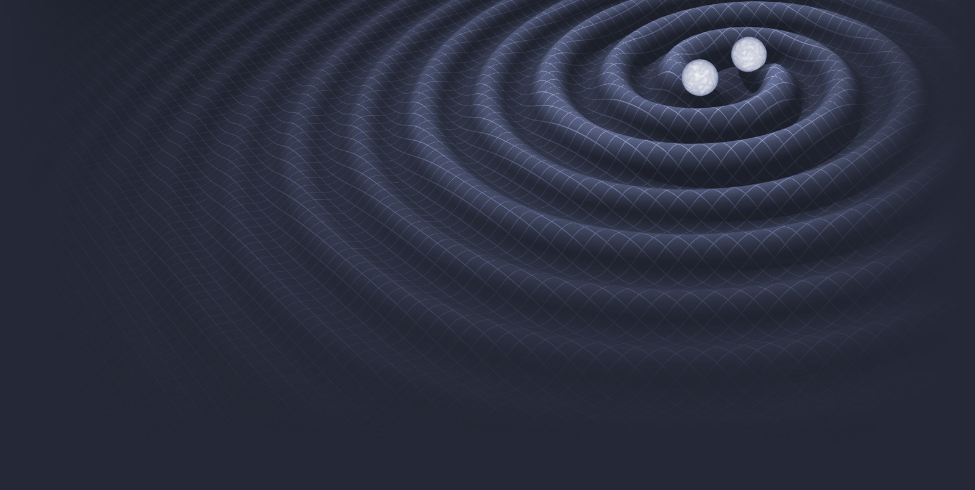
Faculty, Post-doc & Staff
1968
Nergis Mavalvala
Erik Katsavounidis
Matthew Evans
Rainer Weiss
Peter Kramer
Peter Saulson
Daniel Sigg
Gabriela Gonzalez
Edward Daw
Pradeep Sarin
Laura Cadonati
Lisa Barsotti
Gregg Harry
Eugeniy Mikhailov
Edith Innerhofer
Thomas Corbitt
Patrick Kwee
Ruslan Vaulin
Fan Zhang
Brennan Hughey
Filippo Grimaldi
John Miller
Katherine Rawlins
Laura Cadonati
Tania Regimbau
Salvatore Vitale
Sebastian Biscans
Slawek Gras
Adam Libson
Antonios Kontos
Robert Lanza
Lee McCuller
Den Martynov
David Shoemaker
Paul Linsay
Yaron Hefetz
Michael Burka
Peter Fritschel
Richard Mittleman
Michael Zucker
Michele Zanolin
Ken Mason
Fabrice Matichard
Sebastian Biscans
John Miller
Slawek Gras
Satya Mohapatra
Junwei Cao
2016

Slide 12
Support Staff
1968
Elizabeth Busch
Susan Merullo
Jennifer Holder
Marie Woods
Tom Evans
Keith Bayer
Fred Donovan
Charles Summers
Edward Kruzel
Ralph Burgess
Matthew Smith
Richard Benford
Jon Allen
Robert Laliberte
Fred Miller
Myron MacInnis
2016

