Slide 1
The Beginning of Gravitational Wave Astronomy
R. Weiss, MIT on behalf of the LIGO and VIRGO Scientific Collaborations
CTA Symposium
Bologna, Italy
May 6, 2019

Slide 2
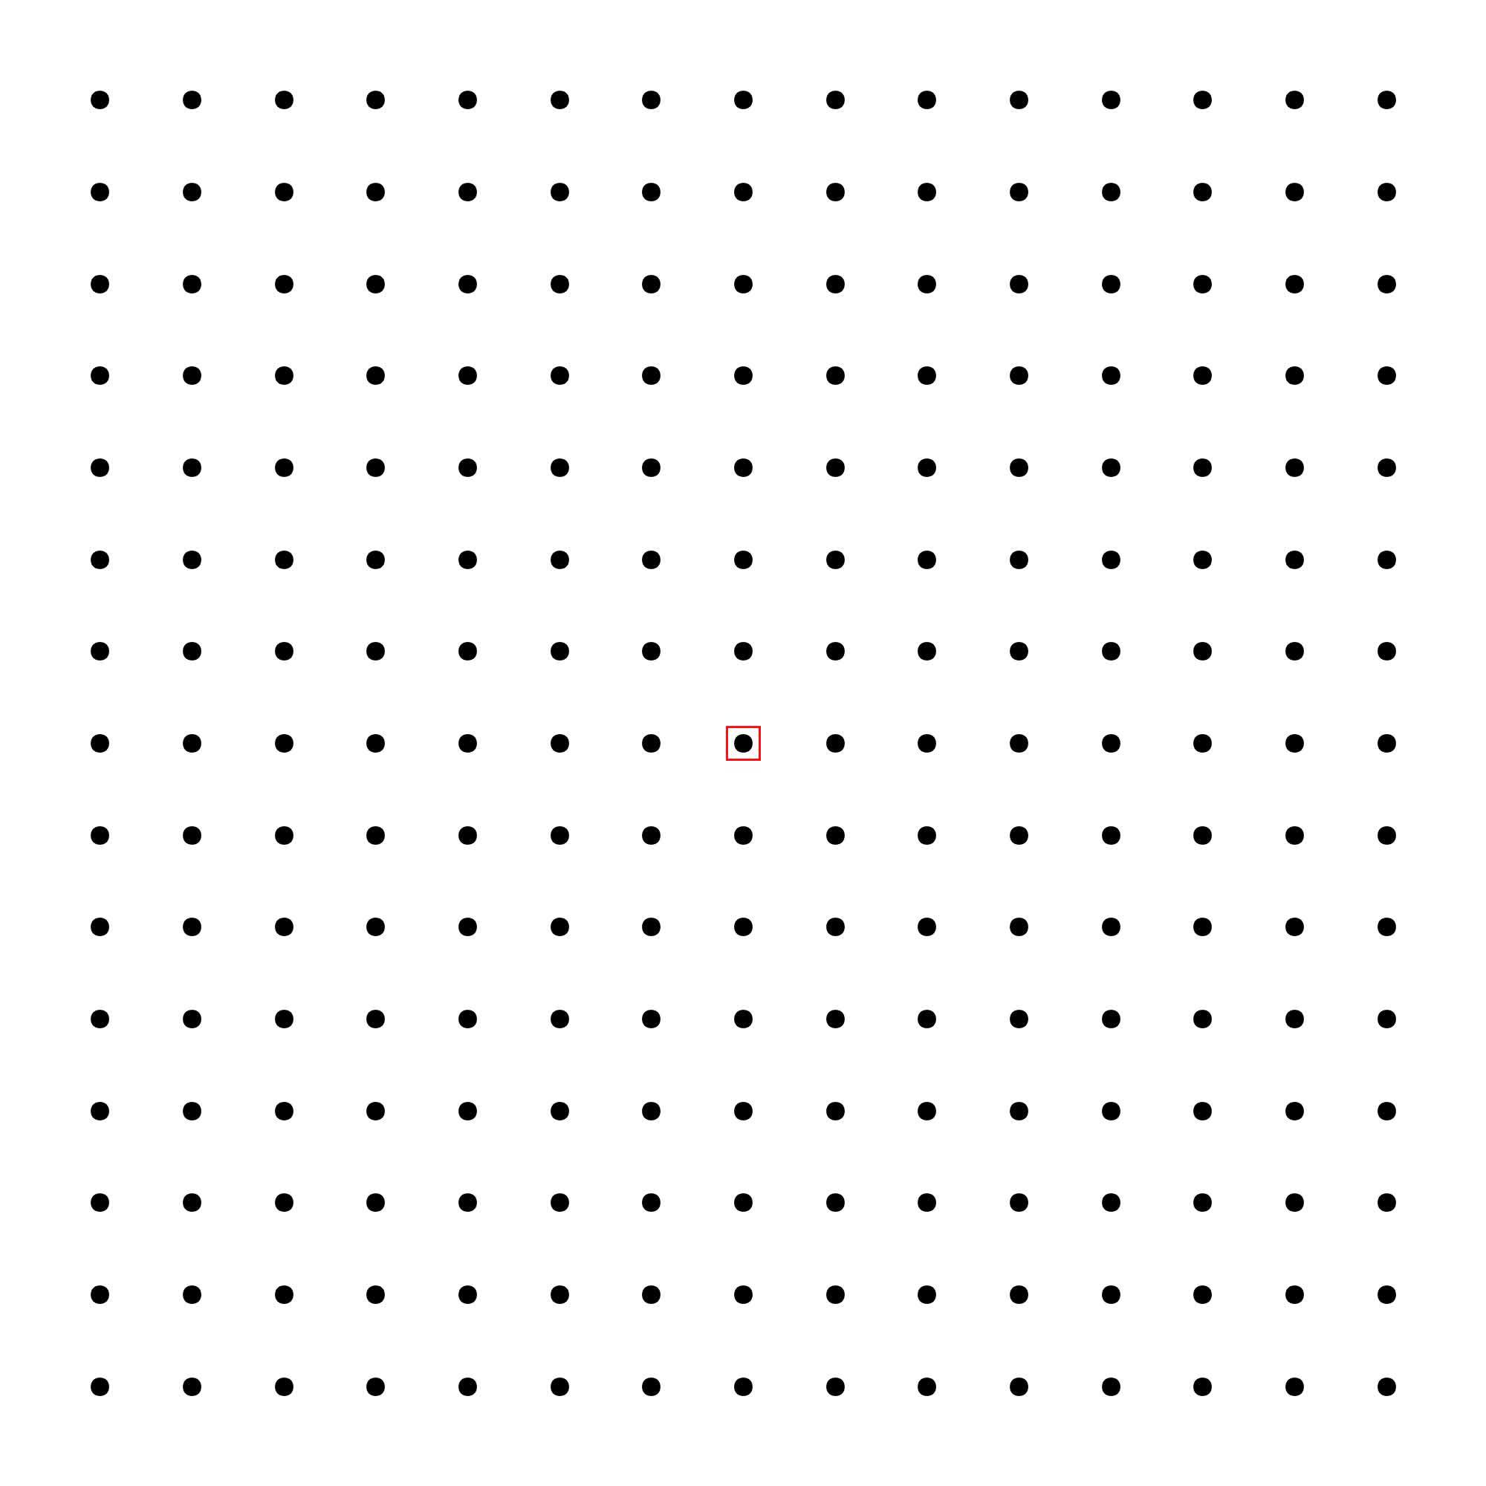
Gravitational waves
Einstein 1916 and 1918
  Sources: non-spherically symmetric accelerated masses
  Kinematics:
    propagate at speed of light
    transverse waves, strains in space (tension and compression)

Slide 3
Gravitational waves
Einstein 1916 and 1918
  Sources: non-spherically symmetric accelerated masses
  Kinematics:
    propagate at speed of light
    transverse waves, strains in space (tension and compression)

Slide 4
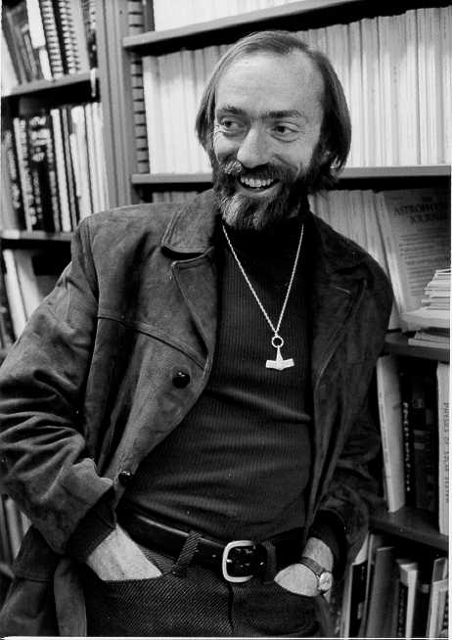
The measurement challenge
Kip Thorne

Slide 5
Advanced LIGO Fabry-Perot Michelson Interferometer Schematic

Slide 6
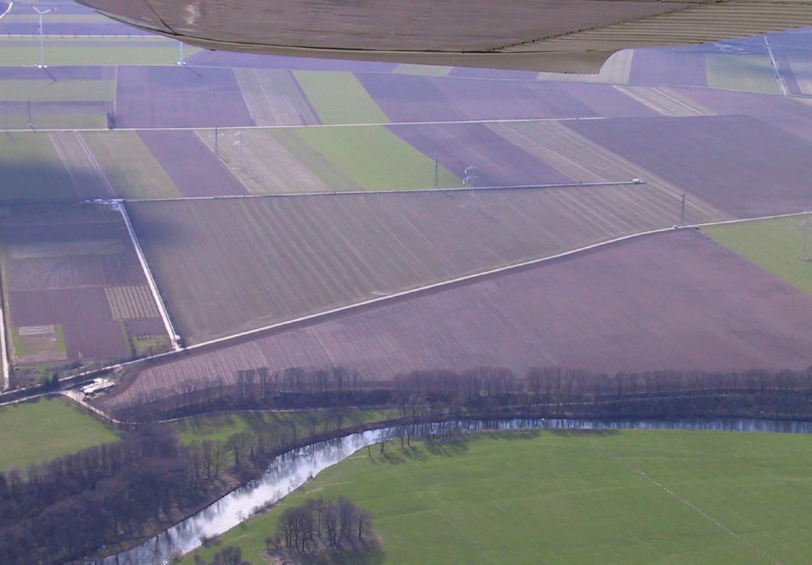
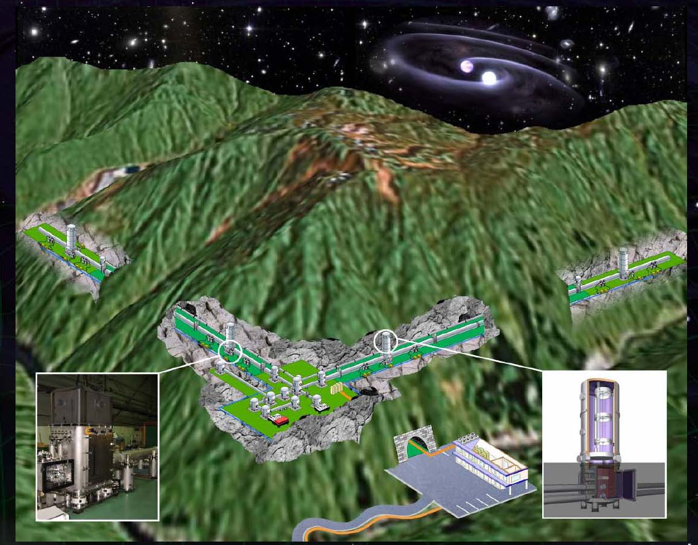
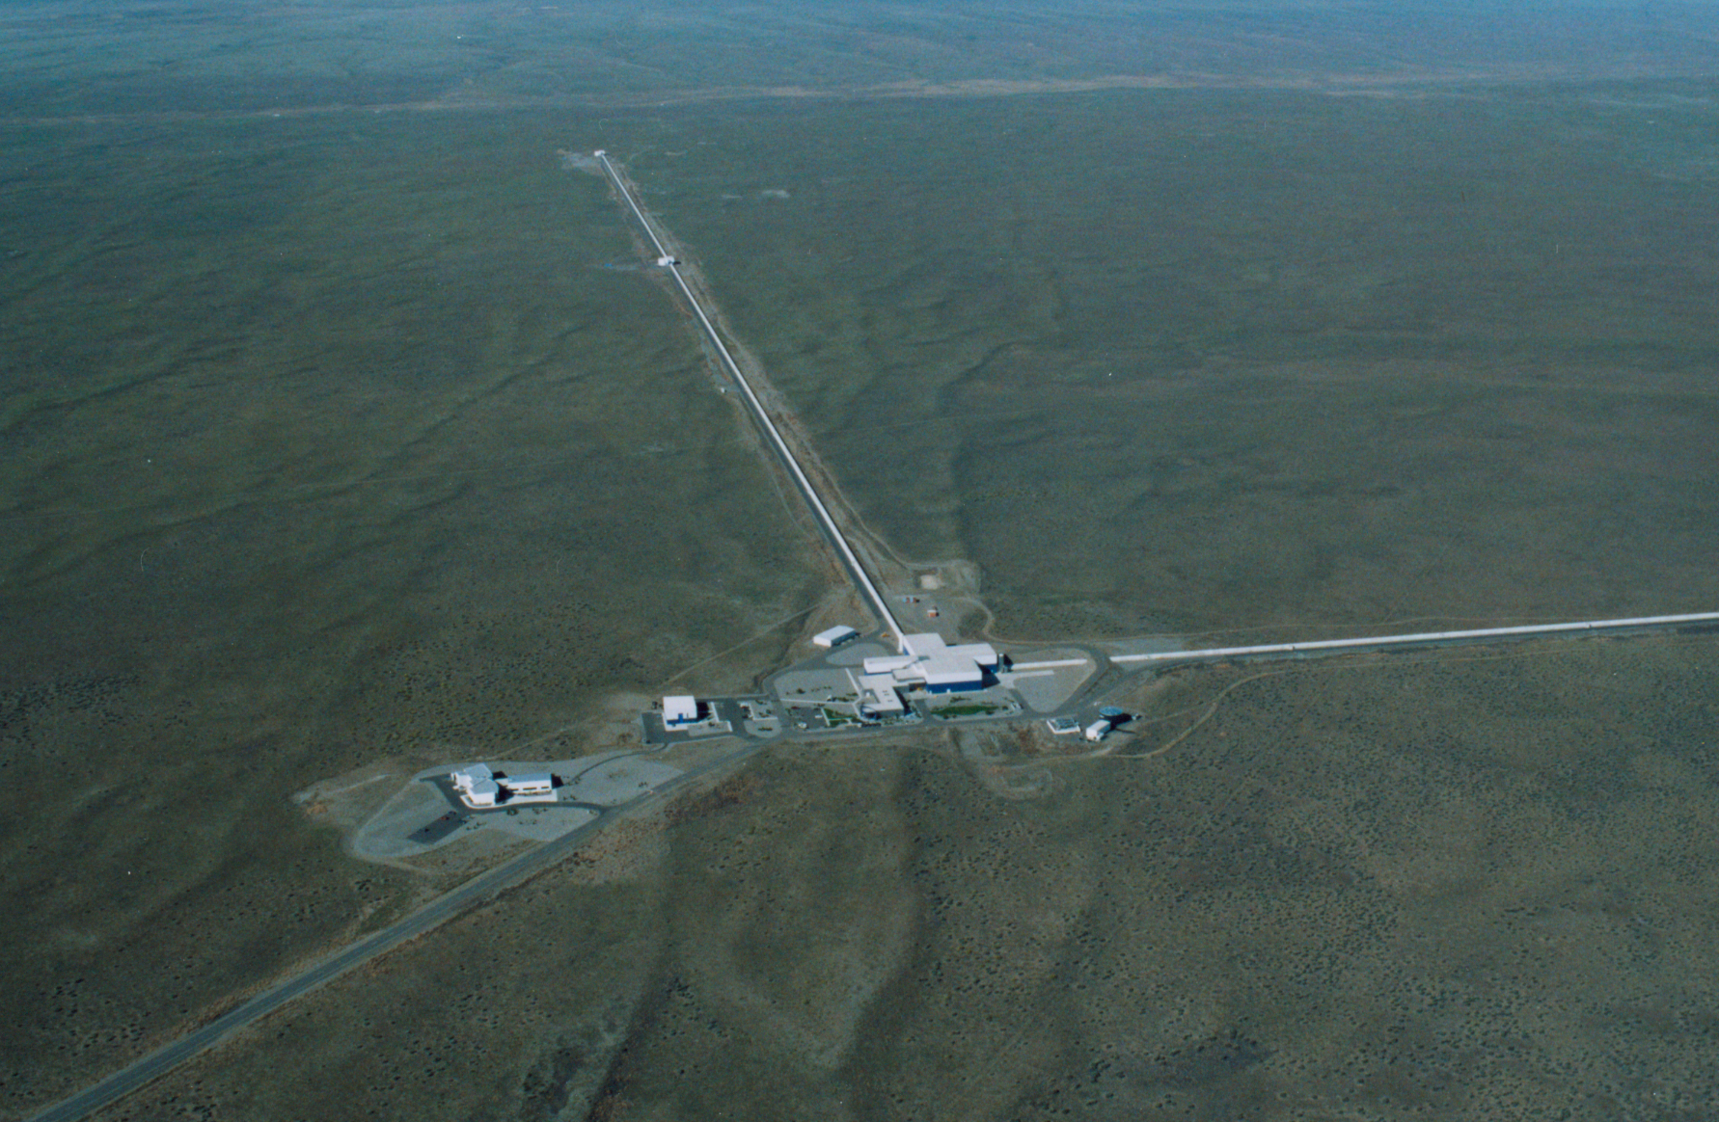
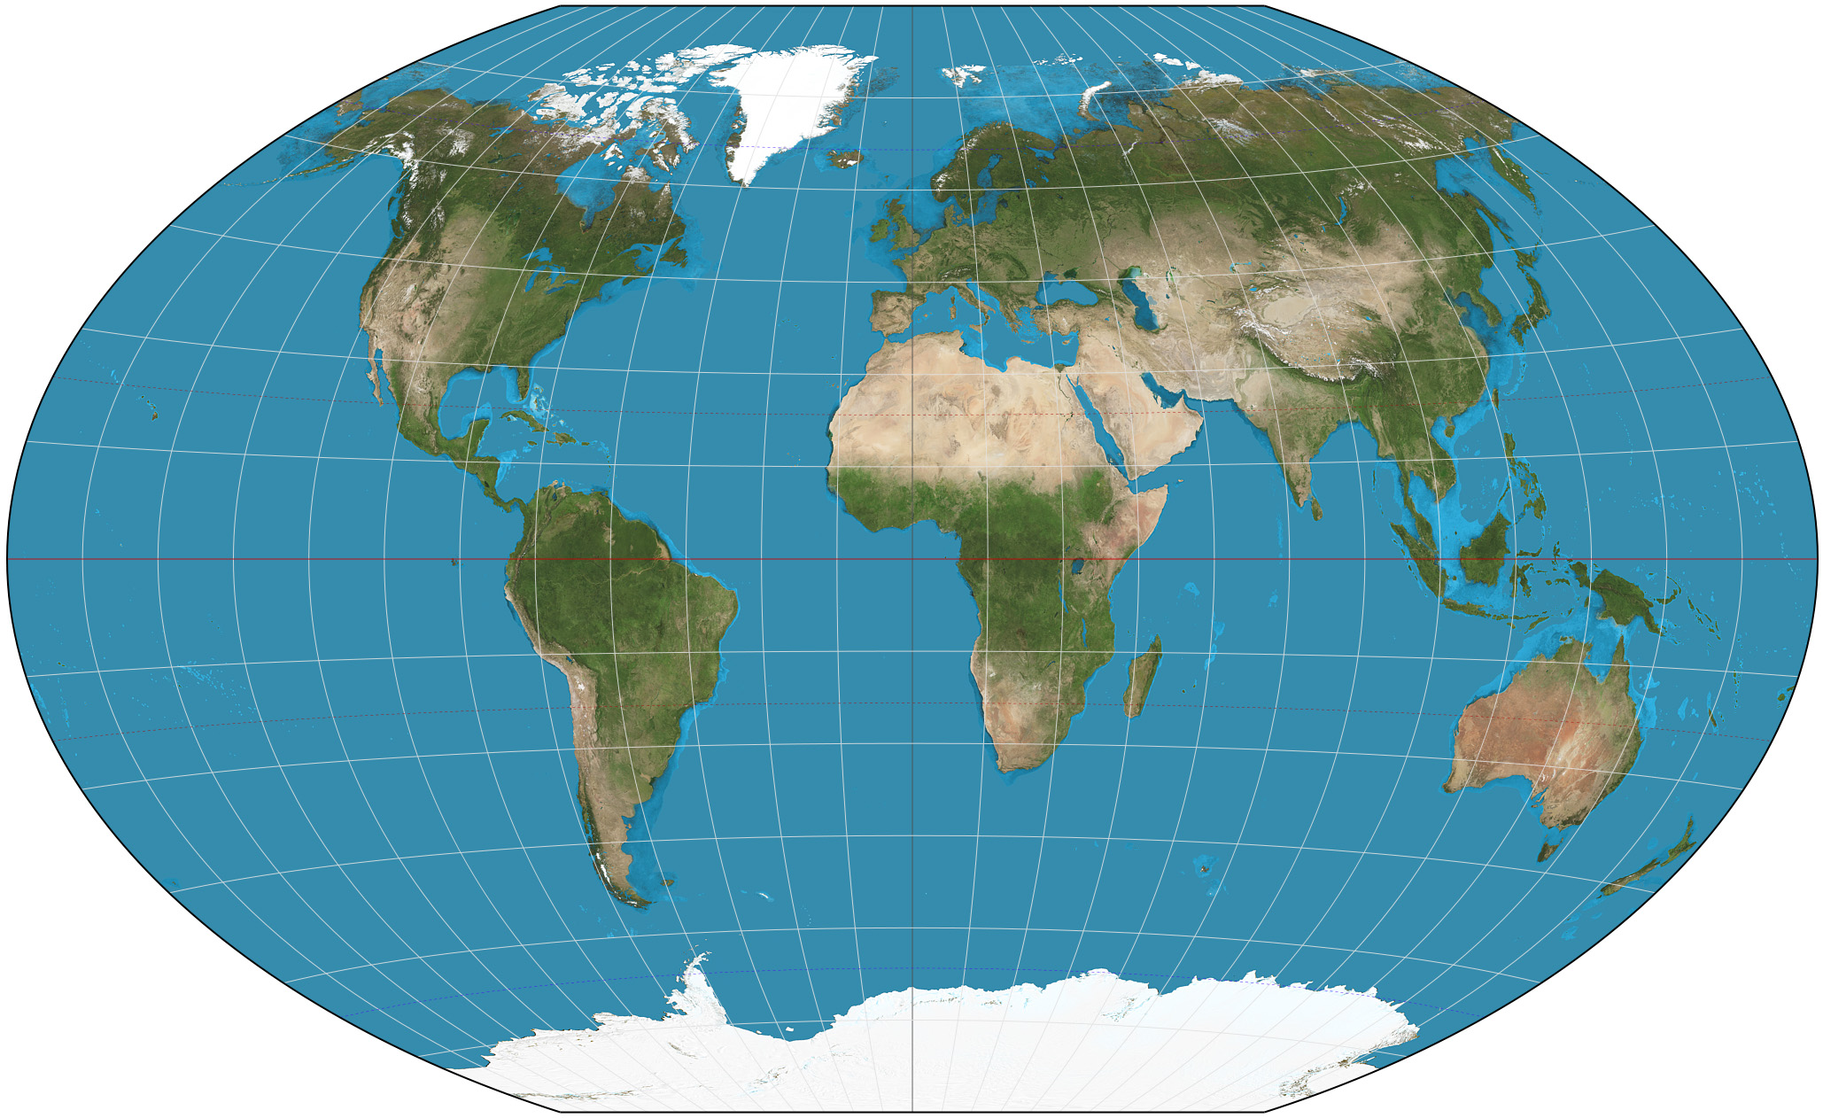
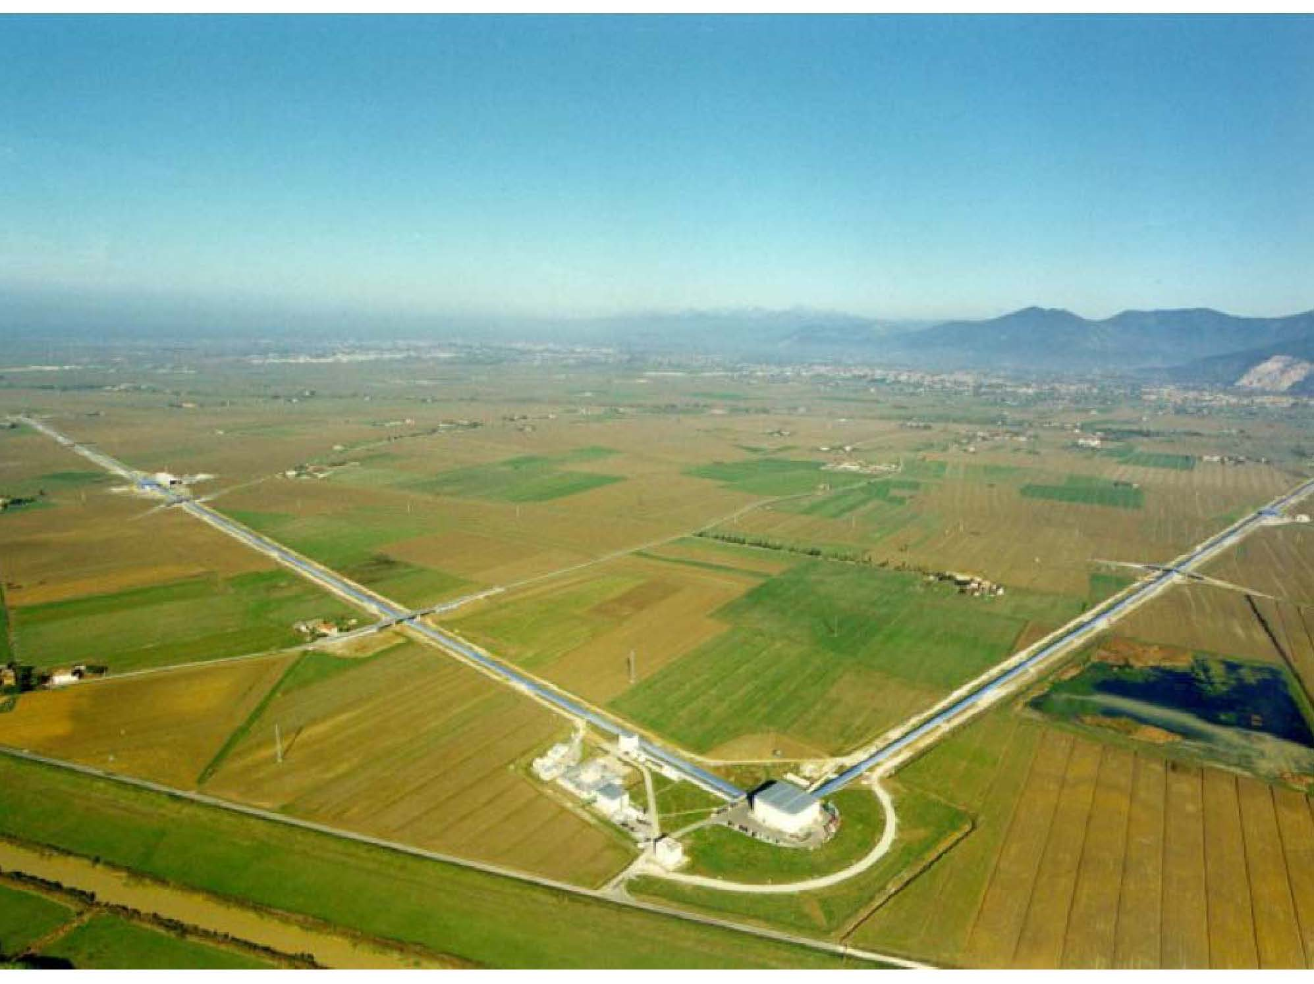
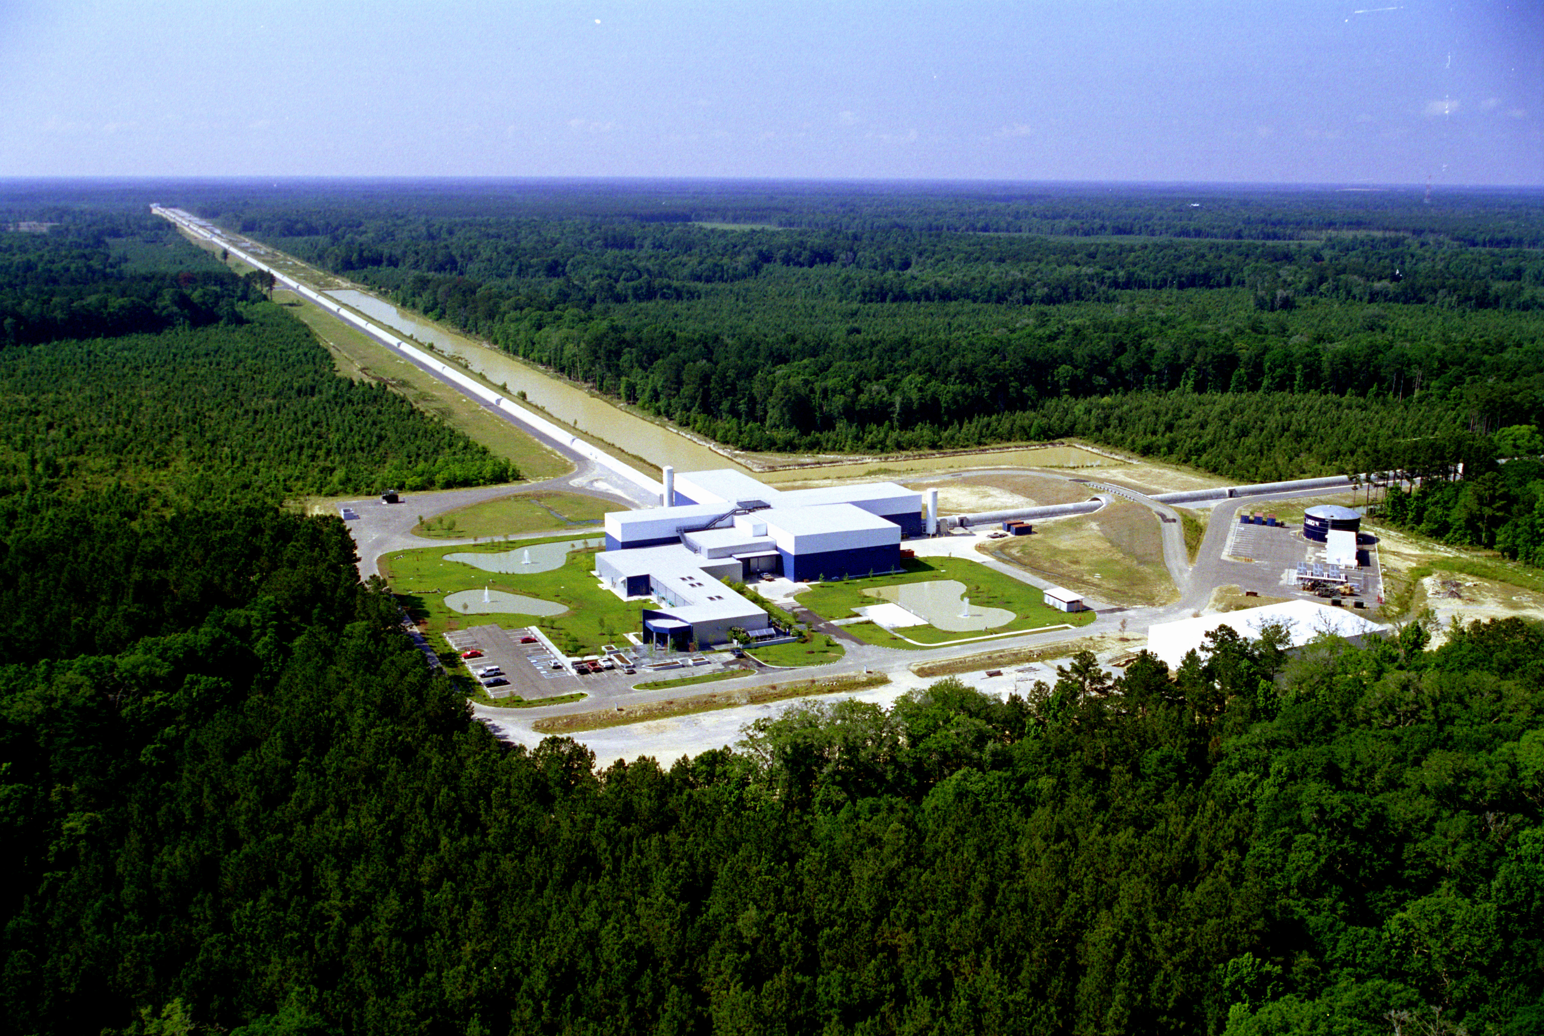
GEO
KAGRA
LHO
VIRGO
LIGO INDIA
LLO

Slide 7
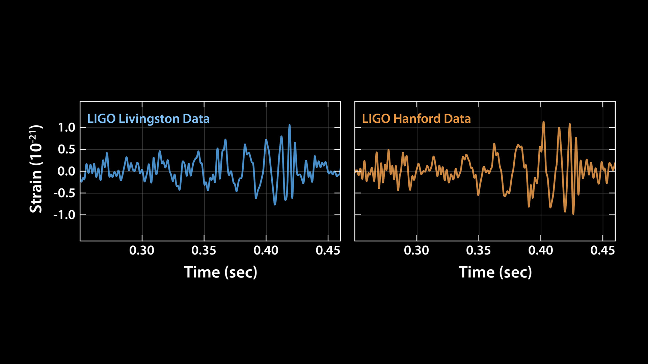

Slide 8
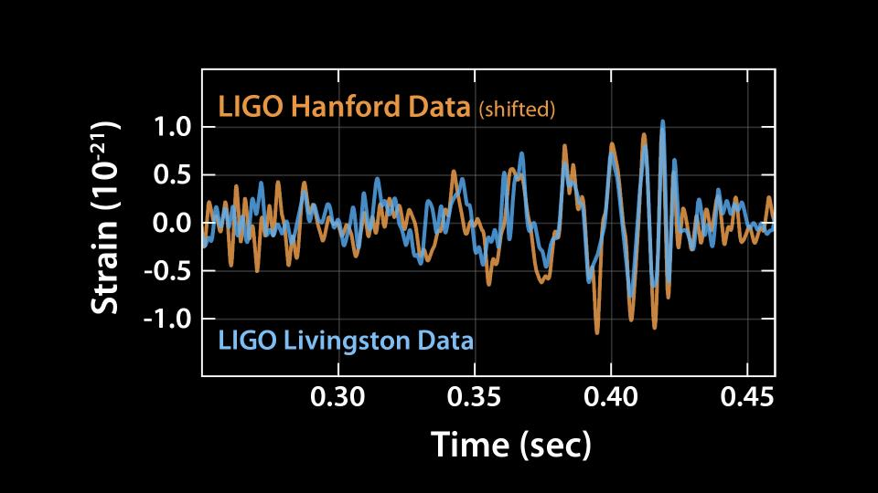
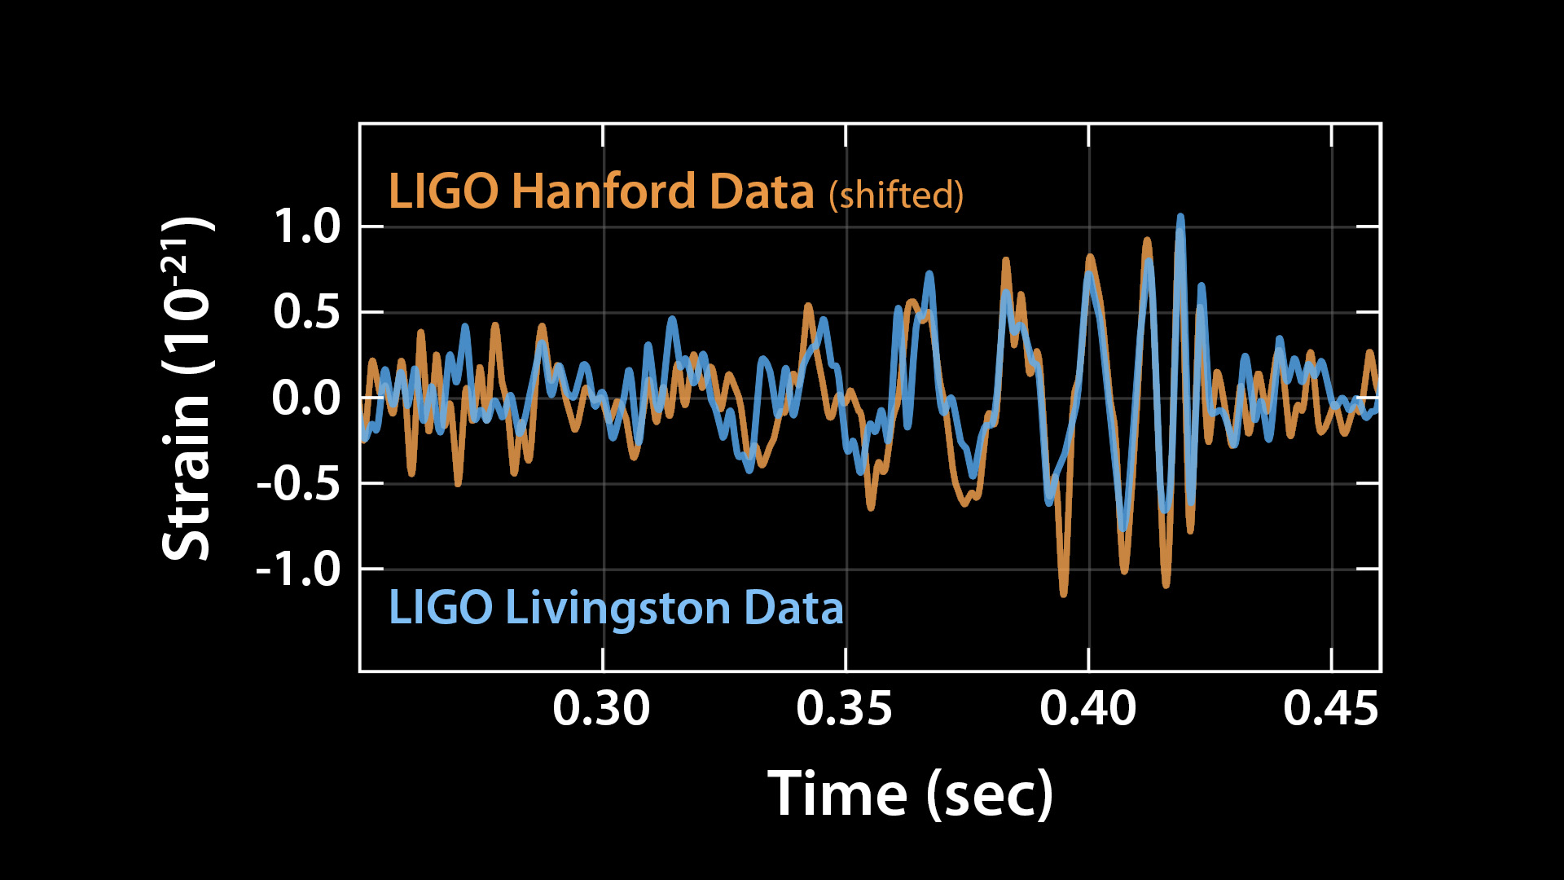

Slide 9
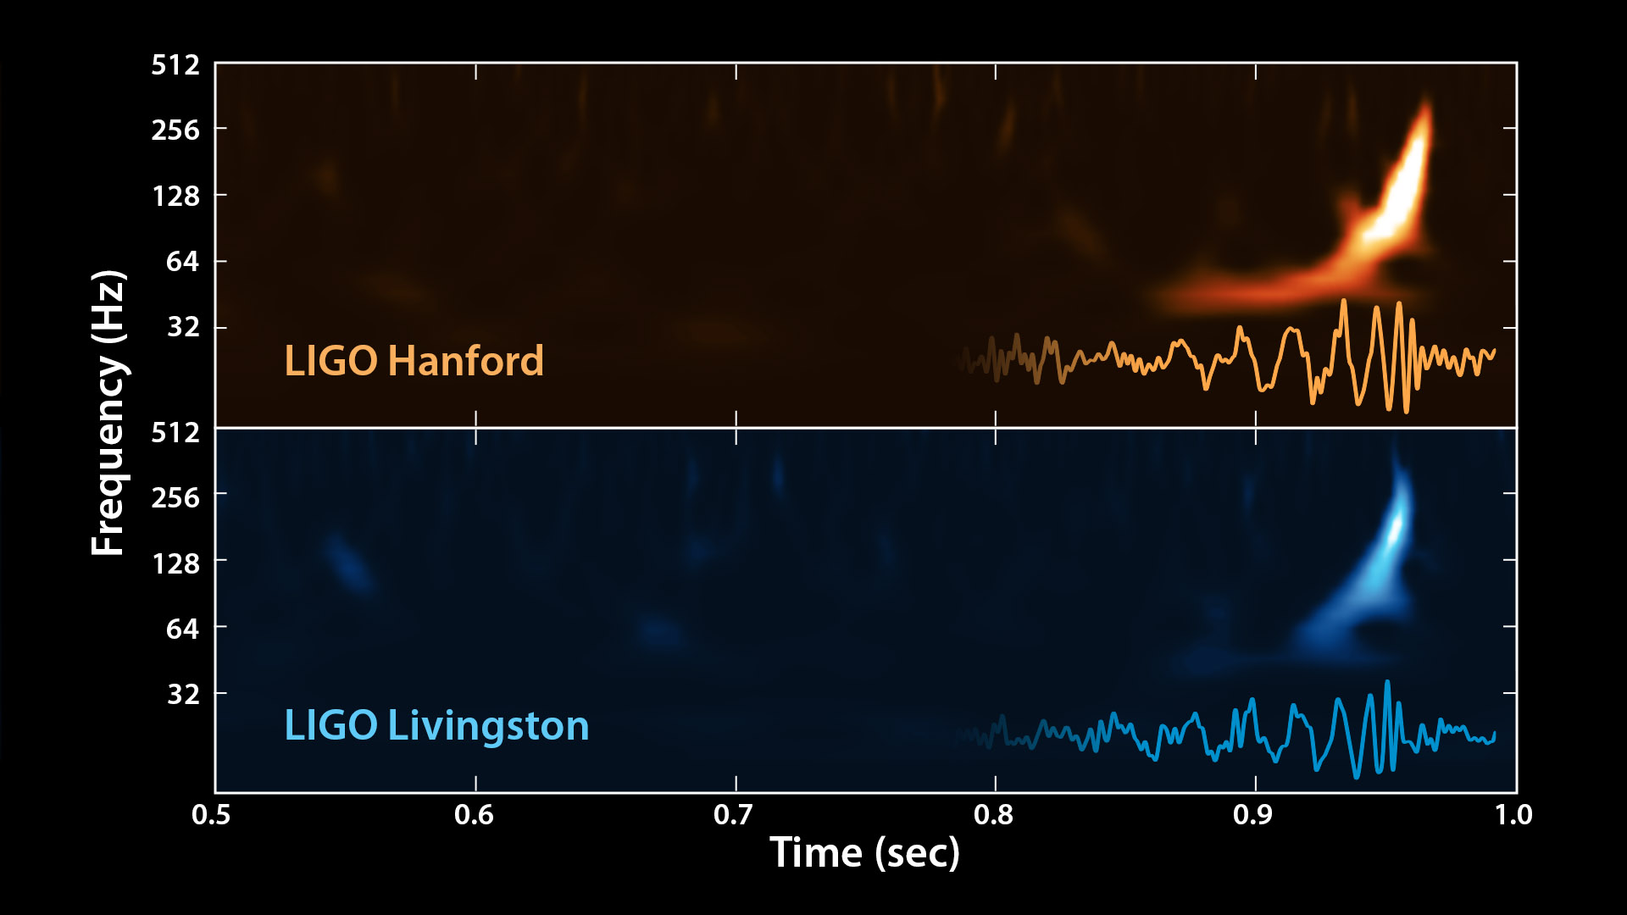

Slide 11
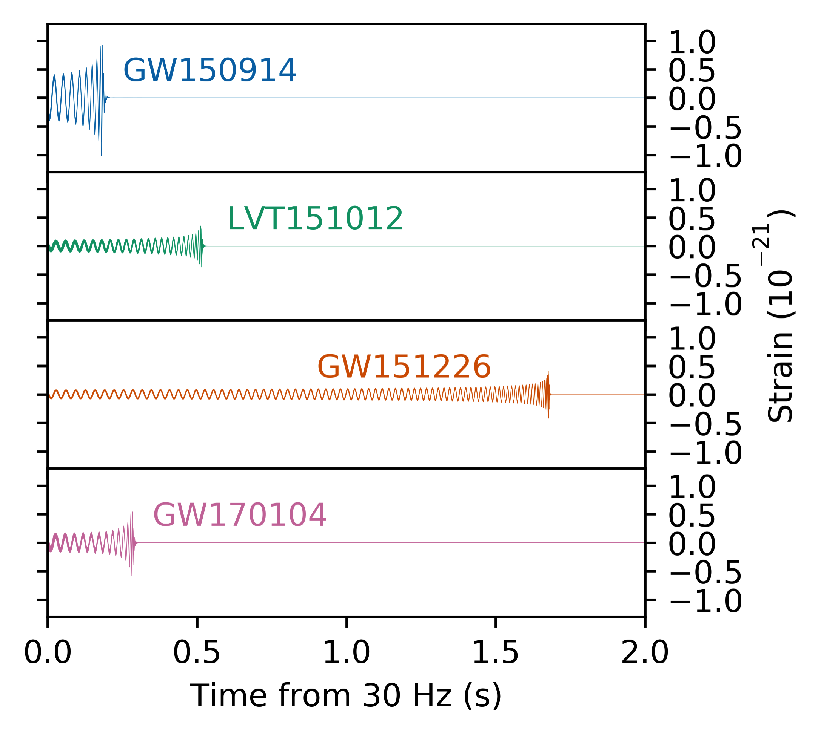
Results of O1 and O2 run announced June 1, 2017
m1=36, m2= 29, Δm=3
if at 1 au
h ~10⁻⁶
I_{g}~ 10²⁵ w/m²
m1=23, m2= 13, Δm=1.5
m1=14.2, m2= 7.5, Δm=1
m1=31, m2= 19, Δm=2
masses in source frame

Slide 12
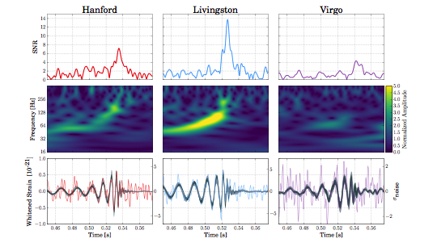
Triple coincidence
GW 170814
M₁ = 30
M₂ = 25
ΔM = 2.7
Localization on sky and distance

Slide 13
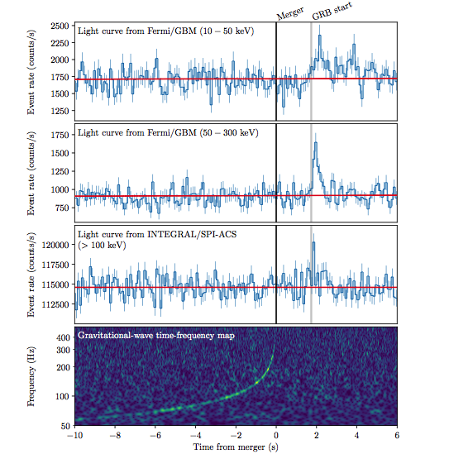


Slide 14
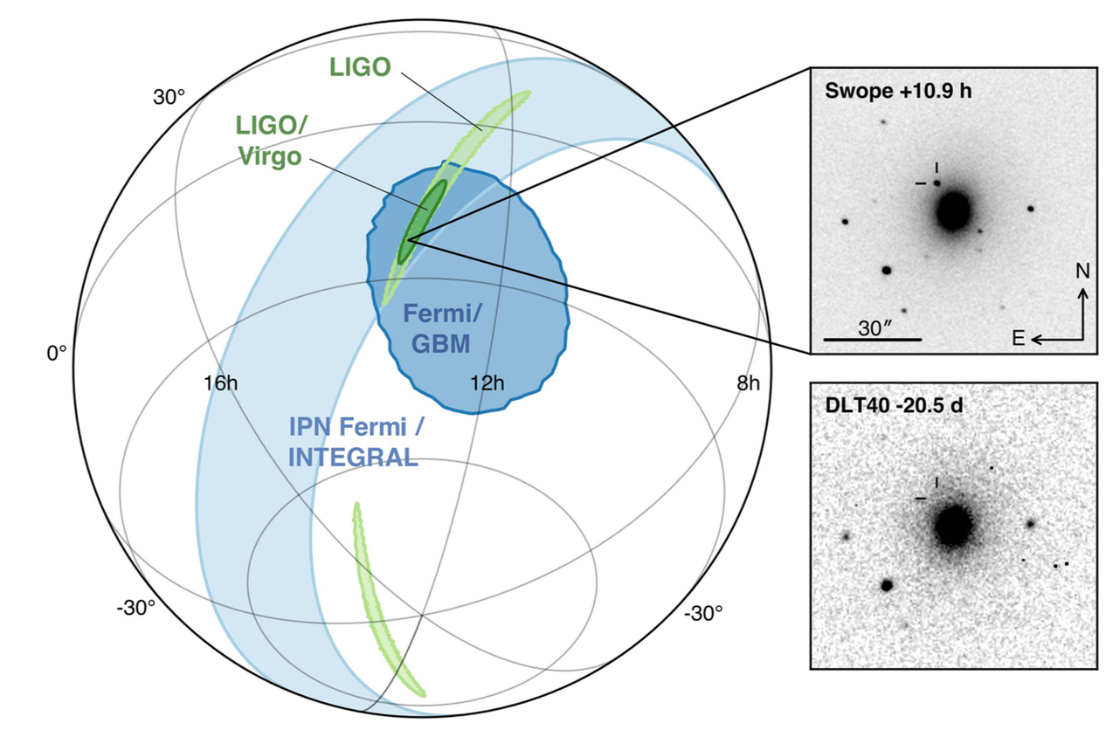
NGC4493

Slide 16
Origin of the elements

Slide 17
Hubble constant measurement: Galaxy z and distance from GW amplitude

Slide 18
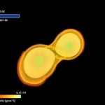
Neutron Star Tidal Distortion
high spin
low spin
tidal distortion

Slide 19
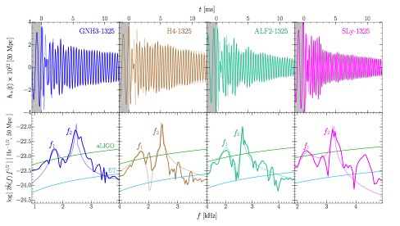
Binary neutron star spectroscopy
S.Bose,K.Chakravarti, L.Rezzolla, B.S. Sathyaprakash, K. Takami

Slide 23
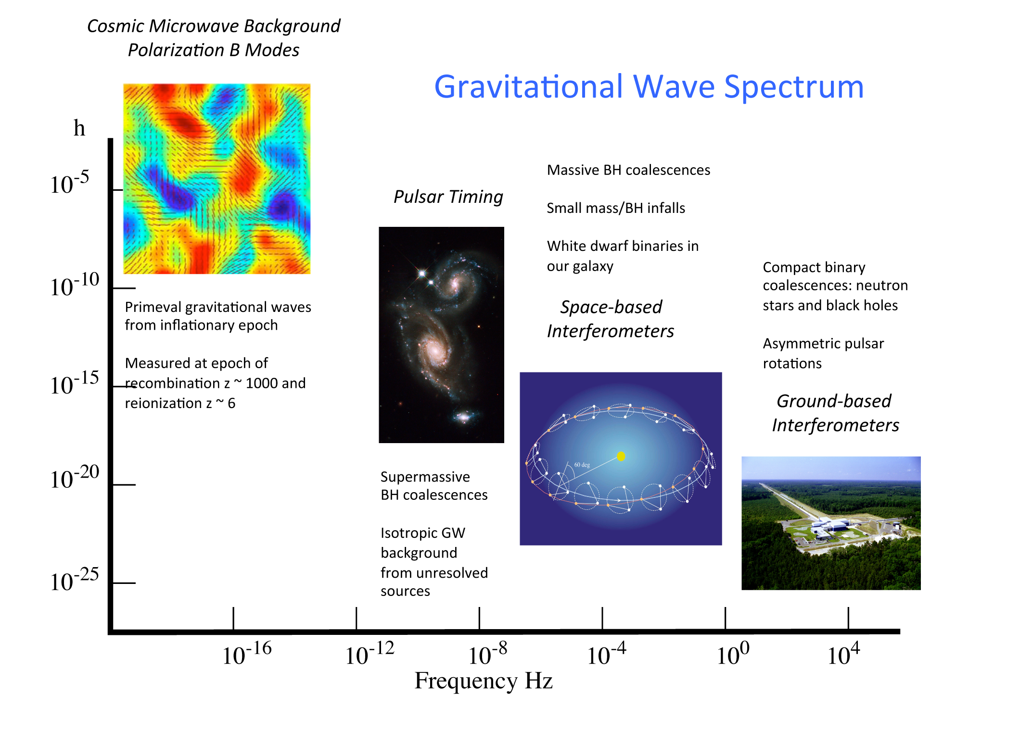
age of universe years hours minutes 1/10 to 1/1000 sec

Slide 24
SPARE SLIDES

Slide 25
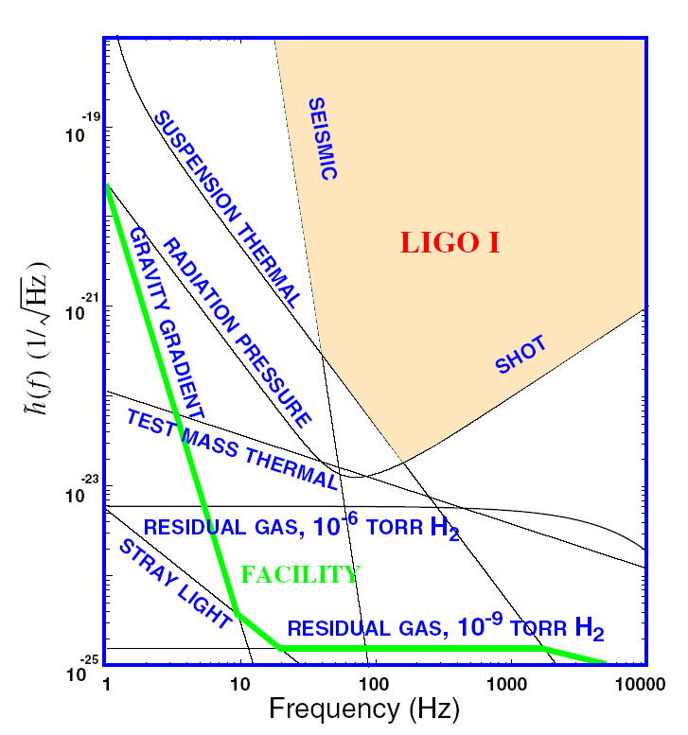

Slide 26
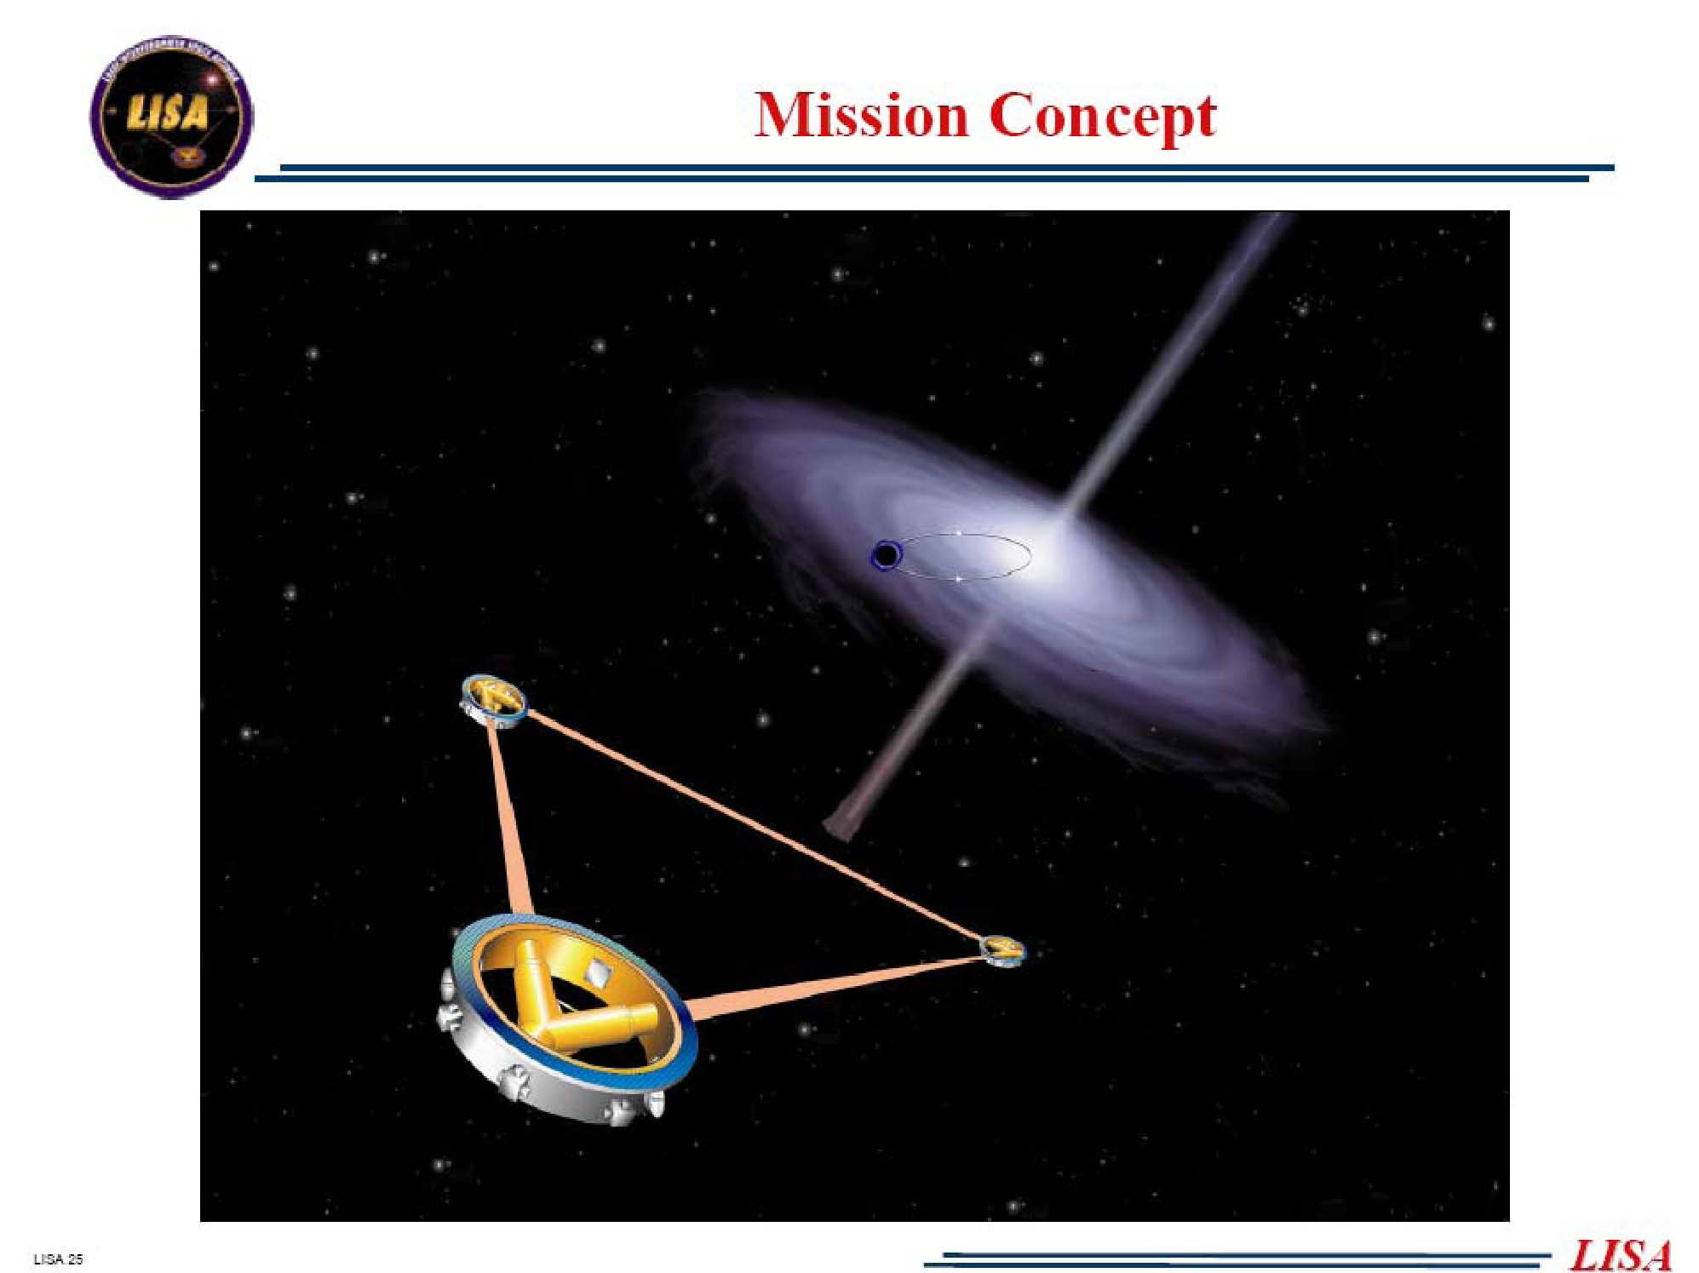

Slide 27
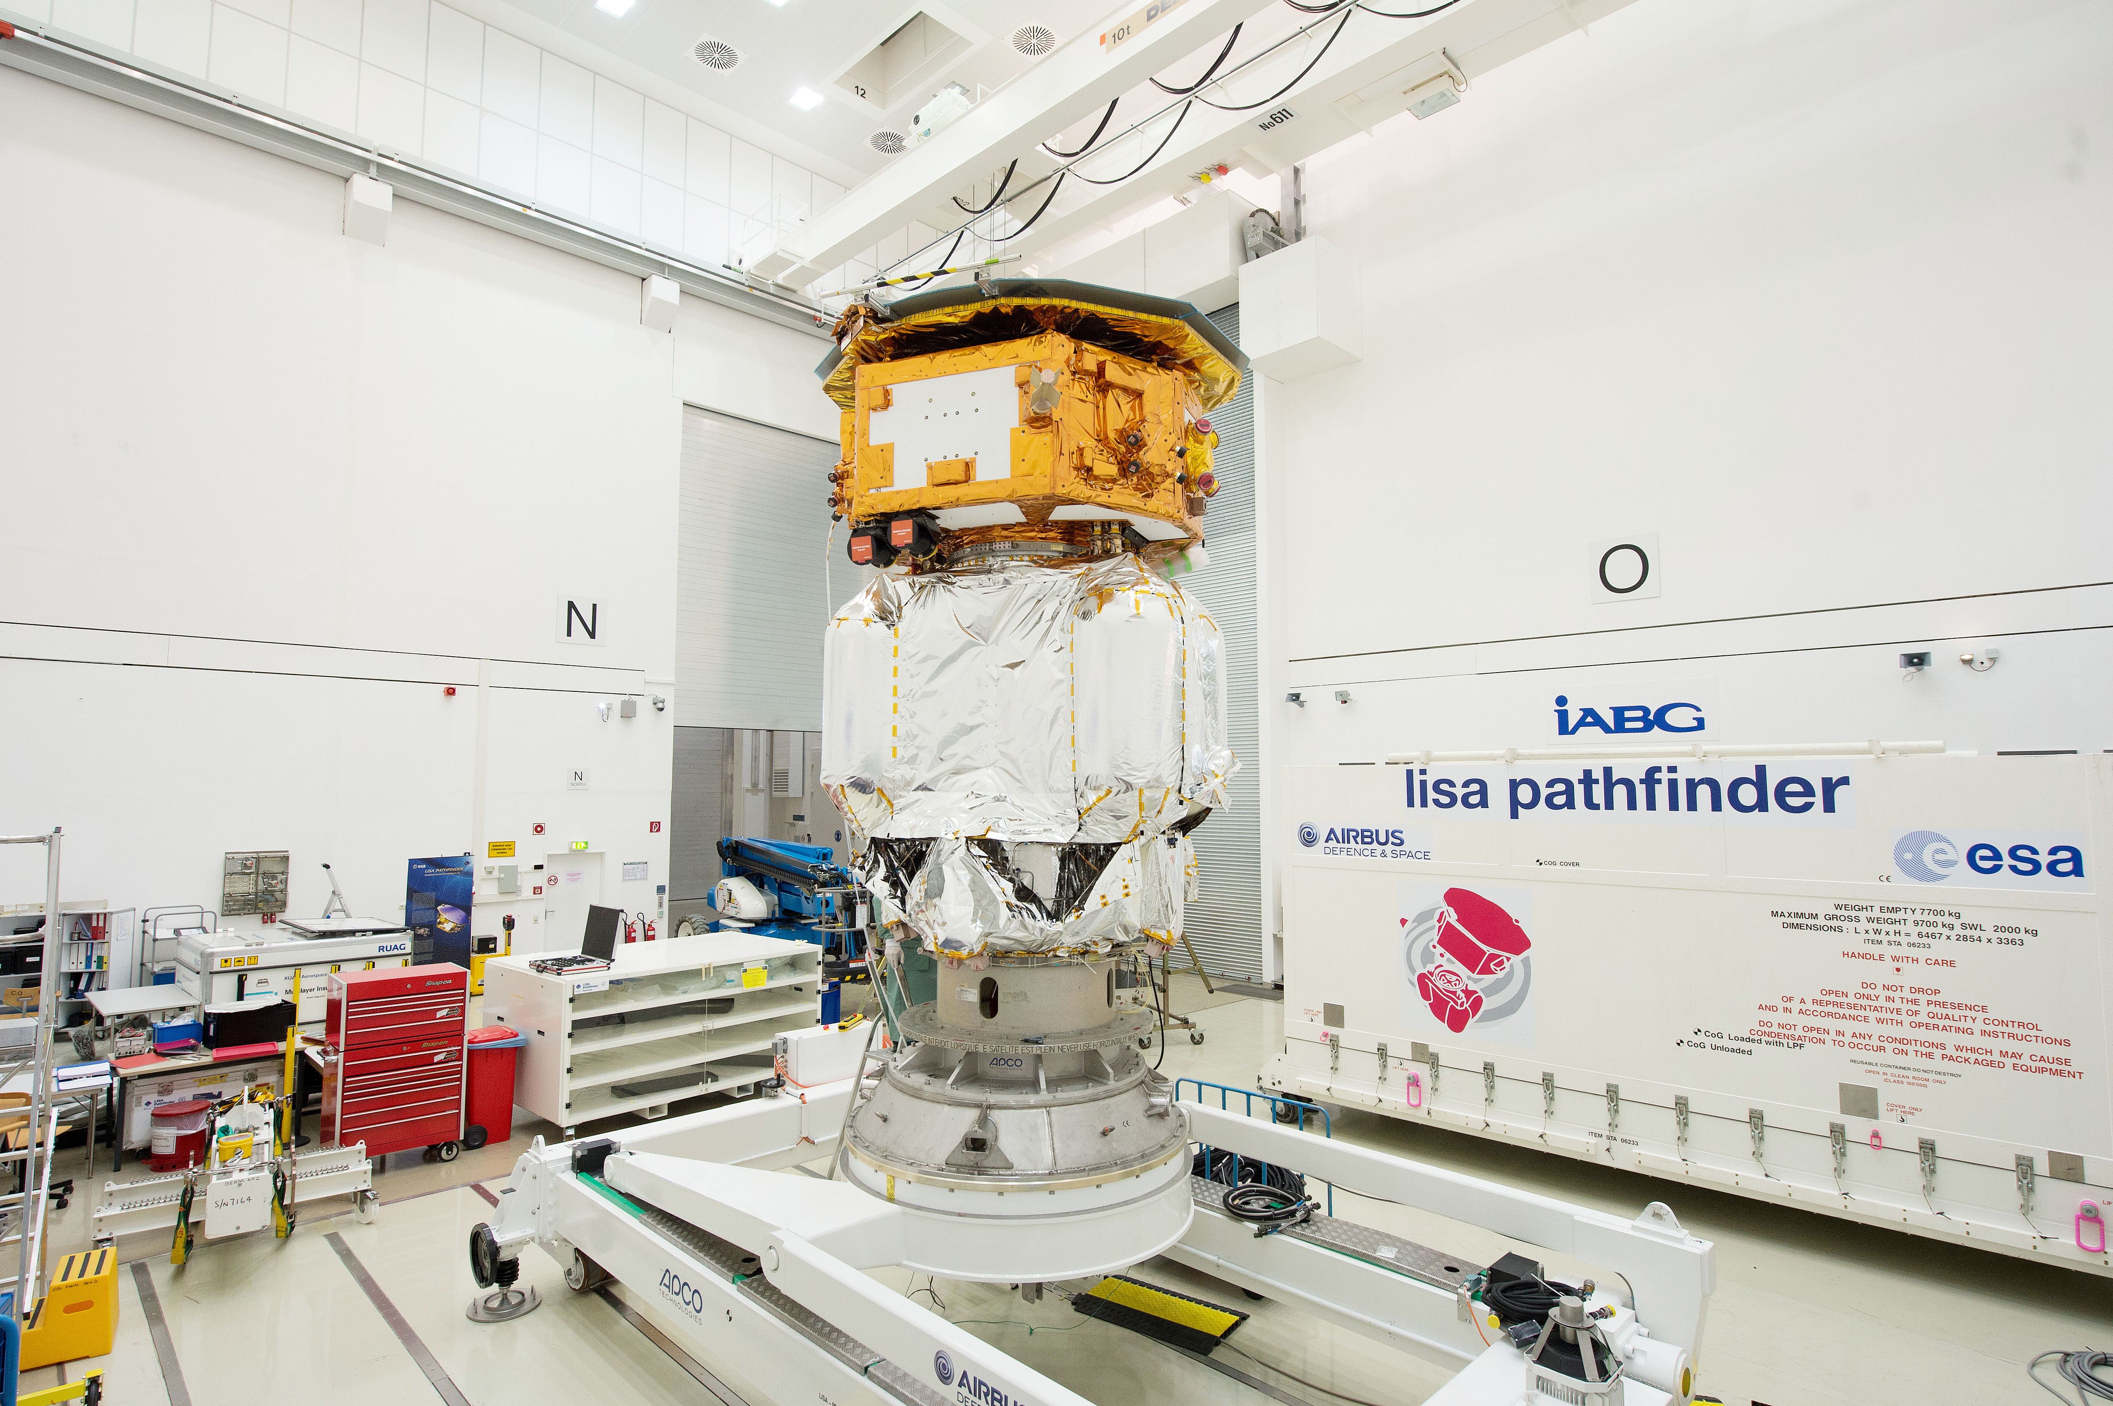
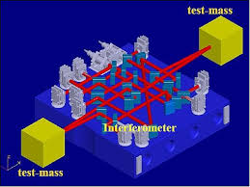
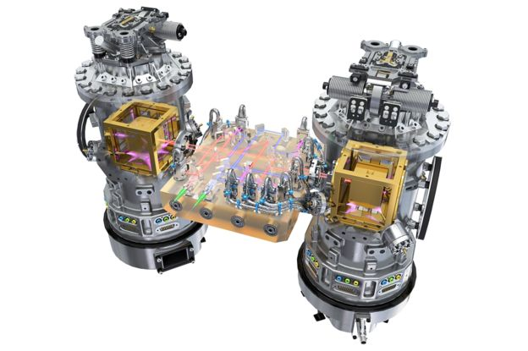
LISA Pathfinder
Launched 12/03/2015
At L1, masses released
Passed acceleration tests
Next, thruster tests
PRL article in prep

Slide 30
