Slide 1
Status and Prospects for
Gravitational Wave Physics and Astronomy
V. Kalogera, T. Prince, R. Weiss
Board on Physics and Astronomy
National Academies
Washington DC, April 25, 2015

Slide 2
Outline
Overview of field and Ground-based Science
— Vicky Kalogera
Pulsar Timing and Space-based Science & Detectors
— Tom Prince
Evolution of Ground-based Detectors
— Rai Weiss
Request of Board on Physics and Astronomy
NRC Study of long-term directions
for ground-based detectors and science

Slide 4
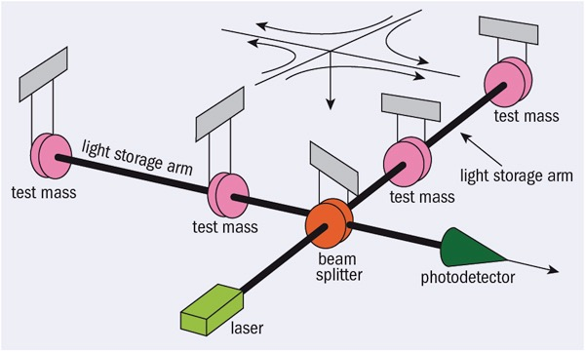
LIGO - Virgo Detector Network
LIGO-Hanford (H1)
LIGO-Livingston (L1)
Virgo-Pisa
(V1)

Slide 5
slide: D. Shoemaker

Slide 6
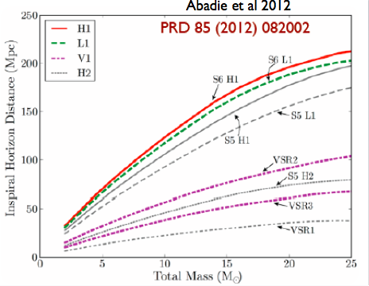
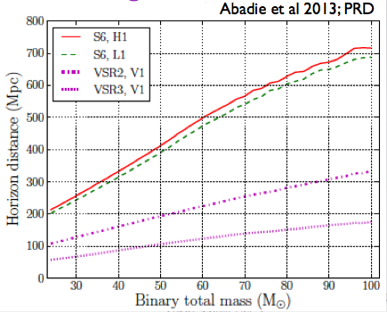
Initial LIGO Science Reach

Slide 7
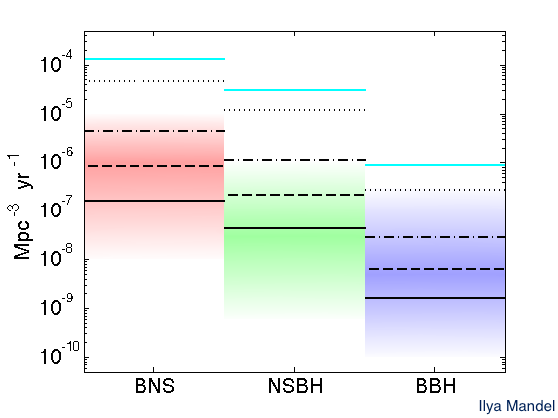
Initial LIGO Science Reach
Rates Upper Limits
Abadie et al. 2010 & Abadie et al. 2012
Just factor of ~2
off astrophysical
predictions for
BH-BH

Slide 8
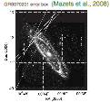
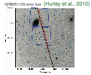
Follow-up of 2 close short GRBs
Abbott et al. 2008 & Abadie et al. 2012b
Binary Coalescence in M31 & M81
excluded at > 98% CL
GRB origin constraints:
Neutron Star Quake in M31/M81
OR
Binary Coalescence @distance > 3.5-5Mpc

Slide 9
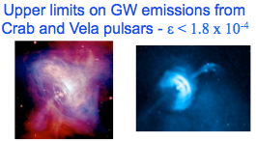
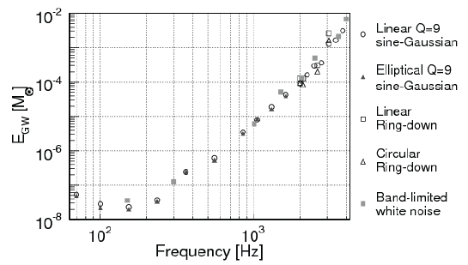
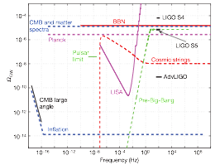
Other Science Highlights
Continuous Wave Sources
Bursts
Abadie et al. 2012
Abbott et al. 2010
Abadie et al. 2011
Stochastic Backgrounds
below
BBN
1000’s of
magnetar
bursts
100’s of
gamma-ray
bursts
Upper
Limits
on
Abadie et al. 2011
Abadie et al. 2012
Abbott et al. 2009

Slide 10
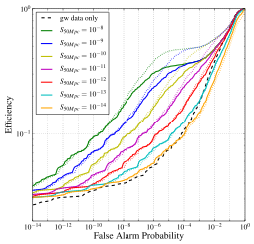
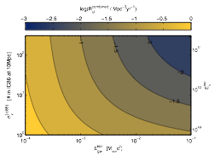
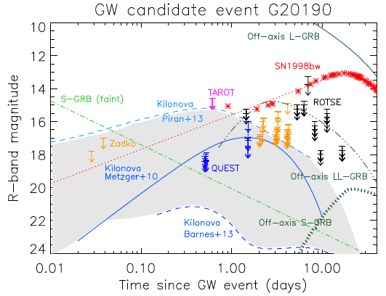
Multi-Messenger Highlights
Gamma Rays
Neutrinos
Evans et al. 2012
Aartsen et al. 2014
Swift
follow-up
within
12 hr
Icecube-LIGO
coherent
analysis
Optical
- 5 telescopes
- as soon as
40min out to ~10d
- transient models excluded

Slide 11
On the way to
Advanced LIGO …
Major Progress
in Theory and Data Analysis

Slide 12
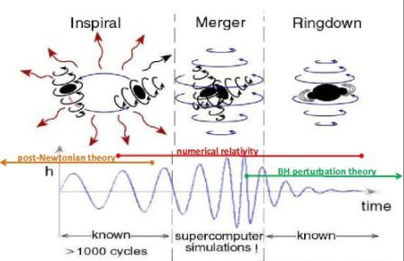
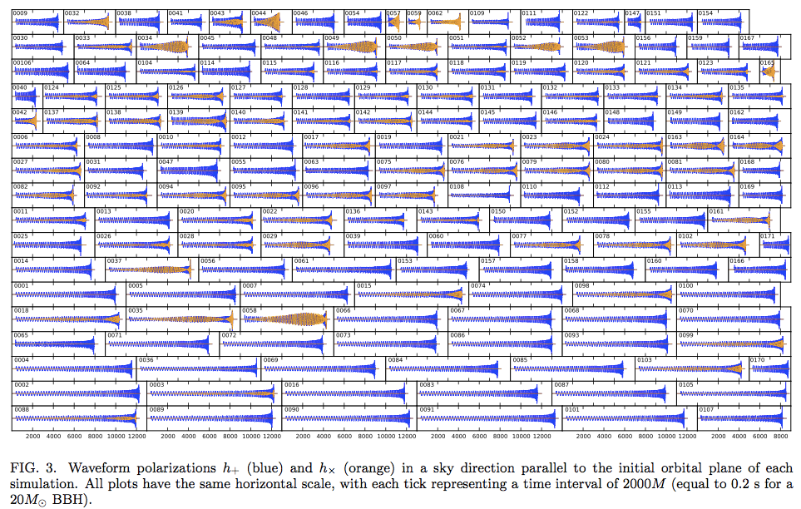
Numerical Relativity
Breakthroughs!
Pretorius 2005
Campaneli et al. 2006
Baker et al. 2006
100’s of
NR waveforms
Mroue
et al. 2013
MAJOR REMAINING CHALLENGE:
High-Fidelity, Fast
Inspiral+Merger+Ringdown
with Full
double-spin Precession
across all source parameters
! do not exist !

Slide 13
Gravitational-Wave Astrophysics:
The parameter estimation era
Ben Farr 2015
BH spin
cannot be ignored
Great Need for:
- Fast Waveforms
- Smart Sampling
in highly structured
15-dimensional space
Tremendous speed progress:
from months to days/hours
and soon to just minutes

Slide 14
Multi-Messenger Searches
Binary Inspirals and Mergers
Supernova Explosions
Other Burst Signals

Slide 15
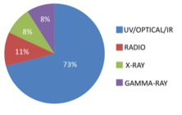
Multi-Messenger Searches
Expected EM signals following binary NS inspirals
LIGO-EM official partnerships
75 MOUs signed already
full EM coverage: from radio to gamma-ray
Follow-up will start already with LIGO-O1, Fall 2015
major challenge:
sky localizations of 100’s of square degrees initially

Slide 16
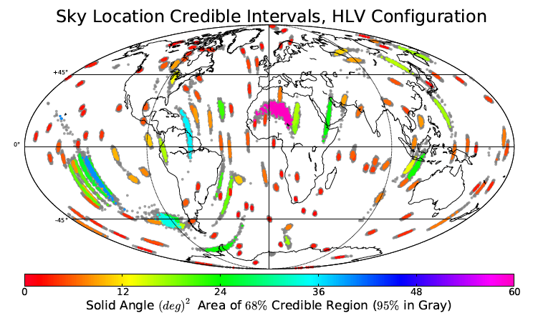
Localization:
NS-NS Inspiral at high SNR
Rodriguez et al 2014
at 95% CL
median error
~ 10 deg^2
@ Design
Sensitivity
for distributed SNR
40% of
error boxes
> 100 deg^2

Slide 17
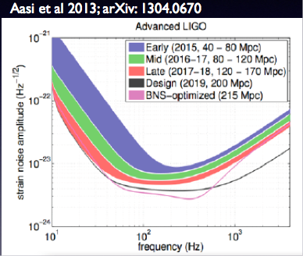
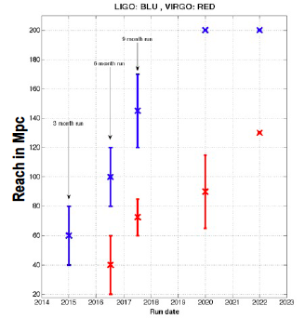
Current Science Plan for
Advanced Detectors
NS-NS Reach in Mpc
200
LIGO
140
130
Virgo
100
90
70
60
BH-BH Reach:
out to z~2 for 150Msun
out to 1,000Msun
40
2015
2017
2020
2022

Slide 18
Advanced Expectations by 2020 ?
Binary Merger Rates
Abadie et al. 2010 & Abadie et al. 2012
AdLIGO Design Sensitivity | Low (per yr) | “Realistic” (per yr) | High (per yr)
NS-NS | 0.4 | 40 | 400
NS-BH | 0.2 | 10 | 300
BH-BH | 0.4 | 20 | 1000
How many coincident
with short Gamma Ray Bursts?
only ~ 0.5 - 2 / yr
Best expected Upper Limits
from Advanced
LIGO - Virgo

Slide 19
Science to still reach out for
post-Advanced-LIGO
large samples of high-SNR GW-GRB events for precision cosmology
large samples of high-SNR BH-BH mergers to test strong-field GR
high-SNR detection to nail the NS EOS —> tidal/merger effects - supernovae - pulsars
nail the origin of short GRBs
constrain the supernova and/or magnetar mechanisms
definitively assess the existence of IMBH
measure reliably the maximum NS mass
nail the BH mass spectrum out to 1,000’s of solar masses
uncover the origin of BH spins
quantify the relative BH-BH pops from dense clusters or the field
best constrain the evolution processes of stellar binaries

Slide 20
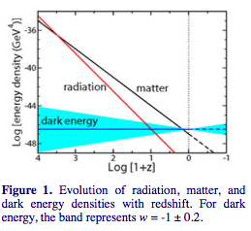
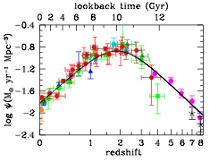
What is needed for
post-AdLIGO Science?
Deep GW observations: out to redshifts of 3-5
Broadband GW observations: out to about 5 kHz
Comparable detector in southern-most location
Some words of caution:
Wright 2015
Madau & Dickinson 2015
Notes:
Deep: big samples at cosmologically significant distances to beat statistical errors and probe dark energy - probe IMBH, BH formation and coupling to SF history and metallicity evolution - probe NS ellipticity/EOS - target SN detection
Broadband: NS EOS, lots of cycles for GR tests (tests are better at lower masses)
Southern Detector: Sky Localization, EM follow-up

Slide 21
Pulsar Timing and
Space-based Science & Detectors
Tom Prince

Slide 22
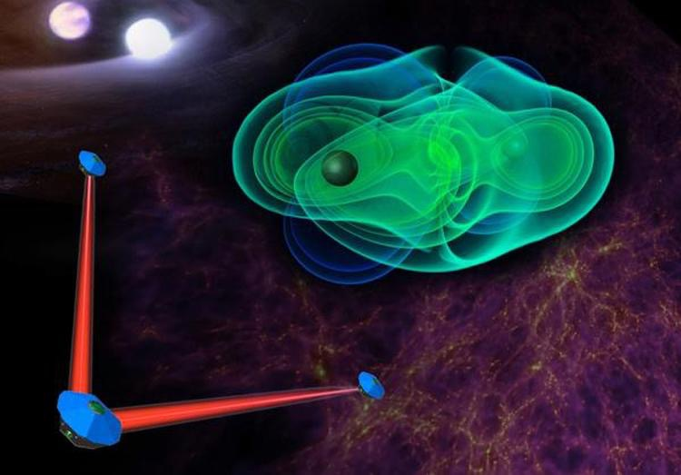
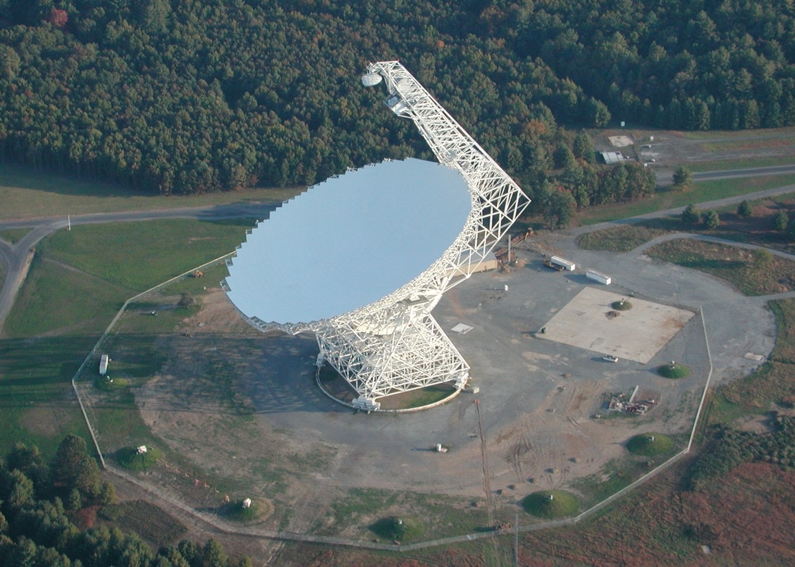
Low-Frequency GW
Two categories: space-based and pulsar timing
Pulsar timing: 1 – 100 nHz
Space-based: 0.1 – 100 mHz
Major science objectives
Massive BH mergers
Supermassive BH binaries
Capture of compact objects by BHs in centers of galaxies
Ultra-compact binaries in the Galaxy
Cosmic GW background
Tests of GR

Slide 28
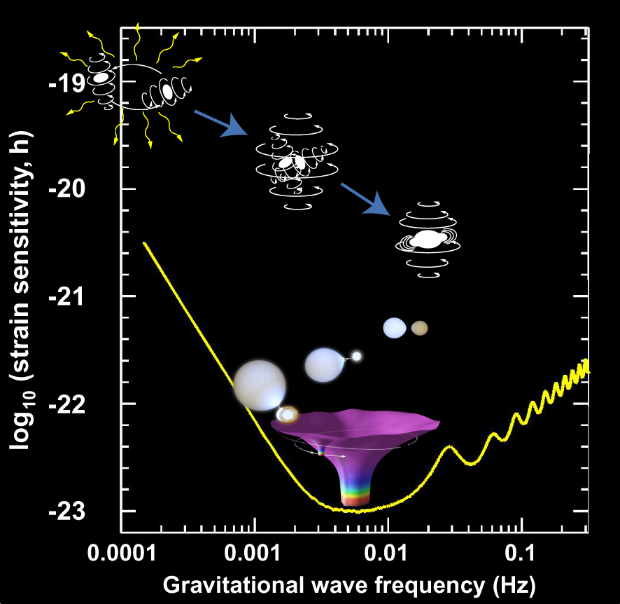
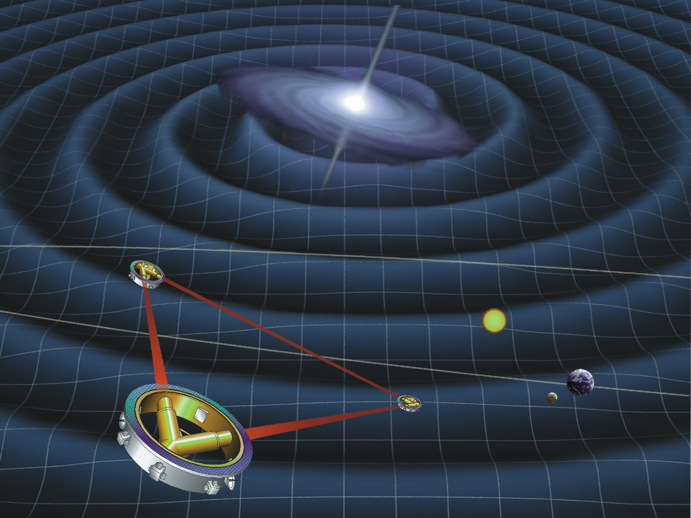
Space-Based GW with a LISA Mission
Massive Black Hole Mergers (~tens to hundreds)
Ultra-Compact Binaries
(~thousands)
Capture of stellar-mass black holes by massive BHs in normal galactic nuclei (~hundreds)

Slide 31
Evolution of Ground-based Detectors
Near and Long-term Goals
Rai Weiss

Slide 32
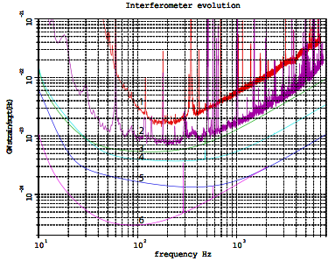
NS/NS coalescence localization errors for two networks

Slide 33
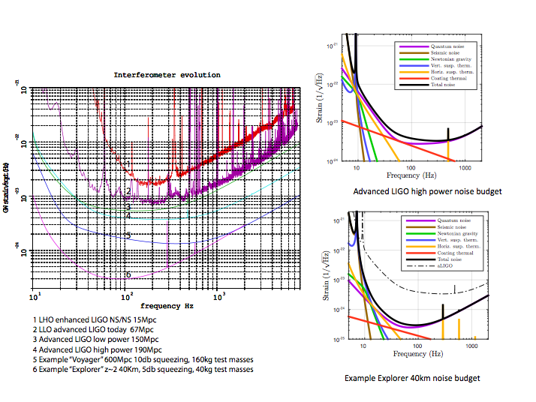

Slide 35
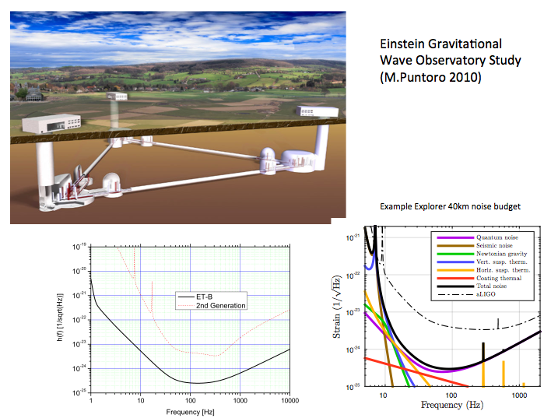

Slide 36
Near and long-term goals
CMB polarization
NT: Ground and balloon based
Increased sky and wavelength coverage
Angular scales as large as 10 degrees with polarization modulators
Large format detector arrays BLIP limited by CMB
LT: Space based: Inflation Probe (CMBPol)
Pulsar timing
NT: continued access to telescope time (GBT and Arecibo), continued funding for observations and algorithm development
LT: SKA or other advanced facilities with increased pulsar timing & search capabilities
Space
NT: NASA funding of technology development commensurate with future strong role in LISA-like mission (lasers, telescopes, thrusters, analysis…)
NT: NASA support of LISA science community in advance of Astro2020 -- currently almost no NASA science funding – not commensurate with strong science support for LISA from Astro2010
LT: Strong US role in future LISA-like space mission
Ground
NT: Operate and improve Advanced LIGO
NT&LT: increase the network
LT: new detectors/configurations & science reach (needs study)

Slide 37
Request of BPA
An NRC study about the future directions of ground-based gravitational-wave research
Why now:
The possibility of detections in the next few years
The long development times for the technology
Scientific input on technical and scientific tradeoffs
Continuity for the strong technical and experimental physics groups now in the field

Slide 38
Extra Slides

Slide 39
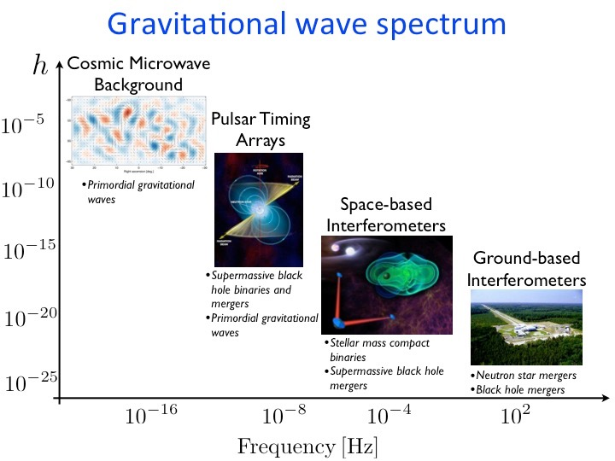

Slide 40
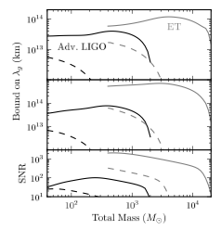
Keppel & Ajith 2010
GR tests: graviton mass
Solar System Limit:
2.8x10^12 km

Slide 41
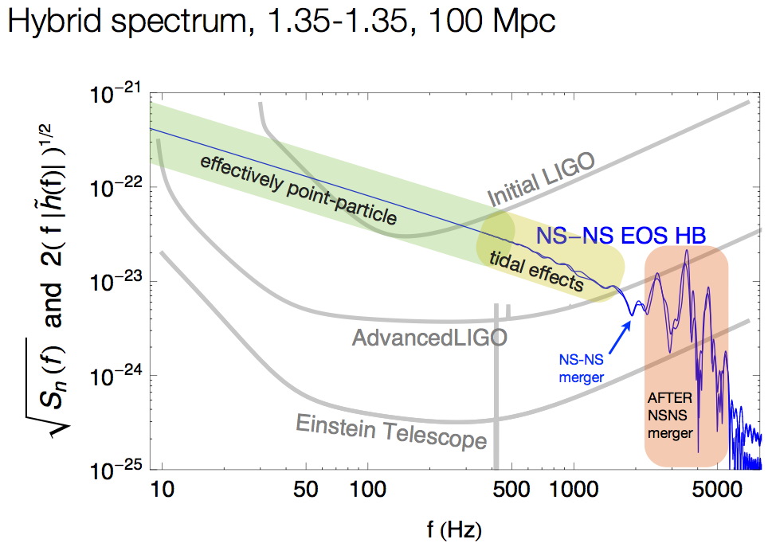
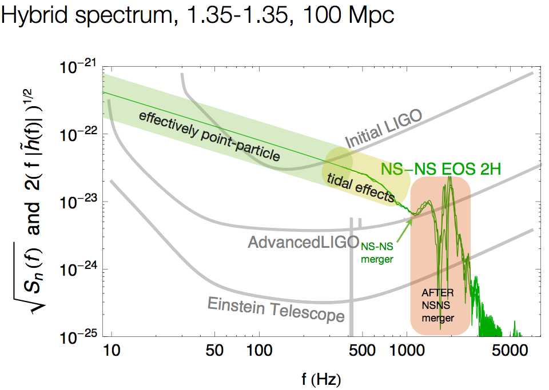
optimally oriented binary
Jocelyn Read 2015
R=11km
optimally oriented binary
R=15km

Slide 42
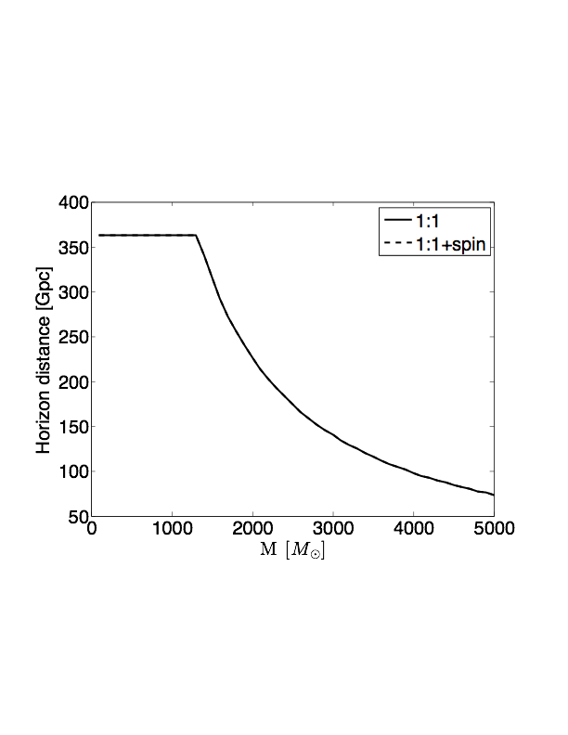
Sensitivity to Intermediate-Mass BHs
Mandel 2015
AdLIGO
Explorer
source total mass
source total mass

Slide 43
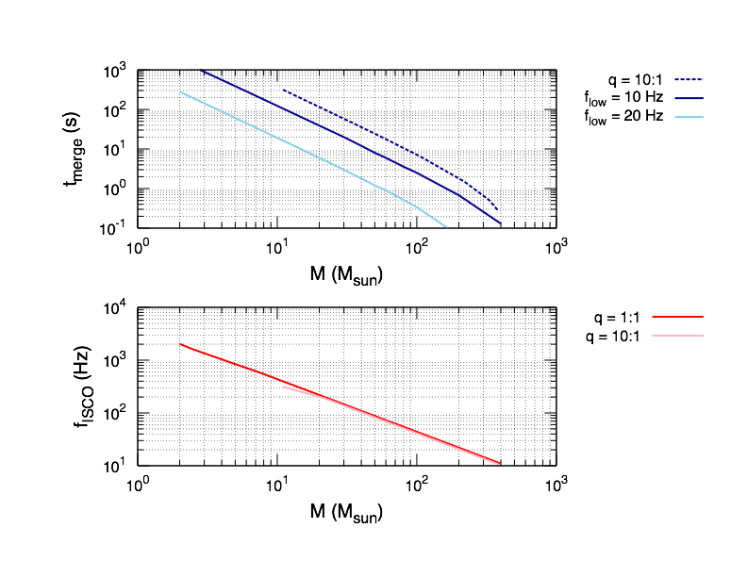
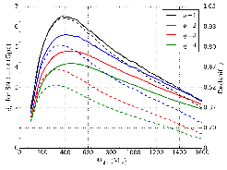
Littenberg 2015
Graff et al. 2015
observed total mass

Slide 44
Mandel 2014

Slide 45
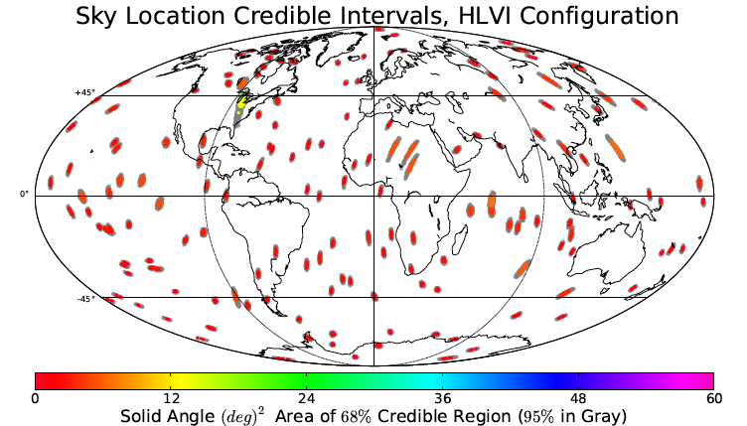
Localization:
NS-NS Inspiral
Rodriguez et al 2014
with INDIGO
at 95% CL
median error of
~ 5 deg^2

Slide 46
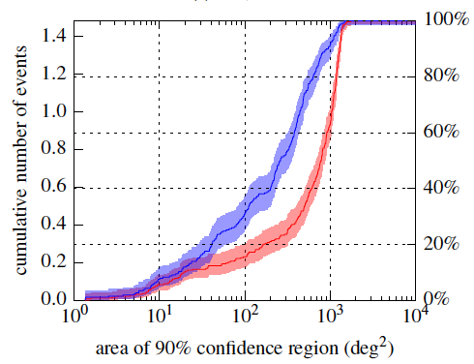
Localization:
NS-NS Inspiral
What about the Ad run in 2016?
Singer et al 2014
3 detectors:
2 LIGO & Virgo
(V less sensitive by ~3)
BayesPE
decreases median area by ~3-5
can account for
non-detection in Virgo

Slide 47
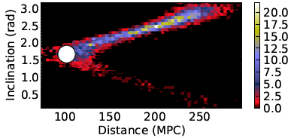
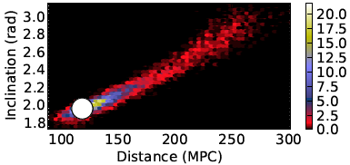
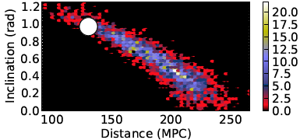
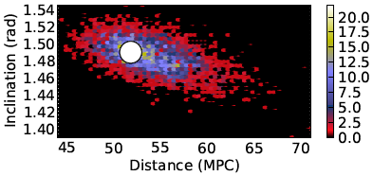
Physical Parameter Estimation:
NS-NS Inspiral
What about distance, masses,
binary inclination?
only
with
BayesPE
typically
within
factor of ~2
if only
we knew
inclination

Slide 48
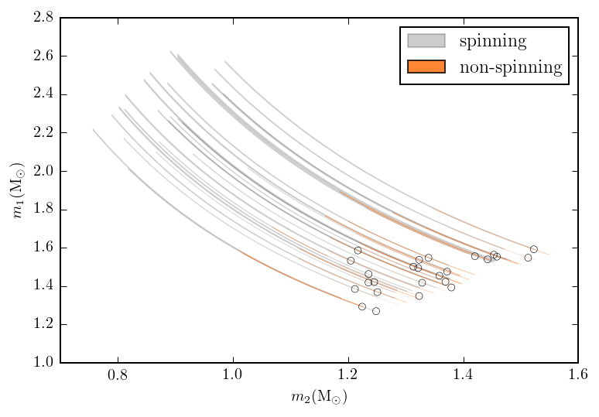
Physical Parameter Estimation:
NS-NS Inspiral
Farr et al 2015
allowing for
spin increases
mass errors
to ~50%

Slide 49
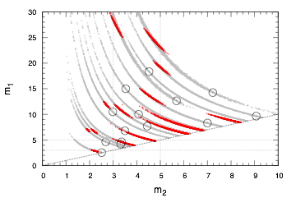
Individual Mass Recovery:
NS-BH and BH-BH Inspiral
Littenberg et al 2015
Mass errors
increase
when freedom
of spin is
accounted for
but is also
becomes correct!
Notes:
Why is mass determination more like 30-50% instead of 3-10%?
— SNR is not 20, more typically ~10
— allowing for spin in the model breaks degeneracy and improves mass determination, if precession is significant - if not, then allowing for spin broadens allowed masses …
- also significantly less-massive object does contribute significantly to precession effects, —> we can’t constrain spin2 well, and therefore we can’t constrain m2 well; this is particularly bad for NS identification in NSBH systems

Slide 50
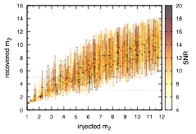
Individual Mass Recovery:
NS-BH and BH-BH Inspiral
Littenberg et al 2015
Can we tell
a NS-BH
from
a BH-BH ?
Yes, if
m2 < 1.5 Msun
or
m2 > 6 Msun
Notes:
Why is mass determination more like 30-50% instead of 3-10%?
— SNR is not 20, more typically ~10
— allowing for spin in the model breaks degeneracy and improves mass determination, if precession is significant - if not, then allowing for spin broadens allowed masses …
- also significantly less-massive object does contribute significantly to precession effects, —> we can’t constrain spin2 well, and therefore we can’t constrain m2 well; this is particularly bad for NS identification in NSBH systems

Slide 51
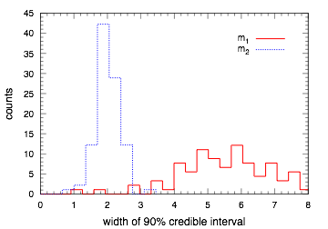
Is there anything in the Mass Gap?
Source-by-source, when are component masses constrained to be within [3,5] Msun?
Errors in component masses are typically larger than the gap

Slide 52
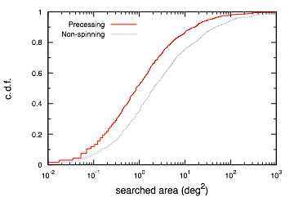
Littenberg et al 2015
Sky Localization
improves when
spin is accounted for

Slide 53
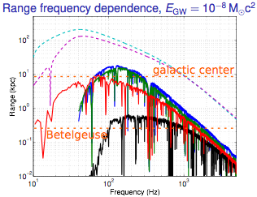
Expectations for Advanced Searches
of Generic Bursts
good rule
of thumb?
M. Was (priv. comm.)
Advanced
Could GW emission
efficiency be
frequency dependent?

Slide 54
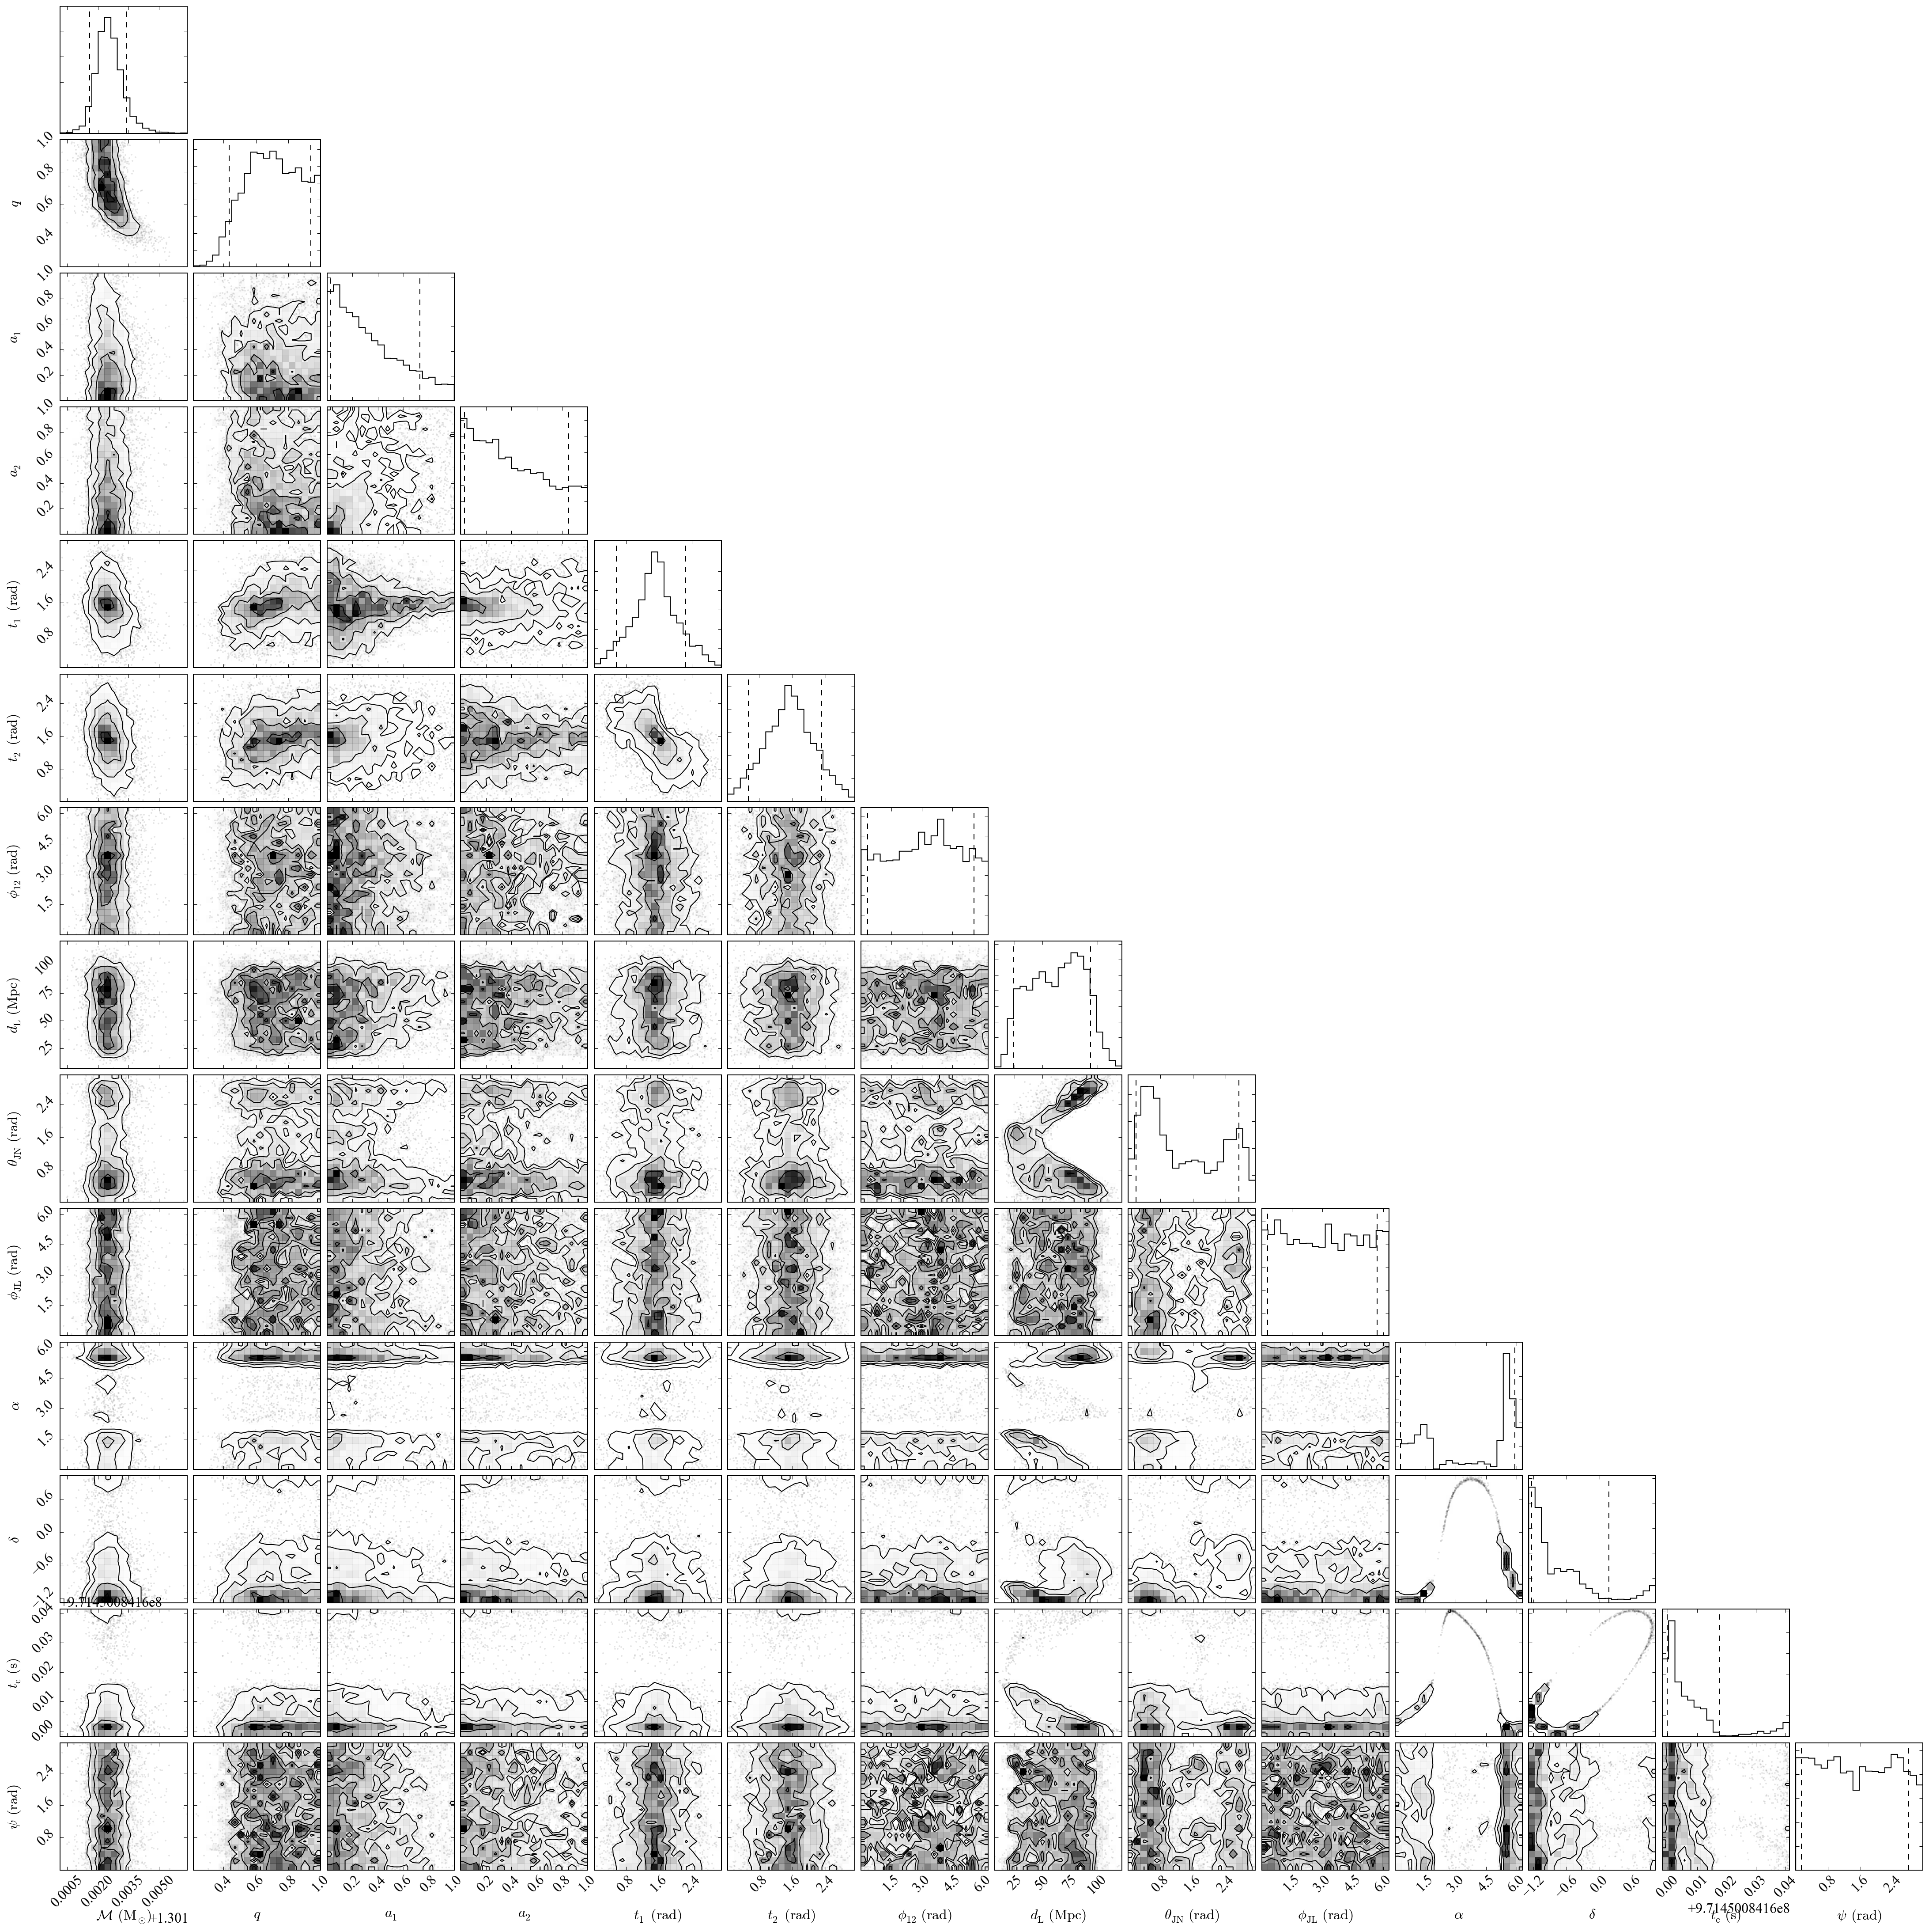
2015 AdLIGO
2 detectors
Ben Farr

Slide 55
Christian Ott (priv. communication)

Slide 56
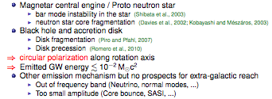
Christian Ott (priv. communication)

Slide 57
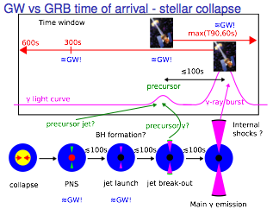
Christian Ott
(priv. communication)

